Slide 1
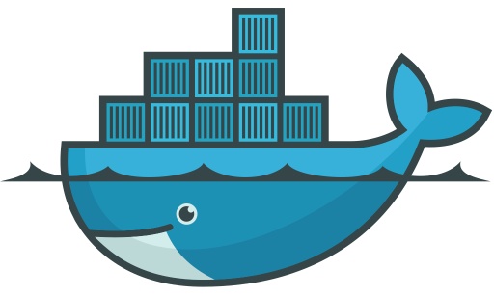
Introduction to Docker
By
Karandeep Singh
karan.singh@samsung.com

Slide 2
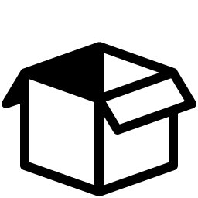
What is in the Box for me Today?
Today We’ll Learn :
The Problem Statement
The What, Why and Where of Docker
Docker Containers
Containers vs Virtual Machines
Overall Visualization and Architecture
Why is Docker so popular
Terminologies & Commands
Dockerfile and it’s Instructions
Docker Build & Docker Run
Docker Volumes
Port Mapping
Docker Save
Docker Load
Hands On…

Slide 3

The Problem Statement…
My code is ready but how do I ship it ?
The code works on my machine but what about others ?
How to manage all the dependencies ?
What if the end user has a different Operating System ?
How do I manage the generated Artifacts ?
Is there a way I can deploy my application in a One-Click fashion ?

Slide 4
The What, Why & Where…

Slide 5
What is Docker ?
Open-source platform for Developing, Shipping and Running applications.
Separates the applications from their underlying Infrastructure.
Helps in delivering the software quickly.
Enables to manage the infrastructure in the same ways one manages their applications, thus providing more control.
Makes use of Containers to separate out code from the working environment with a lot more advantages.

Slide 6

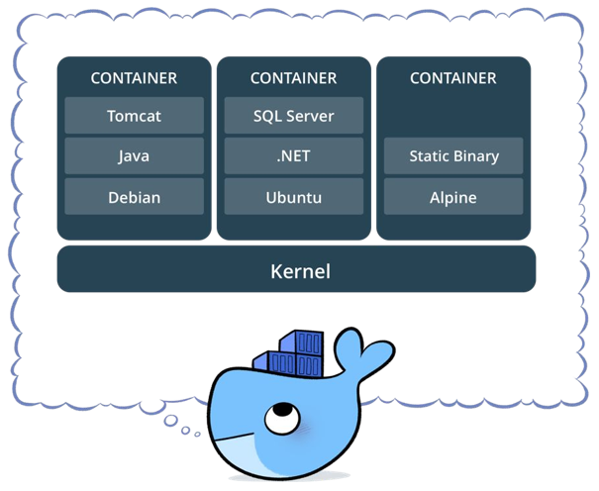
What’s inside those Containers ?
Allows developers to isolate their app from its environment.
Solve the headache of “It works on my machine Buddy : (”.
Package software as well as all of the related dependencies in one place.
Loosely Isolated and provides security.
Lightweight: Share the machine’s OS system Kernel and therefore do not require an OS per application, driving higher server efficiencies and reducing server and licensing costs.
Secure: Applications are safer in containers and Docker provides the strongest default isolation capabilities in the industry.

Slide 7
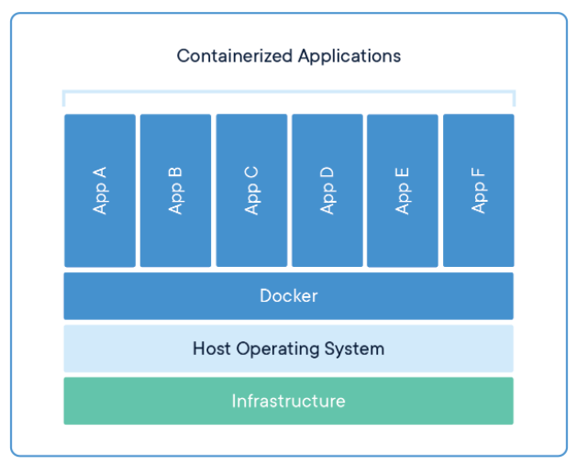
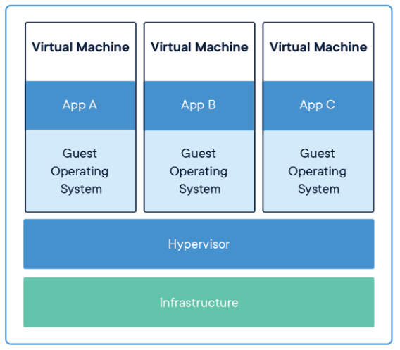
But What about Virtual Machines ?
Docker | Virtual Machines
OS level process isolation | Hardware-level process isolation
Each container can share OS | Each VM has a separate OS
Boots in seconds | Boots in minutes
Containers are lightweight (KBs/MBs) | VMs are of few GBs
Pre-built docker containers are easily available (Docker Hub) | Ready-made VMs are difficult to find
Deployment is easy as multiple containers can be spun up from a single image | Deployment is lengthy as new instances are required for each execution
Portability is Easy | Portability is Difficult
Less resource usage | More resource usage
More : @ Here

Slide 8
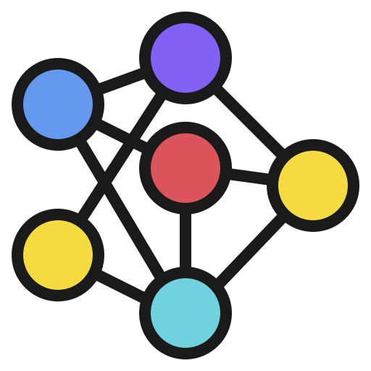
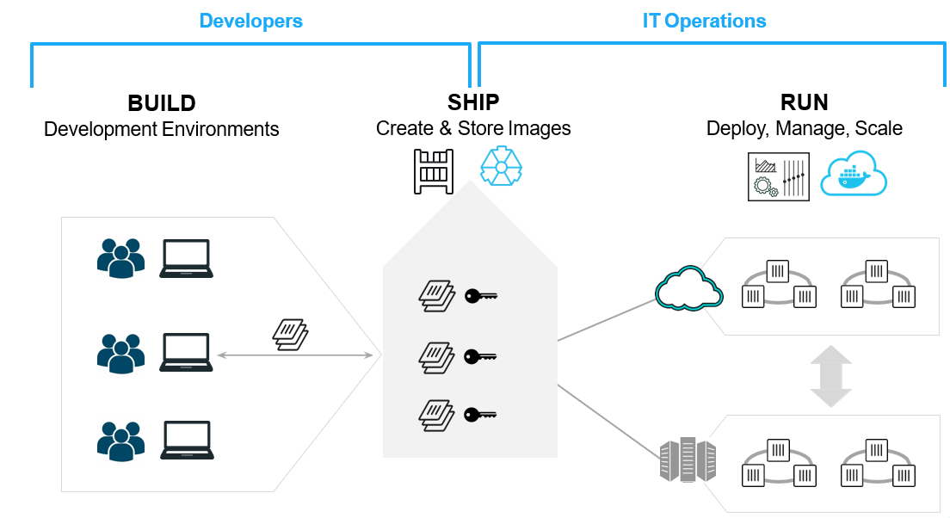
The Overall Docker Picture
Images
Docker Hub

Slide 9

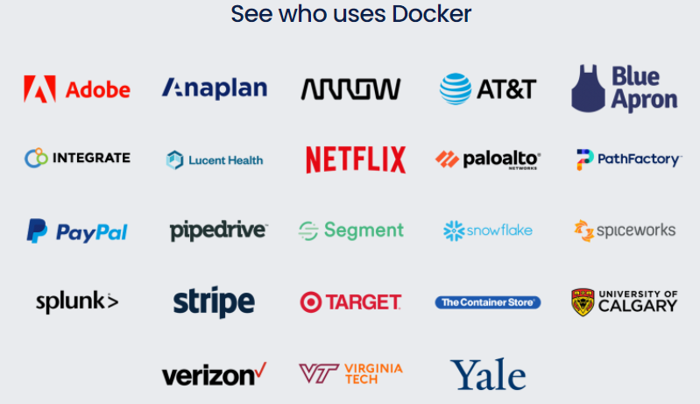
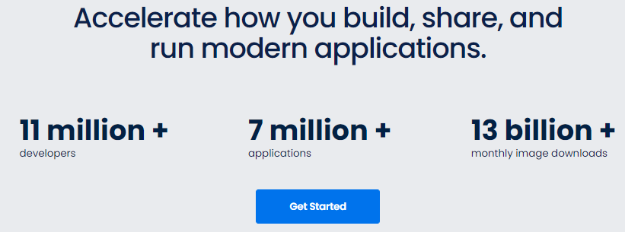
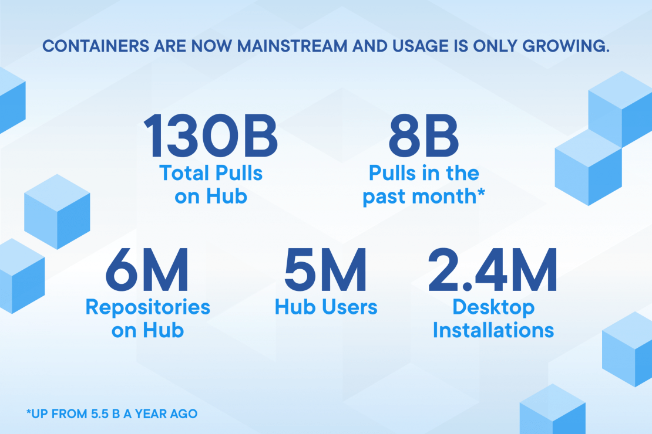
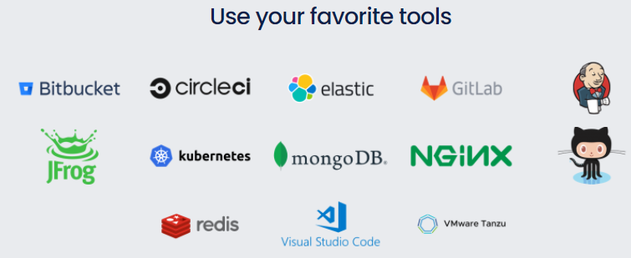
It must be really Popular then ?
More : @ Here

Slide 10
Shall we Begin ?

Slide 11

Okay, Let’s get into some Terminology…
Docker Engine Creates, ships and runs Docker containers deployable on a physical or virtual, host locally, in a datacenter or cloud service provider.
Docker Daemon : Listens for Docker API requests and manages Docker objects such as images, containers, networks, and volumes.
Docker Client : Command Line Interface to interact with Docker Daemon.
Docker Image Immutable (unchangeable) file that contains the source code, libraries, dependencies, tools and other files needed for an application to run.
Docker Container Virtualized Isolated Run-Time environment running on Host OS sharing the Kernel. Deployed instance of a Docker Image.
Registry Service – Docker Hub Cloud or server based storage and distribution service for the images.

Slide 12
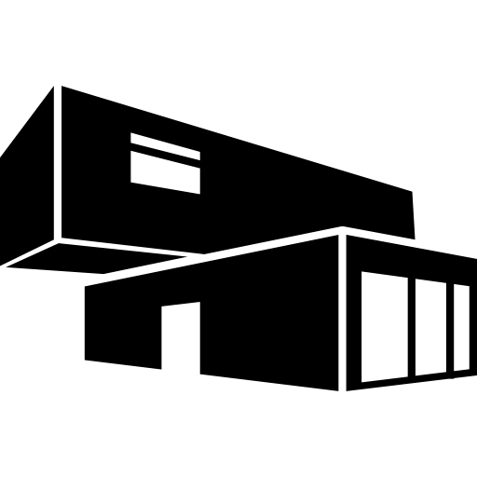
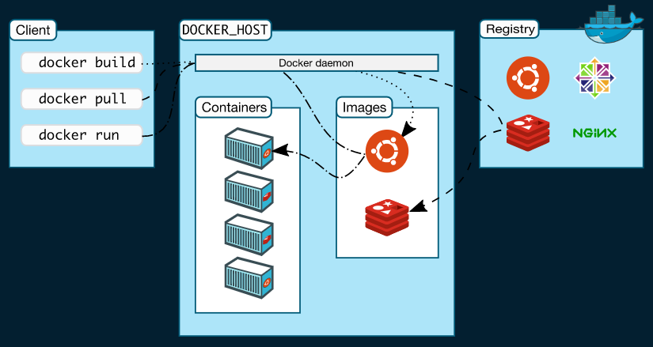
Visualizing Architecture
Docker uses a client-server architecture.
Docker client talks to the Docker daemon, which does the heavy lifting of building, running, and distributing the Docker containers.
Docker client and Daemon can run on the same system, or Docker client can be connected to a remote Docker daemon as well.
Communication happens using REST APIs, over UNIX sockets or a network interface.
Docker Hub
Docker Architecture

Slide 13


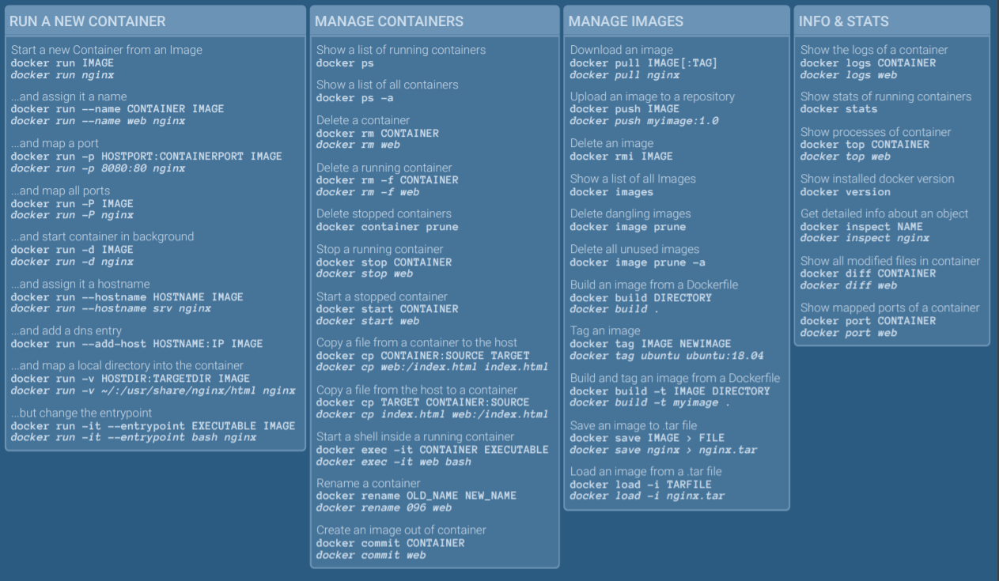
The Cheat-Sheet
More @ Here & Here
Notes:
More At : https://tinyurl.com/hmhh8xex

Slide 14
Prepare – Assemble - Action

Slide 15
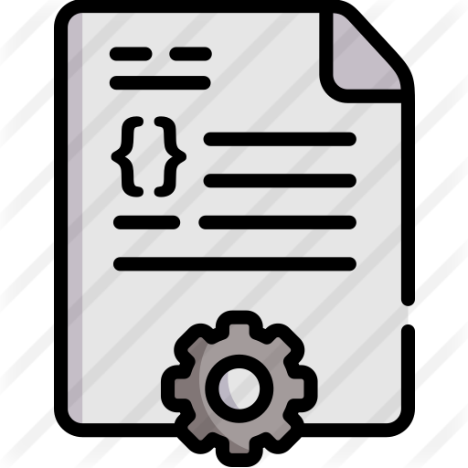
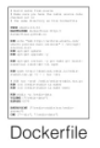
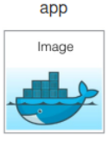
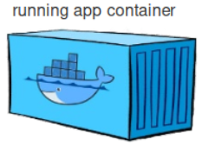
The “Dockerfile” - Prepare
A text document which contains all the commands a user could call on the command line to assemble/build an image.
Docker image generation needs a Dockerfile which contains instructions needed to build the image.
The Dockerfile is processed by the “Docker Build” process which generates the “Docker image”.
The Generated Image is used by “Docker Run” process to start a container containing all the source code and dependencies as mentioned in Dockerfile.
docker build
app
docker run

Slide 16

Dockerfile Instructions - I
.dockerignore - Modifies context to exclude files and directories sent to Docker
FROM - Sets the Base Image for subsequent instructions.
RUN - Execute any commands in a new layer on top of the current image and commit the results.
CMD - Provide defaults for an executing container.
EXPOSE - Informs Docker that the container listens on the specified network ports at runtime. NOTE: does not actually make ports accessible. Use –p while running Container. Used for Documentation purposes.
ENV - Sets environment variable.

Slide 17
Dockerfile Instructions - II
ADD - Copies new files, directories or remote file to container. Invalidates caches. Avoid ADD and use COPY instead.
COPY - Copies new files or directories to container.
ENTRYPOINT - Configures a container that will run as an executable.
VOLUME - Creates a mount point for externally mounted volumes or other containers.
USER - Sets the user name for following RUN / CMD / ENTRYPOINT commands.
WORKDIR - Sets the working directory.
ARG - Defines a build-time variable.
More @ Here

Slide 18
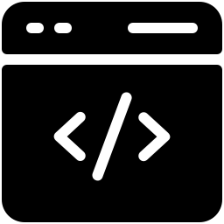
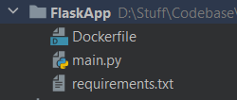
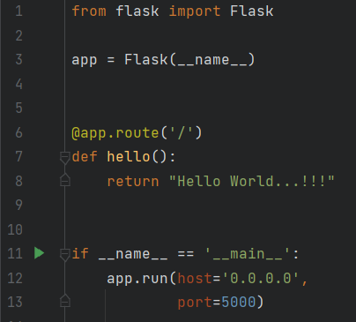
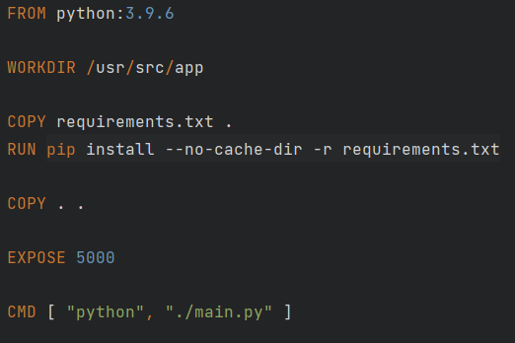

Some Code Maybe ?
Directory Structure
requirements.txt
main.py
Dockerfile
Notes:
Copy Requirements.txt first as Code will have frequent changes to speed up builds and use Docker Layering Effectively.

Slide 19

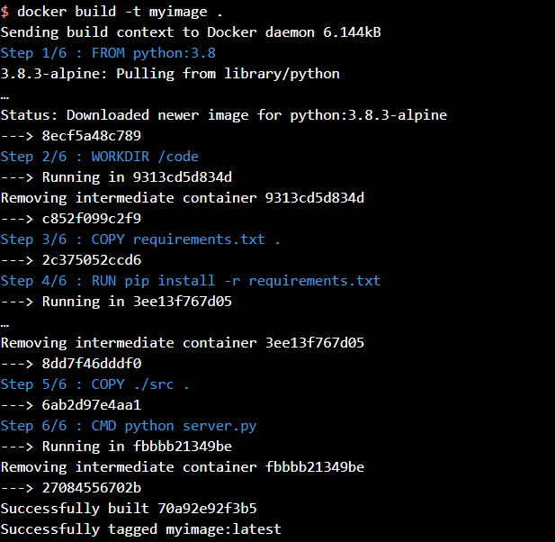

Docker Build - Assemble
Processes the “Dockerfile” to generate the “Docker Image”.
For each instruction or command from the Dockerfile, the Docker builder generates an image “layer” and stacks it upon the previous ones.
Hence, the Docker image resulting from the process is simply a read-only stack of different layers.

Slide 20

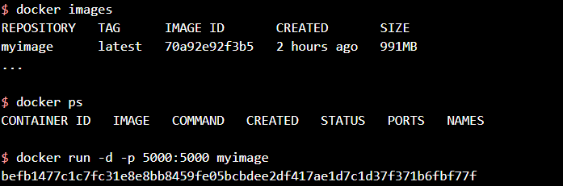
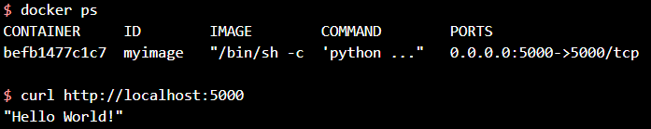
Docker Run - Action
Processes the Image file supplied and starts a Container.
Container started is always Isolated.
Container host may be local or remote.
Container process has its own file system, its own networking, and its own isolated process tree separate from the host.

Slide 21
Diving Deeper

Slide 22

How to Share/Persist Data OR What if Container Dies ?
Docker Volumes are the preferred mechanism for sharing/persisting data generated and used by Docker containers.
Volumes mount a directory on the host into the container at a specific location.
Enables Developer to Share/Persist Container Data even If Container is Lost or Stopped.
Easier to Backup or Migrate.
Can be shared safely among multiple containers.
Does not increase the size of the containers as the contents exist outside the lifecycle of the given container.

Slide 23

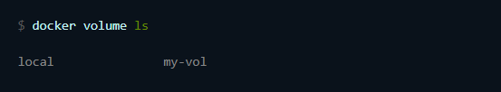
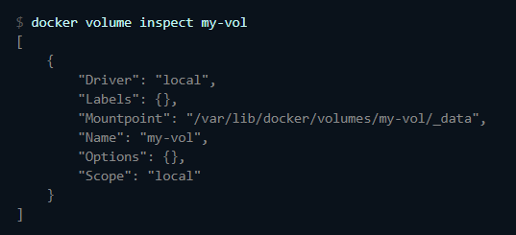
How to Create a Docker Volume ?
Create a Volume
Delete a Volume
List All Volumes
Start Container with Volume
*This will mount the contents in my-vol to /usr/data-vol
Inspect a Volume

Slide 24
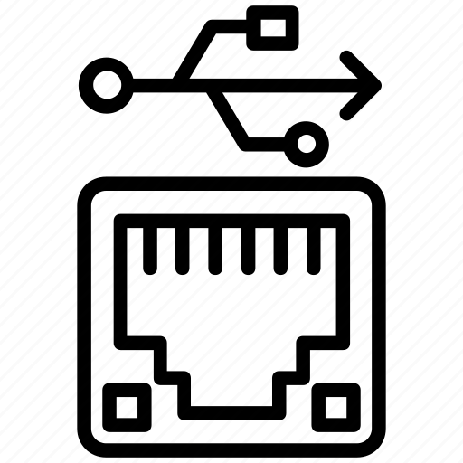
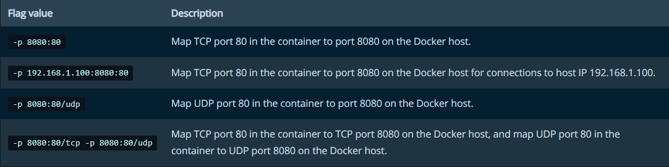
Port Mapping
By default, a container does not publish any of its ports to the outside world.
Use the --publish or -p flag to make a port available to services outside of Docker, or to Docker containers which are not connected to the container’s network.
Above flag creates a firewall rule which maps a container port to a port on the Docker host to the outside world.
Docker Port Mapping Examples

Slide 25

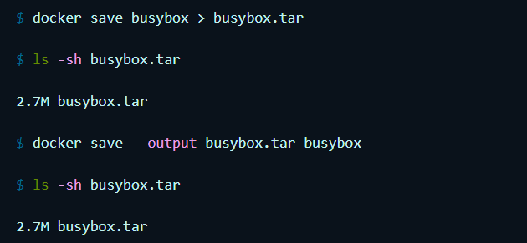
How can I share/export my Image ?
Docker Save is used to save one or more images to a tar archive.
Produces a tarred repository to the standard output stream.
Contains all parent layers, and all tags + versions, or specified repo:tag, for each argument provided.
The created backup can be used by Docker Load.
Save Image busybox with default tag “latest” to
“busybox.tar”
Use gzip to save the image file and make the backup even smaller.

Slide 26

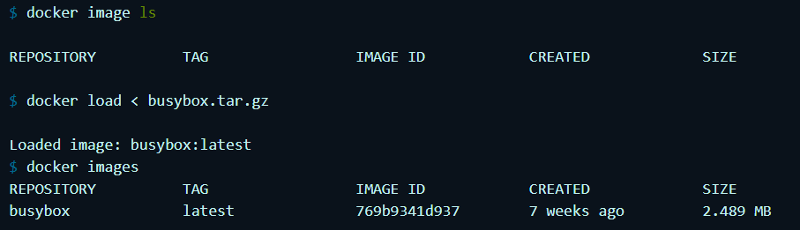
Loading Docker Images
Docker Load an image from a tar archive or STDIN.
Load an image or repository from a tar archive or STDIN.
It restores both images and tags.

Slide 27

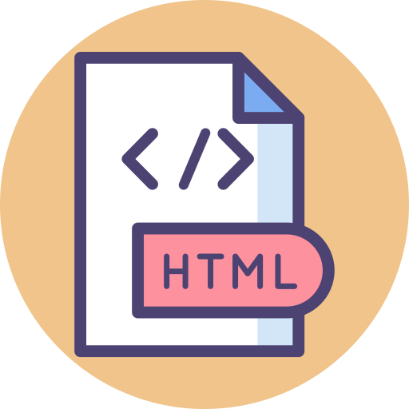


It’s Practical Time…

Slide 28

That’s all Folks. Thank You : ) Any Questions ?

