Slide 1
Design and Analysis of All-Optical Circuits using 2D Photonic Crystals
Presented by
Sumanth Munnangi (15BEC0451)
Amanjot Singh (15BEC0452)
Anuj Chandan Gurbaxani(15BEC0294)
Under the Guidance of
Dr. A. Rajesh
Associate Professor
School of Electronics Engineering
VIT University

Slide 2
Overview
Objective
Introduction
Photonic crystals
-Photonic Band Gap
Literature Survey
Proposed Structures
Results and Discussion
Technical Specifications
Work Plan
References

Slide 3
Objective
Our objective is to design an all-optical encoder, a flip flop and a decoder on 2 Dimensional photonic crystal with small footprint, good response time and minimal leakage.
In this project, a basic flip-flop, 4 to 2 Encoder and 2 to 4 Decoder design is proposed using two-dimensional photonic crystal (2D PhC). Encoder has four input and two output waveguides as the ports, Decoder has three input(including one reference input) and four output waveguides as the ports, and flip-flop has four input (including two reference inputs) and two output waveguides as the ports.

Slide 4
Introduction
In recent years , optical logic circuits have been attracting wide attention because of their potential application in fields of optical computing systems, optical signal processing and optical interconnection networks.
As the conventional electronic technology would reach its speed limit in computation and communication of information in future, all optical IC have become the most promising alternative to face this problem.
Optical logic circuits have unique ability to control the propagation states of photons with their photonic band gaps provide a perfect platform for the realisation of integrated photonic device.

Slide 5
Photonic crystals
Photonic crystals are the periodic structure in one ,two or three dimensions that introduce photonic band gaps (i.e.)the range of frequencies within which propagating electromagnetic wave does not exist.
Photonic band gaps provides the ability of guiding and engineering the flow of light.
Total compactness obtained by the use of PC structures makes it suitable for optical integration.

Slide 6
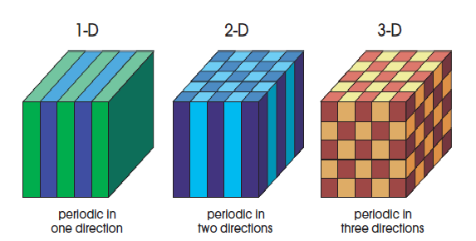
Types of photonic crystals
The fabrication method depends upon the number of dimensions that the Photonic band gap must exist in.
Depending on geometry of the structure, PhCs can be divided into three broad categories , namely
I. One dimensional(1D)
II. Two dimensional(2D)
III. Three dimensional(3D)
Source: John D.Joannopoulos,Steven G.Jonson,Joshua N.Winn,Robert D.Meade. ‘Photonic crystal –Molding the flow of light’

Slide 7
Types of photonic crystals (contd..)
In 1D PhCs, the periodic modulation of the permittivity occurs in one direction only, while in two other directions structure is uniform.
2D PhCs can have comparatively large variety of configurations, because it possesses periodicity of the permittivity along two directions, while in the third direction the medium is uniform.
2D PhCs attracted more attention because of their fabrication process is similar to that used for planar electronic integration circuits.
This structures are used in the implementation of fast devices such as waveguides , resonators , logic gates and switches.
3D PhCs has permittivity modulation along all three directions.

Slide 8
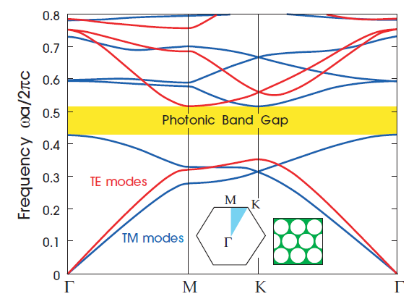
Photonic Band Gap
In photonic crystals, perforation are analogous to the atoms in the semiconductor. Light entering the perforated material will reflect and refract off interfaces between glass and air.
The complex pattern of overlapping beams will lead to cancellation of band of wavelength in all directions leading to prevention of band into the crystal.
The resulting photonic band structure can be modified by filling in some holes and creating some defects in perfectly periodic systems.

Slide 9
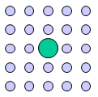
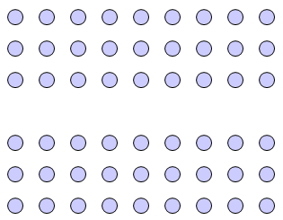
Defects in 2D photonic crystals
Point defect:
A point defect involves a alteration of a single lattice in the crystal structure. The hole can be modified in size, properties or even it can be deleted.
Representation of point defect
Line defect:
In this case the defect is created by removing the rods from the whole row in structure. This can be act as a waveguide.
Representation of line defect

Slide 10
Literature Survey
Ref. No. | Title | Publisher | Description
1 | An ultra-fast all-optical flip-flop based on nonlinear photonic crystal structures | The Optical Society of Japan 2018 | A square lattice photonic crystal with lattice constant equal to 575 nm was used for designing an all optical RS flip-flop. The proposed structure consists of two ring resonator-based switches with different resonant modes that are connected to a core section.
2 | All optical XOR and OR gate based on line and point defects in 2-D photonic crystal | Optics and Laser technology, 2015 | Studying of phase difference between beams responsible for constructive and destructive interference of light in optical logic gates and control the light by defects . Device for optical switch and gates with low power consumption based on line and point defect. Speed is near to velocity of light.

Slide 11
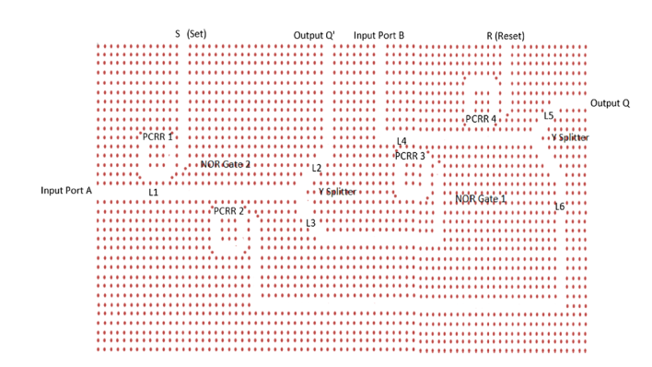
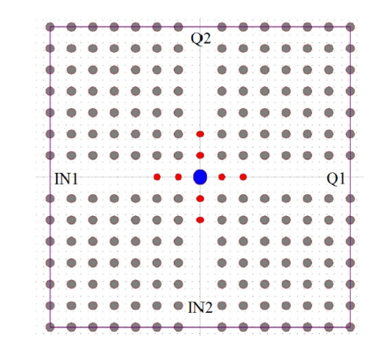
Literature Survey (Contd…)
Ref. No. | Title | Publisher | Description
3 | All optical SR flip flop in 2D PhC | Springer Science+Business Media New York 2015 | The photonic crystals (PhC) draw significant attention to build all optical logic devices and considered one of the solutions for the opto-electronic bottleneck via speed The PhC structure has a square lattice of silicon rod with refractive index of 3.39 in air. Response time is also calculated.
4 | Reconfigurable design of flip flops based on a swith. | The Optical Society of Japan 2018 | All-optical RS flip-flop was proposed using nonlinear Kerr effect in photonic crystals. The proposed structure is composed of a core section and two optical switches. The core section consists of two cross-connected resonant cavitieswhose resonant mode are at wavelengths 1586 and 1620 nm.

Slide 12
Literature Survey (Contd…)
Ref. No. | Title | Publisher | Description
5 | All optical 1 to 2 decoder based on photonic crystal ring resonator | Iranian Solar Energy Scientific Society, 2017 | Controlling the optical behavior of the resonant ring via optical power intensity The resonant wavelength of the photonic crystal ring resonator is very sensitive upon the refractive index of dielectric rods, on the other hand the refractive index of dielectric materials depend on the optical power intensity.

Slide 13
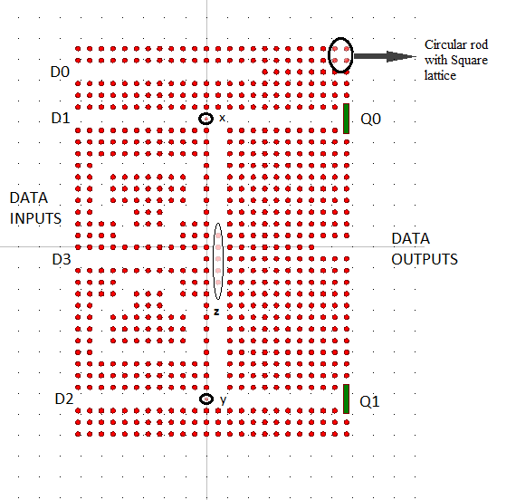
Module-1.1 Proposed Logic circuit of encoder using waveguides

Slide 14
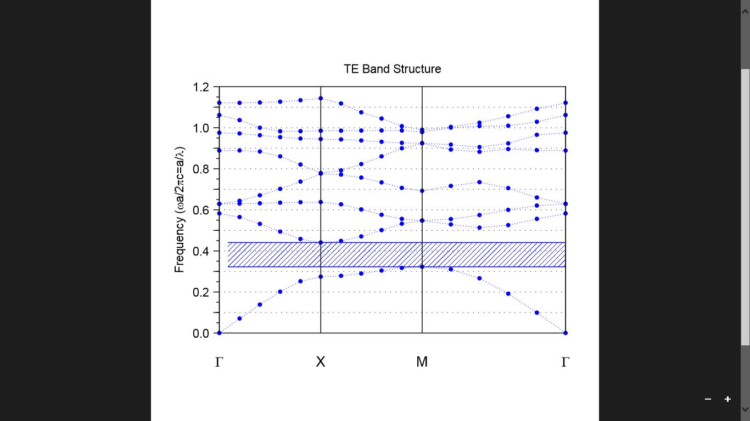
Region of photonic band gap

Slide 15
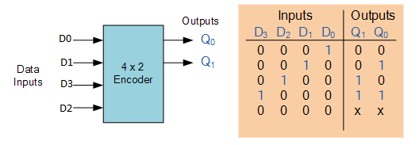
Proposed structure (contd..)

Slide 16
Proposed structure (contd..)
It has 24a×34a square lattice silicon rods at air with the refractive index of 3.39 and the radius r is 0.2a, where ‘a’ is the lattice constant of the photonic crystal structure.
The fundamental Phc has one PBG in the TE mode and it is suitable for designing the logic structure.
The frequency range of this PBG is at 0.32167<a/λ<0.4403 which is equal to the wavelength range of 1272nm<λ<1717nm where lattice constant a is 0.565.
The operating wavelength for this structure is 1560nm.

Slide 17
Proposed structure (contd..)
Here at x and y radius of Phc rod has been kept 67% of original radius (or 0.134a), this has been calibrated such that they will allow waves coming from D1 and D2 to pass but would block waves coming from D3 to some extent.
Two T-shaped resonators in the circuit are used to switch direction of circuit in case when D3=1 and required output is one at both Q1 and Q2, the lattice constant, operating wavelength, circuit material(for refractive index) are chosen such as to allow easy coupling with resonator.
Here output is considered one when at output the power is greater than or equal to 0.5 units.

Slide 18
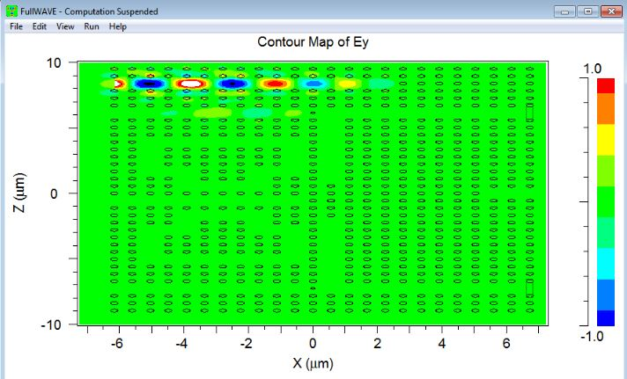
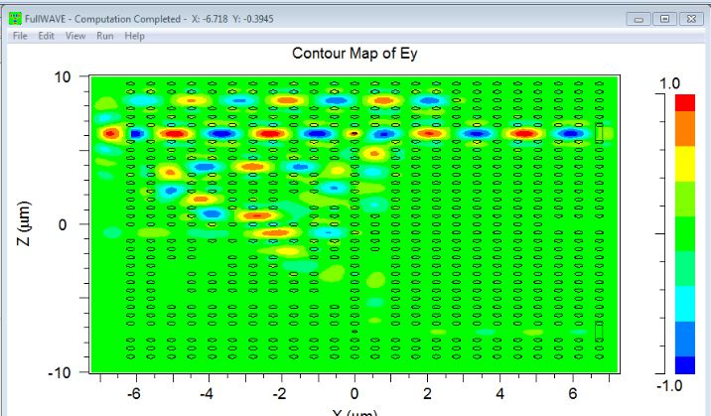
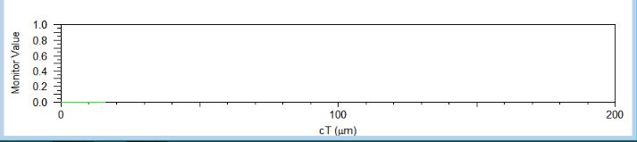
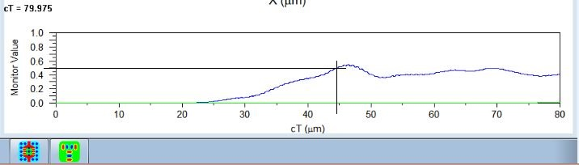
Field Distribution of Encoder:
(a) D0=1, D1=D2=D3=0, Q0=Q1=0 (b) D1=1, D0=D2=D3=0, Q0=1, Q1=0

Slide 19
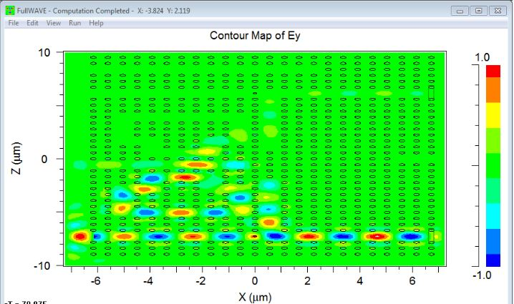
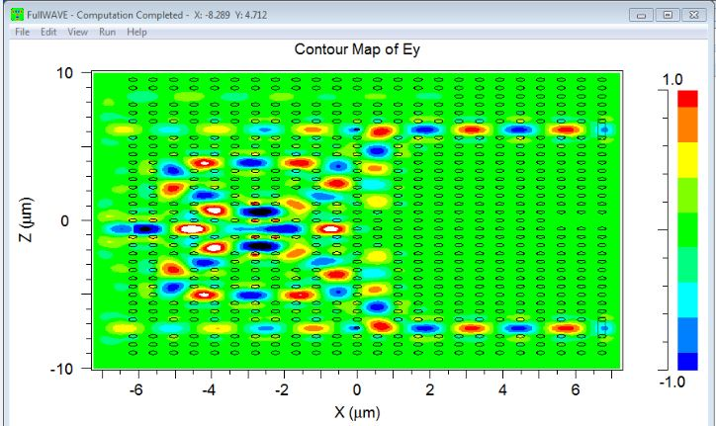
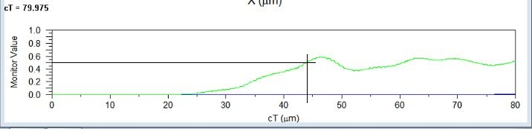
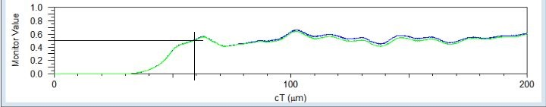
Field Distribution of Encoder:
(c) D2=1, D0=D1=D3=0, Q0=0, Q1=1 (d) D3=1, D0=D1=D2=0, Q0=1, Q1=1

Slide 20
(a) Here, D0=1, D1=D2=D3=0, which gives output as Q0=Q1=0 which is in line with Truth Table of Encoder.
(b) Here D1=1, D0=D2=D3=0, which gives output as Q0=1, Q1=0 which is in line with Truth Table given of Encoder. As visible from output graph, we get required 'high' output at 45 microsecond(when output is greater than or equal to 0.5), as no leakage through Q1 in other cases, so it is easy to detect, but it is at cost of leakage from D0 and D3.
(c) Here D2=1, D0=D1=D3=0, which gives output as Q0=0, Q1=1 which is in line with Truth Table of Encoder. Here we get required 'high' output at 44 microseconds(when output is greater than or equal to 0.5)and output is also easy to detect, as there is almost zero output at Q0, but again it is possible at the cost of leakage from D3.
(d) HereD3=1, D0=D1=D2=0, which gives output as Q0=1, Q1=1 which is in line with Truth Table of Encoder. Here, Output from Q0 of green color and output from Q1 is of Blue color. As visible from design, here two T-resonators are used to get identical output at Q0 and Q1. Here time taken is 60 millisecond, there is leakage from D0 and D2.

Slide 21
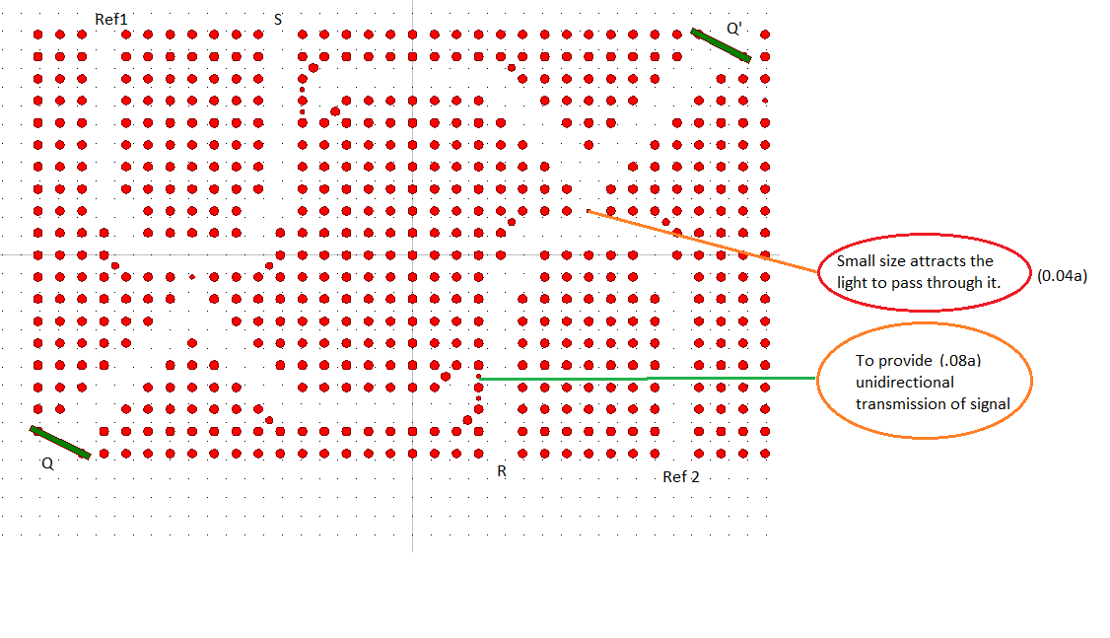
Module-1.2 Proposed Logic circuit of SR Flip Flop using waveguides

Slide 22
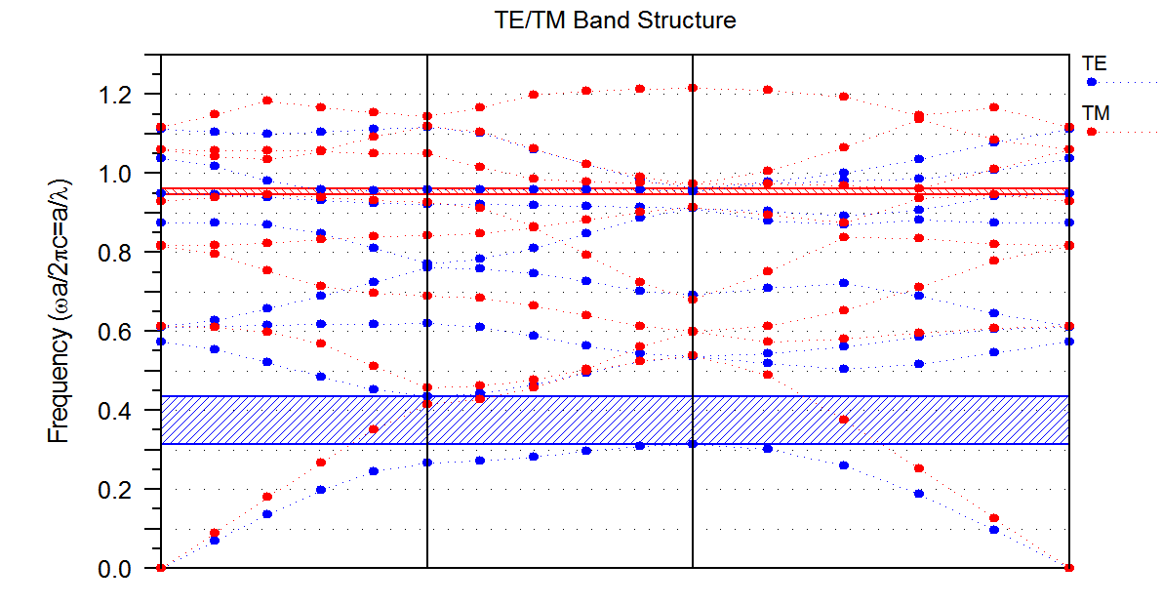
Region of photonic band gap
Frequency(𝟂a/2∏c=(a/λ)

Slide 23
Proposed structure (contd..)
It has 35a×20a square lattice silicon rods at air with the refractive index of 3.1 and the radius r is 0.2a, where ‘a’ is the lattice constant of the photonic crystal structure.
In this proposed structure, it has two PBG in both the modes.
The fundamental Phc has one PBG in the TM mode and one PBG in TE mode. The PBG in the TE mode is neglected as their band gap is very small and narrow. But PBG in TM mode has wider wavelength and they are suitable for designing the logic gates.
The frequency range of this PBG is at 0.27558<a/λ<0.4465 which is equal to the wavelength range of 1298nm<λ<2104 where ‘a’ is 580nm.
The operating wavelength for this structure is 1550nm.

Slide 24
Optical SR Flip Flop

Slide 25
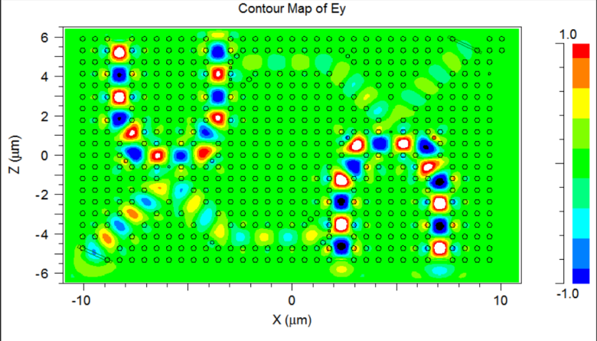
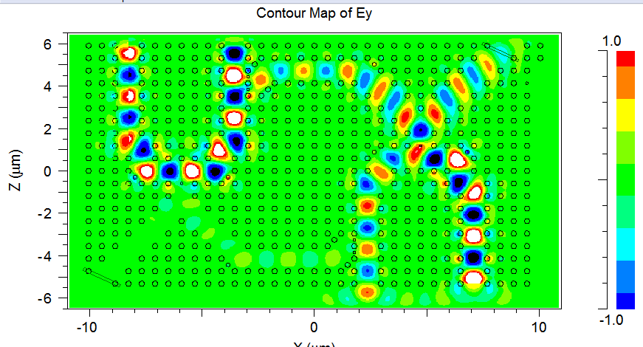
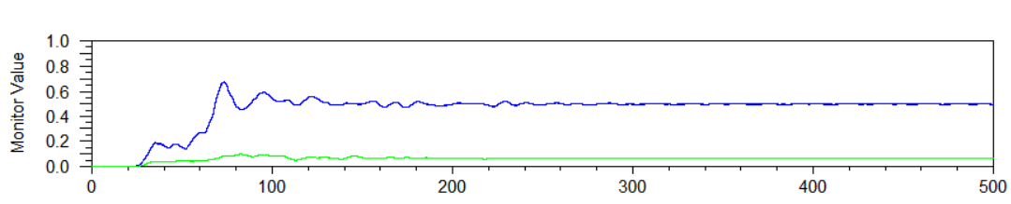
Field Distribution of SR gate:
(a)
(b)
Output power of SR Flip Flop:
cT (uM)

Slide 26
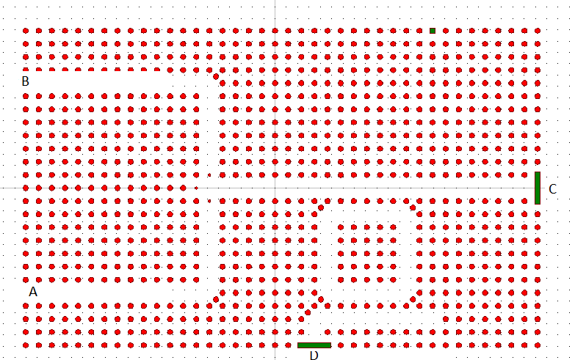
Module-1.3 Proposed Logic circuit of DECODER

Slide 27
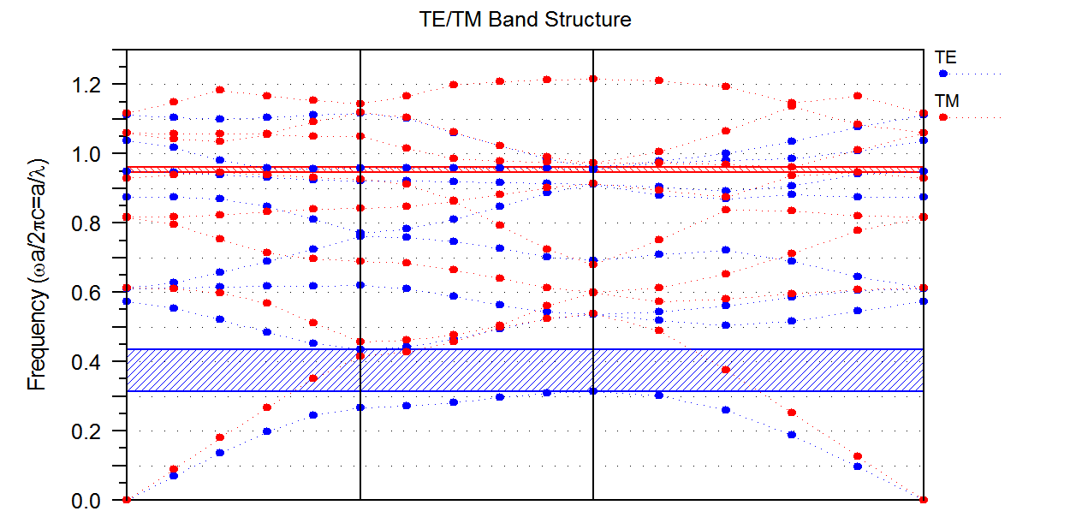
Before proceeding the deign procedure of the proposed structure we should inspect, whether the fundamental structure has suitable photonic band gap (PBG) according to our goals. For this purpose using plain wave expansion (PWE) method and with the aid of Bandsolve toolbox of RSoft photonic CAD software, the band structure diagram of the fundamental PhC structure is obtained

Slide 28
Resonant ring
The main sub-structure of the decoder is the resonant ring, which works as an optical power level comparator. The resonant ring was designed such that it has a resonant mode at a particular wavelength. It means that at that particular wavelength the resonant ring will drop the optical waves from BUS into DROP waveguide.
The resonant wavelength of the resonant ring depends on the refractive index of the dielectric rods . According to the Kerr effect, the refractive index of the dielectric rods depend on the power intensity of the optical waves. As a result increasing the power intensity of the input optical waves will shift the resonant mode of the resonator toward higher wavelengths and causes a mismatch between the input optical beam wavelength and the resonant mode of the resonator. Therefore the resonator could not drop the optical beam into DROP waveguide.

Slide 29
SIMULATION
A = Reference/Bias
B =Input
C = Output 2
D = Output 1

Slide 30
Case 1 A = 1 , B = 0
In this case the optical beam coming from the BIAS port travels toward the resonant ring. The optical power intensity near the resonant ring is less than switching threshold, so the resonant mode of the resonator coincides with the central wavelength of the optical waves and resonator will couple optical beam from the BUS into DROP waveguide. As a result optical beam will reach the D port and turn it ON but the C port will be OFF. Therefore one can summarize that when B is OFF, D is ON and C is OFF.

Slide 31
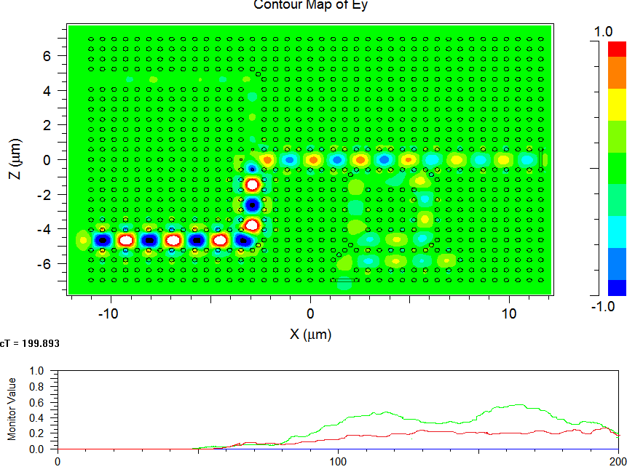

Slide 32
Case 2 A = 1 , B = 1
Both optical beams reach together at the mixing point and due to the identical length of the mixer branches both are in phase, therefore the power intensity will be increased. In this case the optical power intensity near the resonant ring will reach the switching threshold and causes wavelength mismatch between the resonator and optical beams. Consequently the resonator would not drop the optical waves into DROP waveguide and the optical beams would travel toward port C and turn it ON. Therefore one can summarize that when B is ON, D is OFF and C is ON.

Slide 33
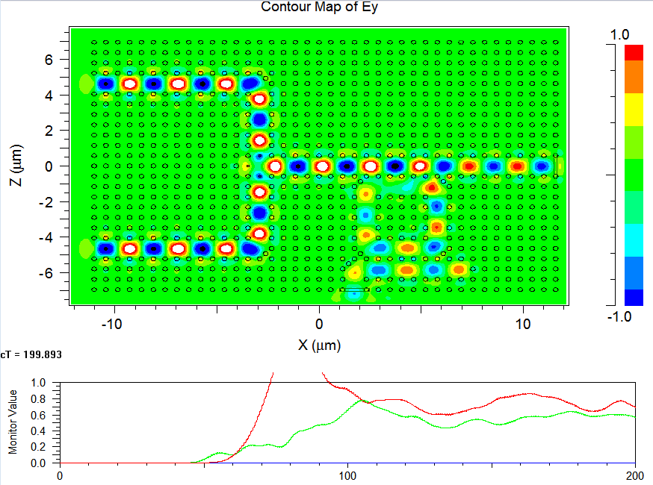

Slide 34
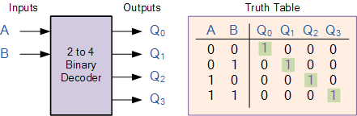
2-4 Decoder

Slide 35
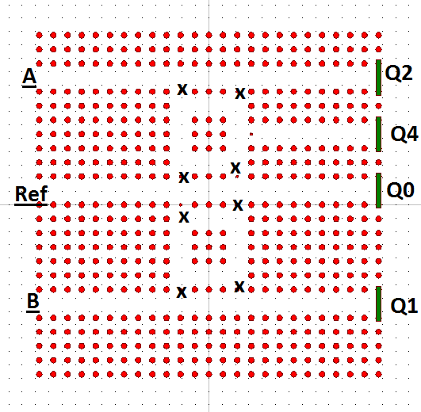
Crystal Lattice structure of 2-4 Decoder

Slide 36
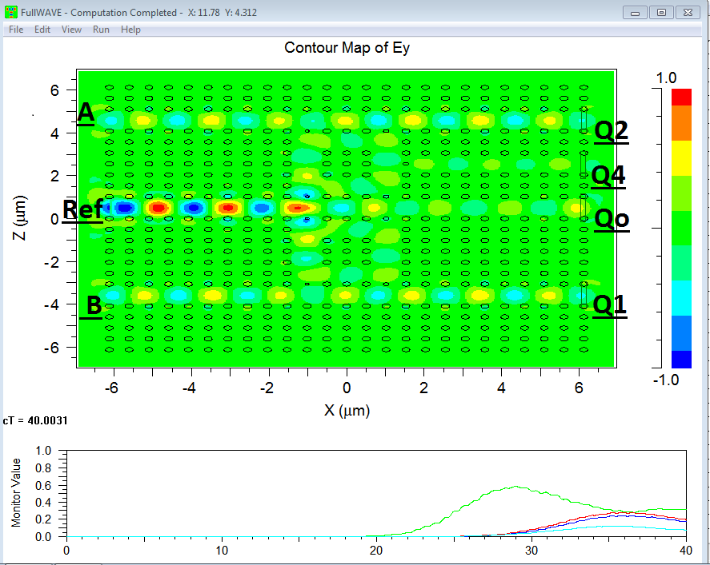
CASE 1 : When A=0 , B=0 (Decoder with no inputs)
As we can see that when A=0, B=0 then we have Qo=1 because its monitor value is above 0.5 (shown by green color) and hence is considered 1 in binary)

Slide 37
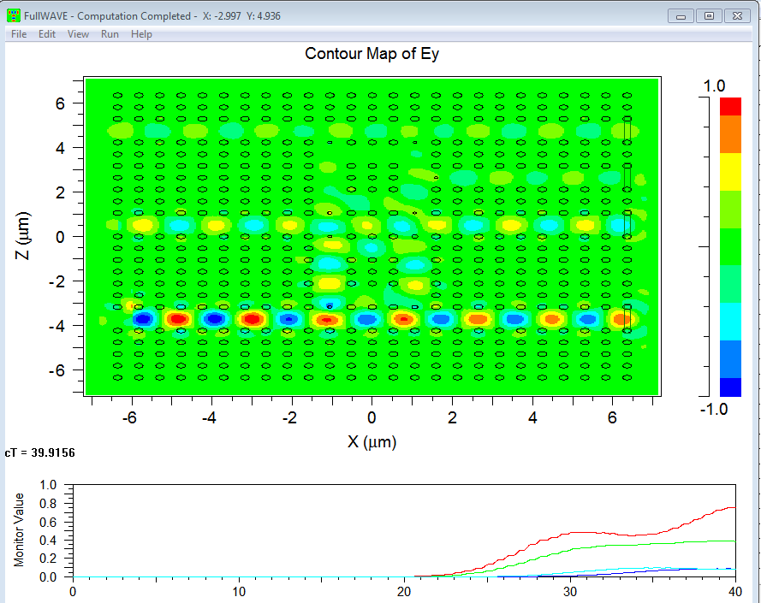
Case 2 : When A=0, B=1 (Decoder with one input high)
As we can see that when A=0, B=1 then we have Q1=1 because its monitor value is above 0.5 (shown by red color) and hence is considered 1 in binary

Slide 38
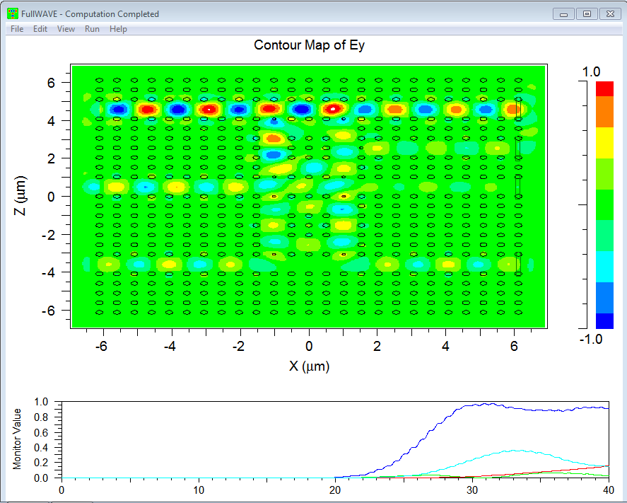
Case 3 : When A=1, B=0 (Decoder with one input high)
As we can see that when A=1, B=0 then we have Q2=1 because its monitor value is above 0.5 (shown by dark blue color) and hence is considered 1 in binary

Slide 39
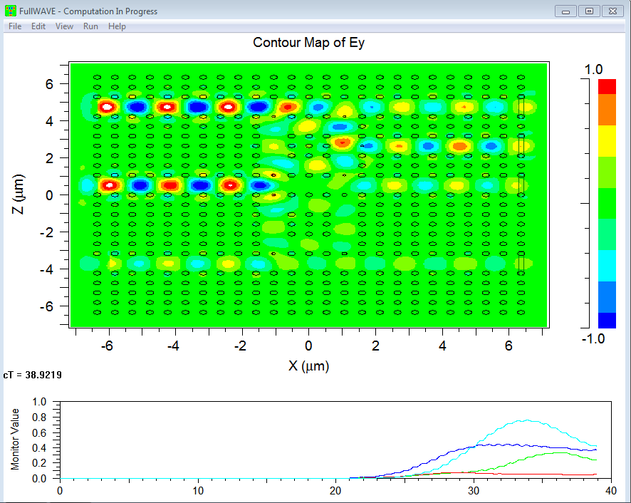
Case 4 : When A=1, B=1 (Decoder with two inputs)
As we can see that when A=1, B=1 then we have Q3=1 because its monitor value is above 0.5 and hence is considered 1 in binary

Slide 40
Work Plan
Phases | RESEARCH TARGETS | DURATION
I | Literature Survey Study of Simulating tool Analysis of existing structures Modifying the existing structure | 1 Month (Dec 2018-Jan 2019)
II | To design all-optical flip flop, encoder and decoder on 2D photonic crystals. | 2 Months (Jan 2019-Mar 2019)

Slide 41
Work Plan
Phases | RESEARCH TARGETS | DURATION
III | Interpretation of results and documentation | 1 month (Mar 2019-April 2019)

Slide 42
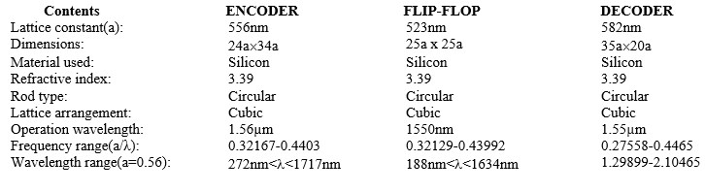
Technical Specifications:

Slide 43
References
[1] S. S. Zamanian‑Dehkordi, M. Soroosh, G. Akbarizadeh. "An ultra-fast all-optical RS flip-flop based on nonlinear photonic crystal structures." The Optical Society of Japan 2018
[2] Tamer A. Moniem "All-optical S-R flip flop using 2-D photonic crystal." Springer Science+Business Media New York 2015.
[3] Gaurav Kumar Bharti, Jayanta Kumar Rakshit "Design of all-optical JK, SR and T flip-flops usingmicro-ring
resonator-based optical switch." Springer Science+Business Media, LLC, part of Springer Nature 2018
[4] K.Naga Maruthi, R.Manohari Ramchandran, and Shanthi prince, ."Design of All Optical JK Flip Flop." International Conference on Communication and Signal Processing, April 6-8, 2016, India
[5] Amin Abbasi, MortezaNoshad, RezaRanjbar, RezaKheradmand, "Ultra compact and fast All Optical Flip Flop design in photonic crystal platform." Optics Communications285(2012)5073–5078
[6] Enaul haq Shaik, Nakkeeran Rangaswamy. "Investigation on photonic crystal based alloptical
clocked D-flip flop." IET Optoelectronics
[7] John D. Joannopoulos, Steven G. Johnson, Joshua N. Winn ,Robert D. Meade "Photonic Crystals Molding the Flow of Light" Second Edition

Slide 44
References
[8]Yulan Fu, Xiaoyong Hu, and Qihuang Gong. "Silicon photonic crystal all-optical logic gates." Physics Letters A 377.3 (2013): 329-333.
[9] Raghda M.Younis, Nihal FF Areed, and Salah SA Obayya. "Fully integrated AND and OR optical logic gates." IEEE photonics technology letters 26.19 (2014): 1900-1903.
[10] Preeti Rani, Yogita Kalra, and R. K. Sinha. "Design and analysis of polarization independent all-optical logic gates in silicon-on-insulator photonic crystal." Optics Communications 374 (2016): 148-155.
[11] John D.Joannopoulos,Steven G.Jonson,Joshua N.Winn,Robert D.Meade. ‘Photonic crystal –Molding the flow of light’.
[12] Junjie Bao, , et al. "All-optical NOR and NAND gates based on photonic crystal ring resonator." Optics communications 329 (2014): 109-112.
[13] Yi-Pin Yang, et al. "All-optical photonic crystal AND gate with multiple operating wavelengths." Optics Communications 297 (2013): 165-168.
[14] Chunrong Tang, et al. "Design of all-optical logic gates avoiding external phase shifters in a two-dimensional photonic crystal based on multi-mode interference for BPSK signals." Optics Communications 316 (2014): 49-55.
[15] Preeti, Rani, Yogita Kalra, and R. K. Sinha. "Design of all optical logic gates in photonic crystal waveguides." Optik-International Journal for Light and Electron Optics 126.9 (2015): 950-955

Slide 45
THANK YOU

