Slide 1

Finding Reductions Automatically
Arshdeep Singh
Notes:
Hi everyone, this is a brief overview to my project in the field of complexity theory. Let’s understand what are complexity classes.

Slide 2
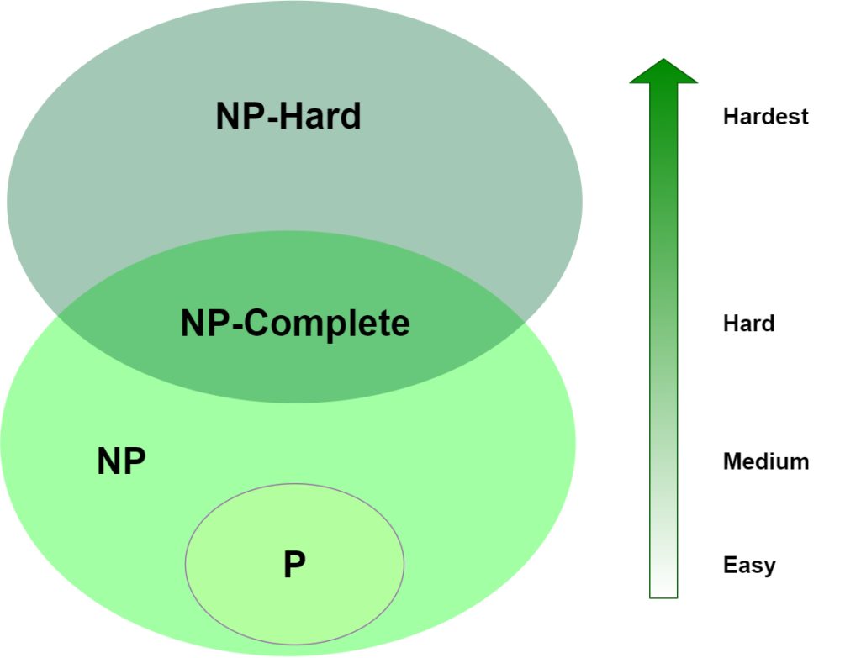
Complexity Classes
Does being able to quickly recognize correct answers mean there's also a quick way to find them?
Notes:
These are classes of problems based on how easy they are to solve.
P is a class that includes all the problems that can be solved by a reasonably fast program, like multiplication or addition.
However, if no particular rule is followed to make a guess and verify the solution, meaning it is not reasonable fast. The problem is placed in the NP class.
One benefit of this categorisation is to make it easier for us to find any relationships between the classes or inside themselves. Therefore, we can use reductions.

Slide 3

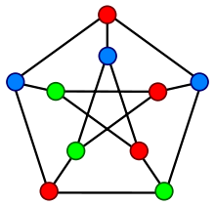
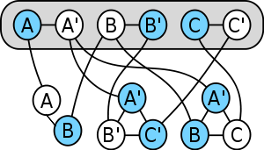
Reductions
Transform problem A to another problem B
$→$B is at least as hard as A
→B is at least as hard as A
Notes:
A reduction is a technique for mapping one problem to another. A good reduction can be used to demonstrate that the second problem is at least as complex as the first.
Meaning theoretically, a fast program for solving any NP-complete problem could be used to solve every problem in NP. The whole class would instantly collapse. So, amazingly, Sudoku is hard because it involves, literally, the same NP-complete task that makes protein folding hard.
Don’t worry if you don’t know what’s NP completeness or any of those problems are. Let us look at a very simple example.
B is my problem. And A is a NP hard one. If I find a redn, I prove b is np hard.

Slide 4
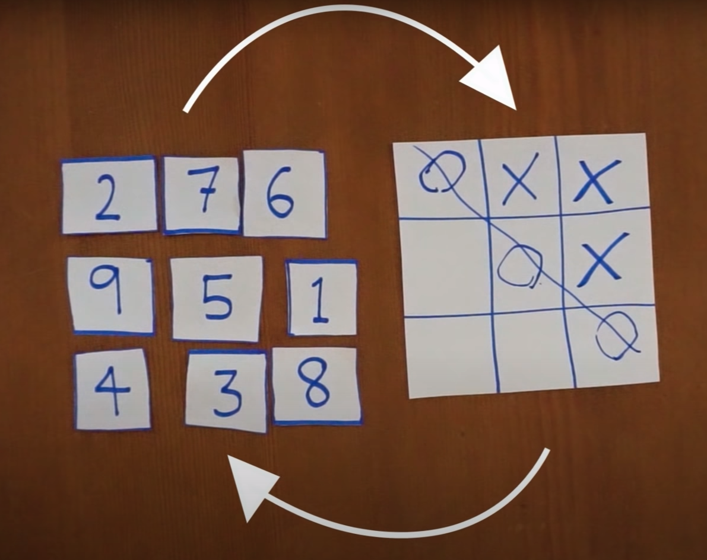
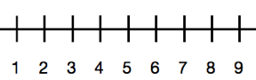
Number scramble to tic-tac-toe
Notes:
In this number scramble problem, we need to find any 3 numbers between 1 to 9 whose sum is 15. Numerous ways to solve this.
We arrange these numbers in a magic square whose sum of the diagonal, col, row is 15. This is very similar to the Tic tac toe problem.
If two problems can be reduced to the same problem, they can be solved by the same strategy. Any solution to tic-tac-toe can also solve number scramble. This is how we reduce number scramble to tic tac toe. And hence, we have a reduction.
Now let us look at a real world scenario.

Slide 5
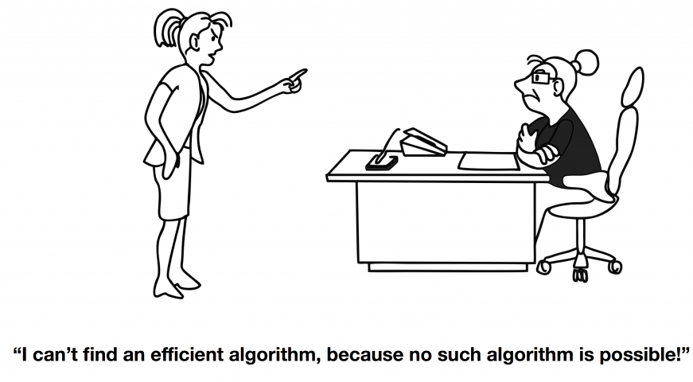
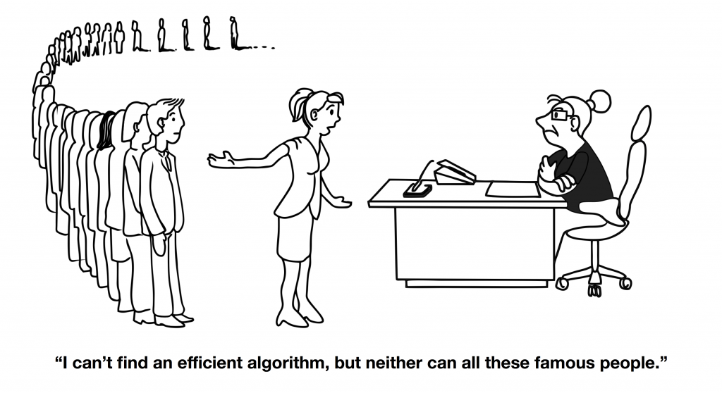
Importance of reductions
Notes:
Imagine you are working on a problem and can’t find a solution. You think it is unsolvable, but you need proof. How do you do it? Reductions come to your rescue.
This way, you can find a reduction from problems that are proven to be hard to solve and reduce any one to the given problem. And, hence we have a proof.
Apart from this, for those of you in data science will understand that features derived from a dataset can be tweaked or transformed to use in a trained ML model.
However, finding proofs takes time and a lot of effort.
Tedious work. Therefore, researching a way to find these reductions automatically is very important.

Slide 6
Intersection between AI and Th. CS
Finding reductions manually is a tedious and lengthy process
I investigate different ways to find reductions automatically
The equation below can be used to find reductions between 2 decision problems and be solved using logic solvers.
Notes:
We work with decision problems. This enables us to use logic solvers. People have been improving these solvers for years. Therefore. We can use them to solve the following equation to find reductions. I suggest you to read the report to understand it in detail.

Slide 7
Thank YOu
https://github.com/SinghArshdeep/Finding-Reductions-Automatically-

