Slide 1

AI-Based Network Intrusion Detection System
Bappi Raman Singh
AICTE ID : STU681211419101f1746014529
Apply ID:APPLY_1764241591692830b7e0ce6
Internship ID: INTERNSHIP_1762343729690b3b31bb89f

Slide 2

PROBLEM STATEMENT
Organizations are more vulnerable to cyberthreats including DDoS attacks, illegal system access, and malicious network activity as digital infrastructure and online services grow quickly. New and evolving attack techniques are frequently missed by traditional intrusion detection systems that rely on set criteria. Additionally, they frequently generate false alerts and find it difficult to adjust to new security threats.

Slide 3
Project Description
The AI-Based Network Intrusion Detection System (NIDS) is a real-time security solution that uses machine learning—specifically the Random Forest Classifier—to analyze and classify network traffic as either normal or malicious. It supports a simulation mode using synthetic data for academic demonstrations and can be extended to real-world datasets like CIC-IDS2017 for practical deployment. Designed to adapt to evolving threats, the system improves detection accuracy, reduces false positives, and offers scalability for various network environments. Its modular architecture allows customization, while performance metrics help monitor effectiveness and responsiveness across different use cases.

Slide 4

WHO ARE THE END USERS?
Engineering students with a focus on cybersecurity, information technology, or computer science
Students in their final year working on significant projects
Learning interns Network Security and Machine Learning
Trainers & Faculty
Teachers of cybersecurity
Scholars investigating intrusion detection and network security
IT managers in charge of corporate networks

Slide 5

Technology Used
  Hugging face
  Streamlit
  Pandas
  Sklearn
  Python

Slide 6
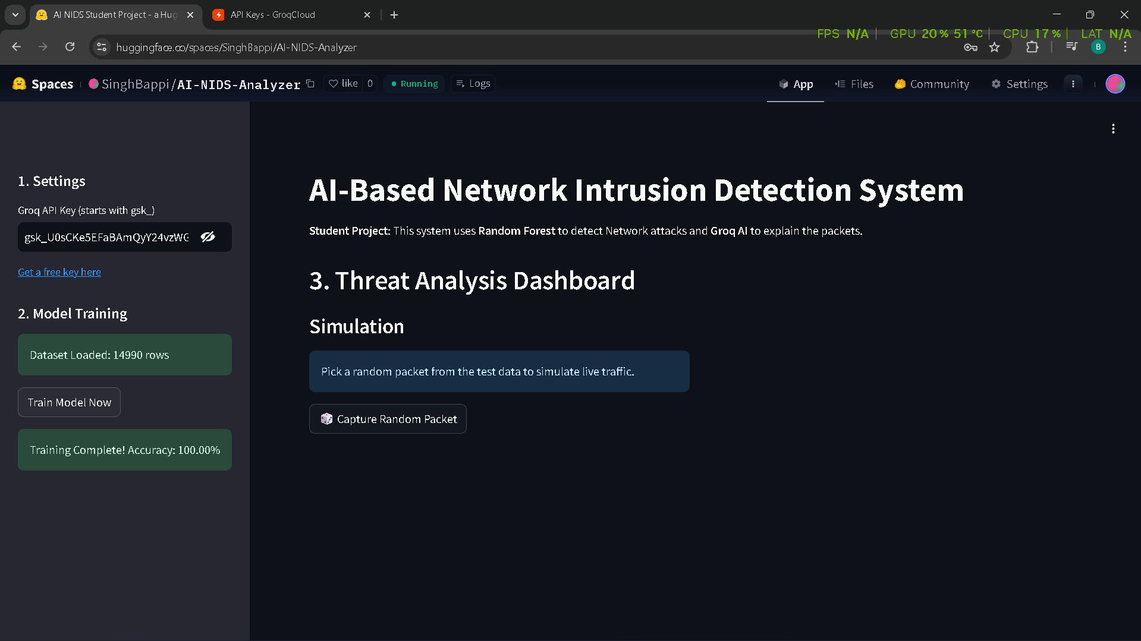
RESULTS
[Add screen shots of your code ]
Demo Link

Slide 7
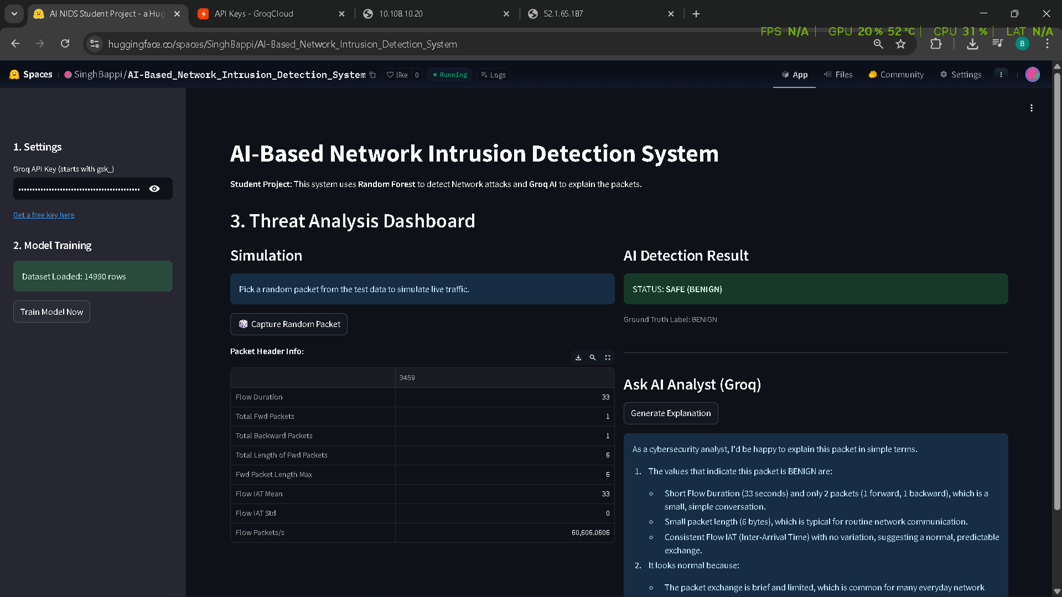
RESULTS
[Add screen shots of your code ]
Demo Link

Slide 8

Certificate - Protection from browser attacks

Slide 9

Certificate - Introduction to System Security

Slide 10

Certificate - Securing Android Devices

Slide 11
GitHub link:https://github.com/SinghBappi/AI-Based-Network-Intrusion-Detection-System

Slide 12
Thank you
.
.

