Slide 1
SNAPDRAGON AI LAB · BUILD & PRESENT CHALLENGE
VaaniNotes
Offline, multilingual lecture and meeting notes
that run on the Snapdragon NPU.
Whisper-Small on the Hexagon NPU
Local LLM via Qualcomm GenieX
11 languages · 0 bytes sent to the cloud
Vaani (वाणी) means speech.

Slide 2
THE PROBLEM
Hours of spoken knowledge are lost, or sent to someone else's server
Classrooms and meetings are multilingual
Connectivity is not guaranteed
Audio is private
A single lecture moves between Hindi, English and a regional language. Note-taking tools built for English-only audio break down.
Hostels, trains, rural campuses and field offices have patchy internet. Cloud transcription stops exactly where it is needed most.
Lectures, patient consultations, client calls and internal meetings should not be uploaded to a third party to get a summary.
A Snapdragon X laptop already has the hardware to solve this locally. The NPU just needs the right application.
VaaniNotes · 2

Slide 3
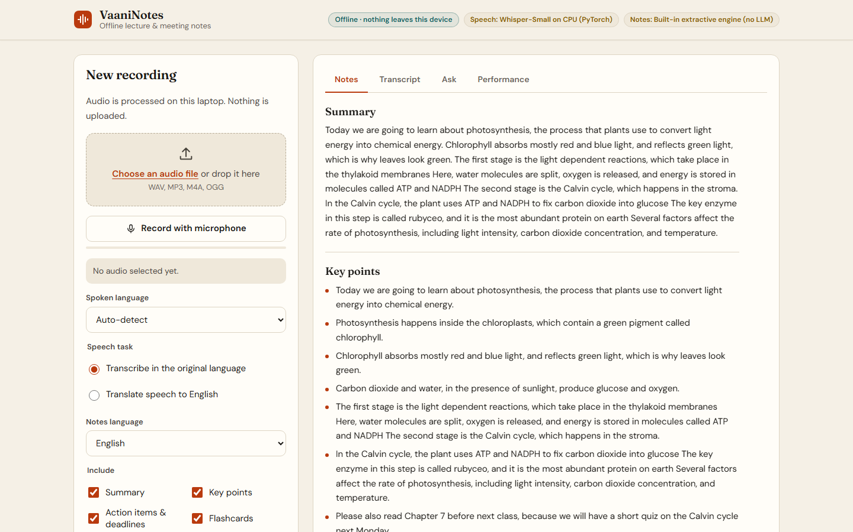
THE SOLUTION
Press record. Get notes. Nothing leaves the laptop.
Transcribes 11 languages
Auto-detects the language, or translates speech straight to English.
Writes real notes
Summary, key points, action items with deadlines, and flip-card flashcards, in the language you choose.
Answers questions
"When is the lab report due?" returns the answer with its timestamp.
Private by construction
Binds to 127.0.0.1 with a strict Content-Security-Policy: the page cannot call out.
The app turning a 93-second biology lecture into notes (development build, CPU fallback).
VaaniNotes · 3

Slide 4
HOW IT WORKS
One pipeline, two models, all on the NPU
HEXAGON NPU
Audio in
Whisper-Small
Qwen3-4B LLM
Notes out
Microphone or file.
Encoded to 16 kHz
WAV in the browser.
AI Hub precompiled
QNN ONNX.
30 s windows.
Qwen3-4B-Instruct on
GenieX (QAIRT), w4a16.
Map-reduce, 4K context.
Summary, key points,
actions, flashcards,
Q&A, Markdown.
FastAPI on 127.0.0.1 runs a single-worker job queue and streams results to the page as they are produced: transcript first, then each notes section.
Fallback chain keeps it useful anywhere: NPU → CPU for speech; GenieX → any local OpenAI-compatible server → built-in extractive engine for notes.
VaaniNotes · 4

Slide 5
TECHNICAL IMPLEMENTATION
Optimised for Snapdragon, not just ported to it
Chipset-specific AI Hub models
ONNX Runtime + QNN on HTP
setup.ps1 detects X Elite, X Plus or X2 Elite and fetches the matching precompiled QAIRT context binaries for Whisper-Small from Qualcomm AI Hub.
Encoder and decoder run through the QNN execution provider in burst mode. Both the plugin EP (2.x) and the legacy built-in EP are supported.
A PyTorch-free NPU path
LLM on the NPU via GenieX
The KV-cache decoding loop is written in numpy against the AI Hub I/O contract (float16, named tensors), so the Snapdragon install stays small and native ARM64.
Qwen3-4B-Instruct (w4a16, QAIRT) is reached over GenieX's local OpenAI-compatible endpoint. Long recordings are condensed map-reduce style to fit 4K tokens.
VaaniNotes · 5

Slide 6
PERFORMANCE
About 30× faster than real time on the NPU
117 ms
10.5 ms
22.6 tok/s
Time to transcribe a 60-minute lecture
Whisper-Small encoder
per 30 s of audio
Whisper-Small decoder
per token
Qwen3-4B-Instruct
GenieX QAIRT, w4a16
CPU fallback (measured, i5)
≈ 30 min
Published by Qualcomm AI Hub for Snapdragon X Elite (NPU), models v0.63.0. On X2 Elite: 53 ms / 6.3 ms.
Snapdragon X Elite NPU (from AI Hub figures)
30 s of speech ≈ 117 ms + 80 tokens × 10.5 ms ≈ 1 s of NPU time.
A one-hour lecture transcribes in about two minutes, then notes are written at roughly 20 tokens per second.
Measured CPU fallback on a 13th-gen Intel i5: 1.7–2.1× real time for the same model.
≈ 2 min
VaaniNotes · 6

Slide 7
DEPLOYMENT & ACCESSIBILITY
Two commands to install. Usable by everyone.
Deployment
Accessibility
powershell -File setup.ps1
.\run.ps1
• Full keyboard operation, visible focus, skip link
• Screen-reader landmarks, ARIA tabs, live progress updates
• WCAG AA contrast, 44 px targets, 200% zoom safe
• Light and dark themes; respects reduced motion
• Notes in 11 languages with correct lang tags, so Indic scripts get the right font and voice
• Status is never colour-only: icon + words every time
• Detects the chipset and downloads the right AI Hub model
• No API keys, no accounts, no cloud services
• Works in airplane mode after setup; fonts are self-hosted
• CPU and no-LLM fallbacks, so it runs on any Windows PC
• Web UI, command line, and Markdown export
VaaniNotes · 7

Slide 8
USE CASE & IMPACT
Who gets their hours back
Students
Teachers
Clinics & legal aid
Field teams
Lectures in mixed Hindi-English become revision notes and flashcards, even in a hostel with no Wi-Fi.
Class recordings turn into summaries and homework lists to share with absentees.
Consultations stay confidential because audio never leaves the device.
Government and NGO staff get minutes and action items in low-connectivity offices.
What makes it different
Indian languages first, not an afterthought · Both models on the NPU, not just one · Provably offline (CSP + loopback) · Degrades gracefully instead of failing
VaaniNotes · 8

Slide 9
STATUS & ROADMAP
What is built, what is verified, what is next
Built
Verified
Next
• NPU speech path (QNN EP)
• GenieX LLM client + fallbacks
• Notes, flashcards, Q&A
• Web UI, CLI, Markdown export
• One-step setup, benchmark script
• 11 unit tests, including the AI Hub decoder I/O contract
• End-to-end pipeline, API and UI on the CPU path
• Model I/O checked against the published AI Hub assets
• Still to do on a Snapdragon laptop: NPU timings with scripts/benchmark.py
• Whisper-Large-v3-Turbo from AI Hub for higher Indic accuracy
• Live captions while recording
• Speaker diarisation
• Packaged installer (MSIX)
VaaniNotes · 9

Slide 10
Your lecture stays yours.
VaaniNotes turns the Snapdragon NPU into a private note-taker for India's multilingual classrooms and workplaces.
Source code, setup guide, design system and benchmarks are in the GitHub repository linked with this submission.
Models: Whisper-Small and Qwen3-4B-Instruct via Qualcomm AI Hub. Snapdragon and Qualcomm are trademarks of Qualcomm Incorporated.

