Slide 1
Ambrosia Microservices
Lesson 0 (optional) – Ultra low latency Java

Slide 2
Learning objectives
Relationship between Ambrosia microservices and ultra low latency programming.
What sort of latencies can be achieved with Ambrosia
Is Java a suitable language for ultra low latency development
What special techniques need to be employed by when programming in the ultra low latency space
Are microservices a suitable paradigm in the low latency space.

Slide 3
Are Ambrosia microservices only for low latency applications?
In a word – no.
Whilst a lot of effort has gone into making them low latency compliant it would not be a bad choice for any microservices architecture within Citi.
Remember if you have a problem with throughput reducing latency is a fantastic way to increase throughput!
The rest of this slide is only relevant to those in the low latency arena.

Slide 4
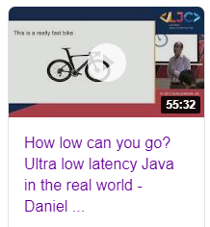
Ultra low latency programming in Java
For a discussion on these questions:
Is Java a suitable language for ultra low latency development?
What special techniques need to be employed by when programming in the ultra low latency space?
Are microservices a suitable paradigm in the low latency space?
Watch my video here:
https://www.youtube.com/watch?v=BD9cRbxWQx8

Slide 5
InfinityCable
InfinityCable is a DMA (Direct Market Access) system developed in Citi using Ambrosia microservices.
It receives a fix message from the client which is parsed, some risk checks are applied to it, there is some order management effected before it needs to be transformed back into a fix message and sent to the venue in an architecture that looks like this.
Client decodes fix and adds market data
ORA performs risk checks and order management
Venue recreates the fix message and sends to the exchange
Fix In
Fix Out
On our fastest boxes in the lab we have the time measured on Corvil at 11us at the 50th %ile (see full stats in the next slide)
The time for a smallish message to transfer between microservices including serialisation and deserialization should be well under 1us.

Slide 6
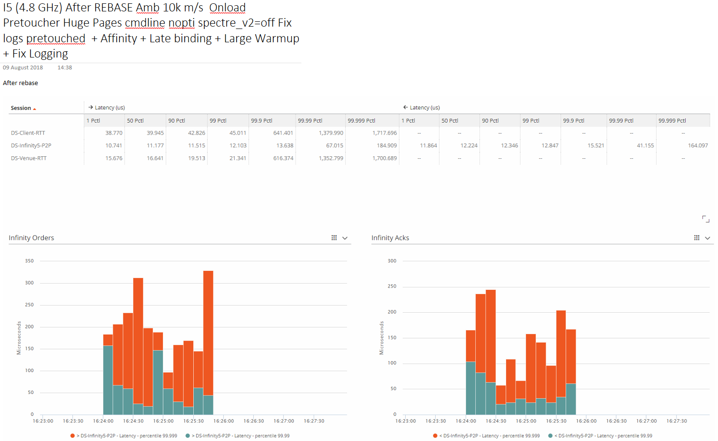
Full benchmark stats

