Slide 1
Ambrosia Microservices
Lesson 2 – HelloWorld
Getting your first pod of microservices up and running!

Slide 2
Learning Objectives
Through developing a HelloWorld pod of microservices we will learn
The structure of an ambrosia microservice
The event loop single threaded architecture
How to use the special annotations to build Ambrosia microservices
Ambrosia message serialisation to and from queues
How to use timers in microservices
How to create a microservices landscape
How to start microservices
How to read and write messages to and from a microservice

Slide 3
Ambrosia microservices - definitions
Podmaster
Podmaster
Microservices (small boxes) communicate with each other via queues (arrows).
Groups of microservices are called pods and live on single server. You can have more than one pod on a big server.
Each pod may have a podmaster.
Pods can communicate with each other through their podmasters.
Pods can share data with each other using replication or bridge communication (more of that later).
MS
MS
MS
MS
MS
MS
MS
MS
MS
MS
MS
MS
MS
MS
Podmaster
MS
MS
MS
MS
MS
MS
MS

Slide 4
The anatomy of an Ambrosia microservice
.
Single threaded event loop reading data off input queues, processing it and writing to an output queue.
The key thing to stress at this point is the single threaded nature of the microservice.
Microservice
Data in 1
Data in 2
Data out

Slide 5
HelloWorld Microservice
SrcMicroservice writes a HelloWorld message
HelloWorld Microservice reads the HelloWorld message and writes a HelloWorldReply message
SinkMicroservice reads the HelloWorldReply message and write a confirmation to sdout
Three microservices collaborating to produce a HelloWorld message.

Slide 6
The Ambrosia event loop
.
The event loop provides the pulse for the service. As well as reading inputs from queues as a trigger for work, timers and service tasks can be added to it to keep the all tasks in the service single threaded.
The event loop can be called in busy (spinning mode) or in various sleepy modes depending on how much CPU is available to the service.
Data in 1
Timer: call back every 5 seconds
Microservice
Data in 2
Service task: check for data on a socket

Slide 7
Ambrosia Serialisation
001011110000000010
ServiceDTO
setId()
getId()
setPrice()
getPrice()
001011110000000010
Microservices communicate with each other by writing messages to queues stored in shared memory accessible to the pod.
One of the key features in Ambrosia is the efficient manner in which it serialises or marshals data from shared memory to and from the service where it appears to the service as a POJO. All the developer has to do is use the Java @ServiceDTO annotation on a class and this will happen automagically, we will see this in the code shortly.

Slide 8
HelloWorld - SrcService
A service to generate numbers and write them into the HelloPayload shared memory queue.
Timer: call back every second
sayHello()
SrcService
HelloPayload

Slide 9
HelloWorld - HelloWorldService
A service that reads from the HelloPayload queue and writes to the HelloWorldReply queue.
sayHello(HelloPL) reply()
HelloWorldService
HelloPayload
HelloWorldReply

Slide 10
HelloWorld - SinkService
A service that reads from the HelloWorldReply queue and logs messages to stdout.
reply(HelloWorldReply)
SinkService
com.citi.icg.demo.ambrosia.microservice.helloworld.SinkService - [QUEUE-IN] '...well hello, that was quick!'
12:11:21.564734 [helloworld-sink] INFO com.citi.icg.demo.ambrosia.microservice.helloworld.SinkService - [QUEUE-IN] '...well hello, that was quick!'
HelloWorldReply

Slide 11
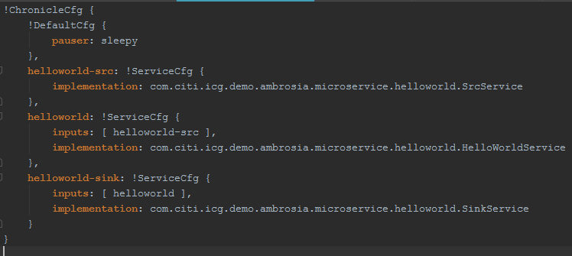
Configuring Ambrosia Microservices
Ambrosia services can be configured using a configuration file typically referred to as ‘services.yaml’.
In the HelloWorld example it looks like this →
There are 3 services each with their own implementation and inputs where applicable.

Slide 12
Starting Ambrosia Microservices
Ambrosia services are launched from com.citi.icg.ambrosia.Microservice.main()
It takes as parameters at least a service file and a service name. If you want to start all the services in the service file then you can pass the token ‘all’ as a parameter. Typically that would only be done in testing or demonstration scenarios.
You can also pass other parameters into to it that will be delivered to the service if they are constructed to accept those arguments. We’ll see more about those later.
public final class HelloWorldMain {
private HelloWorldMain() {
}
public static void main(String... args) throws Exception {
Microservice.main("helloworld-services.yaml", "All");
}
}

Slide 13
Ambrosia Microservices Modelling the Messages
The best way to start building an Ambrosia microservice is by modelling the messages that are going to be passed between the services.
Each message maps onto a method call annotated with the @MethodAPI() annotation. These methods must be collated in interfaces annotated with the @ServiceAPI annotation.
The @MethodAPI() must be created with an integer unique for that service.
@ServiceAPI
public interface HelloWorld {
@MethodId(MethodIds.HELLO_WORLD_SAY_HELLO)
void sayHello(HelloPayload payload);
}

Slide 14
Structuring Ambrosia Microservices
As shown in the services.yaml configuration file there is one service implementation per service.
That class must be annotated with the @Service annotation
The class might implement Microservice as this will allow it to hook into lifecycle events such as onActive(), onRecovering(), onIdle() …
The class should implement any ServiceAPI interfaces that it wants to process as these callbacks will be triggered when the input queue reader meets a message of that description.
@Service
public class HelloWorldService implements Microservice, HelloWorld {
…….
…….
}

Slide 15
Constructing Ambrosia Microservices
There are a number of ways to overload the constructor of the service class that will give the class access to hooks and data in the Ambrosia container.
In the simplest case no constructor is necessary. For example in the SinkService where nothing is written out of the service.
More commonly the service will want a reference to the ServiceAPI that represents its output. For example the HelloWorldService.
The constructor can be overloaded to provide a reference to the ServiceBuilder which provides many useful features such as the ability to add timers. The SrcService uses this feature in its construction.
More advanced overloading options include the ability to get hold of the AffinityMapper as well as arguments to the program which can be passed into the service constructor.
public HelloWorldService(HelloWorldReply out) {
this.out = out;
}
public SrcService(ServiceBuilder serviceBuilder, HelloWorld out) {
this.out = out;
final ServiceController controller = serviceBuilder.getController();
timer = controller.createTimer(this::sayHello);
}

Slide 16
Putting it all together - Taking a look at the code
The code can be found in microservices-demo: https://cedt-icg-bitbucket.nam.nsroot.net/bitbucket/projects/MICRO/repos/microservices-demo/browse

Slide 17
After running the demo – Examining the data directory with QueueCat
The messages that were produced in the demo were stored in a directory called ‘data’.
The sub directories will be named after the microservices in the services.yaml file.
Run QueueCat against them to see the contents of the files.
These files will be critical to understanding the next lesson which is ‘recovery with Ambrosia MicroServices’.

