Slide 1
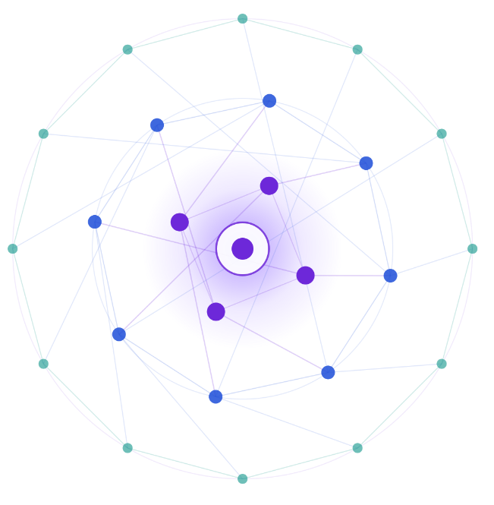
SAMSUNG PRISM
Generative AI Hackathon
3rd Edition 2026–27
PRISM Agentic Code Intelligence
Theme 1: Agentic Code Intelligence
SRM_Team Ctrl Alt Elite_1
SRM Institute of Science and Technology
Devansh Singh (Team Lead) · ds8467@srmist.edu.in
Sankalp Kumar · sk4156@srmist.edu.in
Ved Kumar · vk9977@srmist.edu.in
Shreel Singh · ss9735@srmist.edu.in
Public GitHub repository
Notes:
Team name formatted per final form: CollegeName_Teamname_ThemeNo. Team lead selected Team Ctrl Alt Elite; original registration spelling has not been independently confirmed. Members and emails supplied by the team lead.
Sources: https://github.com/SinghDevansh-2006/prism-code-intelligence/tree/030e29f6133f0ff0ea138243891c886fcff5a039; user-provided final submission form and team confirmations, 30 September 2026.

Slide 2
Theme
Relevant code without inspecting every file
Find Python implementations even when the question uses different wording or includes structural and version constraints.
Find by behavior
Compare query meaning with stored code embeddings and rank the strongest matches.
Inspect evidence
Trace imports, symbols and structural matches to the source code.
Understand versions
Retrieve stored versions and inspect their lineage.
Scope: Retrieval of existing Python code
Notes:
Main problem: efficient relevant retrieval by behavior, usage, structure and versions. Precomputed embeddings avoid re-encoding the corpus per query. No measured developer-productivity gain claimed.
Sources: https://github.com/SinghDevansh-2006/prism-code-intelligence/tree/030e29f6133f0ff0ea138243891c886fcff5a039; user-provided final submission form and team confirmations, 30 September 2026.

Slide 3
Existing Solutions & Gaps
Approach | Useful for | Gap addressed
Keyword search | Names and literal terms | Can miss paraphrased behavior
Dense retrieval | Natural-language intent | Does not enforce source structure
Single-version search | Current implementation | Does not show version relationships
Our response: Select a retrieval strategy suited to the question.
Conceptual comparison. No competitor benchmark is claimed.
Notes:
Revised third row to avoid assigning missing version context to history tools. These are conceptual differences, not empirical competitor results.
Sources: https://github.com/SinghDevansh-2006/prism-code-intelligence/tree/030e29f6133f0ff0ea138243891c886fcff5a039; user-provided final submission form and team confirmations, 30 September 2026.

Slide 4
Our Solutions & Architecture Diagram
User question
FastAPI + rule-based router
One route per query
SEMANTIC
Search by meaning
EXACT USAGE
Imports and calls
STRUCTURAL
Code constraints
EVOLUTION
Git snapshots
Gemma 300M
65% weight
Qwen 0.6B
35% weight
AST usage index
Source-line evidence
Scope-aware AST
Source ordering
Gemma similarity
Commit / path lineage
Z-score then 65/35 fusion
Rank highest first
Ranked source code + evidence + version context where applicable
Both models read the full query. Git scope: all versions, latest snapshot or selected commit.
Notes:
Local sources: README.md; docs/review/windows-recheck.json; docs/review/mteb-uniform-result.json; docs/windows-review.md. Verified candidate SHA256 cb77efdbc0230b0342b6285770b687a5af856170776940559a0f079f9a002b72. Publication authorized on 4 October 2026; the release tag identifies the final package.

Slide 5
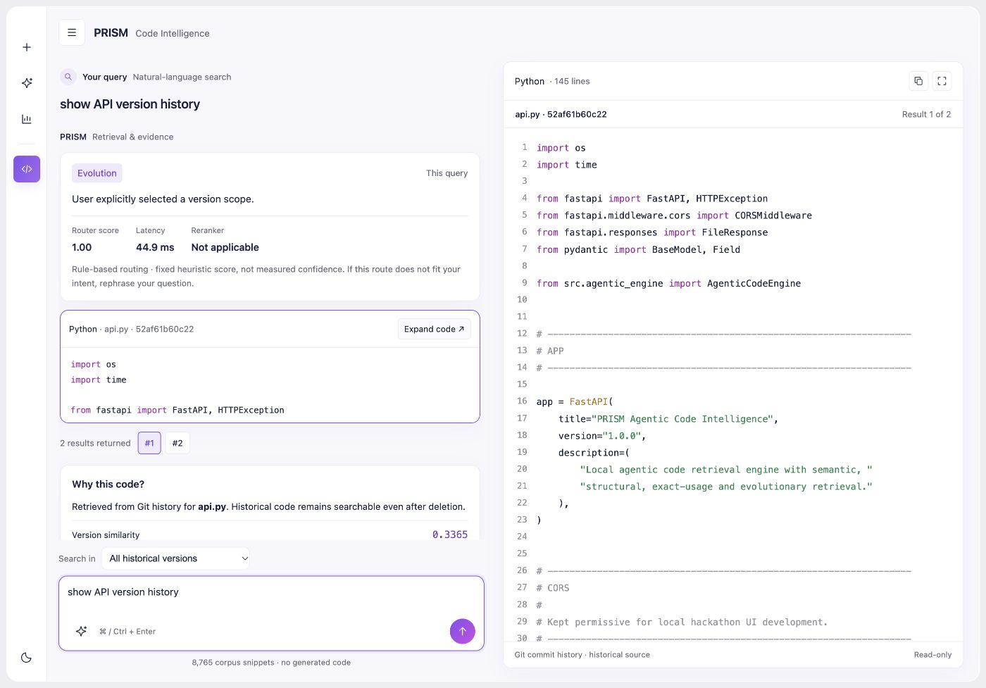
Demo & Product Walkthrough
Four query types
Semantic
Find a relevant validator
Exact usage
Files importing collections
Structural
Range before print
Evolution
Actual Git / API history
Watch the demo — 4:49
Current local UI · Actual Git history · 8,765-document code corpus
Notes:
Local sources: README.md; docs/review/windows-recheck.json; docs/review/mteb-uniform-result.json; docs/windows-review.md. Verified candidate SHA256 cb77efdbc0230b0342b6285770b687a5af856170776940559a0f079f9a002b72. Publication authorized on 4 October 2026; the release tag identifies the final package. Final video URL supplied by the team; duration confirmed as 4 minutes 49 seconds. Screenshot shows the current local build.

Slide 6
Tools and tech stack used
Application runtime
Python 3.11, FastAPI / Uvicorn
HTML / CSS / JavaScript
Retrieval runtime
PyTorch, SentenceTransformers / Transformers
EmbeddingGemma-300M + Qwen3-Embedding-0.6B
Indexes and evaluation
Python AST, NumPy, datasets and MTEB
Precomputed embeddings, AST and bounded Git history
Packaging and experiments
Docker, GitHub Actions
Evaluated alternatives: BM25, adaptive fusion, reranking
Notes:
Local sources: README.md; docs/review/windows-recheck.json; docs/review/mteb-uniform-result.json; docs/windows-review.md. Verified candidate SHA256 cb77efdbc0230b0342b6285770b687a5af856170776940559a0f079f9a002b72. Publication authorized on 4 October 2026; the release tag identifies the final package.

Slide 7
Impact & Use case
Code discovery
Find existing implementations from a description of behavior.
Onboarding and inspection
Inspect imports, calls and source evidence alongside each result.
Version understanding
Inspect actual Git revisions by commit, path and snapshot.
CPU operation with precomputed indexes
Intended benefits. Productivity gains are not measured. Model downloads and cold starts add setup time.
Notes:
Local sources: README.md; docs/review/windows-recheck.json; docs/review/mteb-uniform-result.json; docs/windows-review.md. Verified candidate SHA256 cb77efdbc0230b0342b6285770b687a5af856170776940559a0f079f9a002b72. Publication authorized on 4 October 2026; the release tag identifies the final package.

Slide 8
Innovation highlights, results and limitations
AppsRetrieval test: 3,765 queries / 8,765 documents
NDCG@10
MRR@10
Recall@100
0.853100
0.821803
0.993625
Frozen rankings, top 100 per query. Configured live corpus: 8,765 documents.
Private validation: 1,000 queries / 5,000 documents
NDCG@10 | Qwen | Gemma | Dual fusion | Fusion + reranker
Validation | 0.8215 | 0.8716 | 0.9177 | 0.9204
Dense fusion remains the default. Reranking did not improve test NDCG.
Limits: rule-based routing, Python scope and gated models. Metrics cover dense retrieval only.
Notes:
Local sources: README.md; docs/review/windows-recheck.json; docs/review/mteb-uniform-result.json; docs/windows-review.md. Verified candidate SHA256 cb77efdbc0230b0342b6285770b687a5af856170776940559a0f079f9a002b72. Publication authorized on 4 October 2026; the release tag identifies the final package. Frozen submission scores retained. Separate corrected CPU evaluation: NDCG@10 0.853220; MRR@10 0.8220444149328615; MRR@100 0.8243958749403522; Recall@10 0.94927 versus frozen 0.94953519. Small numerical changes are not a new algorithmic improvement. Dense retrieval only; private validation remains separate.

Slide 9
What’s next
FUTURE WORK
Broader code support
Extend beyond Python and evaluate larger repository histories.
Retrieval evaluation
Evaluate routing and structural search on a separate held-out query set.
Fresh Windows setup
Test model downloads and access setup from an empty Windows cache.
Notes:
Local sources: README.md; docs/review/windows-recheck.json; docs/review/mteb-uniform-result.json; docs/windows-review.md. Verified candidate SHA256 cb77efdbc0230b0342b6285770b687a5af856170776940559a0f079f9a002b72. Publication authorized on 4 October 2026; the release tag identifies the final package.

Slide 10
Brownie points slide (differentiation)
Evidence-driven choices
Compared retrieval variants and retained frozen dual fusion with reranking off by default.
CPU execution
Precomputed indexes, lazy model loading and shared Gemma reuse.
Inspectable results
Source-line evidence, real Git lineage and snapshot filters.
Verification
Windows CPU: 23/23 tests and all four routes passed. Python 3.11; cached models.
Notes:
Local sources: README.md; docs/review/windows-recheck.json; docs/review/mteb-uniform-result.json; docs/windows-review.md. Verified candidate SHA256 cb77efdbc0230b0342b6285770b687a5af856170776940559a0f079f9a002b72. Publication authorized on 4 October 2026; the release tag identifies the final package. Windows models already cached; no fresh download or full benchmark repeated. New GitHub CI not yet run.

Slide 11
Checklist - Updated on Public GitHub
Required item | Current status
Source code + requirements | Source, requirements and verified runtime indexes
README + Docker setup | Setup, Docker and verification instructions
Presentation | Final presentation included in repository
Demo video | 4:49 demo linked in README and presentation
AI disclosure | Signed disclosure included in DOCX and PDF
Final tag + result release | Required tag identifies the final submission
APK / SDK | Not applicable: browser-based Python app
Required tag: PRISM_GENAI_HACKATHON_Y2026
Final submission package · Updated 4 October 2026
Notes:
Local sources: README.md; docs/review/windows-recheck.json; docs/review/mteb-uniform-result.json; docs/windows-review.md. Verified candidate SHA256 cb77efdbc0230b0342b6285770b687a5af856170776940559a0f079f9a002b72. Publication authorized on 4 October 2026; the release tag identifies the final package.

Slide 12
PRISM Agentic Code Intelligence
Theme 1: Agentic Code Intelligence
SRM_Team Ctrl Alt Elite_1
SRM Institute of Science and Technology
Thank you
View the public GitHub repository
Watch our 4:49 demo
Organised by the Language AI Team and the PRISM Team, Samsung R&D Institute India
Notes:
Local sources: README.md; docs/review/windows-recheck.json; docs/review/mteb-uniform-result.json; docs/windows-review.md. Verified candidate SHA256 cb77efdbc0230b0342b6285770b687a5af856170776940559a0f079f9a002b72. Publication authorized on 4 October 2026; the release tag identifies the final package. Final video URL supplied by the team; duration confirmed as 4 minutes 49 seconds. Screenshot shows the current local build.

