Slide 1
Free Electron Theory
By Pooja Bhardwaj
Assistant Professor(Applied Science)

Slide 2
Introduction
Electron Theories
Drude Theory
Sommerfeld theory
(Quantum free electron Theory)
Drude-Lorentz Theory
(Classical free electron theory)

Slide 3
Free Electron Theory
Electrons are free to move anywhere in the metal in the same way as gas molecules. Therefore it can be terms as free electron gas model .
Metal as 3D array of ions
Conduction Electrons
Therefore they obey law of kinetic theory of gases

Slide 4
Force of repulsion between electrons is considered insignificant
Potential = Constant
Force = 0

Slide 5
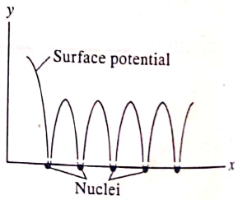

Failures
Never explain the difference between metal, semiconductor, insulators.
It tells that F=0 which is not actually true. When an electron passes near an ion , a force acts on it.
V= constant (by theory) , but actually a periodic change in potential occurs when electron pass from one place to the other.

Slide 6
It does not explain the concept of specific heat, temperature dependence of electrical conductivity and dependence of electrical conductivity on concentration of electrons.

Slide 7
Thank You

