Slide 1

INDIAN INSTITUTE OF INFORMATION TECHNOLOGY, ALLAHABAD
V Semester B.Tech in Information Technology
MINI PROJECT
Final Project Presentation
Under the supervision of :-
Prof. Shirshu Verma
Submitted By:-
Palak Mittal (IIT2018117)
Nehal Singh (IIT2018119)
Puja Kumari (IIT2018191)
Prabha Kumari (IIT2018195)

Slide 2
Problem Statement
Title : Image Based Diabetes detection using retinal images.
In this topic , we are going to predict diabetic problems using deep neural network and image processing using the color images of the retinas input data.

Slide 3
Introduction
Here we are going to predict diabetic using deep neural networks and image processing. We will have color images of the retina as input data. Vision is the most important human sense. Retinal disease affects millions of people and it mat result in loss of vision if proper treatment is not done. One of these disease is diabetic .
Generally , we have ophthalmoscopy for eye disease screening which is the best approach done today . but this approach limits the number of testing per day. So , we are going to make such a model which will help human beings by detecting eye disease called diabetic.

Slide 4
Abstract
Diabetes damages blood vessels all over the body. The damage to your eyes starts when sugar blocks the tiny blood vessels that go to our retina, causing them to leak fluid or bleed.
For detection of diabetic eyes firstly detected diabetic retinopathy by screening the eye structure of normal and diabetic patients using ophthalmoscope screening tools. Diabetic retinopathy is a complication of diabetes that affects the blood vessels of the retina.
Growth of new blood vessels ,known as proliferative retinopathy, may lead to blindness through hemorrhage and scarring.
In this project we are going to develop a model for the classification of diabetic and detect disease (Diabetes) by using Retinal images as our dataset, eye movement and deep neural networks.

Slide 5
Objectives
Primary Objectives :
Detect the diabetic eye with maximum accuracy .
Requirements : A good amount of dataset
Secondary Objective :
To make it cost effective when the project is at its expandable stage so that the project can serve a social cause.

Slide 6
Literature Review
Paper Title | Name of the Conference/journal (Year) | Purpose | Methodology | Dataset | Results
Detection of Diabetic Retinopathy Images using A Fully Convolutional Neural Network | 2nd International Conference on Data Science and Business Analytics | It develop a model for the detection of the diabetic retinopathy from fundus images of the patient. | In Data Pre-Processing , the diabetic retinopathy image is taken for detection .The optic disc and blood vessels are detected by applying edge detection algorithm. | Thay have used an HRF dataset containing a fundus image of a healthy and diabetics person.They have used all three classes for classification to form a 3 class classifier. The dataset was divided into 50% training and 50% testing sample | In this paper , it is concluded that the retinal images are evaluated to diagnose the diabetic retinopathy . This model works with an accuracy of 91.66 %.

Slide 7
2. Literature Review
Paper Title | Name of the Conference/journal (Year) | Purpose | Methodology | Dataset | Results
Support Vector Machine for Diabetic Retinopathy | International Conference On Medical Imaging Understanding and Analysis, July 2016 | The main objective of this paper is developing a network with SVM architecture and data augmentation on color images for the recognition task of diabetic retinopathy staging. | This paper use the methodology of Pre-processing technique after that Augmentation process and finally for classification purpose use CNN algorithm | Data set contains over 80,000 images, of approximately 6M pixels per image and scales of retinopathy | It shows that CNN has the potential to be trained to identify the features of diabetic Retinopathy in fundus image.

Slide 8
Experimental DataSet Description
Dataset (Name/ Description) | Characteristics of dataset | Publicly available (if yes then mention URL)
Standard Diabetic Retinopathy Database | The database consists of 89 colour fundus images of which 84 contain at least mild nonproliferative signs of the diabetic retinopathy, and 5 are considered as normal which do not contain any signs of the diabetic retinopathy. | http://www2.it.lut.fi/project/imageret/diaretdb1/

Slide 9
Dataset Explanation
We will be using this (Dataset) as our dataset.
The database consists of 89 colour fundus images .The 89 images of size 1152x1500 were manually assigned into categories representing the progressive states of retinopathy: normal, mild, moderate and severe non-proliferative, and proliferative. Images were captured using the same 50 degree field-of-view digital fundus camera with varying imaging settings.
The dataset descriptions is as follows:-
Train Datasets: Train dataset images used to prepare our model, to train it.
Test Datasets: Test dataset images used to test our model and then we measure performance of our model.
Testing and Training dataset contain hard exudates, soft exudates, microaneurysms, and hemorrhages type images.
Dataset described above is in the public domain, and can be easily downloaded. We have done worked from
https://drive.google.com/drive/u/1/folders/1hIwmhfVJnc5cpja7AQ7nxFFEZUOVcvBp

Slide 10
Algorithm
Grayscale conversion
Original Image
Adaptive Histogram Equalization
Affected Eyes
Healthy Eyes
Discrete Wavelet transform
FINAL Model
Gabor Kernel
K-Means Clustering

Slide 11
Grayscale Conversion:
An RGB Image consists of 3 layers R,G,B as it is clearly see through its name.
It’s a 3 dimensional matrix , where grayscale image is of only 2 dimensions, and the values ranges between 0–255 (8-bit unsigned integers).
gray = cv2.cvtColor(image, cv2.COLOR_BGR2GRAY)
Adaptive Histogram Equalization :
A computer image processing technique used to improve contrast in images.
Ordinary histogram transforms using the single complete image histogram which does not work when the image contains regions that are significantly lighter or darker than most of the image .
Here, adaptive histogram equalization comes to the rescue by creating transforms using the neighbourhood pixels that means taking the small part of image for each transformation.

Slide 12
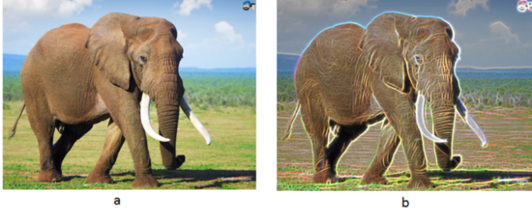
Gabor Kernel :
When a Gabor filter is applied to an image, it gives the highest response at edges and at points where texture changes.
Moreover, it’s assumed that it shows lot of similarity with human eye visual system.

Slide 13
Discrete Wavelet transform :
The Discrete Wavelet Transform (DWT), which is based on sub band coding, is found to yield a fast computation of Wavelet Transform.
It is easy to implement and reduces the computation time
and resources required.
It captures both frequency and location information (location in time)
K-Means Clustering :
A method of clustering that allows one piece of data to belong to two or more clusters.
Here, the k value decides the number of clusters to be formed.
It forms k number of centroid and assign a cluster to each centroid.

Slide 14
Methodology
Import the necessary libraries and python modules.
Input images: First, we will take the input images from the dataset in the drive. There will be a total 89 images of size 1152x1500.
Then, we will do the preprocessing of images loaded above which will include the following:
Gray scale Conversion
Adaptive Histogram Equalization
Discrete Wavelet Transform
Gabor Kernel
K-Means Clustering for segmentation
Now, we will train the model using the following classifier and will compare their results.
Support Vector Machine
K- nearest neighbor
We will calculate and predict the results by using each of above classifier and visualize the results by:
Accuracy
Classification Report
Confusion Matrix

Slide 15
Languages & Libraries
Language:
Python
Tools
Keras
TensorFlow
PIL
Libraries :
Numpy
Pandas
Matplotlib
SKlearn
Seaborn
Os
Layers
Optimizer
Model
VGG16

Slide 16
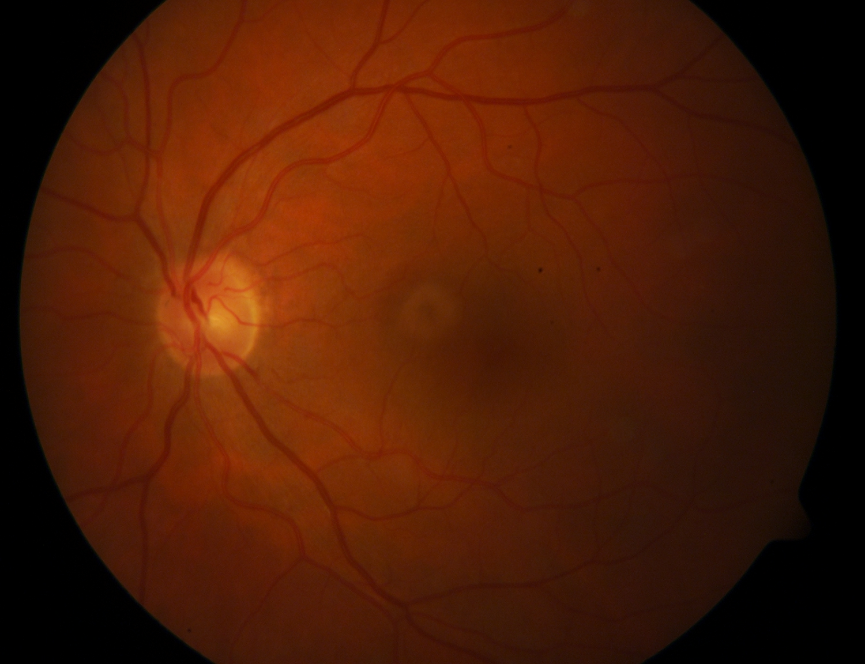
Implementation
We will mount the drive so as to access the dataset.
Import the libraries and python modules from the local environment.
Now, we will load all the images of size 1152x1500 from the drive.
Original Image

Slide 17
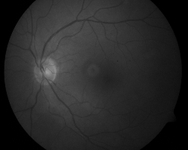
Implementation (continued)
Now, we will convert all the images to grayscale so as to get them easily processed.
WHY?
Therefore, some algorithms can only applied on 2-D image rather than 3-D, hence we convert an RGB image into a grayscale image, for instance
Grayscale Image

Slide 18
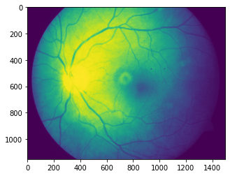
Implementation (continued)
Then, we will do Adaptive Histogram Equalization of all the images to improve contrast of images.
Why?
As a result of this adaptive histogram equalization,
the dark area in the input eye image that was badly
illuminated has become brighter In the output eye image
while the side that was highly illuminated remains or
reduces so that the whole illumination of the eye
image is same.
After Applying Adaptive Histogram Equalization

Slide 19
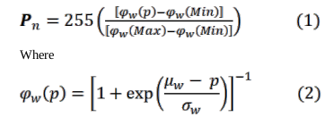
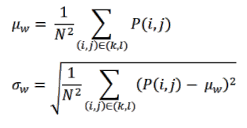
Consider a running sub image W of N×N pixels centered on a pixel P(i,j), the image is filtered to produce another sub image P of (N×N) pixels according to the equation below:

Slide 20
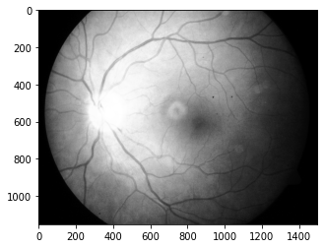

Implementation (continued)
We will now apply the Discrete Wavelet Transform on all the images.
As resolution of image increases, it requires a lot of disk space.
Why??
DWT is used to reduce the size of an image without compromising on quality and hence resolution increases.
Wavelets are obtained from a single prototype wavelet ψ(t) called mother wavelet by dilations and shifting:
After DWT

Slide 21
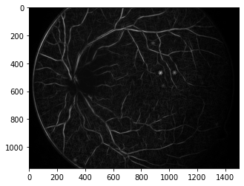
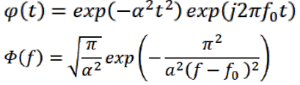
Implementation (continued)
Now we will apply Gabor Kernel filters by finding a suitable filter for it.
Why??
This is applied to enhance blood vessels and retinal pores in the image.
Applying Gabor Kernel Filters

Slide 22
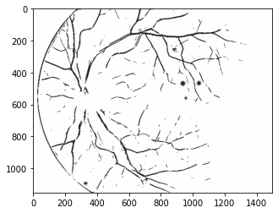
Implementation (continued)
We will then apply the K-means clustering algorithm on all the data.
Why??
Here it is used to segment the input eye image and detect the blood vessels.
Information about blood vessels can be used in grading disease severity
After the data is pre processed, then the data is ready to be fit and predicted by the different classifiers. In our project we have used SVM and KNN to predict the results.
After applying K-means clustering

Slide 23
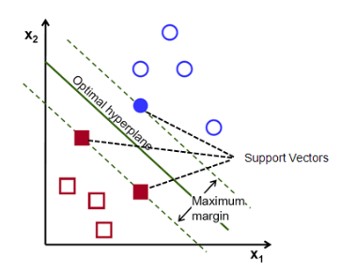
Implementation (continued)
Support Vector Machine: Support vector machine training process is applied to analyze training data to find an optimal way to classify images into their respective classes namely Normal and Diseased.
Classification parameters are calculated using support vector machine learning.
The training process analyzes training data to find an optimal way to classify images into their respective classes.
The training data should be sufficient to be statistically significant.
The support vector machine learning algorithm is applied to produce the classification parameters according to calculated features.
The derived classification parameters are used to classify the images.
Support Vector Machine

Slide 24
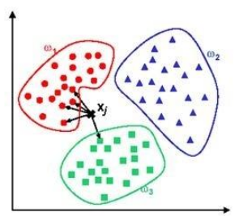
Implementation (continued)
K-NEAREST NEIGHBORS : KNN is a case-based learning method, which keeps all the training data for classification.
There are many existing algorithms such as decision trees or neural networks initially designed to build such a model.
One of the evaluation standards for different algorithms is their performance.
As KNN is a simple but effective method for classification and it is convincing as one of the most effective methods, it motivates us to build a model for KNN to improve its efficiency whilst preserving its classification accuracy as well.
KNN

Slide 25
Implementation (continued)
We will first fit the model and then predict the results for each of the above classifiers.
Here we will visualize the results of classification as follows:
Accuracy score
Classification Report
Confusion Matrix
Now we will be describing our arrays and parameters used in code :
imm_kmean : Numpy array ,which is conversion of all images in the dataset.
Y: Array for Results (1 : Diabetic, 0: Non-Diabetic)
Imm_train : Numpy Array, Containing Training Dataset
y_train : Array Containing results of Training Dataset.
We will fit our model using imm_train and y_train , and then test the model using imm_kmean and Y.

Slide 26
Intermediate Result Snapshots

Slide 27
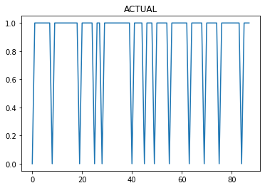
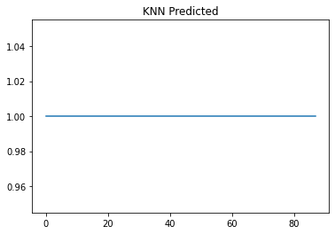
Final Results : KNN

Slide 28
Final Results (continued)
TP - True Negative 0
FP - False Positive 13
FN - False Negative 0
TP - True Positive 75
Accuracy Rate: 0.8522727272727273
Misclassification Rate: 0.14772727272727273
Classification Report:
precision recall f1-score support
0.0 1.000000 0.076923 0.142857 13
1.0 0.862069 1.000000 0.925926 75
accuracy 0.852272 88
macro avg 0.931034 0.538462 0.534392 88
weighted avg 0.882445 0.863636 0.810245 88
0 | 13
0 | 75
Confusion Matrix

Slide 29
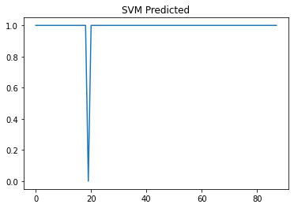
Final Results : SVM

Slide 30
Final Results (continued)
TP - True Negative 1
FP - False Positive 12
FN - False Negative 0
TP - True Positive 75
Accuracy Rate: 0.8636363636363636
Misclassification Rate: 0.13636363636363635
Classification Report :
precision recall f1-score support
0.0 1.000000 0.076923 0.142857 12
1.0 0.862069 1.000000 0.925926 75
accuracy 0.863636 88
macro avg 0.931034 0.538462 0.534392 88
weighted avg 0.882445 0.863636 0.810245 88
0 | 12
0 | 75
Confusion Matrix

Slide 31
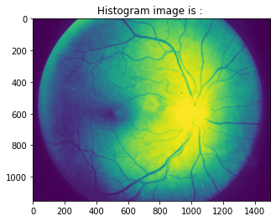
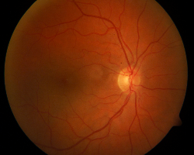
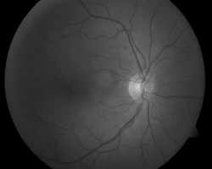
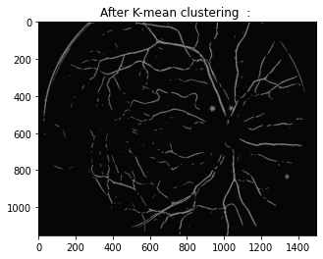
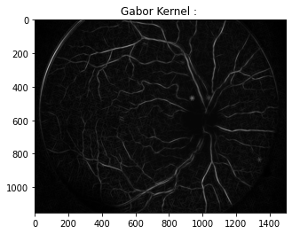
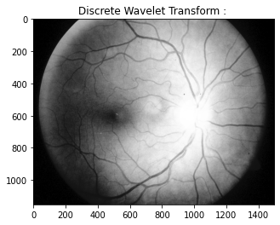
Prediction of A given Image !!!! → Diabetic
Original Image
Grayscale Image

Slide 32
Activity Chart
Steps | Time Required | Date and Time
Requirement Verify | ~ | 5th September 2020
Project Planning | 3 days | 8th September 2020
System Design | 7 days | 15th September 2020
Detail Design | 15 days | 30th September 2020
Coding | 10 days | 10th October 2020
Debugging and coding | 15 days | 25th October 2020
Report | 3 days | 28th October 2020
Testing | 5 days | 2nd November 2020
Improvements | 5 days | 7th November 2020
Final | 5 days | 13th November 2020

Slide 33
Conclusion
Diabetic Retinopathy is detected by analyzing coloured eye images.
The input retinal images are of poor quality. So they were preprocessed using Grayscale conversion, Adaptive Histogram Equalization, Discrete Wavelet Transform, Gabor kernel and k- means clustering.
As an achievement of this work, we are able to detect if a person has Diabetic Retinopathy or not.
Both the techniques used for classification were good in performance, but SVM is more efficient than KNN.
Thus this work has given a successful Diabetic Retinopathy Diagnosing method which helps to diagnose the disease in early stages which mutually reduces the manual work.

Slide 34
References
[1]. Harry Pratt , Frans Coenen , Deborah M Broadbent , Simon P Harding , Yalin Zheng,
“Convolutional neural networks for Diabetic Retinopathy”, International Conference on Medical
Imaging Understanding and Analysis 2016,MIUA 201616
Convolutional neural networks for Diabetic Retinopathy
[2]. Yiyue Lou,Department of Biostatistics, College of Public Health, University of Iowa, Iowa
City, Iowa, United States Ali Erginay,Service d' Ophtalmologie, Hôpital Lariboisière, APHP,
Paris, France Warren Clarida, IDx LLC, Iowa City, Iowa, United States,
Improved Automated Detection of Diabetic Retinopathy on a Publicly Available Dataset Through Integration of Deep Learning
[3]. Manaswini Jena ,Samita Prava Mishra , Debahuti Mishra , “Detection of Diabetic
Retinopathy Images using A Fully Convolutional Neural Network”, 2nd International
Conference on Data Science and Business Analytics.
Detection of Diabetic Retinopathy Images using A Fully Convolutional Neural Network

Slide 35


