Slide 1

Inferential Analysis of IMDb Data Using Python
PRACHI SINGH

Slide 2

Project Overview
Inferential analysis refers to the process of making inferences or drawing conclusions about a larger
population based on a sample of data.
IMDb (Internet Movie Database) is a comprehensive database of movie and TV show information, including ratings, reviews, and cast data.
Objective
To perform inferential statistical analysis using IMDb data (movie ratings, genres, etc.).
To extract insights on movie ratings, correlations, and test hypotheses.

Slide 3
Data Collection
IMDb Dataset: IMDbPY Library: Python library to fetch IMDb movie data.
Movie Ratings: Rating of the movie out of 10.
Genres: The genre(s) associated with the movie (Action, Drama, etc.).
Votes: Number of votes the movie received.
Year of Release: Release year of the movie.
Duration: Length of the movie in minutes.

Slide 4
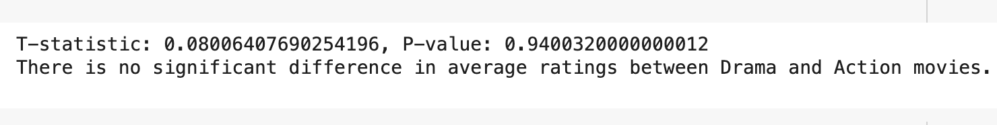
Inferential Statistics

Slide 5
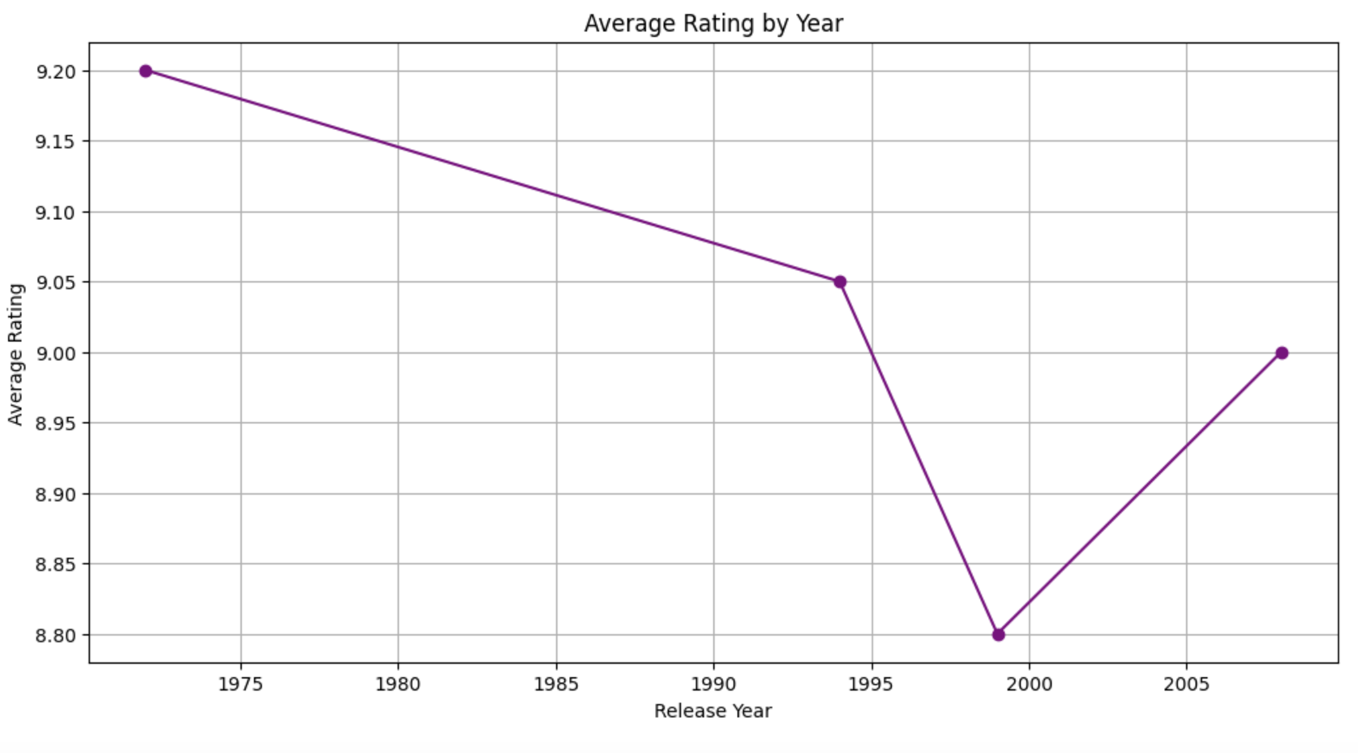
Rating Vs Release Year of movies

Slide 6
Thank you!

