Slide 1

Netflix Content Analysis: A Descriptive Study of Movies and TV Shows
PRACHI SINGH

Slide 2

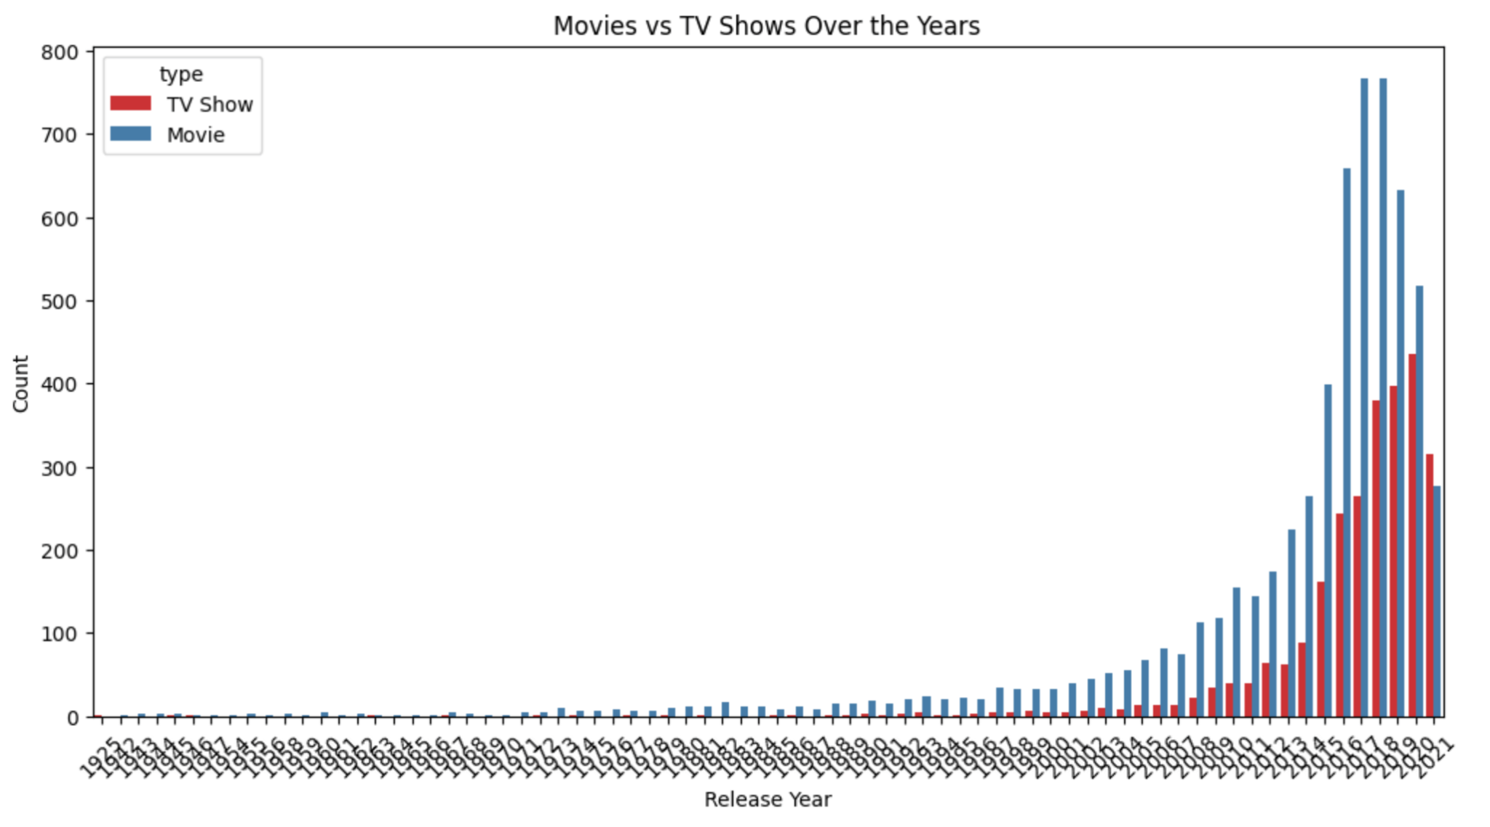
Project Overview
Objective: Analyze Netflix's content library to extract insights about movies and TV shows.
Data Source: Included in the git repo.
Analysis Goals:
Distribution of movies and TV shows over the years.
Genre distribution.
Popular countries.
Average length of movies vs. TV shows.

Slide 3
Data Overview
The dataset contains information on 8,500+ Netflix titles.
Key Columns:
Type: Movie or TV Show
Title: Name of the movie/show
Release Year: Year of release
Duration: Length in minutes (for movies) or number of episodes (for TV shows)
Country: Country of origin
Genres: Genre(s) of the content

Slide 4
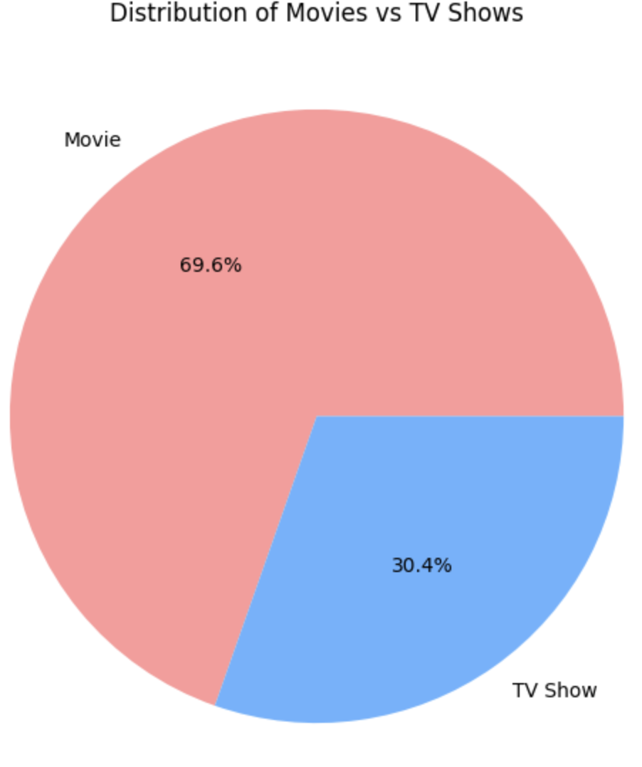
Movies and TV Shows Over the Years
Insight: There has been a clear rise in the number of TV shows being released on Netflix in recent years, especially
in the 2010s.
Conclusion: Netflix shifted its focus toward creating more TV shows compared to movies in recent years.

Slide 5
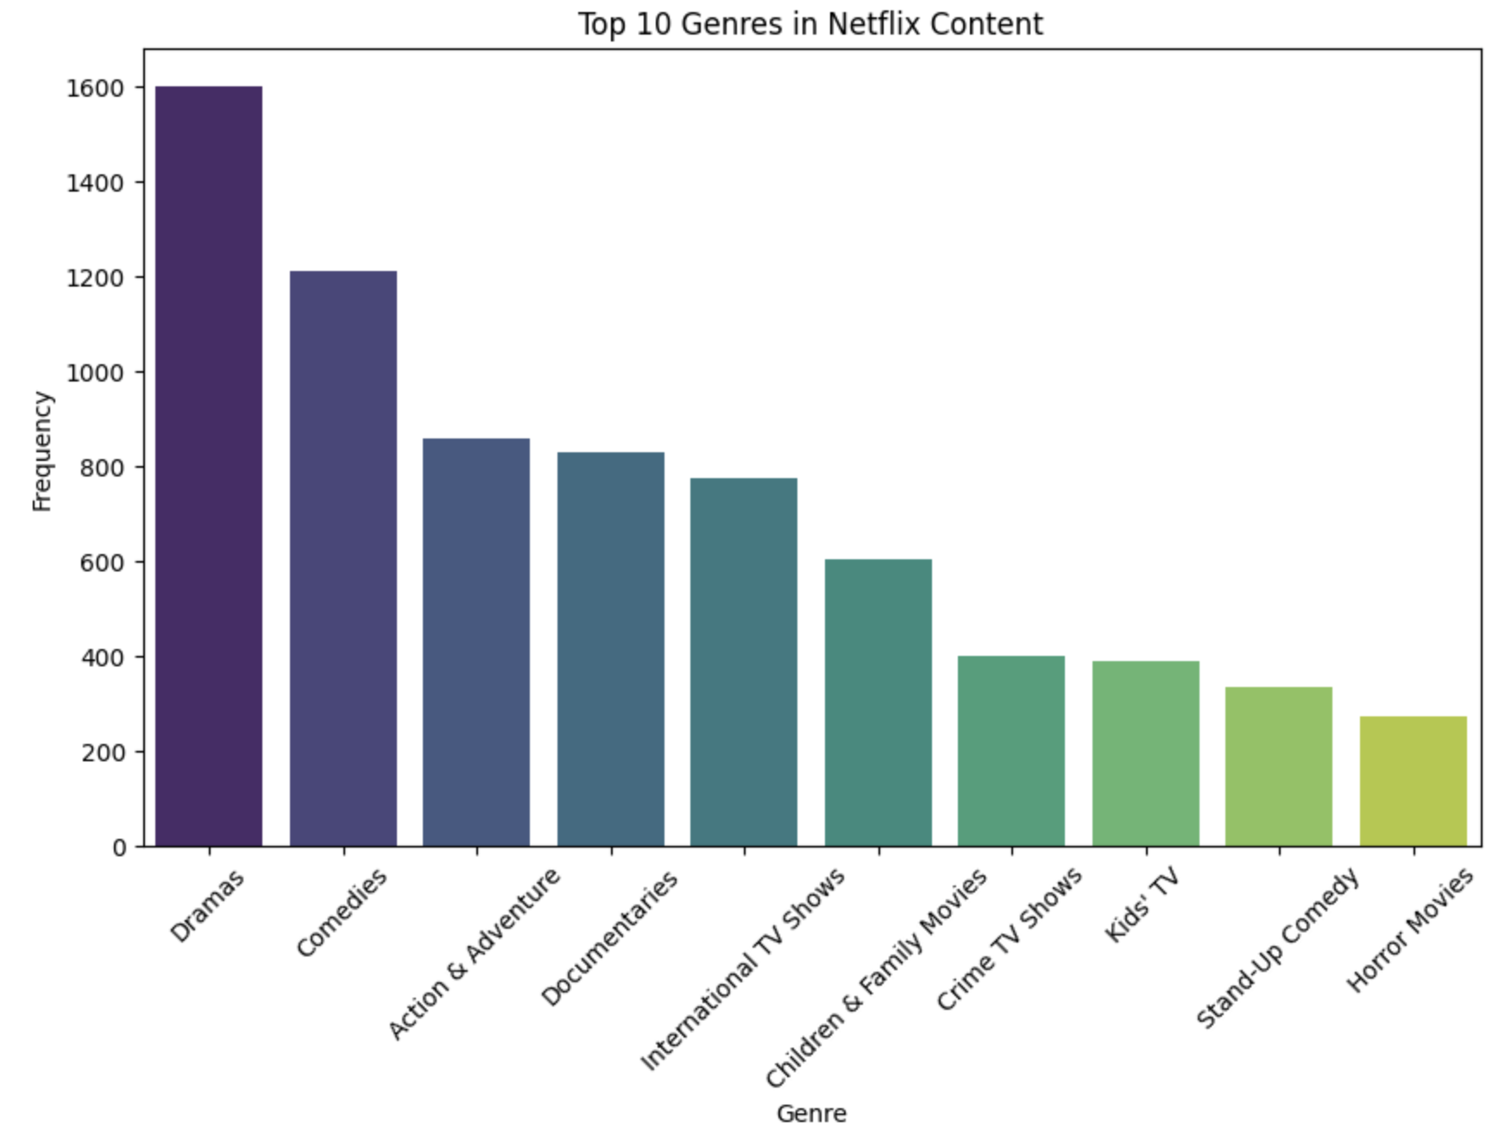
Content Type Distribution
Insight: Netflix has a higher number of TV Shows compared to Movies.
Conclusion: The higher number of TV shows indicates Netflix’s shift towards serial content (e.g., binge-worthy TV shows).

Slide 6
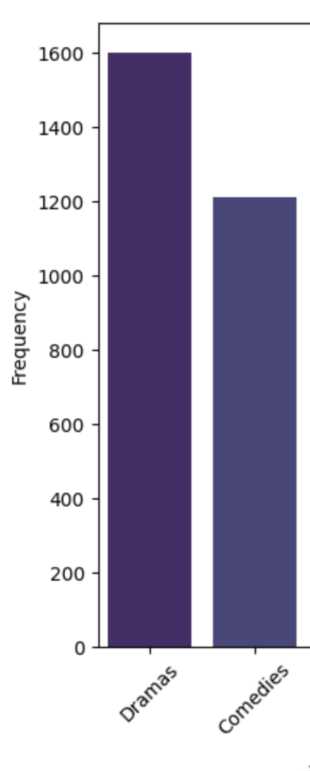
Top Genres in Netflix Content
Insight: The most popular genres on Netflix include Drama, Comedy, and Action.
Conclusion: Netflix offers a large variety of genres, with a focus on genres that have broad audience appeal.

Slide 7
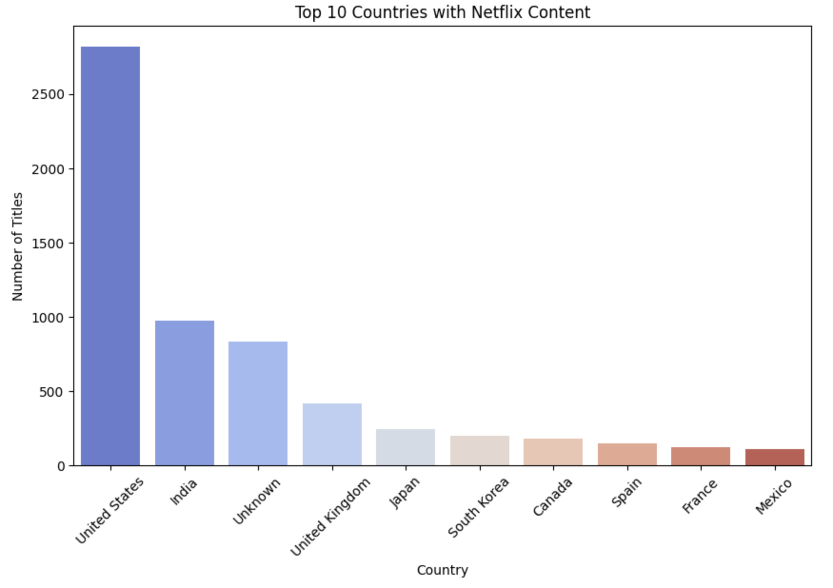
Top Countries with Netflix Content
Insight: The United States has the highest number of Netflix titles, followed by India and the UK.
Conclusion: Netflix has a global reach, with a large number of titles coming from diverse countries.

Slide 8
Key Insights and Conclusion
Movies vs TV Shows: Netflix has more TV shows than movies, and the number of TV shows is increasing.
Content Duration: Movies are generally shorter, while TV shows have more varied durations.
Top Genres: Drama, Comedy, and Action dominate Netflix's library.
Country Distribution: The U.S. leads in Netflix content, with other countries contributing significantly.

Slide 9
Closing Thoughts
Netflix's content library is growing rapidly, and the analysis can help understand their strategy and
audience preferences.

Slide 10
Thank you!

