Slide 1
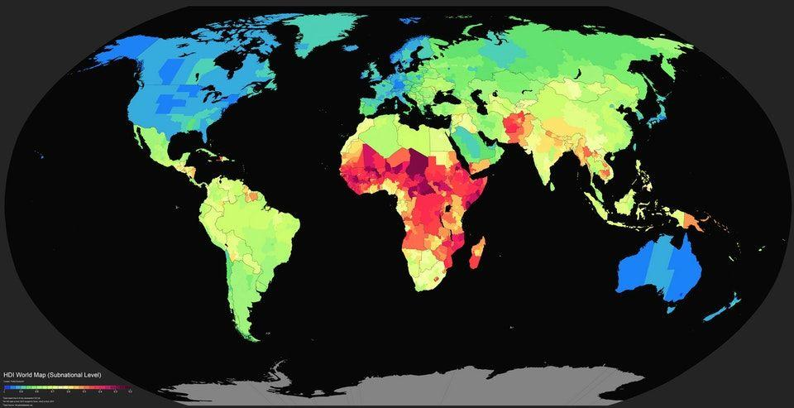
Exploring Global Life Expectancy Trends Using Python
PRACHI SINGH

Slide 2

Project Overview
Objective
The goal of this project is to explore global life expectancy trends, identify patterns and
anomalies across countries and regions, and provide insights that can guide policy-making and
public health interventions.
Tools & Libraries
Python (Pandas, Matplotlib, Seaborn, etc.), Gapminder/World Bank data.

Slide 3
Data Cleaning and Preprocessing
Handled missing values:
Dropped rows with missing life expectancy values.
Data type conversion:
Ensured all columns had appropriate data types (e.g., year as datetime).
Ensured consistency across regions and countries.

Slide 4
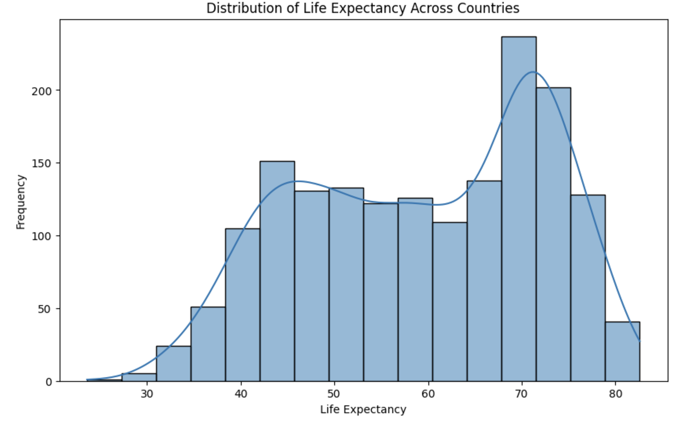
Exploratory Data Analysis
To gain an understanding of the data, find patterns, and summarize key characteristics.

Slide 5
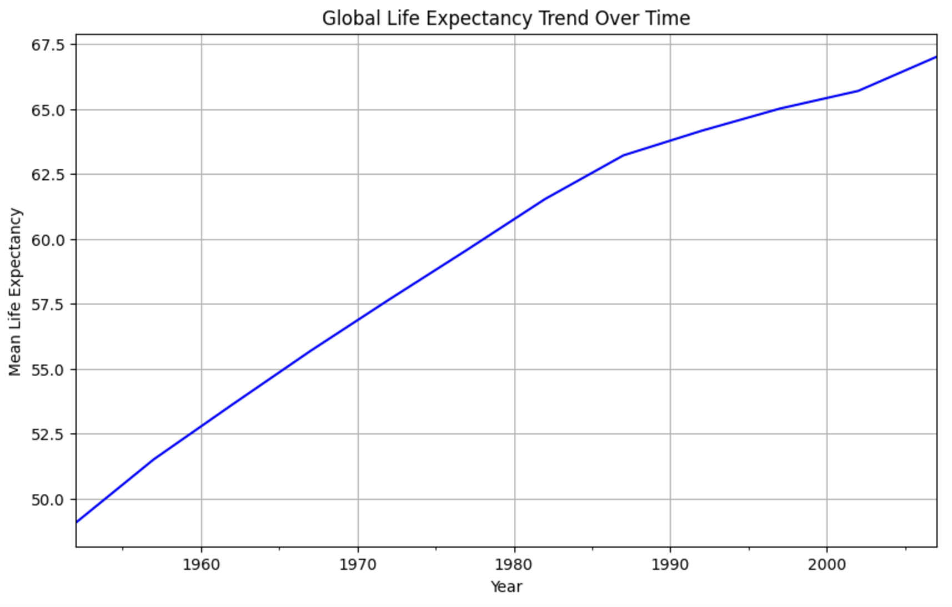
Life Expectancy Trends Over Time
Over time, life expectancy has been increasing globally.

Slide 6
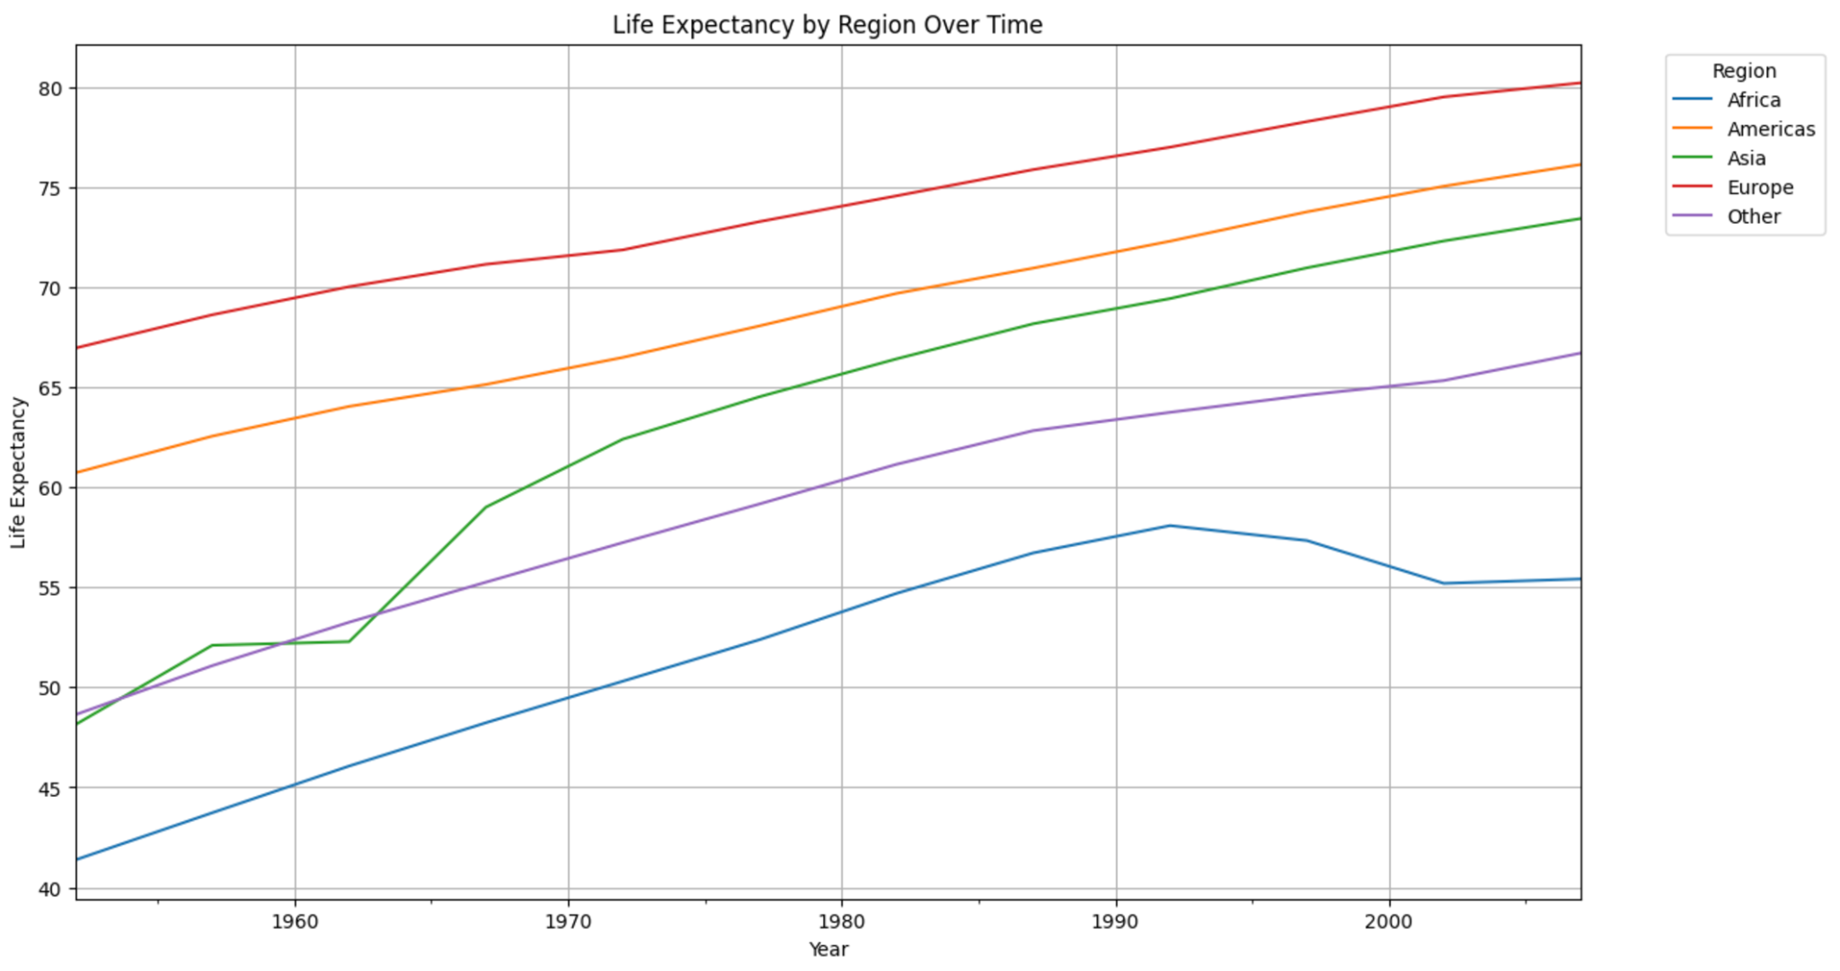
Regional Life Expectancy Trends

Slide 7
Limitations
The dataset may not account for all socio-economic factors that influence life expectancy
(e.g., quality of healthcare, political stability, etc.).
The dataset is not up-to-date beyond a certain year, which may limit the analysis of more recent
trends (e.g., the impact of COVID-19).
Regional classifications were simplified for this analysis and may not fully reflect all nuances in
life expectancy across different cultures and economies.

Slide 8
Thank you!

