Slide 1


Depression & Anxiety Prediction (DeAP)
Group 2 – Sagar Khilavdiya, Mohan Samala & Prateek Singh

Slide 2

Introduction
Purpose
Data Set EDA

Slide 3
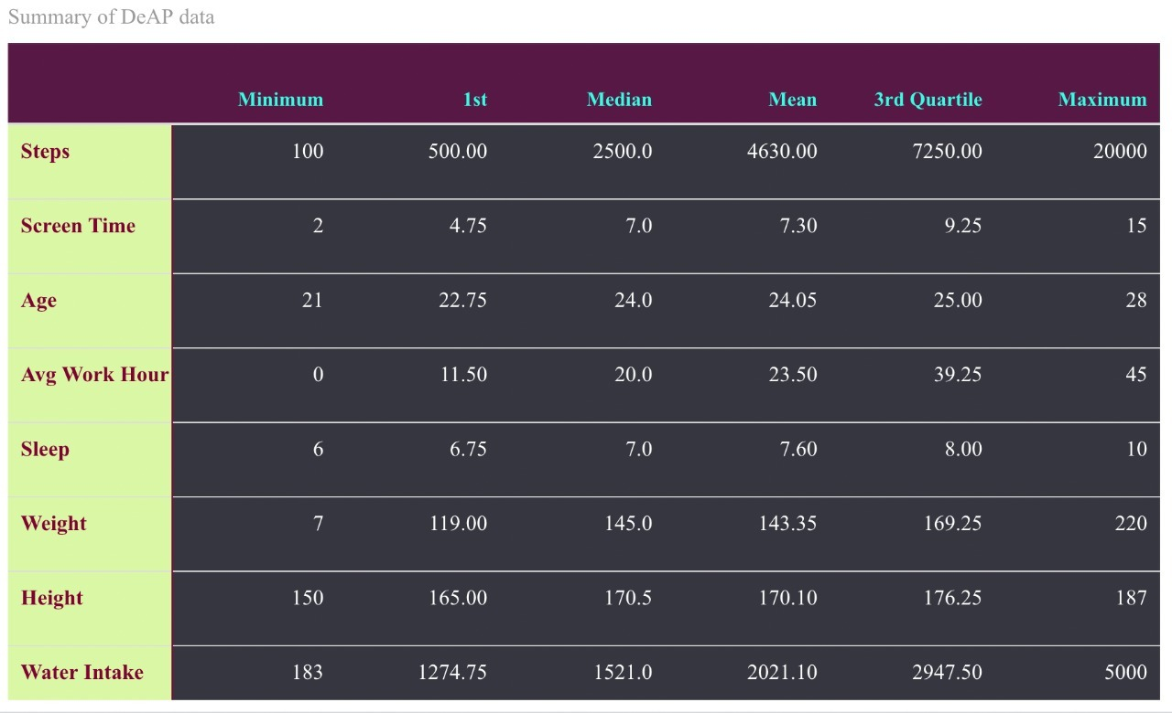
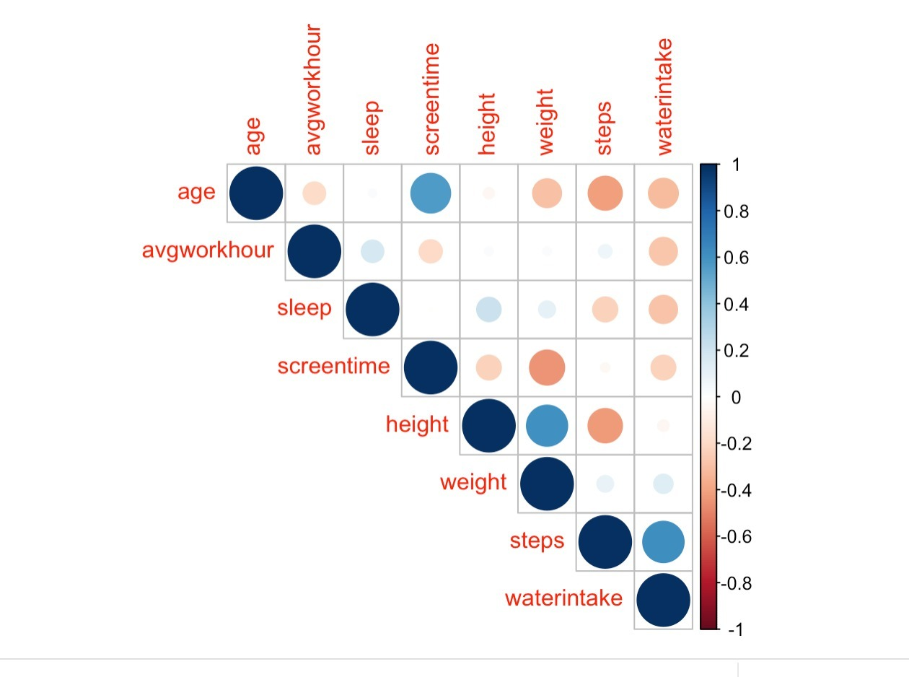
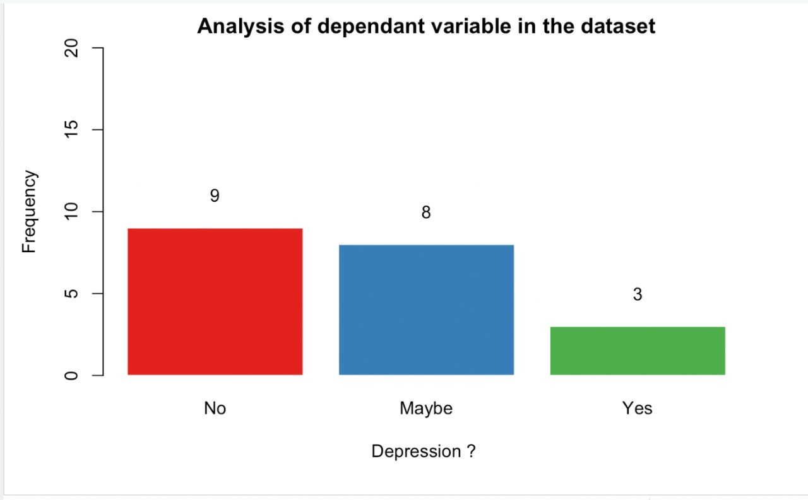
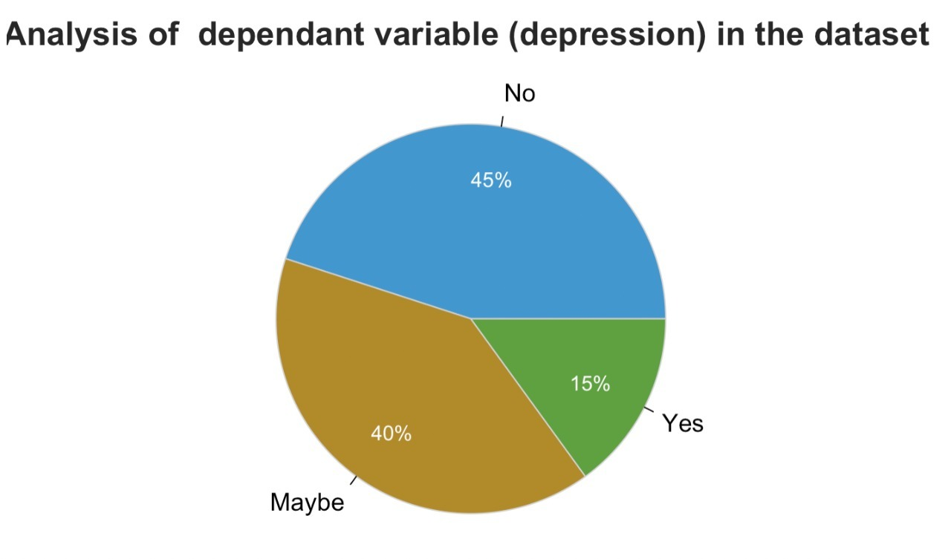
Analysis

Slide 4
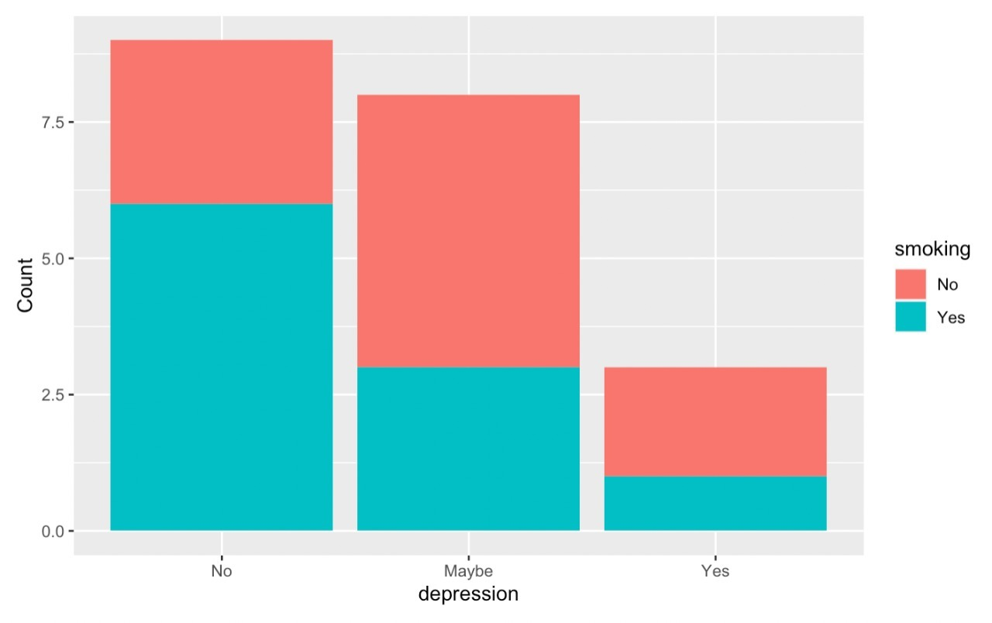
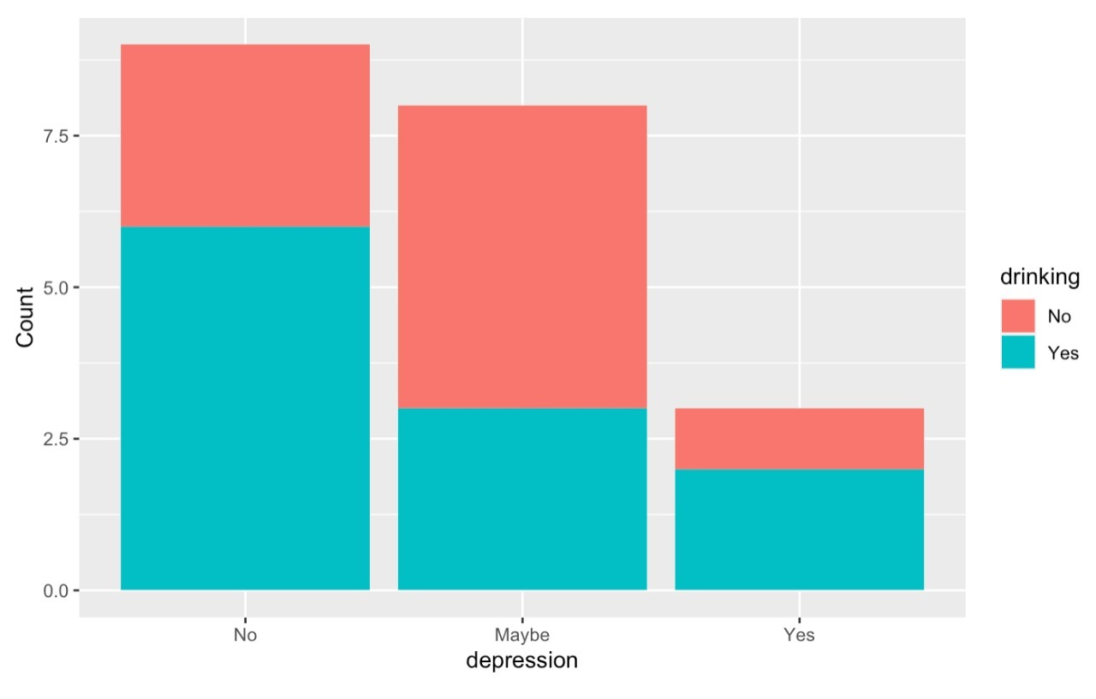
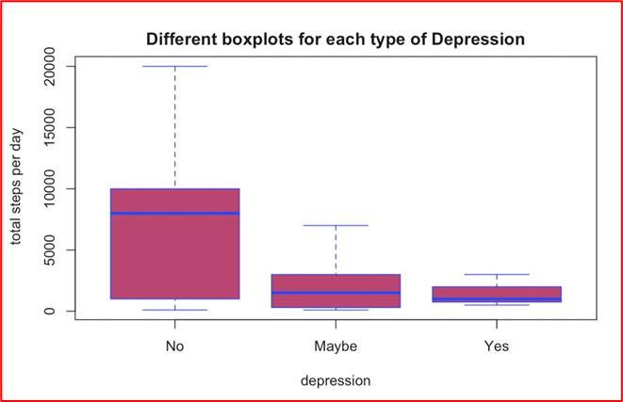
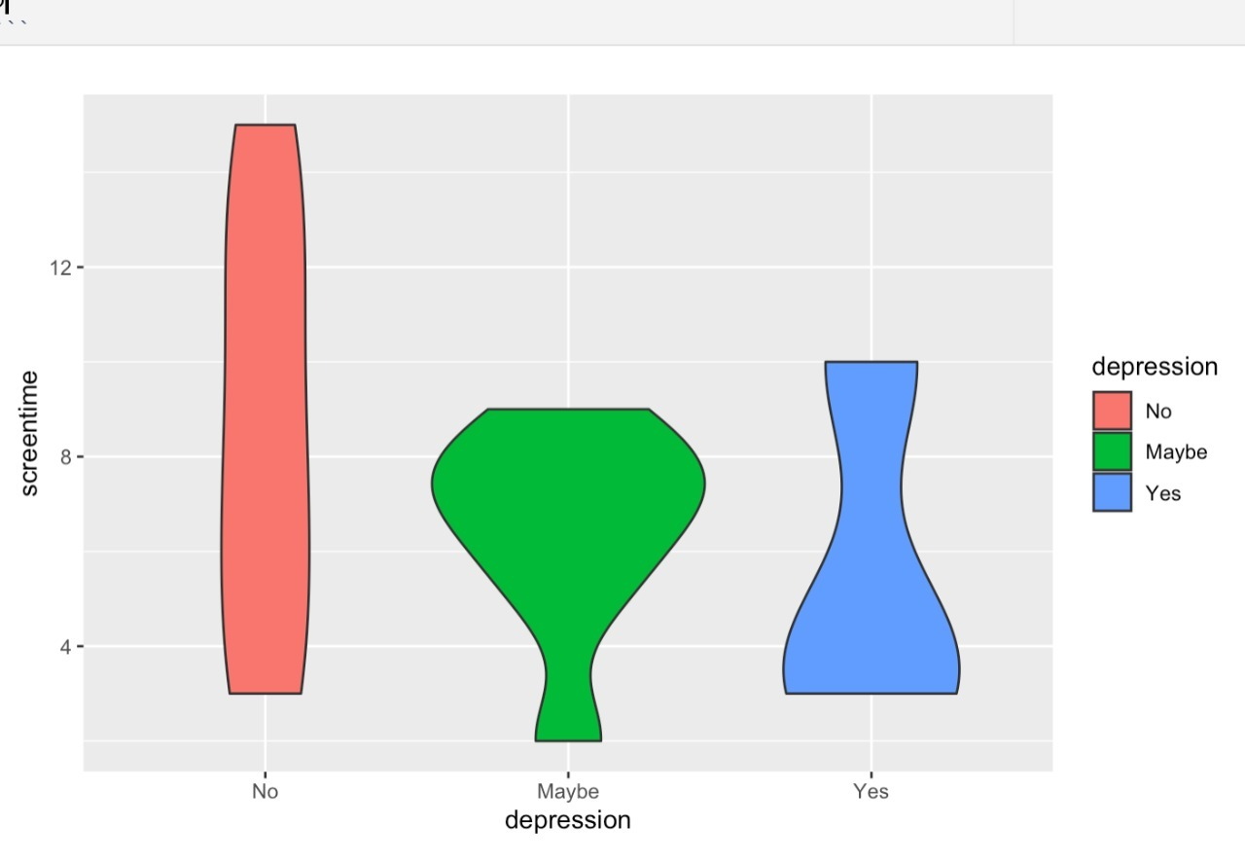
Analysis
(Contd.)

Slide 5
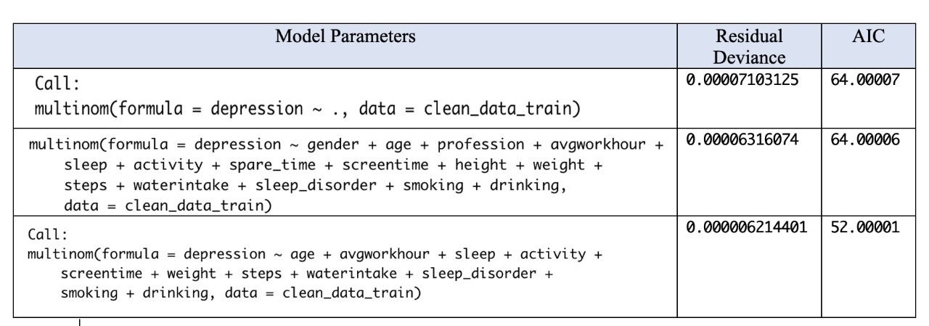
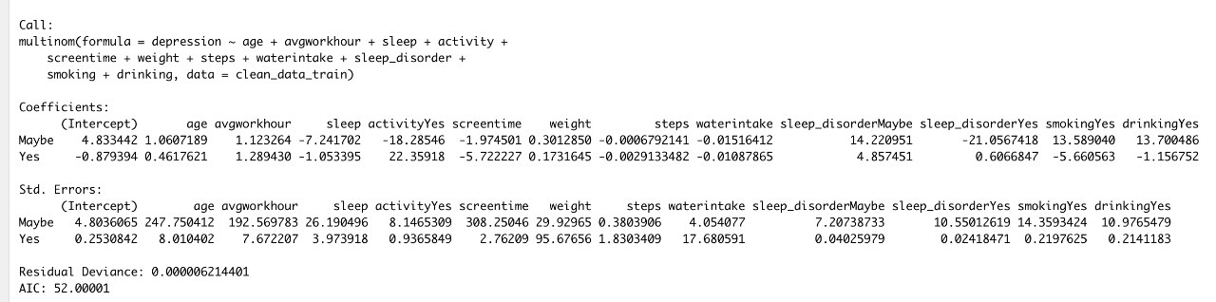
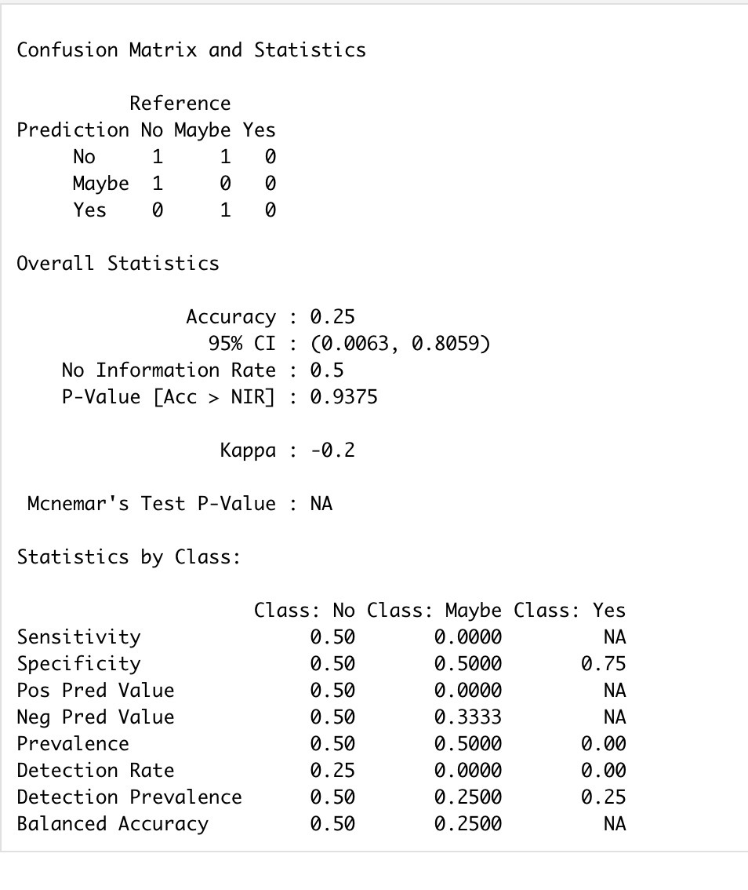
Model Fitting &
Confusion Matrix

Slide 6
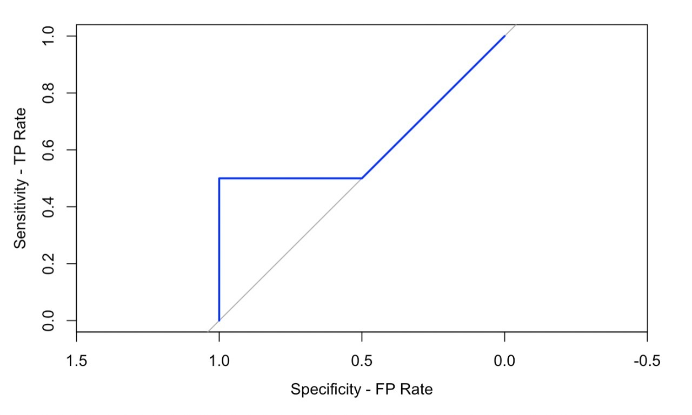
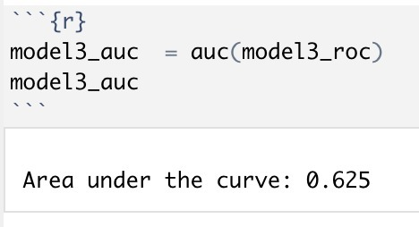
ROC & AUC

Slide 7
Conclusion
Challenges while cleaning the data.
Fewer observation is affecting the analysis and prediction.
Drinking habits are affected due to depression state.
Screen time gets reduced while in depression.
Depression affects the steps and healthy habits of an individual.
If we apply advanced algorithms like SVM, Random Forest & Bays theorem we can get better predictions.

Slide 8
References
Bevans, R. (2021, June 18). An introduction to the Akaike Information Criterion. Scribbr. Retrieved February 16, 2022, from https://www.scribbr.com/statistics/akaike-information-criterion/
Datasciencebeginners. (2020, May 27). Multinomial logistic regression with R. R-bloggers. Retrieved February 16, 2022, from https://www.r-bloggers.com/2020/05/multinomial-logistic-regression-with-r/
Le, J. (2018, April 10). Logistic regression in R. DataCamp Community. Retrieved February 16, 2022, from https://www.datacamp.com/community/tutorials/logistic-regression-R
Rodriguez, C. I. (2022, February 2). Multinomial logistic regression. Carlos I. Rodriguez. Retrieved February 16, 2022, from https://www.carlosivanrodriguez.com/guides/regression/multinomial-regression/
Siddiqui, N. (2021, March 6). How to remove a character in an R data frame column? tutorialspoint. Retrieved February 16, 2022, from https://www.tutorialspoint.com/how-to-remove-a-character-in-an-r-data-frame-column

