Slide 1
TensorFlow

Slide 2
Introduction to TensorFlow 2
TensorFlow is an open-source deep learning framework developed by Google. It is widely used for various tasks such as machine learning, deep learning, and numerical computation. TensorFlow provides both high-level APIs, such as tf.keras() for easy model building, and low-level APIs for more control.
Key Features:
Flexibility: Allows both eager execution (for beginners) and graph-based execution (for optimization and scaling).
Support for Different Platforms: TensorFlow models can be deployed on various platforms like web, mobile (TensorFlow Lite), and cloud services.
Scalability: You can easily scale your computations to use GPUs and TPUs.
Interoperability: TensorFlow supports different programming languages, although Python is the most commonly used.

Slide 3
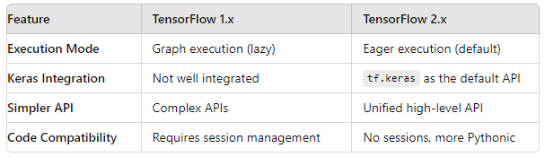
TensorFlow 1.x vs TensorFlow 2.x
TensorFlow 2.x is designed to be easier to use, more Pythonic, and more efficient in terms of performance. It also emphasizes eager execution, which allows operations to run immediately, making TensorFlow code more intuitive and easier to debug.

Slide 4
Step-by-Step Installation:
Install Python (Recommended: Python 3.8 or higher).
Set up a virtual environment:
Install TensorFlow 2 using pip:
pip install tensorflow
Checking TensorFlow Version:
import tensorflow as tf
print(tf.__version__)
python -m venv tf_env
source tf_env/bin/activate # On Windows: tf_env\Scripts\activate

Slide 5
TensorFlow 2 Architecture and Workflow
TensorFlow 2 is designed to follow an end-to-end machine learning workflow, which consists of several stages such as:
Data Preparation: Loading and preprocessing datasets.
Modeling: Building neural networks using high-level APIs like tf.keras.
Training: Optimizing model weights through backpropagation and gradient descent.
Evaluation: Measuring model performance on unseen data.
Deployment: Deploying the model to different environments (mobile, web, cloud).

Slide 6
TensorFlow Workflow
Define the Model: Using the Sequential or Functional API in tf.keras.
Compile the Model: Specifying the optimizer, loss function, and evaluation metrics.
Train the Model: Using the fit() method to train the model on the dataset.
Evaluate the Model: Assessing performance on a test set using the evaluate() method.
Save/Load the Model: For reusability and deployment.

Slide 7
Tensors
In TensorFlow, tensors are multi-dimensional arrays (or generalizations of vectors and matrices). These are the fundamental data structure in TensorFlow and are used to represent data, which can be anything from a scalar (a single number) to a high-dimensional dataset (such as images or sequences).
Tensors can be categorized based on their dimensions:
Scalar: A 0-dimensional tensor (single number). Example: tf.constant(5)
Vector: A 1-dimensional tensor (array). Example: [1, 2, 3]
Matrix: A 2-dimensional tensor (2D array). Example: [[1, 2], [3, 4]]
N-Dimensional Tensors: Higher-dimensional arrays.

Slide 8
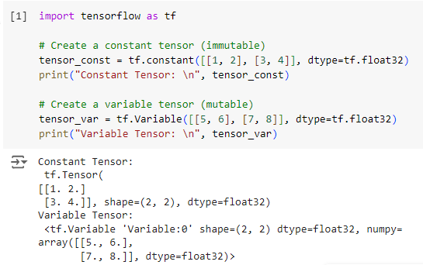
Creating Tensors
In TensorFlow, tensors can be created using various functions:
tf.constant: Creates a tensor that cannot be changed (immutable).
tf.Variable: Creates a tensor that can be modified (mutable).

Slide 9
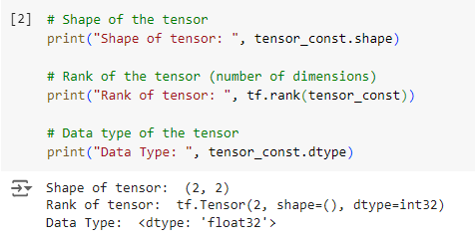
Tensors' Properties
Tensors have the following key properties:
Shape: The dimensions of the tensor, represented as a tuple.
Rank: The number of dimensions (axes) of the tensor.
Data Type: The type of data stored in the tensor (e.g., float32, int32).

Slide 10
Basic Tensor Operations
TensorFlow provides several operations to manipulate and work with tensors.
Some of the most common operations are:
Element-wise Operations: Addition, subtraction, multiplication, division.
Matrix Multiplication: Dot product between two tensors.
Reshaping: Changing the shape of a tensor without altering its data.

Slide 11
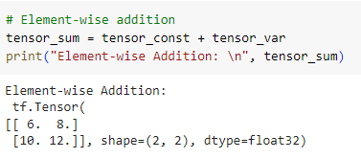
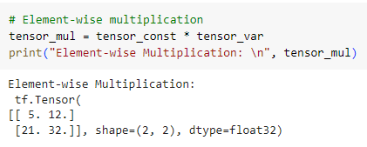

Slide 12
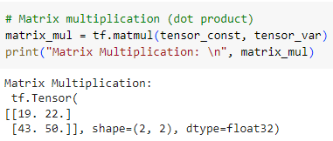
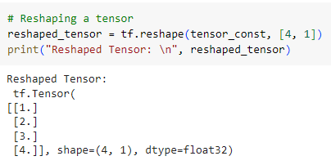

Slide 13
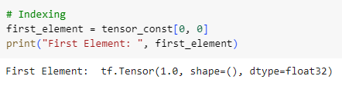
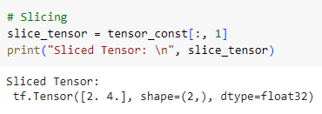
Indexing and Slicing
Similar to Python's NumPy library, can extract specific elements or slices of a tensor using indexing and slicing.

Slide 14
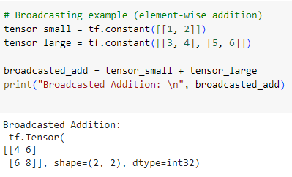
Broadcasting in TensorFlow
TensorFlow supports broadcasting, which allows you to perform operations between tensors of different shapes as long as their dimensions are compatible. This is especially useful when performing element-wise operations between tensors of different sizes.

Slide 15
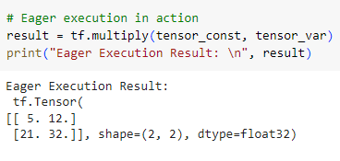
Eager Execution
By default, TensorFlow 2 uses eager execution, which means operations are executed immediately, returning results directly. This is in contrast to TensorFlow 1.x, where operations were added to a computational graph and executed later in a session. Eager execution is easier to work with and helps debug TensorFlow code more effectively.

Slide 16
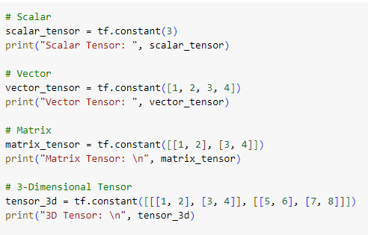
Types of Tensors
Tensors can be categorized based on their immutability and mutability:
Constant Tensors (tf.constant): Immutable tensors that can't be modified after creation.
Variable Tensors (tf.Variable): Mutable tensors that can change their values during runtime.

Slide 17
TensorFlow Variables
In TensorFlow, a variable is a special type of tensor that is mutable. While regular tensors (created using tf.constant) are immutable, meaning their values cannot be changed after being assigned, variables allow you to update their values during the training of a model. This makes them useful for storing model weights, biases, and other parameters that need to be updated during optimization.
Variables are often used to hold:
Model weights in neural networks.
Bias terms used in linear and deep learning models.
Any value that needs to be updated or optimized over time.

Slide 18
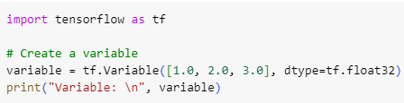
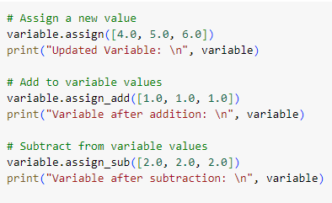
Creating a Variable
Updating Variables
Since variables are mutable, their values can be modified. TensorFlow provides in-place operations like assign(), assign_add(), and assign_sub() to update variables during training.

Slide 19
Gradient Tape
One of TensorFlow's most powerful features is its automatic differentiation mechanism, which is enabled by the Gradient Tape. This feature allows you to automatically compute the gradient (derivative) of a function with respect to some inputs, typically used to calculate the gradients of loss functions with respect to model parameters (weights and biases) during optimization.
tf.GradientTape() records operations that involve variables and computes gradients by backpropagating through the recorded operations.

Slide 20
Why is Gradient Tape Useful?
It is used in the optimization process to minimize loss functions.
It can compute gradients of arbitrary computations.
It simplifies the process of implementing custom training loops.
Why Does This Matter?
In real life, we adjust things based on results all the time. For example, if a store sets a price too high and people stop buying, they might lower the price a bit. TensorFlow’s variables and Gradient Tape help us automatically figure out how to adjust things during the training of machine learning models to get better results.

Slide 21
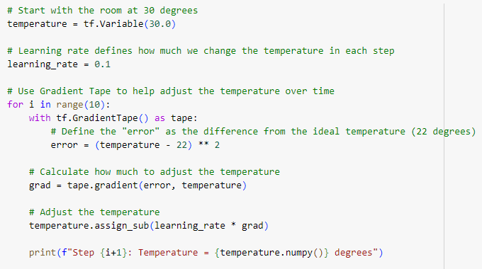
Hands-On Exercise: Adjusting the Temperature
Let’s say we’re controlling the temperature of a room. Our goal is to reach the perfect temperature (22 degrees Celsius), but the room starts at 30 degrees. Each step, we adjust the temperature a little closer to the perfect value.

Slide 22
What is a Loss Function?
Imagine you’re throwing darts at a target. Your goal is to hit the bullseye, but each time you throw a dart, it might land somewhere else on the board. The loss function is like a measure of how far your dart is from the bullseye. The farther you are from the target, the higher your loss.
In machine learning, a loss function tells us how well (or poorly) our model is performing. It measures the difference between the model’s predictions and the actual correct answers. Our goal is to make this difference (or loss) as small as possible, just like getting closer to the bullseye in darts.
Why is the Loss Function Important?
The loss function helps guide the learning process. If the loss is large, it means the model's predictions are far from the actual answers, and we need to make some adjustments. If the loss is small, the model is doing well.

Slide 23
What is the Learning Rate?
Now that we know how far we are from the target (loss), the next step is to figure out how much we should adjust our model to improve. This is where the learning rate comes in. It controls how big the steps are when the model makes adjustments.
High Learning Rate: The model takes large steps but might overshoot the optimal solution.
Low Learning Rate: The model takes small, careful steps but might take a long time to reach the solution.
Think of it as adjusting the volume on a radio:
If you turn the knob too fast (high learning rate), you might skip past the right volume.
If you turn it very slowly (low learning rate), it will take longer to get there, but you’re less likely to miss the right setting.

Slide 24
Neural Network
A neural network is a computer system that mimics how the human brain works. In our brains, we have neurons (nerve cells) that pass information to each other. Similarly, a neural network is made up of layers of nodes (also called neurons) that pass information through the network. The goal of a neural network is to make predictions, like recognizing patterns in data.
Key Terms to Understand:
Neuron/Node: This is the basic building block of a neural network. It takes inputs, performs some calculations, and gives an output.
Layers: Neural networks are made of layers, and each layer contains multiple nodes. Information flows through these layers to help the network learn.
Weights: These are numbers that determine the importance of inputs. The network adjusts the weights during training to make better predictions.

Slide 25
Building a Neural Network
In TensorFlow, we can create a simple neural network using a model made up of different layers. Let’s break this down into steps:
Input Layer: This is where the neural network receives data. For example, if we’re working with an image of a cat, the input layer would receive all the pixels of the image.
Hidden Layers: These layers process the input data and learn patterns.
Output Layer: This layer gives the prediction. For example, if the task is to recognize cats, the output could be “cat” or “not a cat.”

Slide 26

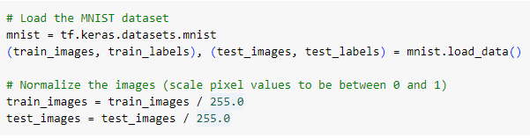
Simple Neural Network
Let’s create a simple neural network that can classify handwritten digits (0-9) using the popular MNIST dataset. The MNIST dataset contains images of digits, and the task is to classify which digit is in each image.
Step 1: Import Libraries
Step 2: Load the Dataset

Slide 27
Why normalize? When we normalize the pixel values (scaling them between 0 and 1), it helps the model learn faster by keeping the values small.
Step 3: Build the Neural Network
Now, we’ll define our neural network model. It consists of:
Input Layer: The input is an image (28x28 pixels).
Hidden Layer: We’ll use a fully connected layer (dense layer) with 128 neurons and an activation function called ReLU.
Output Layer: Since we have 10 possible digits (0-9), the output layer will have 10 neurons with a softmax activation function.

Slide 28
Activation Function
An activation function determines whether a neuron should be activated (pass information forward). The ReLU (Rectified Linear Unit) activation function is commonly used because it helps the network learn faster by introducing non-linearity. Softmax is used in the output layer for classification tasks, as it gives probabilities for each class (digit).
Flatten Layer: This converts the 28x28 images into a flat 1D array (since each layer expects a list of numbers, not a 2D image).
Dense Layer: This is a fully connected layer where every neuron is connected to each neuron in the previous layer.

Slide 29
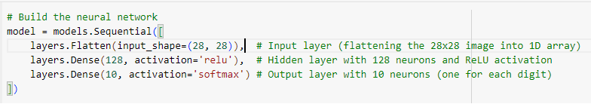
To check the model summary: -

Slide 30
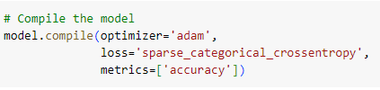
Step 4: Compile the Model
Before we can train the model, we need to compile it. We’ll specify:
Loss Function: Measures how wrong the model’s predictions are. For classification tasks, we use sparse categorical cross entropy.
Optimizer: The algorithm that adjusts the model’s weights. We’ll use Adam, a popular optimizer.
Metrics: Metrics are used to monitor the training process. Here, we’ll track accuracy.
Optimizer:
The optimizer, like Adam, helps the model learn by adjusting weights based on the gradients. It makes the learning process efficient.

Slide 31

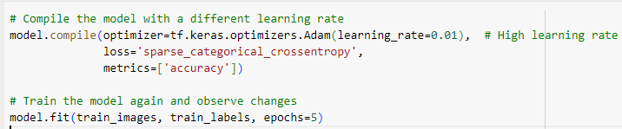
Step 5: Train the Model
Now, we’ll train the model on the training data.
Epoch: One epoch means that the model has seen the entire training data once. We train for 5 epochs to see how the model improves with each pass through the data.
With Learning Rate: -

Slide 32

Step 6: Evaluate the Model
Finally, we evaluate the model on test data to see how well it performs.

