Slide 1
Employee Retention Prediction

Slide 2
WHAT-
In today’s competitive job market, retaining skilled employees—especially in fast-growing fields(like data science)—is a significant challenge for companies. Hiring and training new employees is costly and time-consuming. Therefore, predicting which employees are likely to leave their jobs can help HR departments take proactive measures to improve retention.
This project aims to build a predictive model that determines the likelihood of a data scientist switching jobs. Using machine learning techniques, we analyze various features like education level, experience, training hours, company type, etc., to make an informed prediction.

Slide 3
WHY
Business Need
Reduce attrition costs: Losing employees disrupts productivity and is expensive.
Targeted retention efforts: HR can focus on employees most likely to leave.
Better hiring decisions: Understand which candidate profiles are likely to stay long-term.
Academic and Technical Goals
Apply a full ML pipeline: From EDA and preprocessing to model selection and deployment.
Handle class imbalance using SMOTE.
Use advanced algorithms like Logistic Regression, XGBoost, LightGBM.
Perform feature engineering, model evaluation, and SHAP-based interpretability.

Slide 4
Utilizing predictive analytics to enhance employee satisfaction and reduce turnover rates
Predictive Analytics Utilizing
predictive analytics to enhance employee satisfaction and reduce turnover rates Predictive analytics harnesses historical data to identify trends and patterns that can indicate potential employee turnover. This proactive approach aids organizations in making data-driven decisions.
Machine Learning Utilizing
Machine learning algorithms enables the analysis of vast datasets, allowing HR teams to effectively pinpoint factors influencing employee retention and dissatisfaction.
Statistical Analysis
Statistical analysis of employee data helps organizations to uncover hidden correlations between various factors and turnover rates, leading to better retention strategies.
Proactive Decision-Making
By implementing insights from data science, HR can engage in proactive decision-making, addressing issues before they escalate and improving employee morale.
Enhanced Employee Satisfaction
Ultimately, leveraging data science can lead to enhanced employee satisfaction, as organizations tailor their strategies based on predictive insights and employee feedback.

Slide 5




Tailored strategies
Implementing tailored strategies based on the factors can improve retention rates
Job Satisfaction
Job Satisfaction significantly impacts retention, as happy employee are less likely to leave
Key Features Influencing Employee Retention
Understanding Important factors that enhances employee retention and reduce turnover rates
Workplace Culture
A positive workplace culture fosters loyalty and commitment among employees
Career Development
Offering Carrer Development opportunities encourages employees to grow with in the organization.

Slide 6
HOW
Now we will be looking at our project in detail to discuss how we have achieved it.
By analysing the dataset and performing EDA we will be building up a model using various classification algorithms.

Slide 7
INDEX
Dataset Description
Tools and Techniques
EDA
Data Preprocessing
Models
Performance metrices used
Model Comparison
Future Scope
References

Slide 8
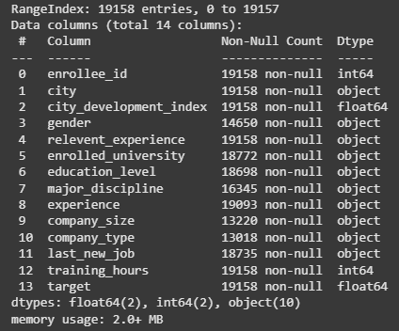
Dataset Description
Enrollee_id : Unique ID for enrollee
City: City code
Citydevelopmentindex: Development index of the city
Gender: Gender of enrollee
Relevent_experience: Relevant experience of enrollee
Enrolled_university: Type of University course enrolled
Education_level: Education level of enrollee
Major_discipline :Education major discipline of enrollee
Experience: Enrollee total experience in years
Company_size: No of employees in current employer's company
Company_type : Type of current employer
Lastnewjob: Difference in years between previous job and current job
Training_hours: training hours completed
Target:
0 – Not looking for job change,
1 – Looking for a job change

Slide 9
Tools and Techniques
Python (Pandas, NumPy, Scikit-learn, Imbalanced-learn)
Machine Learning: Logistic Regression, Random Forest, XGBoost, LightGBM
Hyperparameter Tuning: GridSearchCV
Model Explainability: SHAP
Deployment: Flask (for optional web app)
EDA & Visualization: Seaborn, Matplotlib

Slide 10
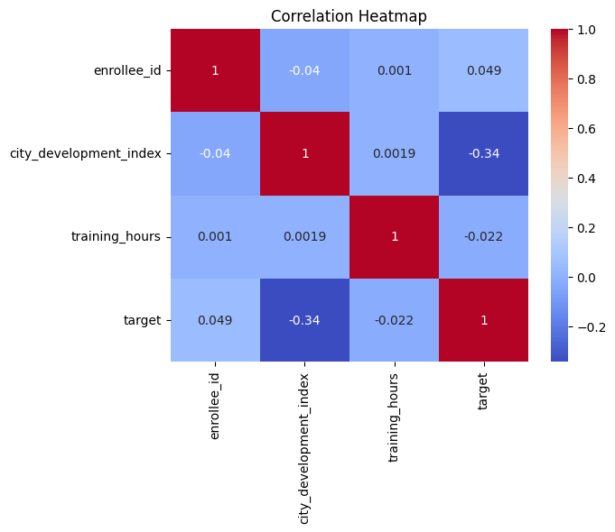
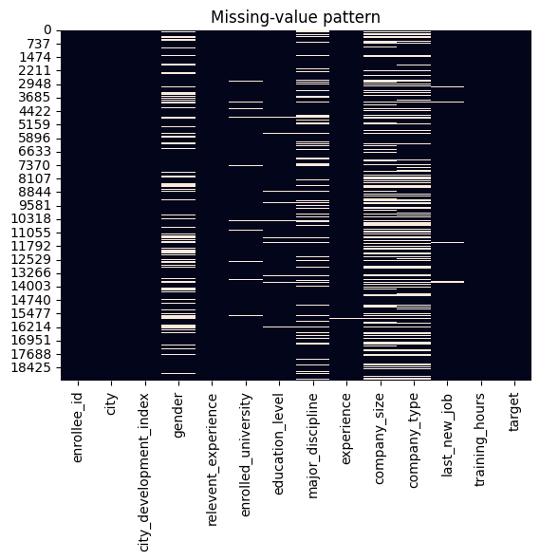
EDA

Slide 11
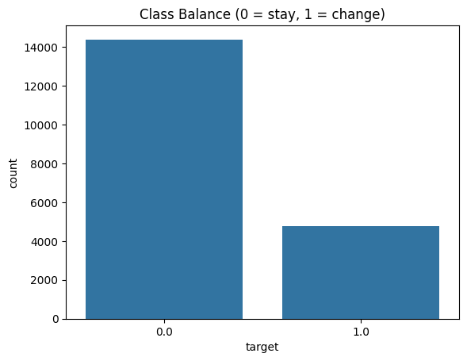
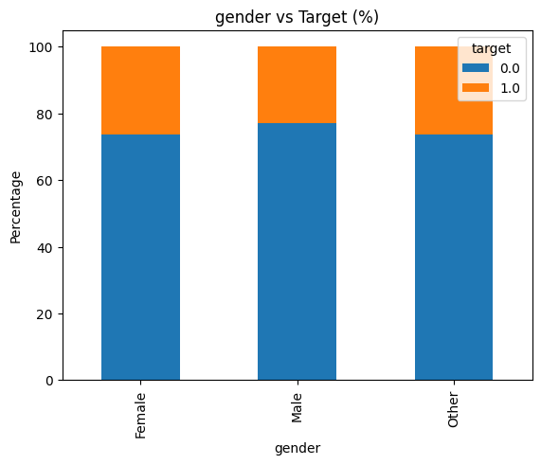
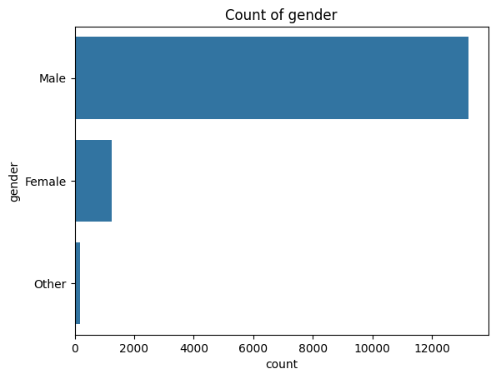
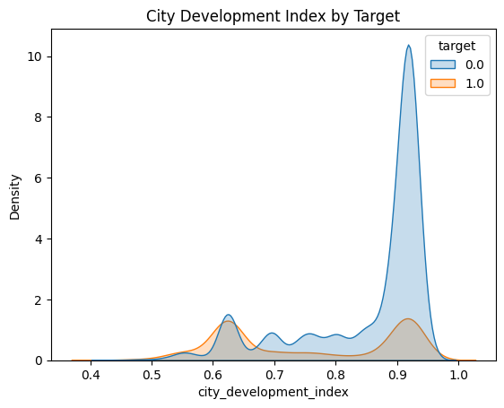
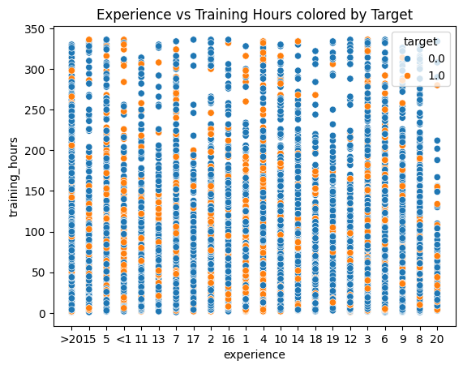
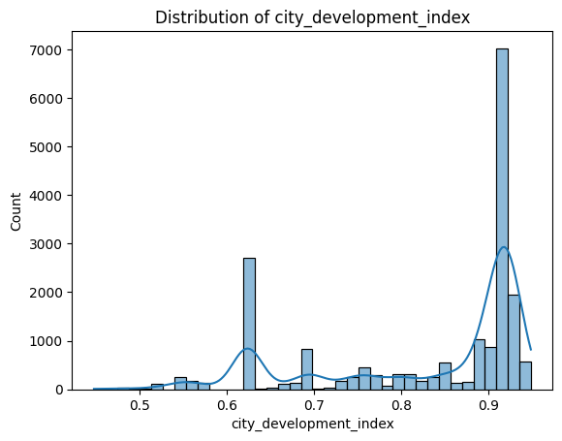

Slide 12
Data Preprocessing
Label Encoding for binary categories
One-Hot Encoding for nominal categorical features
Standardization using StandardScaler
Imbalanced data handled using SMOTE

Slide 13
Label Encoding for binary categories
enrolled_university
education_level
company_type
major_discipline
One-Hot Encoding for nominal categorical features
gender
relevent_experience

Slide 14
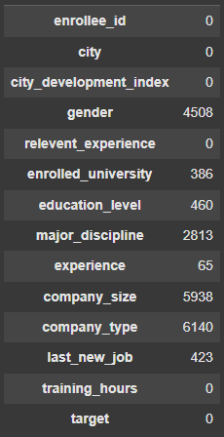
Missing value handling using SimpleImputer

Slide 15
Standard Scaling(Standardization)

Slide 16
Models
Logistic Regression
Random Forest
XGBoost
LightGBM

Slide 17
Performance metrics used
ROC-AUC Score: To evaluate model's ability to distinguish classes
Confusion Matrix: To analyze true/false positives and negatives
Classification Report: Precision, Recall, F1-Score
Feature Importance (Model & SHAP): To understand feature contribution

Slide 18
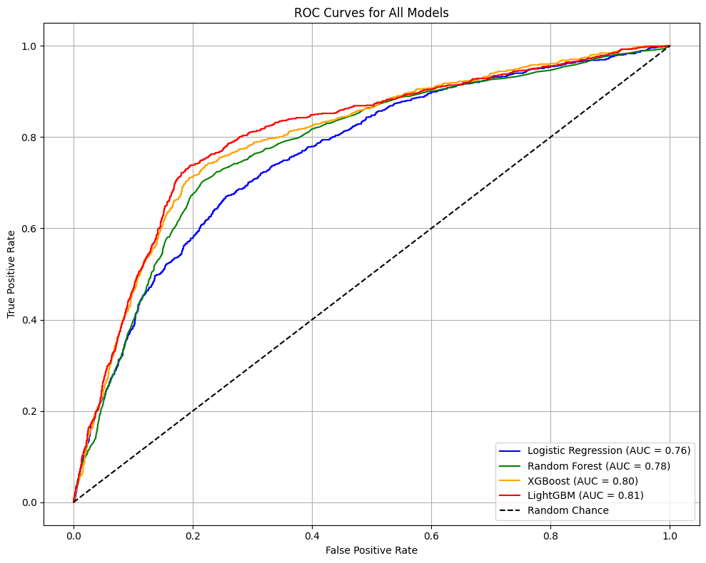
Model Comparison Summary (Model ROC-AUC Score)
Logistic Regression 0.76
Random Forest 0.78
XGBoost 0.80
LightGBM 0.81

Slide 19
Future Scope
Model Deployment in Real-Time HR Systems- Integrate the model into HR tools to provide instant predictions about which employees are at risk of leaving, enabling proactive retention strategies.
More Sophisticated Feature Engineering- Generate interaction features (e.g., experience × company size). Use NLP techniques on job descriptions (if available) for richer inputs. Time-based features for modeling employee tenure more accurately.
Ensemble Stacking or Blending- Improve prediction accuracy by combining multiple models (e.g., stacking Logistic Regression, XGBoost, and LightGBM).
Continuous Model Retraining- Set up automated retraining pipelines as new data (e.g., from employee feedback or exit surveys) becomes available.
Geographic or Department-Wise Risk Segmentation- Extend the model to give department- or location-specific attrition risks and recommendations.
Integration with External Datasets- Include external job market trends, company reviews (e.g., Glassdoor), or macroeconomic factors that influence employee decisions.

Slide 20
References
SMOTE: Synthetic Minority Over-sampling Technique
Chawla, N.V., Bowyer, K.W., Hall, L.O., & Kegelmeyer, W.P. (2002). SMOTE: Synthetic Minority Over-sampling Technique. Journal of Artificial Intelligence Research, 16, 321-357.
https://arxiv.org/abs/1106.1813
XGBoost
Chen, T., & Guestrin, C. (2016). XGBoost: A Scalable Tree Boosting System. Proceedings of the 22nd ACM SIGKDD International Conference on Knowledge Discovery and Data Mining.
https://doi.org/10.1145/2939672.2939785
LightGBM
Ke, G., Meng, Q., Finley, T., Wang, T., Chen, W., Ma, W., ... & Liu, T.Y. (2017). LightGBM: A Highly Efficient Gradient Boosting Decision Tree. NeurIPS. https://papers.nips.cc/paper_files/paper/2017/hash/6449f44a102fde848669bdd9eb6b76fa-Abstract.html
SHAP (SHapley Additive exPlanations)
Lundberg, S.M., & Lee, S.I. (2017). A Unified Approach to Interpreting Model Predictions. Advances in Neural Information Processing Systems.
https://github.com/slundberg/shap
Scikit-learn Documentation
https://scikit-learn.org/stable/user_guide.html
Source for machine learning algorithms, pipelines, preprocessing, evaluation metrics

Slide 21
Questions ?

Slide 22
Thank You!

