Slide 1
Cloud-Powered Mental Health System
Submitted in the partial fulfillment for the award of the degree of
BACHELOR OF ENGINEERING
IN
BIG DATA ANALYTICS
Submitted by:
Raj Singh(22BDA70035)
Anmol Rana(22BDA70032)
Gautam Singla(22BDA70030)
Sidharth Pundir(22BDA70006)
Under the Supervision of:
Dr. Amardeep Singh
Department of AIT-CSE
DISCOVER . LEARN . EMPOWER

Slide 2
Outline
Introduction to Project
Problem Formulation
Objectives
Methodology used
Results and Outputs
Conclusion
Future Scope
References

Slide 3
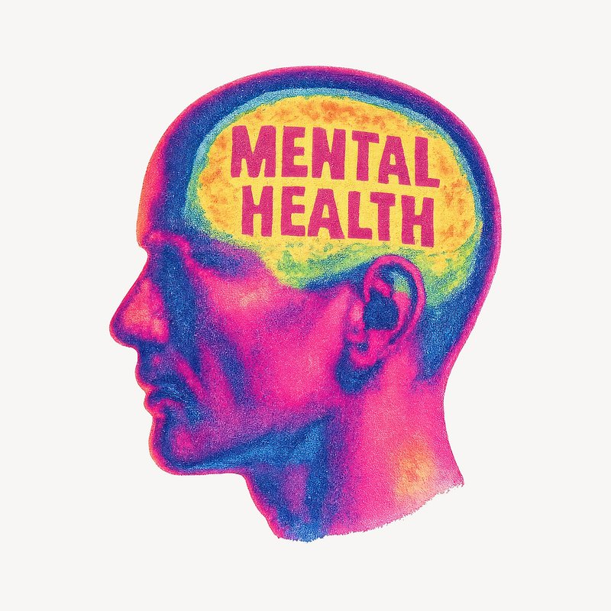
INTRODUCTION
Rising stress, anxiety, depression among students
Institutions lack real-time monitoring
Need for a continuous, anonymous, cloud-based system
Project provides data-driven insight for student well-being
Converts survey data into useful insights.

Slide 4
INTRODUCTION TO PROJECT
Rising stress, anxiety, and depression among students require continuous monitoring rather than occasional surveys.
Current systems are manual, non-real-time, and offer limited insights for administrators.
The project provides an anonymous, cloud-based platform to collect and analyze student mental-health data.
Integrates Google Forms, Google Sheets, Python, and Power BI to create a fully automated data pipeline.
Delivers interactive dashboards that help institutions identify trends, correlations, and high-risk student groups.

Slide 5

PROBLEM FORMULATION
Institutions lack a structured, technology-driven system to monitor students’ mental health.
Existing surveys are conducted infrequently and do not provide real-time insights.
Students hesitate to report mental-health issues due to stigma and lack of anonymity.
Administrative decisions are based on limited or fragmented data.
No automated analytics or visualization tools exist to identify trends or high-risk groups.

Slide 6
OBJECTIVES
To design an anonymous mental health survey.
To build a real-time cloud pipeline using Google Forms and Google Sheets.
To clean and analyze collected data using Python (Pandas, NumPy).
To develop an interactive Power BI dashboard for visualizing stress, anxiety, and depression trends.
To generate meaningful insights and recommendations for institutions to support student well-being.

Slide 7
METHODOLOGY
Data Collection & Exploration:
Designed an online survey using Google Forms to collect anonymous mental-health responses.
Stored all responses in Google Sheets for real-time cloud access.
Data Pre-processing:
Performed data cleaning and data processing using the ms-excel.
Data Analysis:
Perform analysis using Python like: statistical analysis, Correlation analysis, Time-series analysis etc.
Data Visualization:
Processed and structured data exported to Power BI for dashboard creation.
Build interactive charts, filters, and correlation heatmaps to analyze trends and identify high-risk patterns.

Slide 8
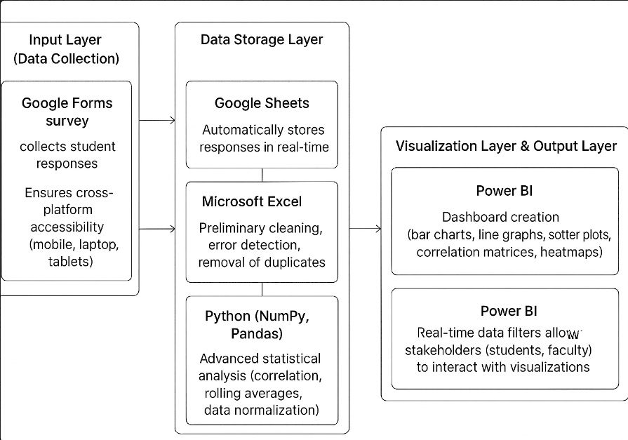
FLOWCHART
PIPELINE
Google Forms
(Data Collection)
Google Sheet
(Data Storage)
Excel/Python
(Data cleaning and Analysis)
Power BI
(Data Visualization)

Slide 9
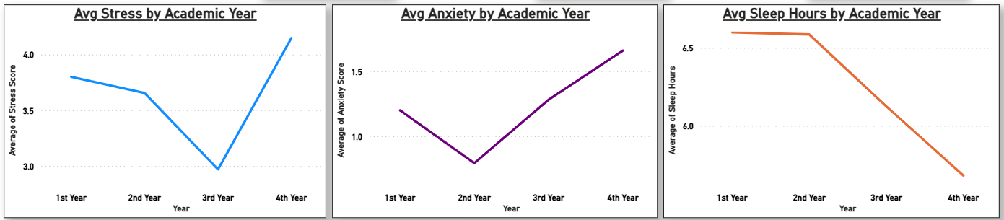
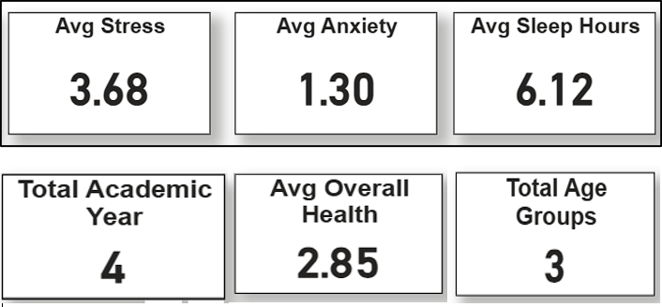
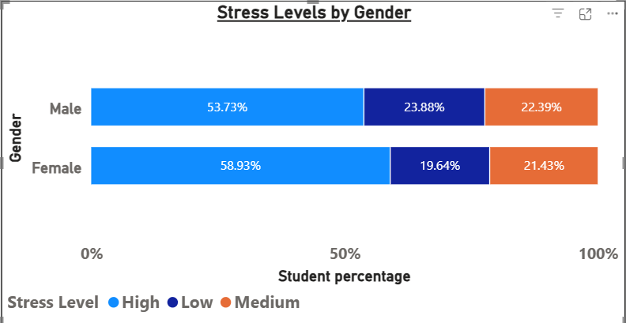
RESULTS AND OUTPUTS
Displays stress, anxiety, and sleep insights.
4th year students have high stress, anxiety level and minimum sleep hour.
Female stress level are high as compared to Males

Slide 10
RESULTS AND OUTPUTS
Shows average stress, anxiety, sleep hours, and overall health scores.
Displays academic-year trends for stress, anxiety, and sleep.
Highlights gender-wise stress distribution.
Presents real-time dashboard insights from 200+ responses.
Reveals strong correlations between stress, anxiety, and depression.
Shows decline in sleep hours as stress increases.

Slide 11

CONCLUSION
The project successfully created a real-time, cloud-based system that analyzes student mental-health data with accuracy and anonymity.
Python analytics and Power BI dashboards revealed clear trends and correlations, enabling data-driven decision-making for institutions.
The system is scalable, cost-effective, and provides a practical foundation for future predictive and wellness-focused enhancements.
This Photo by Unknown Author is licensed under CC BY-ND

Slide 12
FUTURE SCOPE
Develop a complete web-based interface with automated backend processing and real-time visualization.
Integrate advanced analytics such as machine-learning prediction, sentiment analysis, and trend forecasting.
Expand the system with mobile app support, counsellor dashboards, and IoT data (sleep/heart-rate) for deeper insights.
Extend the system for institutional deployment with semester-based comparisons and long-term wellness tracking.

Slide 13
REFERENCES
D. Eisenberg, M. Golberstein, and E. Gollust, “Help-seeking and access to mental health care in a university student population,” Medical Care, vol. 45, no. 7, pp. 594– 601, 2007.
J. Hunt and D. Eisenberg, “Mental health problems and help-seeking behavior among college students,” Journal of Adolescent Health, vol. 46, no. 1, pp. 3–10, 2010.
B. Andrews and J. Wilding, “The relation of depression and anxiety to life-stress and achievement in students,” British Journal of Psychology, vol. 95, no. 4, pp. 509– 521, 2004.
S. Kumar and K. Nayar, “Academic stress among university students in India,” Indian Journal of Health and Wellbeing, vol. 7, no. 1, pp. 44–48, 2016.

Slide 14
THANK YOU

