Slide 1
Doubly Robust Estimation
This is a discussion-cum-coding session.
Our focus will be on the survival outcome.
Last week, Jincheng presented about treatment specific cox and weighted Nelson-Aalen approach.
Our focus will be on “Pseudo-observation-based” approach to DR.
Wang J. A simple, doubly robust, efficient estimator for survival functions using pseudo-observations. Pharm Stat. 2018 Feb;17(1):38-48. doi: 10.1002/pst.1834. Epub 2017 Nov 1. PMID: 29094501. https://pubmed.ncbi.nlm.nih.gov/29094501/

Slide 2
Outline of today’s (or next session) presentation
Theory of Pseudo-Observation based estimators.
Simulation study set up.
- Point estimate: DR-Pseudo vs. IPTW-Pseudo vs. Unadjusted KM.
- SE estimate: Empirical vs. Bootstrap for DR-Pseudo.
3. R codes.
- Manually written based on theory presented on the paper.
- R package (adjustedCurves).
4. Simulation results.

Slide 3
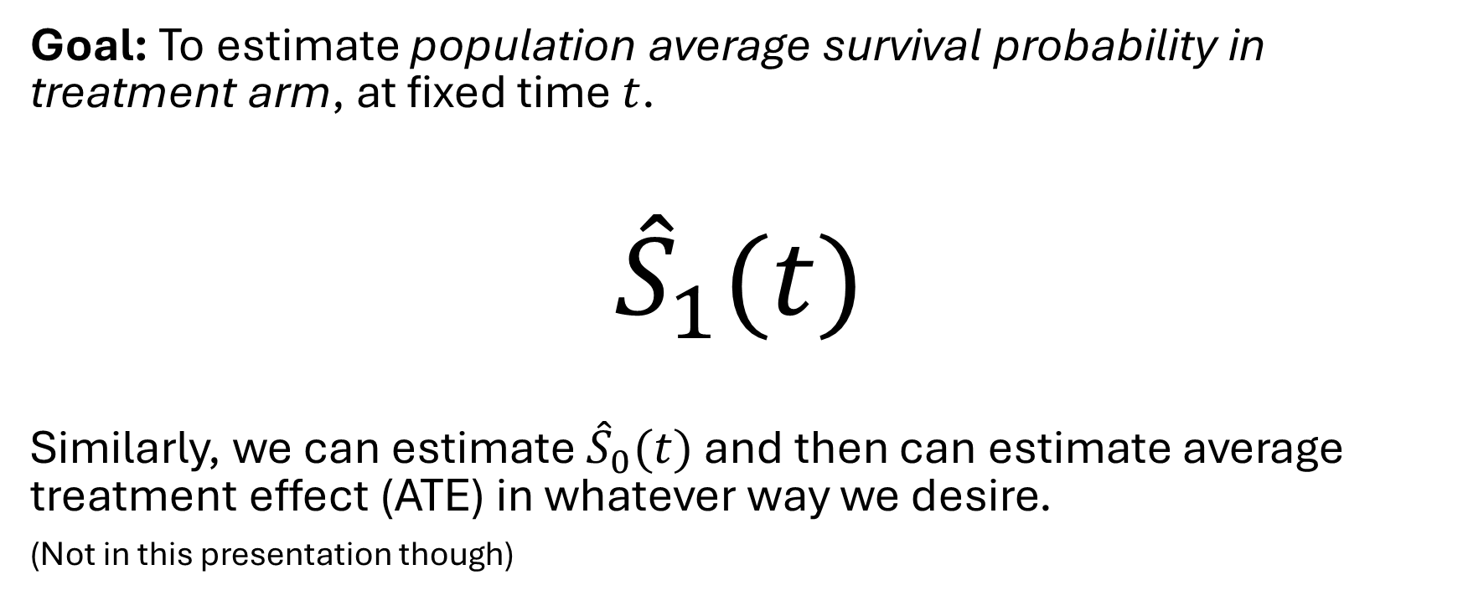
Through out this presentation..
Goal: To estimate population average survival probability in treatment arm, at fixed time $t$.
$${\hat{S}}_{1}(t)$$
Similarly, we can estimate ${\hat{S}}_{0}(t)$ and then can estimate average treatment effect (ATE) in whatever way we desire.
(Not in this presentation though)

Slide 4
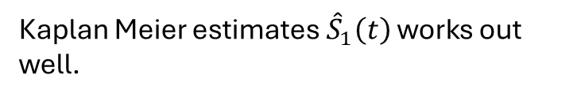
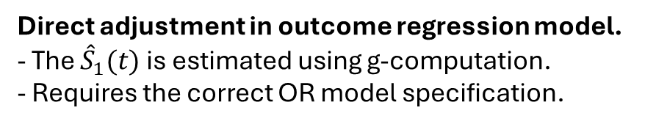
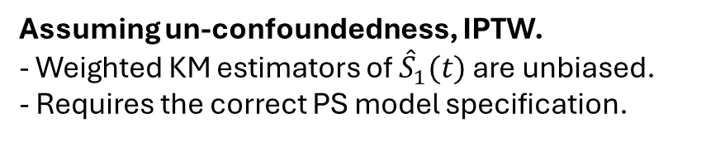
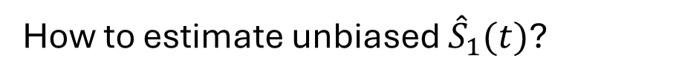
Treatment is randomized
Treatment is not randomized
Kaplan Meier estimates ${\hat{S}}_{1}\left(t\right)$ works out well.
Kaplan Meier estimates ${\hat{S}}_{1}(t)$ are biased.
How to estimate unbiased ${\hat{S}}_{1}(t)$?
Assuming un-confoundedness, IPTW.
- Weighted KM estimators of ${\hat{S}}_{1}(t)$ are unbiased.
- Requires the correct PS model specification.
Both require the correct model.
Direct adjustment in outcome regression model.
- The ${\hat{S}}_{1}(t)$is estimated using g-computation.
- Requires the correct OR model specification.
Doubly Robust Estimators – Combination of above two!
Doesn’t require both models to be correctly specified simultaneously. Only one correct model suffice.

Slide 5
DR estimation for continuous outcomes - Easy to implement.
Survival outcomes, not so easy.
Because of censoring.
What if we modify the survival outcomes to a continuous outcome (in pseudo way)?

Slide 6
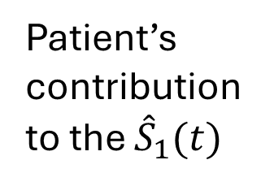
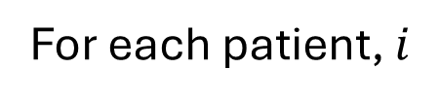

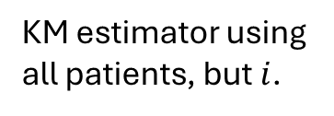
Pseudo-observation approach
Complex survival data
Patient’s contribution to the ${\hat{S}}_{1}(t)$
For each patient, $i$
How much does the overall survival curve changes when we remove this one patient?
$${{\hat{S}}^{i}}_{1}\left(t\right)=n {\hat{S}}_{1}\left(t\right)−(n−1){{\hat{S}}^{−i}}_{1}\left(t\right)$$
New outcome (continuous)
KM estimator using all patients
KM estimator using all patients, but $i$.
$E\left({{\hat{S}}^{i}}_{1}\left(t\right)|Z\right)=S_{1}(t|Z)$ + o(1) as $n→ ∞$

Slide 7
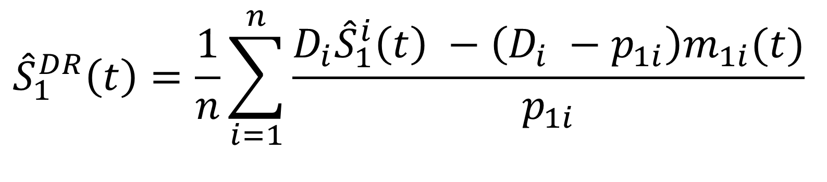
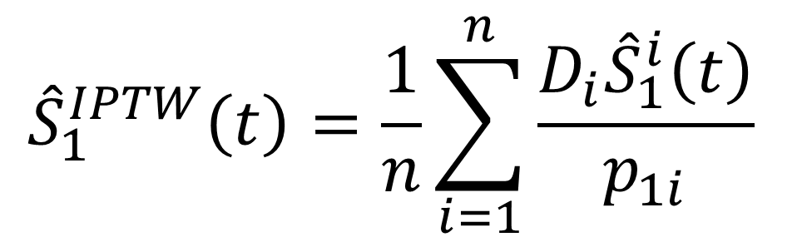

Constructing estimators based on generated pseudo-observations.
$${\hat{S}}_{1}^{IPTW}\left(t\right)=\frac{1}{n}\sum_{i=1}^{n}{\frac{D_{i}{\hat{S}}_{1}^{i}\left(t\right)}{p_{1i}} }$$
Pseudo observations.
Estimate of ${\hat{S}}_{1}(t)$ based on OR model.
Two options:
GLM/GEE on pseudo-observations.
Cox model on survival outcomes.
I used option 2, as option 1 had some model convergence issues. Will see the differences in results.
Propensity scores from PS model.
$${\hat{S}}_{1}^{DR}\left(t\right)=\frac{1}{n}\sum_{i=1}^{n}{\frac{D_{i}{\hat{S}}_{1}^{i}\left(t\right) −\left(D_{i} −p_{1i}\right)m_{1i}(t)}{p_{1i}} }$$

Slide 8
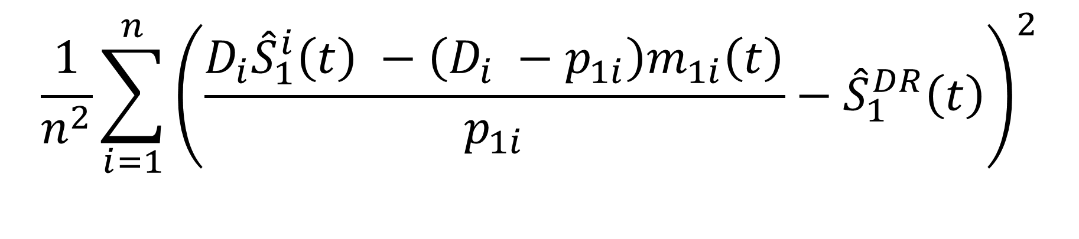

Empirical variance of ${\hat{S}}_{1}^{DR}(t)$
$$\frac{1}{n^{2}}\sum_{i=1}^{n}{{\left(\frac{D_{i}{\hat{S}}_{1}^{i}\left(t\right) −\left(D_{i} −p_{1i}\right)m_{1i}\left(t\right)}{p_{1i}}−{\hat{S}}_{1}^{DR}\left(t\right)\right)}^{2}}$$
Alternatively, we can use bootstrap method to estimate uncertainty in point estimates.

Slide 9
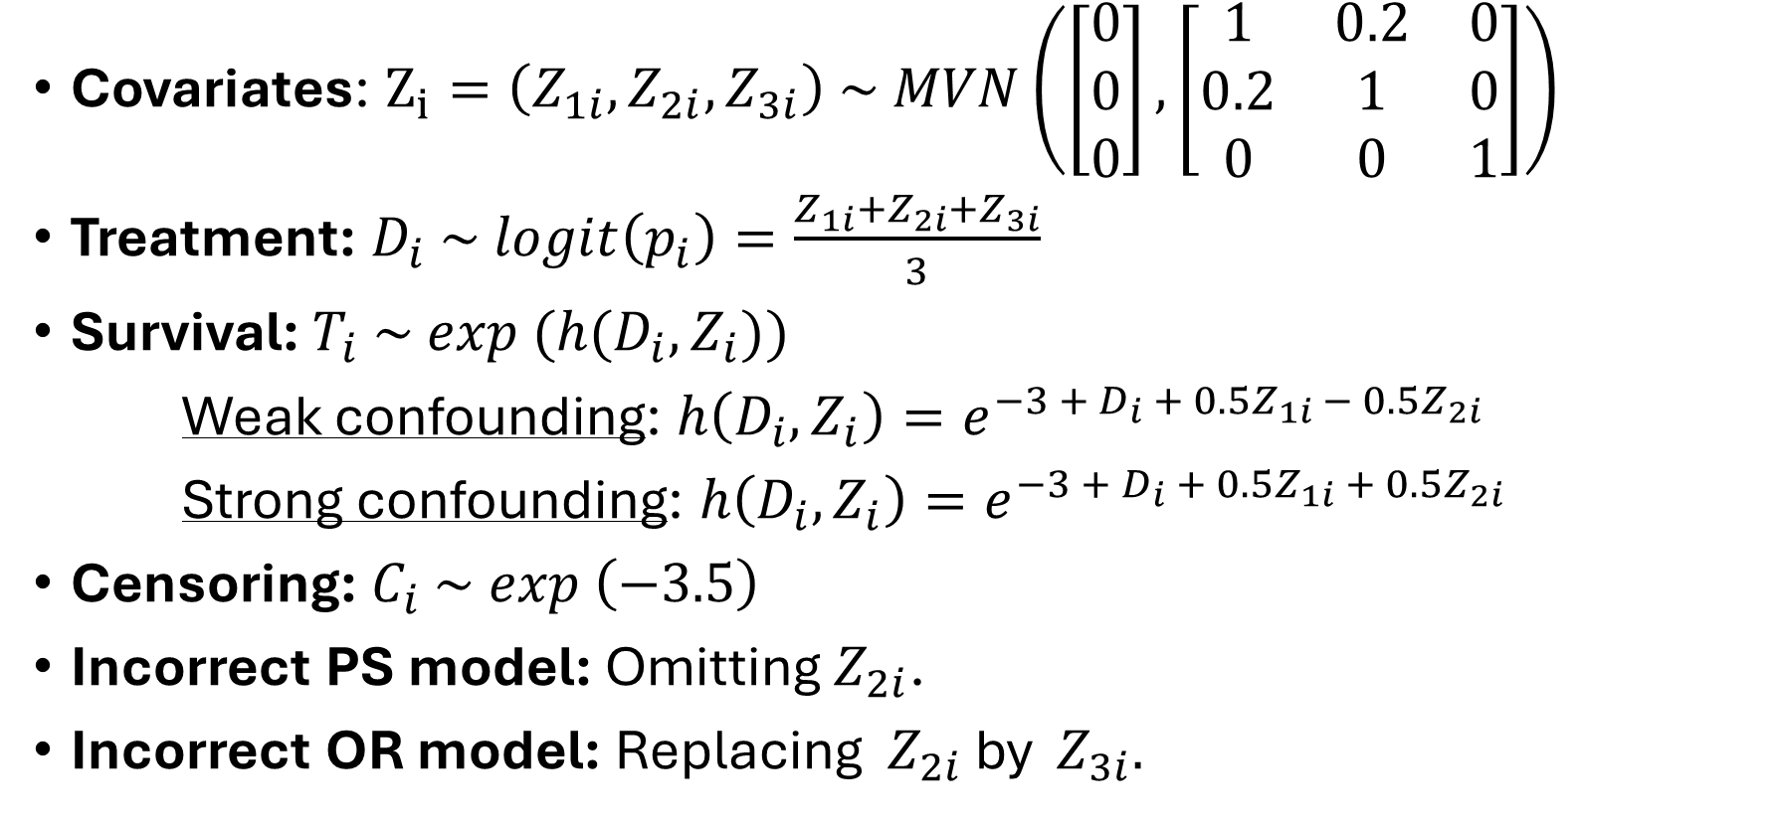
Let’s simulate….
Covariates: $Z_{i}=\left(Z_{1i}​,Z_{2i}​,Z_{3i}​\right) \sim MVN\left(\left[\begin{matrix}0 \\ 0 \\ 0\end{matrix}\right], \left[\begin{matrix}1 & 0.2 & 0 \\ 0.2 & 1 & 0 \\ 0 & 0 & 1\end{matrix}\right]\right)$
Treatment: $D_{i} \sim logit\left(p_{i}\right)=\frac{Z_{1i}+Z_{2i}+Z_{3i}}{3}$
Survival: $T_{i} \sim exp (h(D_{i}, Z_{i}))$
Weak confounding: $h\left(D_{i}, Z_{i}\right)=e^{−3 +{ D}_{i} + 0.5Z_{1i} − 0.5Z_{2i}}$
Strong confounding: $h\left(D_{i}, Z_{i}\right)=e^{−3 +{ D}_{i} + 0.5Z_{1i} + 0.5Z_{2i}}$
Censoring: $C_{i} \sim exp \left(−3.5\right)$
Incorrect PS model: Omitting $Z_{2i}$.
Incorrect OR model: Replacing $Z_{2i}$ by $Z_{3i}.$

Slide 10
Simulation Set-Up
Point Estimation Performance
Variance Estimation Performance
Total # of simulations | 500
Sample sizes | 500, 2000
Time points | 5, 10, 20
Degree of confounding | Weak, Strong
PS model correction | TRUE, FALSE
OR model correction | TRUE, FALSE
Total # of simulations | 50
Sample sizes | 500, 2000
Total # of bootstraps | 500
Time points | 5, 10, 20
Degree of confounding | Weak, Strong
PS model correction | TRUE, FALSE
OR model correction | TRUE, FALSE

Slide 11

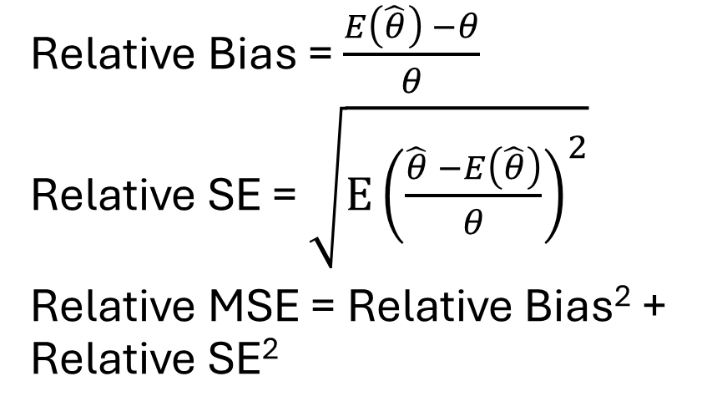
Performance Metrics
Point Estimation Performance
Variance Estimation Performance
Relative Bias = $\frac{E\left(\hat{θ}\right) −θ}{θ}$
Relative SE = $\sqrt{E{\left(\frac{\hat{θ} −E\left(\hat{θ}\right)}{θ}\right)}^{2}}$
Relative MSE = Relative Bias² + Relative SE²
Relative Bias = $\frac{E\left(\hat{SE}\right) −SE_{DR}}{SE_{DR}}$

Slide 12

R Codes

Slide 13
Simulation results

Slide 14
Old results
Total # of simulations = 500

Slide 15
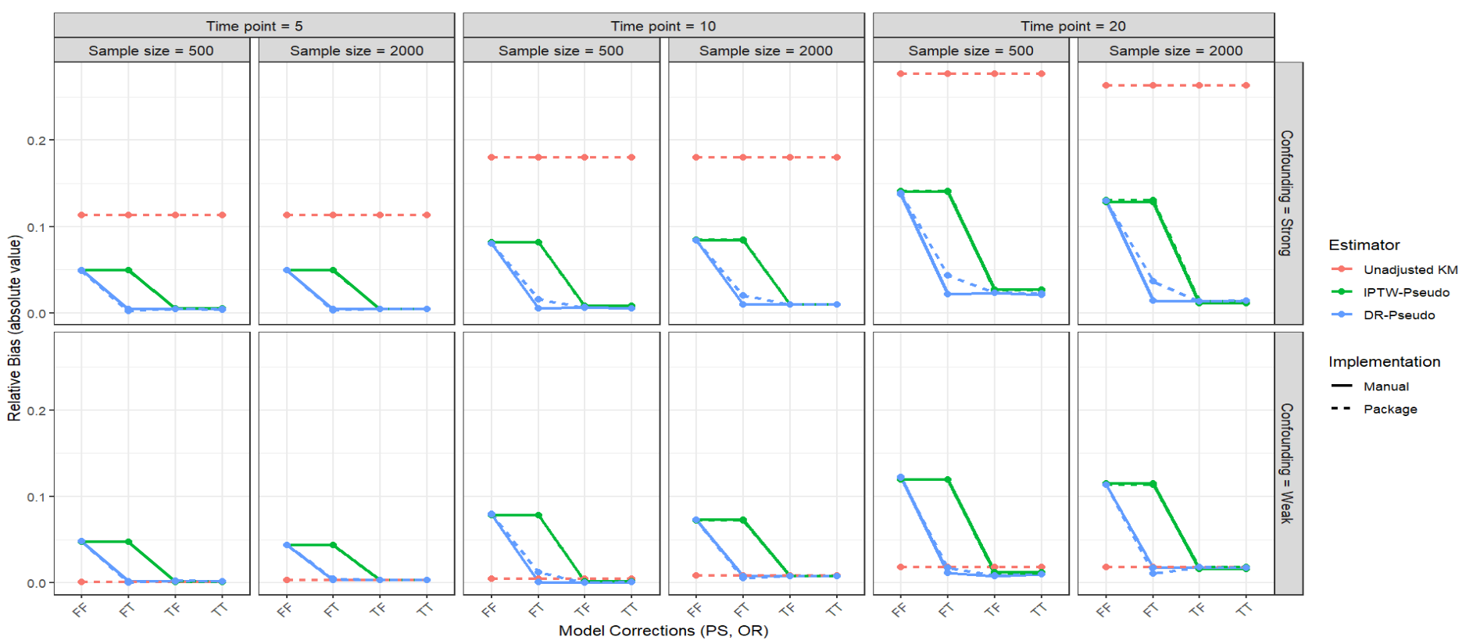
Relative bias of estimates for $S_{1}(t)$

Slide 16
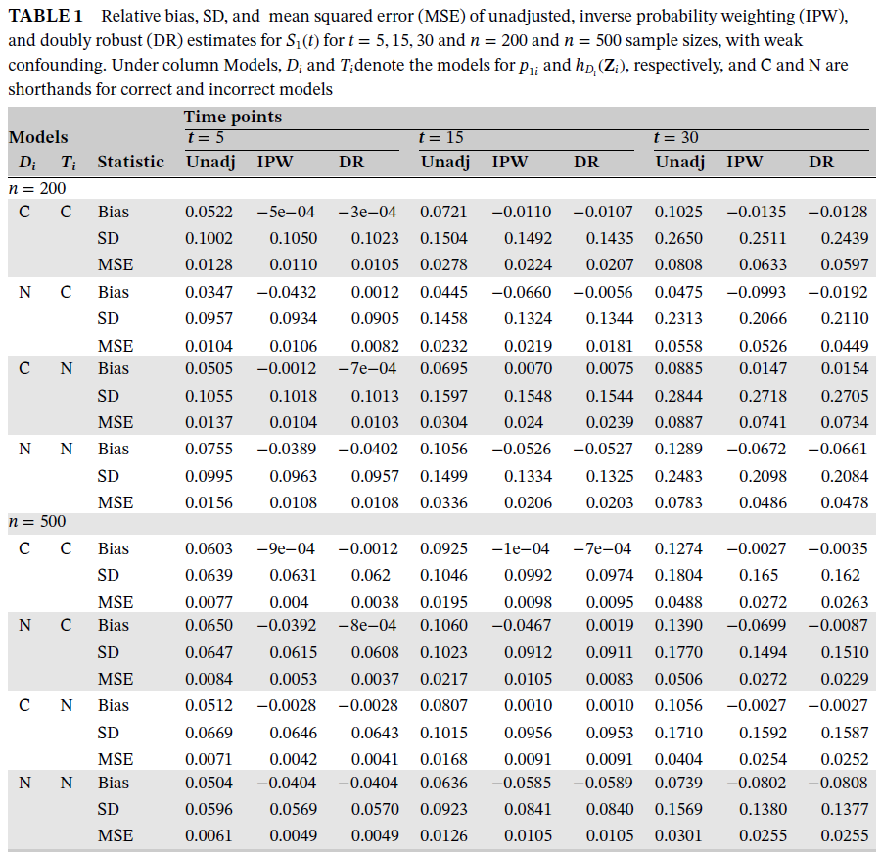
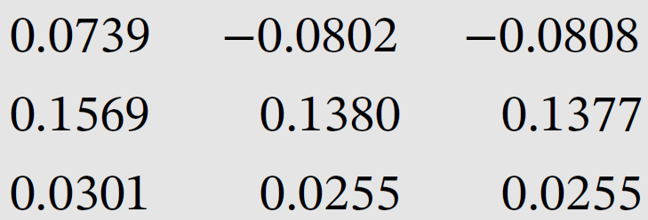
‘Counter-intuitive’ results in the paper.
Due to random variability?
Probably need larger number of simulations.
More frequent counter-intuitive results in our case. We used 500 simulations in our results, but now 1000.
Possibility: When the confounding isn’t too bad, perhaps the unadjusted method does better than any adjustment (under FF case)? i.e., adjusting with a mis-specified model is more harmful than not adjusting.

Slide 17
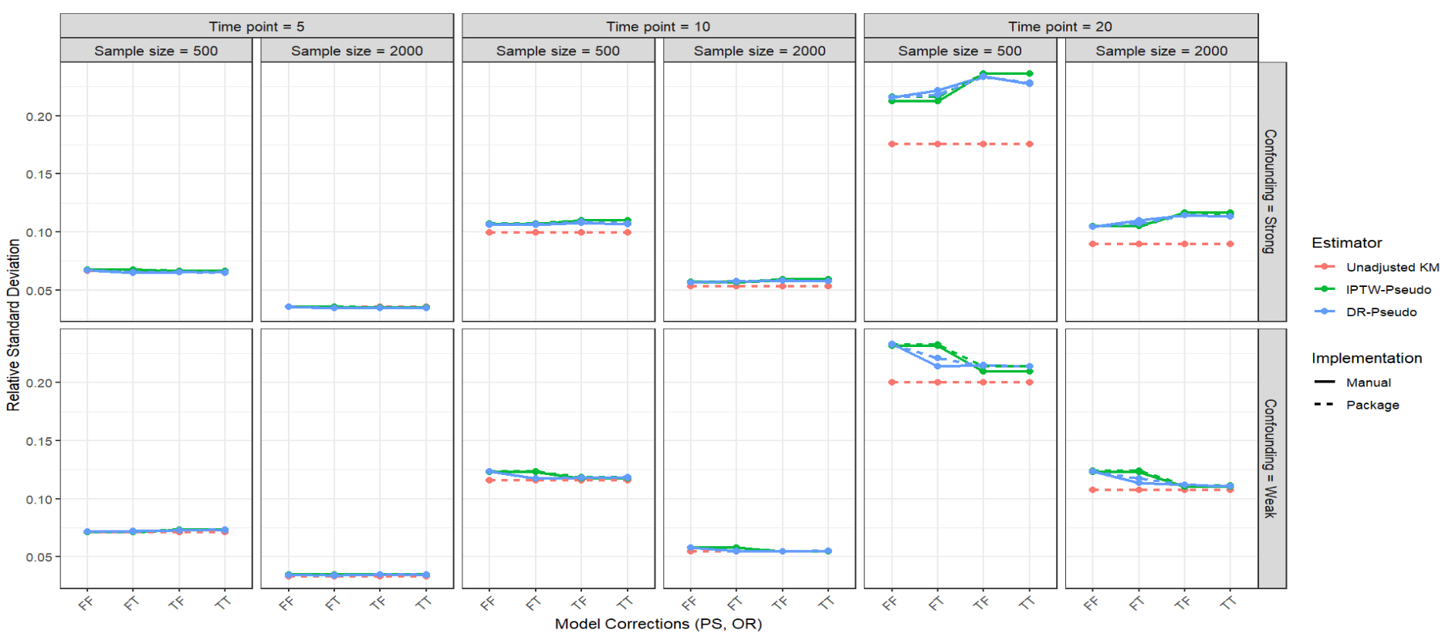
Relative SE of estimates for $S_{1}(t)$

Slide 18
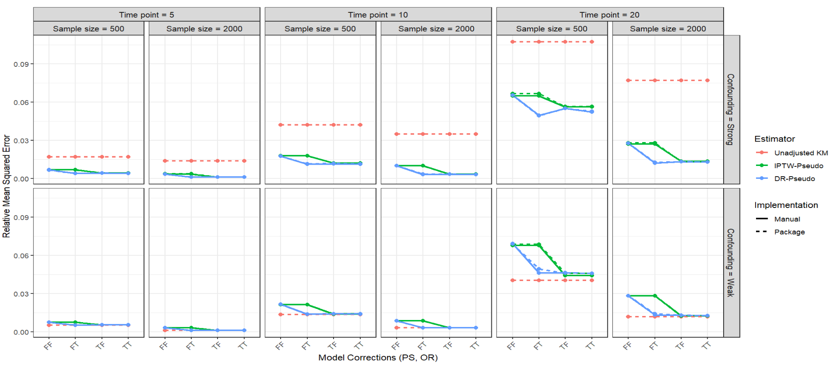
Relative MSE of estimates for $S_{1}(t)$

Slide 19
New results
Total # of simulations = 1000

Slide 20
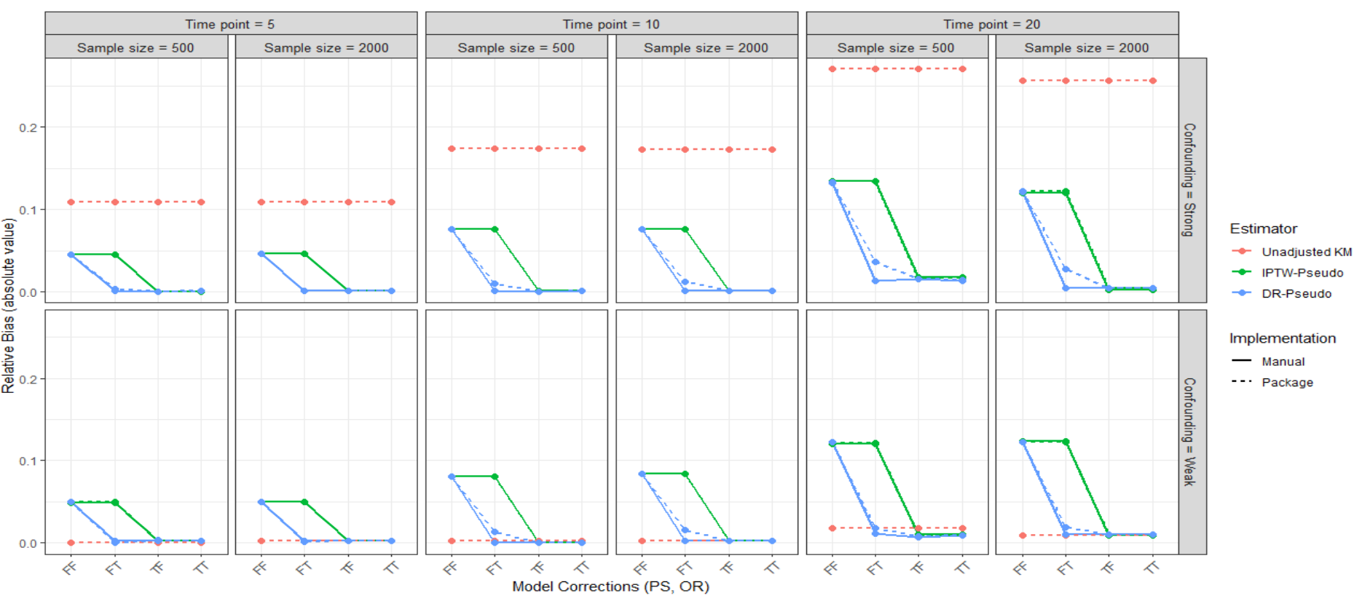
Relative bias of estimates for $S_{1}(t)$

Slide 21
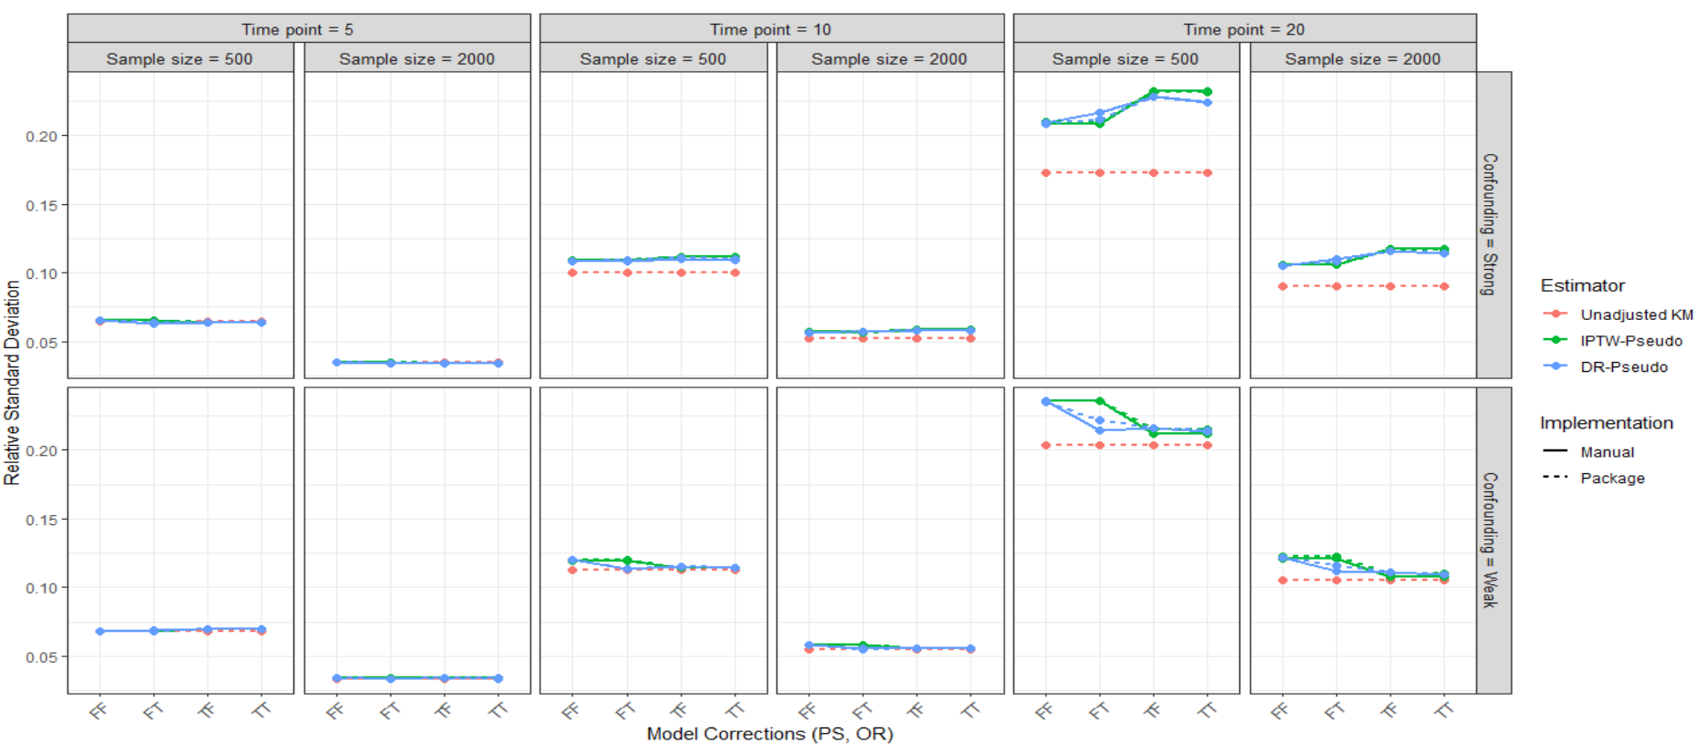
Relative SE of estimates for $S_{1}(t)$

Slide 22
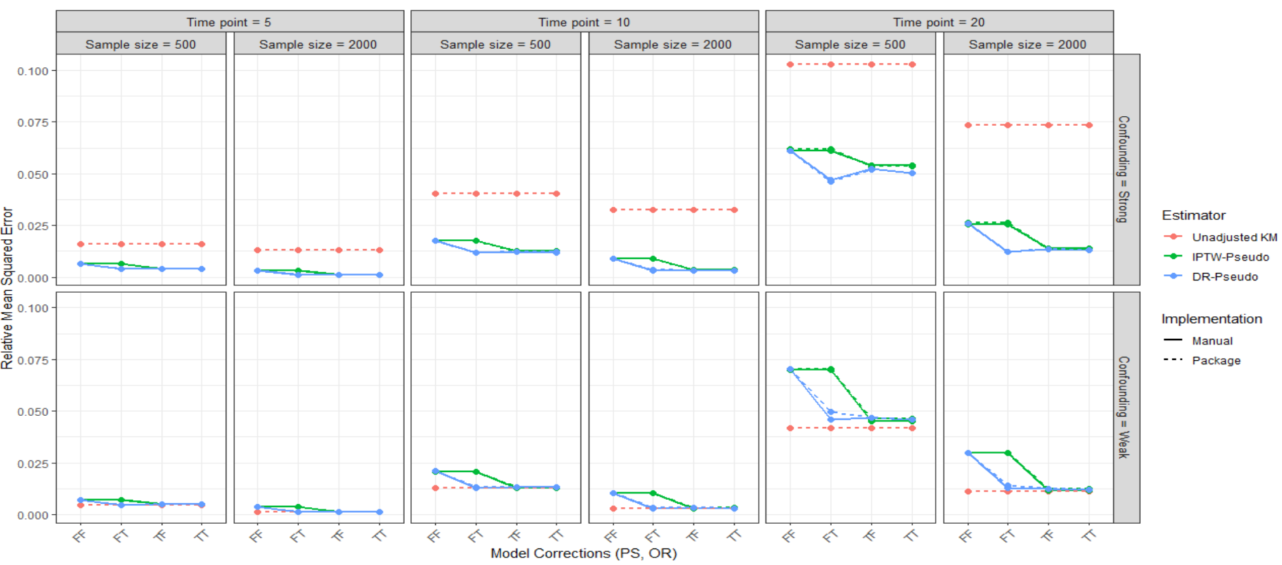
Relative MSE of estimates for $S_{1}(t)$

Slide 23
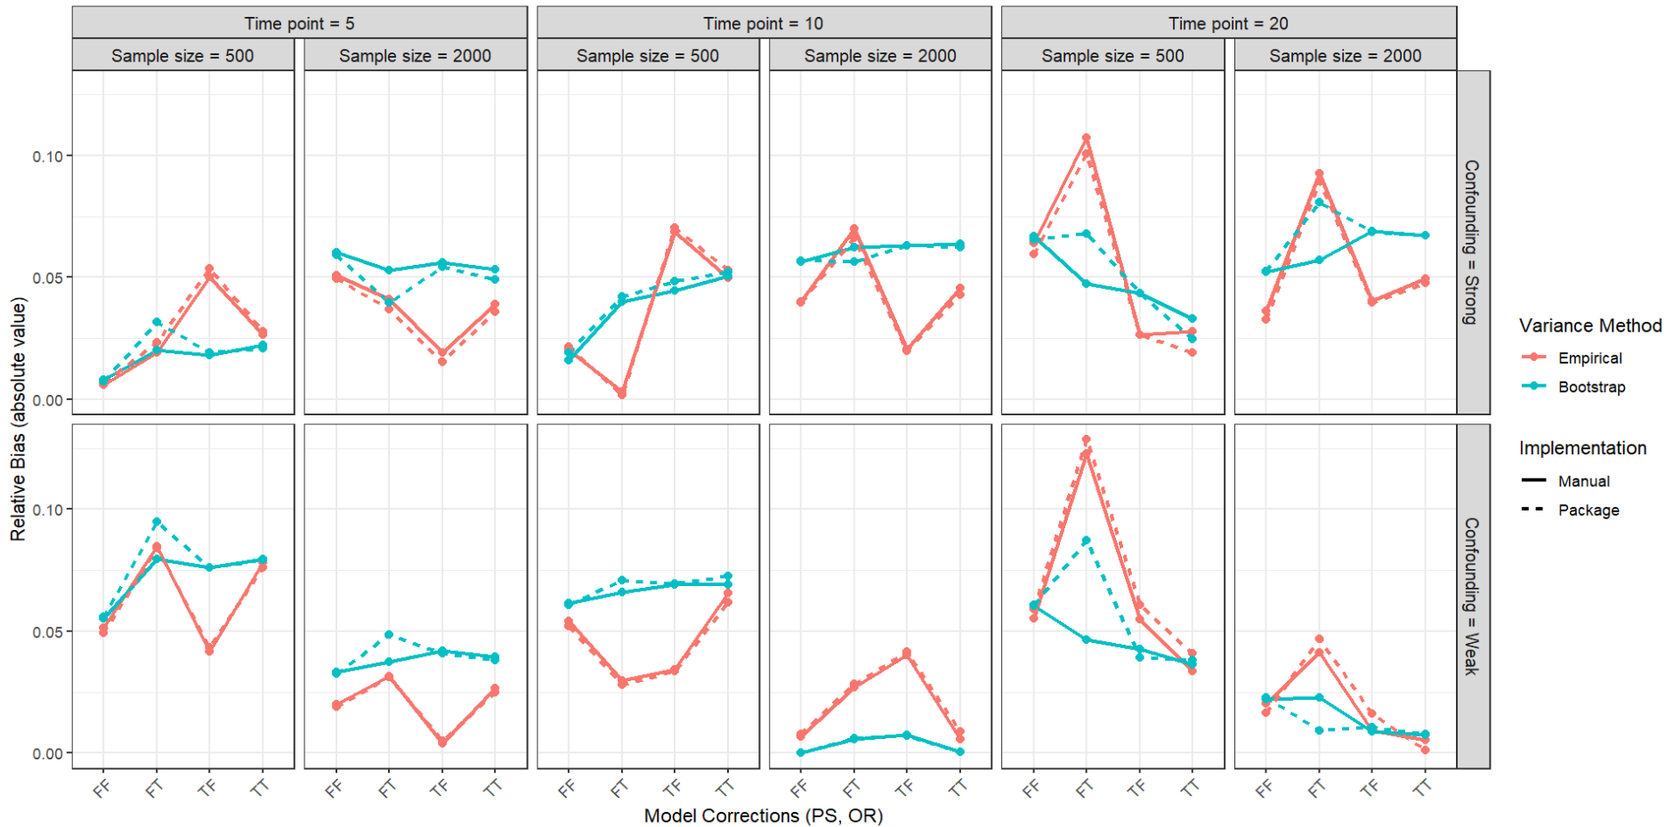
Relative Bias of Empirical Vs. Bootstrap SE of DR estimates for $S_{1}(t)$

Slide 24
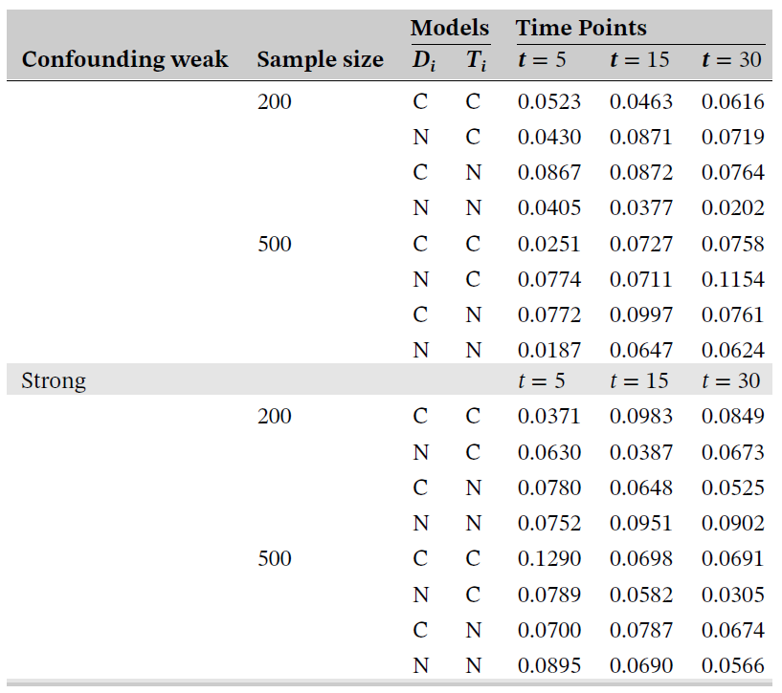
Results from paper
Another ‘counter-intuitive’ results

Slide 25
Thank you

