Slide 1
Simulation Study on Performance of Bayesian Dynamic Borrowing on DSI Gastric Cancer Clinical Data.
Intern: Ravi
Project inspired by a 2023 paper: “Bayesian Dynamic Borrowing Of Historical Information With Applications To The Analysis Of Large-Scale Assessments”

Slide 2
Why this project?
DG-01 Study
(Phase-2 randomized trial)
- Enrolls 125 patients in T-DXd arm
PROSPERITY
(Gastric Non-interventional Study)
- Plans to enroll 162 patients in T-DXd arm
DG-02 Study
(Phase-2 single arm trial)
- Enrolls 79 patients in T-DXd arm

Slide 3
Same compound (T-DXd) and same outcome of interest studied in all 3 studies:
Aim:
Increase effective sample size.
Improve prediction accuracy.
Reduce estimation bias.

Slide 4
Key Question: To what extent should historical data be used? Answer: It depends on the similarity between historical and current data.
Using a flexible informed prior distribution for PROSPERITY, based on DG-01 and DG-02 study data, would be a wise attempt.

Slide 5
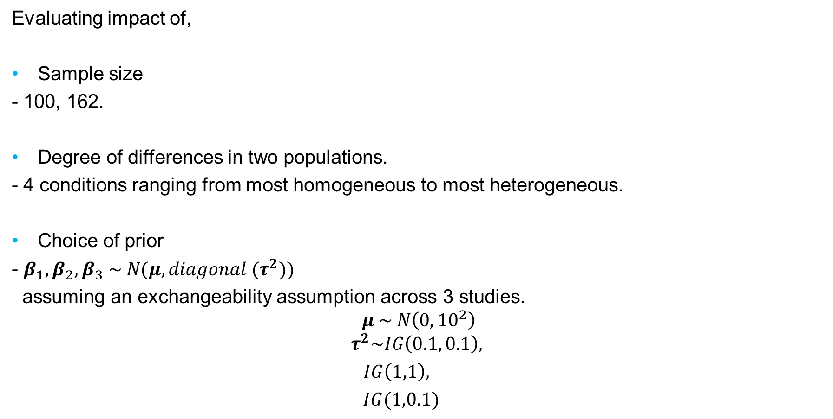
What is the research question?
Evaluating impact of,
Sample size
- 100, 162.
Degree of differences in two populations.
- 4 conditions ranging from most homogeneous to most heterogeneous.
Choice of prior
- $β_{1}, β_{2},β_{3} \sim N(μ, {diagonal (τ}^{2}))$
assuming an exchangeability assumption across 3 studies.
$$μ \sim N\left(0, 10^{2}\right)$$
$$τ^{2}\sim IG\left(0.1, 0.1\right),$$
$IG\left(1,1\right),$
$IG(1,0.1)$

Slide 6
on the parameter estimation in terms of following measures (all or some of them):
Leave-One-Out Cross-Validation Information Criterion.
Total Effective Sample Size.
Mean Squared Error.
Percent Bias.
Width of 95% HPD credible intervals.
Coverage of 95% HPD credible intervals.

Slide 7
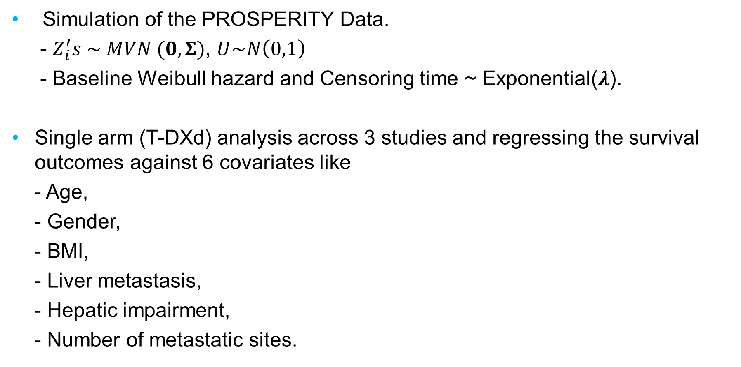
How are we planning to answer it?
Simulation of the PROSPERITY Data.
- $Z_{i}^{′}s \sim MVN (0,Σ)$, $U\sim N\left(0,1\right)$
- Baseline Weibull hazard and Censoring time ~ Exponential($λ$).
Single arm (T-DXd) analysis across 3 studies and regressing the survival outcomes against 6 covariates like
- Age,
- Gender,
- BMI,
- Liver metastasis,
- Hepatic impairment,
- Number of metastatic sites.

Slide 8
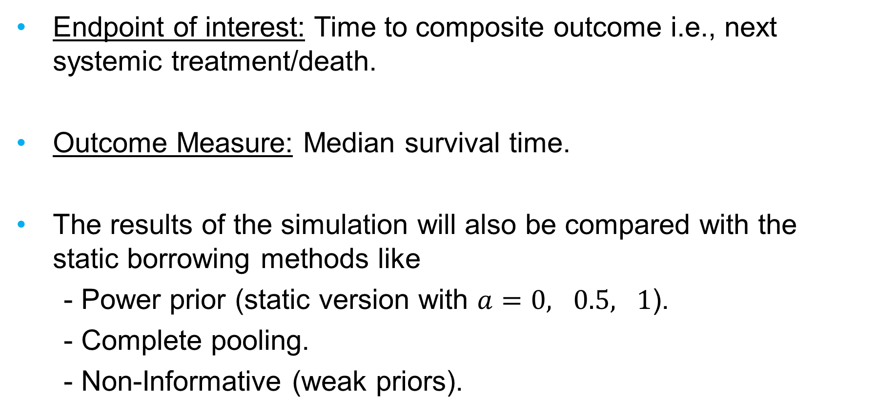
Endpoint of interest: Time to composite outcome i.e., next systemic treatment/death.
Outcome Measure: Median survival time.
The results of the simulation will also be compared with the static borrowing methods like
- Power prior (static version with $a=0, 0.5, 1$).
- Complete pooling.
- Non-Informative (weak priors).

Slide 9
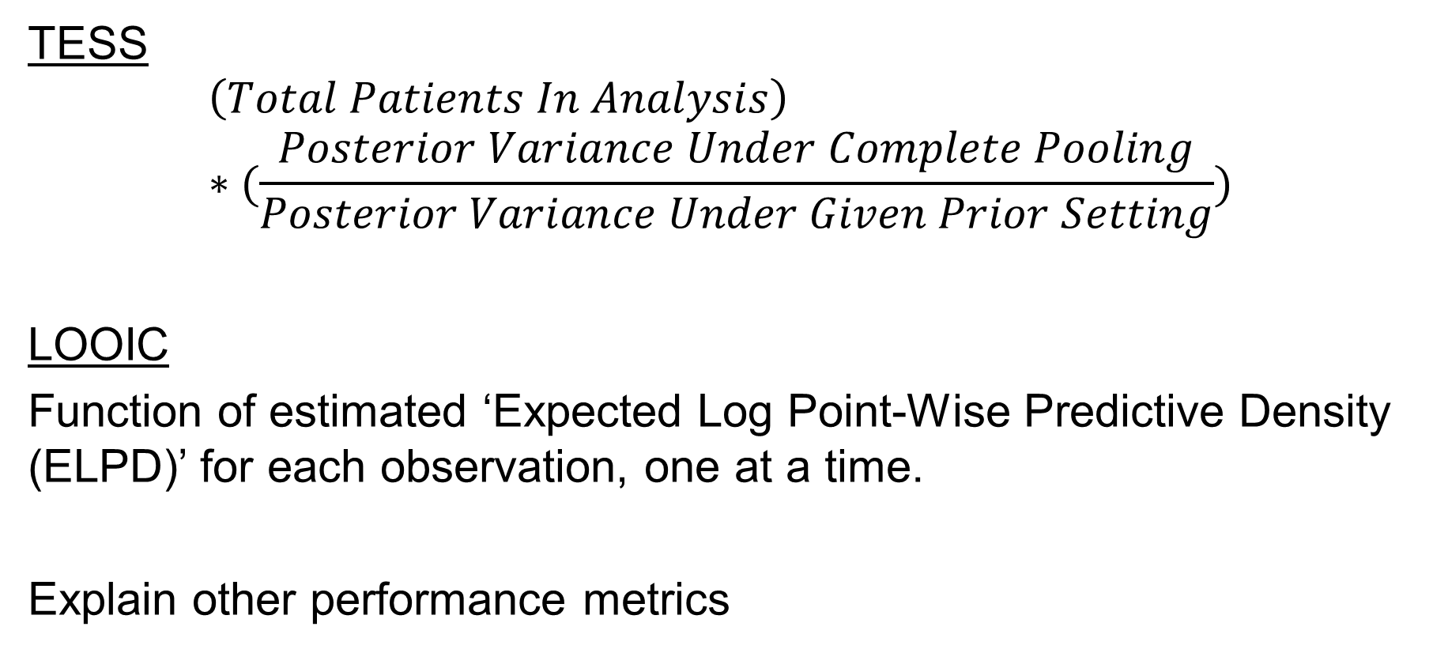
TESS and LOOIC
TESS
$$\left(Total Patients In Analysis\right)∗(\frac{Posterior Variance Under Complete Pooling}{Posterior Variance Under Given Prior Setting})$$
LOOIC
Function of estimated ‘Expected Log Point-Wise Predictive Density (ELPD)’ for each observation, one at a time.
Explain other performance metrics

Slide 10
Details about simulation.
10,000 iterations in 3 MCMC chains.
Number of replications per each combination of Sample Size, Prior Setting, Heterogeneity Condition, and Baseline Covariates (including Intercept) is 35.
We are interested in the overall performance of the priors; hence effective number of replication is 35*7 = 245.
For performance results, we won’t be focusing on differentiating between priors within each prior/borrowing setting.

Slide 11
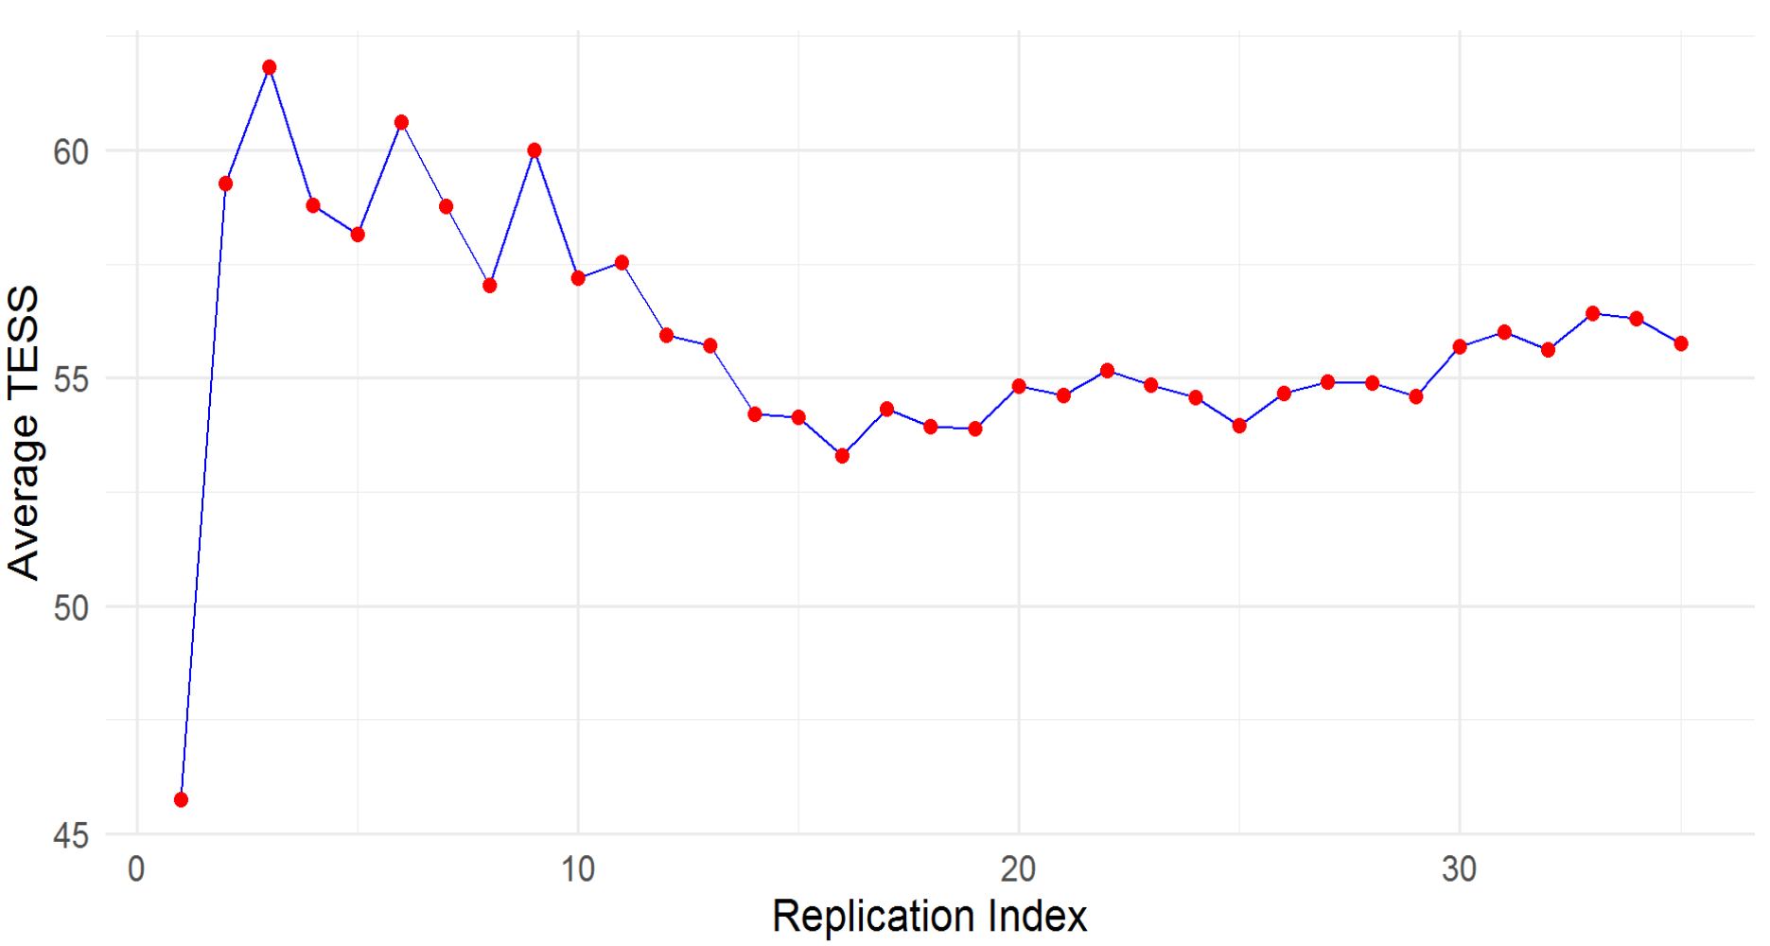
Why only 35 replications?

Slide 12
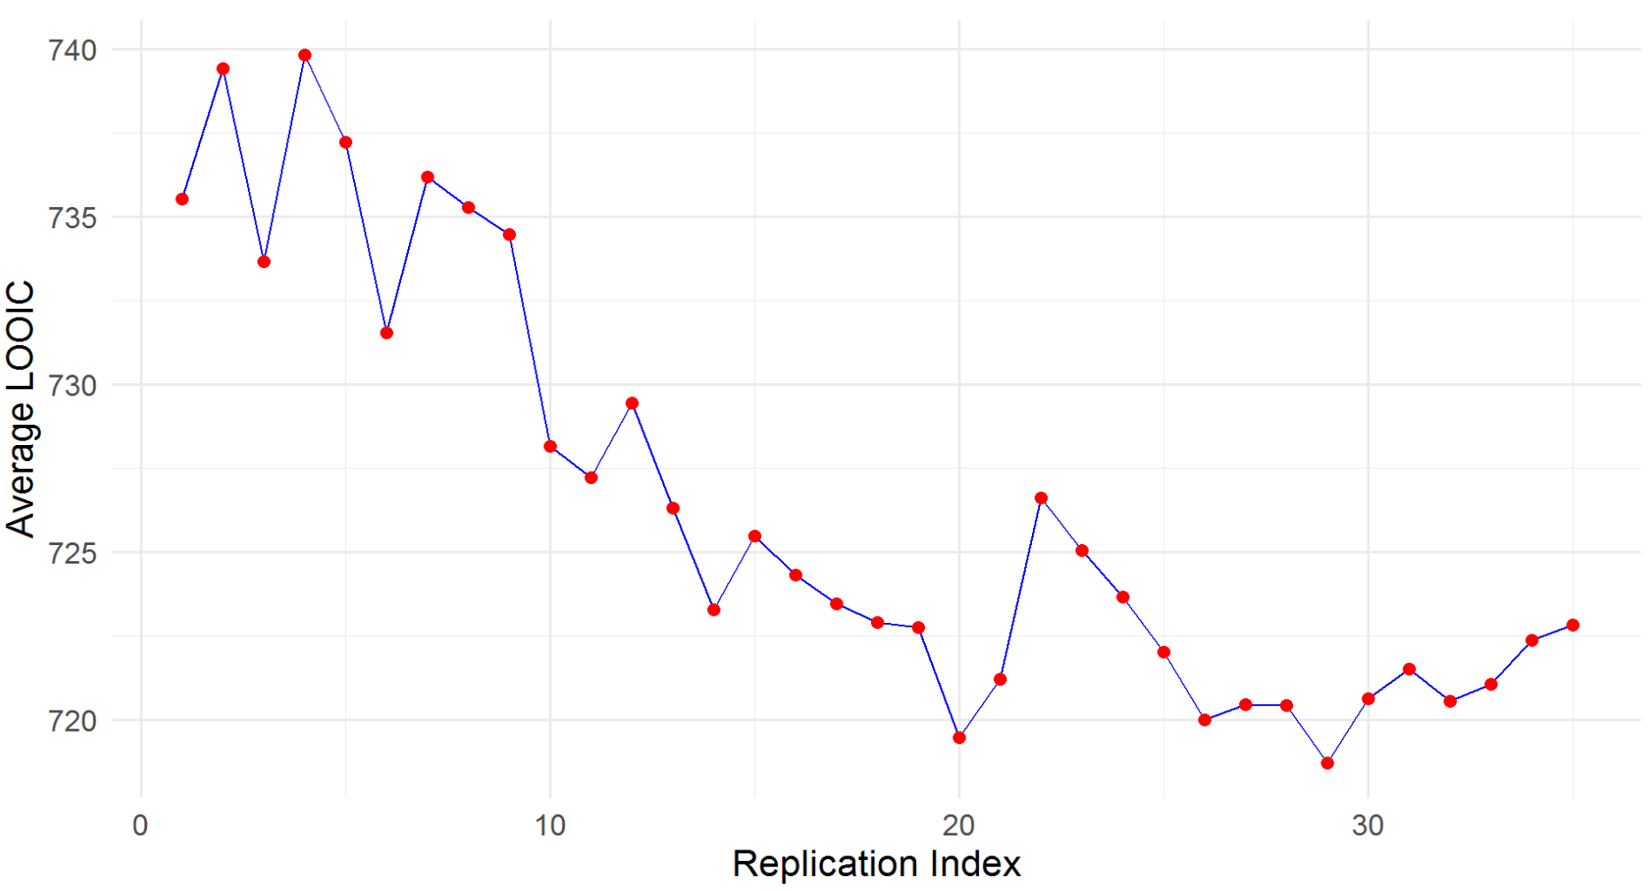
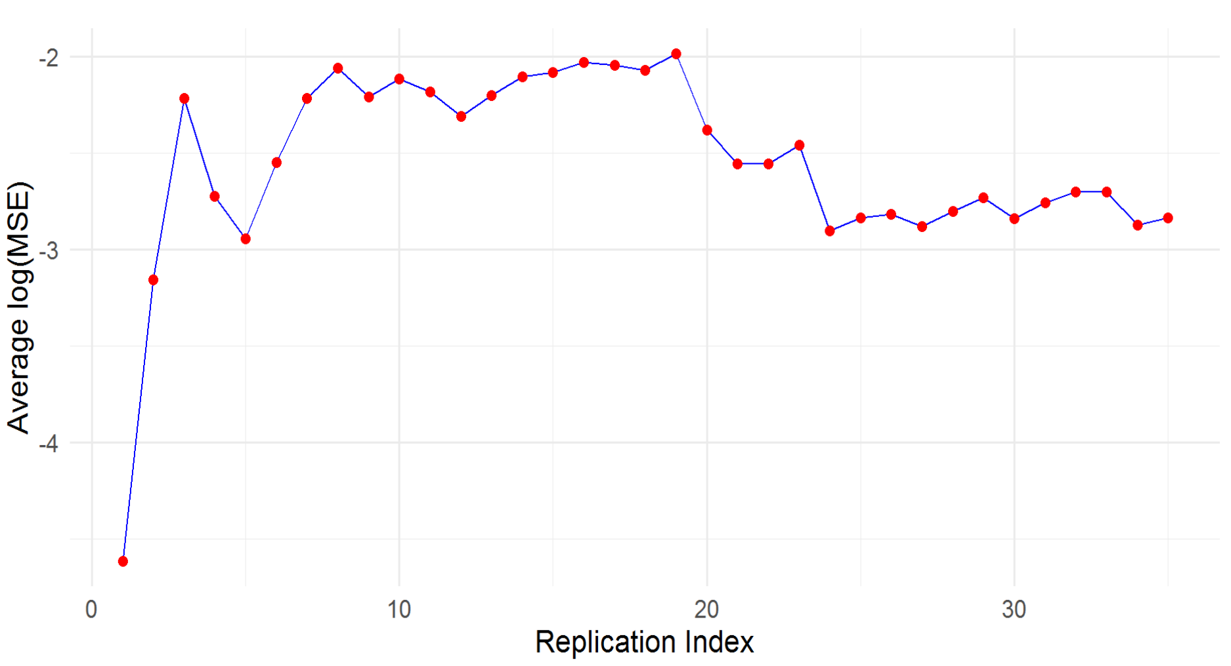
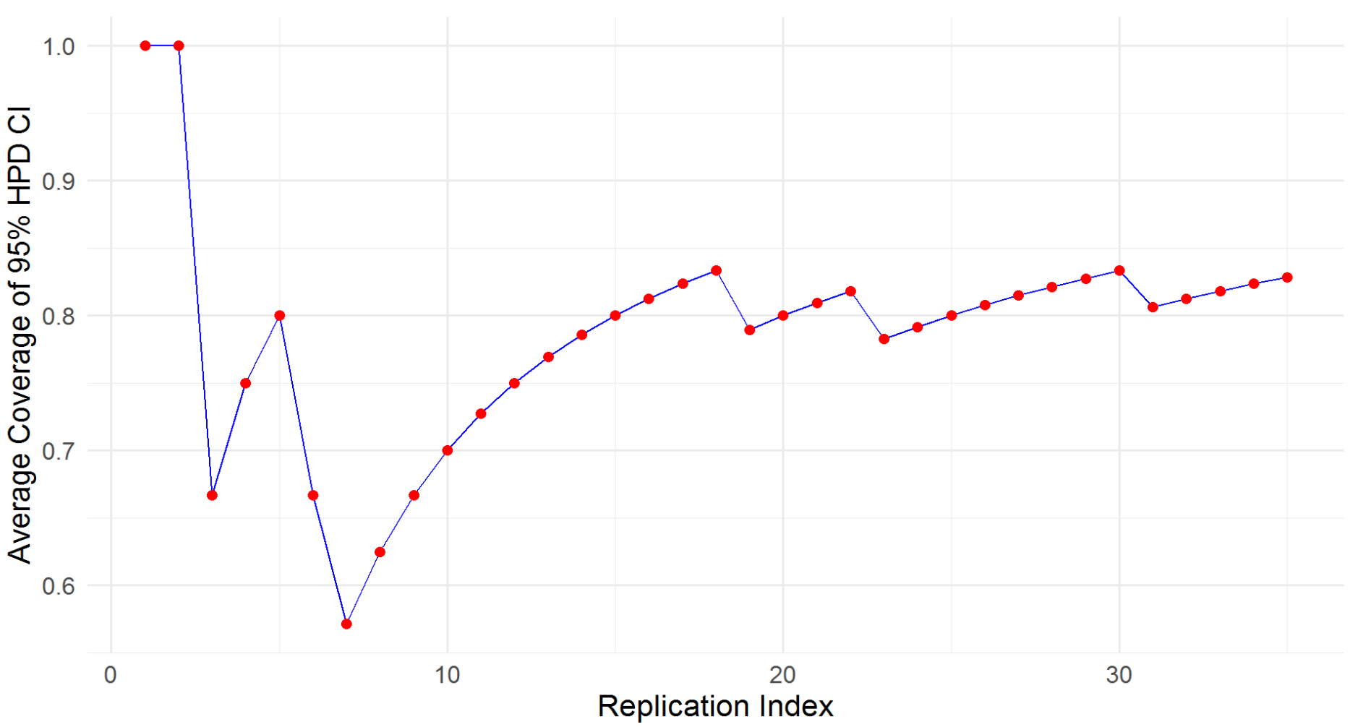
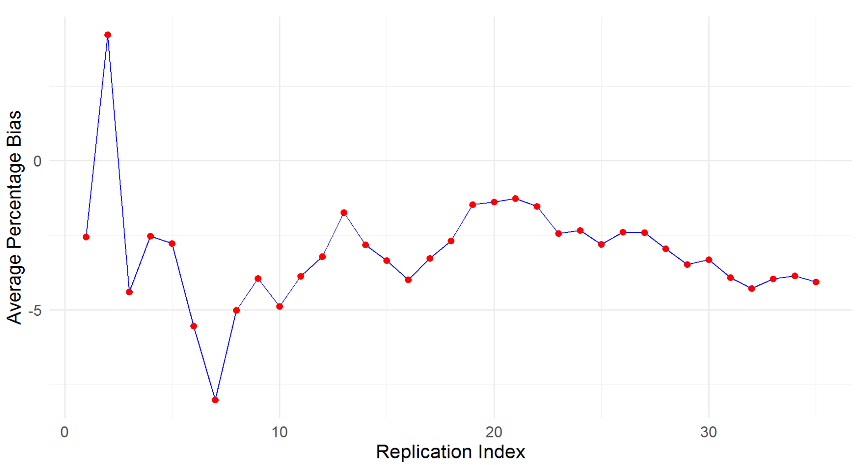
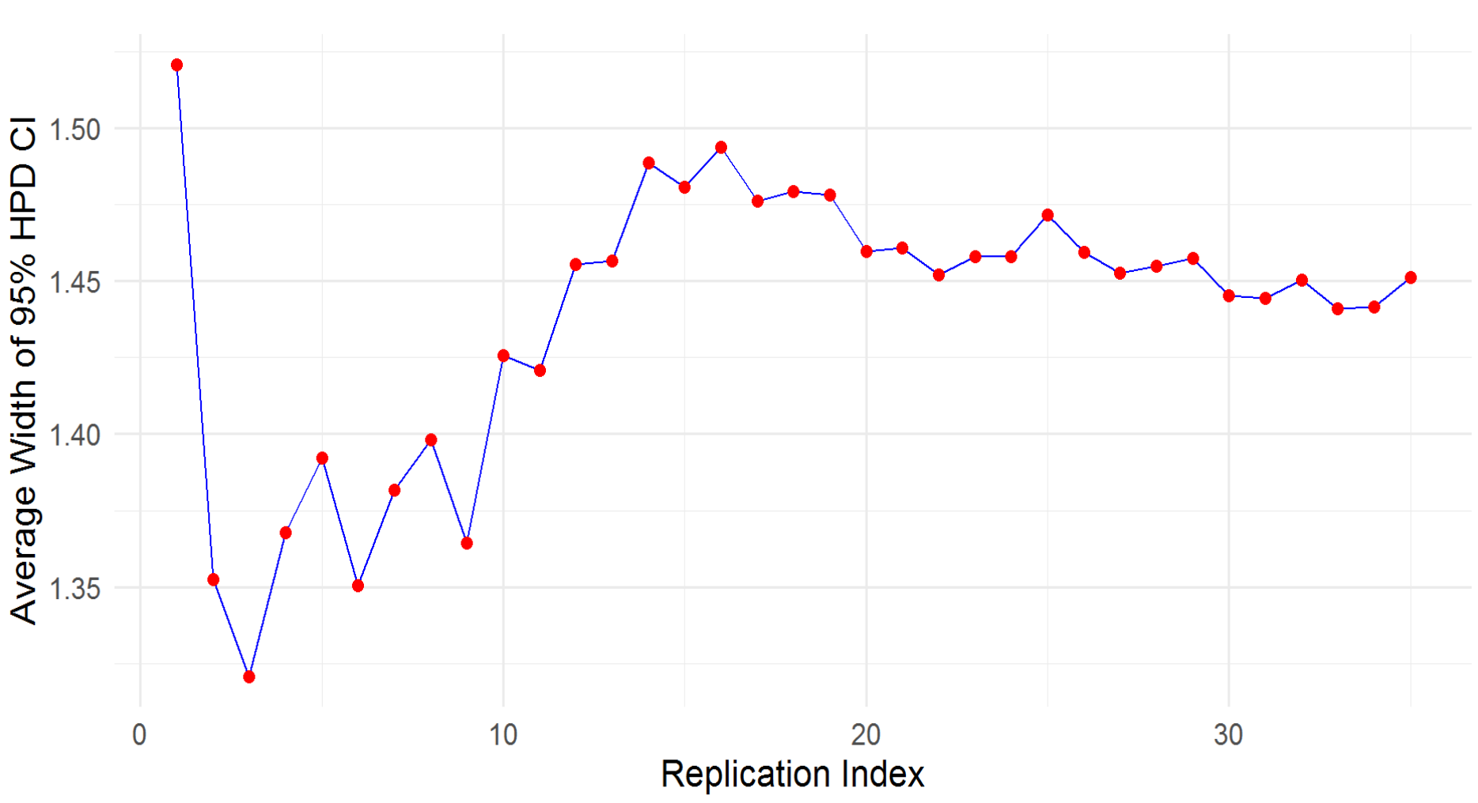

Slide 13
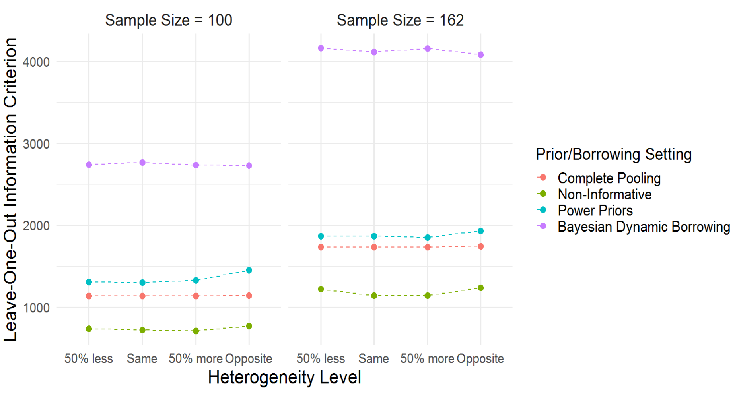
Results - LOOIC

Slide 14
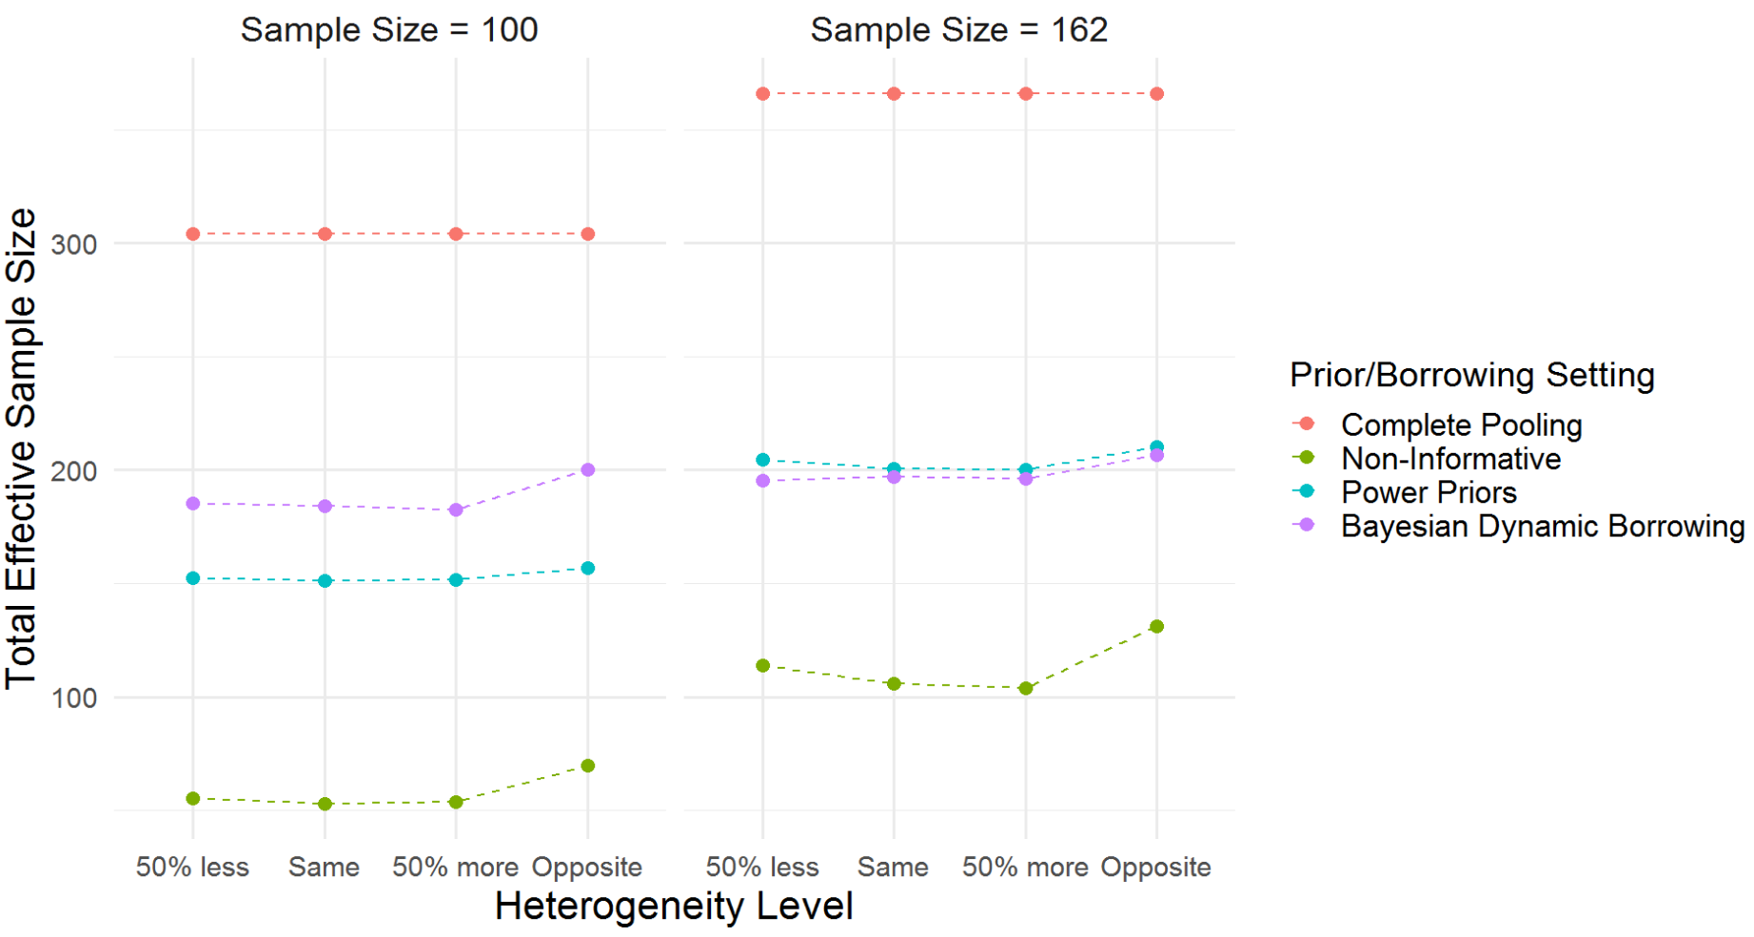
TESS

Slide 15
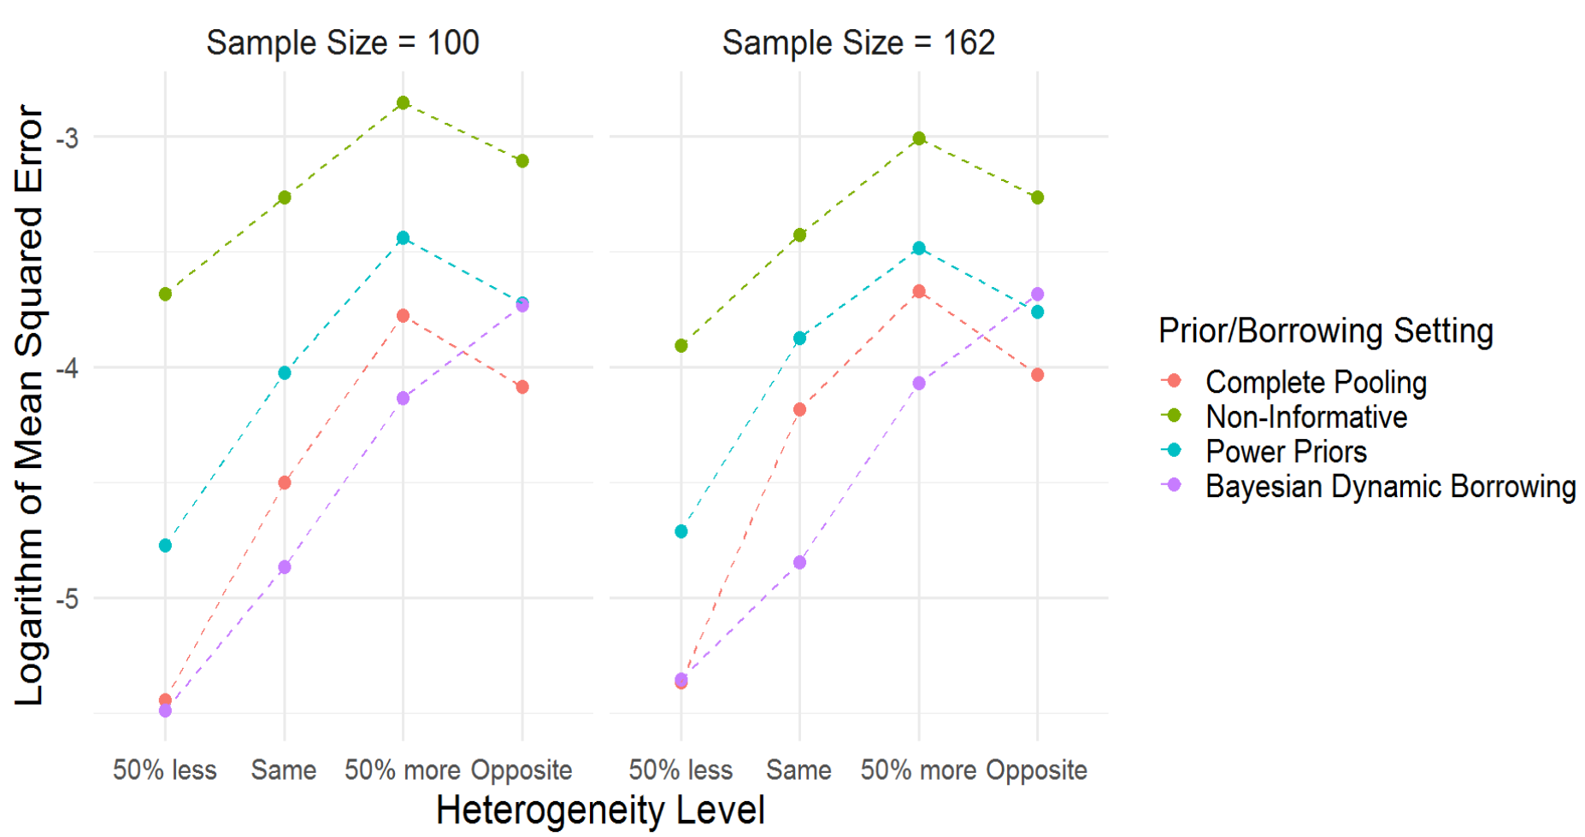
Logarithm of MSE

Slide 16
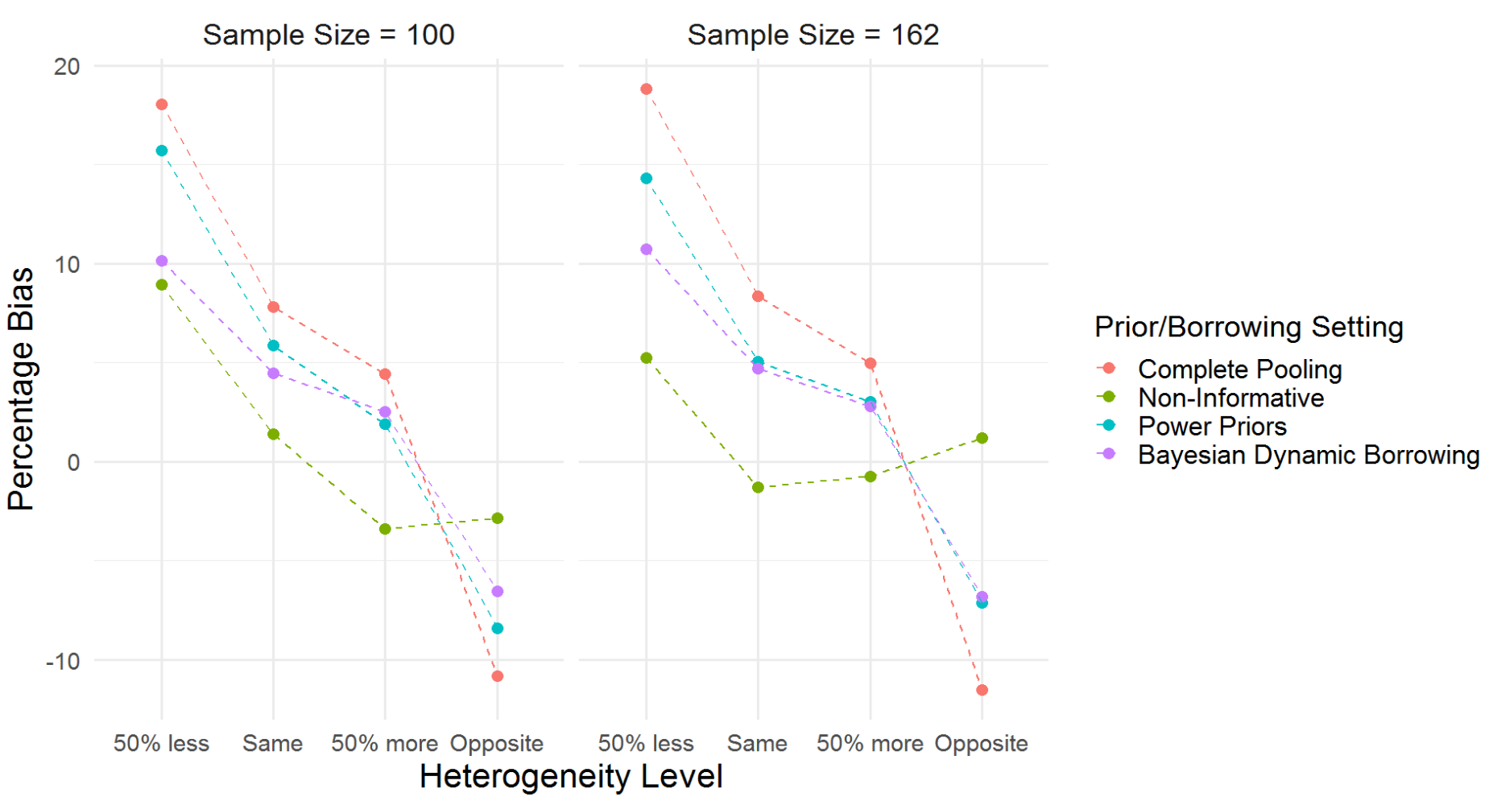
Percentage Bias

Slide 17
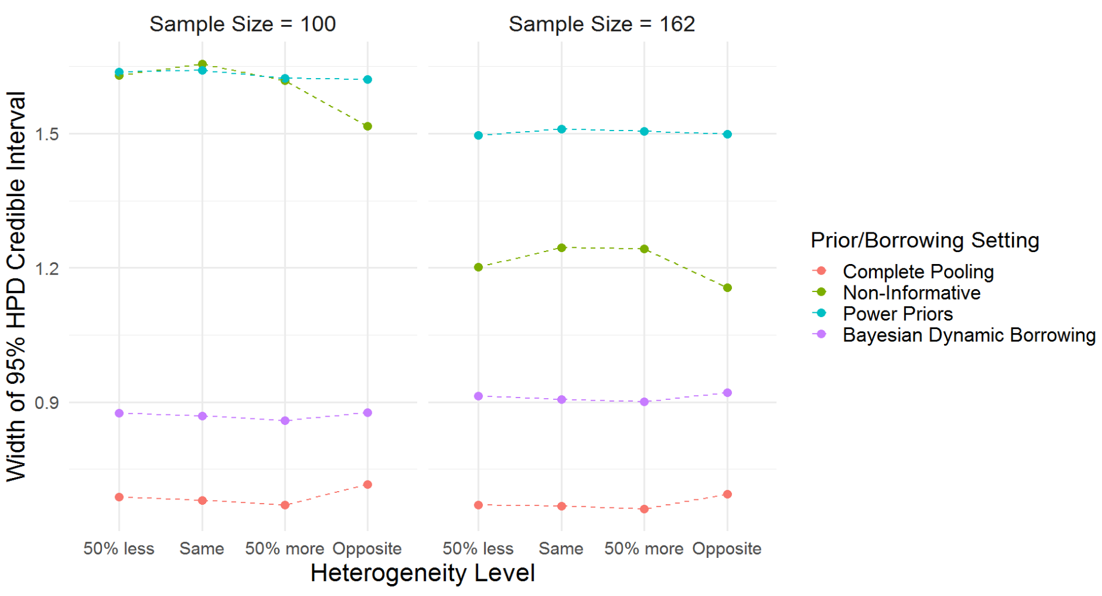
Width of 95% HPD CI

Slide 18
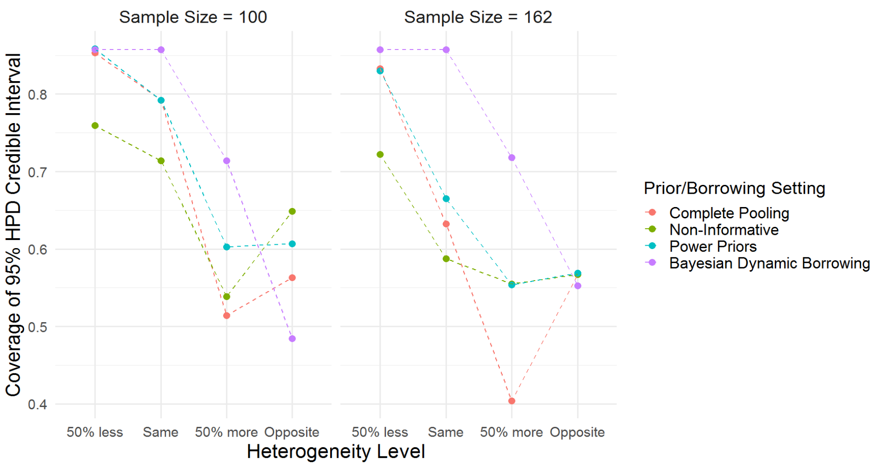
Coverage of 95% HPD CI

Slide 19
Conclusions
BDB performs worst in terms of LOOIC across borrowing methods.
BDB maintained higher TESS even in case of smaller sample size.
BDB achieves lowest MSE among other borrowing methods.
BDB achieves smaller width for credible intervals among all priors only next to complete pooling.
BDB performs best in terms of coverage of credible interval. Better than complete pooling which has narrowest width.
Overall, BDB performed best in terms of Width-Coverage tradeoff.

Slide 20
Future Work and Improvements
Include the standard errors of performance metric values in discussion, to achieve quantification of the uncertainty in our results.
Include more heterogeneity levels, sample sizes, priors in simulation.
Studying absolute percentage bias instead of percentage bias.
Include more prognostic covariates that drives the similarities and dissimilarities among the clinical trails.

Slide 21
Thank You
Any Questions?

