Slide 1

WebMind AI – Advanced AI- Powered Browser Interaction
Enhancing Web Accessibility for AI Agents. A presentation on building an AI-powered browser interaction system for seamless web automation. Built on advanced browser automation technologies.
By:
Himanshu Singh
Sachin Patel

Slide 2
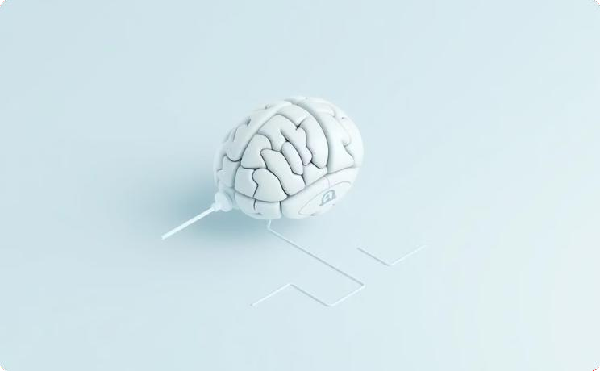

Introduction to WebMind AI
What is WebMind AI?
AI-powered browser interaction system. Seamless web automation for AI agents.
Built on advanced browser automation technologies.

Slide 3
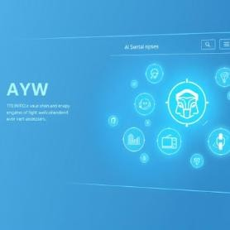
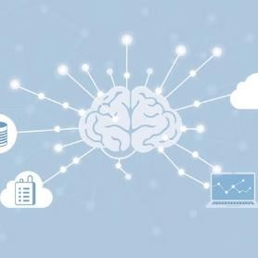




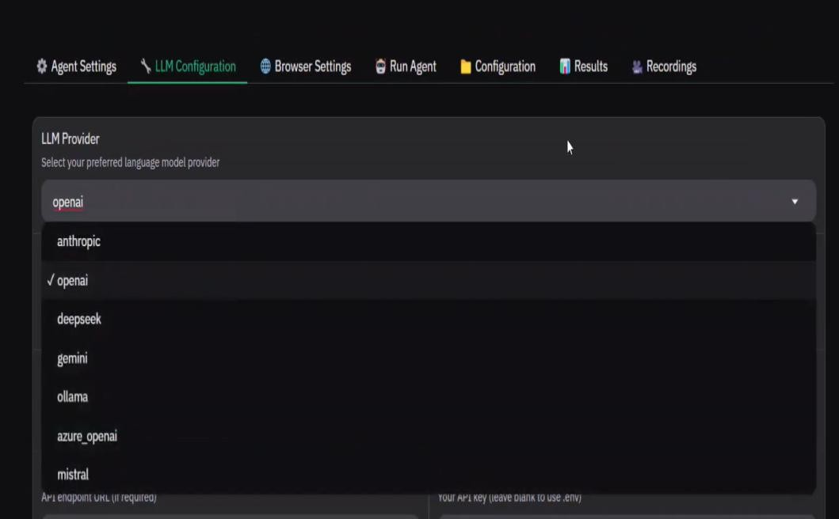
Key Features of WebMind AI
Web-Based User Interface.
Multi-LLM Integration. Custom Browser Support. Persistent Browser Sessions.
High-Definition Screen Recording. Flexible Deployment Options.

Slide 4
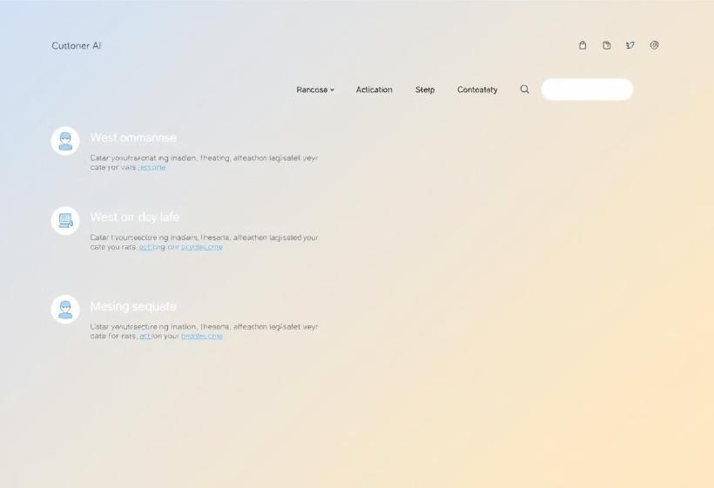
Web-Based User Interface (WebUI)
Built on Gradio for an intuitive experience.
Supports direct AI-driven web interactions.
Features a chat-based command system for automation.

Slide 5
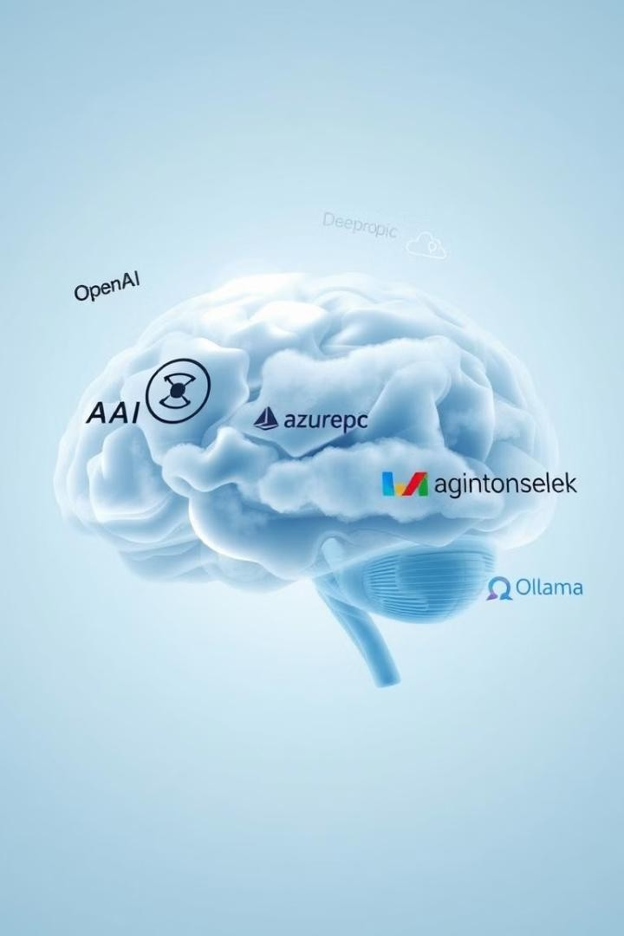
Multi-LLM Integration
OpenAI, Google AI, Azure OpenAI.
Anthropic Claude, DeepSeek, Ollama. Future updates will add more integrations. Enables intelligent decision-making.

Slide 6
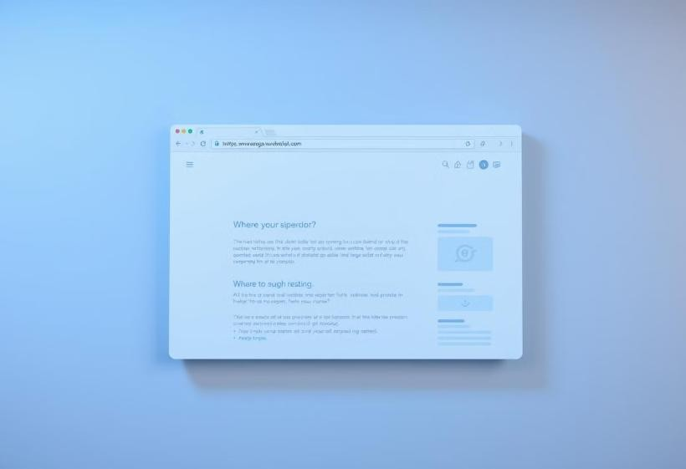
Custom Browser Support M Persistent Sessions
Users can integrate their own browser.
No need to re-login to websites.
Maintains authentication & session continuity. Supports real-time monitoring.

Slide 7

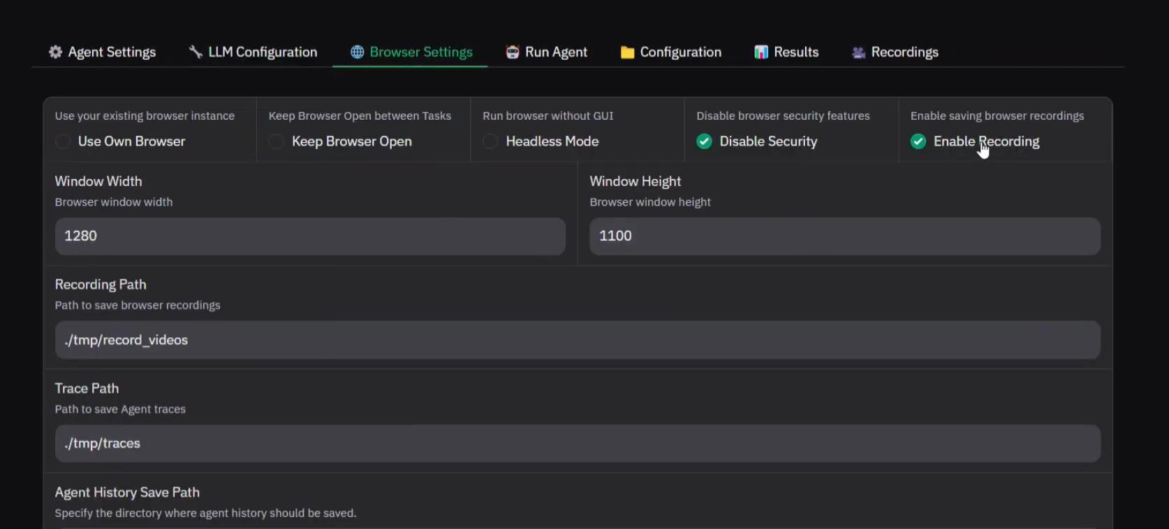
High-Definition Screen Recording
AI Interactions in Real Time
Watch AI-driven browser interactions.
Enables monitoring and debugging.
Secure and configurable video settings.

Slide 8

Installation M Deployment Options
Local Installation: Python, Git, Playwright setup.
Docker Installation: Deploy across environments. Customization Options:
UI Themes, Dark Mode, Adjustable resolution.

Slide 9
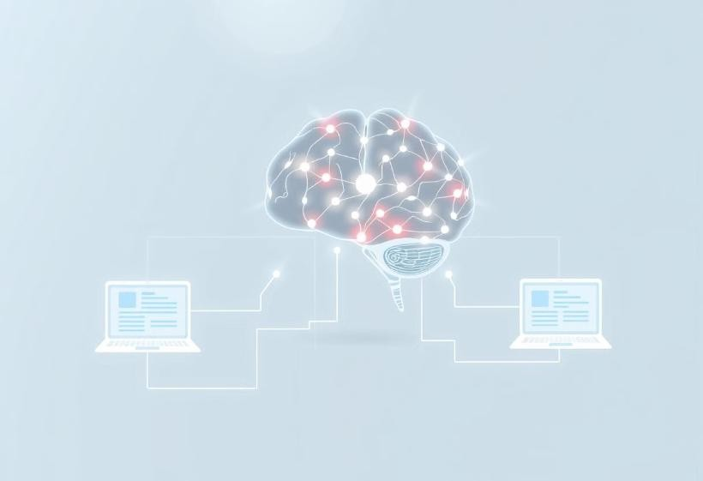
Key Use Cases
Automate workflows and extract information.
Intelligent data extraction with LLMs.
Maintain seamless authentication securely. Test AI models in web environments.

Slide 10


Conclusion
WebMind AI is scalable and customizable.
Seamless AI web interaction, persistent sessions.
Multi-LLM support for developers.
Empowering the future of AI!

