Slide 1
🎓
Scholar-Bot
AI-Powered Resume Optimizer · LinkedIn Job Matcher · Auto-Apply Agent
github.com/Singhniku/scholar-bot

Slide 2
The Problem
Job seekers waste 10+ hours per week customising resumes for ATS
75%
3-5 min
of resumes are auto-rejected by ATS before any human reads them
average time to manually customise one resume per job
100s
Generic
of jobs posted daily — manual review is unsustainable
applications get lower interview rates than tailored ones

Slide 3
The Solution
End-to-end AI automation: parse → match → rewrite → apply
📄
🧠
🔍
Parse
Extract
Search
Read PDF / JPG / PNG / SVG resumes via pdfplumber + OCR
AI extracts skills, experience, education as structured JSON
Scrape LinkedIn for jobs matching your title + filters
📊
✨
🚀
Score
Rewrite
Auto-Apply
Weighted match algorithm against required + preferred skills
AI tailors bullet points to mirror each job's exact keywords
Selenium fills Easy Apply forms — you approve, it submits

Slide 4
Architecture
Layered design — UI · Pipeline · Services · External integrations
Streamlit UI · 5 tabs: Upload · Job Matches · Optimised Resumes · Auto Apply · Report
Pipeline (src/pipeline.py) · parse → extract → fetch → match → filter → upgrade
Resume Parser
Skills Extractor
LinkedIn Scraper
ATS Optimiser
pdfplumber pytesseract cairosvg
AI Client (Gemini / Claude) + Keyword fallback
requests BeautifulSoup lxml
AI Client + ResumeGenerator (reportlab PDF)
Google Gemini (free tier, default)
Anthropic Claude (paid, optional)
LinkedIn Public Jobs + Easy Apply (Selenium)
Output: PDF · Markdown · JSON · CSV · Cached in /output, /uploads

Slide 5
Pipeline Flow
Six pure functions in src/pipeline.py — same code path for UI, CLI, tests
Resume File
parse_resume() → raw text
extract_resume_skills() → resume_data
fetch_jobs() → list[job]
match_resume_to_jobs() → list[ScoredJob]
filter_by_match() → above / below
upgrade_cv() → optimised resume
ResumeGenerator → PDF / Markdown
AutoApply → Easy Apply form
Each step is independent · Falls back gracefully when AI quota runs out
61 unit + integration tests · 100% pipeline coverage

Slide 6
Features
Battle-tested features for real-world job hunting
📄
Multi-format parsing
🤖
Dual AI provider
PDF (native + OCR fallback), JPG, PNG, SVG
Google Gemini (free) or Anthropic Claude (paid)
🛡️
Keyword fallback
🔍
Title + filter search
Fully usable when AI quota is exhausted
Job title, location, days, min match %
📊
ATS audit
✨
ATS-safe rewrites
7-rule keyword score + AI bullet rewrites
Mirror exact JD keywords without fabrication
📈
Before/after ATS
🚀
Human-gate auto-apply
See exactly how much your score improved
Bot fills, you approve, it submits

Slide 7
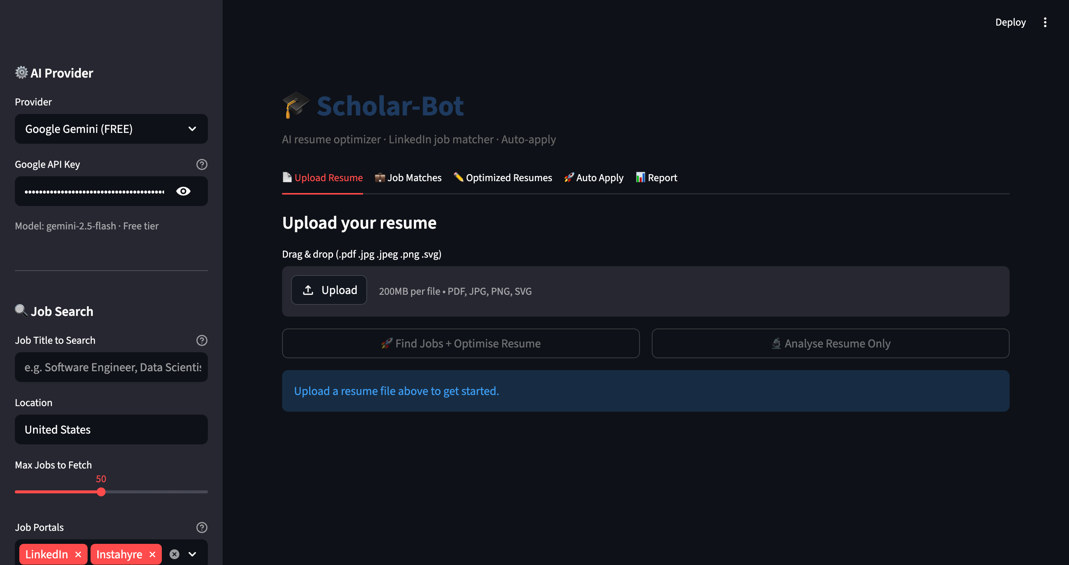
Tab 1: Upload Resume
Drag & drop · Sidebar configures provider, search, auto-apply
Skills, experience, education extracted instantly. ATS audit shows 90/100 with 7-rule breakdown.

Slide 8
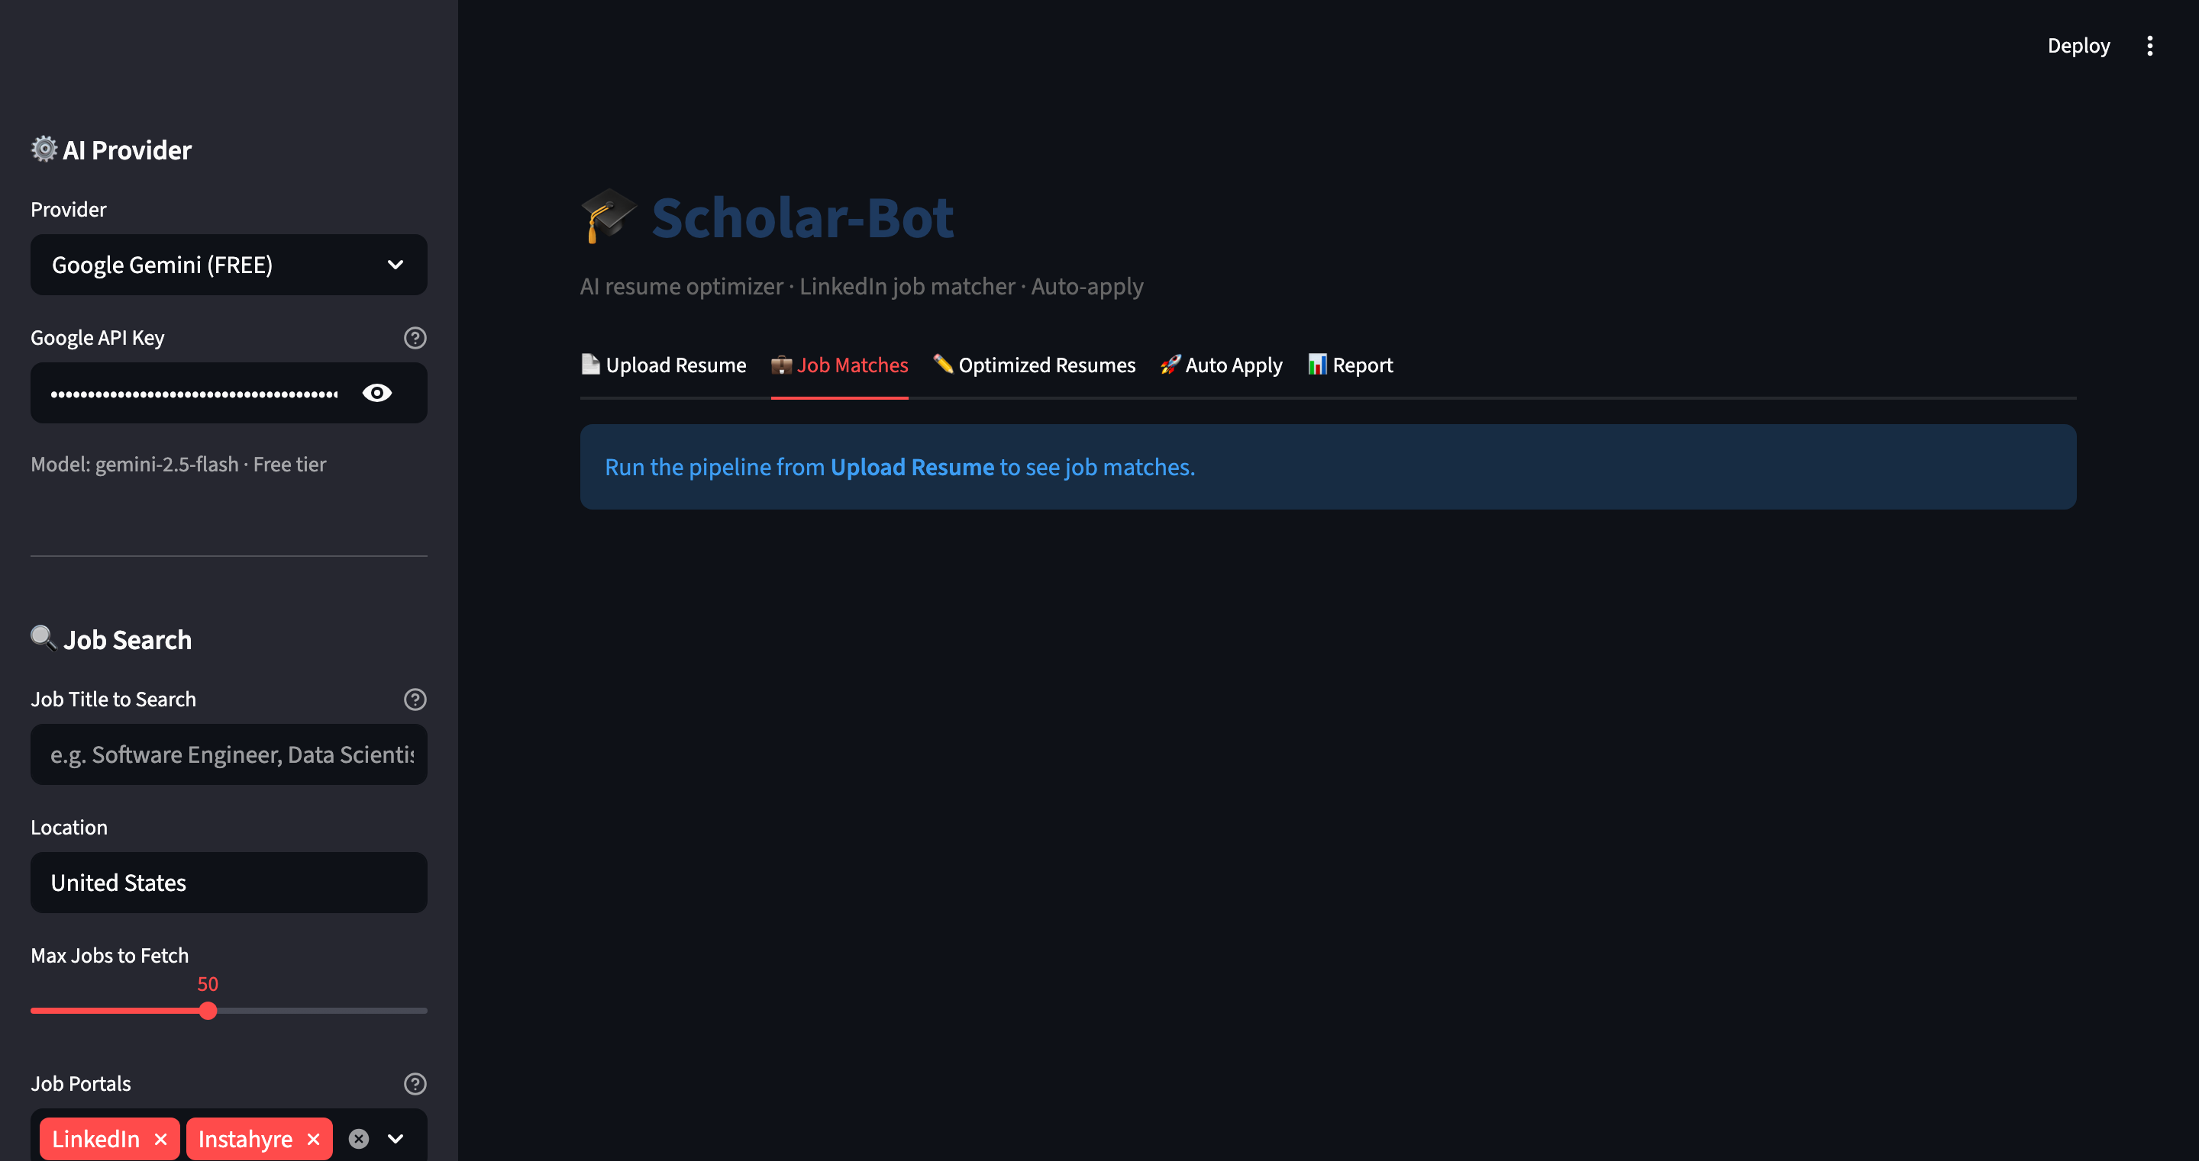
Tab 2: Job Matches
Ranked LinkedIn results with match score, expandable details, per-job actions
Each job shows title, company, location, posting date · 'Upgrade CV' button per job

Slide 9
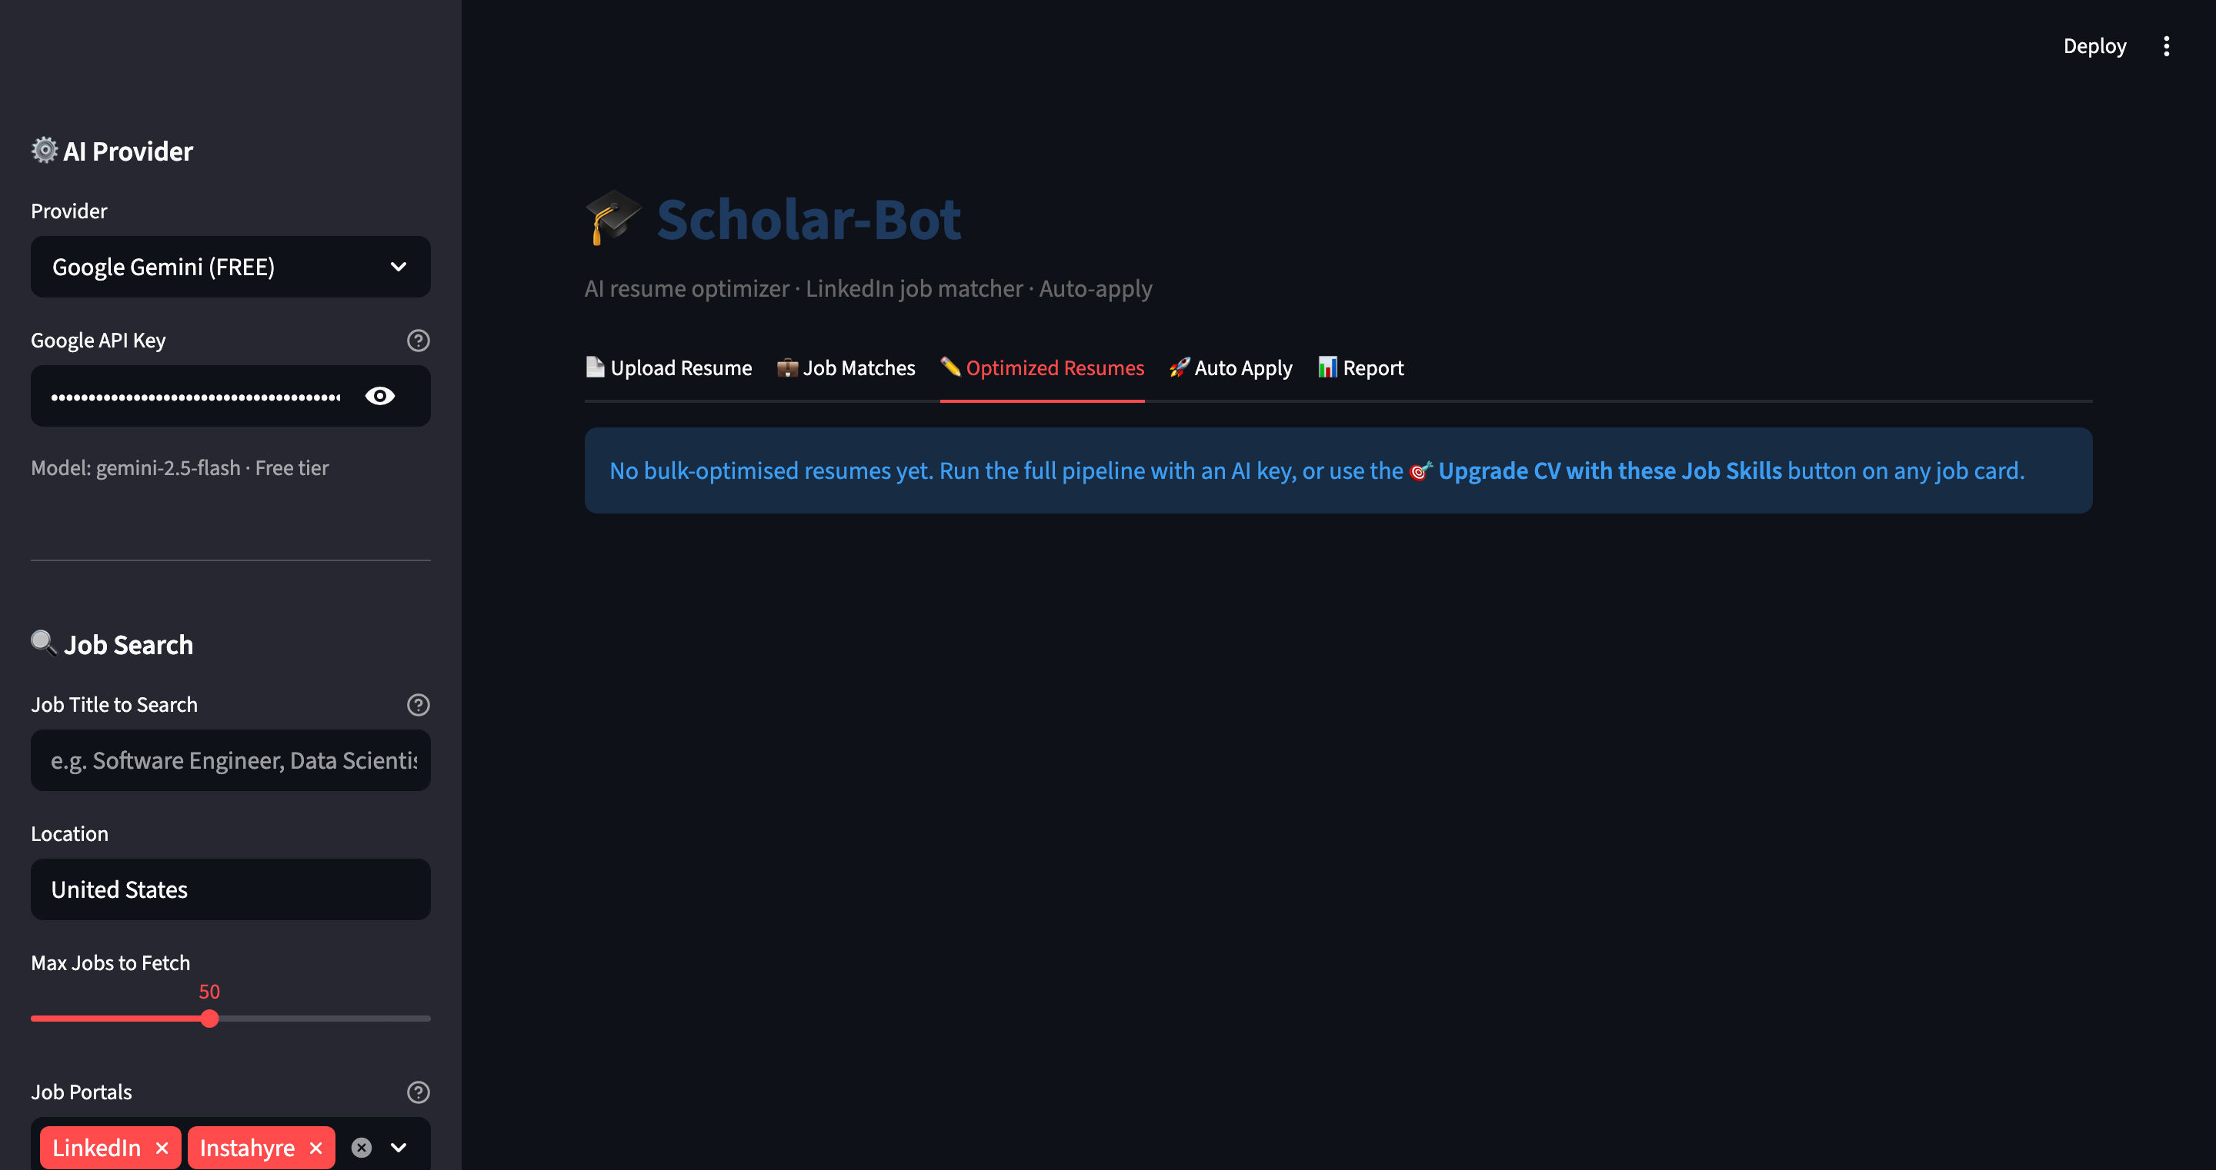
Tab 3: Optimised Resume
Full preview with before/after ATS score and downloadable PDF/Markdown
AI rewrites every bullet to mirror job keywords · downloads PDF + Markdown

Slide 10
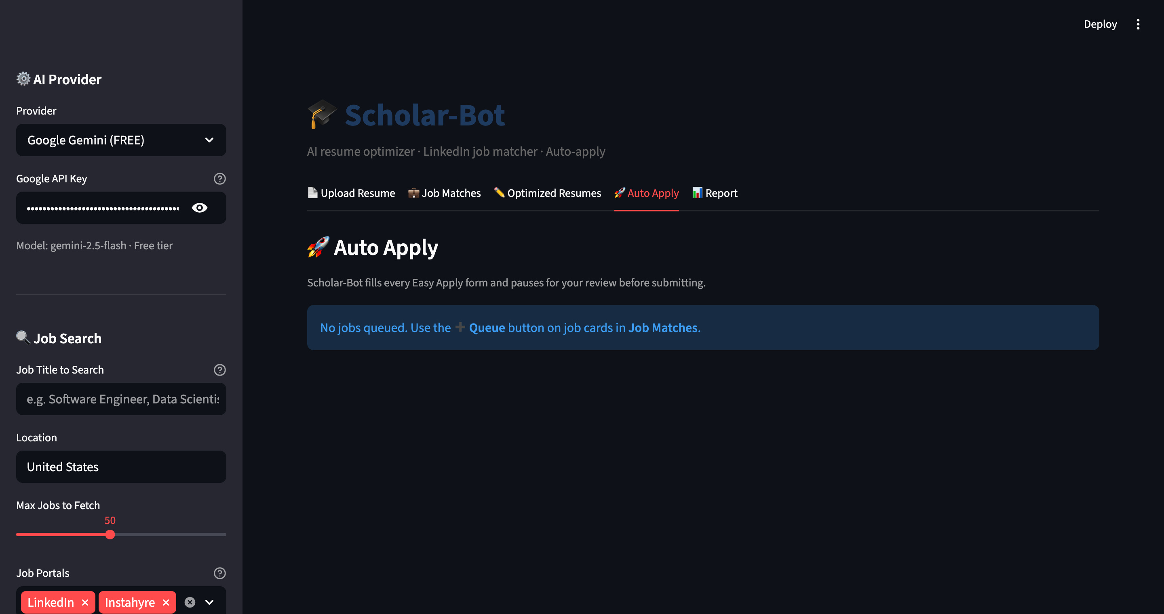
Tab 4: Auto Apply
Selenium fills LinkedIn Easy Apply forms — pauses for your approval before submit
Human-in-the-loop gate · threading.Event blocks the bot until you click submit

Slide 11
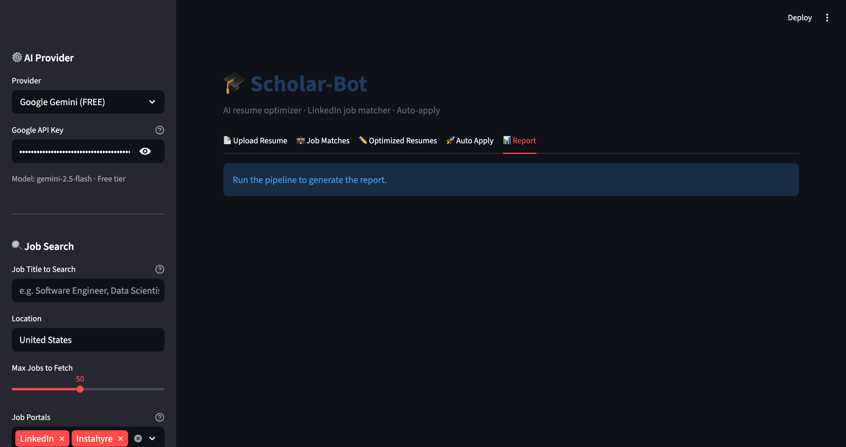
Tab 5: Report
Ranked job table with match scores, distribution chart, CSV export
Full audit trail of every job seen, scored, queued, applied

Slide 12
AI Models & Libraries
Production-grade open-source stack
🤖 AI Models
📚 Key Libraries
Google Gemini 2.5 Flash
streamlit
1.57 · 5-tab UI
Default · Free tier · 1500 req/day
google-genai
0.8 · Gemini SDK
Gemini 2.0 Flash
anthropic
0.97 · Claude SDK
Auto-fallback when 2.5 is rate-limited
pdfplumber
0.11 · PDF text + tables
Gemini 2.0 Flash-Lite
Final fallback in the chain
pytesseract
0.3 · OCR for images
Anthropic Claude Sonnet 4.6
cairosvg
2.9 · SVG → PNG
Optional · Paid · w/ prompt caching
beautifulsoup4
4.14 · LinkedIn HTML parse
selenium
4.43 · Easy Apply automation
reportlab
4.5 · ATS-safe PDF gen

Slide 13
ATS Scoring Logic
Transparent, explainable 7-rule audit · 0-100
Check
Points
Contact info present (name + email + phone)
20
Professional summary (≥30 chars)
15
Skills section present
15
Work experience with bullet points
20
Education section present
10
≥10 technical keywords detected
10
Word count between 400-1200
10
🤖 With AI: bullet rewrites · keyword gap analysis · format issue detection

Slide 14
Benefits
Hours saved · Higher response rate · Zero fabrication
⏱️
🎯
🆓
10× faster
ATS-optimised
Free forever
Customise 10 resumes in the time it takes to do 1 manually
Single-column PDFs with mirrored keywords pass automated filters
Gemini's free tier handles 1500 req/day — no credit card needed
🤝
🔒
📈
Human-in-the-loop
Privacy-first
Measurable
Auto-Apply pauses for approval before every single submission
Resume processed locally · API keys stored in your .env only
Before/after ATS score + match analytics on every job

Slide 15
Tech Stack at a Glance
Chosen for: free-tier-friendly, production-ready, easy to deploy
Frontend
Streamlit (Python web UI)
AI / LLM
google-genai · anthropic SDK · prompt caching
Parsing
pdfplumber · pytesseract · cairosvg · Pillow
Scraping
requests · beautifulsoup4 · lxml · python-dateutil
Automation
selenium · webdriver-manager (Chrome)
Output
reportlab (PDF) · pandas (CSV)
Testing
pytest · 61 unit + integration tests
Setup
setup.sh · 3-command install

Slide 16
Quality & Testing
61 tests · zero-network mocked unit tests · live integration tests
61
9
0
100%
Tests passing
Test categories
Failures
Pipeline coverage
Test categories:
✓ Fallback resume parser — positive cases
✓ Edge cases — empty, no dates, single role
✓ Overlapping date-range merging
✓ Normalizer type coercion ("5+" → 5, "5 yrs" → 5)
✓ LinkedIn query construction
✓ Score match — perfect, zero, partial
✓ Job description extraction
✓ PDF + Markdown generation
✓ Live LinkedIn search — title vs skills
✓ Pipeline orchestration — 8 tests for src/pipeline.py

Slide 17
Quick Start
From clone to running app in under 2 minutes
$ git clone https://github.com/Singhniku/scholar-bot.git $ cd scholar-bot $ ./setup.sh ← creates venv, installs deps, tesseract, .env, folders $ source .venv/bin/activate $ streamlit run app.py ← open localhost:8501
1.
2.
3.
Clone
Setup
Run
git clone the repo
./setup.sh — one command
streamlit run app.py

Slide 18
Roadmap & Future Work
Where Scholar-Bot is heading next
🌐 Indeed · Glassdoor · Naukri scrapers
✉️ AI-generated cover letter per job
📊 Application tracking dashboard
📝 .docx resume input
🐳 Docker image for one-command deploy
🌍 Multi-language resume support
🎓 github.com/Singhniku/scholar-bot · Try it · Fork it · Star it

