Slide 1
AP, GP & HP

Slide 2
The two simplest sequences to work with are arithmetic and geometric sequences. An arithmetic sequence goes from one term to the next by always adding (or subtracting) the same value. For instance, 2, 5, 8, 11, 14,... and 7, 3, –1, –5,... are arithmetic, since you add 3 and subtract 4, respectively, at each step. A geometric sequence goes from one term to the next by always multiplying (or dividing) by the same value. So 1, 2, 4, 8, 16,... and 81, 27, 9, 3, 1, 1/3,... are geometric, since you multiply by2 and divide by 3, respectively, at each step.

Slide 3
The number added (or subtracted) at each stage of an arithmetic sequence is called the "common difference" d, because if you subtract (find the difference of) successive terms, you'll always get this common value. The number multiplied (or divided) at each stage of a geometric sequence is called the "common ratio" r, because if you divide (find the ratio of) successive terms, you'll always get this common value.

Slide 4
For arithmetic sequences, the common difference is d, and the first term a₁ is often referred to simply as "a". Since you get the next term by adding the common difference, the value of a₂ is just a + d. The third term is a₃ = (a + d) + d = a + 2d. The fourth term is a₄ = (a + 2d) + d = a + 3d. Following this pattern, the n-th term a_{n} will have the form a_{n} = a + (n – 1)d.

Slide 5
For geometric sequences, the common ratio is r, and the first term a₁ is often referred to simply as"a". Since you get the next term by multiplying by the common ratio, the value of a₂ is just ar. The third term is a₃ = r(ar) = ar². The fourth term is a₄ = r(ar²) = ar³. Following this pattern, the n-th term a_{n} will have the form a_{n} = ar^{(n – 1)}.

Slide 6
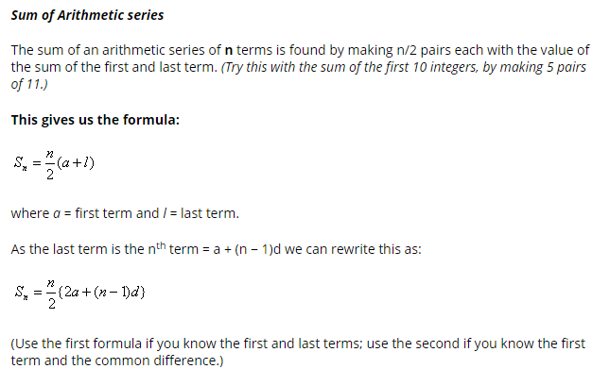

Slide 7
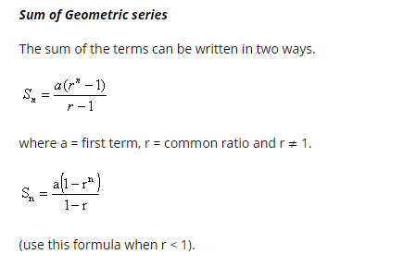

Slide 8
Find the sum of the first 20 terms of the sequence 4, 6, 8, 10, ...
460
470
540
640

Slide 9
2. Find the sum of the sequence -8, -5, -2, ..., 7
-3
-4
3
4

Slide 10
3. Find the 9th term of the sequence
20
24
16
12

Slide 11
4. A display of cans on a grocery shelf consists of 20 cans on the bottom, 18 cans in the next row, and so on in an arithmetic sequence, until the top row has 4 cans. How many cans, in total, are in the display?
110
118
108
112

Slide 12
5. How many terms of the arithmetic sequence -3, 2, 7, ... must be added together for the sum of the series to be 116?
8
9
7
6

Slide 13
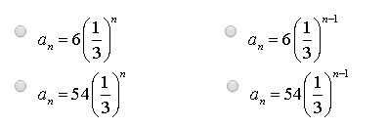
6. Which of the following choices is the formula for the nth term of the sequence 54, 18, 6, ... ?

Slide 14
7. What is the sum of all 3 digit numbers that leave a remainder of '2' when divided by 3?
897
1,64,850
1,64,749
1,49,700

Slide 15
8. The sum of the three numbers in A.P is 21 and the product of the first and third number of the sequence is 45. What are the three numbers?
5, 7, and 9
9, 7, and 5
3, 7, and 11
Both (1) and (2)

Slide 16
9. A piece of equipment cost a certain factory 600,000. If it depreciates in value, 15% the first year, 13.5 % the next year, 12% the third year, and so on, what will be its value at the end of 10 years, all percentages applying to the original cost?
2,00,000
1,05,000
4,05,000
6,50,000

Slide 17
10. How many 2-digit positive integers are divisible by 4 or 9?
32
22
30
34

Slide 18
11. What is the sum of the following series? -64, -66, -68, ..... , -100
-1458
-1558
-1568
-1664

Slide 19
12. How many 3 digit positive integers exist that when divided by 7 leave a remainder of 5?
142
143
141
129

Slide 20
13. The sum of the fourth and twelfth term of an arithmetic progression is 20. What is the sum of the first 15 terms of the arithmetic progression?
300
120
150
170

Slide 21
14. In the first 1000 natural numbers, how many integers exist such that they leave a remainder 4 when divided by 7, and a remainder 9 when divided by 11?
11
14
12
13

Slide 22
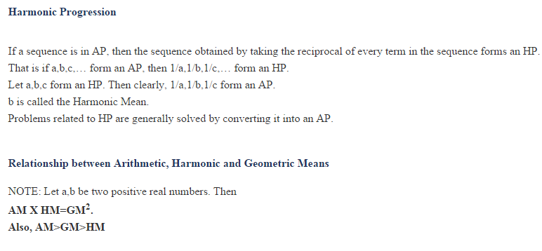

Slide 23
Three numbers a, b, c are in H.P. iff 1/a, 1/b, 1/c are in A.P. i.e. iff 1/a + 1/c = 2/b i.e. iff b= 2ac/(a + c) Thus the H.M. between a and b is H = 2ac/(a + c)

Slide 24
15. If a and d are the first term and the common difference of the A.P respectively, then the nth term of corresponding H.P is
a^{n} = a+(n-1)d
a^{n} = 1/a+(n-1)d
a^{n} = a/1+(n-1)d
a^{n} = a/a+(n-1)d

Slide 25
16. No terms of a Harmonic sequence can be
1
2
3
0

Slide 26
17. The tenth term of the arithmetic progression 1, 4, 7, 10--------is
28
31
34
37

Slide 27
18. The sum of first thirteen term of the arithmetic progression 1 ,4, 7,10 ----- is
287
317
247
376

Slide 28

The Binomial Theorem is a quick way (okay, it's a less slow way) of expanding (or multiplying out) a binomial expression that has been raised to some (generally inconveniently large) power. For instance, the expression (3x – 2)¹⁰ would be very painful to multiply out by hand. Thankfully, somebody figured out a formula for this expansion, and we can plug the binomial 3x – 2and the power 10 into that formula to get that expanded (multiplied-out) form.
The formal expression of the Binomial Theorem is as follows:

Slide 29
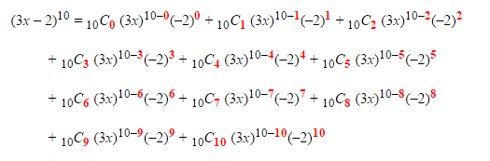

Slide 30
Find the term involving y⁵ in the expansion of (2x² + y)¹⁰.
A. 8064 x¹⁰y⁵
B. 8046 x⁵y⁵
C. 8046 x¹⁰y⁵
D. 4680 x⁵y⁵

Slide 31

Find the 5th term of expansion of
A. 260 x⁸
B. 5040 x⁸
C. 210 x⁸
D. 420 x⁸

Slide 32
In the expression of (x + 4y)¹², the numerical coefficient of the 5th term is,
A. 63,360
B. 126,720
C. 506,880
D. 253,440

