Slide 1

IILM UNIVERSITY
GREATER NOIDA, U.P.
AICTE – EDUSKILLS VIRTUAL INTERNSHIP
CANDIDATE CREDENTIALS
Siemens Data Science Master
PRAJJWAL SINGH
Roll No: 2410031316
B.Tech (CSE) | Batch 2024-28
An 8-Week Professional Internship Presentation Report
GRADE
O — Outstanding
INTERNSHIP DURATION
June 2026 – August 2026 (8 Weeks)

Slide 2


Candidate & Program Overview
Candidate Details
Internship Profile
Student Name
Program Name
PRAJJWAL SINGH
AICTE – EduSkills Virtual Internship
Roll Number
Specialization Domain
2410031316
Siemens Data Science Master
Degree
Duration
B.Tech (Computer Science & Engineering)
8 Weeks (June 2026 – August 2026)
Academic Batch
Certificate ID
2024-28
402ba7d147034138cc08
University
Offer Letter Ref
IILM University, Greater Noida, U.P.
C17Y2026M081499400
Siemens Data Science Master | PRAJJWAL SINGH
2

Slide 3




Organization Profile: EduSkills Academy
EduSkills Academy is an ISO 9001:2015 and ISO 20000-1:2018 certified organization operating under the vision of "Nation Building Through Skills".
AICTE Collaboration
Industry Alignment
Operates under the patronage of the AICTE National Internship Portal, Ministry of Education, to empower engineering talent across India.
Partners with Siemens Industry Software to bridge the gap between academic learning and real-world data science practice.
Core Focus Domains
Quality Assurance
Data Engineering, Machine Learning, Data Preparation & Automation, and Enterprise Platform Administration.
Recognized as a Great Place to Work; structured, assessment-driven curriculum with certified learning outcomes.
Siemens Data Science Master | PRAJJWAL SINGH
3

Slide 4


Problem Statement & Industry Context
The Industry Challenge
The Solution Scope
While academic curricula extensively cover the theory of statistics and machine learning, students often lack hands-on exposure to the complete, real-world data science workflow used in the industry.
This internship addresses the complete data science lifecycle: identifying suitable business problems, engineering and preparing data, building machine learning models, and deploying, monitoring, and administering them at scale.
A high-performing model built in isolation provides little business value until it is grounded in a real use case, fed by clean engineered data, and properly deployed, monitored, and administered on an enterprise platform.
Learners master an industry-grade platform — RapidMiner AI Hub — to transform raw business data into reliable, monitored, production-ready machine learning solutions.
Siemens Data Science Master | PRAJJWAL SINGH
4

Slide 5



Core Project Objectives
Business & Use-Case Framing
Data Engineering & Prep
Machine Learning Mastery
Deployment & Platform Admin
Identify business problems suitable for AI and machine learning solutions before writing any code.
Access, load, transform, and calculate data; master advanced data handling and automation.
Build foundational and then advanced machine learning models across professional and master levels.
Deploy and monitor ML models, and configure/manage RapidMiner AI Hub at enterprise level.
Siemens Data Science Master | PRAJJWAL SINGH
5

Slide 6

Technologies & Data Science Toolchain
Data Engineering
Machine Learning
Data access, loading & transformation
Data calculation & cleaning
Advanced automation workflows
Foundational ML model building
Advanced ML techniques (Master level)
Model evaluation & refinement
Deployment & Monitoring
Platform Administration
Model deployment for business use cases
Performance monitoring
Applications & use-case management
RapidMiner AI Hub configuration
Enterprise-level operations
Platform governance & management
Siemens Data Science Master | PRAJJWAL SINGH
6

Slide 7


Data Science Workflow — Layered Approach
Business Understanding Layer
Identifying business problems suitable for AI and machine learning.
Data Engineering Layer
Accessing, loading, transforming, and calculating raw data.
Modelling Layer
Building foundational, then advanced, machine learning models.
Data Preparation & Automation Layer
Advanced data handling, cleaning, and automated workflows.
Deployment & Monitoring Layer
Deploying trained models and monitoring their performance.
Platform Administration Layer
Configuring and managing RapidMiner AI Hub at enterprise level.
Siemens Data Science Master | PRAJJWAL SINGH
7

Slide 8
Curriculum Timeline (Weeks 1 to 4)
Week 1
Week 3
Applications & Use Cases — Professional
Machine Learning — Professional
Identify business problems suitable for AI and machine learning.
Build foundational machine learning skills.
Week 2
Week 4
Data Engineering — Professional
Data Preparation — Master
Access, load, transform, and calculate data.
Master advanced data handling and automation.
Siemens Data Science Master | PRAJJWAL SINGH
8

Slide 9
Curriculum Timeline (Weeks 5 to 8)
Week 5
Week 7
Machine Learning — Master
Platform Administration — Master
Learn advanced machine learning techniques.
Configure and manage RapidMiner AI Hub.
Week 6
Week 8
Applications & Use Cases — Master
Platform Administration — Master
Deploy and monitor ML models.
Enterprise-level platform operations.
Siemens Data Science Master | PRAJJWAL SINGH
9

Slide 10
Key Learnings & Demonstrated Skills
Business Use-Case Identification
Data Engineering Pipelines
Learned to evaluate business problems and determine where AI/ML delivers real value.
Built practical skills in accessing, loading, transforming, and calculating raw datasets.
Machine Learning Model Building
Advanced Data Prep & Automation
Developed foundational and advanced machine learning models across the curriculum.
Mastered advanced data handling, cleaning, and automated processing workflows.
Model Deployment & Monitoring
Enterprise Platform Administration
Deployed machine learning models and monitored their performance in use.
Configured and managed RapidMiner AI Hub at an enterprise operational level.
Siemens Data Science Master | PRAJJWAL SINGH
10

Slide 11
Certification & Official Verification
Verification Metric | Official Record / Credential Details
Internship Title | Siemens Data Science Master Virtual Internship
Issuing Organization | EduSkills Academy (ISO 9001:2015 & ISO 20000-1:2018 Certified)
Academic Patronage | AICTE National Internship Portal, Ministry of Education
Supported By | Siemens Industry Software (India) Pvt. Ltd.
Certificate ID | 402ba7d147034138cc08 (Grade: O — Outstanding)
Offer Letter Ref | C17Y2026M081499400
AICTE Student ID | STU698c0da0f3a561770786208
Siemens Data Science Master | PRAJJWAL SINGH
11

Slide 12
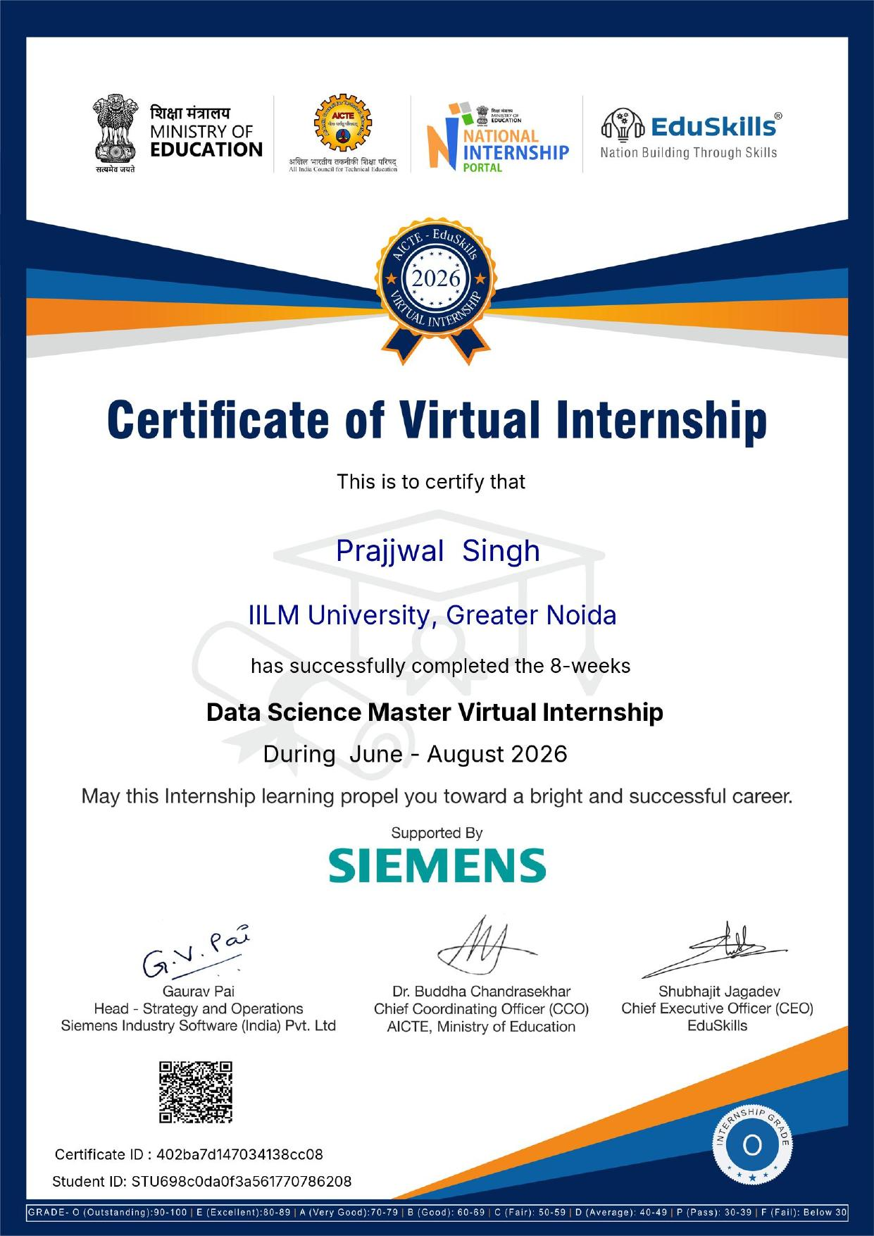
Certificate of Virtual Internship

Slide 13
Thank You!
PRAJJWAL SINGH
School of Computer Science & Engineering
Roll No: 2410031316
IILM University, Greater Noida, U.P.

