Slide 1

Identifying genetic markers in Skin cancer cells
Team 7
Tripti Singh
Emre Karakus

Slide 2
Motivation
Drug treatment researches have indicated a relationship between certain genetic markers and melanoma cancerous & non-cancerous cells. Such genetic markers can be used in improving drug therapies to treat skin cancer (melanoma).
We intend to explore such associations using data mining methods.

Slide 3
Hypotheses
There are some genetic markers that can assist in classifying Benign and Malignant cells

Slide 4
Data Source
Data is provided by Benjamin Soibam,PhD

Slide 5
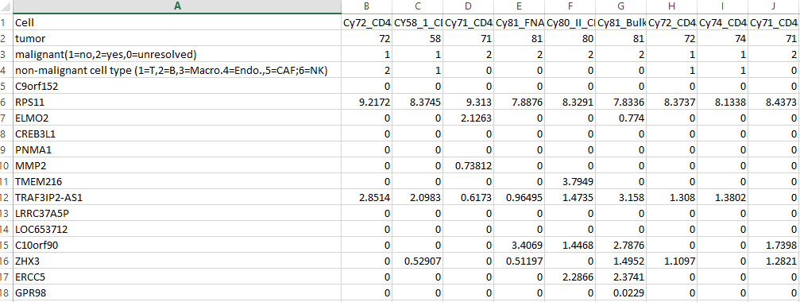
Data
 | 4645 Observation
23689 attributes

Slide 6
Data Preparation

Slide 7
removed columns with ‘0’ values :
 | 22848 attributes
4645 Observation

Slide 8
Curse of
Dimensionality

Slide 9
removed columns with near zero variance
 | 5628 attributes
4645 Observation

Slide 10
removed correlated variables
 | 5564 attributes
4645 Observation

Slide 11
Keeping only
Benign & Malignant observations
 | 5564 attributes
4613 Observation

Slide 12
Reduced Data used for all further data mining
 | 5564 attributes
4613 Observation

Slide 13
Curse of Dimensionality
Still not able to use most of the algorithms to develop classification models

Slide 14
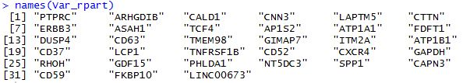
a dataframe of 4513 X 33 -> data_set1 created to develop classification models
Identified 33 genes that helped in developing models with accuracy >90%

Slide 15
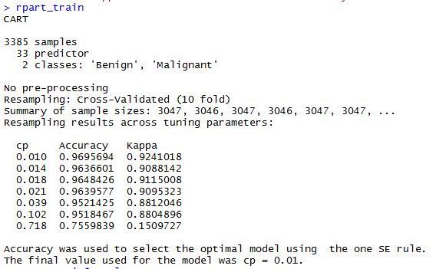
rpart
97% Accuracy with 92 % kappa

Slide 16
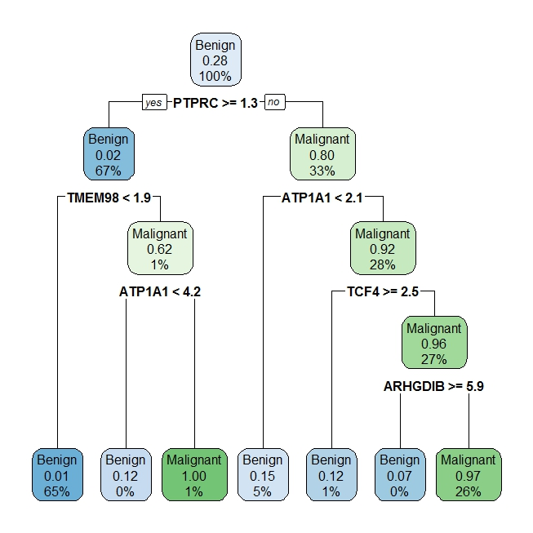
rpart
n= 3385
node), split, n, loss, yval, (yprob)
* denotes terminal node
1) root 3385 943 Benign (0.721418021 0.278581979)
2) PTPRC>=1.325 2253 41 Benign (0.981802042 0.018197958)
4) TMEM98< 1.92 2216 18 Benign (0.991877256 0.008122744) *
5) TMEM98>=1.92 37 14 Malignant (0.378378378 0.621621622)
10) ATP1A1< 4.19 16 2 Benign (0.875000000 0.125000000) *
11) ATP1A1>=4.19 21 0 Malignant (0.000000000 1.000000000) *
3) PTPRC< 1.325 1132 230 Malignant (0.203180212 0.796819788)
6) ATP1A1< 2.14 176 26 Benign (0.852272727 0.147727273) *
7) ATP1A1>=2.14 956 80 Malignant (0.083682008 0.916317992)
14) TCF4>=2.535 48 6 Benign (0.875000000 0.125000000) *
15) TCF4< 2.535 908 38 Malignant (0.041850220 0.958149780)
30) ARHGDIB>=5.895 14 1 Benign (0.928571429 0.071428571) *
31) ARHGDIB< 5.895 894 25 Malignant (0.027964206 0.972035794) *
97% Accuracy with 92 % kappa

Slide 17
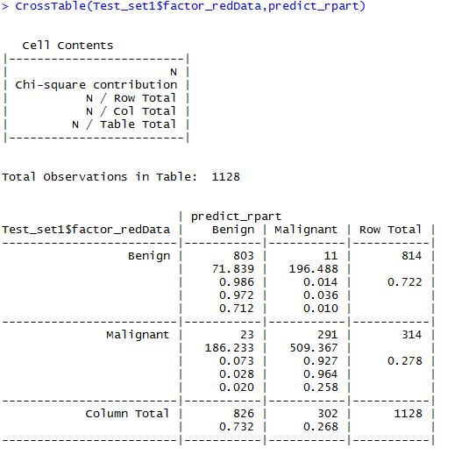
rpart
Confusion matrix on predicting Class of Blind Holdout
97% Accuracy

Slide 18
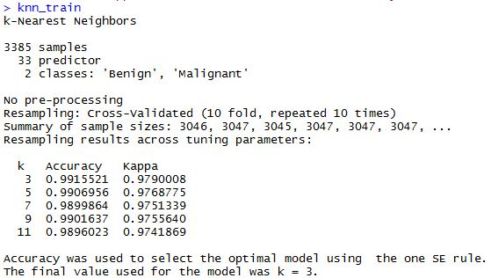
knn
99% Accuracy with 98 % kappa

Slide 19
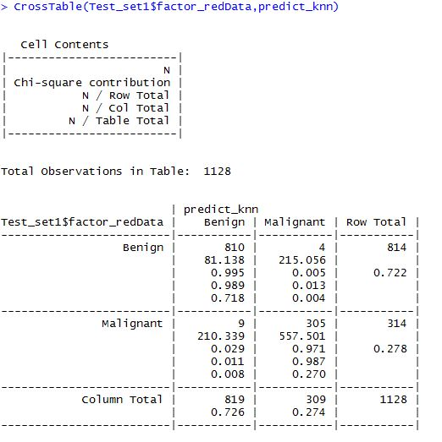
knn
Confusion matrix on predicting Class of Blind Holdout
99% Accuracy

Slide 20
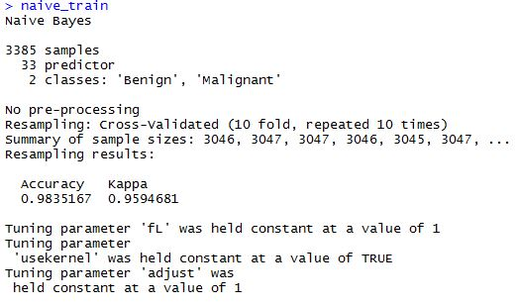
naive
98% Accuracy with 96 % kappa

Slide 21
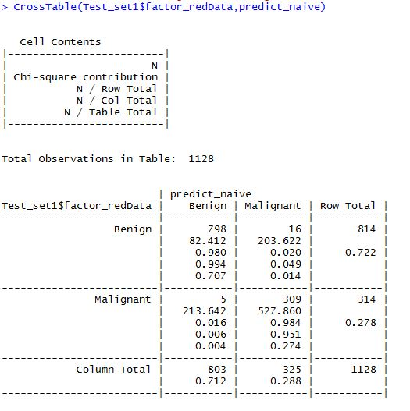
naive
Confusion matrix on predicting Class of Blind Holdout
Only 5 Malignant are misclassified as Benign*
98% Accuracy

Slide 22
CLUSTERS

Slide 23
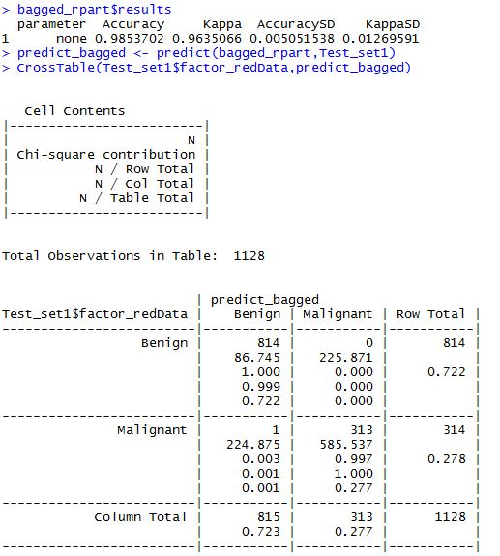
bagged
Confusion matrix on predicting Class of Blind Holdout :
Only 1 Malignant is misclassified as Benign*
‘0’ Benign is misclassified as Malignant

Slide 24
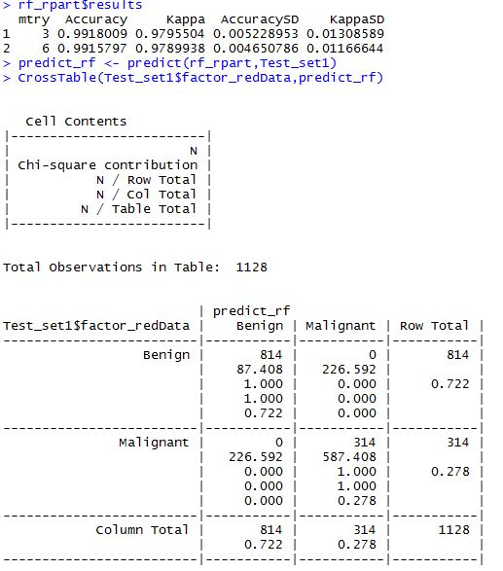
rf
Confusion matrix on predicting Class of Blind Holdout :
‘0’ Malignant is misclassified as Benign*
‘0’ Benign is misclassified as Malignant

