Slide 1

Crop detection using satellite image

Slide 2

Maulana azad national institute of technology, Bhopal india
MAJOR PROJECT REPORT ON :
CROP DETECTION USING SATELLITE IMAGE
PREPARED BY :
BHAVESH AGRAWAL 191112215
ANSH KAUSHIK 191112219
RAHUL SINGH 191112235
MOHIT TOMAR 191112277
UNDER THE GUIDANCE OF :-
DR. B N ROY

Slide 3
CONTENT
INTRODUCTION
ABOUT DATASET
LITERATURE REVIEW AND SURVEY
GAPS IDENTIFIED
DATA PREPROCESSING
RESNET MODEL
TRAINING & TESTING MODEL
RESULTS AND PARAMETERS
CONCLUSION
REFERENCES

Slide 4
Introduction

Slide 5
INTRODUCTION
Classifying and mapping vegetation are essential tasks in environmental science research and natural resource management. Conventional methods (e.g., field surveys, manual interpretation of aerial photographs), however, are not effective for acquiring vegetation data because they are labor-intensive and often economically expensive. Remote sensing technology offers a practical and economical means to acquire information on vegetation cover, especially over large areas. The spatial pattern of crops reflects the planting structure and characteristics of crops. It is an important basis for understanding the utilization of production resources, estimating the potential social and economic impact, and adjusting the agricultural structure.

Slide 6
dataset

Slide 7
dataset
We developed a Database with a method (chopped picture method) to conveniently classify ambiguous and amorphous objects
We used Rice Crop Field from Purbasthali Block in Bardhaman, West Bengal (23°28'06.1"N 88°19'42.3"E), Harinder Nagar, Patiala, Punjab, Ramanathapuram, Tamil Nadu.
We used an 8K UHD Image which is a High Resolution (8192X5134) Image. This was a satellite Image from Google Earth images.
We chopped the picture into 400 images. This Database was split into 300 for training and 100 for testing. Training and Testing Data was labeled as Soil and Crop.

Slide 8
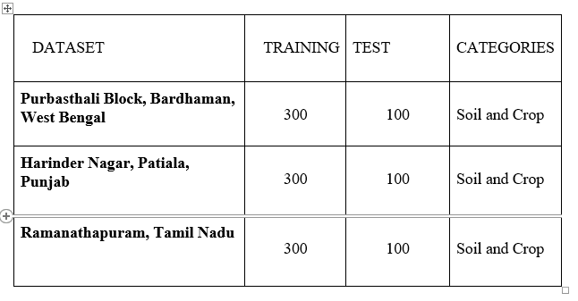
dataset

Slide 9
Literature review and survey

Slide 10
Literature review and survey
Recently, Guirado et al. used CNNs to detect a wild shrub (Ziziphus lotus) that has a wide range of shapes and sizes, from Google Earth images.
CNN models that have been used for remote crop detection are AlexNet, VGG, Inception, DenseNet, ResNet. We are using ResNet as it performs good High accuracy, Efficient feature learning, Good generalization, Robustness.
ResNet can be used to classify satellite images of crops into different categories. Once the model is trained, we can use it to classify new satellite images of crops and make predictions about the crops
Technique used to improve the performance of a pre-trained machine learning model on a new task (Fine-tuning). It involves taking a model that has already been trained on a large dataset and adapting it to a new dataset or task.

Slide 11
Gaps identified

Slide 12
Gaps identified
In this project we have used ResNet152 network to train and test the images which is by far the best performing ResNet model having 152 layers interconnected to each other, because ResNet solves the problem of vanishing gradient that makes it even more useful to use in this project to detect the vegetation.
we have used 8K UHD Image which is a High Resolution (8192X5134) Image to train the model and there is not much research that is at present going on these types of images. Due to high resolution of images, makes it easier for the model to detect the various elements in the image and increase the overall accuracy of the model
Also, our project is mainly focused on detection of Indian crop and crops that are usually found in Indian subcontinent and there isn’t much study that is conducted particularly around this.

Slide 13
Data preprocessing

Slide 14
DATA PREPROCESSING
Cropping: Depending on the size of satellite image and the area of interest, we need to crop the image to remove any unnecessary information.
Resizing: We need to resize the image to a specific size in order to use it as input to deep learning model.
Labeling: This can be a time-consuming process, but it is an important step in building model.
Splitting: Split data into training and test sets in order to evaluate the performance of model.
Erosion and dilation are morphological image processing techniques that are used to modify the shape and size of objects in an image
Gray-level thresholding is a type of thresholding that is used to separate objects in a grayscale image based on their intensity values

Slide 15
Resnet model

Slide 16
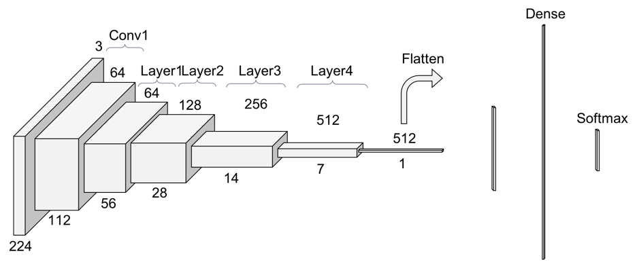
RESNET model
The term ResNet expands to Residual network is a classic neural network used as a backbone for many computer vision tasks. In this project we have used ResNet152 which have 152 layers which are stacked on each other to make a interconnected network of layers

Slide 17
Problem with resnet
We can’t directly add more layer to the deep neural network because increasing network depth does not work by simply stacking layers together.
Vanishing Gradient Problem — as the gradient is back-propagated to earlier layers, repeated multiplication may make the gradient extremely small.
As a result, as the network goes deeper, its performance gets saturated or even starts degrading rapidly. ResNet solve this issue with the help of skipping the connection.

Slide 18
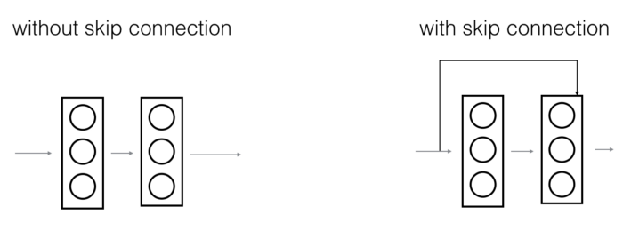
Skip connection

Slide 19
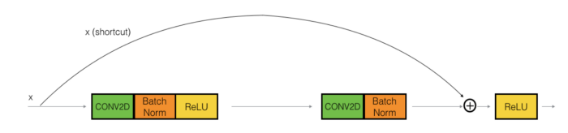
Identity block
The identity block is the standard block used in ResNets and corresponds to the case where the input activation has the same dimension as the output activation.

Slide 20
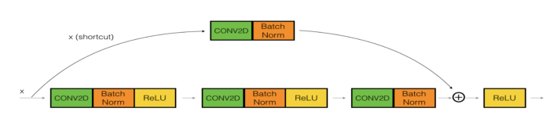
CONVOLTION BLOCK
We can use this type of block when the input and output dimensions don’t match up. The difference with the identity block is that there is a CONV2D layer in the shortcut path.

Slide 21
Architecture
ResNet152 contains 152 layers stacked on top of each other with some layers connected via skip connections. The original input image shape is 224*224*3 and the final output feature extracted shape is 1*1*2048.
It contains fifty 3*3 convolution layers, hundred 1*1 convolution layer, one 7*7 layer and one 3*3 max pool layer.
Batch Normalization is used after each conv. Activation function after each convolution layer is Relu.
At the final layer of ResNet we get output of shape (1*1*2048) which is then passed to sequential model.
A Sequential model is appropriate for a plain stack of layers where each layer has exactly one input tensor and one output tensor. In sequential model we added two dense with 256 and 2 neurons respectively, Relu and SoftMax respectively.
These 2048 features are passed to sequential model and the final output will be 2 classes that will be our required classes i.e. corps present or not.

Slide 22
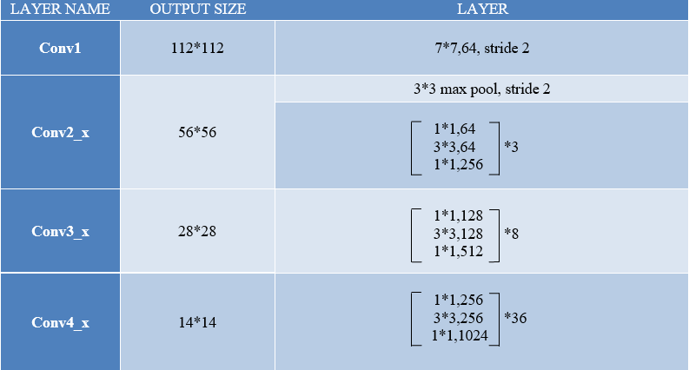
RESNET model

Slide 23
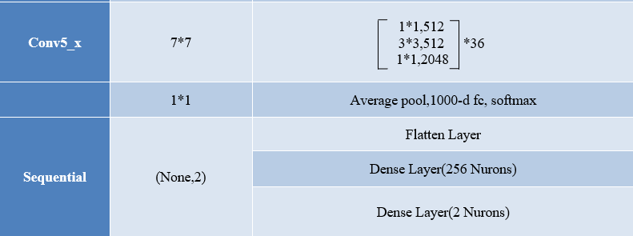
RESNET model

Slide 24
Training and testing model

Slide 25
TRAINING AND TESTING MODEL
For training and testing purposes of our model, we should have our data broken down into two distinct dataset splits.
The Training Set : It is the set of data that is used to train and make the model learn the hidden features/patterns in the data.
The Test Set : The test set is a separate set of data used to test the model after completing the training.
The training as well as learning of a model can be done using the Adam optimizer or any other kind of optimizer. The given optimizer uses a categorical cross entropy function and does the adaptation of weights. The model is trained with a fit function and evaluated using test data.

Slide 26
Results and parameter

Slide 27
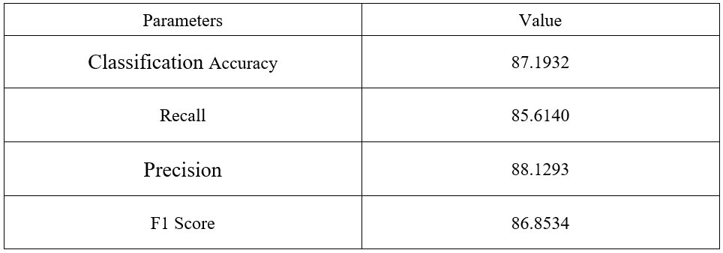
Results and parameter

Slide 28
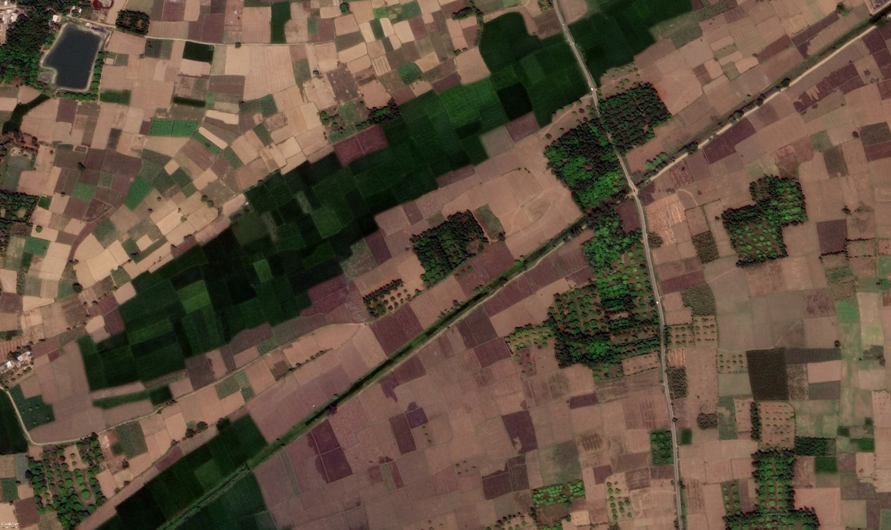
DENSENET PREDICTION

Slide 29
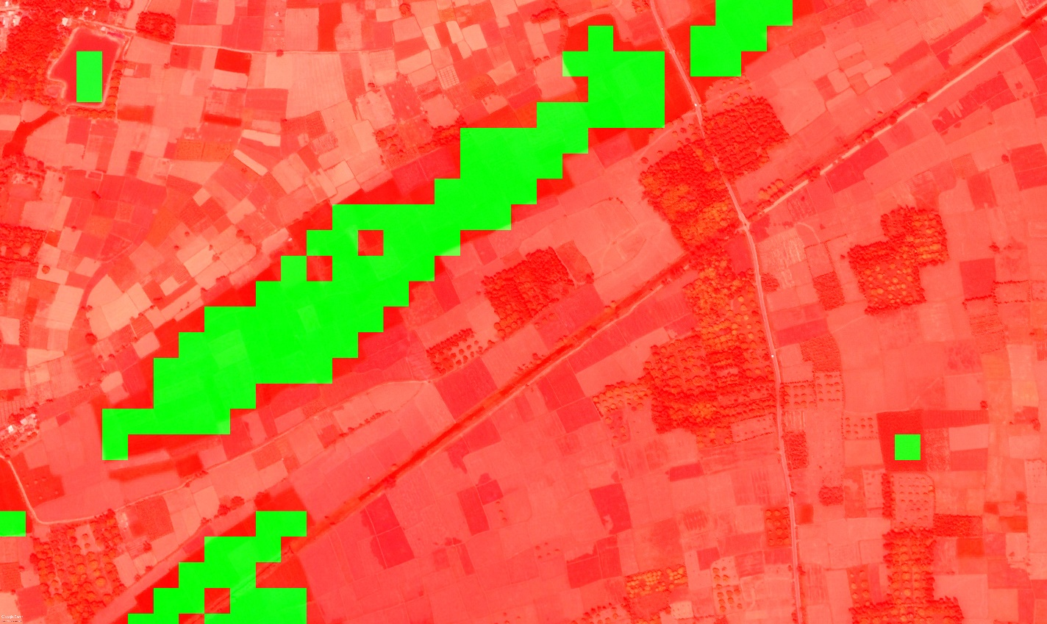
200*200 chopped image

Slide 30
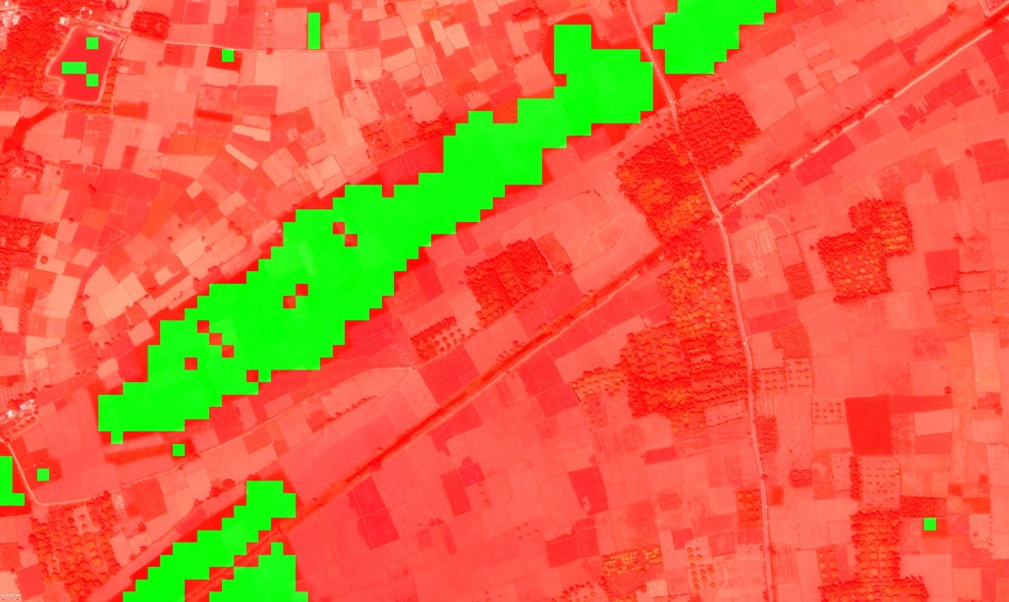
100*100 chopped Image

Slide 31
Conclusion and future work

Slide 32
CONCLUSION
This project work addresses the crop detection with motivation of its applicability in real-life scenarios. In this work we present a fully automated crop detection approach that can trivially scale to many different types of crops. We achieve crop detection performance comparable to the state-of-the-art models, while using low end technology and using Google colab as an online interpreter with an efficiency of more than 86%. Our results demonstrated that ResNet and the chopped picture method are potentially powerful tools for high-accuracy automated detection and mapping of vegetation. Recently government allowed satellite and UAV based detection system to detect the area.

Slide 33
Future works
Crop monitoring: Satellite imagery can be used to track the growth and development of crops over time, allowing farmers to monitor their crops and identify any problems early on.
Crop yield prediction: Satellite imagery can be used to predict crop yields by analyzing the health and vigor of the crops.
Crop stress and disease detection: Satellite imagery can be used to identify areas of crop stress or disease, allowing farmers to take appropriate action to address these issues.
Irrigation management: Satellite imagery can be used to help farmers optimize irrigation practices by identifying areas of the field that may be lacking sufficient water

Slide 34
Efficient-Net Architecture
Fancy Techniques but worked extremely well and outperformed
ResNet , ResNeXt , DenseNet , InceptionNet , SENet , AmoebaNet and is MORE EFFICIENT.
Efficient Nets significantly outperform other ConvNets. In fact, EfficientNet-B7 achieved new state of art with 84.4% top-1 accuracy.
The great thing about Efficient Nets is that not only do they have better accuracies compared to their counterparts, they are also lightweight and thus, faster to run.

Slide 35
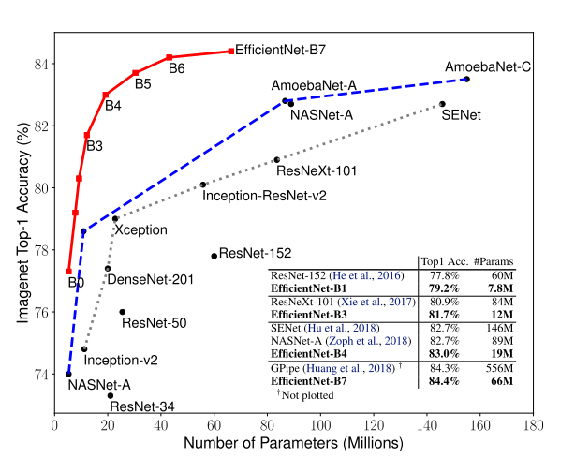
comparison

Slide 36
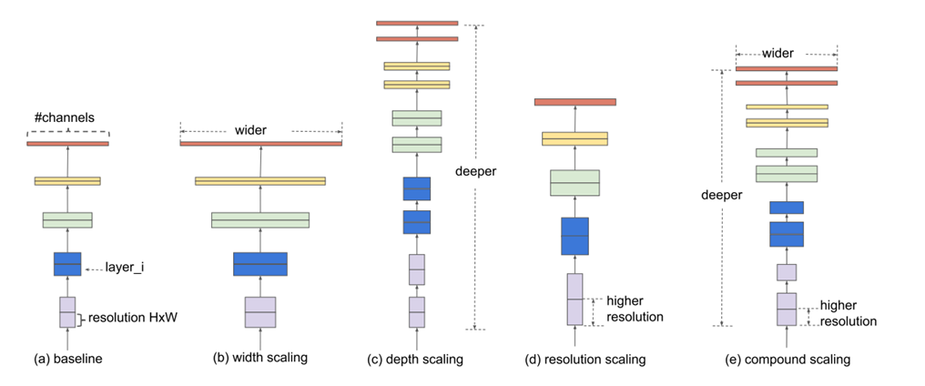
How ?
Efficient Nets on the other hand perform Compound Scaling - that is, scale all three dimensions while maintaining a balance between all dimensions of the network.

Slide 37
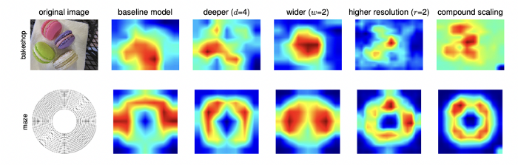
Results

Slide 38
Architecture
The researchers first designed a baseline network by performing the neural architecture search, a technique for automating the design of neural networks. It optimizes both the accuracy and efficiency as measured on the floating-point operations per second (FLOPS) basis. This developed architecture uses the mobile inverted bottleneck convolution (MBConv). The researchers then scaled up this baseline network to obtain a family of deep learning models, called Efficient Nets. Its architecture is given in the below diagram.
MBConv is an inverted residual bottleneck block with depth-wise separable convolution.
It separates the simple 3x3 convolution into the1x1 compression, 3x3 on the compressed, 1x1 expansion process.

Slide 39
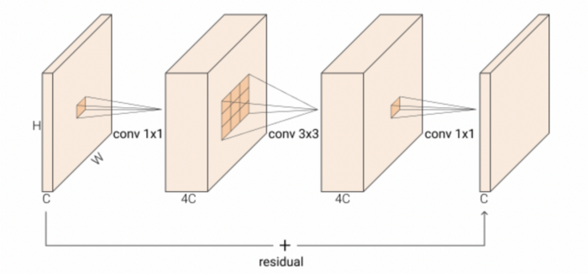
MBConV

Slide 40
Practice Model
Dataset Used : The CIFAR-10 dataset is a publically available image data set provided by the Canadian Institute for Advanced Research (CIFAR).
It consists of 60000 32×32 colour images in 10 classes, with 6000 images per class. The 10 different classes represent airplanes, cars, birds, cats, deer, dogs, frogs, horses, ships, and trucks.
Dataset loading
One –Hot encoding
Dataagumentation (rotation, flips, zoom etc)
Making Baseline model of B0 , then adding dense layers to get output
Output : Classifies different objects accurately.

Slide 41
REFERENCES
[1] Shuntaro Watanabe , Kazuaki Sumi and Takeshi Ise. Identifying the vegetation type in Google Earth images using a convolutional neural network: a case study for Japanese bamboo forests, pages 7291–7299, 2015.
[2] Drucker H, Burges CJ, Kaufman L, Smola A, Vapnik V. Support vector regression machines. Neural information processing systems 9. eds Mozer MC, Jordan JI & Petsche T. pp. 155–161, MIT Press 1997.
[3] Ali Hamidisepehr, Seyed Vahid Mirnezami Jason K. Ward. COMPARISON OF OBJECT DETECTION METHODS FOR CORN DAMAGE ASSESSMENT USING DEEP LEARNING.19(18), 3859.
[4] Kaiming He, Xiangyu Zhang, Shaoqing Ren, Jian Sun. Deep Residual Learning for Image Recognition, 2015. Microsoft Research
[5] S. Ren, K. He, R. Girshick, X. Zhang, and J. Sun. Object detection networks on convolutional feature maps. arXiv:1504.06066, 2015.
[6] Maeda-Gutierrez, V., Galvan-Tejada, C. E., Zanella-Calzada, L. A., Celaya-Padilla, J. M., Galván-Tejada, J. I., Gamboa-Rosales, H., ... & Olvera-Olvera, C. A. (2020). Comparison of convolutional neural network architectures for classification of tomato plant diseases. Applied Sciences, 10(4), 1245.

Slide 42
REFERENCES
[7] Nogueira K, Penatti OAB, Dos Santos JA. Towards better exploiting convolutional neural networks for remote sensing scene classifcation. Pattern Recogn. 2017;61:539–56.
[8]Gao Huang and Zhuang Liu and Laurens van der Maaten and Kilian Q. Weinberger, Densely Connected Convolutional Networks, arXiv 1608.06993 (2016)
[9] P. Sermanet, D. Eigen, X. Zhang, M. Mathieu, R. Fergus, and Y. LeCun. Overfeat: Integrated recognition, localization and detection using convolutional networks. In ICLR, 2014.
[10] K. Simonyan and A. Zisserman. Very deep convolutional networks for large-scale image recognition. In ICLR, 2015
[11] Tripicchio, P., Satler, M., Dabisias, G., Ruffaldi, E., & Avizzano, C. A. (2015). Towards smart farming and sustainable agriculture with drones. Paper presented at the 2015 International Conference on Intelligent Environments.
[12] [13] Maeda-Gutierrez, V., Galvan-Tejada, C. E., Zanella-Calzada, L. A., Celaya-Padilla, J. M., Galván-Tejada, J. I., Gamboa-Rosales, H., ... & Olvera-Olvera, C. A. (2020). Comparison of convolutional neural network architectures for classification of tomato plant diseases. Applied Sciences, 10(4), 1245.

Slide 43
Thank You

