Slide 1
Snake Oil Benchmark Comparison:
Trust Me Bro
Joshua-Connor Knapp R.S.M
Registered single mom

Slide 2
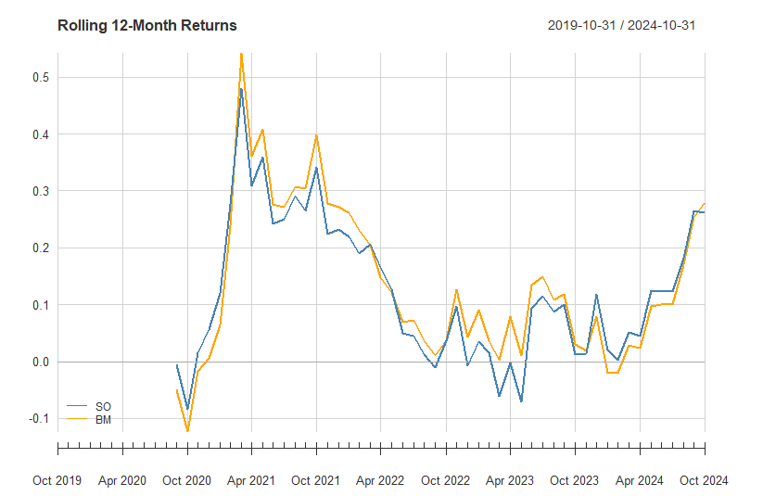
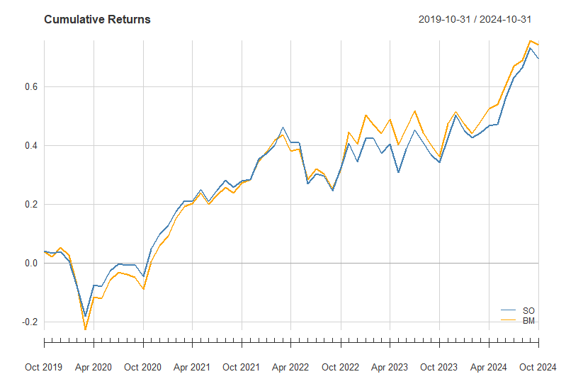
Relative Performance
Returns relative to the benchmark (Capped SWIX):
Compared to the benchmark (BM), the snake oil fund (SO) bears consistent similarity across the sample period.
However, it mostly falls short of the benchmark on a rolling basis and exhibits slightly worse cumulative returns. While this may not seem convincing, there is more to this than meets the eye.

Slide 3
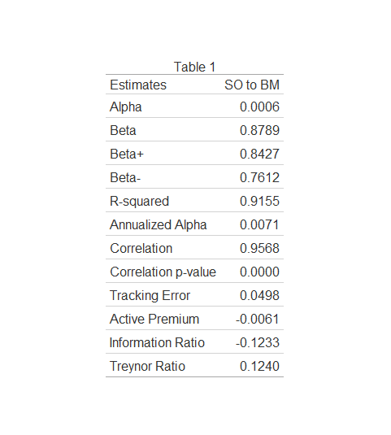
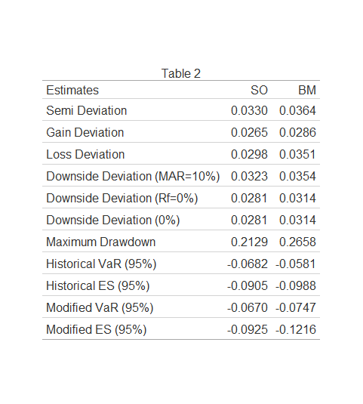
Risk measures relative to the benchmark:
Relative Risk
The moderate tracking error, and negative information ratio and active premium in Table 1 echoes the sentiments of the previous slide.
However, the Alpha, albeit very small, indicates that the snake oil fund outperformed the benchmark after taking risk into account. The Beta further suggests a lower volatility compared to the benchmark.
Table 2 shows that the snake oil fund exhibits smaller maximum drawdowns, as well as smaller modified value at risk and expected shortfall estimates. Just ignore the Historical estimates please.

Slide 4
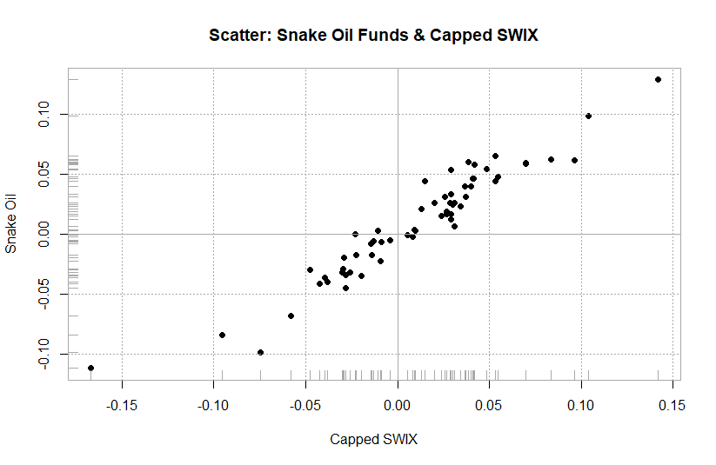
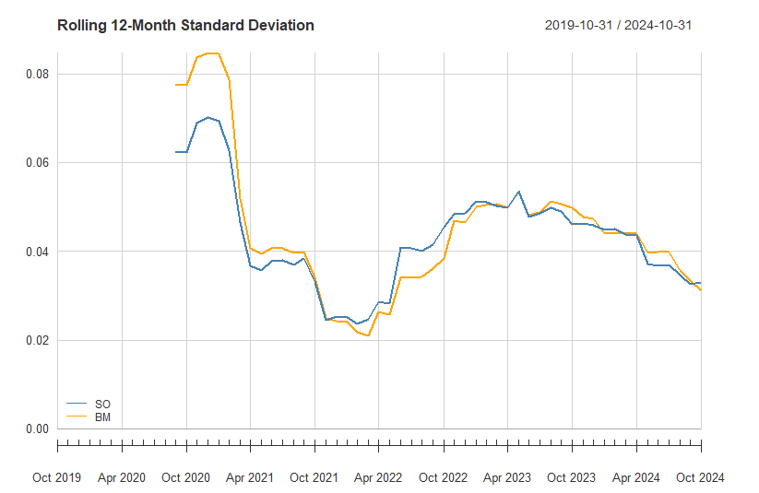
Relative Risk
A more representative look:
Comparing the 12-month rolling volatility, which helps to identify short-term trends and assess how performance evolves during specific periods, we see that the snake oil fund exhibits much lower volatility in the midst of the pandemic. This suggests an aversion to high levels of risk. The scatter plot of returns echoes this as well. The fund experiences smaller relative negative returns than the benchmark during certain periods (left tail). Thus, it would seem the fund performs better in positive market conditions.

Slide 5
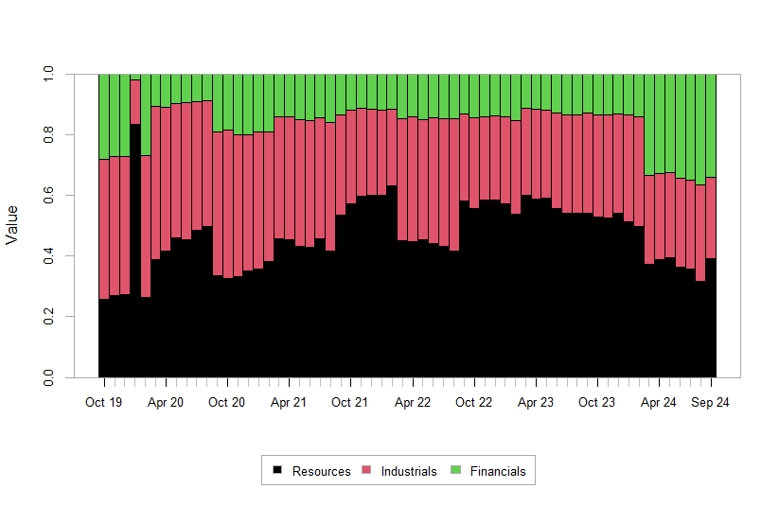
Snake oil fund sectoral composition:00 basis point fee:
Composition
In January of 2020, with the impact of looming domestic and global shutdowns, resources made up much of the portfolio.
While all three sectors were hit particularly hard, gold, one of South Africa's major exports, performed relatively well with investors flocking to safe haven assets.
After the rebalance the following month, resources have played a much larger role, constituting most of the fund up until recently. This is likely due to increased global economic uncertainty.

Slide 6
Conclusion
The fund performs worse than the benchmark during periods of uncertainty where it avoids risk more intently. The true potential of the fund can only be determined over a longer period characterised by both favourable and unfavourable economic conditions where the effects of crises are smoothed. Looking at it solely in a post crisis period is not representative of its long term potential. So for now, trust me bro

