Slide 1
Beating the Benchmark:
AI Based Fund Performance
Joshua-Connor Knapp R.S.M
Registered single mom

Slide 2
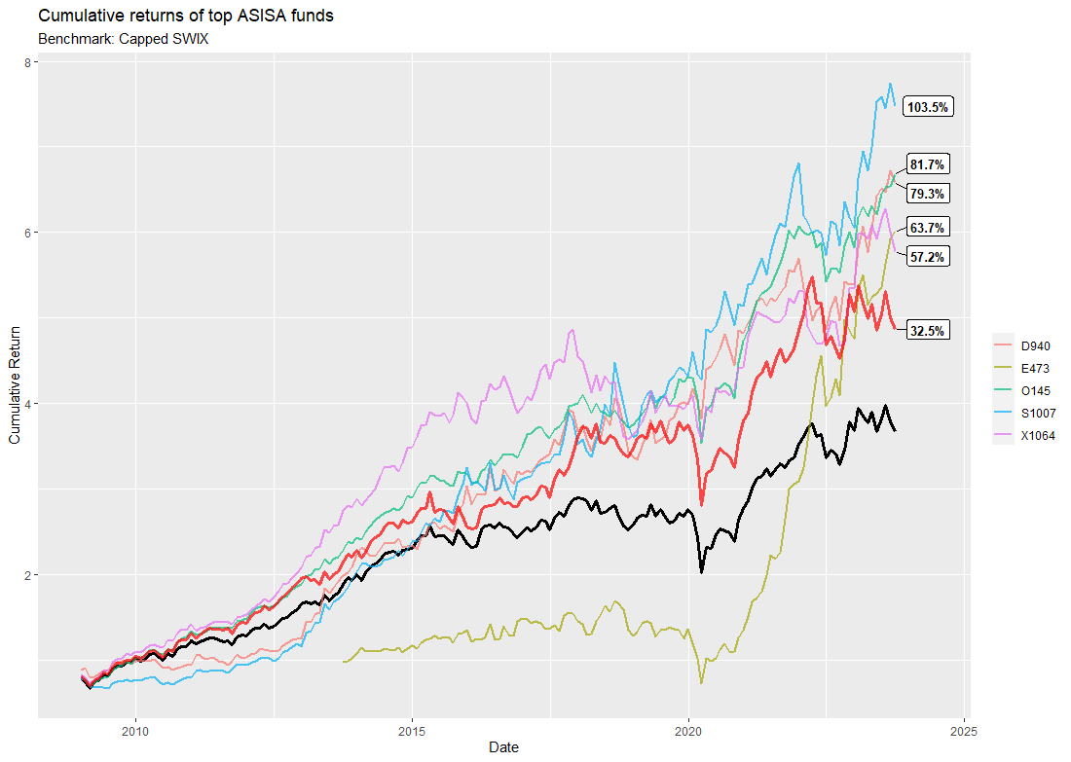
Compared to the best of the best
The AI Implementer compared to the top 5 performing ASISA funds:
Compared to the capped SWIX as a benchmark (black line), the AI Implementer (red line) outperforms it consistently since 2008.
The top 5 funds do outperform the AI fund by quite a large margin though. However, these differences are lessened when potential fees are taken into account…

Slide 3
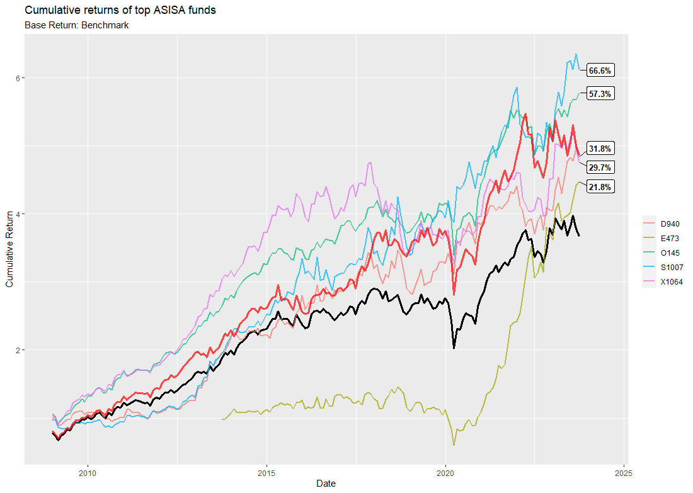
The AI Implementer compared to the top 5 performing ASISA funds after a 300 basis point fee:
Compared to the best of the best
When taking fees into account, and keeping the same difference from the previous slide, the AI Implementer (red line) performs right up there with the very best.

Slide 4
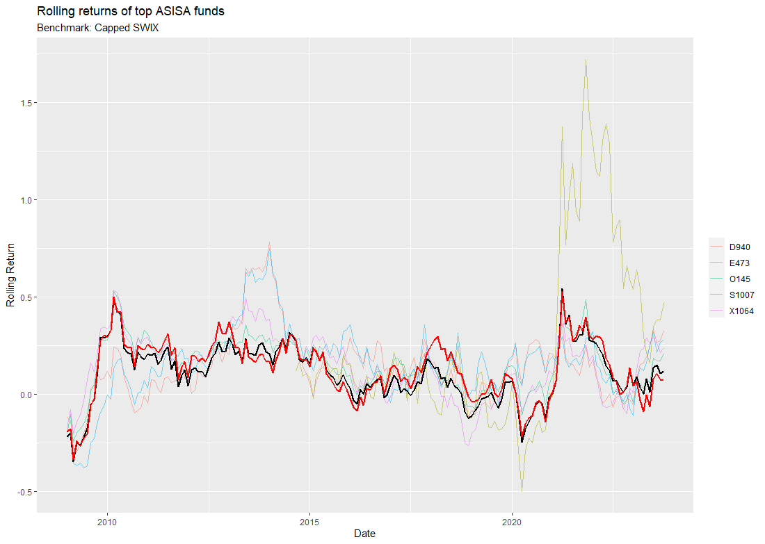
Compared to the best of the best
A more representative look:
Using 12-month rolling returns, which helps to identify short-term trends and assess how performance evolves during specific periods, we see that these top funds have much more volatile movements around the benchmark while the AI Implementer co-moves with it much more closely.
However, given that only 1.3% of all the funds beat the benchmark at the end of the sample period, this is the best case scenario AGAINST the AI Implementer.
If we were to randomly select 5 funds from the ASISA, the story would look very different.

Slide 5
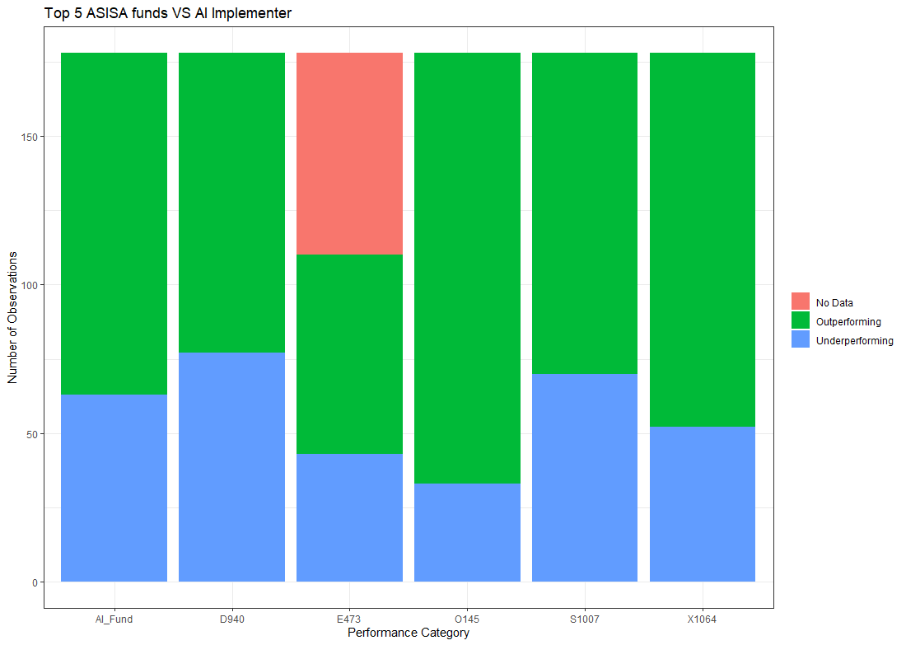
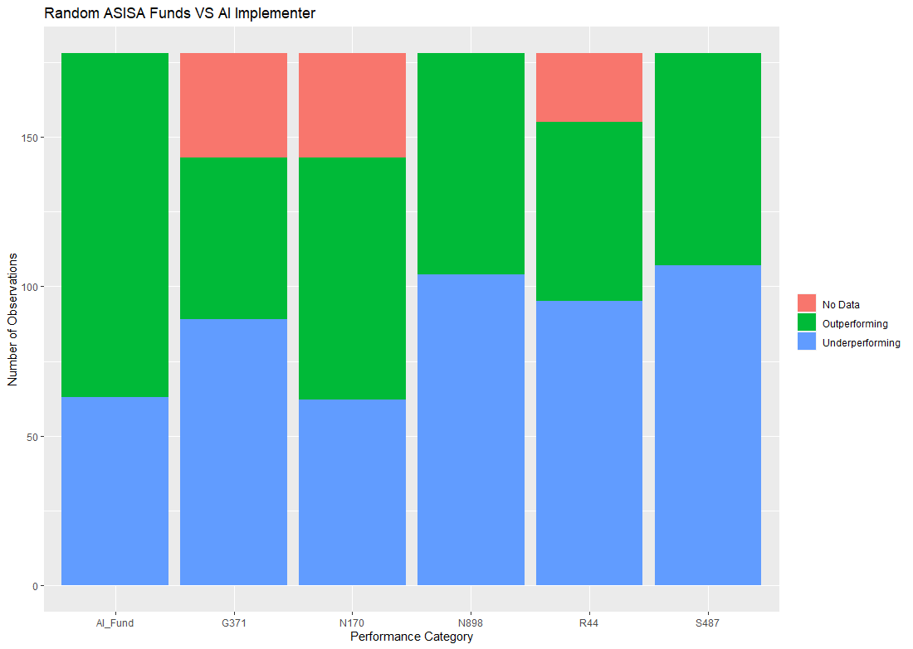
The AI_Implementer compared to 5 randomly selected ASISA funds:00 basis point fee:
The reality
When compared to 5 randomly selected ASISA funds, 4 out of the 5 underperform the benchmark more often than beat it. The AI Implementer is thus a top dog competitor.

