Slide 1
ENGI 301
Interactive LED Table Proposal
September 25th 2022
Singrhu Poltanawasit

Slide 2
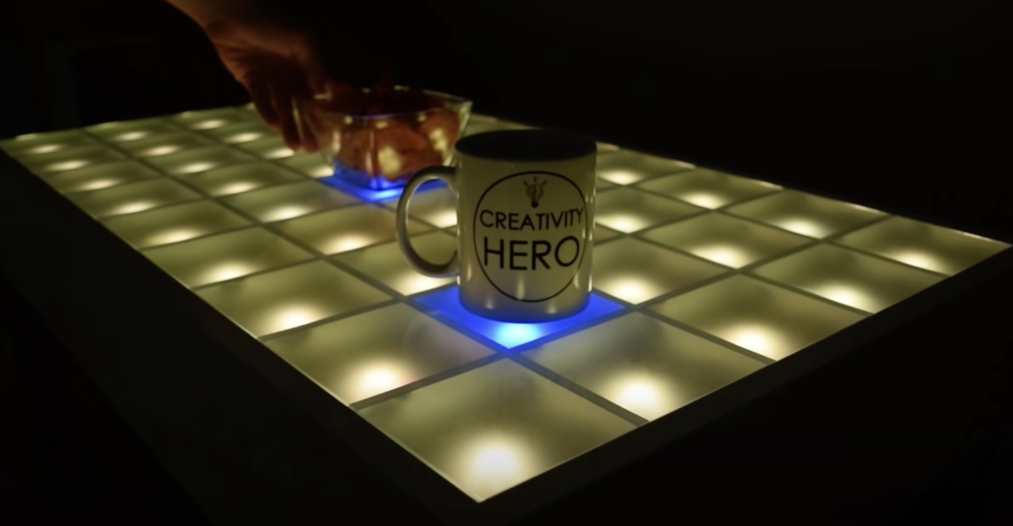
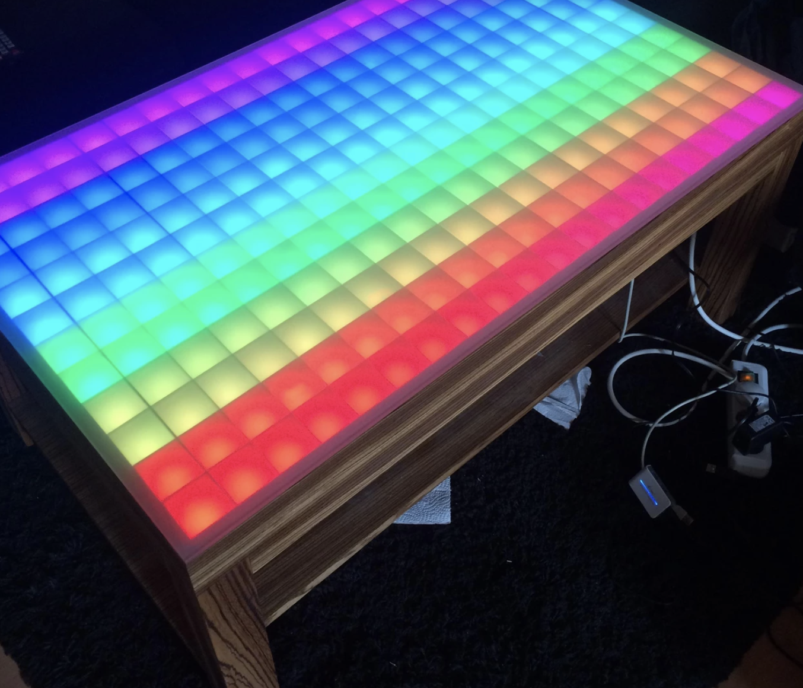
Background Information
An LED coffee table that lights up in areas experiencing downward force
Links to existing projects:
https://imgur.com/gallery/mfAce
https://www.hackster.io/arbalet/touch-led-table-retrogaming-and-ambiant-light-3d3204
Possible Improvement: LED color change according to varying magnitudes of force
I am inspired by the integration of art and technology!

Slide 3
System Block Diagram
Touchscreen
Create a System Block Diagram
Label interfaces / pins
Components (part numbers if possible)
MPR121
ITO Plastic
ITO Plastic
SCL
ITO Plastic
ITO Plastic
SDA
ITO Plastic
Pocket Beagle
SPI0
ITO Plastic
I2C2 SCL
LED Strip
LED Strip
I2C2 SDA
LED Strip
LED Strip
Digital Pin (GPIO 49)
LED Strip

Slide 4
Power Block Diagram
MPR121
Create a Power Block Diagram
Label voltages / currents of components
Vin
Touchscreen
Pocket Beagle
3.3V
GND
Vin
GND
GND
LED Strip
5V
LED Strip
LED Strip
LED Strip
5V, >5A Power Supply
Wall
LED Strip

Slide 5
Components / Budget
Component | Need to Buy | Cost
ITO Plastic 10cm x 20cm | 2 | $19.90
MPR121 capacitive sensor | 1 | $7.95
WS2812B RGB 5050SMD Individual Addressable 16.4FT 30Pixels/m 150Pixels | 1 | $22.99
5V >5A AC/DC adapter | 1 | $29.95
Soldering Board
Electrical Wires
Wood
Translucent Acrylic/Glass
Adafruit Velostat 1361 | 1 | $4.95
2.8" TFT LCD with Touchscreen Breakout Board w/MicroSD Socket - ILI9341 | 1 | $29.95
Need all components to be purchased by instructor listed; additional components may be purchased by student

