Slide 1

YOLO-Based Feature Extraction: Revolutionizing PCB Design Analysis
Transforming electronic design verification and quality control by leveraging AI for intricate PCB analysis, addressing complexities in modern high-density PCBs.
TEAM MEMBERS:
RAJAT -102305065
HIMESH JINDAL-102483029
Sanskriti Srivastava - 102206272
Shubham -102206120
RAHUL- 102203140
PROJECT MENTORS:
DR SHARAD SAXENA
DR JYOTI MUGGU

Slide 2
Current PCB Analysis Challenges
Manual Inspection
Slow and error-prone, leading to up to a 30% defect miss rate.
Data Extraction
Lack of structured, extractable data from visual PCB designs.
AOI Limitations
Automated Optical Inspection suffers from high false positives and negatives.
Reverse Engineering
Time-consuming process for existing boards, hindering rapid iteration.

Slide 3
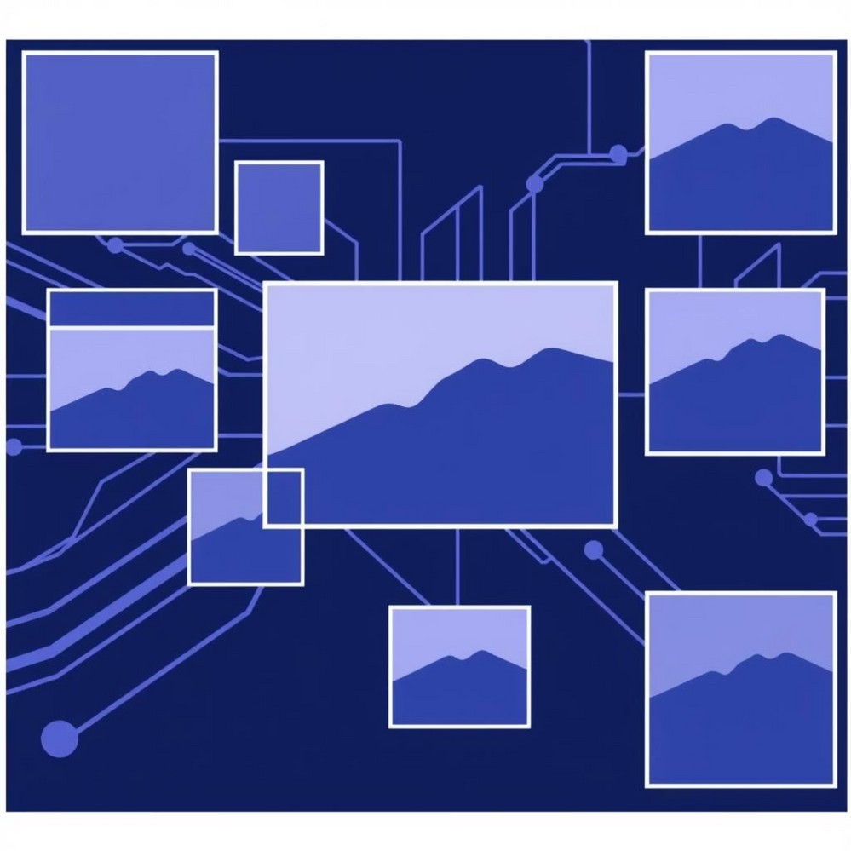
Introducing YOLO (You Only Look Once)
YOLO is a state-of-the-art real-time object detection algorithm renowned for its speed and accuracy. It processes an entire image once, making rapid predictions across various objects.
Processes entire image once for rapid predictions.
Achieves high Mean Average Precision (mAP) for diverse objects. YOLOv8 boasts 30+ FPS on high-resolution images.

Slide 4




Why YOLO for PCB Feature Extraction?
Rapid Identification
Quickly identifies diverse PCB elements like components and traces.
Complex Handling
Effectively processes complex, dense visual information on PCBs.
Performance
Outperforms traditional computer vision on varied component sizes.
Time Savings
Potential to reduce inspection time by 80% compared to manual methods.

Slide 5
The Feature Extraction Workflow
Input Data
High-resolution PCB images (Gerber renders, scans, photos).
Data Annotation
Manually label components, traces, and vias in images for training.
Model Training
Fine-tune pre-trained YOLO model using the meticulously labeled dataset.
Output
Generates bounding box coordinates, class labels, and confidence scores.

Slide 6

Challenges and Future Outlook
Small Object Detection: Remains challenging in ultra-high-density PCBs.
Data Requirements: Need for large, diverse, and expertly annotated datasets.
Multi-modal Integration: Combining with X-ray or thermal imaging for comprehensive analysis.

Slide 7
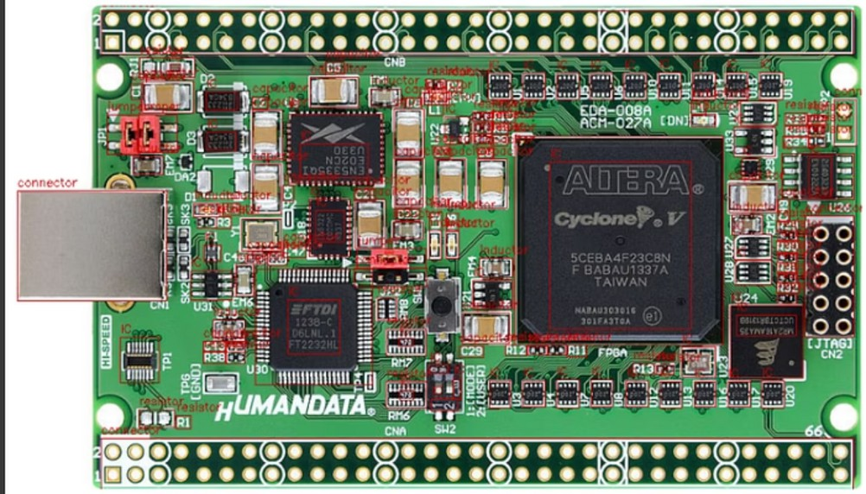
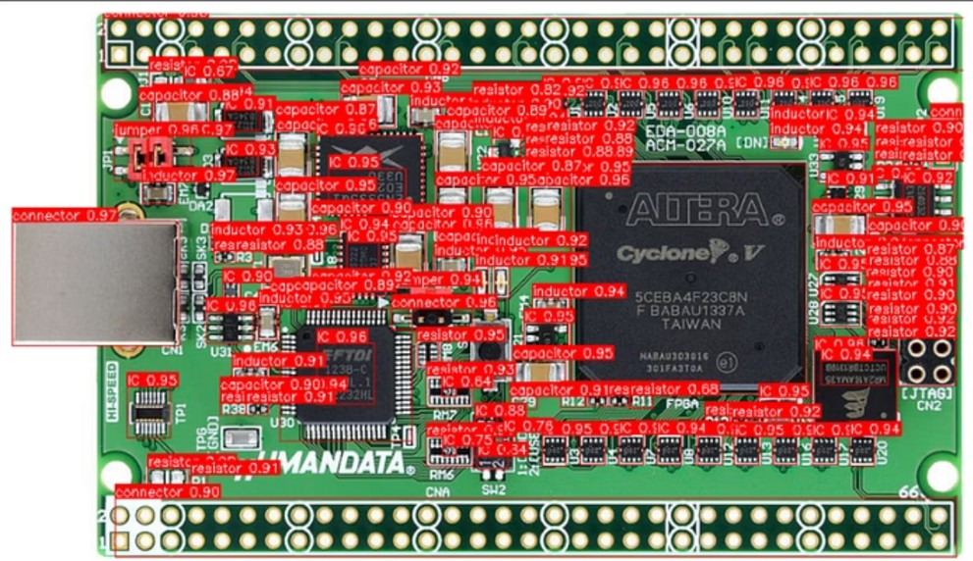
Output: Component Detection
Actual components: 40 ICs, 35 capacitors, 9 connectors, 25 inductors, 9 jumpers, 30 resistors.
Identified components: 50 ICs, 27 capacitors, 6 connectors, 17 inductors, 3 jumpers, 38 resistors.

Slide 8
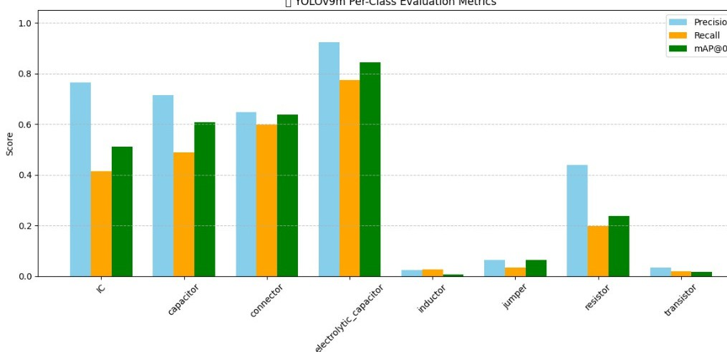
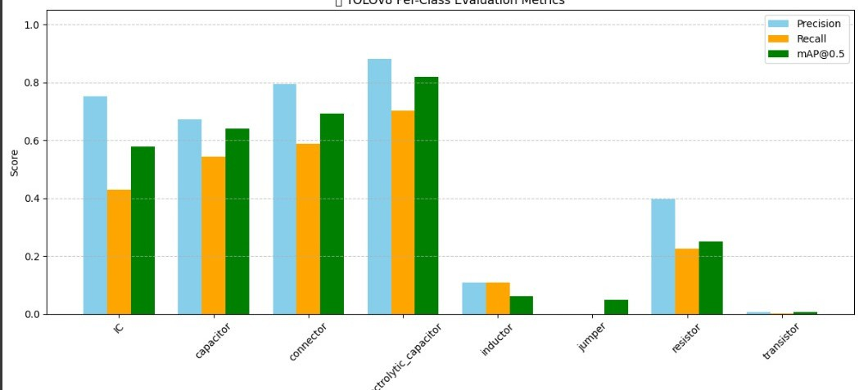
EVALUATION MATRICS :
YOLOv9m
YOLOv8m

Slide 9
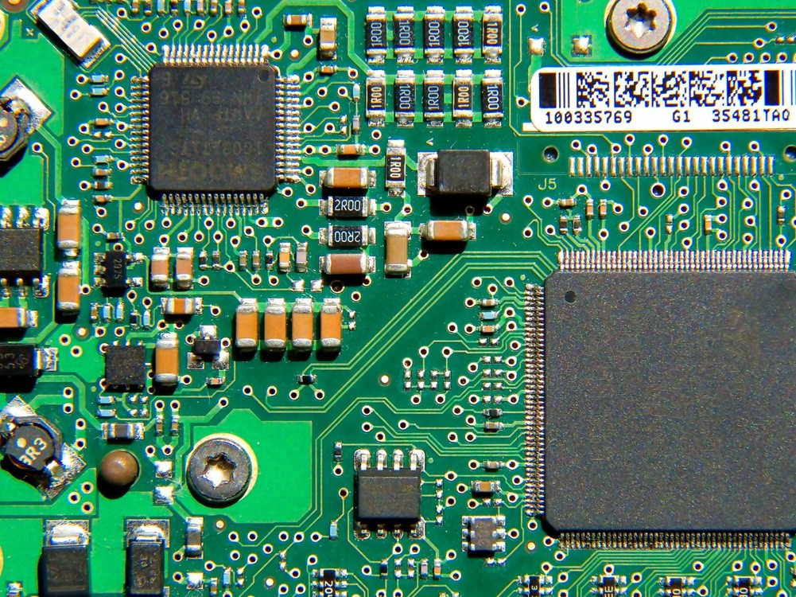
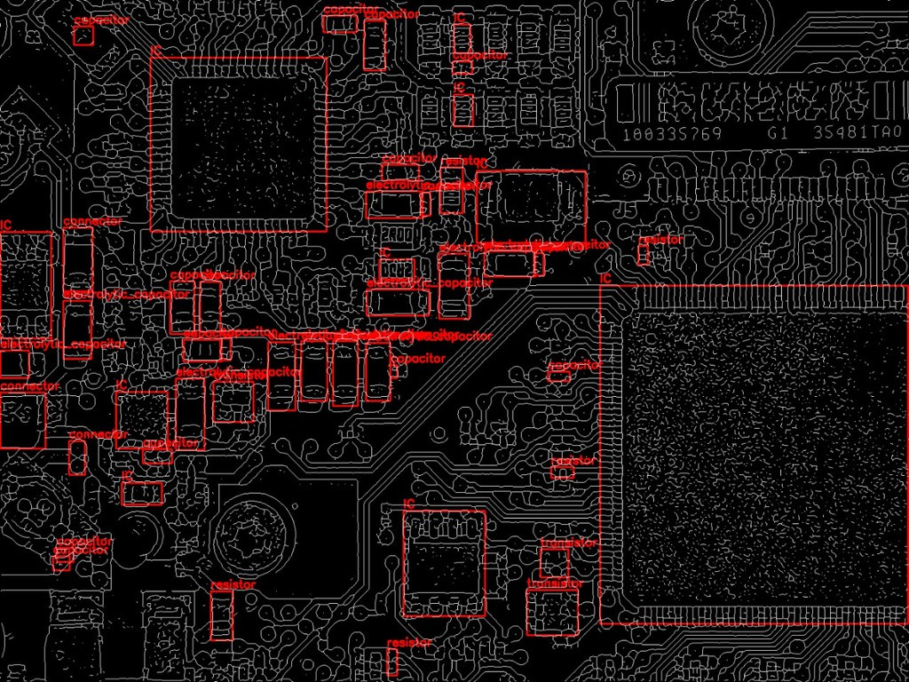
OUTPUT(SKELTON IMAGE):
ORIGINAL IMAGE:
SKELETON IMAGE:

Slide 10
Conclusion: The Future of Smart PCB Analysis
Enhanced Processes
YOLO for feature extraction significantly enhances PCB design and reconfiguration.
Future Research
Continuous improvement in accuracy and exploration of advanced deep learning.
Industry Crucial
Essential for meeting demands as electronic devices grow in complexity.

