Slide 1
RER/Italy/CEE Domain
ITelDomain
FHIR
HL7v23
«Leggere» FHIR alla luce
dei processi / protocolli che ipotizza
FHIR
ITelDomain
HL7v23

Slide 2
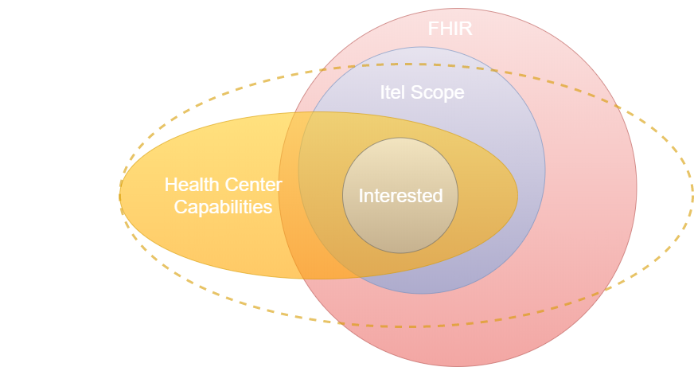

Slide 3
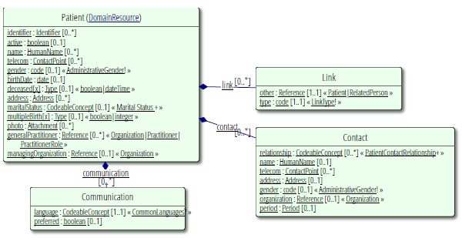
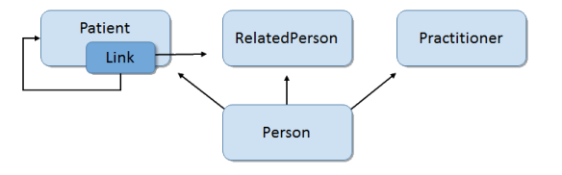

Slide 4
ADMINISTRATION

Slide 5
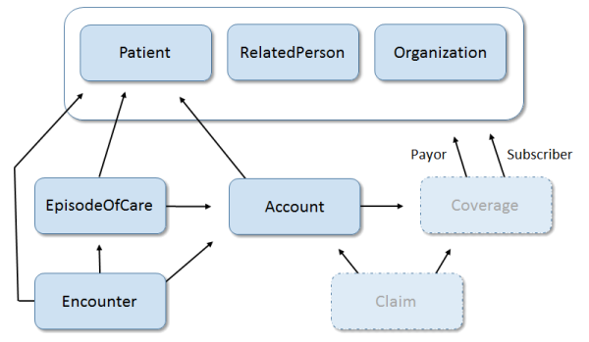
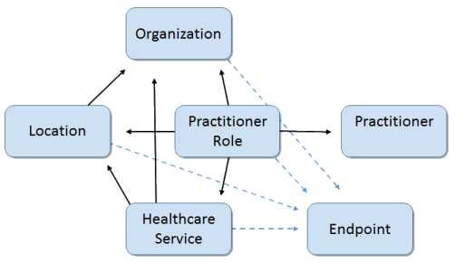

Slide 6
activity/performer
outcomeReference
Observation
Encounter
CarePlan
author
subject
1471027
Practitioner
CareTeam
Goal
Patient
1471023
1471026
1471024
1471025
Organization
Endpoint
Organization
(hl7) 1470790
managingOrganization
1471022
1470818
managingOrganization

Slide 7
activity/performer
outcomeReference
CarePlan
author
subject
Observation
Encounter
Practitioner
CareTeam
Goal
1471328
1471284
subject
Patient
Organization
Endpoint
1471023
managingOrganization
1471022
1470818
managingOrganization
Organization
(hl7) 1470790

Slide 8
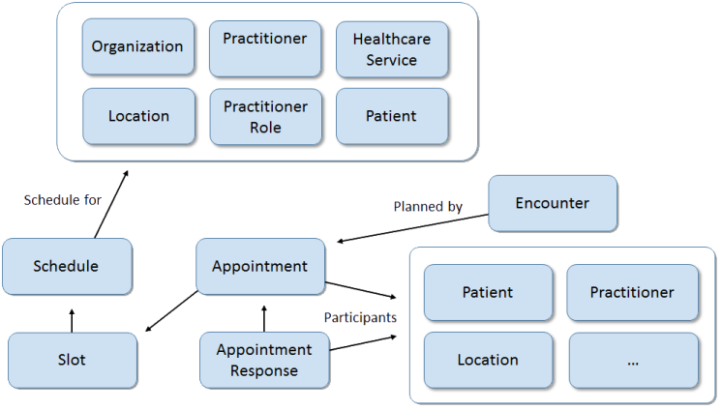

Slide 9
DIAGNOSIS

Slide 10
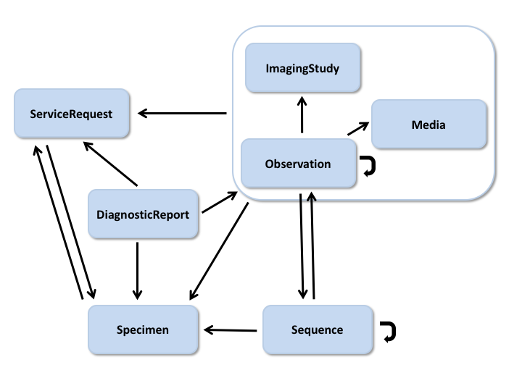

Slide 11
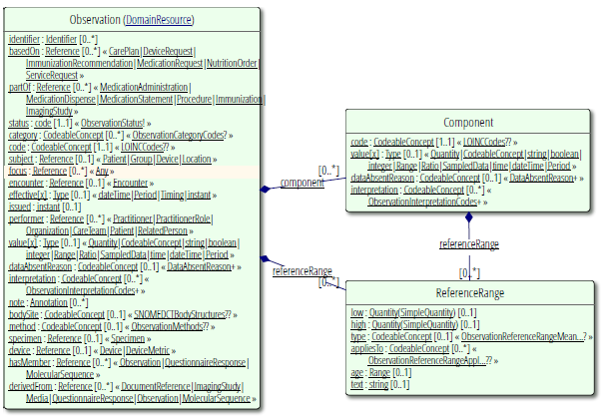

Slide 12
CLINICAL

Slide 13
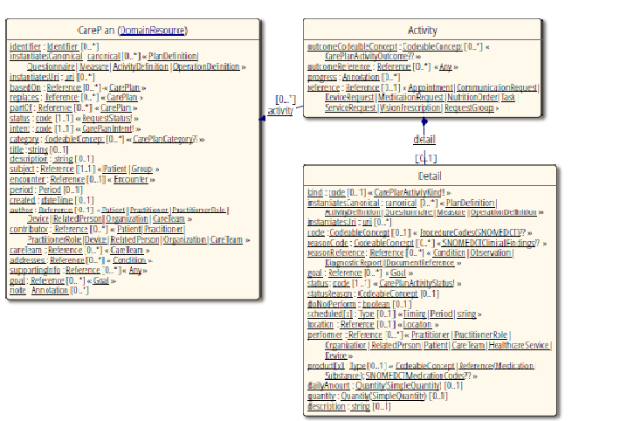

Slide 14
ORGANIZATION

Slide 15
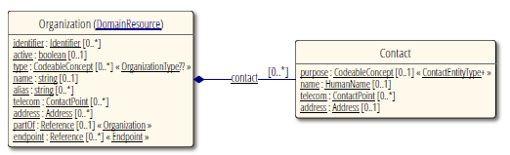

Slide 16
MEDICATIONS

Slide 17
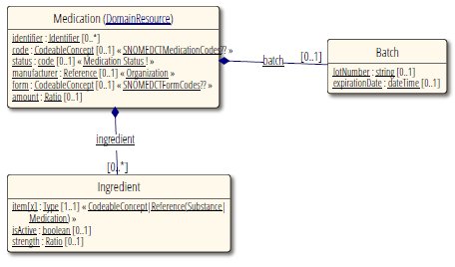

Slide 18
