Slide 1
Generic Entity
Data base
called
caller
Function
Procedure Call
Object
sender
receiver
Object with
internal Tread)
Dispatch
Actor
Request
Reply
server
Service
Event

Slide 2
Itel-post
Itel-pre
Adapter
?
?
Other

Slide 3
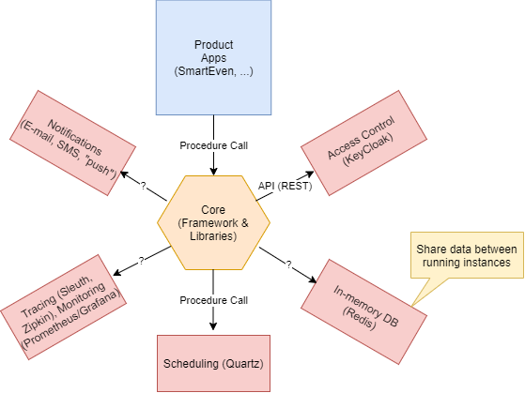
ITEL-BASIC SUPPORTS
That live into ‘some’ infrastructure (Docker, …)
Shared by all the applications

Slide 4
Infrastructure-related adapters
<event>
License
synchronizer
Infrastructure
Adapter
US1
Licence update
Infrastructure (CLI)
(docker, swarm, kubernetes)
<event>
Metrics
Adapter
Infrastructure
Adapter
US2 (MA)
monitor
Infrastructure (CLI)
Infrastructure
Adapter
Operator
US3
install
Infrastructure (CLI)

Slide 5
Application-related adapters
Health Data
Provider
Health Data
Adapter
US4 ( HDA )
Health data
Health service
Sensor Data
Provider
Sensor Data
Adapter
US5 ( IOTA )
Domotic
Domotic system
WebRTC
Adapter
Developer
US6 ( WA )
WebRTC
Web RTC

Slide 6
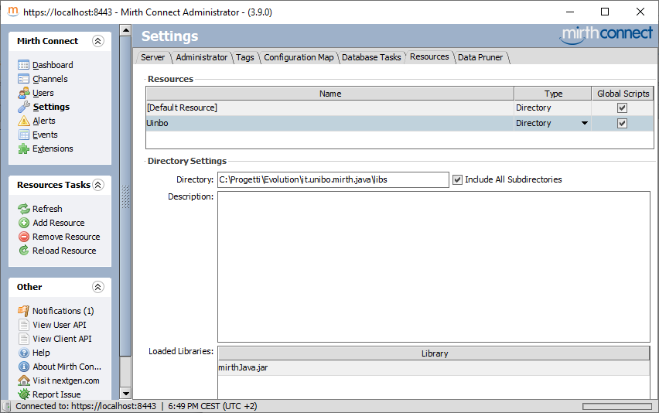

Slide 7
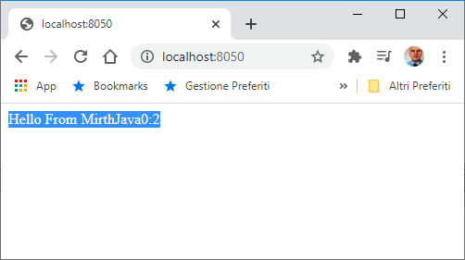
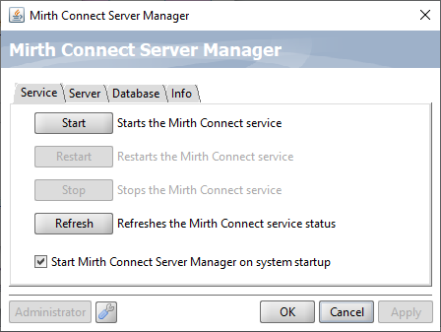

Slide 8
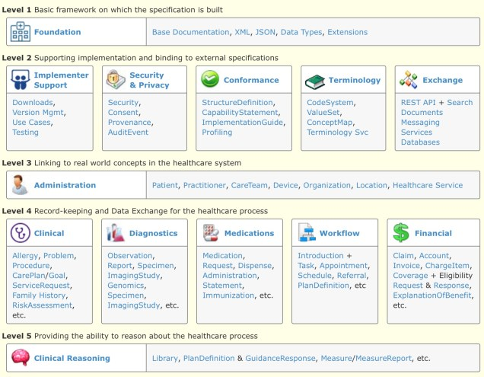
30
26
37
43
11

Slide 9
Core-Ite
HealthProduct
CentroHealth
Case A
Rest
Payload: FHIR
SocketIo
HTML5 SSE
Mqtt
Case B
Rest
Payload: HLT7 or FHIR
???
POJO: excluded
Excluded:
We want to use REST standard oly

Slide 10
Core-Ite
HealthProduct
CentroHealth
Rest
Payload: HLT7 or FHIR
Itel Standard
Message

Slide 11
NESTAGORA
Itel Business Logic
Adapter
CentroHealth
Output (with HL7 data)
T
Some protocol
???
Input
(with HL7 data)
A different adapter
for each CentroHealth
with a data-transformer (T)

Slide 12
Itel
CentroHealth
Output (with HL7 data)
CHFacade
T
Some protocol
Input
(with HL7 data)
ItelFacade
???

Slide 13
Sm@rteven
Core-Itel
HealthProduct
CentroHealth
Case A: a caller Thread
1) Legacy Old
TO BE DEFINED
HL7
2) Legacy with HL7
Case B: a server
3) The future
With FHIR
Rest
Could expose an API
FHIR-oriented by
defining a proper set of
RESOURCES
A framework based on Mirth
that exposes to Core-Itel
An healthin-channel and halthout-channel
Or, an API and … TO BE DEFINED
The framework defines a channel for each CentroHealth
associated wtih ‘well structured code’

Slide 14
Sm@rteven
Core-Itel
HealthProduct
CentroHealth
CHFacade
1) Legacy Old
ICoreFacade
CHFacade
HL7
2) Legacy with HL7
Exposes an API
full FHIR
….
By defining a proper
set of RESOURCES
3) The future
With FHIR
Rest
A framework : exposes
a REST-API to Core-Itel

Slide 15
Sm@rteven
Core-Itel
HealthProduct
CentroHealth
CHFacade
A) Legacy Old
Icore
FHIR server
CHFacade
HL7
B) Legacy with HL7
Rest
C) FHIR server
Exposes an API full FHIR
Exposes a REST-API

Slide 16
HealthProduct
Java programs
HealthService
(BusinessLogic)
HealthServiceFhirUsage
M2M Rest
HealthServiceHL7
HealthServiceFhir
FhirServiceClientUsage
HealthServiceInterface
todo
FhirServiceClient
CentroHealth
FHIR server
ICoreFacade
M2M Rest
/selectHealthCenter
/createPatient
/searchPatient
/readResource
/deleteResource
HealthHttpClient
HealthWebClient

Slide 17
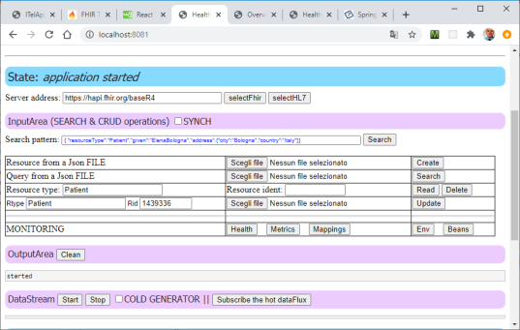
HealthProduct
Java programs
HealthService
(BusinessLogic)
HealthServiceFhirUsage
M2M Rest
HealthServiceHL7
HealthServiceFhir
/selectHealthCenter
/createResource
/searchResource
/readResource
/deleteResource
FhirServiceClientUsage
HealthServiceInterface
FhirServiceClient
CentroHealth
FHIR server
todo
ICoreFHIR
server
HealthHttpClient
Browser
HealthWebClient

Slide 18
ICoreFHIR server
HealthProduct
CentroHealth
HealthAdapterMIController
HealthProductClient
HealthServiceInterface
HealthServiceFhirUsageSynch/Asynch
HealthServiceFhir
Legacy with HL7
HealthServiceHL7
TCP/HTTP
Todo
FhirServiceClient
FHIR server
HTTP
HealthFhirpublicClient
Browser

Slide 19
To
ICoreFHIR
server
HealthProduct
From

Slide 20
HealthProduct
HealthProductClient
M2M Rest
HealthAdapterMIController
/API
/APISycnh
Browser
HealthServiceInterface
HTTP
HealthServiceFhirUsageSynch/Asynch
HealthServiceFhir
ICoreFHIR
server
HealthServiceHL7
FhirServiceClient
From
CentroHealth
FHIR server

Slide 21
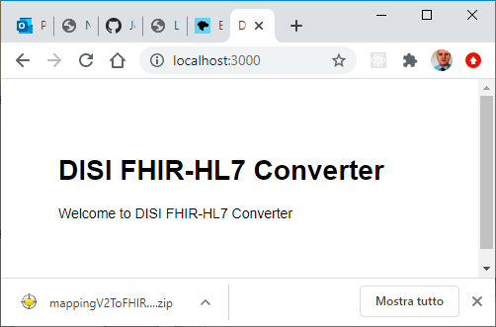
DisiFhirConverter
/hl7tofhir
rununiboworker.js
M2M Rest
uniboworker.js
convert
worker.convert(templateString, data, null);
DisiFhirConverter
DisicvtClient.java
/hl7tofhir
M2M Rest
uniboworker.js
convert
browser

Slide 22
HealthProduct
DisiFhirConverter
ICoreFHIR
sever
/hl7tofhir
uniboworker.js
convert
generateResult
M2M Rest
dataHandlerFactory.js
hl7v2.js
HandlebarsConverter.js

Slide 23
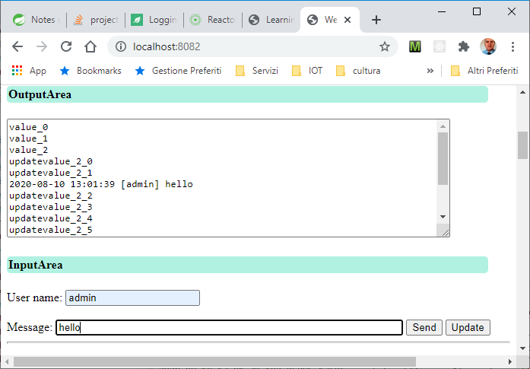

Slide 24
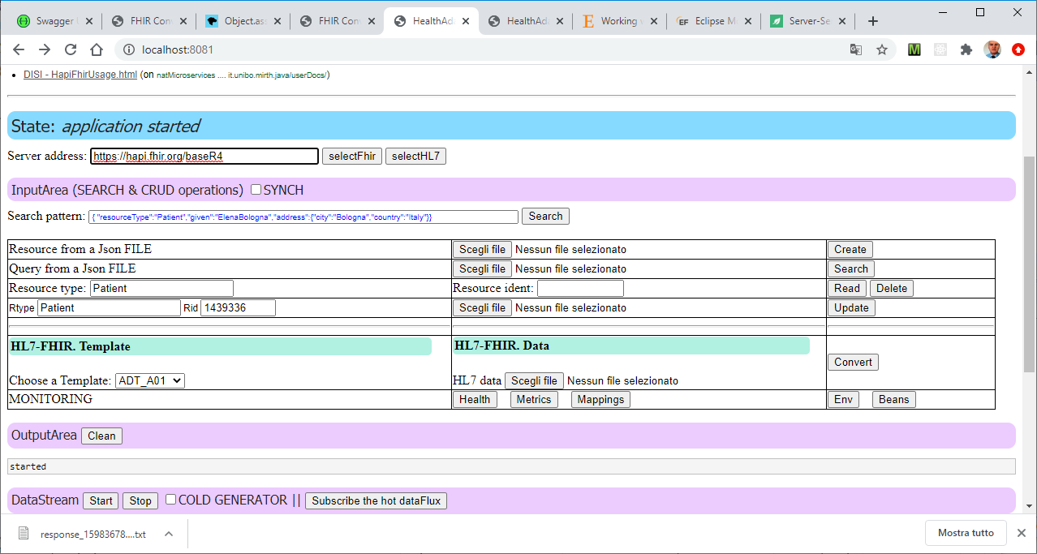
Definizione del server CentroHelath
OPERAZIONI –CRUD
(API Synch /Asynch)
Esperimenti
Conversione HL7/FHIR
Esperimenti
Flux (Hot e Cold)

Slide 25
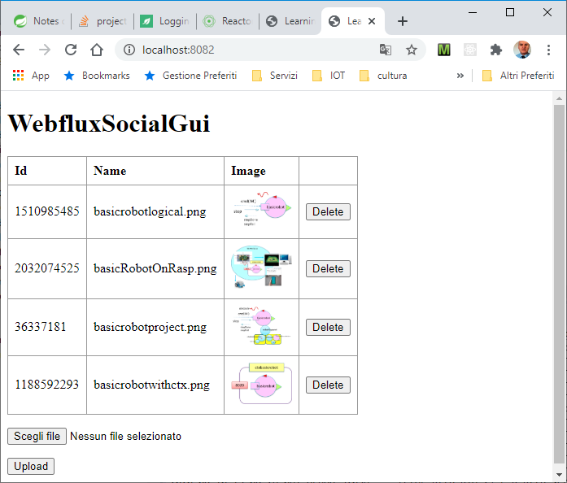

Slide 26
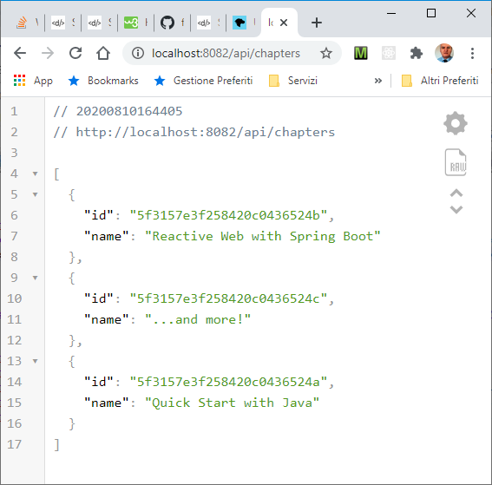

Slide 27
RER/Italy/CEE Domain
ITelDomain
FHIR
HL7v23
«Leggere» FHIR alla luce
dei processi / protocolli che ipotizza
FHIR
ITelDomain
HL7v23

Slide 28
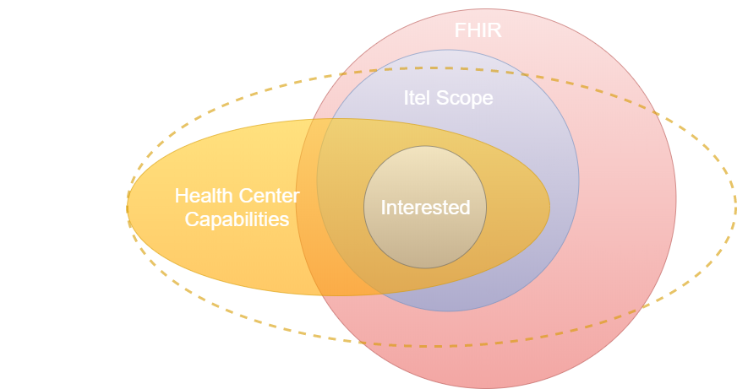

Slide 29
RER/Italy/CEE Domain
ITelOperations
FHIR
HL7v23
message
FHIR-to-HL7
ITelDomain
HL7v23

