Slide 1
Generic Entity
Data base
called
caller
Function
Procedure Call
Object
sender
receiver
Object with
internal Tread)
Dispatch
Actor
Request
Reply
server
Service
Event

Slide 2
Itel-post
Itel-pre
Adapter
?
?
Other

Slide 3
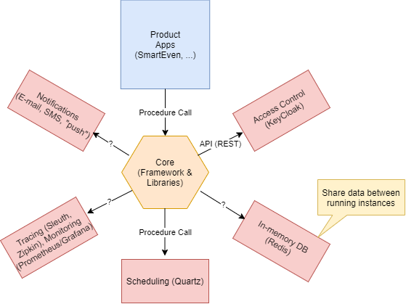
ITEL-BASIC SUPPORTS
That live into ‘some’ infrastructure (Docker, …)
Shared by all the applications

Slide 4
At the current state of the work, it seems appropriateto distinguish between the concept of adapter related to the ‘infrastructure’ from the concept of adapter related to application (services).
The application under development is SmartEven: this could give us a possible scenario and a set of application reqirments as they are intended at this moment. Why there is non adapter for the SmartEven?
Do we need adapters only for ‘other’ (i.e. non ITel) subsystems?.
Is it excluded the possibility/opportunity of definine a Itel-infrastructure as a (micro) service of as a set of (cooperating) micro-services?
From generic to specific: a first model from the user stories
Basic question: what is an adapter, and what is its role?

Slide 5
Infrastructure-related adapters
<event>
License
synchronizer
Infrastructure
Adapter
US1
Licence update
Infrastructure (CLI)
(docker, swarm, kubernetes)
<event>
Metrics
Adapter
Infrastructure
Adapter
US2 (MA)
monitor
Infrastructure (CLI)
Infrastructure
Adapter
Operator
US3
install
Infrastructure (CLI)

Slide 6
Application-related adapters
Health Data
Provider
Health Data
Adapter
US4 ( HDA )
Health data
Health service
Sensor Data
Provider
Sensor Data
Adapter
US5 ( IOTA )
Domotic
Domotic system
WebRTC
Adapter
Developer
US6 ( WA )
WebRTC
Web RTC

Slide 7
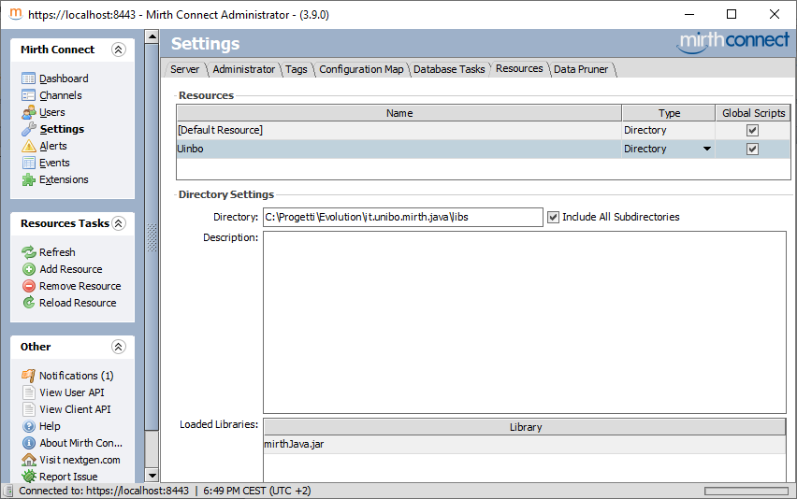

Slide 8
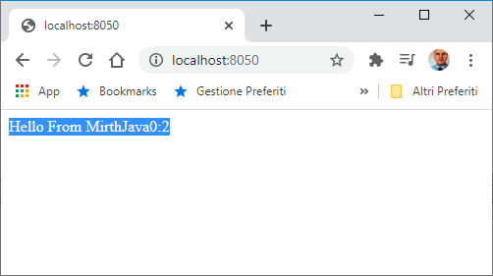
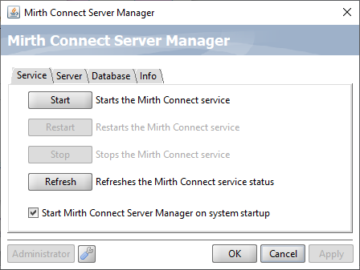

Slide 9
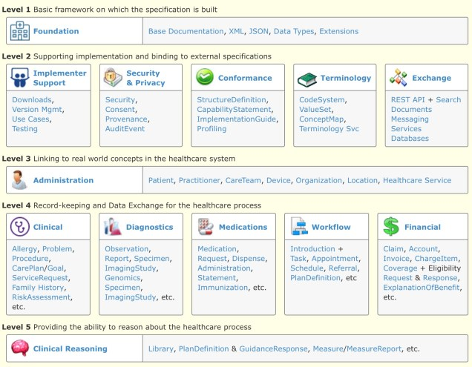
30
26
37
43
11

