Slide 1
Generic Entity
Data base
called
caller
Function
Procedure Call
Object
sender
receiver
Object with
internal Tread)
Dispatch
Actor
Request
Reply
server
Service
Event

Slide 2
Itel-post
Itel-pre
Adapter
?
?
Other

Slide 3
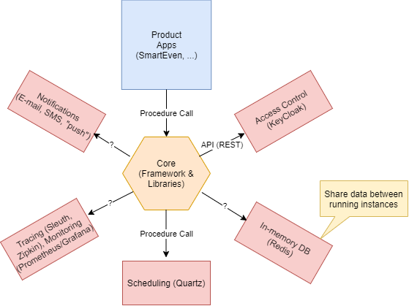
ITEL-BASIC SUPPORTS
That live into ‘some’ infrastructure (Docker, …)
Shared by all the applications

Slide 4
Infrastructure-related adapters
<event>
License
synchronizer
Infrastructure
Adapter
US1
Licence update
Infrastructure (CLI)
(docker, swarm, kubernetes)
<event>
Metrics
Adapter
Infrastructure
Adapter
US2 (MA)
monitor
Infrastructure (CLI)
Infrastructure
Adapter
Operator
US3
install
Infrastructure (CLI)

Slide 5
Application-related adapters
Health Data
Provider
Health Data
Adapter
US4 ( HDA )
Health data
Health service
Sensor Data
Provider
Sensor Data
Adapter
US5 ( IOTA )
Domotic
Domotic system
WebRTC
Adapter
Developer
US6 ( WA )
WebRTC
Web RTC

Slide 6
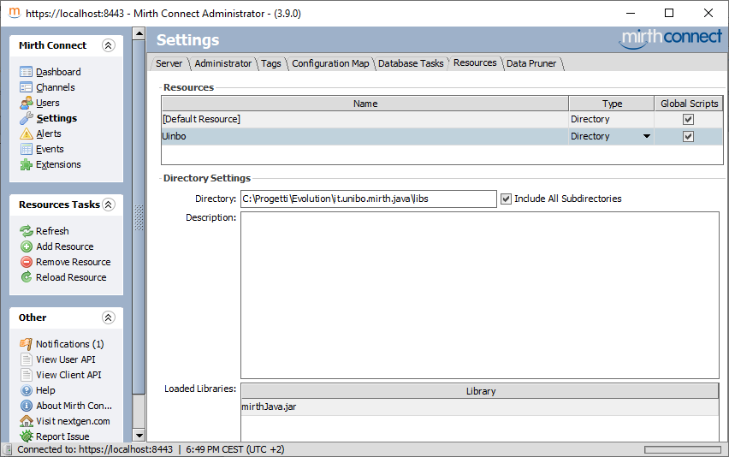

Slide 7
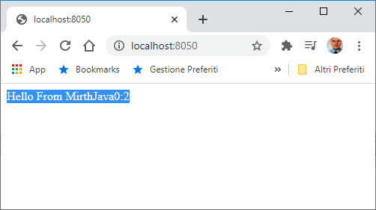
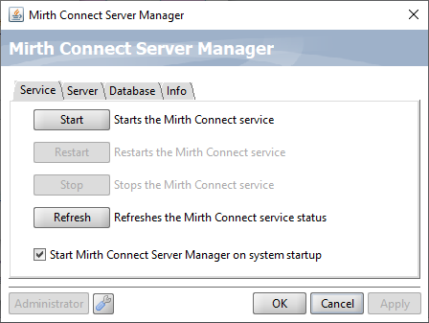

Slide 8
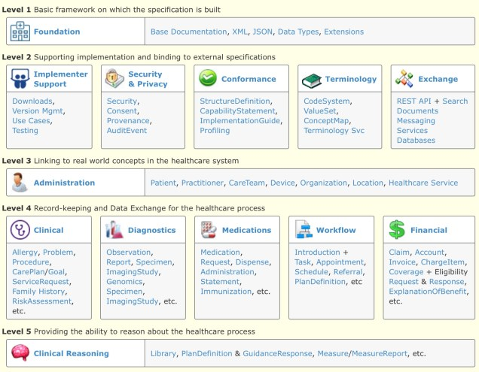
30
26
37
43
11

Slide 9
Core-Ite
HealthProduct
CentroHealth
Case A
Rest
Payload: FHIR
SocketIo
HTML5 SSE
Mqtt
Case B
Rest
Payload: HLT7 or FHIR
???
POJO: excluded
Excluded:
We want to use REST standard oly

Slide 10
Core-Ite
HealthProduct
CentroHealth
Rest
Payload: HLT7 or FHIR
Itel Standard
Message

Slide 11
NESTAGORA
Itel Business Logic
Adapter
CentroHealth
Output (with HL7 data)
T
Some protocol
???
Input
(with HL7 data)
A different adapter
for each CentroHealth
with a data-transformer (T)

Slide 12
Itel
CentroHealth
Output (with HL7 data)
CHFacade
T
Some protocol
Input
(with HL7 data)
ItelFacade
???

Slide 13
Sm@rteven
Core-Itel
HealthProduct
CentroHealth
Case A: a caller Thread
1) Legacy Old
TO BE DEFINED
HL7
2) Legacy with HL7
Case B: a server
3) The future
With FHIR
Rest
Could expose an API
FHIR-oriented by
defining a proper set of
RESOURCES
A framework based on Mirth
that exposes to Core-Itel
An healthin-channel and halthout-channel
Or, an API and … TO BE DEFINED
The framework defines a channel for each CentroHealth
associated wtih ‘well structured code’

Slide 14
Sm@rteven
Core-Itel
HealthProduct
CentroHealth
CHFacade
1) Legacy Old
ICoreFacade
CHFacade
HL7
2) Legacy with HL7
Exposes an API
full FHIR
….
By defining a proper
set of RESOURCES
3) The future
With FHIR
Rest
A framework : exposes
a REST-API to Core-Itel

Slide 15
Sm@rteven
Core-Itel
HealthProduct
CentroHealth
CHFacade
A) Legacy Old
Icore
FHIR server
CHFacade
HL7
B) Legacy with HL7
Rest
C) FHIR server
Exposes an API full FHIR
Exposes a REST-API

Slide 16
HealthProduct
Java programs
HealthService
(BusinessLogic)
HealthServiceFhirUsage
M2M Rest
HealthServiceHL7
HealthServiceFhir
FhirServiceClientUsage
HealthServiceInterface
todo
FhirServiceClient
CentroHealth
FHIR server
ICoreFacade
M2M Rest
/selectHealthCenter
/createPatient
/searchPatient
/readResource
/deleteResource
HealthHttpClient
HealthWebClient

Slide 17
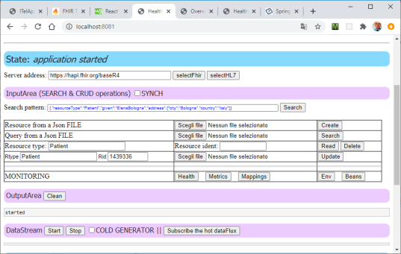
HealthProduct
Java programs
HealthService
(BusinessLogic)
HealthServiceFhirUsage
M2M Rest
HealthServiceHL7
HealthServiceFhir
/selectHealthCenter
/createResource
/searchResource
/readResource
/deleteResource
FhirServiceClientUsage
HealthServiceInterface
FhirServiceClient
CentroHealth
FHIR server
todo
ICoreFHIR
server
HealthHttpClient
Browser
HealthWebClient

Slide 18
ICoreFHIR server
HealthProduct
CentroHealth
HealthAdapterMIController
HealthProductClient
HealthServiceInterface
HealthServiceFhirUsageSynch/Asynch
HealthServiceFhir
Legacy with HL7
HealthServiceHL7
TCP/HTTP
Todo
FhirServiceClient
FHIR server
HTTP
HealthFhirpublicClient
Browser

Slide 19
To
ICoreFHIR
server
HealthProduct
From

Slide 20
HealthProduct
HealthProductClient
M2M Rest
HealthAdapterMIController
/API
/APISycnh
Browser
HealthServiceInterface
HTTP
HealthServiceFhirUsageSynch/Asynch
HealthServiceFhir
ICoreFHIR
server
HealthServiceHL7
FhirServiceClient
From
CentroHealth
FHIR server

Slide 21
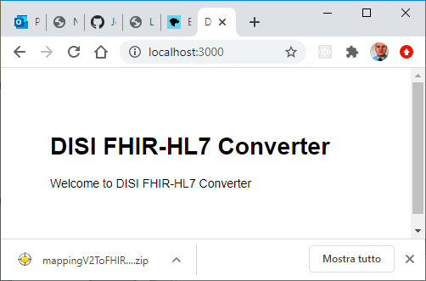
DisiFhirConverter
/hl7tofhir
rununiboworker.js
M2M Rest
uniboworker.js
convert
worker.convert(templateString, data, null);
DisiFhirConverter
DisicvtClient.java
/hl7tofhir
M2M Rest
uniboworker.js
convert
browser

Slide 22
HealthProduct
DisiFhirConverter
ICoreFHIR
sever
/hl7tofhir
uniboworker.js
convert
generateResult
M2M Rest
dataHandlerFactory.js
hl7v2.js
HandlebarsConverter.js

Slide 23
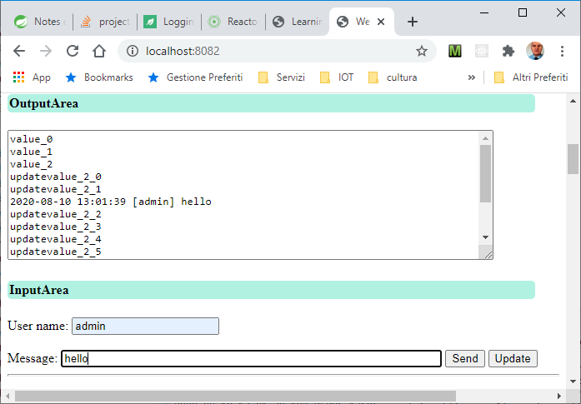

Slide 24
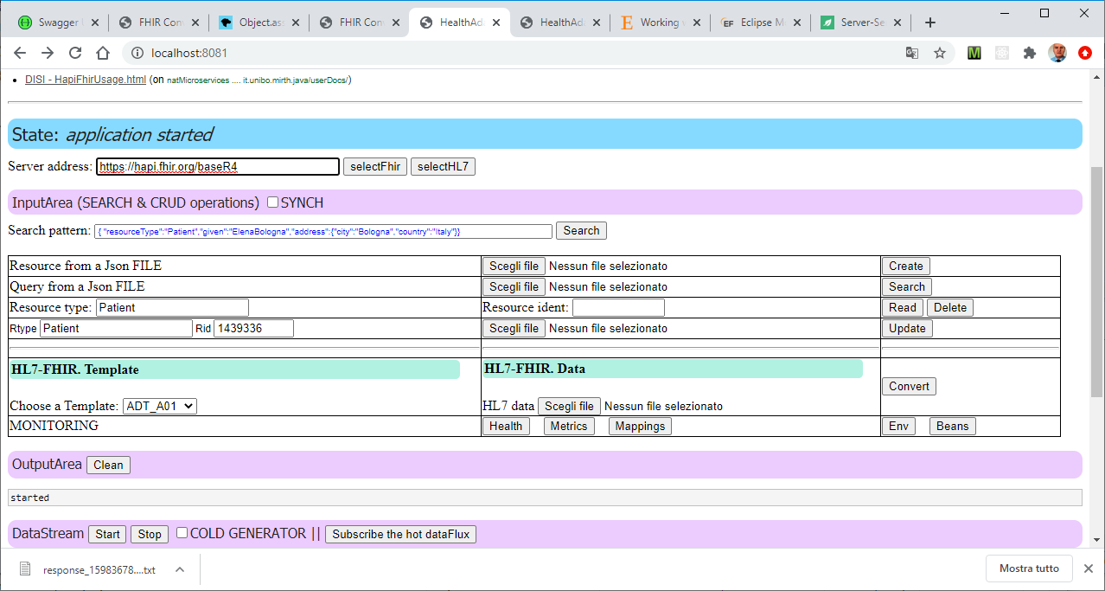
Definizione del server CentroHelath
OPERAZIONI –CRUD
(API Synch /Asynch)
Esperimenti
Conversione HL7/FHIR
Esperimenti
Flux (Hot e Cold)

Slide 25
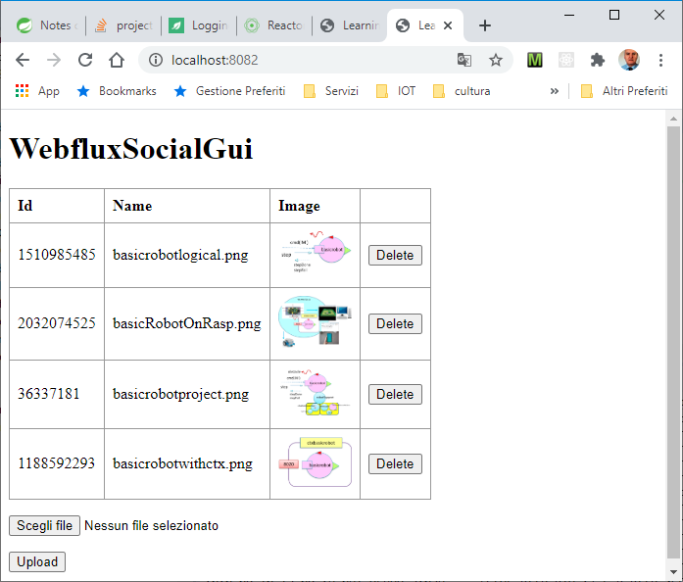

Slide 26
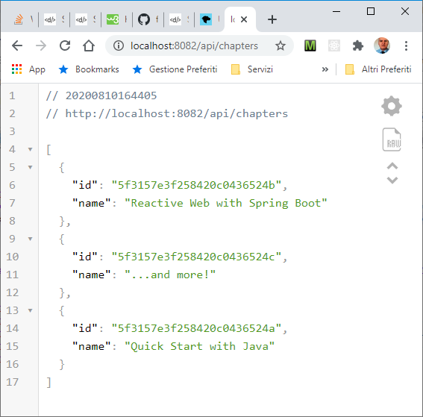

Slide 27
RER/Italy/CEE Domain
ITelDomain
FHIR
HL7v23
«Leggere» FHIR alla luce
dei processi / protocolli che ipotizza
FHIR
ITelDomain
HL7v23

Slide 28
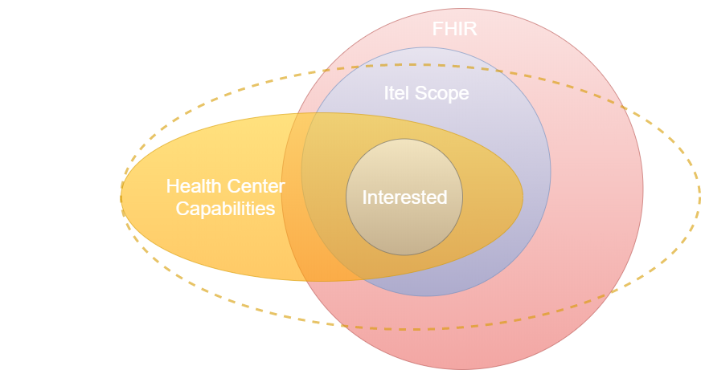

Slide 29
RER/Italy/CEE Domain
ITelOperations
FHIR
HL7v23
message
FHIR-to-HL7
ITelDomain
HL7v23

Slide 30
SmartEven2019
LegacyXXXSpecificPart
ITel19
BusinessLogic
Iltel19Domain
(Internal DataModel)
The use cases could be implemented using a domain model independent
from any specific input details.
SmartEven2019
Iltel19
InputHandlerXXX
ITel19server
ForLegayXXX
Input
Text
Iltel19
OutpuHandlerXXX
ITel19
BusinessLogic
LegacyXXXSpecificPart
Iltel19Domain
(Internal DataModel)
LegayXXX
HL7

Slide 31
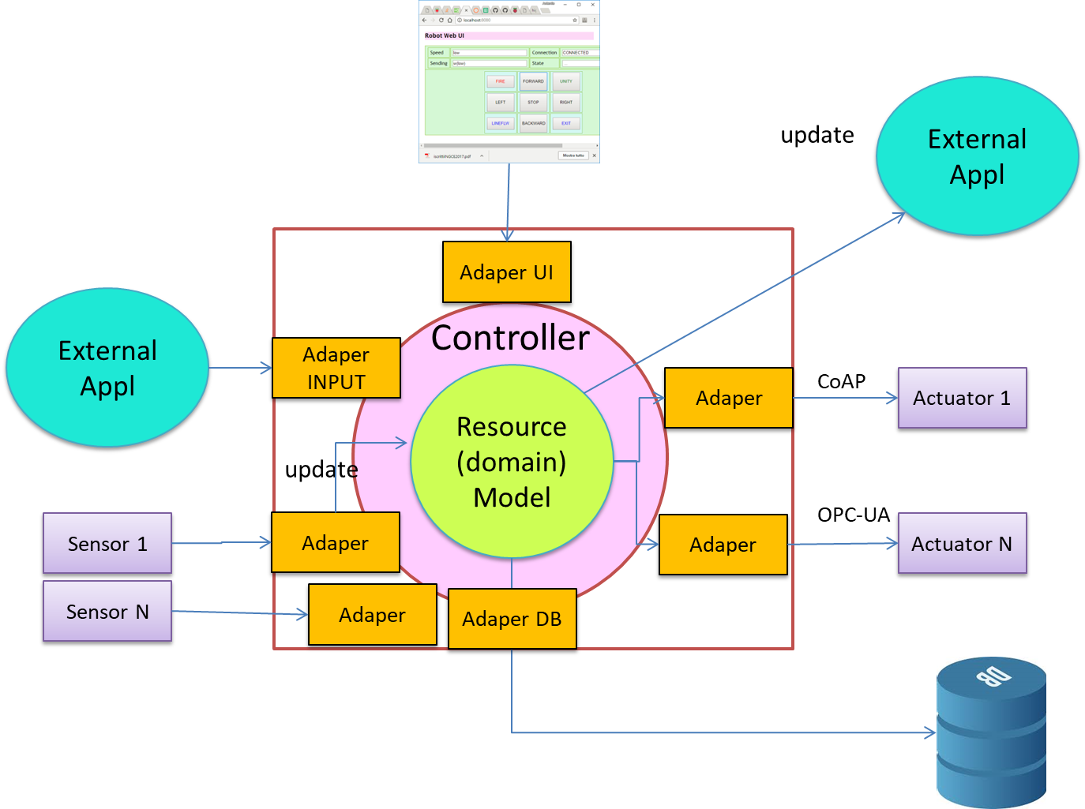
From The Clean Architecture

Slide 32
registerHealthCenter
import
enrollment
update
notify
getstatus
Iltel19
InputHandlerXXX
LegayXXX
HL7
HealthServiceLegacyXXX
INCLUDES
ITel19codeForLegayXXX
Itel
FHIR server
HealthAdapter20
SmartEven20
(controller)
HealthServiceLegacyZZZ
INCLUDES
ITel20codeForLegayXXX
ITel20
FHIR data model
LegagyZZZ
New
Iltel20
InputHandlerZZZ

Slide 33
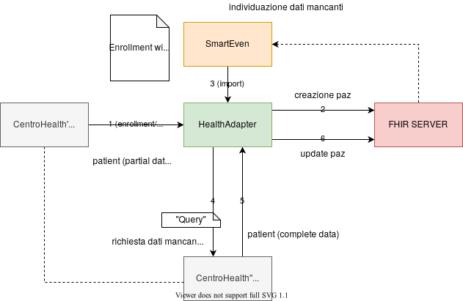

Slide 34
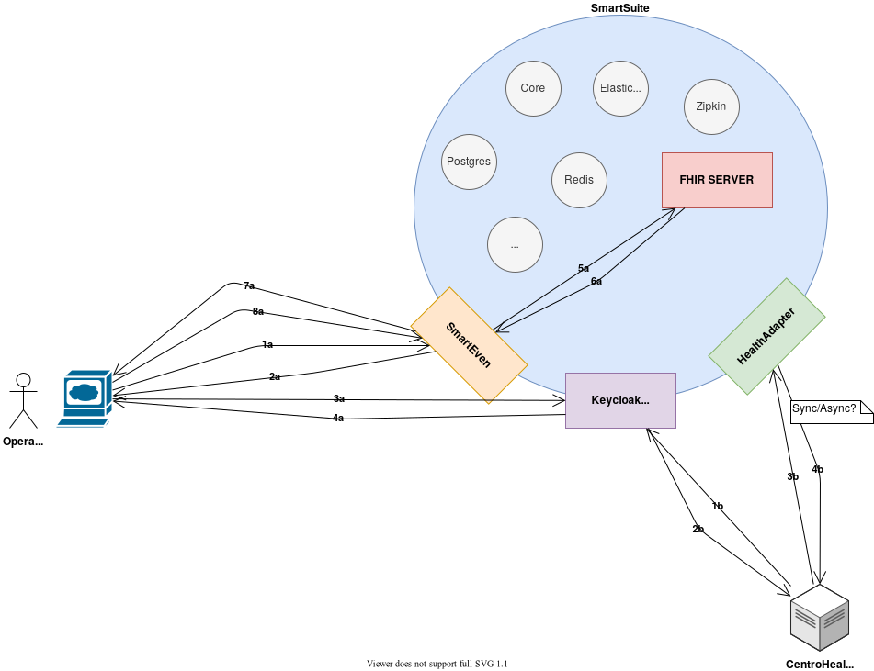

Slide 35
Model–view–viewmodel
The use cases could be implemented using a input data model
independent from any specific input details.
Iltel19
InputHandlerXXX
Iltel
InputModel
?
ITel19server
ForLegayXXX
Input
Text
Iltel19
OutpuHandlerXXX
Iltel
OutputModel
?
LegacyXXXSpecificPart
LegayXXX
HL7
ITel19
BusinessLogic
Iltel19Domain
(Internal DataModel)

Slide 36
ICoreFHIR server
HealthProduct
CentroHealth
HealthAdapterMIController
HealthProductClient
HealthServiceInterface
HealthServiceFhirUsageSynch/Asynch
HealthServiceFhir
Legacy with HL7
HealthServiceHL7
TCP/HTTP
Todo
FhirServiceClient
FHIR server
HTTP
HealthFhirpublicClient
Browser

Slide 37
SmartEven2020
HealthAdapter
CentroHealth Ded
registerHealthCenter
import
enrollment
update
notify
getstatus
HealthAdapterMIController
HealthServiceInterface
HealthServiceLegacyDed
FhirOps
InputServerDed
FHIR
LegacyDedServer
FHIRServerItel20
FHIR
cvtToFHIR
IODM
InputHandlerDed
LegacyDedIO
FhirServiceClient
DedFHIR server
FHIR
cvtToFHIR
IODM
InputHandlerDed

Slide 38
IODATA
InputDATA
OutputDATA
InputPatient
InputCarePlan
Reference?

Slide 39
HealthServiceInterface
implements
FHIRServerItel20
HealthServiceItel20
refTo
extends
LegacyMockServerDed
HealthServiceLegacyZZZ
HealthServiceLegacyDed
refTo
InputServerDed
creates
request
uses
LegacyDedIO
FHIR
cvtToFHIR
IODM
InputHandlerDed

Slide 40
setImportPolicy( String policy )
import( String patientIdentifier )
SmartEven2020
HealthAdapter
Iter0
Invia msgs a server
di CentroHealth remoto
FHIR search
haWeb
MIController
haExternal
ExtServerClient
uses
implements
FHIRServerItel20
haApplication
InputPort
OuputPort
HAServiceInterface
Use Case
HAService
HAOutputInterface
haDomain
DomainEntity (??)

