Slide 1
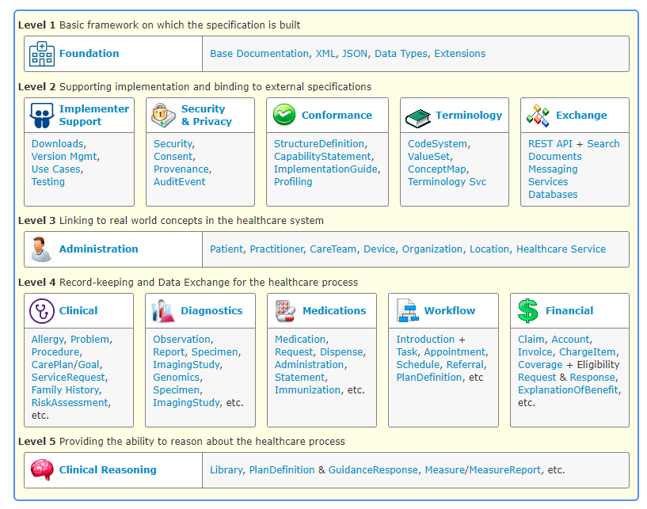

Slide 2
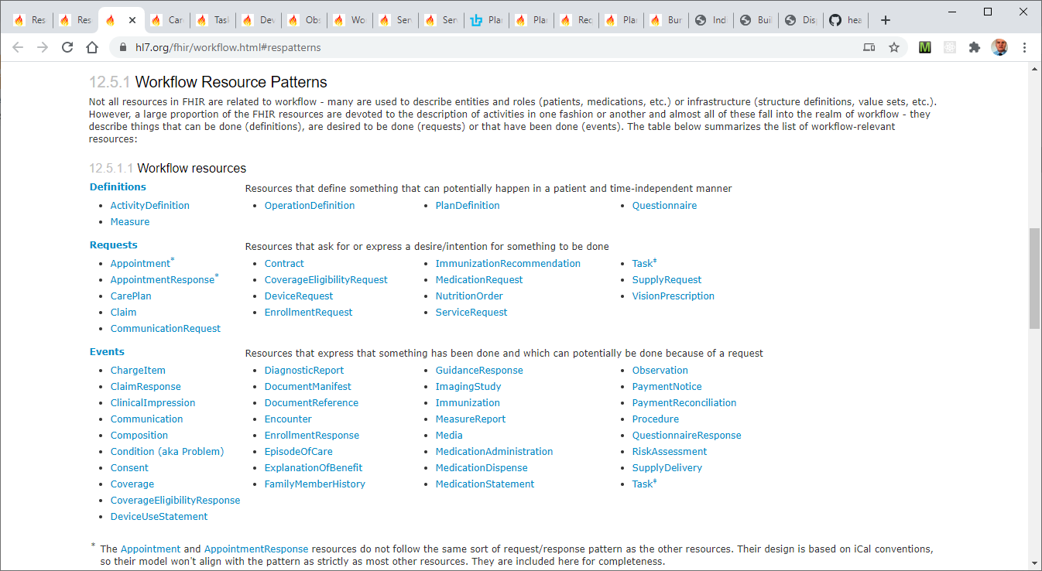

Slide 3
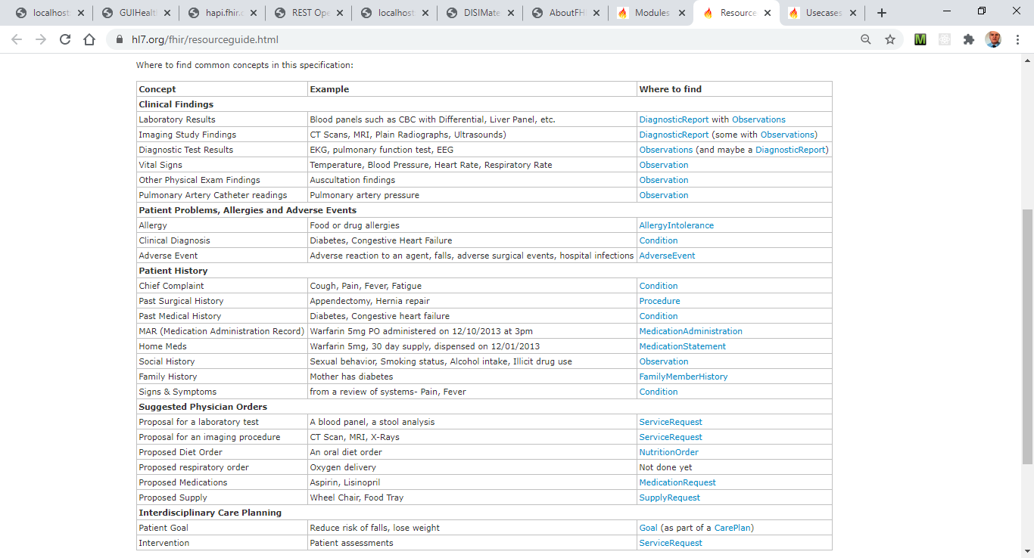

Slide 4
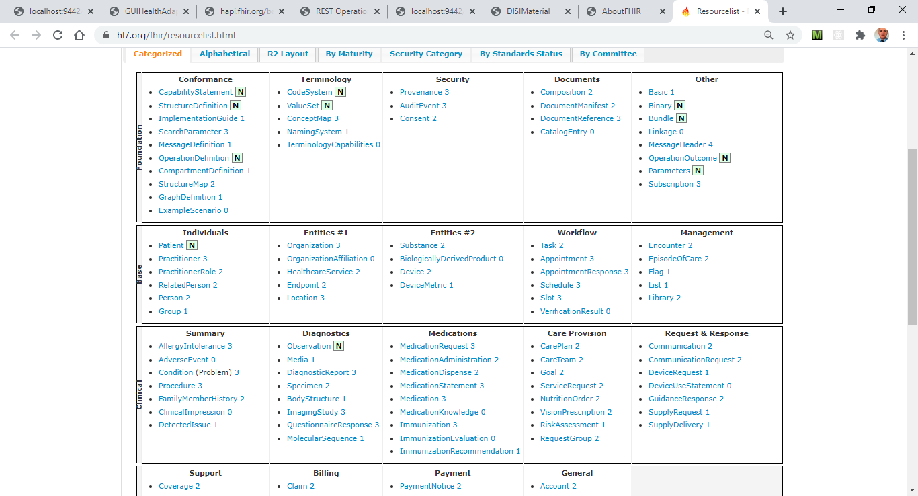

Slide 5
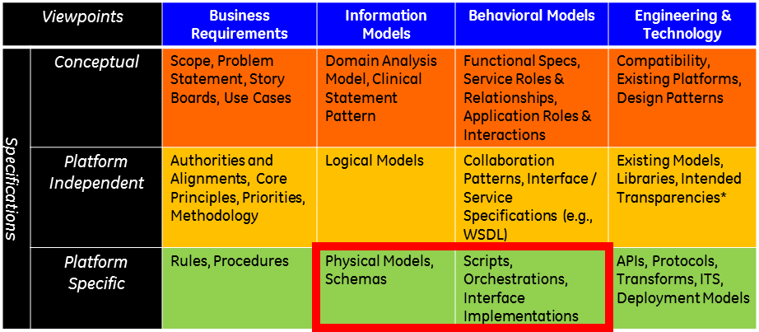

Slide 6
RER/Italy/CEE Domain
ITelDomain
FHIR
HL7v23
«Leggere» FHIR alla luce
dei processi / protocolli che ipotizza
FHIR
ITelDomain
HL7v23

Slide 7
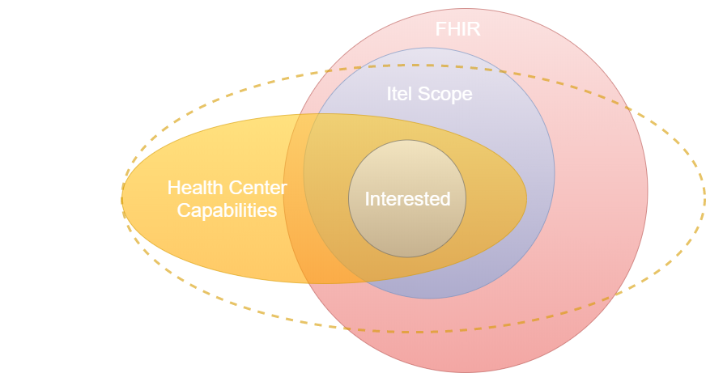

Slide 8
Generic Entity
Data base
called
caller
Function
Procedure Call
Object
sender
receiver
Object with
internal Tread)
Dispatch
Actor
Request
Reply
server
Service
CentroHealth
FHIR server
Event

Slide 9
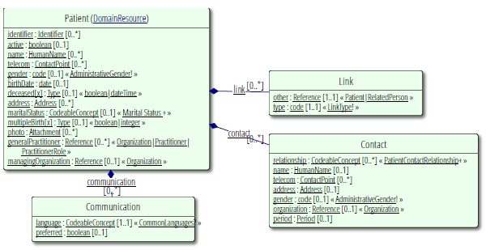
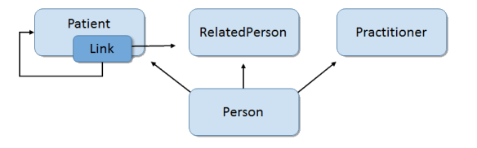

Slide 10
ADMINISTRATION

Slide 11
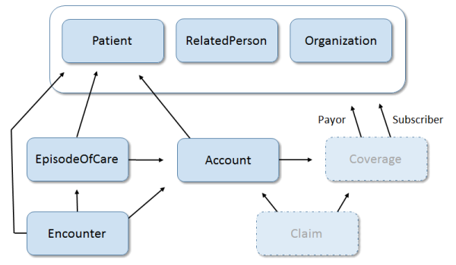
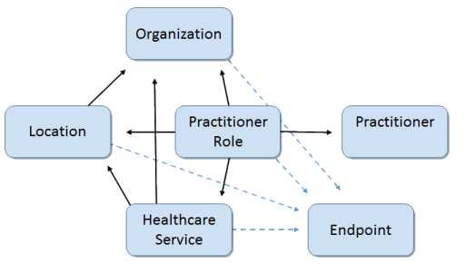

Slide 12
activity/performer
outcomeReference
Observation
Encounter
CarePlan
author
subject
1471027
Practitioner
CareTeam
Goal
Patient
1471023
1471026
1471024
1471025
Organization
Endpoint
Organization
(hl7) 1470790
managingOrganization
1471022
1470818
managingOrganization

Slide 13
activity/performer
outcomeReference
CarePlan
author
subject
Observation
Encounter
Practitioner
CareTeam
Goal
1471328
1471284
subject
Patient
Organization
Endpoint
1471023
managingOrganization
1471022
1470818
managingOrganization
Organization
(hl7) 1470790

Slide 14
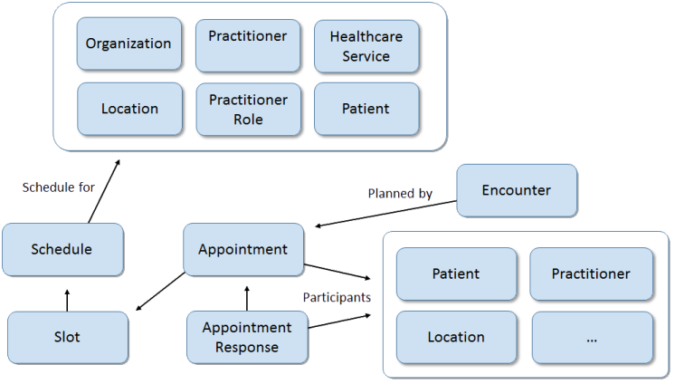

Slide 15
DIAGNOSIS

Slide 16
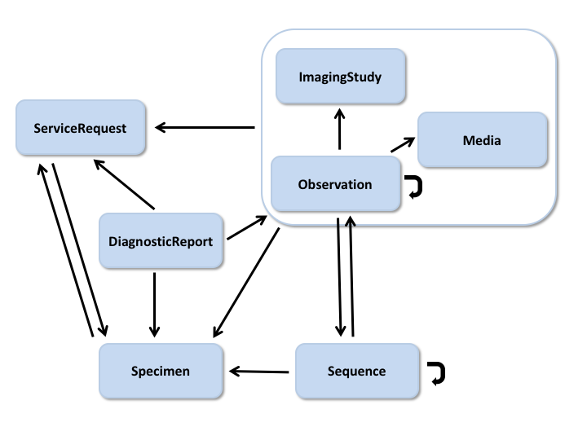

Slide 17
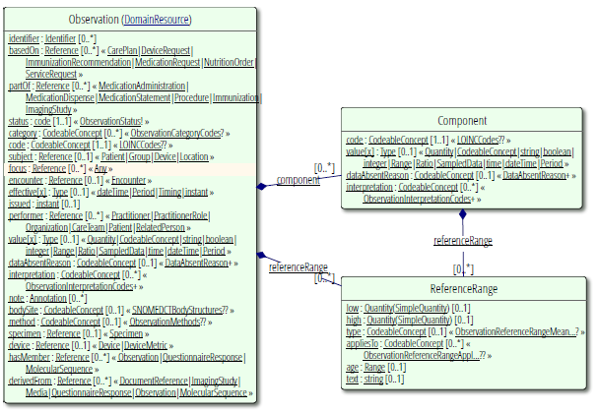

Slide 18
CLINICAL

Slide 19
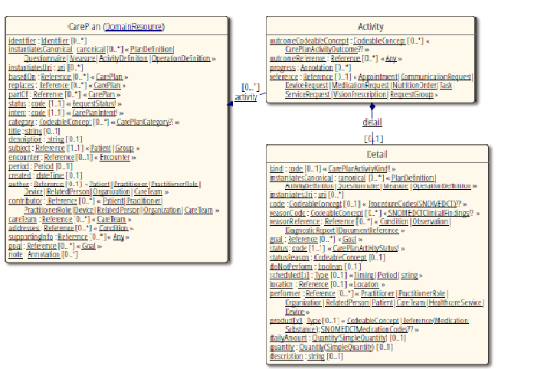

Slide 20
ORGANIZATION

Slide 21
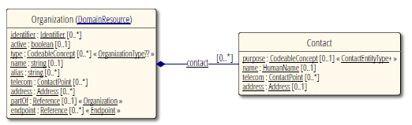

Slide 22
MEDICATIONS

Slide 23
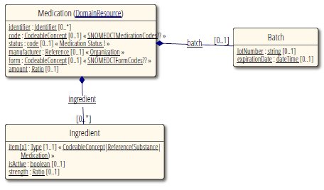

Slide 24
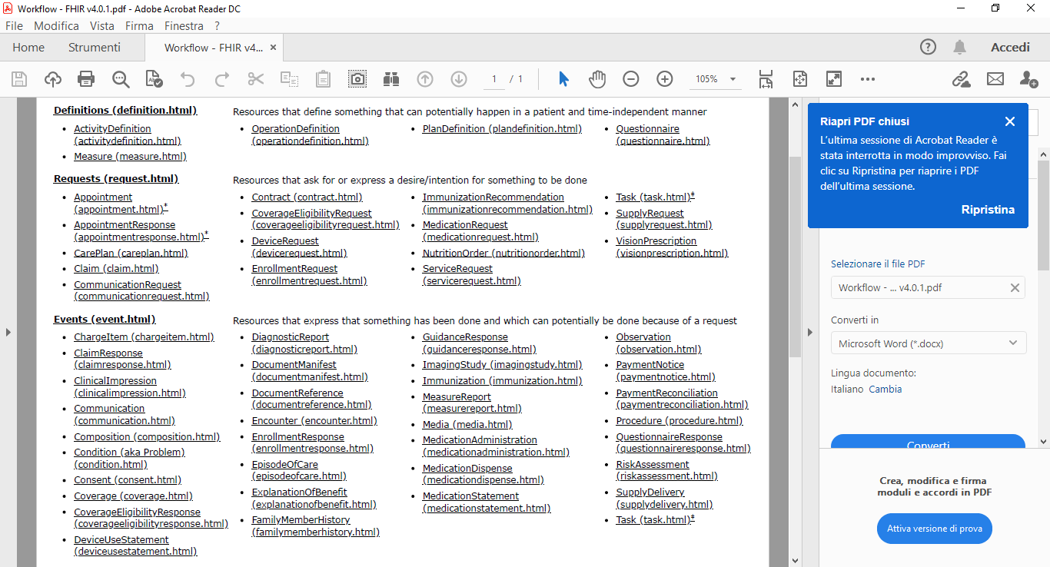

Slide 25
1a) ServiceRequest resource
Task.basedOn
1b) Task resource
Lab
server
Task status | Task.statusReason | Task.businessStatus
Requested | New order | Ordered
ORDER ACCEPTED
Task status | Task.statusReason | Task.businessStatus
Accepted | Able to perform the test. | Accepted
PATIENT AT LAB
Task status | Task.statusReason | Task.businessStatus
In progress | Obtained the specimen | Specimen available
WORK ON
BLOOD SAMPLE
Task status | Task.statusReason | Task.businessStatus
In progress | Preliminary results available | Preliminary results
Task.output.value[1]
FINAL RESULTS
DiagnosticReport resource
Task status | Task.statusReason | Task.businessStatus
Complete | Final results are available | Final results

Slide 26
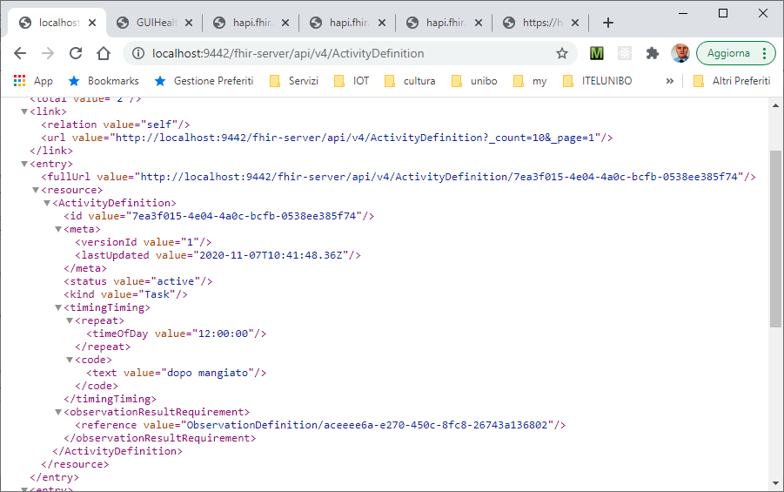

Slide 27
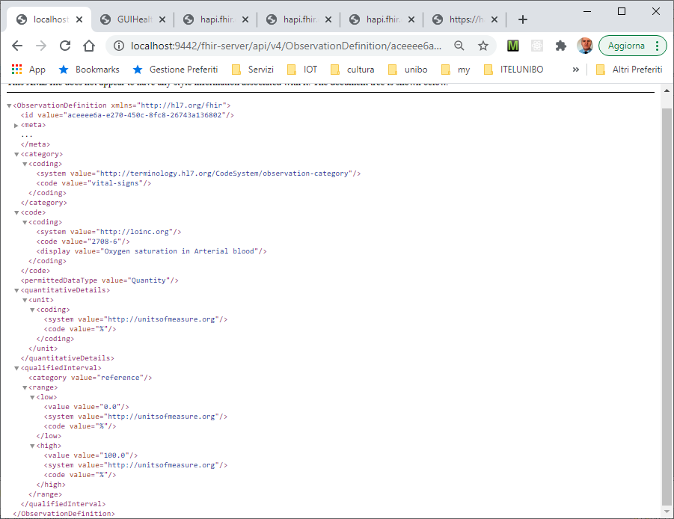

Slide 28
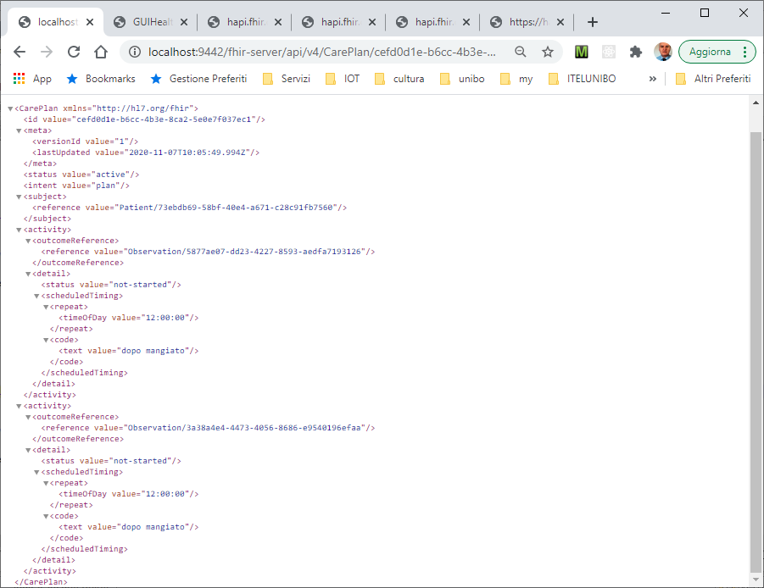

Slide 29
