Slide 1
RER/Italy/CEE Domain
ITelDomain
FHIR
HL7v23
«Leggere» FHIR alla luce
dei processi / protocolli che ipotizza
FHIR
ITelDomain
HL7v23

Slide 2
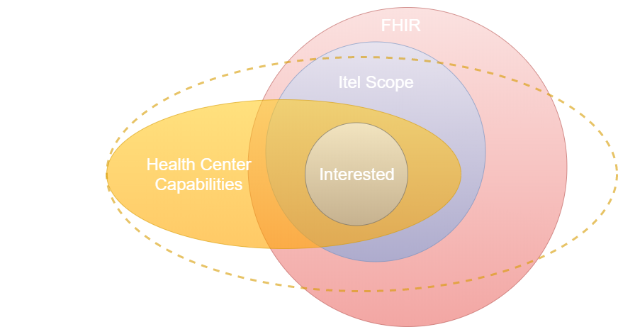

Slide 3
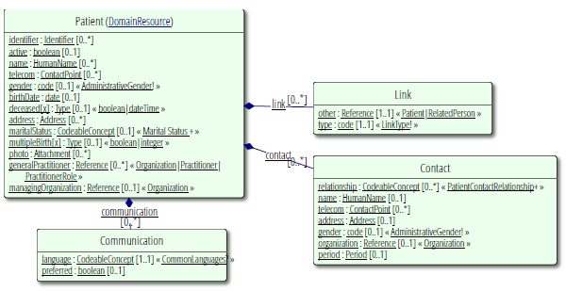
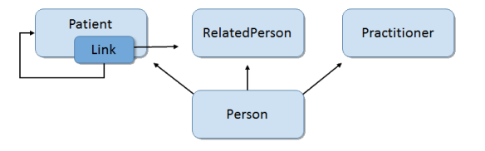

Slide 4
ADMINISTRATION

Slide 5
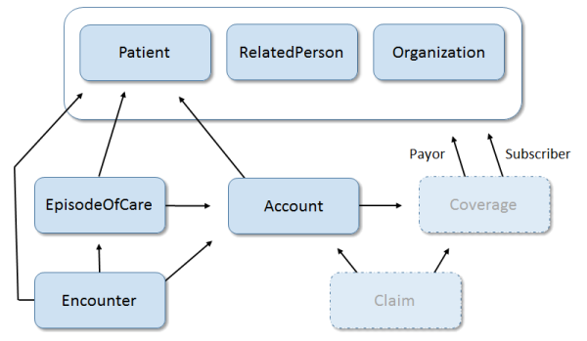
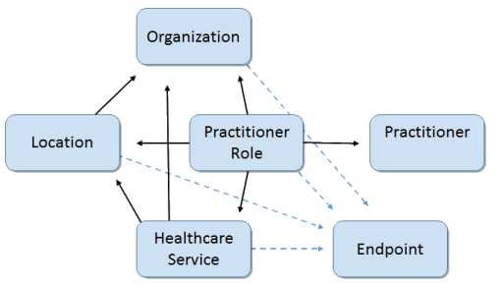

Slide 6
1471027
Patient
1471023
1471026
1471025
1471024
Organization
Endpoint
Organization
(hl7) 1470790
1471022
1470818

Slide 7
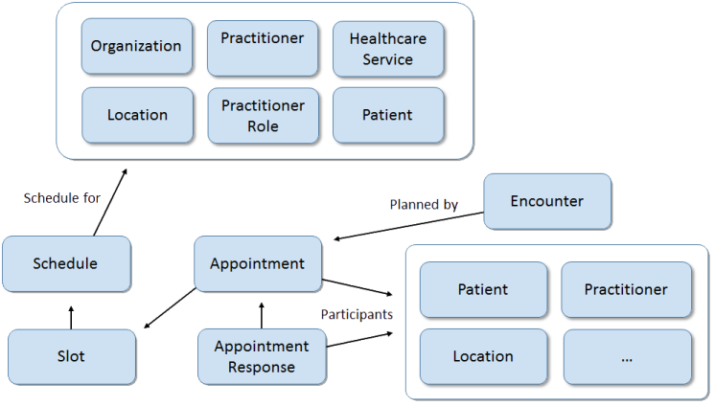

Slide 8
DIAGNOSIS

Slide 9
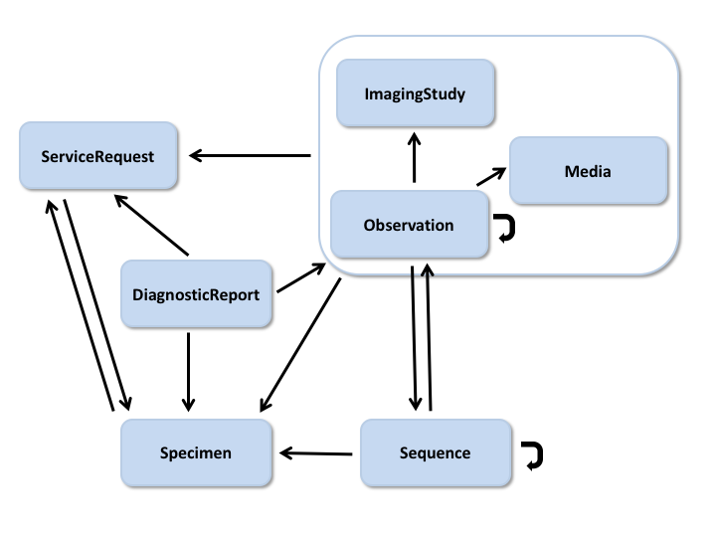

Slide 10
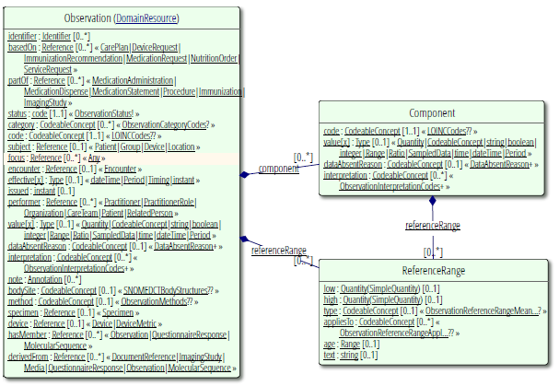

Slide 11
CLINICAL

Slide 12
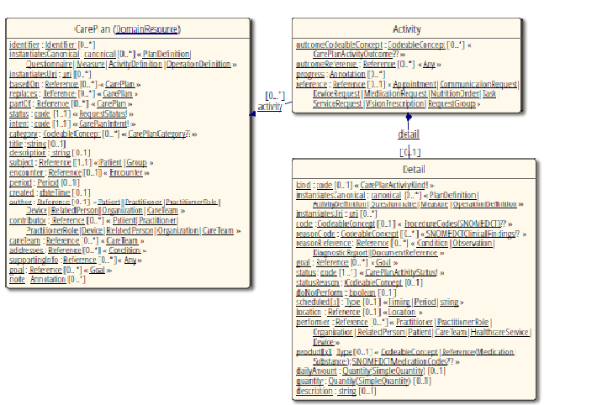

Slide 13
ORGANIZATION

Slide 14
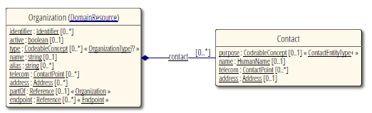

Slide 15
MEDICATIONS

Slide 16
