Slide 1
Loanliness
FINAL MODEL AUC
0.790
PAPER REIMPLEMENTATION
Reimplementing and improving loan default prediction
Based on Liang, Jin and Wang, "Loanliness: Predicting Loan Repayment Ability by Using Machine Learning Methods". Kaggle Home Credit Default Risk data.
Notes:
We reimplemented the Loanliness paper end to end on the Home Credit data, then built one tuned LightGBM that goes past it. The headline number top right is the final model's AUC on the balanced test set.

Slide 2
The task: predict which clients will default
01 OVERVIEW
The paper trains five classifiers on the Kaggle Home Credit Default Risk data: logistic regression, random forest, Naive Bayes, a multi-layer perceptron and LightGBM.
307,511
loan applications
It reports accuracy, per-class precision, recall and F1, ROC curves, and random forest feature importance.
8.1%
of clients default
We rebuilt the pipeline in three notebooks: loan_pipeline, loan_models and loan_improved, sharing one module for splits and metrics so every model is scored identically.
6
source tables joined per client
Loanliness
02
Notes:
The paper is a classic tabular credit risk setup. Five standard classifiers, the usual metrics. Our job was to reproduce it faithfully, then see how far a better model could go. Note the 8.1 percent default rate: the class imbalance drives a lot of what follows.

Slide 3
Reimplementation
01 Overview
02 Reimplementation
03 Beyond the paper
04 Limitations and summary
02
Rebuilding the paper's pipeline, protocol and Table III, and checking where our numbers agree with it.
Notes:
Section two: how we rebuilt the paper and what we got.

Slide 4

From six tables to 700 features
02 REIMPLEMENTATION
STEP 1
STEP 2
STEP 3
STEP 4
Join
Drop
Encode
Split
Application table plus mean, min, max, sum and category shares of bureau, previous application, POS cash, installment and card records
The EXT_SOURCE credit scores, as the paper does, and 221 columns with over 30% missing values
Mean imputation, one-hot encoding and min-max scaling, all fitted on the train split only
Stratified 80/20 with a fixed seed, saved by client ID so later notebooks reuse the same rows
80/20
832
607
700
246,008 train and 61,503 test rows
columns
columns
features
Loanliness
04
Notes:
Every client gets one row: the application plus aggregates of five history tables. We drop the three EXT_SOURCE scores because the paper excludes them, and drop sparse columns. Credit card aggregates mostly disappear here because only about a third of clients have card history. Imputer, encoder and scaler are fitted on train only; the authors fit theirs on all rows before splitting.

Slide 5
Same protocol as the paper: balanced train and test
02 REIMPLEMENTATION
39,720
9,930
61,503
Down-sampled train set
Balanced test set
Natural-ratio test set
50% defaults. Every model trains here.
50% defaults. The paper's headline scores.
8.1% defaults. Reported alongside.
The paper gives no hyperparameters, so we chose standard values. The random forest was then tuned by 3-fold grid search on ROC-AUC, without touching the test set.
Loanliness
05
Notes:
We follow the paper's protocol exactly: down-sample the training set to a 50/50 class balance and score on a balanced test set. We also keep the natural-ratio test set, because that is what a lender would actually see.

Slide 6
LightGBM is our best model, not the paper's second worst
02 REIMPLEMENTATION
Model | Accuracy | Precision 0/1 | Recall 0/1 | F1 0/1 | AUC | Paper acc.
Logistic Regression | 0.674 | 0.68/0.67 | 0.67/0.68 | 0.67/0.68 | 0.735 | 0.693
Random Forest | 0.669 | 0.67/0.67 | 0.68/0.66 | 0.67/0.67 | 0.726 | 0.635
Naive Bayes | 0.591 | 0.57/0.63 | 0.75/0.44 | 0.65/0.52 | 0.630 | 0.521
Multi-layer Perceptron | 0.670 | 0.70/0.65 | 0.59/0.74 | 0.64/0.69 | 0.727 | 0.692
LightGBM | 0.688 | 0.69/0.69 | 0.68/0.69 | 0.69/0.69 | 0.753 | 0.575
Balanced test set. Logistic regression and the MLP land within two points of the paper's accuracy, and Naive Bayes is weakest in both.
Loanliness
06
Notes:
This is our version of the paper's Table III. The last column is the accuracy the paper reports. Logistic regression and the MLP reproduce closely. The random forest and LightGBM rows do not: ours are balanced across both classes and LightGBM comes out on top with 0.753 AUC.

Slide 7
The paper's LightGBM row looks like a model that predicts almost no defaults
WHERE WE DIFFER FROM THE PAPER
Paper, Table III
Ours, no balancing
Ours, down-sampled
Precision 0/1
Precision 0/1
Precision 0/1
0.54 / 1.00
0.51 / 0.93
0.69 / 0.69
Recall 0/1
Recall 0/1
Recall 0/1
1.00 / 0.15
1.00 / 0.02
0.68 / 0.69
Accuracy
Accuracy
Accuracy
0.575
0.511
0.688
Loanliness
07
Notes:
The paper reports positive-class precision of 1.00 with recall of 0.15 for LightGBM, and 0.27 for random forest. That is the signature of a model that almost never predicts a default. When we train LightGBM without any balancing, we get the same shape. Trained on the down-sampled set, as the paper says it did, the model is balanced across both classes. All numbers here are on the balanced test set.

Slide 8
Three more results from the reimplementation
02 REIMPLEMENTATION
0.725
Top 2
+0.006
Accuracy misleads at the natural ratio
Feature importance matches
Tuning the forest helps a little
Naive Bayes has the highest accuracy on the 8.1% test set and the lowest AUC (0.630). Recall and AUC hold for every model, but precision on defaults falls to 0.13 to 0.16.
The tuned random forest ranks DAYS_EMPLOYED and DAYS_BIRTH first, the same two features as the paper's Figure 3.
Grid search lifts random forest AUC from 0.726 to 0.732. Tree depth matters most; it still trails logistic regression and LightGBM.
Loanliness
08
Notes:
Three smaller points. First, on the natural-ratio test, accuracy ranks Naive Bayes first even though it has the worst AUC, so accuracy is the wrong yardstick with an 8 percent default rate. Second, the top two random forest features match the paper. Third, tuning the forest gives only a small gain.

Slide 9
Beyond the paper
01 Overview
02 Reimplementation
03 Beyond the paper
04 Limitations and summary
03
One tuned LightGBM on the same train and test rows, and where its extra AUC comes from.
Notes:
Section three: leaving the paper's protocol to see how far a single model can go.

Slide 10
Four changes to the strongest model
03 BEYOND THE PAPER
1. All training rows
2. Raw features and ratios
No down-sampling: 246,008 rows. Imbalance handled with scale_pos_weight; threshold picked from out-of-fold predictions (max TPR minus FPR).
No column dropping or imputation. LightGBM takes the NaNs and 16 categorical columns directly, plus six ratios such as annuity/credit and credit/goods price.
3. EXT_SOURCE restored
4. Tuning
The paper excludes these three external credit scores, so every result is given both with and without them.
Random search over 20 configurations with early stopping, then a final fit at learning rate 0.02 averaged over 3 folds. Small trees and a 0.2 column fraction worked best.
Loanliness
10
Notes:
Since LightGBM was the strongest model, we built one tuned LightGBM on exactly the same train and test rows, matched by client ID, so the scores are directly comparable. Four things change. Change 3 is the one that leaves the paper's setup, which is why we report results both with and without the EXT_SOURCE columns.

Slide 11
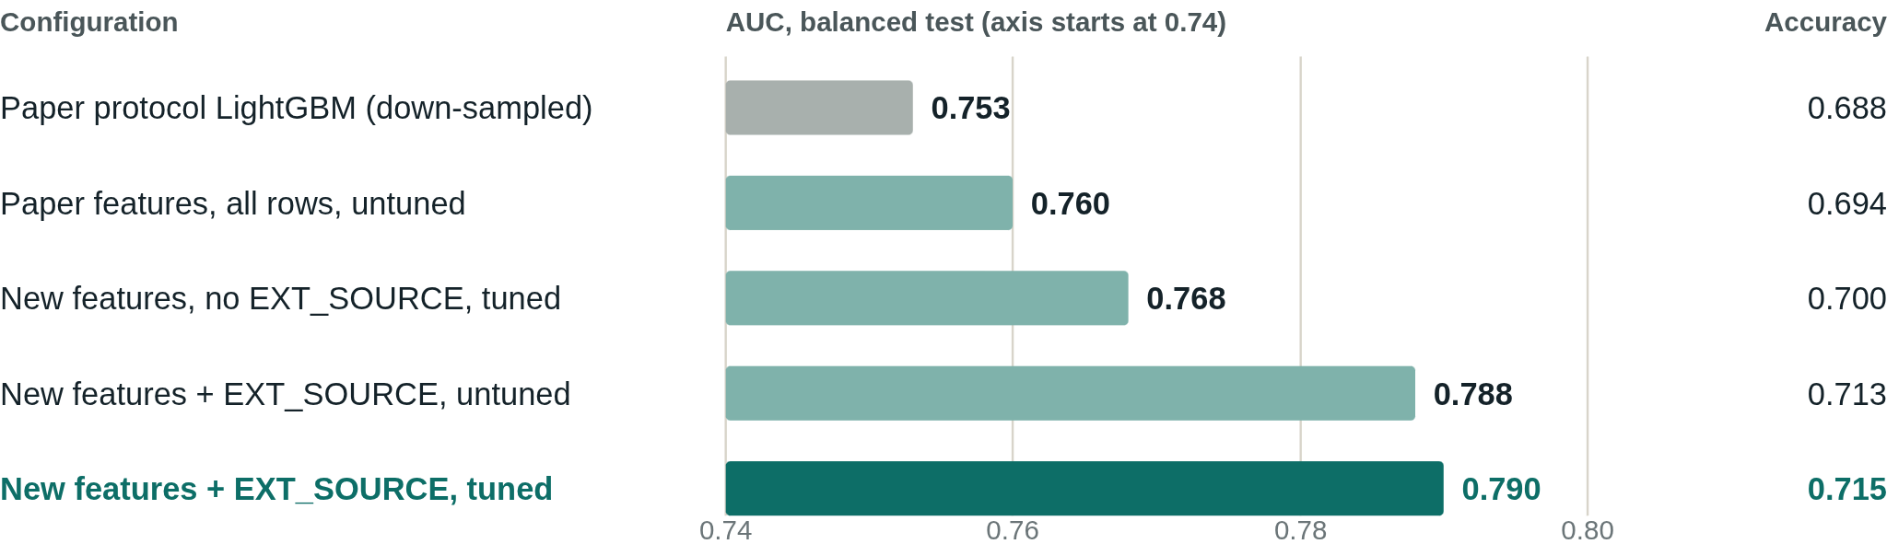
Where the +0.037 AUC comes from
03 BEYOND THE PAPER
All rows add about 0.007 AUC; raw NaNs, ratios and tuning add 0.008 more; EXT_SOURCE adds 0.022. Out-of-fold AUCs on train give the same ordering.
Loanliness
11
Notes:
Read top to bottom as an ablation. Using all rows instead of down-sampling moves AUC from 0.753 to 0.760 on the paper's own 700 features. Raw features, ratios and tuning take it to 0.768 while still excluding EXT_SOURCE. Adding the three EXT_SOURCE columns is the biggest single jump. Tuning on top adds only a little. Note the axis starts at 0.74 so the differences are visible.

Slide 12
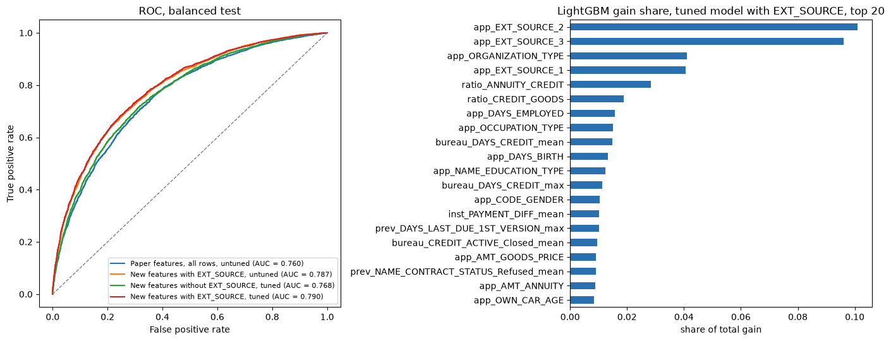
ROC curves and top features
03 BEYOND THE PAPER
Left: ROC of the four improved configurations, balanced test. Right: top 20 features of the final model by share of total gain.
Loanliness
12
Notes:
The ROC curves sit close together, with the tuned EXT_SOURCE model on top at 0.790. On the right, EXT_SOURCE_2 and EXT_SOURCE_3 dominate the gain. Two of our ratio features, annuity over credit and credit over goods price, reach ranks 5 and 6.

Slide 13
Three columns add more than everything else combined
03 BEYOND THE PAPER
+0.022
24%
6.6%
AUC from EXT_SOURCE_1..3, against 0.015 from all other changes
of total gain goes to those 3 columns, out of 837 features
of gain for the six ratios, mainly annuity/credit and credit/goods price
Without EXT_SOURCE the model still respects the paper's feature restriction and scores 0.768 AUC.
Loanliness
13
Notes:
The external credit scores are by far the most informative inputs. Between the two tuned models they add 0.022 AUC, more than every other change put together. EXT_SOURCE_1 is missing for 56 percent of clients and EXT_SOURCE_3 for 20 percent; LightGBM handles the gaps natively.

Slide 14
Limitations and summary
01 Overview
02 Reimplementation
03 Beyond the paper
04 Limitations and summary
04
What the numbers can support, and what we take away from the project.
Notes:
Last section: caveats, then the main findings.

Slide 15
What these numbers can and cannot show
04 LIMITATIONS
No hyperparameters in the paper
Exact numbers differ from the paper because we had to choose our own settings.
One seed, three folds
Differences of 0.002 to 0.003 show direction only.
Search validation is optimistic
Early stopping uses the same rows it is scored on. Out-of-fold and test scores are unaffected.
EXT_SOURCE leaves the paper's setup
Those models are not comparable with Table III, and the model without them reuses the configuration found with them.
Loanliness
15
Notes:
Four caveats. The paper gives no hyperparameters, so exact matches were never possible. Small differences rest on one seed and three folds. The random search score is slightly optimistic, but the reported test numbers are not. And anything using EXT_SOURCE is outside the paper's comparison.

Slide 16
What we found
SUMMARY
2 pts
Logistic regression and the MLP reproduce the paper's accuracy within two points. The random forest and LightGBM rows do not.
0.753
Trained on balanced data as the paper describes, LightGBM is the best of the five models.
0.790
All rows, raw features, EXT_SOURCE and tuning lift it to 0.790 AUC and 0.715 accuracy. Without EXT_SOURCE: 0.768.
Loanliness
16
Notes:
To close: the simple models reproduce, the tree models do not, and the reason looks like class balance. With balanced training LightGBM wins. Going beyond the paper, the final tuned LightGBM gains 0.037 AUC and 0.027 accuracy over the paper protocol, most of it from the EXT_SOURCE scores.

