Slide 1
MAXXING
LONDON
PubMaxing
The price-aware London pub crawl planner.
Price truth + setting + story. Now wired to Supabase for real Pint Drops.
Karan Manoharan
Live demo · Pub culture, mapped

Slide 2
PUBMAXING
MAXXING
The Problem
LONDON
Pub discovery is a directory business. It still misses the one number everyone asks at the bar.
£
?
S
Price is invisible
No trust layer
Culture is fading
A pint can swing from £4.20 to nearly £8 across London. You usually find out only after the round lands.
Existing apps show where pubs are. They do not tell you whether the price is fresh, sourced, contributed, or just guessed.
Historic pubs are closing, and the stories that make them worth saving rarely make it onto the map.
Why this matters
The defensible data is not the list of pubs. It is the live community layer: what people paid, what they saw, and what they remember.
Current build: MapLibre planner, Supabase project connected, storage bucket live.

Slide 3
PUBMAXING
MAXXING
The Opportunity
LONDON
A user-built data moat: the price can only stay accurate if people on the ground keep dropping it.
3,000+
0
1 drop
observed pint prices already in the seed dataset
mainstream pub apps combining price, setting and provenance
turns a visit into fresh data, photo evidence and local memory
The wedge
People choose pubs on price and setting and story.
A £6 pint by the Thames can beat a £4.50 one under a flyover. PubMaxing makes that trade-off explicit, routeable and contributable.
Moat: current prices, public memory, provenance labels, and venue-level story signals.

Slide 4
PUBMAXING
MAXXING
The Solution
LONDON
One map. Three layers that make a crawl worth leaving the house for.
£
M
L
Price truth
Setting
Story
Baseline prices plus community Pint Drops. The map can show a fresh contributor price without erasing the source of the original data.
By the water, beer garden, live sports, food and route window. It is a geospatial planner, not a generic pub list.
Venue Heritage, Writer Trail and The Landlord. Every claim needs provenance: Sourced, Contributor, Anecdote or Needs Source.
Payoff: the best-value crawl through a neighbourhood, ranked by price, filtered by setting, and made memorable by story.
Current route planner: Suggested Crawl + Build Your Own + Venue Detail + Pint Drops.

Slide 5
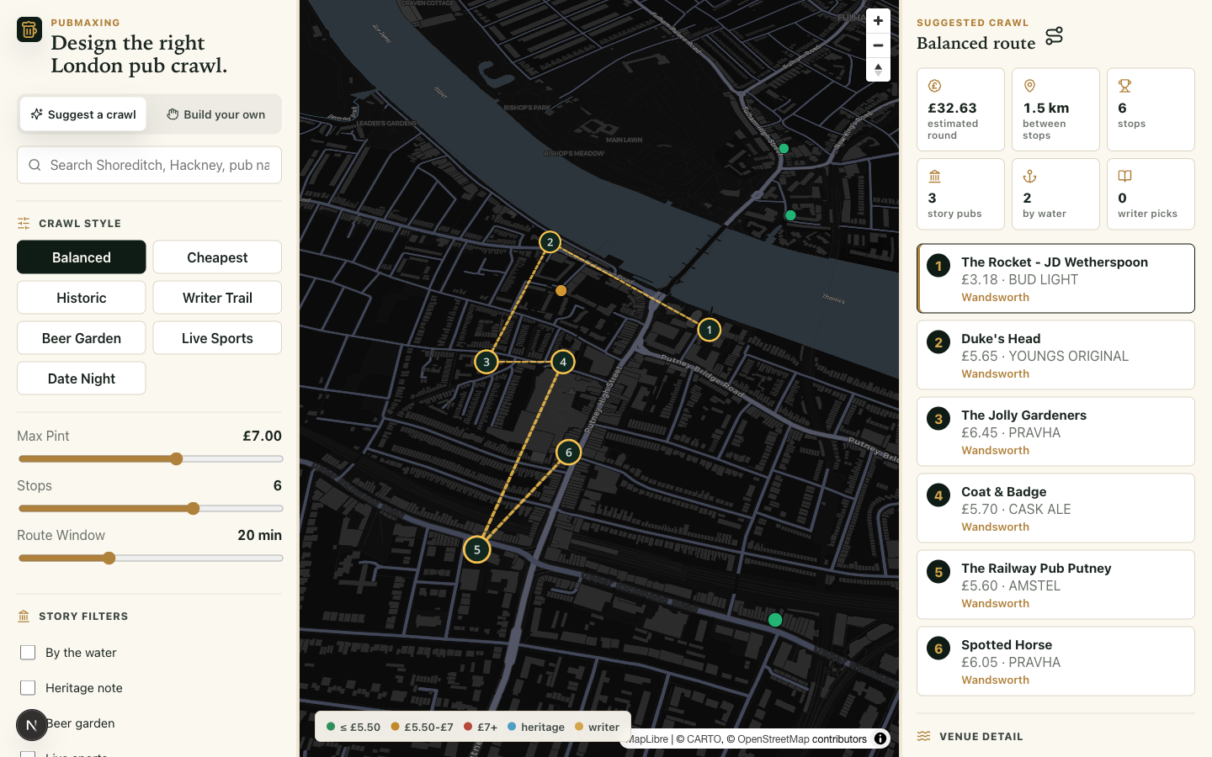
PUBMAXING
MAXXING
Demo
LONDON
What the judges should see in three minutes.
1
Open the site
Landing page sells the wedge, then the map takes over.
2
Plan a crawl
Filter by price, water, heritage and crawl style.
3
Inspect a pub
Baseline price, latest Pint Drop, provenance and story.
4
Drop the pint
Supabase-backed contribution, photo-ready, reportable.
Live map screenshot: `/map` rendered with Supabase env and MapLibre.
Demo status: Supabase tables and storage bucket verified; photo UI is the next completion step.

Slide 6
PUBMAXING
MAXXING
In Production
LONDON
The demo is no longer just a static prototype. The backend boundary is in place.
DB
P
Supabase persistence
Photo + moderation path
Project connected. `visit_reports` and `pub_heritage` tables exist. `pint-drops` storage bucket exists.
Next ship slice: pint photo, venue photo, report reason, hidden queue and restore flow.
AI
QA
The Landlord
Release discipline
Grounded Q&A over trusted venue facts. Must reject client-supplied context as source truth.
CI, browser screenshots, Supabase smoke and rollback docs before public contribution launch.
Production rule: no public Pint Drop should ever be acknowledged into process memory.

Slide 7
MAXXING
LONDON
Thank You
PubMaxing
The price data cannot be bought. It has to be poured.
Next: finish Pint Drop photos, verify provenance, and ship the demo.
Karan Manoharan · Live London

