Slide 1
Auto Review and Grading Technology for Education

Slide 2
Problem
Large number of students under a teacher in schools/colleges
Lack of focus on each student
Little/no review of students’ work/assignments during class/practice
Learning gaps surface only in exam results that too a small proportion
More syllabus covered,
Learning gaps pile up
In India, student teacher ratio in schools is 32:1* which is much worse than Brazil and China (16:1). No access to teachers is a reality for many students.
Be it Offline/Online education, students’ work do not get reviewed regularly.
Even, verifying exam papers of many students is a tedious process for teachers. Often, it is influenced by teachers’ time, availability and mood.
*Source : www.indexmundi.com

Slide 3
Solution
Large number of students under a teacher in schools/colleges
Lack of focus on each student
Auto grading technology for STEM that reviews assignments and provides proper feedback instantly
Learning gaps surface instantly, which can be addressed
Improved learning efficiency
Building an auto grading technology for STEM (science, technology, engineering and mathematics) courses.
This system can read answer sheets, analyse and auto grade student responses (free form handwritten or digital).
Powered by computer vision and natural language understanding, the system should read and understand handwritten/digital text, equations, geometry, graphs etc.

Slide 4
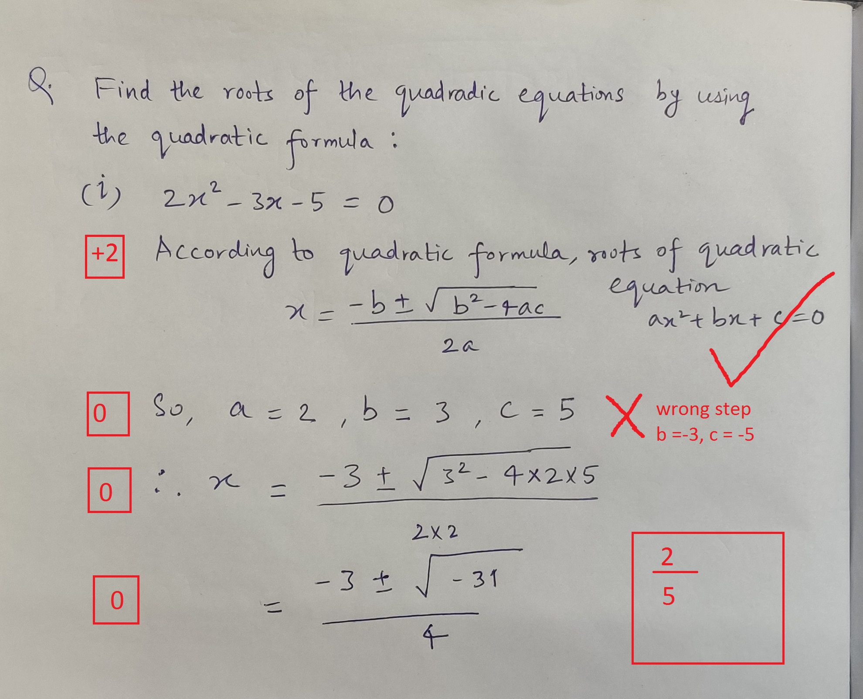
Use cases
Schools/colleges can use this tool to auto grade assignments/answer sheets by just scanning them
Digital database of answer sheets/assignments will be maintained too.
Ed tech platforms providing online courses/tuitions need Auto grading to cater to large number of students.
During online class, student responses can be verified instantly. Students just need to hold it in front of camera or upload the image.
Independent tutors assessing assignments in online/offline tutoring

Slide 5
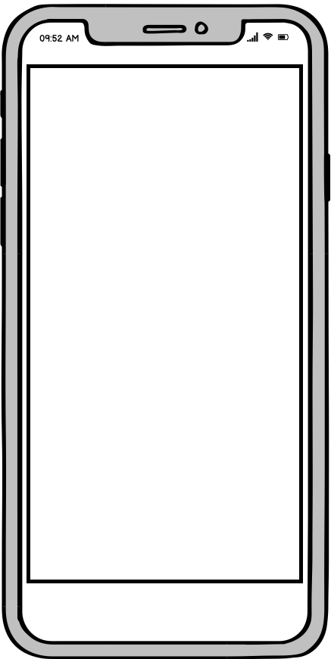
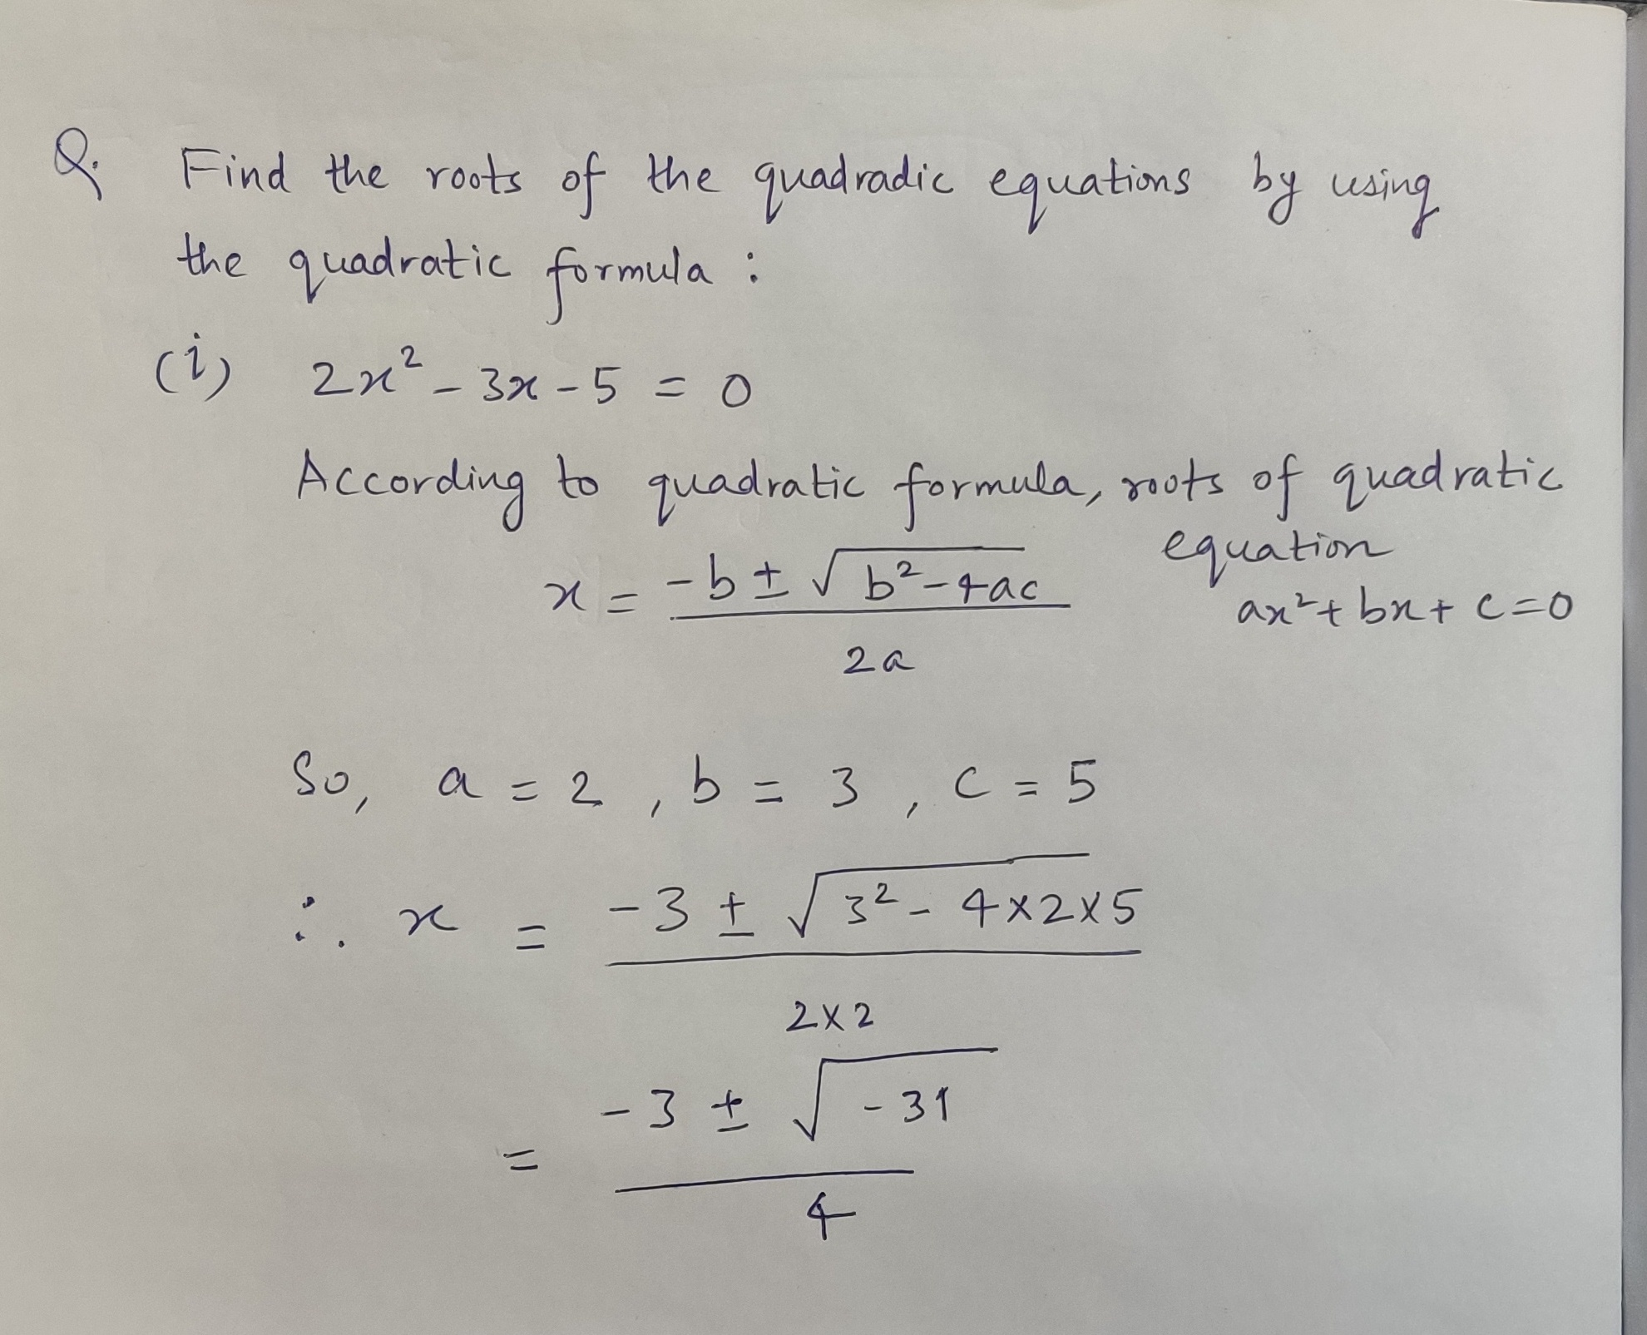
Use cases
Chatbot for self-study
It can assess assignments without the presence of a teacher, providing feedback on what went wrong.
Providing personalized learning by keeping track of all the learning gaps of a student.
It is a B2C product.
Upload your solution
Found few mistakes

Slide 6
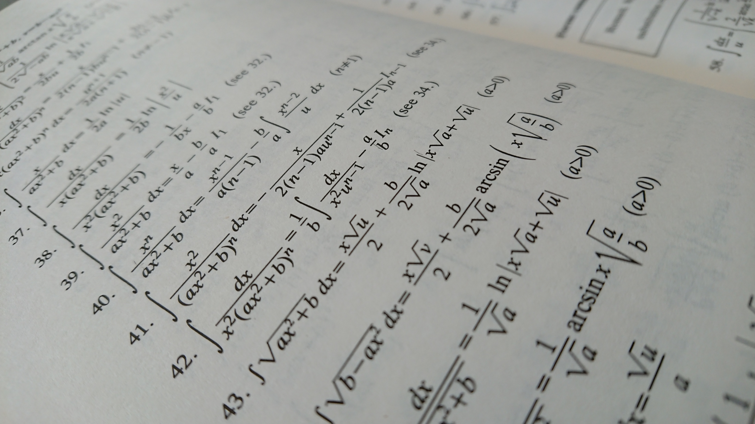
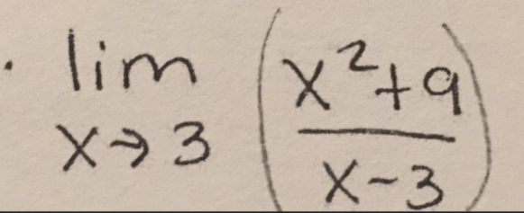

Use cases
API to read and understand mathematical/scientific symbols/equations from images
Ed tech platforms need this technology to convert captured images into digitally readable format which can be used for variety of applications
For example -
Search for solution to a question in the database.
Search for information related to the question in the book/resources

Slide 7





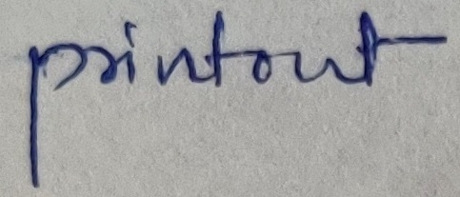

Technical Implementation
Planned Workflow
Text extracted in the form of LaTeX
Text OCR
Math OCR
Graph and Geometry understanding
Assessment using Computer Algebra System e.g. SymPy
Annotation and Grading
Input image
Current implementation outputs :
Text OCR Accuracy : 75 %, Character error rate: 10 %
Math OCR
‘account’
‘roots’
\Gamma ( z + 1 ) = \int _ { 0 } ^ { \infty } ~ d x ~ e ^ { - x } x ^ { z } .
‘pintont’

Slide 8
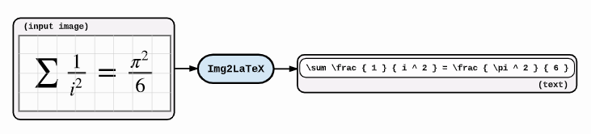
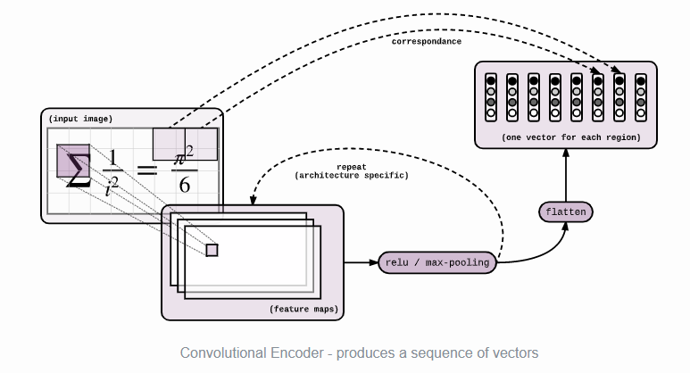

Technical Implementation
LSTM based Decoder
Reference:
https://guillaumegenthial.github.io/image-to-latex.html

Slide 9
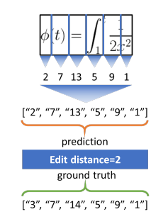
Technical Implementation
Accuracy scores of best solution on IM2LATEX-100K dataset
 | Model | BLEU score (1 is perfect) | Image Edit Distance (1 is perfect)
Current Implementation | WIGIWYS (What you get is what you see) | 87.73 | 87.6
State of the Art | MI2LS with Reinforce | 90.28 | 92.28
BLEU score captures the overlap of n-grams, as it has been shown to be the most correlated with human judgment and it is thus a standard metric in translation (1 is perfect)
References :
[Deng et al., 2016] Deng, Y., Kanervisto, A., and Rush, A. M. (2016). What you get is what you see: A visual markup decompiler. CoRR, abs/1609.04938.
[Zelun Wang et al. 2020] Translating Math Formula Images to LaTeX Sequences Using Deep Neural Networks with Sequence-level Training c

Slide 10
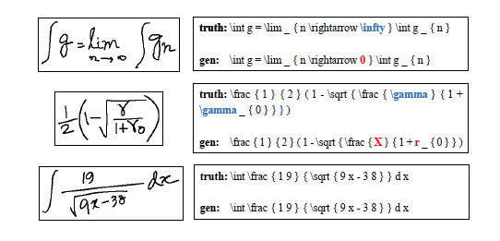
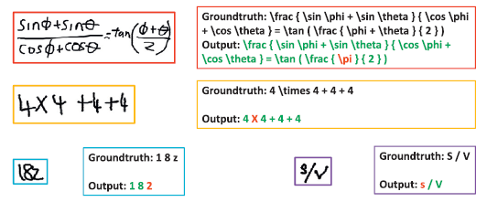
Technical Implementation
Handwritten Mathematical Expression Recognition
ExpRate (%) of Different Systems on CROHME 2014 Test Set
Model | ExpRate(%) | < 1(%)
WAP | 44.42 | 58.4
PAL | 47.06 | 63.49
MyScript (Trained on extra proprietary training data) | 62.68
References :
[Zhang et al., 2017] Watch, attend and parse: An end-to-end neural network based approach to handwritten mathematical expression recognition
[Wu et al., 2020] Image-to-Markup Generation via Paired Adversarial Learning

Slide 11
Milestones
*** removed for confidentiality

Slide 12
Market and competition analysis
Market
Competition
In 2015, There were 65 Mn* secondary school students in India, which should be much higher now.
According to Inc42 media report, India Ed Tech market size will be $10 Bn by 2025
*Source: www.ceicdata.com/
Mathpix
Solvio.ai
Offering:
Math OCR, text OCR API :
API to digitize handwritten or printed text containing mathematical symbols to LATEX
Stage: developed but does not support diagram based OCR
Offering:
Math OCR, text OCR API :
API to digitize handwritten or printed text containing mathematical symbols to LATEX
Graph, Geometry understanding
Auto Grading
Stage : All under development

Slide 13
Incubation Requirements
*** removed for confidentiality

