Slide 1
Problem#1
All Greens Franchise

Slide 2
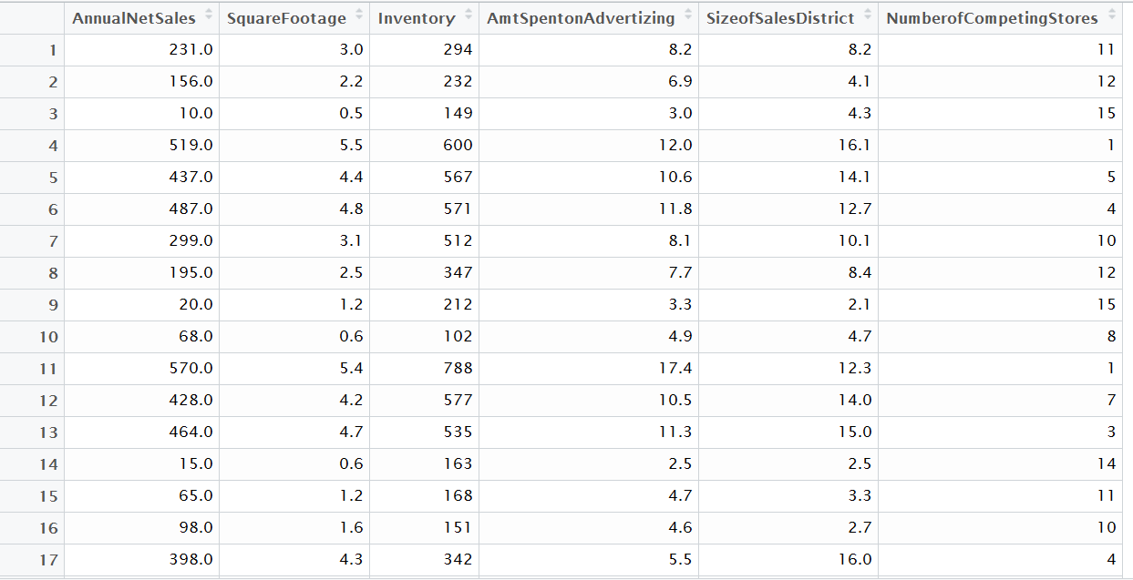
All Greens Franchise and Sample Data

Slide 3
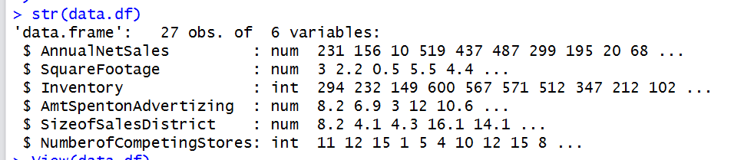
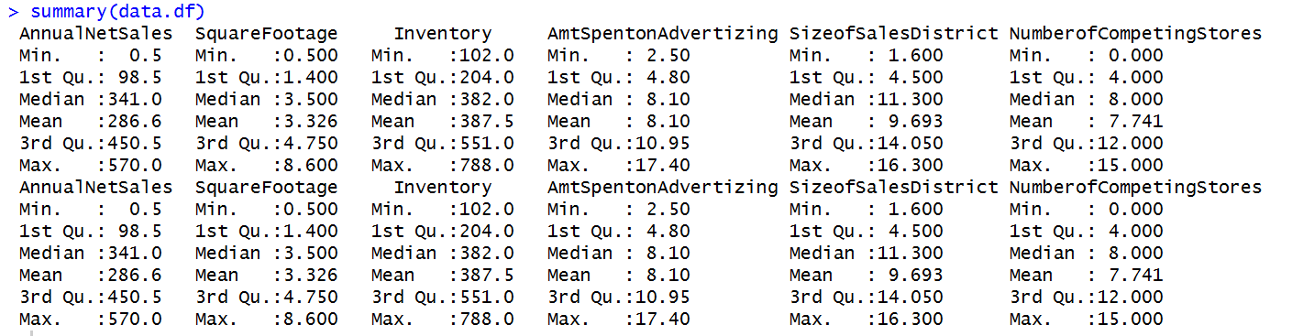
All Greens Franchise and Variables Data Type

Slide 4
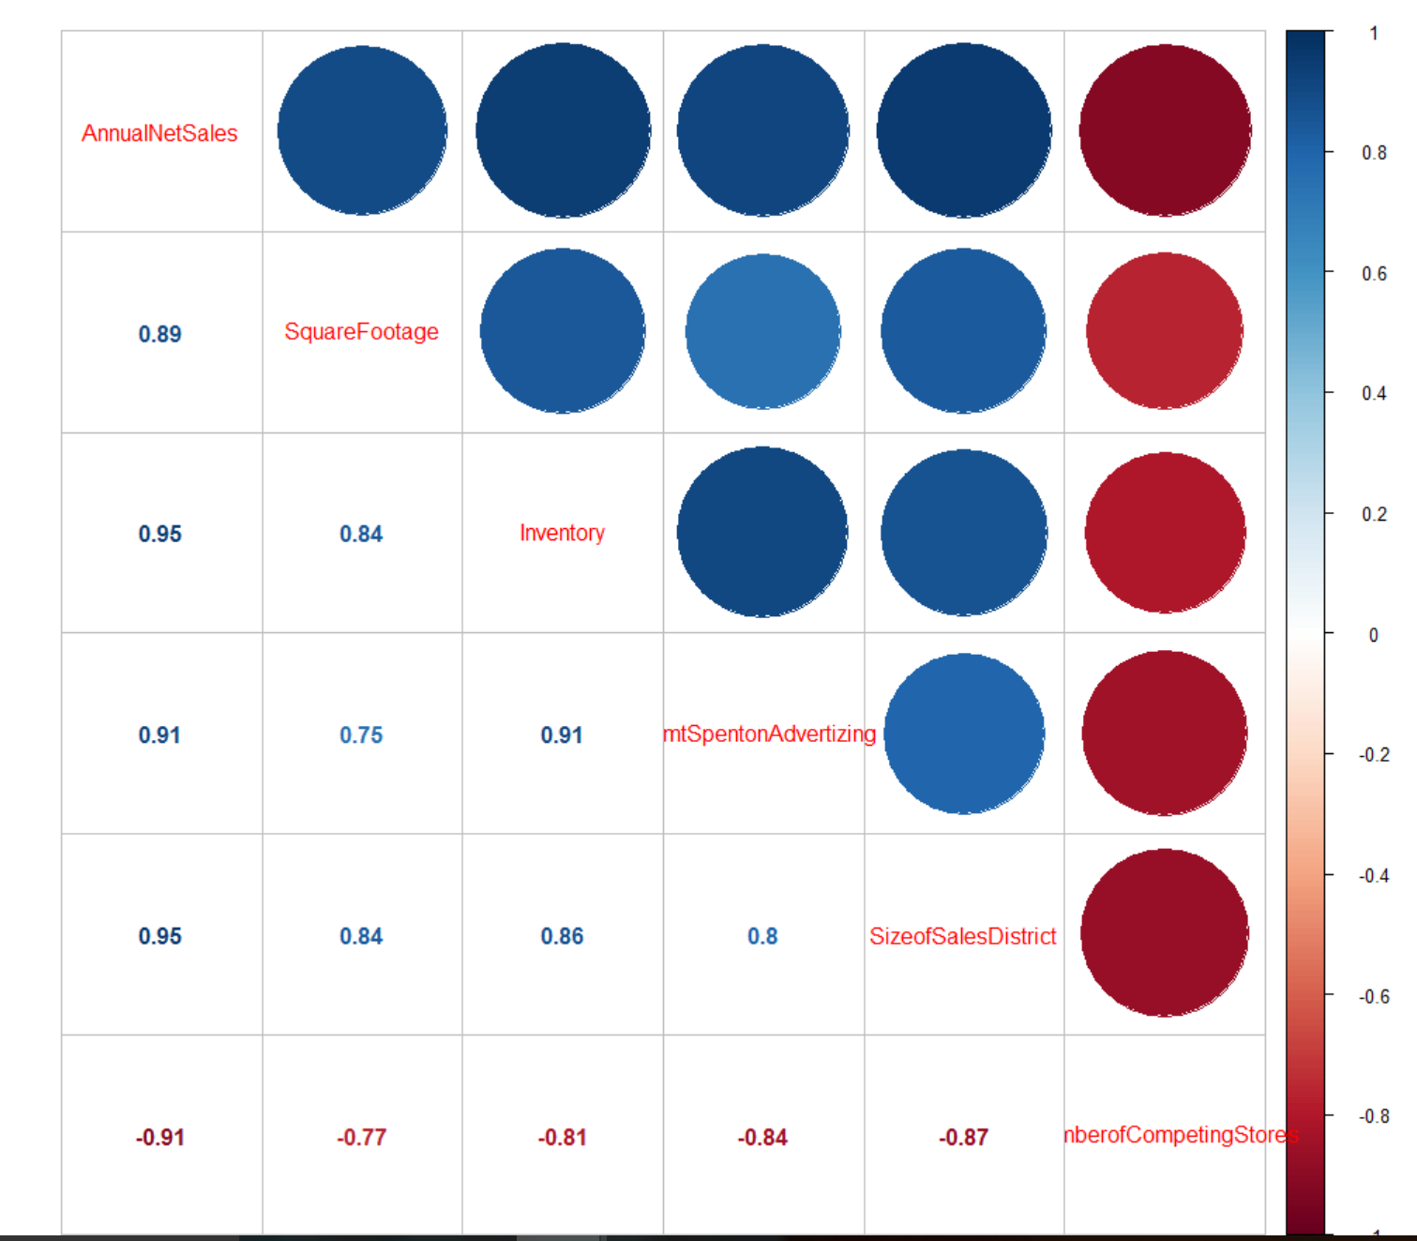
All Greens Franchise and Correlation

Slide 5
All Greens Franchise and Correlation Conclusion
All variables are highly correlated to each other
X1 renamed as AnnualNetSales, X2 renamed as SquareFootage, X3 renamed as Inventory,
X4 renamed as AmtSpentonAdvertizing, X5 renamed as SizeofSalesDistrict
X6 renamed as NumberofCompetingStores
AnnualNetSales is highly positively correlated with SquareFootage, Inventory, AmtSpentonAdvertizing, SizeofSalesDistrict
AnnualNetSales is highly negatively correlated with NumberofCompetingStores
NumberofCompetingStores is negatively correlated to all the remaining variables
The response variable is the AnnualNetSales
The predictor variables are SquareFootage,Inventory,AmtSpentonAdvertizing,SizeofSalesDistrict,NumberofCompetingStores

Slide 6
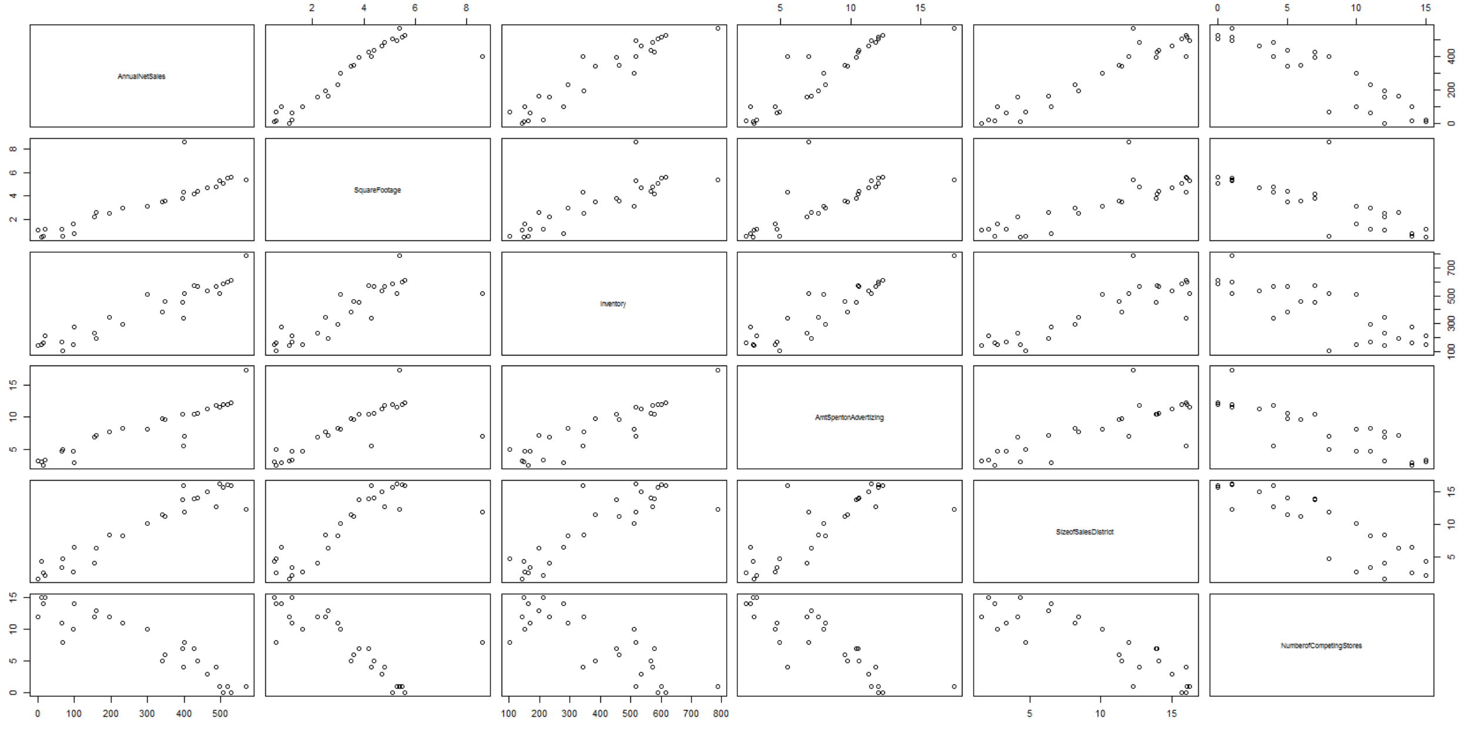
All Greens Franchise and Scatterplots

Slide 7
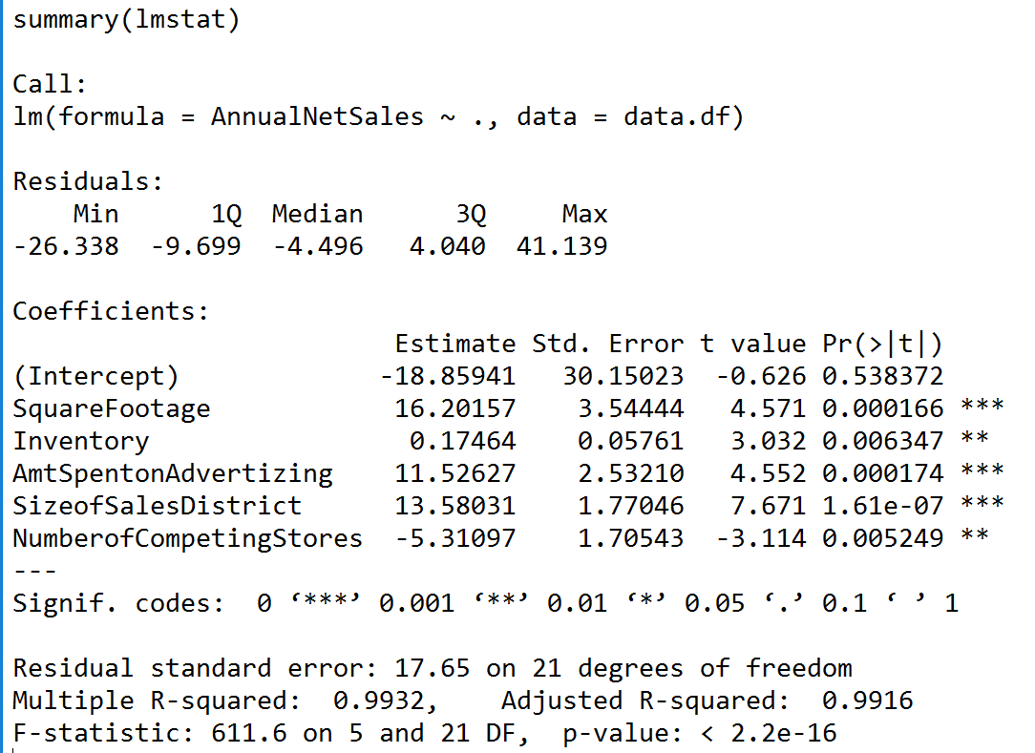
All Greens Franchise and Regression model
Regression Model with all the predictor variables
lmstat<- lm(AnnualNetSales~.,data = data.df)
summary(lmstat)

Slide 8
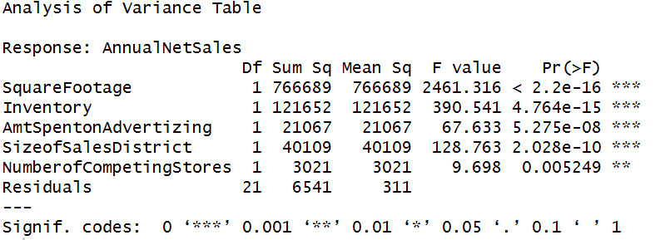
All Greens Franchise and Regression model and Anova
In the regression model, we see 99% variability explained by all the independent variables. We find all the variables significant based on the t statistics and anova
anova(lmstat)

Slide 9
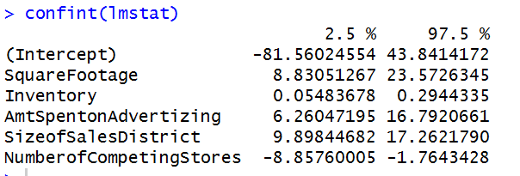
All Greens Franchise and Regression model
Confint(lmstat)
All the predictor variables are significant having pvalue for the corresponding t statistics less then 0.05
The confidence intervals for all the predictor variables does not include 0 hence it proves the po int that all the predictor variables are significant.

Slide 10
All Greens Franchise and Regression model and Coefficients
For an unit increase in squarefootage, the average annualnetsales will increase by 16201$, keeping all the remaining variables constant
For an unit increase in inventory, the average annualnetsales will increase by 17464$, keeping all the remaining variables constant
For an unit increase in the amount spent on advertising, the average annual net sales will increase by 11526$, keeping all the remaining variables constant
For an unit increase in the sizeofsalesdistrict, the average annual net sales will increase by 13580$, keeping all the remaining variables constant
For an unit increase in the numberofcompetingstores, the average annual net sales will decrease by 5311$, keeping all the remaining variables constant

Slide 11
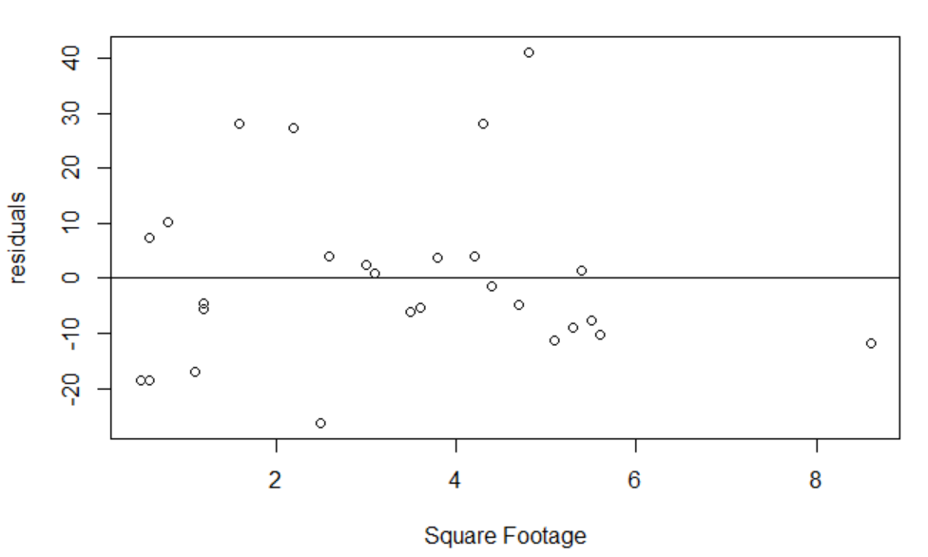
All Greens Franchise and Residual Analysis

Slide 12
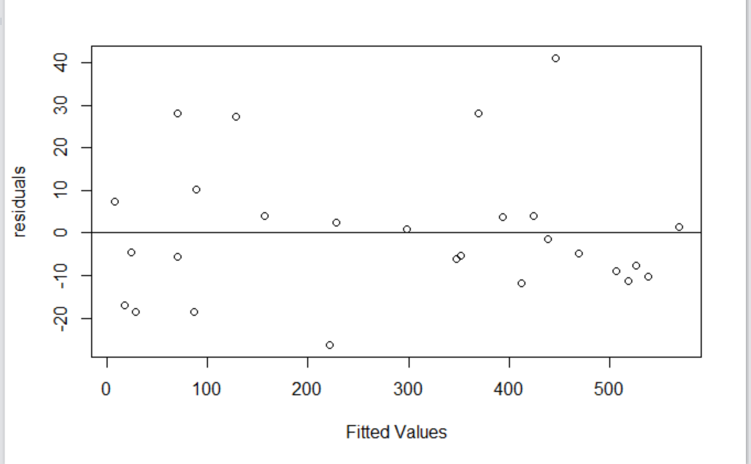
All Greens Franchise and Residual Analysis

Slide 13
All Greens Franchise and Residuals Analysis
From the above two residual analysis plot, we observe that there is no obvious pattern hence the regression model holds true satisfying all the assumptions of regression like linearity, normality, variance of error terms similar across the independent variables.

Slide 14
All Greens Franchise and Regression model
lmstat5<- lm(AnnualNetSales~Inventory+AmtSpentonAdvertizing,data = data.df)
summary(lmstat5)
On running a regression of sales with Inventory and amount spent on advertising, the R square and adjusted R squre values dropped from 0.99 (the original model with all the variables)
Multiple R-squared: 0.9123, Adjusted R-squared: 0.905
lmstat5<- lm(AnnualNetSales~Inventory+AmtSpentonAdvertizing+SizeofSalesDistrict,data = data.df)
summary(lmstat5)
Adding sizeofsalesdistrict variable,the R square and adjsuted R square values moves up, hence we can conclude that adding or removing variables moves the R square/adjusted R square up or down
Multiple R-squared: 0.9821, Adjusted R-squared: 0.9797

Slide 15
Problem#2
Leslie Salt

Slide 16
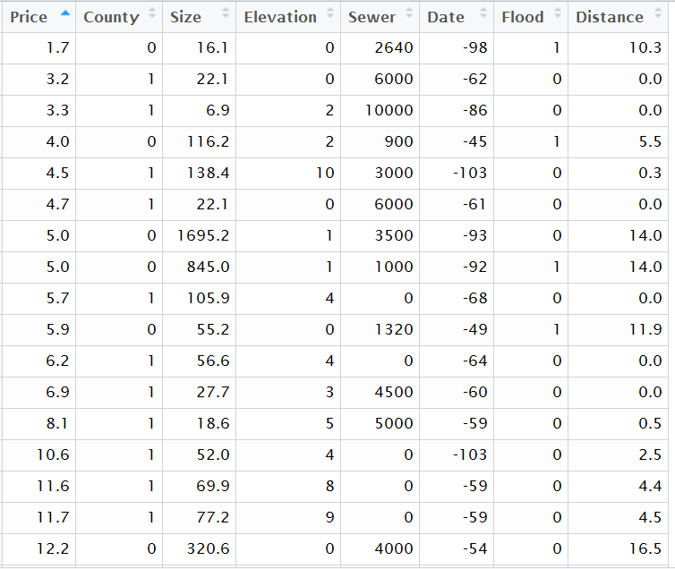
Leslie Salt Sample Data

Slide 17
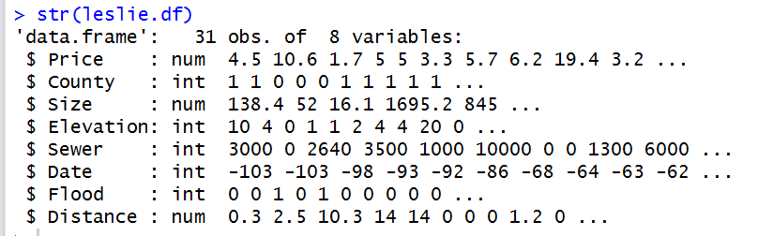
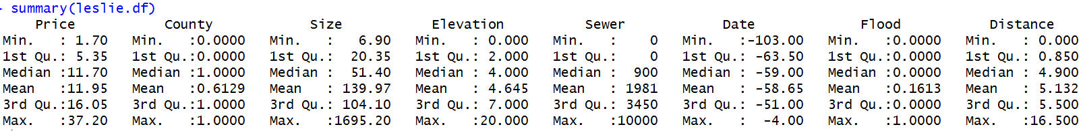
Leslie Salt Data and Data Types

Slide 18
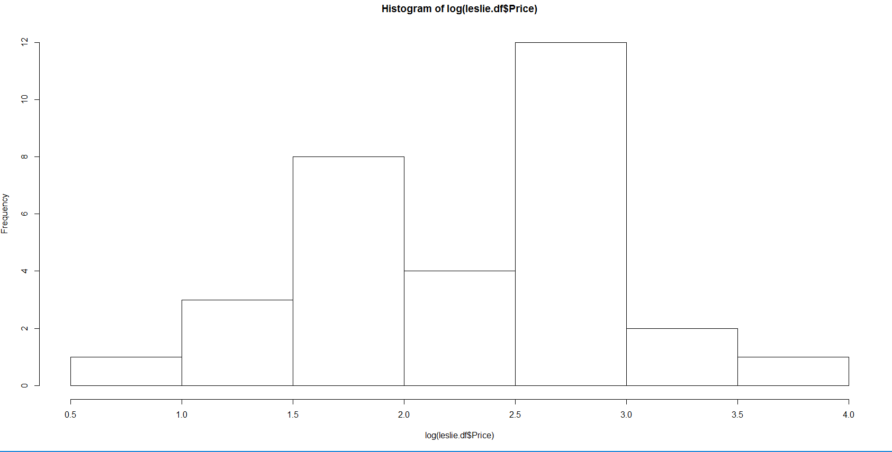
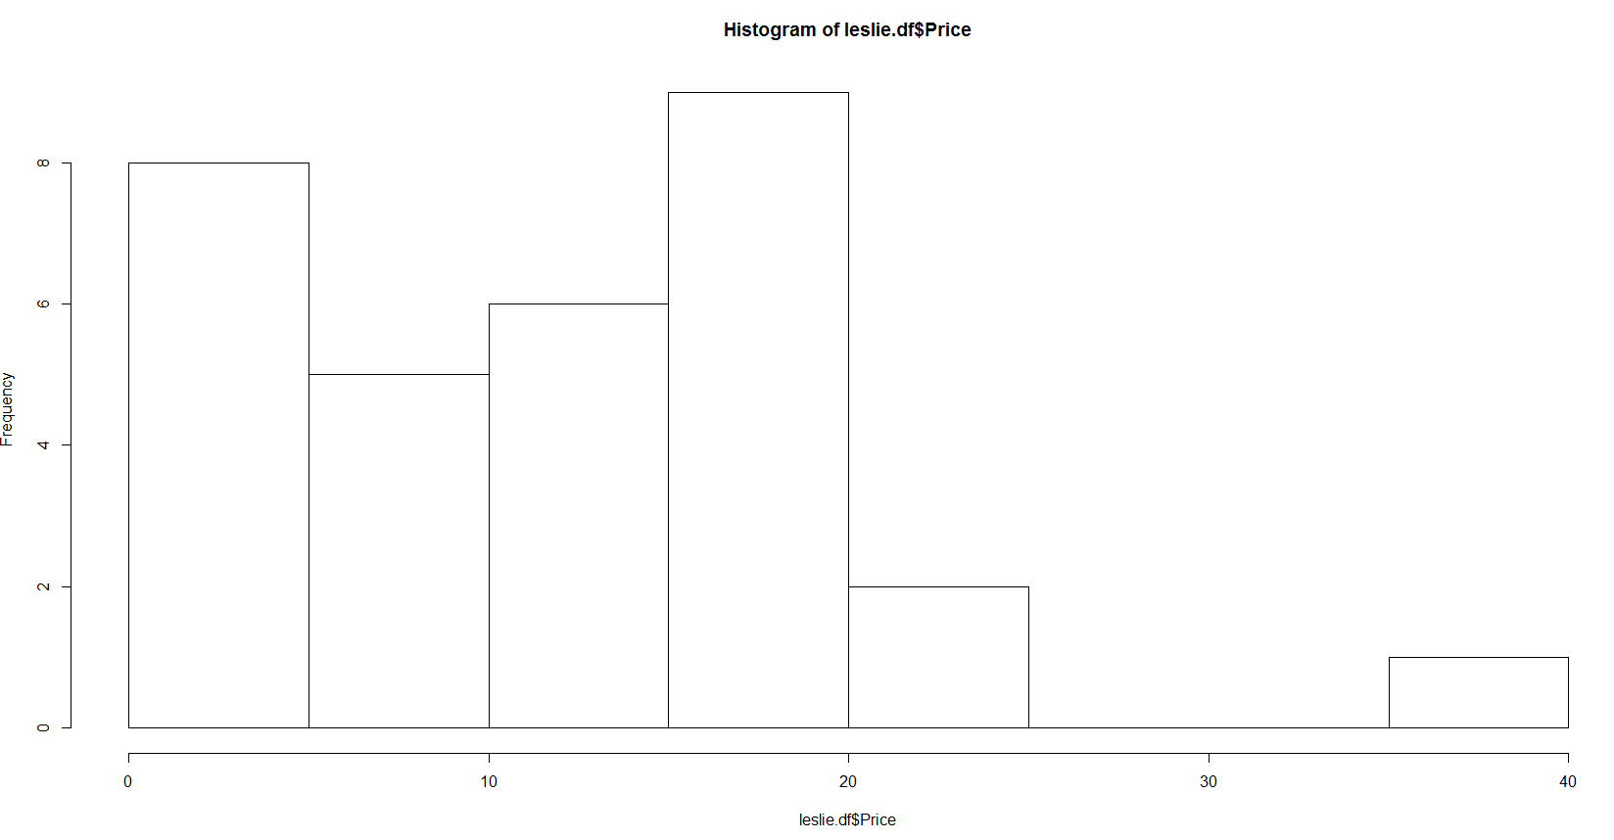
Leslie Salt Data and The Price response variable
We can see the min value is 1.7 and max value is 37.2, the spread is more. For log(price), the min value is 0.5 and max value is 3.6 hence with log transformation for the Price, the spread reduced.

Slide 19
Leslie Salt Data and The Independent Variables
Similarly meaningful log transformation done for the independent variable Size.
For other independent variables like Elevation, Sewer and Distance, when trying to perform log transformation, transformation resulted in few values as "-Inf“ because minimum value is 0.
Hence, our final data frame to run the regression model consisted of logprice as the response variables.
The independent variables as County, logsize, Elevation, Sewer, Date, Flood, Distance

Slide 20
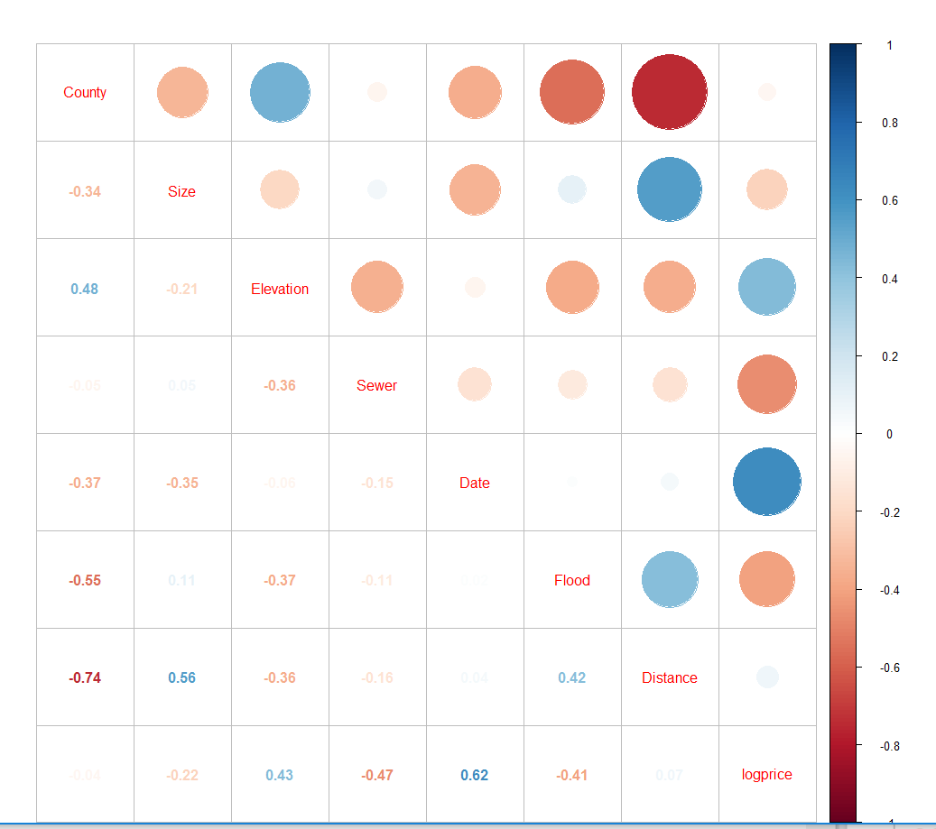
Leslie Salt Data and Correlation Plot

Slide 21
Leslie Salt Data and Correlation Observations
County and Elevation correlated
County and Flood correlated
County and Distance correlated
Size and Distance correlated
Flood and Distance correlated
Elevation and Log Price correlated
Sewer and LogPrice correlated
Date and logprice correlated
Flood and LogPrice correlated

Slide 22
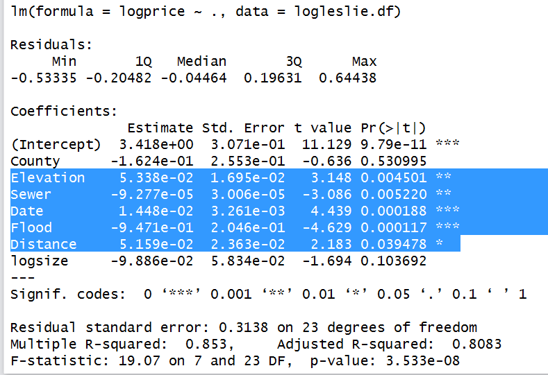
Leslie Salt Data and the Regression model
Regression model with all the independent variables and the response variable as log of price.
Multiple R-squared: 0.853, Adjusted R-squared: 0.8083
Elevation, Sewer, Date, Flood are the significant variables.

Slide 23
Leslie Salt Data and Different Models
County and Elevation correlated , County and Flood correlated
lmstat1<- lm(logprice~County+Elevation+Date+Flood+Sewer, data = logleslie.df)
summary(lmstat1)
Note:
Multiple R-squared: 0.8141, Adjusted R-squared: 0.7769
County and Distance correlated
lmstat2<- lm(logprice~County+Elevation+Date+Flood+Sewer+Distance, data = logleslie.df)
summary(lmstat2)
Note:
Multiple R-squared: 0.8347, Adjusted R-squared: 0.7934

Slide 24
Leslie Salt Data and Different Models
Size and Distance correlated , Flood and Distance correlated
lmstat3<- lm(logprice~County+Elevation+Date+Flood+Sewer+Distance+logsize, data = logleslie.df)
summary(lmstat3)
Note:
Multiple R-squared: 0.853, Adjusted R-squared: 0.8083
County and Elevation correlated , Elevation and Log Price correlated so lets try and check out if any interaction effect of County AND Elevation on logprice??
lmstat4<- lm(logprice~County+Elevation+Date+Flood+Sewer+Distance+County*Elevation, data = logleslie.df)
summary(lmstat4)
Note:
There is change in both R square and adjusted R square
all significant intercepts…this will be our final model for Prediction
Multiple R-squared: 0.8859, Adjusted R-squared: 0.8512

Slide 25
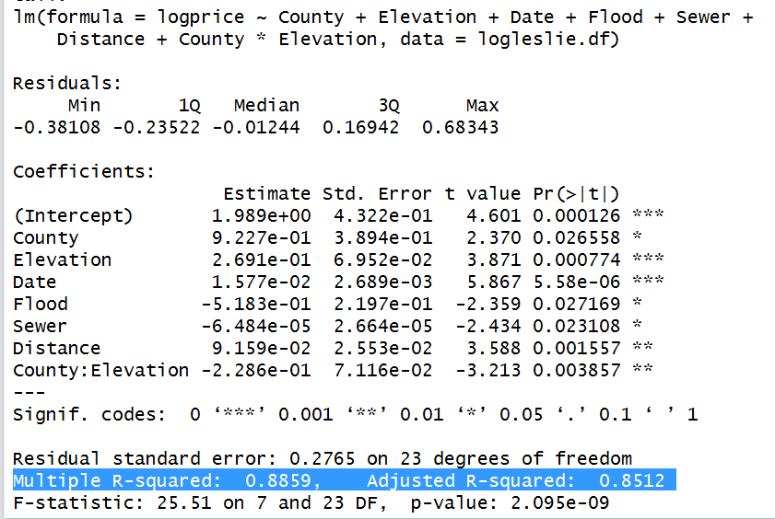
Leslie Sale Data and Regression Model with Interaction Effect

Slide 26
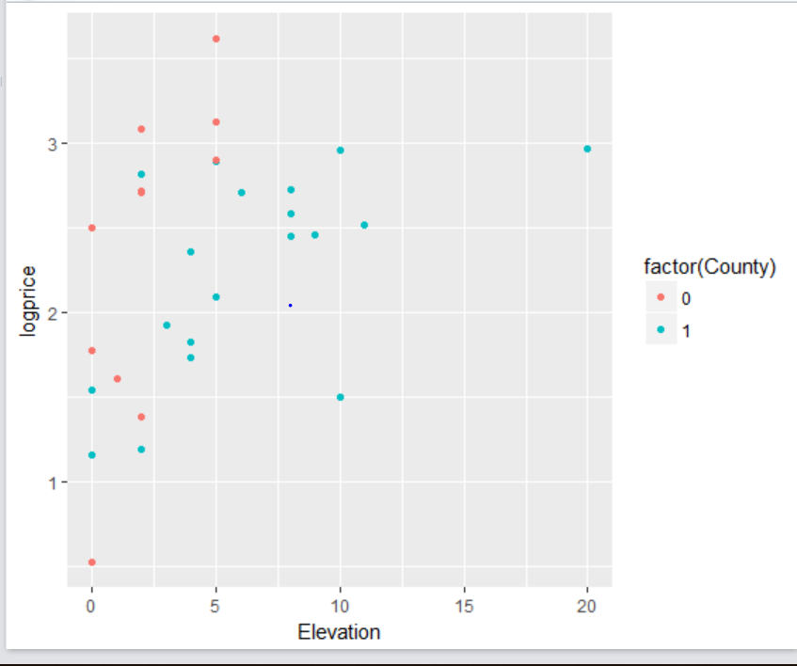
Leslie Salt Data and Scatterplot to display the Interaction Effect

Slide 27
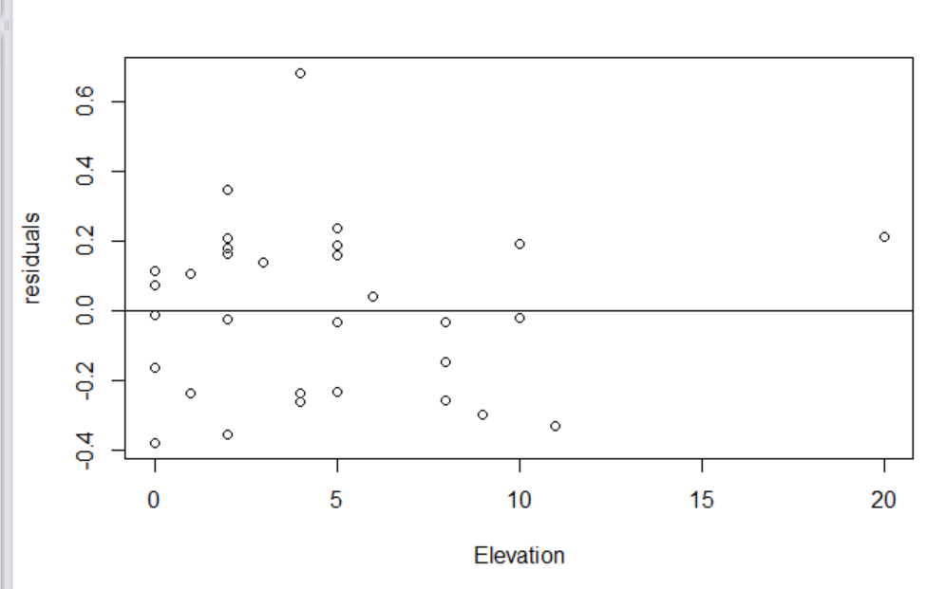
Leslie Salt Data and Residual Analysis

Slide 28
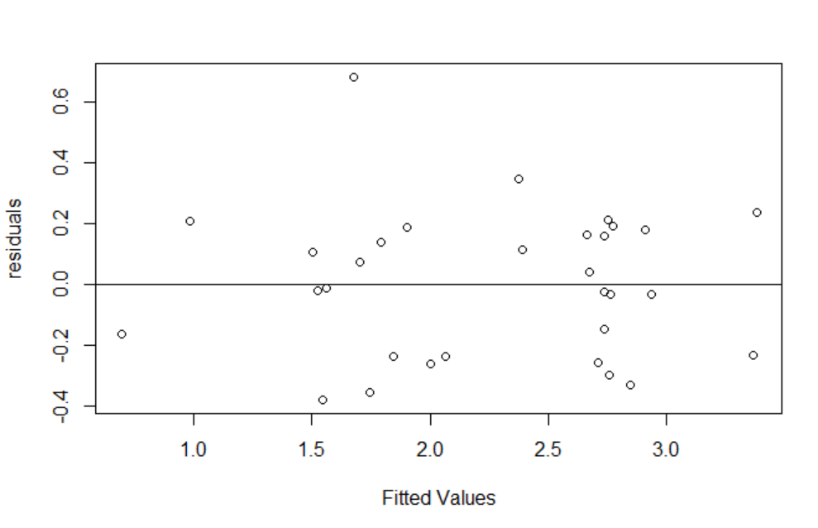
Leslie Salt Data and Residual Analysis

Slide 29
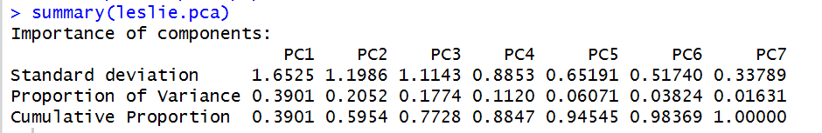
Leslie Salt Data and PCA and Regression
pca_data<- leslie.df[,-1] #removed the response variable
pca_data
pca_data<- scale(pca_data) #standardized the data so that all variables on same scale
pca_data
# Perform Principal Component Analysis
leslie.pca <- prcomp(pca_data)
summary(leslie.pca)

Slide 30
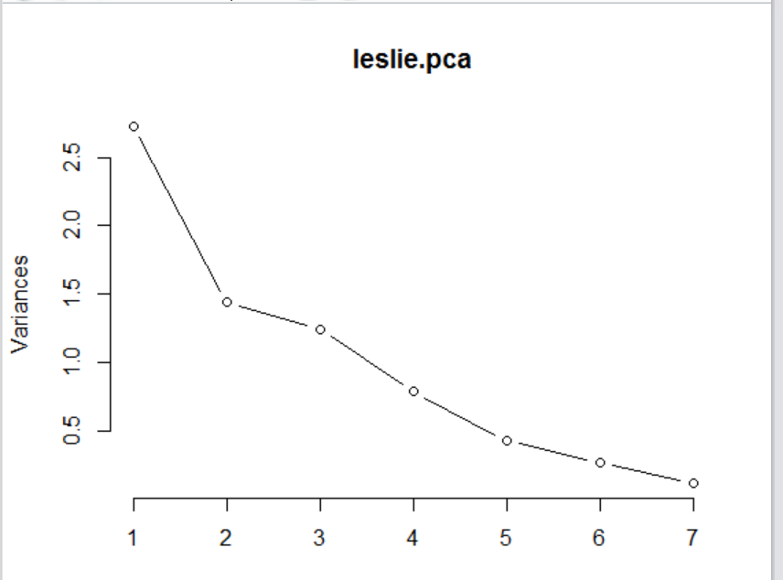
Leslie Salt Data and PCA and Regression
plot(leslie.pca, type="l")

Slide 31
Leslie Salt Data and PCA and Regression
# Let's make a data frame with logprice in the first column, and
# the principal components in the rest of the columns
newleslie.pca = cbind(log(leslie.df[,1]),data.frame(leslie.pca$x))
colnames(newleslie.pca)[1] <- "LogPrice"
# Let's compute a full model
leslie.pcr1 <- lm(Price ~., data = newleslie.pca)
summary(leslie.pcr1)
## PC1,PC2, PC3,PC4 are statistically significant
# will remove the non significant principal components
leslie.pcr2 <- lm(Price ~ PC1+PC2+PC3+PC4, data = newleslie.pca)
summary(leslie.pcr2)

Slide 32
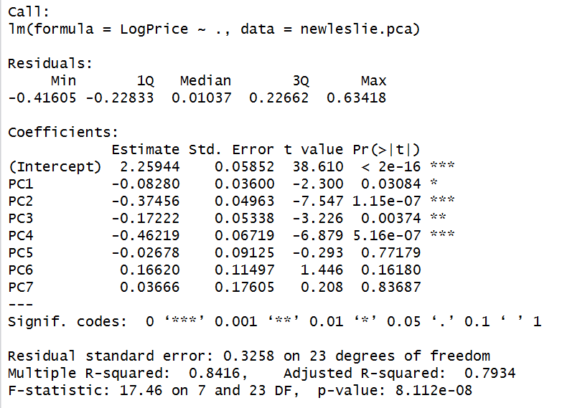
Leslie Salt Data and PCA and Regression

Slide 33
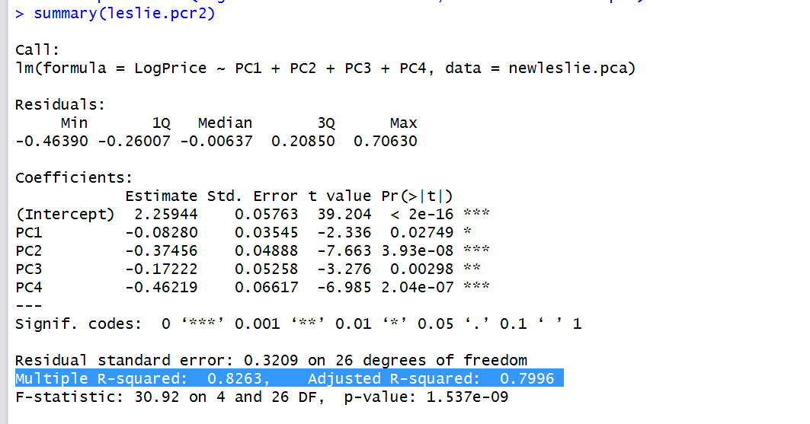
Leslie Salt Data and PCA and Regression

Slide 34
Leslie Salt Data and Regression Model without transformation on Price
lmstat<- lm(Price~Elevation+Date+Flood+Sewer, data = leslie.df)
summary(lmstat)
Multiple R-squared: 0.6029, Adjusted R-squared: 0.5418
lmstat<- lm(Price~., data = leslie.df)
summary(lmstat)
Multiple R-squared: 0.747, Adjusted R-squared: 0.67

Slide 35
Problem#3
House Dataset

Slide 36
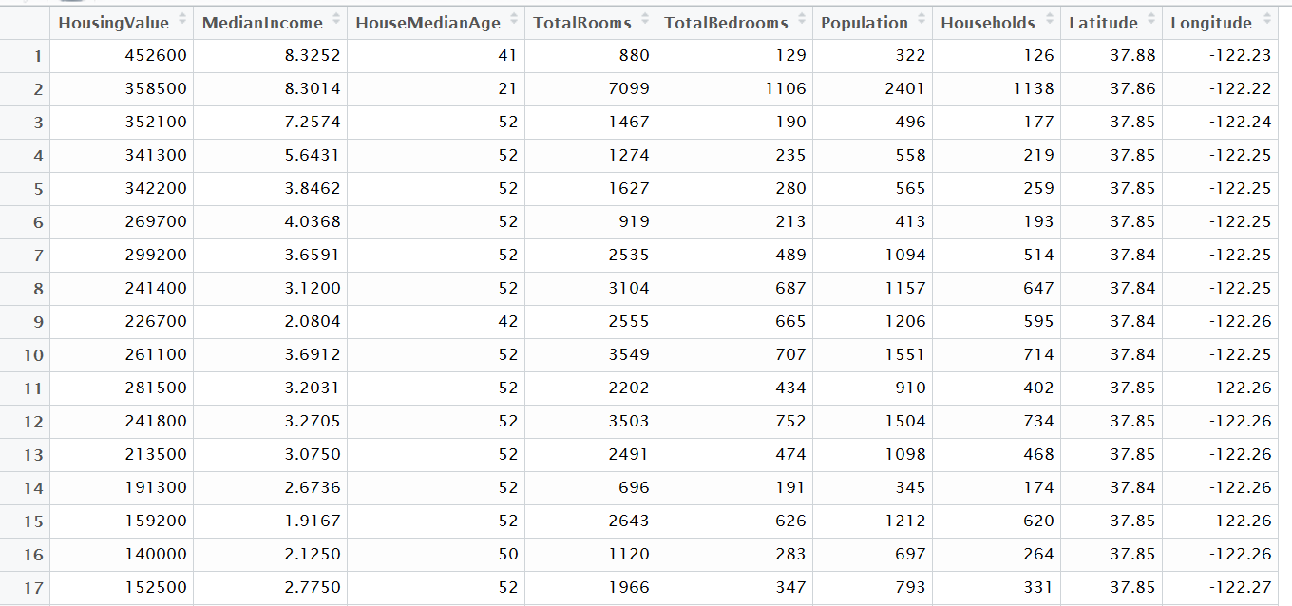
House Dataset and Sample Data

Slide 37
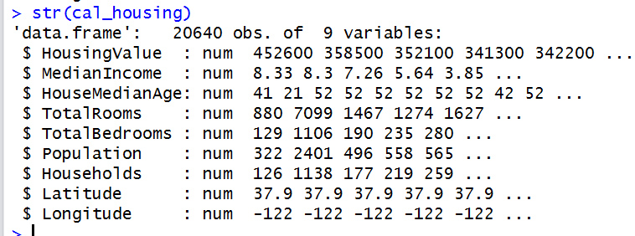
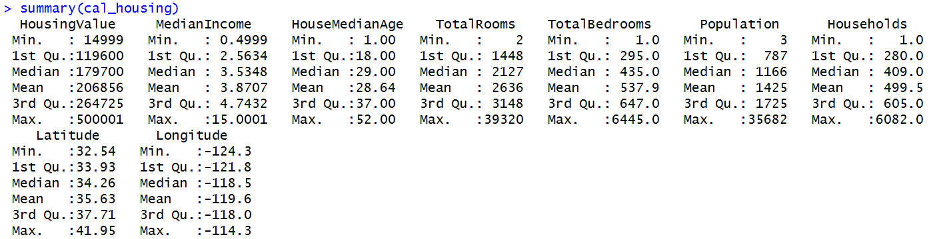
House Data and Variables Data Type and Five Point Summary

Slide 38
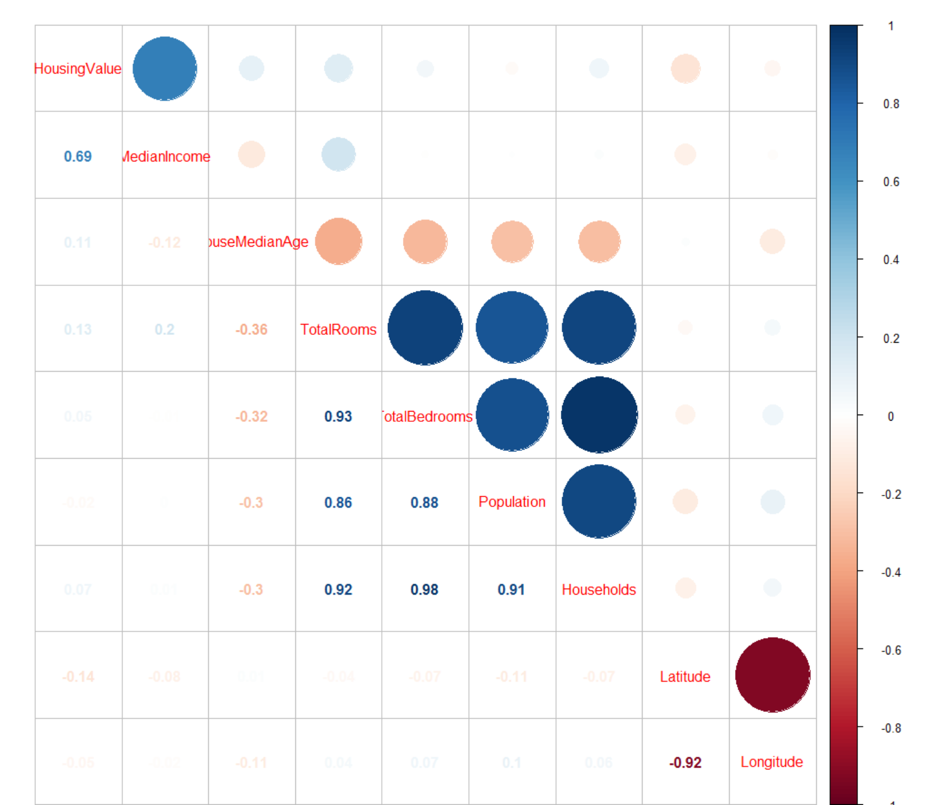
House Data and Correlation

Slide 39
House Data and Correlation Observations
Housing Value and Median Income correlated
TotalRooms and TotalBedrooms correlated
TotalRooms and Population correlated
TotalRooms and Households correlated
TotalBedrooms and Population correlated
TotalBedrooms and Households correlated
Population and Households correlated
Latitude and Longitude correlated

Slide 40
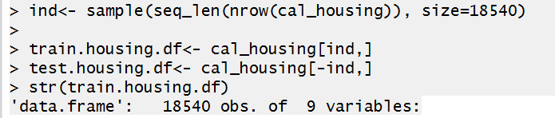
House Data and Training data set/Test Data Set
Training Data Set with 18540 rows and Test Data Set with 2100 rows through random sampling

Slide 41
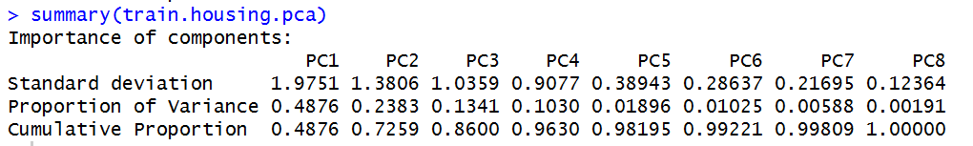
House Data and PCA and Factor Analysis
Training Data…both KMO and bartlett test holds for doing the PCA analysis
# Perform Principal Component Analysis on the training data
train.pca.data <- scale(train.housing.df[,-1]) # removed the response variable and standardized data
train.housing.pca <- prcomp(train.pca.data)
summary(train.housing.pca)

Slide 42
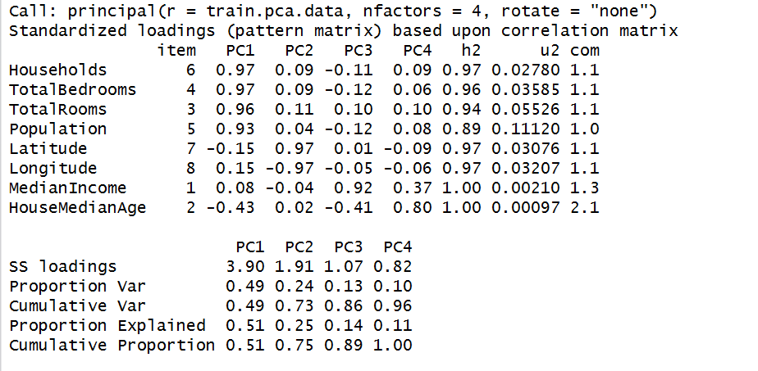
House Data and PCA and Factor Analysis
train.pca2 <- principal(train.pca.data,nfactors = 4, rotate = "none")
print.psych(train.pca2, sort=T)

Slide 43
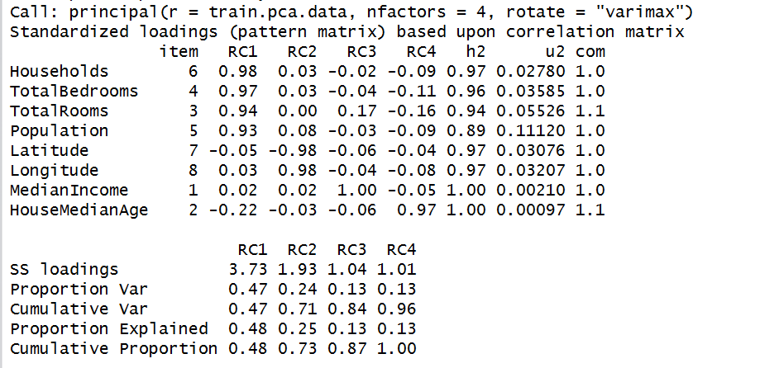
House Data and PCA and Factor Analysis
PC1 loaded on Households, TotalBedrooms, TotalRooms,Population, PC2 loaded on Latitude and Longitude, PC3 loaded on MedianIncome, PC4 loaded on HouseMedianAge. Further confirmation with Varimax rotation as well
train.pca2 <- principal(train.pca.data,nfactors = 4, rotate = "varimax")
print.psych(train.pca2, sort=T)

Slide 44
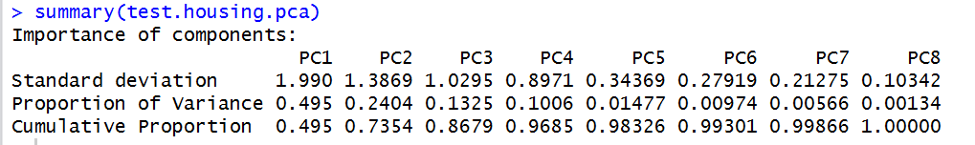
House Data and PCA and Factor Analysis
Test Data
test.pca.data <- scale(test.housing.df[,-1]) #removed the response variable and standardized data
test.housing.pca <- prcomp(test.pca.data)
summary(test.housing.pca)

Slide 45
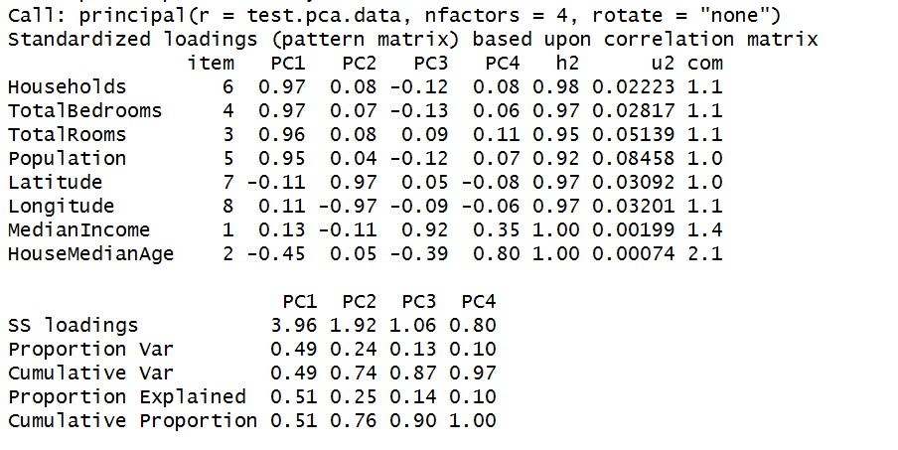
House Data and PCA and Factor Analysis
test.pca2 <- principal(test.pca.data,nfactors = 4, rotate = "none")
print.psych(test.pca2, sort=T)

Slide 46
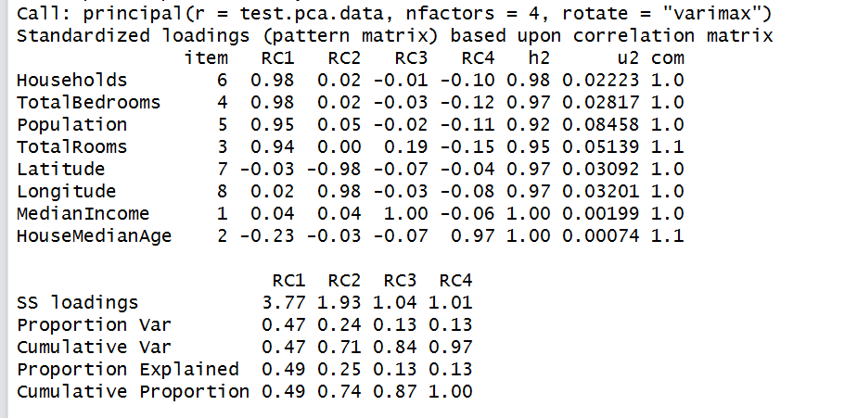
House Data and PCA and Factor Analysis
PC1 loaded on Households, TotalBedrooms, TotalRooms,Population, PC2 loaded on Latitude and Longitude, PC3 loaded on MedianIncome, PC4 loaded on HouseMedianAge. Further confirmed with Varimax rotation as well.
test.pca2 <- principal(test.pca.data,nfactors = 4, rotate = "varimax")
print.psych(test.pca2, sort=T)

Slide 47
House Data and PCA and Factor Analysis and our final conclusion
Both training data set and test data set, our conclusion of 4 factors holds true.
FA1 Households, TotalBedrooms, TotalRooms,Population can be named as HouseSize
FA2 Latitude, Longitude can be named as GeographicRegion
FA3 MedianIncome can be named as Income
FA4 HouseMedianAge can be named as HouseAge

Slide 48
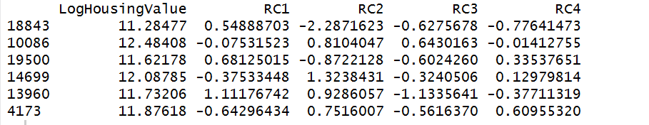
House Data and Regression Analysis with the 4 factors
# Let's make a data frame with the log of the house value in the first column, and
# the factor scores in the rest of the columns
newtrain.pca = cbind(log(train.housing.df[,1]),data.frame(train.pca2$scores))
colnames(newtrain.pca)[1] <- "LogHousingValue"
head(newtrain.pca)

Slide 49
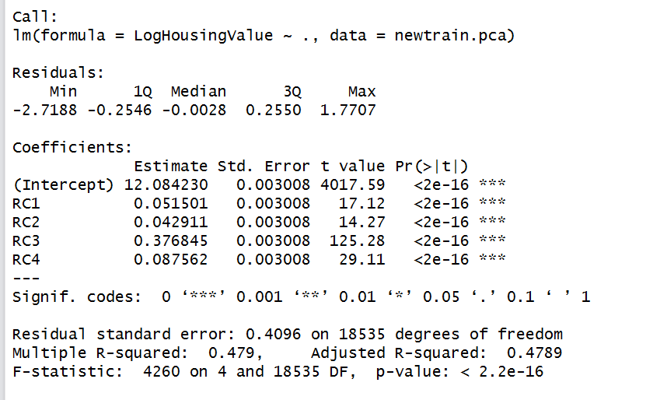
House Data and Regression Analysis with the 4 factors
# Let's compute a full model
newtrain.pcr1 <- lm(LogHousingValue ~., data = newtrain.pca)
summary(newtrain.pcr1) ……48% variability in the data explained by the 4 factors

Slide 50
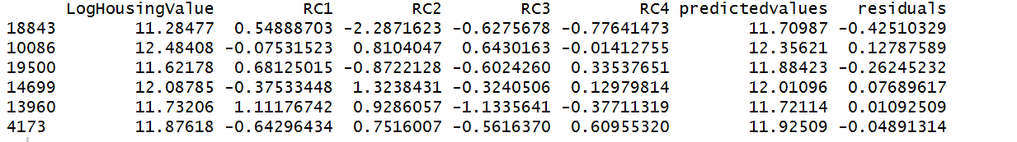
House Data and Regression Analysis with the 4 factors
newtrain.pca$predictedvalues<- newtrain.pcr1$fitted.values
newtrain.pca$residuals <- newtrain.pcr1$residuals
head(newtrain.pca)

Slide 51
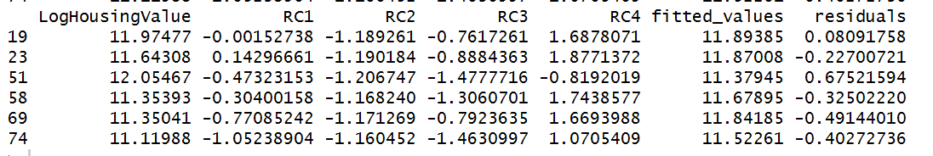
House Data and Regression Analysis with the 4 factors
# Let's make a data frame with with the log of the house value in the first column, and the principal components in the rest of the columns
newtest.pca = cbind(log(test.housing.df[,1]),data.frame(test.pca2$scores))
colnames(newtest.pca)[1] <- "LogHousingValue"
test.predict <- predict.lm(newtrain.pcr1,newdata = newtest.pca[,-1])
newtest.pca$fitted_values<- test.predict
newtest.pca$residuals <- newtest.pca$HousingPrice-newtest.pca$fitted_values
head(newtest.pca)

Slide 52
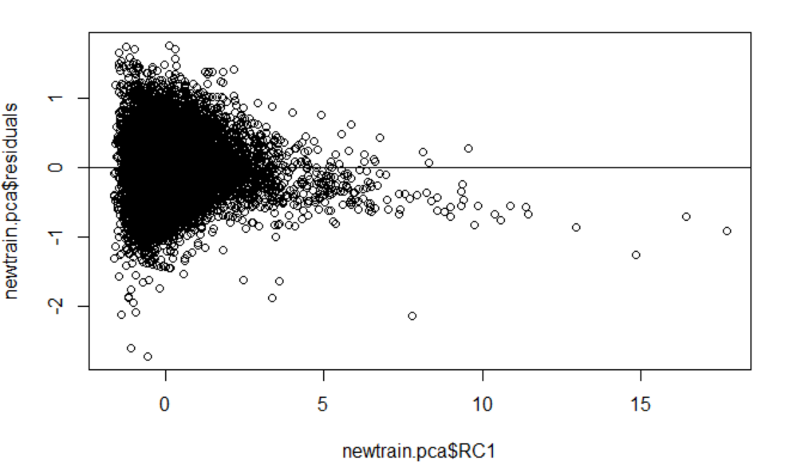
House Data and Regression and Residual Analysis

Slide 53
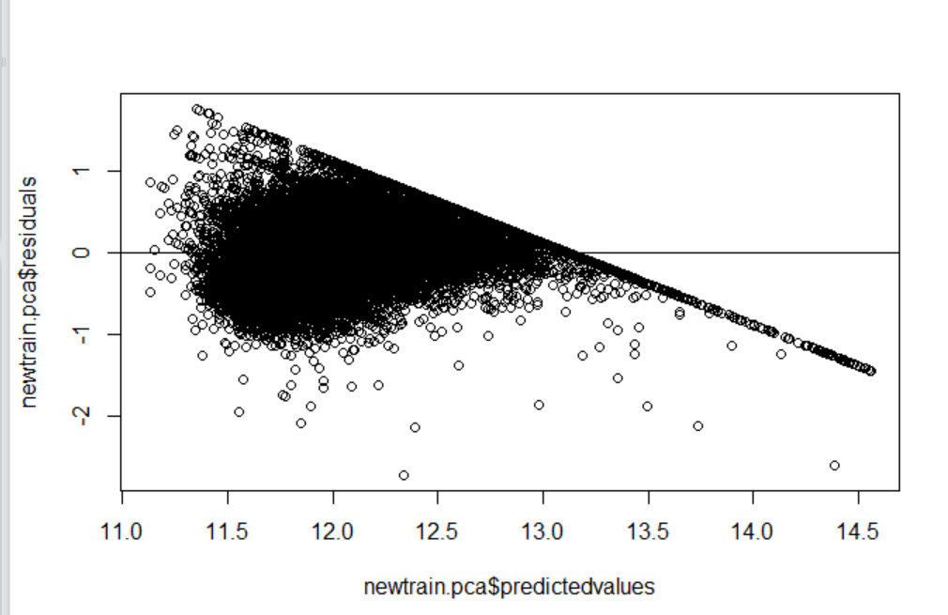
House Data and Regression and Residual Analysis
Though we can see some rough pattern but overall the data points are scattered without displaying any obvious patter hence our assumptions of regression like holds true

Slide 54
Problem#4
IPL Batting and Bowling Data

Slide 55
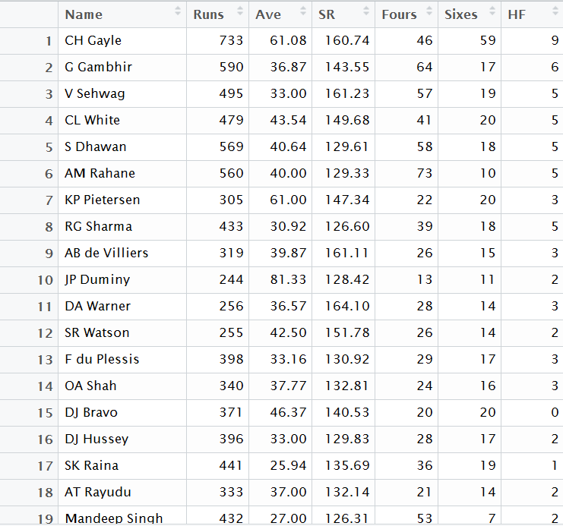
IPL Batting Data

Slide 56
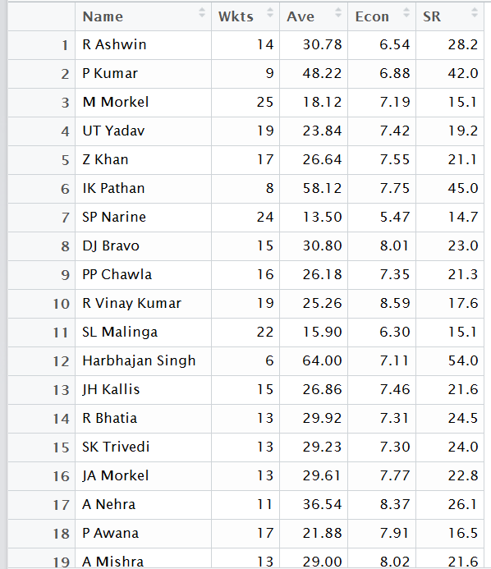
IPL Bowling Data

Slide 57
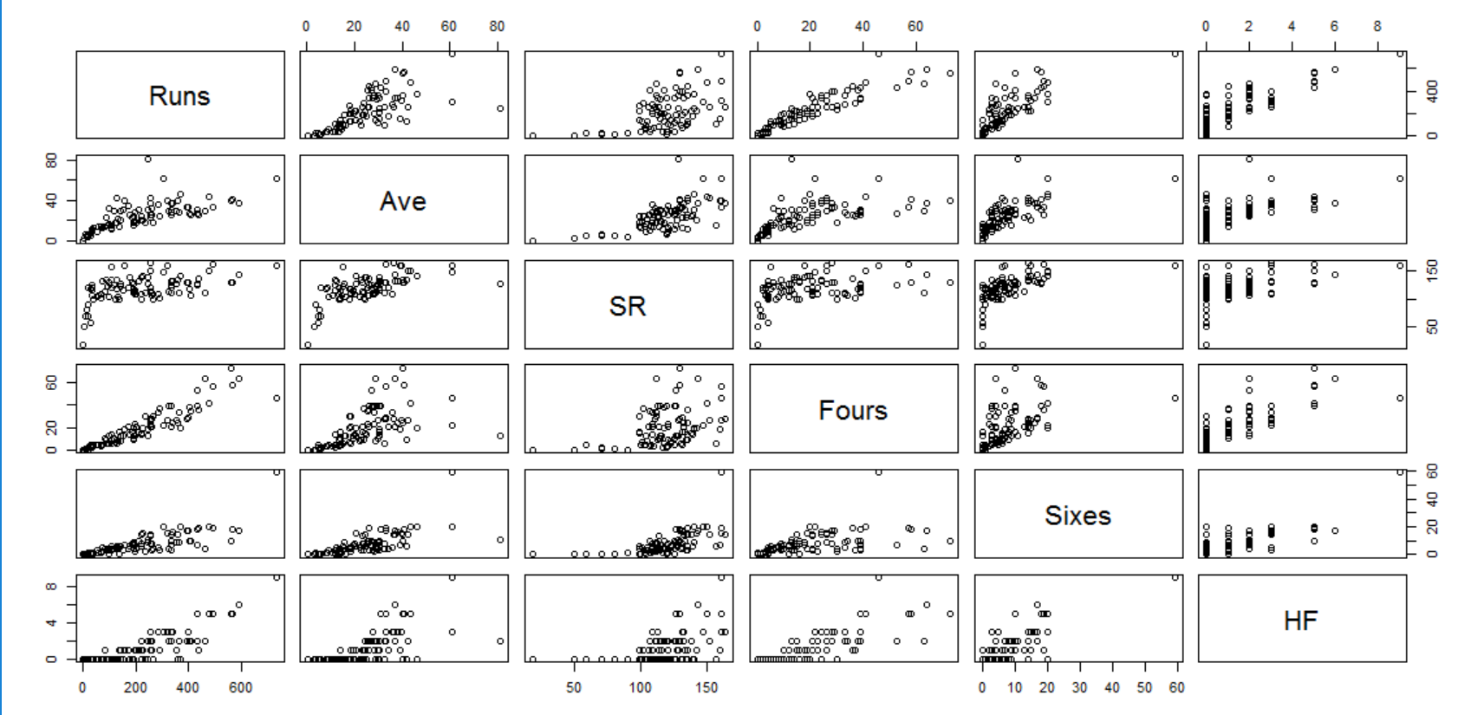
IPL Batting Data Scatterplot

Slide 58
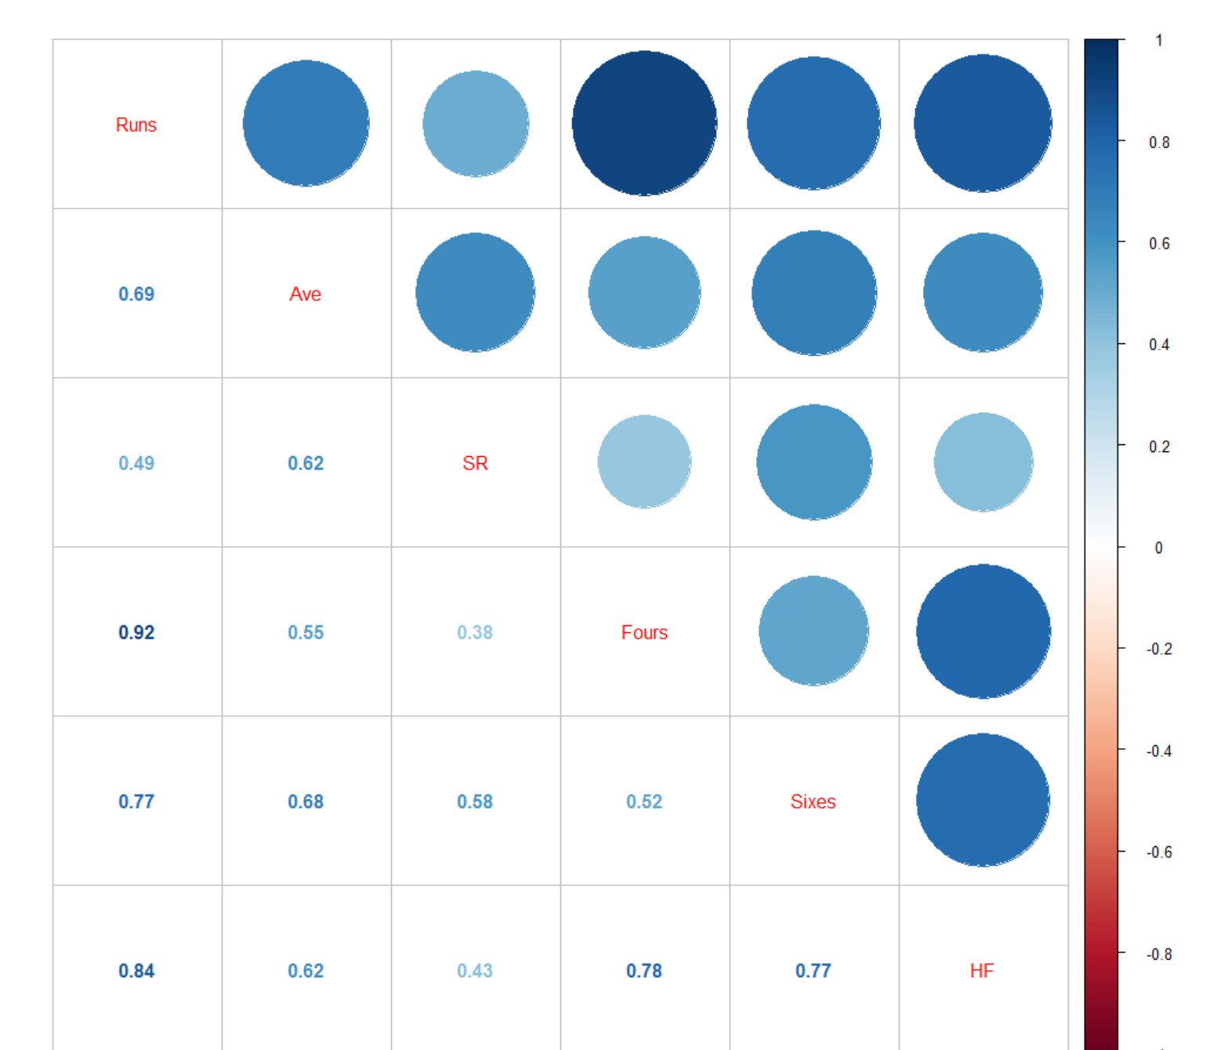
IPL Bowling Data Correlation Matrix

Slide 59
IPL Batting and Bowling Data Correlation Observations
Runs correlated with Ave
Runs correlated with SR
Runs correlated with Fours
Runs correlated with Sixes
Runs correlated with HF
Ave correlated with SR
Ave correlated with Fours
Ave correlated with Sixes
Ave correlated with HF
SR correlated with Fours
SR correlated with Sixes

Slide 60
IPL Batting and Bowling Data Correlation Observations
SR correlated with HF
Fours and Sixes correlated
Fours and HF correlated
Sixes and HF correlated
Wkts and AVE negatively correlated
Ave and Economy positively correlated
Wkts and SR negatively correlated
Ave and SR positive high correlation
KMO and Bartlett test holds for performing the PCA analysis

Slide 61
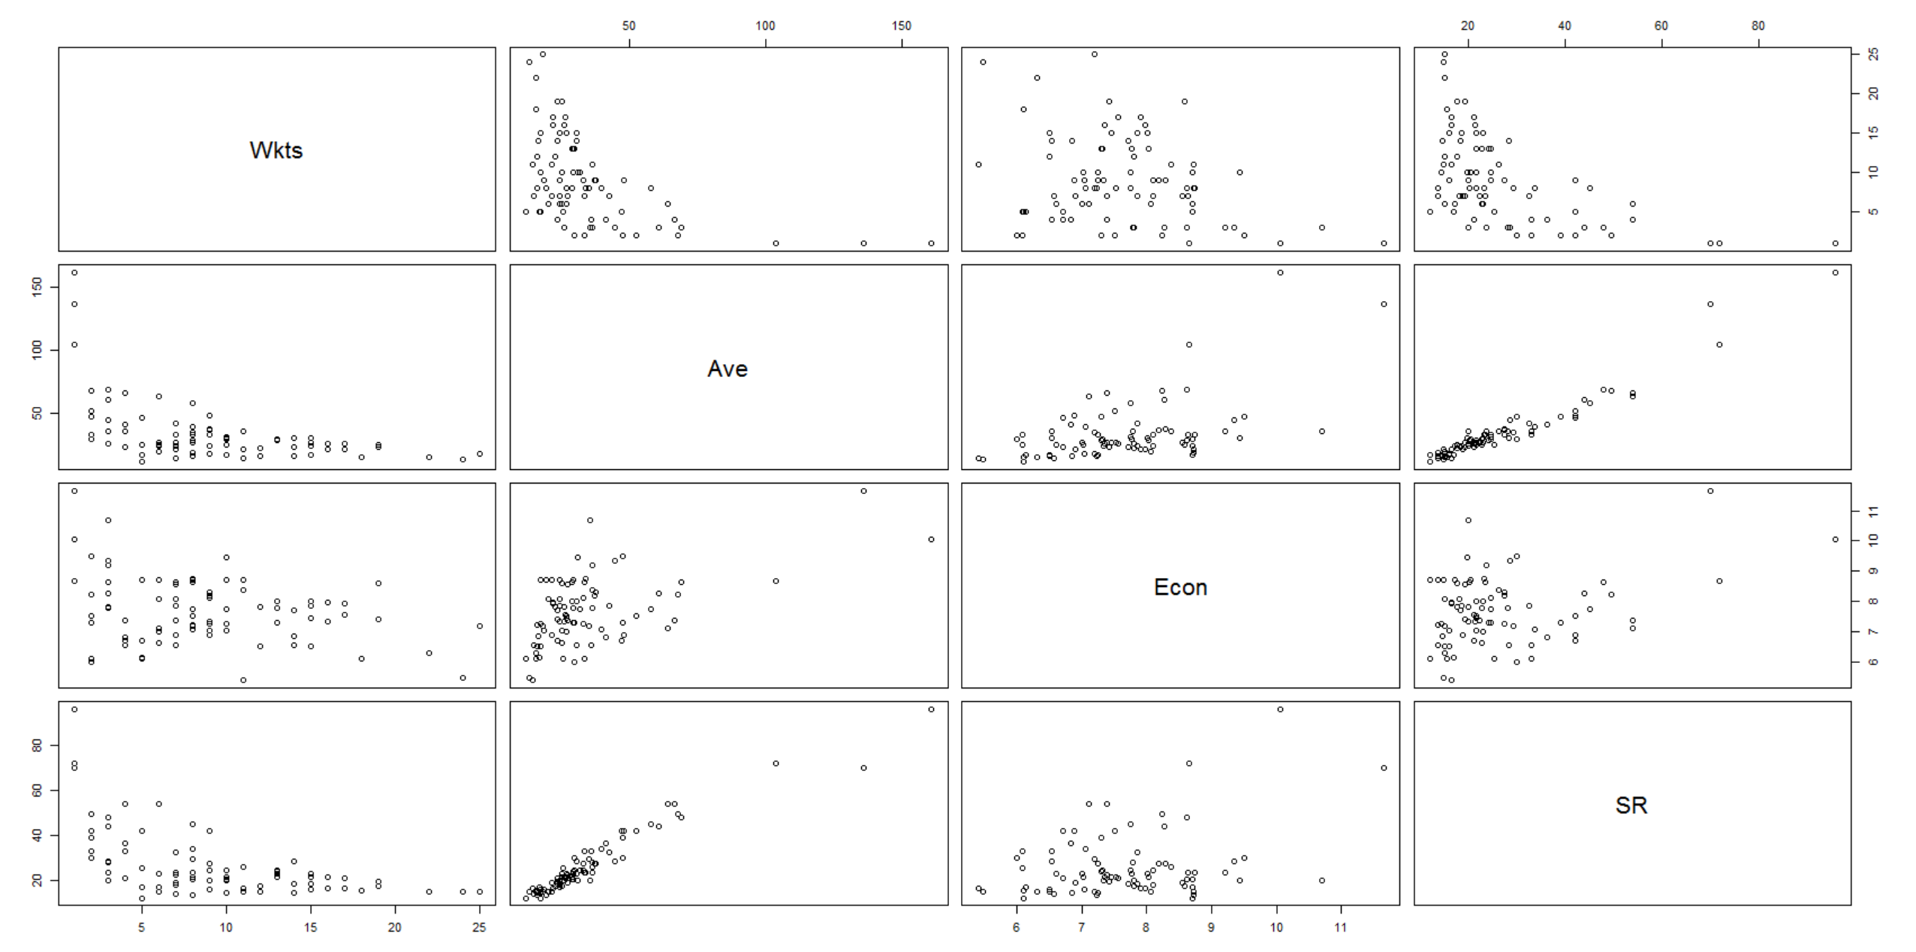
IPL Bowling Data Scatterplot

Slide 62
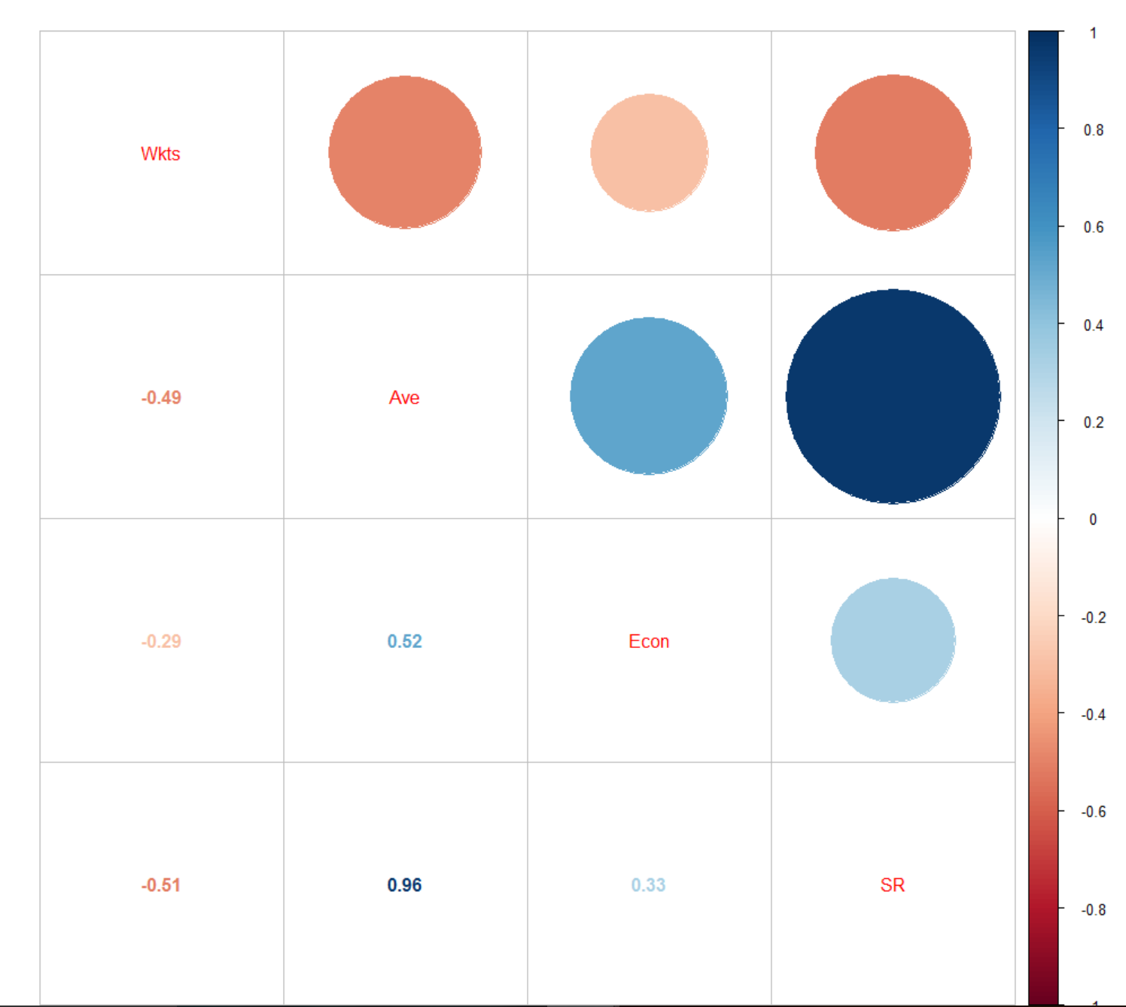
IPL Bowling Data Correlation Matrix

Slide 63
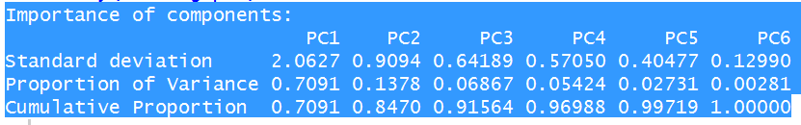
IPL Batting Data and PCA analysis
# Perform Principal Component Analysis
batting.pca.data <- scale(batting.csv[,-1]) #will exclude the name of the batsman and scale the data
batting.pca <- prcomp(batting.pca.data)
batting.pca$sdev^2 #The Eigenvalue
summary(batting.pca)

Slide 64
IPL Batting Data and Top 10 Batsmen
Since only the first principal component has Eigen value greater than 1 so we will extract the first principal component that also explains 71% of the data
We will create a new data frame that will have the batsman name in the first column and the first principal component scores in the second column
batting.new.data<- NULL #Empty data frame
batting.new.data$Batsmanname<- batting.csv[,1] #The batsman name
batting.new.data$PC1<-batting.pca$x[,1] #The first Principal Component Scores
batting.new.data<- as.data.frame(batting.new.data)

Slide 65
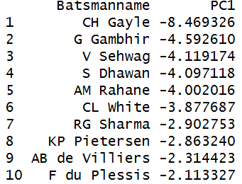
IPL Batting Data and Top 10 Batsmen
#The top 10 batsmen using the first principal component
head(arrange(batting.new.data,PC1), n = 10)

Slide 66

IPL Bowling Data and PCA analysis
# Perform Principal Component Analysis
bowling.pca.data <- scale(bowling.csv[,-1]) #will exclude the name of the batsman
bowling.pca <- prcomp(bowling.pca.data)
bowling.pca$sdev^2 #The Eigen Value
summary(bowling.pca)

Slide 67
IPL Bowling Data and Top 10 Bowlers
Since only the first principal component has Eigen value greater than 1 so we will extract the first principal component that also explains 65% of the data
We will create a new data frame that will have the bowler name in the first column and the first principal component scores in the second column
bowling.new.data<- NULL #Empty Data Frame
bowling.new.data$bowlers<- bowling.csv[,1] #The bowler name
bowling.new.data$PC1<-bowling.pca$x[,1] #Scores with respect to the first Principal Component
bowling.new.data<- as.data.frame(bowling.new.data)

Slide 68

IPL Bowling Data and Top 10 Bowlers
Top ten bowlers
Unlike the analysis for batsmen, where the coefficients in L1 of that discussion are all positive, the
coefficient of Wkts here is negative while the remainder are positive. This makes sense since better
bowler performance is naturally associated with higher numbers of wickets taken from batsmen
head(arrange(bowling.new.data,PC1), n = 10)

