Slide 1
Retail Sales Analysis Dashboard
Excel-Based Business Insights
Prepared by Tejas

Slide 2
Project Overview
• Analyzed retail sales data using Excel
• Built interactive dashboard
• Used Pivot Tables, Charts & Slicers
• Objective: Support business decisions

Slide 3
Key KPIs
• Total Revenue: ₹4,56,000
• Total Units Sold: 2,514
• Total Orders: 1,000
• Average Order Value: ₹456

Slide 4
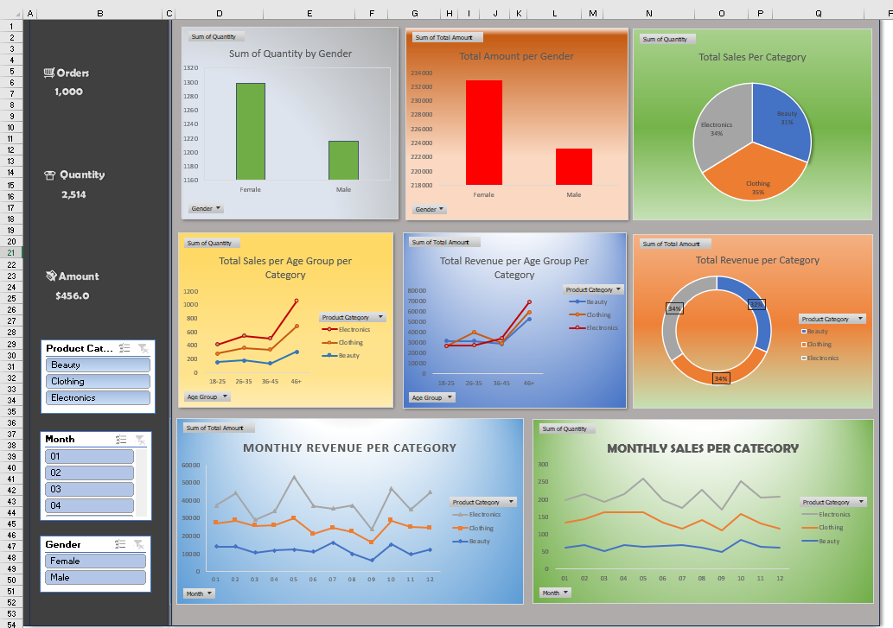
Interactive Sales Dashboard (Excel)

Slide 5
Product Performance
• Electronics: Highest revenue contributor
• Clothing: Highest volume seller
• Beauty: Moderate performer
• Mixed pricing strategy recommended

Slide 6
Customer Insights
• Female customers generate higher revenue
• 46+ age group is top revenue segment
• 26–35 shows strong growth potential
• 18–25 has lower spending power

Slide 7
Monthly & Seasonal Trends
• Sales show seasonal patterns
• Electronics peaks in selected months
• Clothing demand is stable
• Beauty has moderate seasonality

Slide 8
Business Recommendations
• Focus marketing on Electronics & 46+ customers
• Promote Beauty & Clothing bundles
• Improve clothing supply chain
• Launch seasonal campaigns

Slide 9
Conclusion
• Dashboard enables data-driven decisions
• Identified key growth areas
• Supports management planning
• Scalable for future analysis

