Slide 1
MVC

Slide 2

MVC pattern

Slide 3
MVC example
Student object acting as a model
StudentView will be a view class
StudentController is the controller class responsible to store data in Student object and update view StudentView accordingly

Slide 4
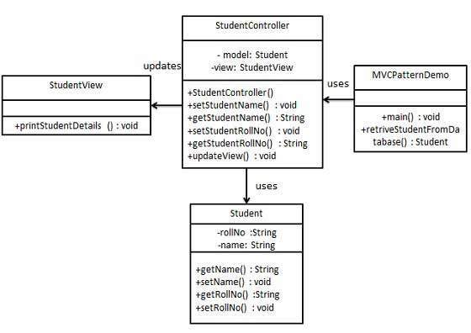

Slide 5
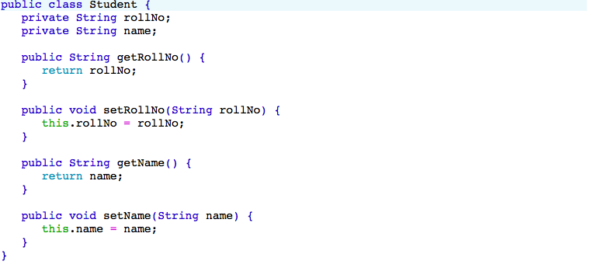
Model (Student.java)

Slide 6
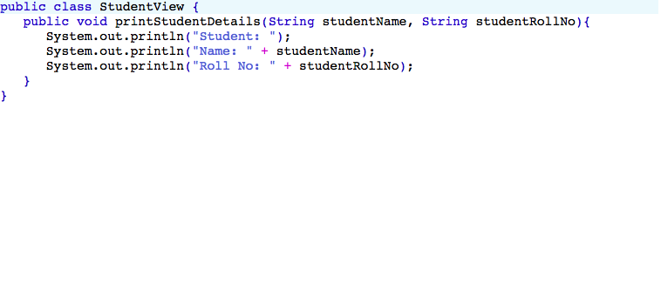
View (StudentView.java)

Slide 7
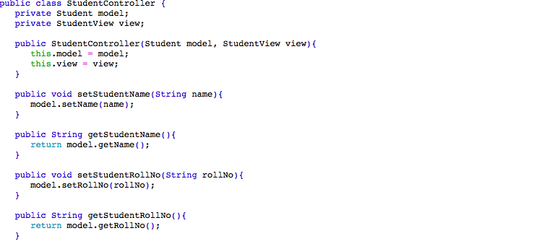
Controller (StudentController.java)

Slide 8
THANK YOU!

