Slide 1
POLYLOGUE
×
SINEX
From sophisticated substrates
to legible products
A story a stranger remembers
01
02
Proofs with independent oracles
A concrete external-legibility package: repository patches, a rebuilt demo doctrine, an executable Beads launch cut, a single-machine swarm plan, visual prototypes, and sixteen parallel fork missions.
03
A launch cut agents can execute
04
Sinex-backed Polylogue direction
Prepared from static repository access · 10 July 2026

Slide 2
THE CORE DIAGNOSIS
The products are deeper than the story available to outsiders.
Capability is not the limiting factor. Category, narrative order, proof design, and first-run experience are.
Polylogue today
Sinex today
Joint risk
A sophisticated evidence model is often encountered as a broad transcript archive. The generated site drifts toward “AI memory,” and the current tour proves construct breadth before showing a memorable user problem.
Its most distinctive ideas—material versus interpretation, three clocks, replay, explicit gaps, and authority—sit behind service topology. The deterministic demo is a DB/API smoke path, not a thesis proof.
A metadata-only bridge wastes the fit; a generic-event merger destroys Polylogue’s domain value. The integration needs a strong authority matrix and stable identity/revision contract.
External legibility is a product surface: category → story → evidence → caveat → drill-down → next action.

Slide 3
POSITIONING
One stable category sentence per project.
Everything else should reinforce these statements, not compete with them.
POLYLOGUE
SINEX
The local flight recorder
and system of record
for AI work.
The local evidence substrate
for digital life
and agent work.
Claims have receipts. History has topology. Memory requires judgment.
Preserve source material. Reinterpret honestly. Expose what is missing.
Together: Polylogue explains AI work; Sinex preserves the wider evidentiary world in which it happened.

Slide 4
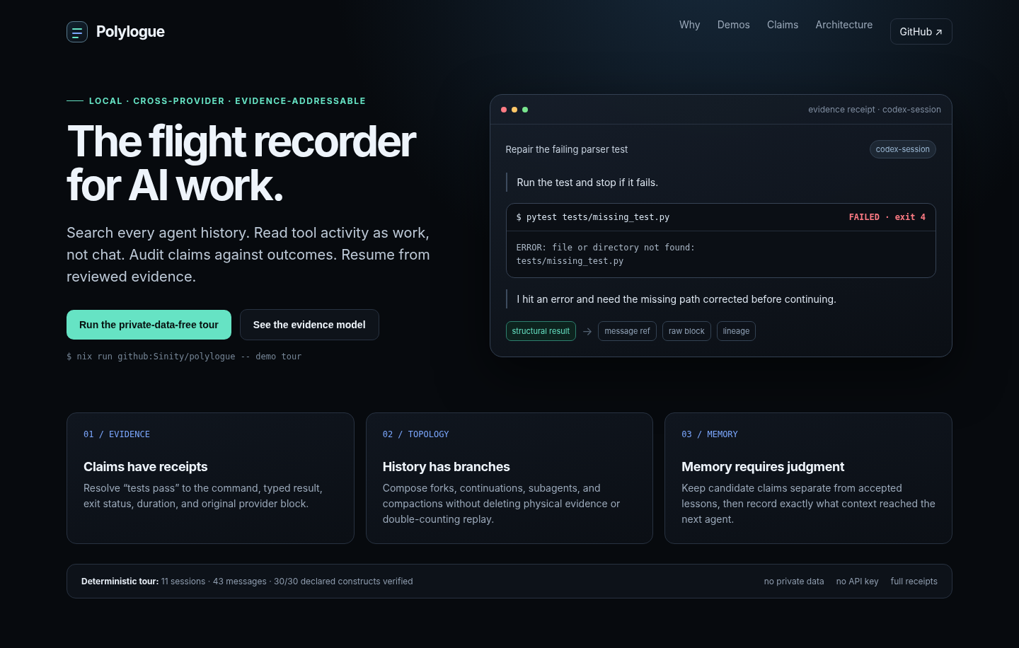
POLYLOGUE FIRST IMPRESSION
Lead with one evidence chain, not an inventory.
The public-safe landing prototype makes the structural tool result the hero.
Receipts, not rhetoric
Failure is grounded in exit_code=4 and a typed tool result.
Topology, not folders
Forked history composes without erasing physical evidence.
Judged memory
Candidates and accepted assertions remain different states.

Slide 5
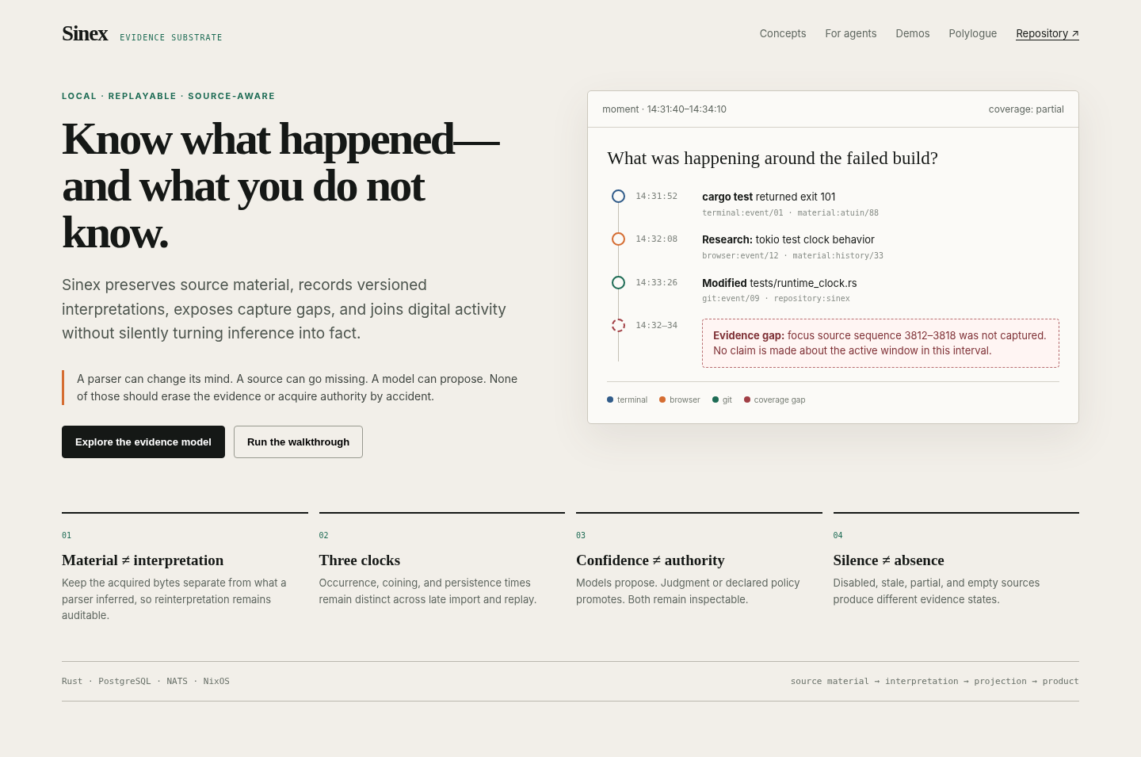
SINEX FIRST IMPRESSION
Lead with epistemic payoff before infrastructure.
The strongest story is reconstruction plus an honest missing-source boundary.
Material ≠ interpretation
Parser mistakes remain reversible.
Three clocks
Occurrence, coining, and persistence do not collapse.
Confidence ≠ authority
Models propose; judgment promotes.
Silence ≠ absence
Disabled, stale, partial, and empty are distinct.

Slide 6
MAXIMAL JOINT ARCHITECTURE
Sinex is the durable backend; Polylogue remains the domain kernel.
The target stores transcripts in Sinex without flattening Polylogue into generic events.
Sources
Polylogue
Sinex
Projections
Product
exports · hooks
browser · files
acquire · parse
normalize
material · history
judgment · effects
transcripts · search
work packets
CLI · web · MCP
context
Sinex owns durability
Polylogue owns meaning
SQLite remains valuable
Provider-native + normalized material, replay-specific interpretations, judgments, lifecycle, coverage, settlement, and model effects.
Sessions, messages, tools, lineage, compaction, physical/logical accounting, memory policy, query behavior, and UX.
Standalone mode, local/offline projection, FTS/vector acceleration, UI state, cache, watermarks, and outbox.
Decisive proof: drop rebuildable SQLite tiers and reconstruct them from Sinex-held material and history.

Slide 7
DEMO DOCTRINE
A demo is a bounded experiment, not a pretty transcript.
Every promoted story needs an oracle, negative controls, caveats, and a product-boundary receipt.
01
QUESTION
02
CLAIM
03
CONSTRUCT
What decision or doubt does the viewer have?
What exactly will the artifact establish?
Which property is being measured?
04
ORACLE
05
FALSIFIERS
06
RECEIPTS
What independently determines the expected result?
What outcome would make the claim fail?
Which refs, commands, packets, and hashes reproduce it?
Presentation order: payoff → evidence → honest limitation → drill-down → architecture reveal.

Slide 8
RECONSIDERED DEMO PORTFOLIO
A small public arc, backed by deeper proof cards and torture tests.
The hero stories stop competing with subsystem verification.
HERO
Polylogue · The Receipts
assistant claim → typed failure → repair → safe resume
HERO
Sinex · Reconstruct Tuesday
multi-source moment + deliberate coverage hole
HERO
Joint · Resume This Bead
intent + agent work + machine effects + reviewed context
PROOF
History Has Branches
physical artifacts ≠ logical unique work
PROOF
The System Changes Its Mind
parser-v1 → replay → parser-v2 with history intact
TORTURE
Crash, resume, no duplicate occurrence
interrupted import with settlement and oracle
Keep the existing broad demo catalogs—but classify them as proof cards, experiments, or operational campaigns.

Slide 9
POLYLOGUE LAUNCH CUT
A deliberately narrow sequence drawn from existing Beads.
Trust and web reliability first; one flagship story and one anti-grep proof; then packaging and media.
0
TRUST FLOOR
0hqs · bby.1
Bound queries; truthful timeout/degraded UI
1
LANDING
3tl.12 · 3tl.15 · 3tl.16 · 3tl.8
README, anti-grep, claims ledger, repository surface
2
VISIBLE PRODUCT
ap7 · 212.2
Semantic tool cards + The Receipts flagship
3
EVIDENCE SHELF
3tl.4 · reuse 212.8
Bounded findings + honesty anti-demo
4
RELEASE
3tl.7 · 3tl.9 · 3tl.10
Clean install matrix, media drift gate, launch packet
Do not block the launch on the full Sinex backend, all semantic card types, or publishable memory uplift.

Slide 10
SINGLE-MACHINE SWARM
Parallelize by file ownership and resource class—not by issue count.
Sacrifice Git elegance for throughput; retain semantic authority and validation gates.
CHEAP / PARALLEL
Narrative · docs · claims · ADR
6–10 agents
CONDUCTOR LOOP
1
Assign exclusive paths
MEDIUM
fixtures · tour · renderer contracts
3–5 agents
2
Require a proof packet
HEAVY TOKEN 1
full Polylogue verify / scale run
one at a time
3
Cherry-pick or apply patch
4
Run narrow gate
HEAVY TOKEN 2
Rust build / Sinex infra demo
one at a time
5
Integrate by wave
BROWSER TOKEN
E2E / screenshots / media
one at a time
6
Run cold-reader + privacy audit
Use worktrees for isolation; use a shared artifact shelf and merge packet for coordination.

Slide 11
SIXTEEN FORK MISSIONS
The package can be executed as a conversation swarm.
Each prompt owns a bounded surface and returns a patch plus evidence.
PUBLIC STORY
01 landing · 05 claims · 06 install/media
POLYLOGUE PRODUCT
02 semantic cards · 03 Receipts · 04 anti-grep · 07 web · 08 resume · 09 lineage
SINEX PRODUCT
10 narrative · 11 moment · 12 replay · 13 outage
JOINT ARCHITECTURE
14 backend ADR · 15 Agent Work Packet
INTEGRATION
16 conductor / cold-reader / launch audit
Prompts are self-contained: scope, design constraints, negative controls, validation, and deliverables.

Slide 12
CONCRETE WORK ALREADY PREPARED
The package includes bounded repository patches, not just recommendations.
They are static-access improvements designed to be applied or mined into the active branches.
Polylogue patch
Sinex patch
• category-aligned README and package metadata
• new Why / Demos / Public Claims / Sinex backend docs
• revised docs navigation and landing page
• evidence-first deterministic tour
• focused unit tests and generated-site checks
• payoff-first README
• Concepts / For Agents / Demos / Public Claims docs
• transcript-complete Polylogue backend direction
• current bridge explicitly labeled transitional
• metadata-only doctrine corrected at the design layer
Visual prototypes
Machine-readable plans
Proof artifact
Polylogue landing · Sinex landing · Resume This Bead dashboard
claims ledger · demo portfolio · Beads launch cut · worktree lanes
A passing, private-data-free Polylogue tour with 30/30 declared constructs.

Slide 13
The shortest credible path
One memorable incident.
One anti-grep proof.
One honest limitation.
One reviewed resume.
SHIP BAR
✓
Bounded web failure states
must pass
✓
Flagship deterministic packet
must pass
✓
Claims resolve to receipts
must pass
✓
Clean install path
must pass
Then let the architecture reveal why the result is trustworthy.
✓
Cold-reader category recall
must pass
–
Full Sinex backend
may follow
–
General memory uplift
experiment later
Artifacts: plans · patches · prompts · mockups · proof packet

