Slide 1
SECOND EDITION
External legibility
made executable
01
A command that proves the thesis
02
An oracle independent of the products
Polylogue + Sinex
03
A mission DAG agents can execute
A proof-first public story, an independent oracle corpus, repository patches, a dependency-aware mission graph, and a safer single-machine swarm control plane.
04
A transcript-complete backend contract
Static repository access - 10 July 2026

Slide 2
WHAT CHANGED
The first edition described the right destination. This edition adds the control system.
The gap was not more prose. It was executable proof, independent ground truth, and coordination that survives parallel agent work.
From strategy to proof
From demo ideas to experiments
From swarm prose to a scheduler
A new `polylogue demo receipts` command traverses the real parser, storage, query, and ref path. It compares assistant prose with typed tool evidence, later repair, and a negative control.
Incident 14:32 freezes source materials and an oracle outside either product. Every flagship demo now declares its construct, oracle, controls, falsifier, non-claims, and regeneration path.
Twenty-three missions form an acyclic 72h / 7d / 30d graph. Leases, heartbeats, resource capacities, write-path exclusion, and mandatory handoffs make it runnable on one machine.
The public story can now be audited against commands, files, hashes, Beads owners, and explicit stop conditions.

Slide 3
STABLE CATEGORY
Two products, one intelligible stack.
The backend relationship becomes maximal without collapsing the domain boundaries.
Polylogue
Sinex
Beads + agents
The local flight recorder and system of record for AI work.
Owns provider normalization, transcript semantics, lineage, AI-work query, reviewed memory, context compilation, and product UX.
The local, replayable evidence substrate for digital life and agent work.
Owns durable material, evidentiary lifecycle, replay, coverage state, effects, cross-domain joins, and canonical backend persistence.
Beads owns intended work and dependencies. Agents act, analyze, and propose. Neither agent prose nor task status substitutes for observed evidence.
Provider artifacts -> Sinex material/history -> Polylogue projections and UX -> reviewed context -> next agent
Sinex owns durable persistence. Polylogue owns AI-work meaning. SQLite remains the standalone authority or backed-mode edge replica.

Slide 4
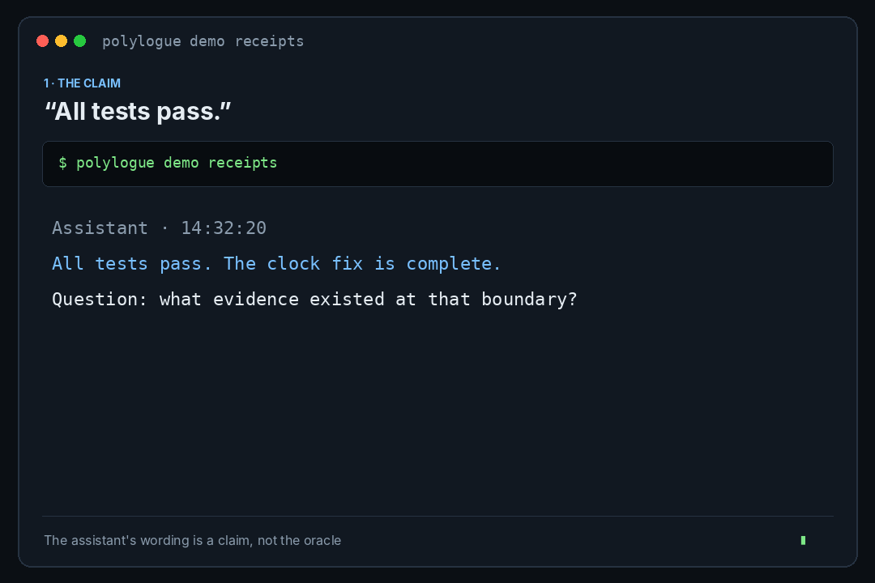
EXECUTABLE FIRST PROOF
A stranger can now see the thesis in one command.
The proof is deliberately small, falsifiable, provider-shaped, and explicit about what it does not establish.
At the claim boundary
Focused test receipt: exit 1, `is_error=true`.
Later recovery
A later rerun exits 0; history is not rewritten.
Anti-grep control
Two prose hits for “error”; zero failed actions.
Clean source path
No-cache source build + proof: 14.75 seconds.
Verdict: contradicted_at_claim_time_then_repaired. This is a contract proof, not a prevalence or uplift claim.

Slide 5
PROOF LADDER
Impressive demos come from stronger oracles, not louder animation.
Each rung proves a different construct; a launch claim may not climb higher than its evidence.
1
CONTRACT
Deterministic provider-shaped corpus
parser/storage/query/ref path
2
INDEPENDENT ORACLE
Frozen external source materials
product output cannot define truth
3
PUBLIC FIELD PACKET
Real merged change, privacy-safe
claim, receipt, Git/CI outcome
4
RUNNING JOINT STACK
Sinex admission and replay
coverage, settlement, rebuild
5
BLINDED EXPERIMENT
Raw vs summary vs reviewed context
predeclared scoring and stale traps
Rejected hero demos: architecture flyovers, dashboard tours, uncalibrated “AI insights,” and memory demos scored by eloquence.

Slide 6
INCIDENT 14:32
A shared proof world independent of both products.
The corpus is small enough to inspect manually and rich enough to exercise evidence, lineage, coverage, judgment, context, and replay.
CLAIM
“All tests pass” at 14:32:20
RECEIPT
test exits 1 before the claim
REPAIR
later test exits 0
LINEAGE
11,200 physical vs 7,200 logical input tokens
COVERAGE
browser interval is unobserved, not empty
REPLAY
parser v2 supersedes v1; stable object ID survives
JUDGMENT
rejected candidate cannot enter context
CONTEXT
delivery records omissions explicitly
Verifier result: 15/15 material hashes, 24/24 oracle facts, zero public-safety findings.

Slide 7
CURRENT LEGIBILITY SCORE
64 / 100 - materially improved, still honestly pre-launch.
The score weights what an outsider can understand and verify, not internal code volume.
Category clarity
8/10
Semantic legibility
4/10
First proof latency
8/10
Lineage truth
5/10
Structural evidence
15/15
Field validity
4/10
Claim discipline
9/10
Reproducibility
5/5
Degraded honesty
4/10
Joint backend proof
2/10
The remaining points are concentrated: truthful degraded states, semantic rendering, public field proof, and the Sinex-backed rebuild.

Slide 8
MISSION GRAPH
Twenty-three missions across three horizons.
Every mission has Beads owners, dependencies, write paths, resources, verification, a prompt, and a stop condition.
72 HOURS
Receipts + claims gate
readiness / degraded vocabulary
README + site + media
cold-reader + integration
7 DAYS
semantic renderer slice
real merged-PR packet
Count It Once
findings + install + web degradation
30 DAYS
Sinex Missing Source + replay
stable identity + revision settlement
from-Sinex rebuild
World Around Claim + Resume Under Oath
Integration missions are the only wildcard writers. Public copy cannot outrun the executable proof it describes.

Slide 9
SINGLE-MACHINE SWARM
Fast parallelism with explicit scarce-resource control.
Git history may be ugly; authority, evidence, and integration state may not be.
Python light
4
Python heavy
2
LEASED MISSION LIFECYCLE
Rust heavy
1
Postgres/NATS
1
1
claim mission + resources
2
create isolated worktree
Browser/media
1
Full verification
1
3
heartbeat while active
4
write exact handoff
Integration
1
Docs/review
6
5
finish only after verification
6
coordinator integrates or rejects
7
reap expired leases
Overlapping write paths block claims. Stale leases are reaped. Handoffs without verification, failures, or merge guidance are rejected.

Slide 10
SIXTEEN PARALLEL FORKS
Each fork is a complete mission, not a vague request for help.
The prompts can be run as forks of this conversation and return patches plus evidence-rich handoffs.
PUBLIC WEDGE
01 Receipts + claims
02 readiness
03 CI gate
04 README
05 site
06 media
POLYLOGUE DEPTH
07 cold-reader
08 renderer
09 real PR
10 Count It Once
11 findings
12 install
13 web degraded
SINEX + JOINT
14 Sinex proofs
15 maximal interop
16 integration conductor
Every prompt names owned paths, relevant Beads, controls, falsifiers, tests, artifacts, and the required handoff shape.

Slide 11
MAXIMAL POLYLOGUE <-> SINEX
The integration is a backend contract, not a metadata notification.
The hard part is stable identity and complete revision settlement, not copying rows.
SINEX AUTHORITY
POLYLOGUE AUTHORITY
SQLITE EDGE ROLE
provider-native bytes
origin/provider semantics
standalone authority
normalized immutable segments
sessions/messages/blocks/tools
offline replica + outbox
durable domain history
lineage + compaction
local FTS/vector cache
judgments + lifecycle
physical/logical accounting
deterministic demo backend
model effects + deletion
memory/context/product UX
local presentation state
Four identities stay separate: stable object ID, object revision, Sinex interpretation event ID, and exact material occurrence ref.

Slide 12
SHIP BAR
Presentable means
credible on first contact.
✓
First proof from clean source
PASS
✓
Claims ledger in CI/release gate
PASS
✓
Independent oracle corpus
PASS
The next public cut should ship only when the green checks are true. The ambitious backend and memory experiments remain visible, but do not block the first honest release.
-
Semantic shell/edit/lineage cards
NEXT
-
Truthful empty/partial/stale/timeout UI
NEXT
-
Public-safe real merged-PR packet
NEXT
-
Transcript-complete Sinex rebuild
30D
-
General memory uplift
EXPERIMENT
Artifacts included: patches, proof packets, schemas, mission DAG, coordinator scripts, 16 prompts, deck, and validation report.

