Slide 1
Introduction to IoT and It’s Application in Real Life
Sinku Kumar
Co. SST Technologies

Slide 2

Getting Started
Download and Install Arduino IDE Software
Install the ESP8266 board support package in Arduino IDE
Introduction to ESP8266 and GPIO pins
Issues and Troubleshooting
CP210x Driver Download and Install
Note: Don’t Install Arduino 2.0 or above

Slide 3














History of Embedded Systems
Industrial Use
Educational or Hobby
Extended Use Case

Slide 4
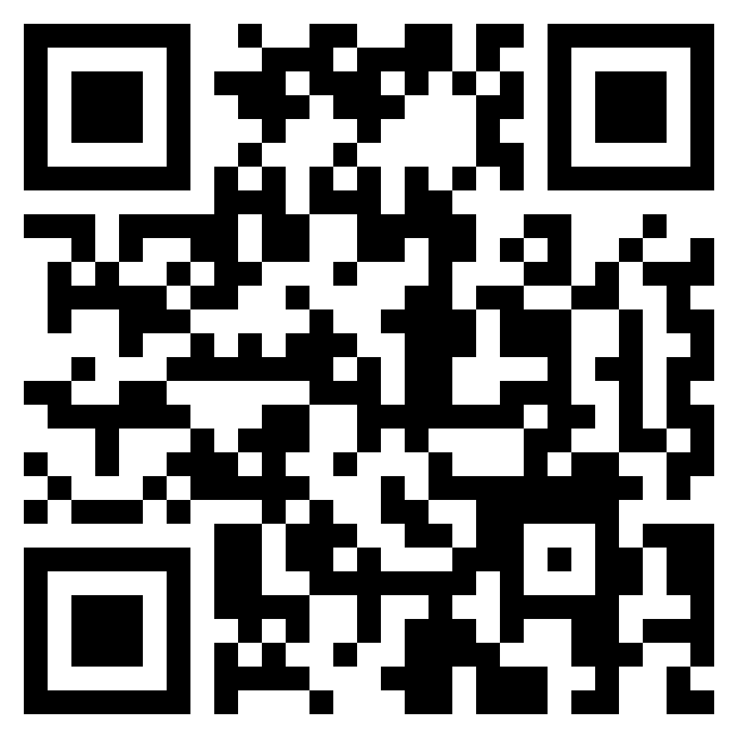
Why Espressif Systems?
Cheap
Connectivity Available
Beginner Friendly
Availability
Extended Development Support
Community Support
Industry Ready
Get Started with Arduino:
https://github.com/esp8266/Arduino

Slide 5
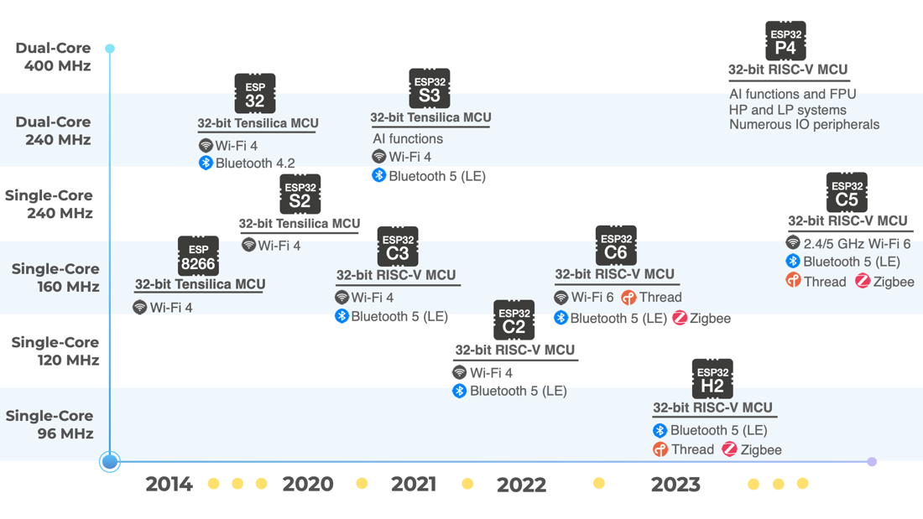

Slide 6
Digital Input and Output
General Purpose Input and Output
pinMode(pin, MODE);
Sets a specified pin as INPUT or OUTPUT
digitalWrite(pin, VALUE);
Use to set the pin HIGH or LOW
digitalRead(pin);
Use the pin to read HIGH or LOW

Slide 7
Programs and Exercises
Programs
Blink an LED
Read a Button State
Trigger Output based on input state
Exercises
Blink 2 LEDs
Trigger output based on input state (inverse)

Slide 8
Analog Input and Output
Analog to Digital Converter - ADC
Digital to Analog Converter - PWM
pinMode(pin, MODE);
Sets a specified pin as INPUT
analogWrite(pin, VALUE);
Use to set the pin 0 to 255
analogRead(pin);
Use the pin to read 0 or 1024

Slide 9
Programs and Exercises
Programs
Fade an LED
Read a sensor value
Trigger Output based on sensor value
Exercises
Fade LED On, Fade LED off
Trigger LED output based on sensor value
Challenge: Fade LED based on the duration of the button state.

Slide 10
What am I doing?
Embedded System
Input
Output
Commu-nication
Power
Input
Digital Input
Analog Input
Output
Analog Input
Analog Output
Communication
UART
Power
Suggestions

Slide 11
Communication
Serial Communication
UART
I2C
SPI
CAN
RS232
MODBUS
Parallel Communication
ISA,
ATA,
SCSI,
PCI and IEEE-488

Slide 12

Universal Asynchronous Receiver Transmitter
Rx – Receiving pin
Tx – Transmission pin
Gnd – Common connection
Serial.begin(BAUD)
Serial.read();
Serial.write(‘character’);
Serial.readString();
Serial.print(“message”);

Slide 13
Programs and Exercises
Programs
Print message on serial console
Control LED based on serial console input
Print sensor data to the console
Exercises
Print status message on serial console and control the LED using sensor value.
Challenge: Use the serial reference to use all the functions and make a solution.

Slide 14
Network Communication
Commu-nication
Short Range
Wide Range
Cellular
Non Terrestial
Short Range
Bluetooth, Wi-Fi
Zigbee
Wide Range
LoRA, SigFox,
NB-IoT
Cellular
2G, 3G, 4G, 5G
Power
Satellite

Slide 15
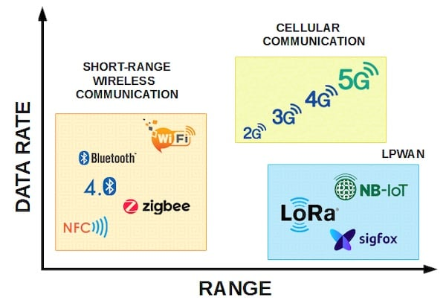
Network Communication
Source: All About Circuits

Slide 16

Wi-Fi Communication
#include <ESP8266WiFi.h>
WiFi.begin("network-name", "pass-to-network");
WiFi.status() != WL_CONNECTED
WiFi.localIP()
Status using Serial Communication
https://arduino-esp8266.readthedocs.io/en/latest
/esp8266wifi/readme.html

Slide 17
Blynk IoT Platform
Create an account on Blynk IoT Platform

