Slide 1
What Is The Model View Controller? Ft. Mongoose
By: Jamil Sinno
For: Me & You
Built: Aug 17, 2022

Slide 2
Outline
What is the Model View Controller (MVC)?
MVC Illustrated
MVC: Model
MVC: View
MVC: Controller
Why use MVC?
Mongoose
Why use Mongoose?

Slide 3
What To Expect?
A general understanding of the Model View Controller architectural paradigm
An understanding of the Model View Controller's component's roles
Why should you use MVC
An introduction to Mongoose
Why should you use Mongoose

Slide 4
What is the Model View Controller (MVC)?
MVC is a way for you to structure and separate your code.
It is considered a framework.
MVC is not a framework you import,
It is a framework to separate your code into different files based on its assigned task.
MVC is made up of 3 components, aptly named:
Model
View
Controller
Each part of the MVC contains code that performs one specific task.

Slide 5
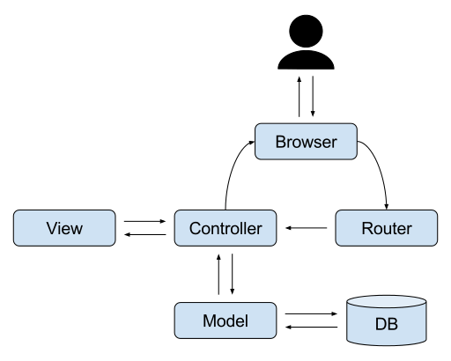
MVC Illustrated
What is happening?
The User interacts with the browser.
The browser communicates with the router which connects your request to the right controller.
The controller communicates with the proper view files and requests information from the database using the model.
View and the Model respond to the controller.
Once the controller receives the files and information, it responds to the browser.

Slide 6
MVC: Model
What is a model?
A model contains data about the application.
It validates that the information passing through the application follows the proper format.
Without a model, other developers would not know how to structure code for information to enter or be read from the database.
The model also verifies access to the information.
The model is the only component in your application that communicates with the database.
The model does not communicate with your view, router, or your browser. It only communicates with the controller and the database.

Slide 7
MVC: View
What is the view?
The view component stores the files that display the information.
The view folder is what contains your front-end files
HTML, CSS, JS, React, EJS and so on…
The view component only communicates with your controller.

Slide 8
MVC: Controller
What is the controller?
The controller is the component that controls the flow of the application.
The controller received user requests from the router and responds with the information relevant to the request
The controller is broken up into many components. Each controller is assigned a specific task.
The separation of controllers allows for easy debugging of your code.
This also abstracts parts of your code.
This eases the debugging of your code
It also makes it so that your application doesn’t stop working if one controller fails.

Slide 9
Why use MVC?
It makes web development an easier time by implementing separation of concerns.
Separation of concerns abstracts your code.
It allows for multiple developers to work on the same application while avoiding multiple developers working on the same file.
Using MVC as an architectural method of building your code allows for easy scalability of your code.
It allows other developers to read your code with ease as the technique instructs developers on how your code operates and the data structure it accepts.
MVC’s greatest advantage is you can replace any component with other technologies and your app will remain intact if the new component follows the proper structure.

Slide 10

Mongoose
What is mongoose?
It is a small terrestrial carnivorous mammal belonging to the family Herpestidae.
It is also an Object Data Modeling library for MongoDB.
It manages the relationship between data, provides schema validation, and translates objects in code to its representation in MongoDB.

Slide 11
Why use Mongoose?
MongoDB is a loose database. It allows you to store JSON data.
Mongoose provides data modeling guidance, schema enforcement, model validation, and general data manipulation with ease.
What is a schema?
A schema applies a structure to the information stored in your database.
It tells the user what the information entering the database is and the type assigned to it.
Mongoose providing the structure to the information interacting with your code becomes the Model in your MVC structure.

