Slide 1
React: A JavaScript Library
By: Jamil Sinno
Built: Aug 29, 2022

Slide 2
Outline
What To Expect
Assumptions
What Is React?
Why Use React?
The JSX Extension
What Is The Virtual DOM?
What Are React Components?
What is React State?
Forms
What Are React Hooks?
When Should You Use React?
Installing React

Slide 3
What To Expect?
This deck presents a simple overview of React, and some of its terminologies. It will present React to the best of my knowledge at the time of building this deck.
A general understanding of:
React,
JSX,
Virtual DOM,
Props,
Components,
Lifecycles,
Hooks.

Slide 4
Assumptions
An understanding of JavaScript and how it operates.
An understanding of coding/development terminology.

Slide 5
What Is React?
React, also known as React JS, is a JavaScript (JS) library used in front-end web development.
What is JavaScript?
A scripting language used to dynamically change webpages.
Functions such as refreshing a page, pressing a button and expecting a reaction, or adding text in a form, etc. are all tasks JS performs.
What is a JavaScript Library?
A JS library is a set of pre-written code that developers can import into their projects.
A developer will choose to import a library when they are working on repetitive tasks.
If you find yourself repeating similar functions in your code base, and other developers have written similar functions, there is likely a JS library out there you can import to reduce your workload.
React Native is the library you would use to build on iOS and Android devices.
This helps create a seamless integration of code between Desktop, and mobile applications.

Slide 6
Why Use React?
React is a library that helps developers build custom user interfaces (UI).
React is considered a front-end framework.
Before React, developers were stuck building headers, menus, lists, and other front-end components by hand.
Reusability of code: with the introduction of React, a component is imported and can be used an endless number of times.
React defines its custom built functions as components.
Key features:
The use of JSX,
The Virtual DOM.

Slide 7
JSX
JSX cannot be read by browsers.
JSX is short for JavaScript Extension.
The main extension for React files.
Grants the ability for React to alter your DOM by using HTML-style code. JSX embeds converts React tags into HTML tags with embedded JavaScript.
JSX can be read by all of the current versions of browsers.
JSX offers more than being a convenience factor to the developer, it allows React to create the Virtual DOM.

Slide 8
What Is The Virtual DOM?
The virtual DOM is React's ability to update your webpage without the need to refresh.
DOM stands for Document Object Model. It is your display in the browser.
Without the use of React, every change you make to your application would require a full refresh of your webpage.
With the use of React, it can tell what elements of your DOM need to refresh and creates a Virtual DOM representing the elements to dynamically update your webpage without refreshing.
This can be simple functions like adding a comment to a blog post.
This improves the efficiency of your program and uses less computing power.

Slide 9

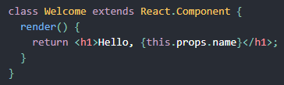
What Are React Components?
Components let you split up your UI into independent, reusable pieces.
The benefit to this is abstracting your code. You can work on one component without breaking others.
Components in React are made from functions and classes.
To React, functions and classes are equivalent.
Function components:
Class components:
Notice the render() in the class.

Slide 10
What Are React Components?
What are React Props?
Props is short for properties.
They are the parameters passed through your React functions as arguments.
Props are read-only. Components should not modify their own props.
Functions which do not alter their props are referred to as pure functions.
How do you call a React Component?
You can call on a component by using the <Component /> syntax throughout your application.
All React components follow one strict rule:
All React components must act like pure functions with respect to their props.

Slide 11
What Is A React State?
States are a way for you to render and dynamically change the output of your React components.
States are objects, and thus, to assign the state of a function in React you can use the state method, this.state().
Updating a React State is referred to as a lifecycle.
Three things to know about React states:
Do not modify a state directly, instead use the this.setState() method.
States may be asynchronous.
State updates are merged.

Slide 12
Forms
Forms operate differently than other HTML components.
Forms, in HTML, will naturally form an internal state when submitted.
Forms and their internal states work with React. However, if we wanted to alter the input through React, we would use a controlled component.
Do not alter the original state of the form, instead use this.setState() to alter the component as needed.

Slide 13
What Are React Hooks?
Hooks are a new addition to React introduced in version 16.8.
The main function of a hook is to be able to assign states in React without the need of a Class.
Hooks are not necessary to get React to function.
Hooks syntax are as follows:
const [count, setCount] = useState(0);
Here the useState() method is actually a hook, and React will save the state between re-renders.

Slide 14
What Are React Hooks?
But what is a hook?
Hooks are functions that allow you to "hook into" React states and lifecycles from function components.
They eliminate the need for you to use classes in React.
Rules of using hooks:
Only use hooks at the top level of your code and not inside loops, conditionals or nested functions.
Only use hooks when calling from a React component, not a JavaScript function.

Slide 15
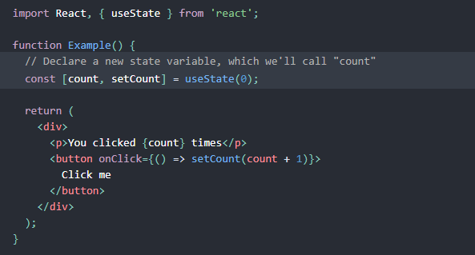
How Do Hooks Work?
In the example below, the highlighted line declares the constant count and assigns it the method setCount.
Then the example assigns an initial state of integer 0.
Later on in the code, the set count method is called adding 1 to count whenever the button is clicked.

Slide 16
When Should You Use React?
React can be used and installed whenever you are building a web application.
You can use React as much or as little as needed.
If you have an existing application, React can be imported into your application to be used immediately.
React can also act as the only technology you use for the front-end applications of your program.

Slide 17
Installing React
When should I add React to my application?
You can add React to your application at any time.
If you are building an exclusively front-end application, to add React you must:
Add a DOM container to the HTML
Add the React Script tags in your HTML page right before the closing </body> tag.
Create a React Component
If you are building with a full-stack application with React (JSX files):
You will need to use the Node.js & Node Packaging Manager (NPM/NPX) & to type the following into your console:
npx create-react-app <myFirstProject>
npm init react-app <myFirstProject>

Slide 18
Sources
https://skillcrush.com/blog/what-is-react-js/
https://reactjs.org/docs/

