Slide 1

CSC 203 / CPE 203
Week 8
Project-Based Object-Oriented
Programming and Design
(using Java)
Bill Foote
wffoote@calpoly.edu
(http://jovial.com)
Notes:
M: 1-14
T:; 1-22
W: To, or through python vars
R: UP to javadocs @ end
F: through 49

Slide 2


Slide 3
Lab 5 contract
Lab 5 didn’t say “don’t round.”
Some people rounded.
Rounding is reasonable.
The autograder didn’t account for this.
It will be fixed.

Slide 4
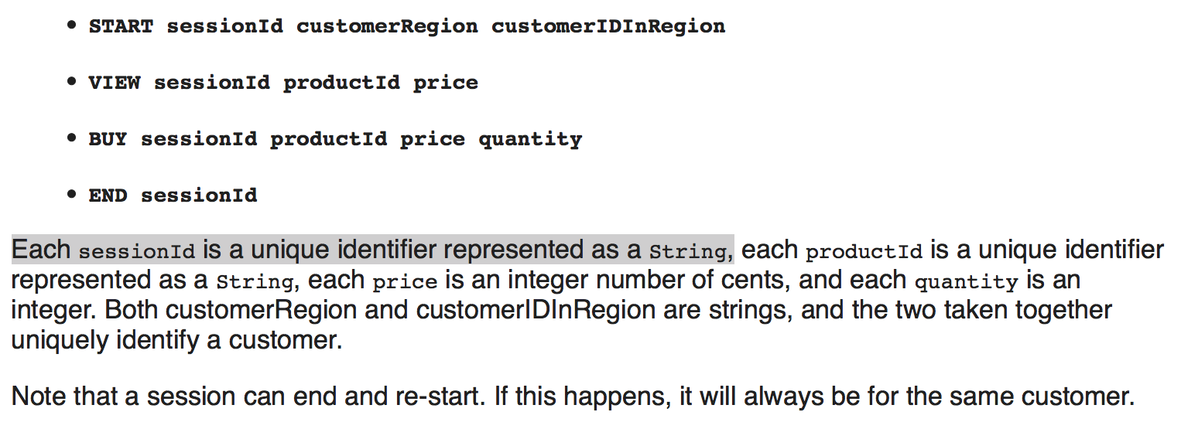
Here’s a contract...

Slide 5
How to write broken code
(in six easy slides)

Slide 6

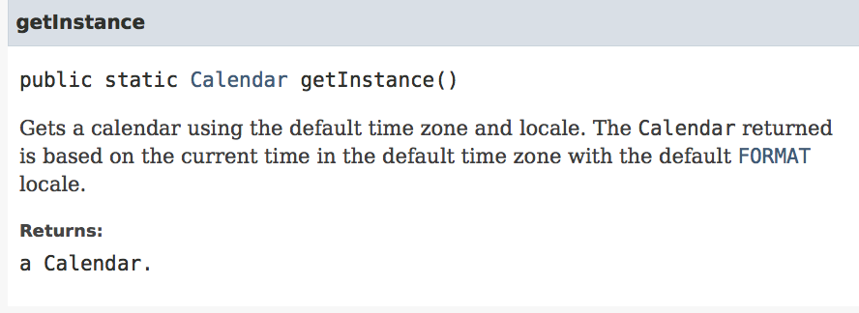

Slide 7
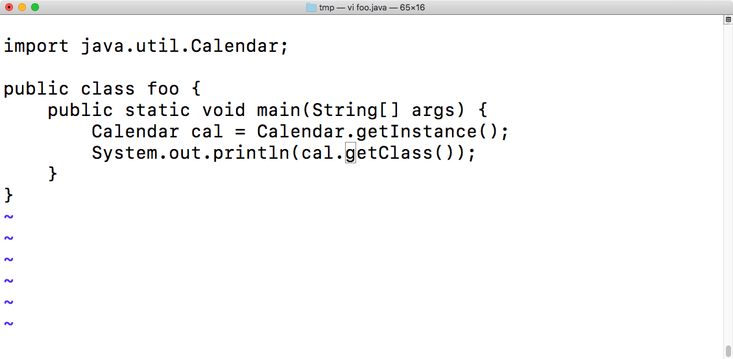

Slide 8
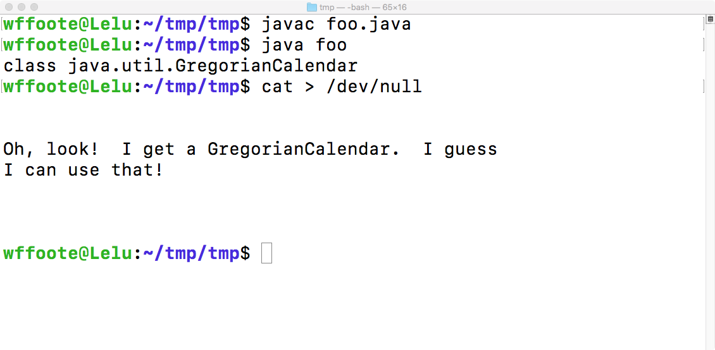

Slide 9
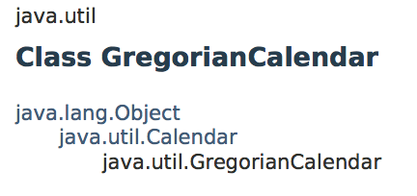
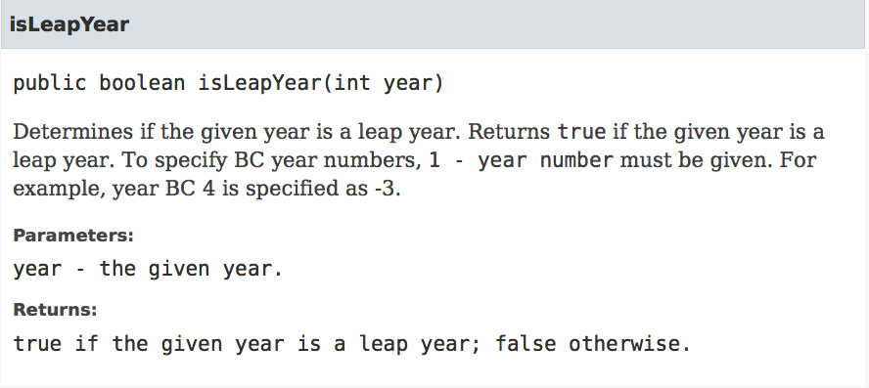

Slide 10
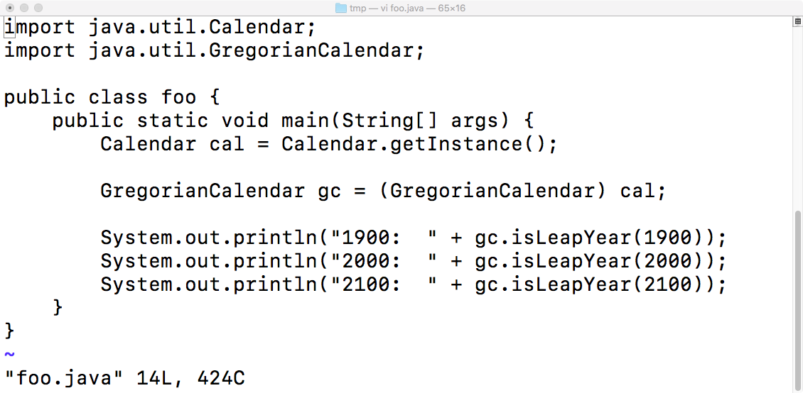

Slide 11
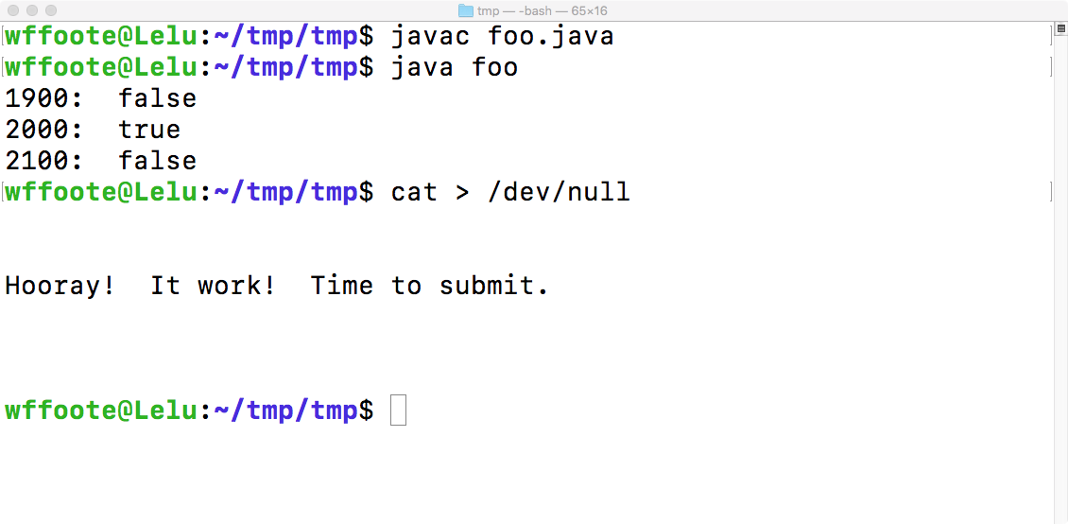

Slide 13

Don’t ignore the contract!

Slide 14
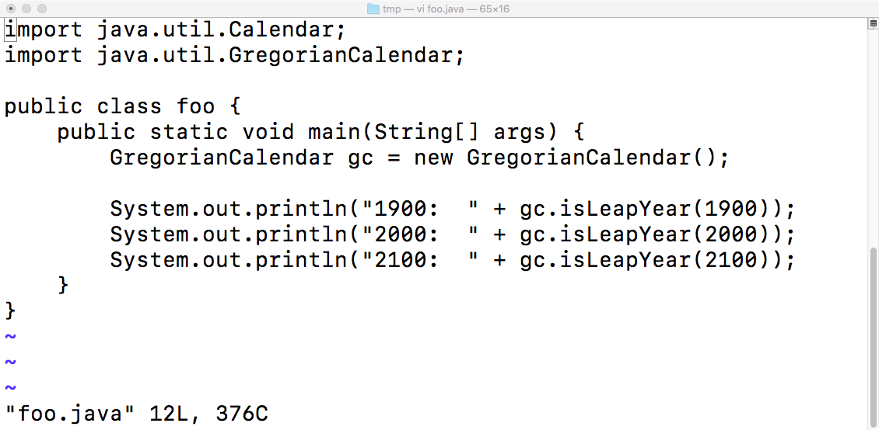

Slide 15
More Broken Software...

Slide 16
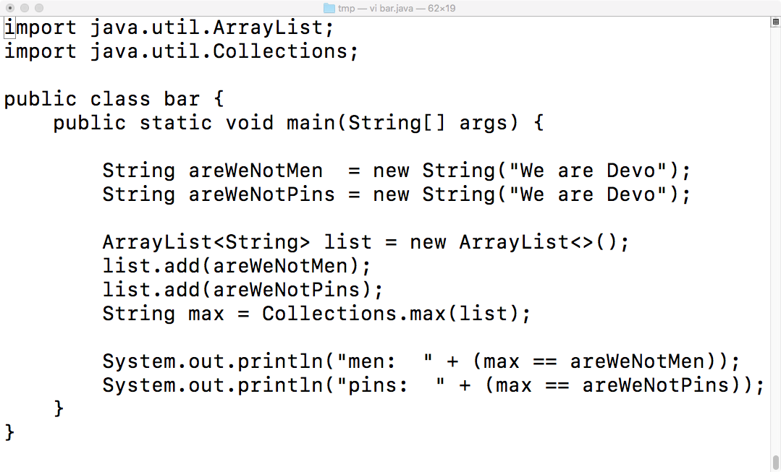

Slide 17
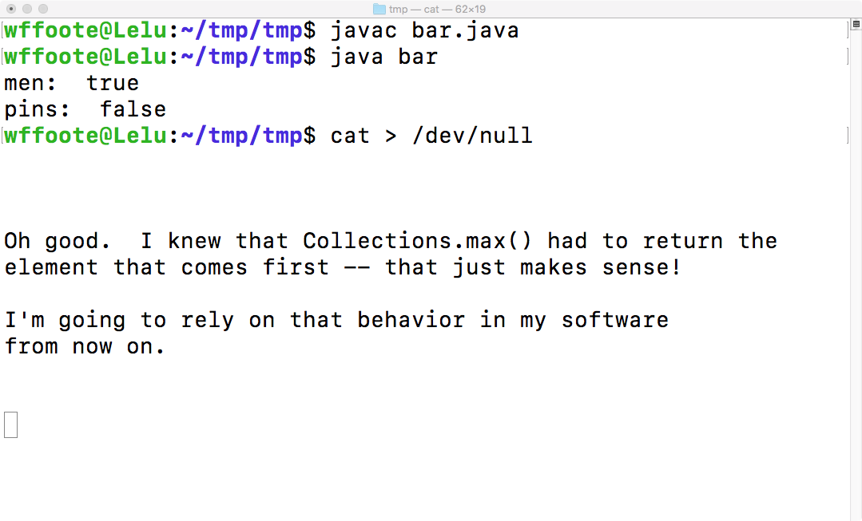

Slide 19
A bit about the class project...

Slide 20
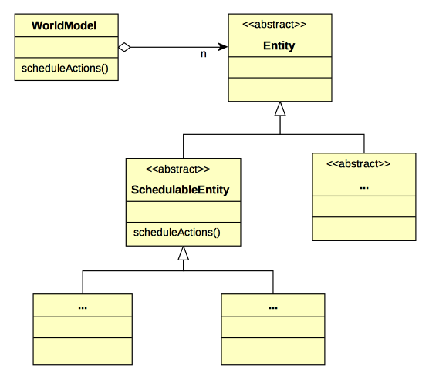

Slide 21
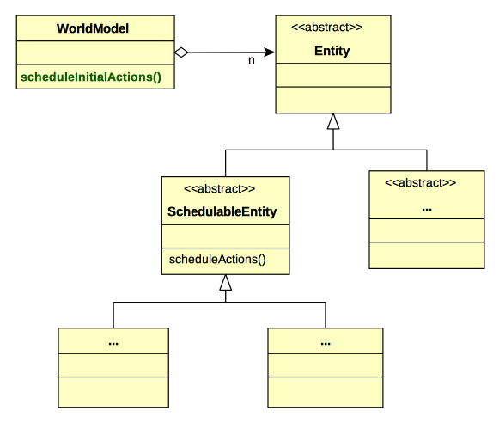

Slide 22
In WorldModel:
public void scheduleInitialActions(
EventScheduler scheduler,
ImageStore imageStore)
{
for (Entity entity : getEntities()) {
if (entity instanceof SchedulableEntity) {
((SchedulableEntity) entity).
scheduleActions(scheduler,
this, imageStore);
}
}
}

Slide 23
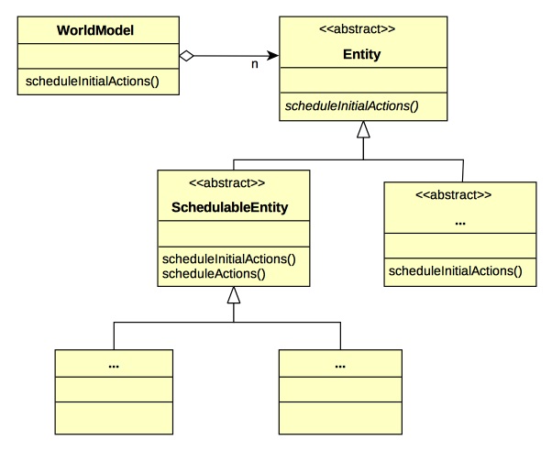

Slide 24
In WorldModel:
public void scheduleInitialActions(
EventScheduler scheduler,
ImageStore imageStore)
{
for (Entity entity : getEntities()) {
entity.scheduleInitialActions(scheduler,
this, imageStore);
}
}

Slide 25
In Entity:
public abstract void
scheduleInitialActions(
EventScheduler scheduler,
ImageStore imageStore);

Slide 26
In SchedulableEntity:
@Override
public void scheduleInitialActions(
EventScheduler scheduler,
ImageStore imageStore)
{
scheduleActions(scheduler, this, imageStore);
}

Slide 27
In ...Entity:
@Override
public void scheduleInitialActions(
EventScheduler scheduler,
ImageStore imageStore)
{
}

Slide 28
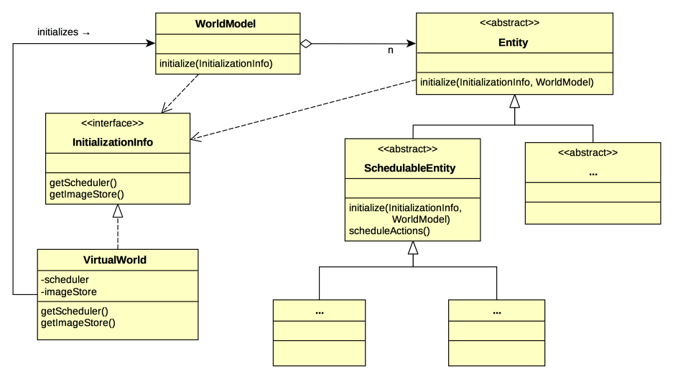

Slide 29
What kind of interface is
InitializationInfo?

Slide 30
In Entity:
/**
* Initialize this entity. Subclasses may override
* this method; if they do they shall invoke this
* method (by calling super.initialize(info, world))
*/
public void initialize(
InitializationInfo info,
WorldModel world)
{
}

Slide 31
In SchedulableEntity:
@Override
public void initialize(
InitializationInfo info
WorldModel world)
{
super.initialize(info, world);
scheduleActions(info.getScheduler(),
world,
info.getImageStore());
}

Slide 32
Assignment 6
/Users/wffoote/cpe203/general/class_project/assignment6.html
https://en.wikipedia.org/wiki/A*_search_algorithm

Slide 33

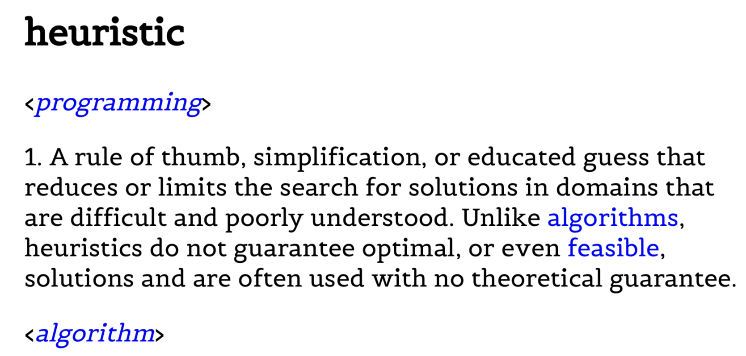

Slide 34
0,0 | 0,1 | 0,2 | 0,3 | 0,4
1,0 | 1,1 | 1,2 | 1,3 | 1,4
2,0 | 2,1 | 2,2 | 2,3 | 2,4
3,0 | 3,1 | 3,2 | 3,3 | 3,4
4,0 | 4,1 | 4,2 | 4,3 | 4,4

Slide 35
0,0 | 0,1 | 0,2 | 0,3 | 0,4
1,0 | 1,1 | 1,2 | 1,3 | 1,4
2,0 | 2,1 | 2,2 | 2,3 | 2,4
3,0 | 3,1 | 3,2 | 3,3 | 3,4
4,0 | 4,1 | 4,2 | 4,3 | 4,4
/Users/wffoote/cpe203/general/notes/astar_pseudocode.pdf

Slide 36
Inheritance Review

Slide 37
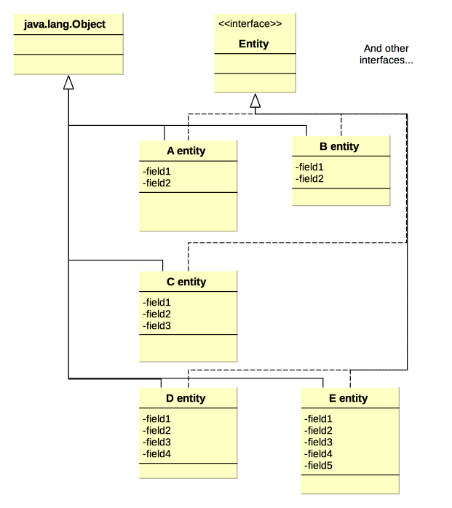

Slide 38
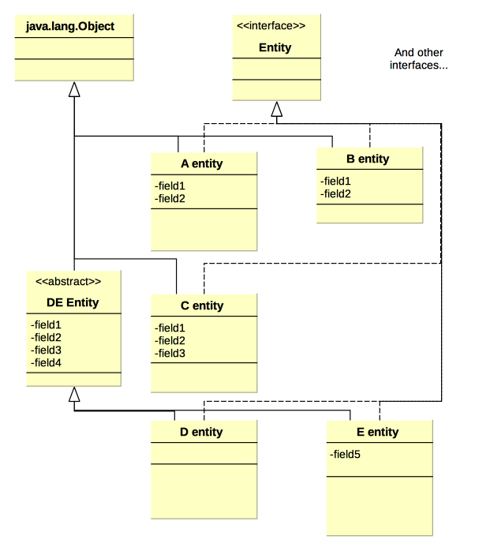

Slide 39
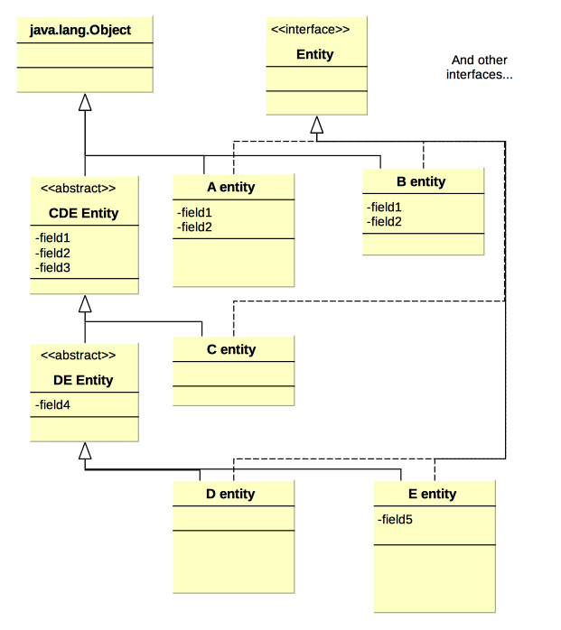

Slide 40
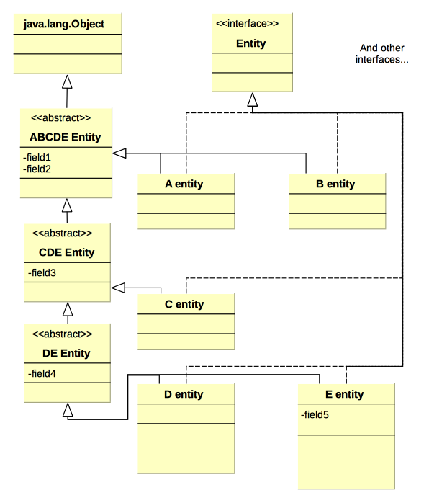

Slide 41
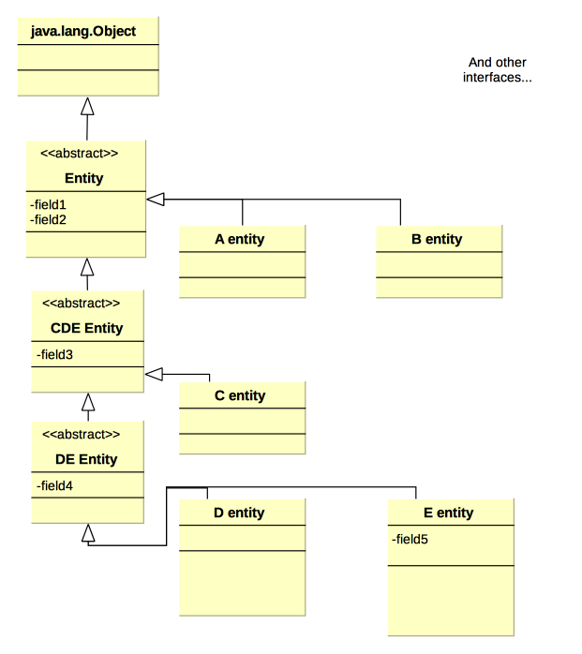

Slide 42
public abstract class Entity {
Mumble field1;
Mumble field2;
}
public abstract class CDEEntity
extends Entity {
Mumble field 3
}
public class CEntity
extends CDEEntity {
}
...
public class EEntity
extends DE Entity {
Mumble field5;
}

Slide 43
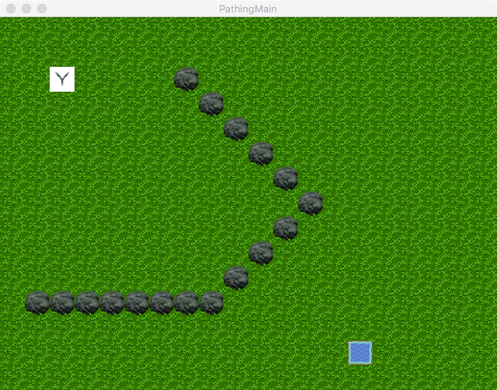
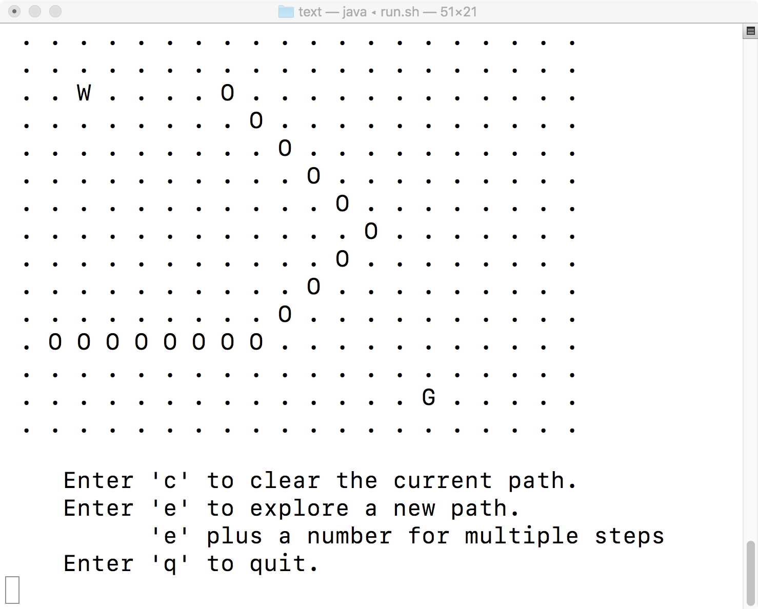
Lab 7

Slide 44
Java Generics

Slide 45
Today
{
List<Point> pointList
= new ArrayList<Point>();
pointList.add(new Point(1, 2));
Point p = pointList.get(1);
}

Slide 46
Before JDK 1.5
{
List pointList = new ArrayList();
// Like today’s List<Object>
}

Slide 47
Before JDK 1.5
{
List pointList = new ArrayList();
// Like today’s List<Object>
pointList.add(new Point(1, 2));
}

Slide 48
Before JDK 1.5
{
List pointList = new ArrayList();
// Like today’s List<Object>
pointList.add(new Point(1, 2));
Point p = pointList.get(0);
}

Slide 49
Before JDK 1.5
{
List pointList = new ArrayList();
// Like today’s List<Object>
pointList.add(new Point(1, 2));
Point p = (Point) pointList.get(0);
}

Slide 50
Today
{
List<Point> pointList
= new ArrayList<Point>();
pointList.add(new Point(1, 2));
Point p = pointList.get(0);
}

Slide 51
public class Pair<T> {
private T left;
private T right;
public Pair(T left, T right) {
this.left = left;
this.right = right;
}
public T getLeft() { return left; }
public T getRight() { return right; }
}

Slide 52
What is a subtype of what?
Is List<Point> a subtype of List<Object>?
Is List<Object> a subtype of List<Point>?

Slide 53
What is a subtype of what?
Is List<Point> a subtype of List<Object>?
  List<Point> myPointList = ...;
  myPointList.add(new Object())
Is List<Object> a subtype of List<Point>?
  List<Object> myObjectList = ...;
  Point p = myObjectList.get(0);
What would Barbara Liskov say?

Slide 54
What is a subtype of what?
Is List<Point> a subtype of List<Object>?
  List<Point> myPointList = ...;
  myPointList.add(new Object())
Is List<Object> a subtype of List<Point>?
  List<Object> myObjectList = ...;
  Point p = myObjectList.get(0);
What would Barbara Liskov say?
  No, no, no!

Slide 55
List<Object>
List<Point>
list.add(new Object())
int size = list.size()
Point p = list.get(0)
Neither set of operations is a subset of the other, therefore,
neither is a Liskov-substitutable subtype of the other

Slide 56
Java Generics Compared
C++
  The code is copied and re-compiled
  List<String> and List<Point> are different, separately compiled classes
Java
  List is compiled once, and re-used for all kinds of lists
  The compiler enforces the types where they are used

Slide 57
Java Generics
C++
  The code is copied and re-compiled
  List<String> and List<Point> are different, separately compiled classes
Java
  List is compiled once, and re-used
  The compiler enforces the types where they are used
    Essentially, for a List<Foo>,
    “list.get(3)” becomes “(Foo) list.get(3)”

Slide 58
Java Generics: A Work in Progress
Java
  List is compiled once, and re-used
  This means the type information is lost inside the implementation of List!
“Type Erasure”

Slide 59
Generic Methods
In a normal (non-generic) class, we can write:
public <T> T secondToLast(List<T>) {
...
}
...
List<String> strList = ...;
String str = secondToLast(strList);
class_slides/week_08/2_generic

Slide 60
Generic Method
We can write this:
public <T> T findNearest(Point pos) {
return null; // TODO: Implement this
}
...
Blob blob = findNearest<Blob>(pt);

Slide 61
Generic Method
We can write this:
public <T> Entity findNearest(Point pos) {
What goes here?
}
...
Blob blob = findNearest<Blob>(pt);

Slide 62
Generic Method
Can we write this?
public <T> Entity findNearest(Point pos) {
for (Entity e : entities) {
if (e instanceof T) {
...
}
}
}

Slide 63
Generic Method : Type Erasure
Can we write this?
public <T> Entity findNearest(Point pos) {
for (Entity e : entities) {
if (e instanceof T) {
...
}
}
}
foo.java:6: error: illegal generic type for instanceof
if (o instanceof T) {
^

Slide 64
Generic Method : Type Erasure
public Entity
findNearest(
Point pos,
java.util.function.Predicate<Entity> isTarget)
{
for (Entity e : entities) {
if (isTarget.test(e)) {
...
}
}
}
...
Blob blob = (Blob) world.findNearest(pos, (Entity e) -> {
return e instanceof Blob;
});

Slide 65
Generic Method : Type Erasure
public Entity
findNearest(
Point pos,
java.util.function.Predicate<Entity> isTarget)
{
for (Entity e : entities) {
if (isTarget.test(e)) {
...
}
}
}
...
Blob blob = (Blob) world.findNearest(pos, e -> e instanceof Blob);

Slide 66
NOTE: Reflection API
world.findNearest(pos, e -> e instanceof Blob);
if (isTarget.test(e) ...)
world.findNearest(pos, Blob.class);
if (type.isInstance(e) ...)

Slide 67

NOTE: Reflection API
world.findNearest(pos, e -> e instanceof Blob);
if (isTarget.test(e) ...)
world.findNearest(pos, Blob.class);
if (type.isInstance(e) ...)
or if (type == e.getClass() ...)
.class is the reflection API: BAD!

Slide 68
Refactoring nearly identical methods...

Slide 69
// in Miner:
void nextPosition(...) {
xxx
if (world.isOccupied(pos) && yyy) {
// in OreBlob:
void nextPosition(...) {
xxx
Entity occupant = world.getEntity(pos);
if (occupant != null && !(occupant instanceof Ore)
&& yyy) {

Slide 70
// in Miner:
void nextPosition(...) {
xxx
Entity occupant = world.getEntity(pos);
if (occupant != null && yyy) {
// in OreBlob:
void nextPosition(...) {
xxx
Entity occupant = world.getEntity(pos);
if (occupant != null && (!occupant instanceof Ore)
&& yyy) {

Slide 71
// in OreBlob:
void nextPosition(...) {
xxx
Entity occupant = world.getEntity(pos);
if (occupant != null
&& !(occupant instanceof Ore)
&& yyy) {

Slide 72
// in OreBlob:
protected boolean occupantBlocks(Entity e) {
return e != null && !(e instanceof Ore);
}
void nextPosition(...) {
xxx
Entity occupant = world.getEntity(pos);
if (occupantBlocks(occupant) && yyy) {

Slide 73
// in Miner:
void nextPosition(...) {
xxx
Entity occupant = world.getEntity(pos);
if (occupant != null && yyy) {

Slide 74
// in Miner:
protected boolean occupantBlocks(Entity e) {
return e != null;
}
void nextPosition(...) {
xxx
Entity occupant = world.getEntity(pos);
if (occupantBlocks(occupant) && yyy) {

Slide 75
// in OreBlob:
void nextPosition(...) {
xxx
Entity occupant = world.getEntity(pos);
if (occupantBlocks(occupant) && yyy) {
// in Miner:
void nextPosition(...) {
xxx
Entity occupant = world.getEntity(pos);
if (occupantBlocks(occupant) && yyy) {

Slide 76
// in MovingEntity:
abstract protected boolean occupantBlocks(Entity e);
void nextPosition(...) {
xxx
Entity occupant = world.getEntity(pos);
if (occupantBlocks(occupant) && yyy) {

