Slide 1
Solaris Fast Track L3 Academy

Slide 2
Types of Clusters
Cluster is a broadly-used term:
  High availability (HA) clusters
  Parallel processing clusters
  Load balancing clusters
  High performance computing clusters
  Fault tolerant clusters
VCS is primarily an HA cluster with support for:
  Parallel processing applications, such as Oracle RAC
  Application workload balancing

Slide 3


Local Cluster Configurations
Active/Active or Active/Passive
N-to-1, N + 1, N-to-N
Utilization:
Utilization:
Examples
Notes:
INTRODUCTION:
You should utilize what you currently have in your environment to increase the value of your current hardware investment.
PROBLEM
The traditional approach is how most customers today doing clustering have configured their environment.
If this is your chosen approach we do have tools to help ease the management headache of this configuration = Management option of VCS = CC Availability
However, there are issues to this approach
Typically customers are running active/active (the grey/grey) cluster or active/passive (grey/shaded out) server.
The active/passive environment provides the highest levels of availability but it is also the most expensive because you have a server sitting completely idle waiting for a failure to occur
The active/active environment is much more cost effective but is provides lower levels of availability because if one server fails then the additional server would have to do the work of both servers = low performance
ADVANCE SLIDE
You can see the exact same configuration with the same number of servers
ADVANCE SLIDE
RECOMMENDATION
Take the current infrastructure that you have with the 2 node clusters
Move the spare/idle servers to a resource pool to be used for other purposes
Move the exact same configuration (using zones) to a single 8 node clusters.
You get the same benefit of the 2-node clusters without having to tons of idle hardware
Now you just have 1 roaming spare vs 5 spares
Overall utilization rate goes up!
BENEFIT
Reduce the need for tons of idle hardware
Increase utilization
Cluster different servers/OS levels in a single cluster
No impact to the users since they don’t know which physical server they are accessing
TRANSITION
By looking at this configuration it may seem complex to implement a cluster configuration.

Slide 4



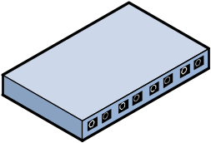
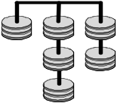
Global Cluster Configurations
REPLICATION
VERITAS
EMC
IBM
NetApp
HDS/HP
Oracle
Campus Cluster
Notes:
HA/DR Architecture
AdvancePCS (Caremark)
Relies on VERITAS for wide area failover in heterogeneous environments.
With over 20 million plan participants AdvancePCS (now Caremark) relies on VERITAS to ensure availability of key applications for prescription services for more than 1,200 plan sponsors.
VERITAS Storage Foundation, VERITAS Volume Replicator, and VERITAS Cluster Server provide local and wide failover capability of databases and applications in a heterogeneous environment.
BT
http://www.veritas.com/news/successstories/listing/SuccessStoryDetails.jhtml?successStoryId=62226
"By delivering 100 percent availability, VERITAS Cluster Server ensures BT Broadcast Services delivers uninterrupted, high quality broadcasting solutions. It's a remarkable product."
“VERITAS Cluster Server allowed us to achieve the necessary distance between our two sites and support all major third-party server and storage platforms.
“VERITAS Cluster Server is also a mature, proven product - designed and engineered by the global leader in high availability solutions: VERITAS Software.
“The final seal of approval arose from our highly successful experience of VERITAS NetBackup and VERITAS Foundation Suite, which is used widely within our business.”
Application/Database Solutions:
KPN
http://eval.veritas.com/downloads/sus/KPN[1].final.pdf
Needed to ensure high availability of its website, kpn.com, for its customers, business partners, and subscribers, with access to online billing, customer service, sales, and product information.
Any disruption in supporting the needs of KPN’s 7.5 million fixed-line subscribers and 16.4 million mobile customers would mean loss of business and revenue.
Solution: KPN decided to deploy a high availability solution using a clustered architecture and data mirroring to a remote site. KPN selected a portfolio of software products which includes VERITAS Database Edition for Oracle, VERITAS Cluster Manager, VERITAS File System, VERITAS Volume Manager, and VERITAS Volume Replicator.
Benefits: With the deployment of the solution powered by VERITAS, kpn.com is providing continuous high availability access for 7M daily site hits and 100K unique users.
The company is also significantly reducing business risks and potential revenue loss through the automated failover capability of the cluster and real-time mirroring of its database to a remote site.
The solution is also lowering TCO by increasing the capacity utilization of servers and automating operations such as failover and backup support.
HA Standardization:
ATA:
http://eval.veritas.com/downloads/sus/ATA_final.pdf
Standardize across UNIX and Windows
As much as 97% reduction in backup administration time
93% increase in availability of business-critical data
96% reduction in planned server downtime
Bluestar Solutions
Standardize across Solaris, HPUX, AIX, Windows and Linux
Single solution across local and remote datacenter (Phoenix and Dallas)
Single tool no matter which OS, servers or storage they chose
Orange
http://eval-internal.veritas.com/mktginfo/products/Sales_Docs/Storage_Server_Management/vsf_orange_case_study.pdf
Orange Denmark uses Volume Manager, File System, Database Edition for Oracle, and VCS with Solaris, HPUX, and Windows
"...We live in a heterogeneous world," Olesen explains. "VERITAS gives us the ability to take different platforms on the system side, different platforms on the disk side, and be able to integrate everything and have it work to keep the PeopleSoft application secure and accessible for our internal and external customers..."

Slide 5
HA Application Services
Collection of all hardware and software components required to provide a service
All components moved together
Components started, stopped in order
Examples: Web servers, databases, and applications
Application
DB
IP
FS
FS
NIC
Vol
Vol
DG
Application requires:
  Database
  IP address
Database requires file systems
File systems require volumes
Volumes require disk groups
Notes:
Can same resource be part of more than one SG? No.
You can proxy the resource OR
Put the shared resource in separate service group and using group dependency
Group Dependencies
More loosely defined compared to resource dependencies
Various types: soft/firm/hard; local/global

Slide 6





Local Application Service Failover
Clients
Application
Application
DB
IP
DB
IP
FS
FS
FS
NIC
FS
NIC
Vol
Vol
Vol
Vol
DG
DG
Notes:
Application failover performs the following general steps:
>>>First, there is a controlled shutdown of resources on one system, based on dependency order in the application service.
>>>Then, the application service is brought online on another server, with resources starting in dependency order.
>>>Most applications can be used in a clustered environment. The following are characteristics of applications that are poor candidates for high availability.
>>>If you can’t shutdown a single server and have the application return to a known usable state, then that application cannot be made highly available.
>>>Applications that store state data in memory on a server are poor high availability candidates.

Slide 7





Local and Global Failover
Site Migration
Failover
Replication

Slide 8
Application Requirements for Clustering
Function | Requirement
Start/ restart | Restarted to a known state after a failure
Stop | Stopped using a defined procedure
Clean | Cleaned up after operational failures
Monitor | Monitored periodically
Node- indepen-dent | Not tied to a particular host due to licensing constraints or host name dependencies
Notes:
Applications running in a high availability configuration must have a defined procedure for certain tasks in order to be successful in an HA environment. These tasks are described in the table on the slide. The programming required to prepare a custom application for use is unique for every application.
Other considerations include:
Failover time: Some databases take a very long time to recover from redo logs. Many database systems run very large redo logs to increase OLTP performance. This can cause very long recovery times for the database to become consistent. In order to reduce failover times, the running application performance may have to be compromised.
Duplicate licenses may be required: Many commercial applications may have a license tied to a host name or host ID. Other applications may bury the host name in data files. Both of these issues can be very problematic, because they can cause problems when moving the application to another server. Duplicate licenses may be required to successfully failover an application to a takeover server. Some vendors allow a reduced price license for the standby server. Under no circumstances is it acceptable to attempt to move the hostname of the system during failover.

Slide 9
Hardware and Infrastructure Redundancy
LAN
Two links to LAN
Server1
Server2
Two independent links connecting nodes
Switch1
Switch2
Two independent links from each server to storage
Notes:
This slide shows how to make your shared storage or your SAN highly available.
>>>Notice that there are two independent links from each server to storage. If any single component fails, you can still access the storage.

Slide 10
External Dependencies
Avoid dependence on services outside the cluster, where possible.
Ensure redundancy of external services, if required.
NIS Master
NIS Slave
Primary DNS
Secondary DNS
Switch
Switch
System A
System B
Notes:
If it is not possible to avoid outside dependencies, those services must be made highly available.
>>>Standard name service systems are designed with redundant capabilities. Standard systems must be properly configured and tested for the redundant capabilities to work. This slide shows an environment with redundant network support services.

Slide 11
Active/Passive
Failed
Before Failover
After Failover

Slide 12
Active/Passive N-to-1
After Failover
Before Failover
Failed
After Repair

Slide 13
Active/Passive N + 1
After Failover
Before Failover
Failed
After Repair

Slide 14
Active/Active
Failed
Before Failover
After Failover

Slide 15
N-to-N
A
C
G
J
B
E
H
K
C
F
I
L
Before Failover
After Failover
Failed
C
G
J
A
B
C
E
H
K
F
I
L

Slide 16
VERITAS Cluster Server for UNIX, Fundamentals
Lesson 2
VCS Building Blocks

Slide 17

Topic 1: VCS Terminology
After completing this topic, you will be able to define clustering terminology.
Notes:
This is <topic 1>, <topic one title>.
As a reminder, the objective(s) for this topic is/are: <topic 1 objective(s)>.

Slide 18
VCS Cluster
VCS clusters consist of:
Up to 32 systems (nodes)
An interconnect for cluster communication
A public network for client connections
Shared storage accessible by each system
Online service
Offline service
Cluster Interconnect

Slide 19

Service Groups
A service group is a container
that enables VCS to manage an
application service as a unit.
Web
A service group is defined by:
Resources: Components required to provide the service
Dependencies: Relationships between components
Attributes: Behaviors for startup and failure conditions
IP
Mount
NIC
Volume
DiskGroup
WebSG

Slide 20
Service Group Types
Failover
  Online on only one cluster system at a time
  Most common type
Parallel
  Online on multiple cluster systems simultaneously
  Example: Oracle Real Application Cluster (RAC)
Hybrid
Special-purpose service group used in replicated data clusters (RDCs) using VERITAS Volume Replicator

Slide 21

Resources
VCS resources:
Correspond to the hardware or software components of an application service
Have unique names throughout the cluster
Are always contained within service groups
Are categorized as:
  Persistent: Always on
  Nonpersistent: Turned on and off
Recommendation: Choose names that reflect the service group name to easily identify all resources in that group; for example, WebIP in the WebSG group.

Slide 22
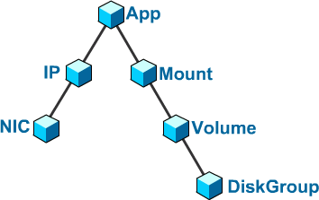
Resource Dependencies
Resources dependencies:
Determine online and offline order
Have parent/child relationships; parent depends on child
Cannot be cyclical
Offline order
Parent
Parent/child
Persistent resources, such as NIC, cannot be parents.
Child
Online order

Slide 23
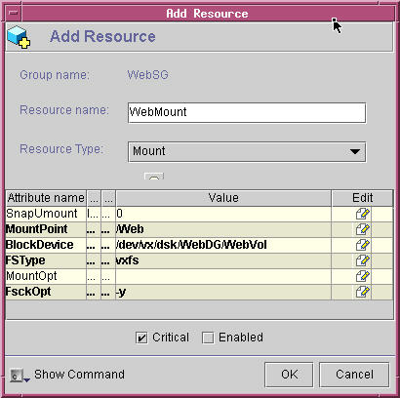
Resource Attributes
Resource attributes:
Define individual resource properties
Are used by VCS to manage the resource
Can be required or optional
Have values that match actual components
Solaris
Online
mount –F vxfs /dev/vx/dsk/WebDG/WebVol /Web

Slide 24

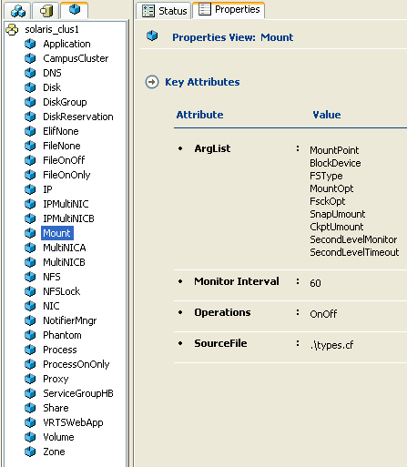
Resource Types
Resources types:
Are classifications of resources
Specify the attributes needed to define a resource
Are templates for defining resource instances
Solaris
mount [-F FSType] [options] block_device mount_point

Slide 25


Agents: How VCS Controls Resources
Each resource type has a corresponding agent
that manages all resources of that type.
Agents have one or more entry points.
Entry points perform set actions on resources.
Each system runs one agent for each active resource type.
/web
/log
10.1.2.3
online
WebDG
WebVol
LogVol
eri0
offline
monitor
Mount
clean
IP
Disk Group
Volume
NIC

Slide 26
Topic 2: Cluster Communication
After completing this topic, you will be able to describe cluster communication mechanisms.
Notes:
This is <topic 1>, <topic one title>.
As a reminder, the objective(s) for this topic is/are: <topic 1 objective(s)>.

Slide 27
Cluster Communication
The cluster interconnect provides a communication
channel between nodes.
The interconnect:
Determines which nodes are affiliated by cluster ID
Uses a heartbeat mechanism
Maintains cluster membership:
A single view of the state of each cluster node
Is also referred to as the private network

Slide 28
Low-Latency Transport (LLT)
LLT is a high-performance, low-latency protocol for
cluster communication.
LLT:
Sends heartbeat messages
Transports cluster communication traffic
Balances traffic load across multiple network links
Is a proprietary protocol
Runs on an Ethernet network
LLT
LLT

Slide 29
Group Membership Services/Atomic Broadcast (GAB)
GAB is a proprietary broadcast protocol that uses LLT as its
transport mechanism.
GAB:
Manages cluster membership—GAB membership
Is a proprietary broadcast protocol
Sends and receives configuration information
Uses the LLT transport mechanism
GAB
LLT
GAB
LLT

Slide 30
High Availability Daemon (HAD)
HAD is the VCS engine, which manages all resources
and tracks all configuration and state changes.
Agent
Agent
Agent
HAD:
Runs on each cluster node
Maintains resource configuration and state information
Manages agents and service groups
Is monitored by the hashadow daemon
HAD
hashadow
Fence
GAB
LLT

Slide 31
Topic 3: VCS Architecture
After completing this topic, you will be able to describe how the VCS architecture implements high availability.
Notes:
This is <topic 1>, <topic one title>.
As a reminder, the objective(s) for this topic is/are: <topic 1 objective(s)>.

Slide 32
Maintaining the Cluster Configuration
HAD maintains the cluster configuration in memory on each node.
Configuration changes are broadcast by HAD to all systems.
The configuration is preserved on disk
(main.cf).
main.cf
HAD
GAB
main.cf
HAD
LLT
GAB
LLT

Slide 33
VCS Configuration Files
/etc/VRTSvcs/conf/config/main.cf
include "types.cf"
cluster vcs_web (
UserNames = { admin = ElmElgLimHmmKumGlj }
Administrators = { admin }
CounterInterval = 5
)
system S1 (
)
system S2 (
)
group WebSG (
SystemList = { S1 = 0, S2 = 1 }
)
Mount WebMount (
MountPoint = "/Web"
BlockDevice = "/dev/vx/dsk/WebDG/WebVol"
FSType = vxfs
FsckOpt = "-y"
)
Cluster configuration stored in text
file on disk

Slide 34
VERITAS Cluster Server for UNIX, Fundamentals
Lesson 3
Preparing a Site for VCS

Slide 35
Hardware Recommendations
No single points of failure
Redundancy for:
  Public network interfaces and infrastructures
  HBAs for shared storage (Fibre or SCSI)
Identically configured systems:
  System hardware
  Network interface cards
  Storage HBAs

Slide 36
Software Requirements
Determine supported software:
  Operating system
  Patch level
  Volume management
  File system
  Applications
Obtain VCS license key
entsupport.symantec.com
Release notes and installation guide
vlicense.veritas.com
Sales representative
Technical Support for upgrades

Slide 37
Software Recommendations
Identical system software configuration:
  Operating system version and patch level
  Kernel and networking
  Configuration files
  User accounts
Identical application configuration:
  Version and patch level
  User accounts
  Licenses

Slide 38
System and Network Preparation
Before beginning VCS installation:
Add /sbin, /usr/sbin, /opt/VRTSvcs/bin to PATH.
Verify that systems are accessible using fully qualified host names.
Create an alias for the abort—>go sequence (Solaris).
Configure ssh or rsh.
Only required for the duration of the VCS installation procedure
No prompting permitted:
  ssh: Set public/private keys
  rsh: Set /.rhosts
  Move /etc/issue or similar type files
Can install systems individually if remote access is not allowed
Notes:
Verify that all operating system concerns identified in the design phase have been addressed. As in hardware verification, document non-compliance and corrective action, and if necessary, impact if the action is not taken.
There can be system configuration considerations that have absolutely nothing to do with VERITAS software, but will prevent the HA solution from working. For example, when adding a second server to create an active-passive Oracle RDBMS cluster it is common for the shared memory parameters to not be set on the second server. Don’t overlook any kernel, /etc/system or boot prom parameters that might have been customized, or need to be.

Slide 39

Required Installation Input
Collect required installation information:
  System (node) names
  License keys
  Cluster name
  Cluster ID (0 – 64K)
  Network interfaces for cluster interconnect links
Notes:
Pre-installation Tasks
The following tasks are recommended in preparation for installing VCS:
Reviewing the hardware requirements
Check latest VCS release notes
VERITAS Customer Support at 800.342.0652
VERITAS Sales Support at 800.327.2232
Check http://entsupport.symantec.com for a list of each country’s contact information
Reviewing the list of supported software
Solaris - 2.6, 7 and 8 (32-bit and 64-bit)
Download Solaris patches for Java
Before running the installvcs utility, download and install the latest Solaris patches for the Java Runtime Environment. You can obtain the patches from:
http://java.sun.com/j2se/1.3/install-solaris-patches.html.
Setting up the private network
Setting up the shared storage
Preparing NFS Services
When systems are sharing external disks, the major and minor numbers for the shared partition must be the same to prevent NFS stale mounts. Run on each machine: ls -lL /dev/dsk/cxtxdxsx
Disabling the abort sequence
When a system under is halted with the abort sequence, it stops producing VCS heartbeats. To disable the abort sequence on Solaris systems, add the following line to the /etc/default/kbd file (create the file if it does not exist): KEYBOARD_ABORT=disable (reboot)
Obtaining VCS license keys
Setting the PATH variable
Add the directories containing VCS executables to the PATH variable in /.profile
Enabling ssh/rsh communication between systems
Preparing cluster information

Slide 40
Cluster Configuration Options
Prepare for configuring options:
  VCS user names and passwords
  Managed host (Cluster Management Console)
  Local CMC (Web GUI):
    Network interface for CMC Web GUI
    Virtual IP address for CMC Web GUI
  SMTP server name and e-mail addresses
  SNMP Console name and message levels
  Root broker node for security
Default account:
User name: admin
Password: password
Notes:
Pre-installation Tasks
The following tasks are recommended in preparation for installing VCS:
Reviewing the hardware requirements
Check latest VCS release notes
VERITAS Customer Support at 800.342.0652
VERITAS Sales Support at 800.327.2232
Check http://entsupport.symantec.com for a list of each country’s contact information
Reviewing the list of supported software
Solaris - 2.6, 7 and 8 (32-bit and 64-bit)
Download Solaris patches for Java
Before running the installvcs utility, download and install the latest Solaris patches for the Java Runtime Environment. You can obtain the patches from:
http://java.sun.com/j2se/1.3/install-solaris-patches.html.
Setting up the private network
Setting up the shared storage
Preparing NFS Services
When systems are sharing external disks, the major and minor numbers for the shared partition must be the same to prevent NFS stale mounts. Run on each machine: ls -lL /dev/dsk/cxtxdxsx
Disabling the abort sequence
When a system under is halted with the abort sequence, it stops producing VCS heartbeats. To disable the abort sequence on Solaris systems, add the following line to the /etc/default/kbd file (create the file if it does not exist): KEYBOARD_ABORT=disable (reboot)
Obtaining VCS license keys
Setting the PATH variable
Add the directories containing VCS executables to the PATH variable in /.profile
Enabling ssh/rsh communication between systems
Preparing cluster information

Slide 41
Symantec Product Authentication Service
Provides secure communication:
  Among cluster systems
  Between VCS interfaces and cluster systems
Uses digital certificates for authentication
Uses Secure Socket Layer (SSL) for encryption
Provides user authentication (single sign-on)
Requires one root broker node to be running
Requires all cluster systems to be authentication brokers
Formerly named VERITAS Security Services (VxSS)
Symantec recommends using a system outside the cluster to serve as the root broker node.

Slide 42



SCSI Controller Configuration Requirements
scsi-initiator-id
scsi-initiator-id
7
5
Typical
default
7
Not applicable for fibre attached storage
If using SCSI for shared storage:
  Use unique SCSI IDs for each system.
  Check the controller SCSI ID on both systems and the SCSI IDs of the disks in shared storage.
  Change the controller SCSI ID on one system, if necessary.
  Shut down, cable shared disks, and reboot.
  Verify that both systems can see all the shared disks.
Solaris
AIX
HP-UX
Linux

Slide 43
SCSI Controller Setup for Solaris
Check the scsi-initiator-id setting using the eeprom command.
If necessary, check the SCSI ids of shared disk devices using the probe-scsi-all command at the ok prompt from one of the systems.
Change the scsi-initiator-id eeprom variable if needed.
  This will impact all the SCSI controllers on the system.
Controller ID can also be changed on a controller-by-controller basis using the corresponding controller configuration file.
Use the format command to verify shared disks after system reboot.

Slide 44
VERITAS Cluster Server for UNIX, Fundamentals
Lesson 4
Installing VCS
Notes:
Hello, and welcome to lesson 4, Installing VCS, of the VERITAS Cluster Server for UNIX, Fundamentals course.

Slide 45
Using the VERITAS Product Installer
The VERITAS product installer:
Is the recommended installation procedure for VCS
Performs environment checking for prerequisites
Enables you to add product licenses
Is started by running the installer file in the DVD mount point directory
Runs the installvcs utility
Logs user input and program output to:
/opt/VRTS/install/logs
Notes:
VERITAS ships high availability and storage foundation products with a VERITAS product installer (VPI) utility
that enables you to install these products using the same interface.
At the end of every product installation, the VPI creates three text files:
A log file containing any system commands executed, and their output
A response file to be used in conjunction with the -responsefile option of the VPI
A summary file, containing the output of the VERITAS Product Install scripts
These files are located in /opt/VRTS/install/logs. The names and locations of each file are displayed at the end of each product installation. It is recommended that these logs be kept for auditing and debugging purposes.

Slide 46
Automated VCS Installation Procedure
Invoke installer.
Verify communication and install infrastructure packages.
Enter system names.
Enter license keys.
Select optional packages.
Configure the cluster (name, ID, interconnects).
What the script
does
User input
to the script
Select root broker node.
Set up VCS user accounts.
Configure cluster connector or local CMC (Web GUI).
Install VCS packages.
Configure VCS.
Configure SMTP and SNMP notification.
Start VCS.
Notes:
The VCS installation utility, installvcs, is interactive. Using information you supply, the installvcs utility installs VCS on each cluster system and sets up the VCS communication services, LLT and GAB. The utility also gives you the option to install and configure the Web-based Cluster Manager (Web Console) and to set up SNMP and SMTP notification features in the cluster.
As you use the installvcs utility, you can review summaries to confirm the information that you provide. You can stop or restart the installation after reviewing the summaries. Installation of VCS packages takes place only after you have confirmed the information. However, partially installed VCS files must be removed before running the installvcs utility again.
The installation utility is described in detail in the VERTIAS Cluster Server Installation Guide for each platform.

Slide 47
VCS File Locations
Directories | Contents
/sbin, /usr/sbin, /opt/VRTSvcs/bin | Executables, scripts, libraries
/var/VRTSvcs/log | VCS engine and agent log files
/etc/VRTSvcs/conf/config | Cluster configuration files
/etc | Configuration files for GAB, LLT, and I/O fencing
/opt/VRTSvcs/doc | PDF versions of VCS documentation
/opt/VRTS/install/logs | VCS installation log files
Notes:
The VCS installation procedure creates several directory structures for
VCS executables, scripts, libraries, configuration files, and logs.
The installation procedure also adds several environment variables during installation.

Slide 48
Communication Configuration Files
LLT configuration files:
  /etc/llttab
    Cluster ID number
    System name
    LLT network interfaces used for the cluster interconnect
  /etc/llthosts
  Cluster host names with corresponding LLT node ID number
GAB configuration file:
/etc/gabtab
GAB startup command with specified number of systems
Notes:
After installation, you can view the cluster communication configuration files, llthosts, llttab and gabtab.
/etc/llttab
The llttab file is the primary LLT configuration file and is used to set ID numbers, specify the network interfaces
used for the cluster interconnect. You can also modify LLT behavior, such as heartbeat frequency within the llttab file.
The llthosts file associates a system name with a unique VCS cluster node ID number for every system in the cluster. This file is the same on all systems in the cluster.
The gabtab file contains the command line that is used to start GAB.
Cluster communication is described in detail later in the course.

Slide 49
Cluster Configuration Files
VCS configuration files
/etc/VRTSvcs/conf/config/types.cf
/etc/VRTSvcs/conf/config/main.cf
  include "types.cf"
  cluster vcs_train (
  …
  )
  system train1 (
  )
  system train2 (
  )
  group ClusterService (
  …
  )
  IP webip (
  Device = eri0
  Address = "192.168.105.101"
  NetMask = "255.255.255.0"
  )
  . . .
Cluster name
Systems in the cluster
Local CMC Web GUI
Solaris
Notes:
You can view the main.cf and types.cf cluster configuration files that are created during installation.
The contents of the main.cf file reflect your installation selections. For example, if you select to
configure the Web GUI, the corresponding VCS resources are defined in the ClusterService group.

Slide 50
Viewing Installation Results
List the VERITAS packages installed.
View VCS configuration files.
Access the local CMC Web Console.
  http://IP_Address:8181/cmc
pkginfo
lslpp
swlist
rpm
llthosts
main.cf
gabtab
llttab
types.cf
Notes:
After the initial installation, you can perform the following tasks to view the cluster
configuration performed during the installation process.
List the VERITAS packages installed on the system using the operating system-specific command for listing packages
Log onto the VCS Web Console
View the product documentation

Slide 51
Viewing Status
View LLT status:
# lltconfig
llt is running
View GAB status:
# gabconfig -a
GAB Port Memberships
================================
Port a gen a36e003 membership 01
Port h gen fd57002 membership 01
View VCS status:
# hastatus –sum
-- System State Frozen
A S1 RUNNING 0
A S2 RUNNING 0
Notes:
After installation is complete, you can check the status of VCS components.
View VCS communications status on the cluster interconnect using LLT and GAB commands.
You can see that LLT is up by running the lltconfig command.
View GAB port a and port h memberships for all systems using the gabconfig –a command.
View the cluster status using the hastatus –sum command.

Slide 52
VERITAS Cluster Server for UNIX, Fundamentals
Lesson 5
VCS Operations

Slide 53
Key Considerations
To manage an application under VCS control:
Use VCS to start and stop the application.
or
Direct VCS not to intervene:
  Freeze the service group.
  Perform administrative operations outside of VCS.
  Unfreeze the service group to reenable VCS control.
You can mistakenly cause problems if you manipulate
resources outside of VCS, such as forcing faults:
Causing failover and downtime
Preventing failover
!

Slide 54
VCS Management Tools
CLI
Java GUI
Web GUI
VCS Simulator
Command-line interface
Runs on the local system
Thick client
Runs on UNIX and Windows systems
Thin client
CMC-managed host mode
Local mode
Create, model, and test cluster configurations
Cannot manage a running cluster configuration

Slide 55
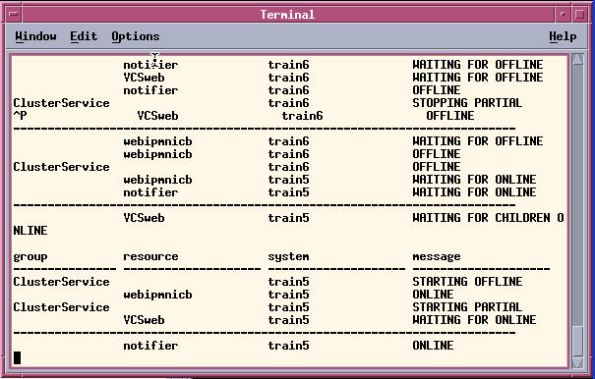

Displaying Cluster Status
Determine the state of the cluster at a point in time:
hastatus –sum
Display continuous cluster status:
hastatus
Status and Attributes

Slide 56

Displaying Logs
VCS log file location: /var/VRTSvcs/log
HAD (engine) log: engine_A.log
Java GUI command log:
  Is useful for learning the CLI
  Can be used to create batch files
  Is cleared when you log out of the GUI
Logs

Slide 57
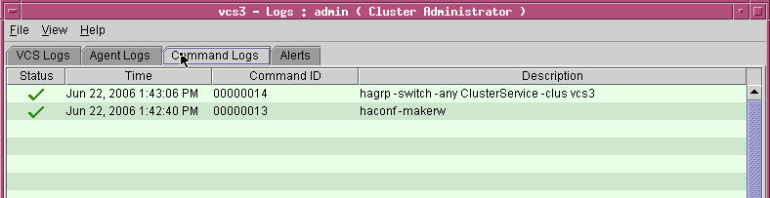
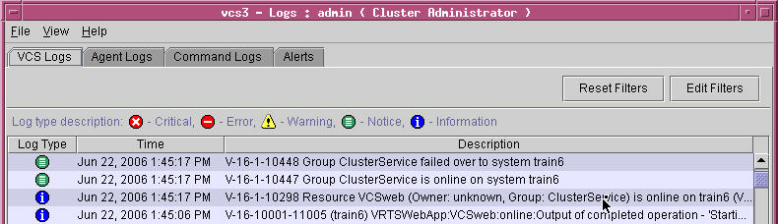
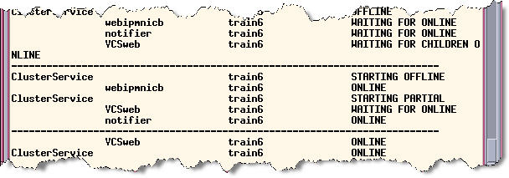
Example: Switching ClusterService
hastatus

Slide 58
Displaying Object Information
Use hares to display resource information:
  hares –display resource
  hares –list condition
  hares –value resource attribute
  hares –state resource
Use hagrp to display service group information:
  hagrp –display group
  hagrp –list condition
  hagrp –value group attribute
  hagrp –state group
Getting help:
Command-line syntax:
  ha_command –help
  man ha_command
Bundled Agents Reference Guide

Slide 59
Bringing Service Groups Online
Service groups are brought online:
  Manually, after maintenance
  Automatically, when VCS is started
Resources are brought online in order from bottom to top.
Persistent resources do not affect service group state.
WebSG
Web
IP
Mount
NIC
Volume
DiskGroup
online
System S1
Online
hagrp -online

Slide 60
Taking Service Groups Offline
Service groups are taken offline:
  Manually, for maintenance
  Automatically, when VCS is stopped or during failover
Resources are taken offline in order from top to bottom.
A service group is offline when all nonpersistent resources are offline.
WebSG
offline
Web
IP
Mount
NIC
Volume
DiskGroup
S1
Offline
hagrp -offline

Slide 61
Switching Service Groups
You can switch a service group
between systems to:
Test failover
Migrate services for maintenance
VCS:
Takes resources offline on system S1.
Brings resources online on system S2.
Only resources online on system S1 are brought online on system S2.
Before
After
Switch
hagrp -switch

Slide 62
Freezing a Service Group
Freeze a service group to prevent offline, online, or
failover actions.
Example use:
  DBA can start and stop database outside of VCS control
Persistent freeze:
  Remains in effect through VCS restarts
  Frozen=1
Temporary freeze:
  Only in effect until VCS restarts
  TFrozen=1
!
You can cause a concurrency violation and possible data corruption if you bring an application online outside of VCS.
Freeze
hagrp -freeze

Slide 63
Bringing Resources Online
Resources are brought online:
  Automatically, when a service group is brought online
  Manually, after maintenance
  In dependency order from bottom
Agent runs the online entry point
Online entry point:
  Runs specific startup operations
  Example: Disk group online vxdg –t import WebDG
WebSG
Web
IP
Mount
NIC
Volume
DiskGroup
online
S1
Online
hares -online

Slide 64
Taking Resources Offline
Resources are taken offline:
  Automatically, when a service group is taken offline
  Manually, for maintenance
  In dependency order from top
Agent runs the offline entry point
Offline entry point:
  Runs specific shutdown operations
  Example: Database offline
  sqlplus "/as sysdba"
  shutdown
OraSG
Oracle
IP
Mount
NIC
Volume
DiskGroup
Ora1
Offline
hares -offline

Slide 65
VERITAS Cluster Server for UNIX, Fundamentals
Lesson 6
VCS Configuration Methods

Slide 66
VCS Startup Behavior
S1
S2
Local Build
Current_Discover_Wait
Cluster
Conf
No config in
memory
4
2
main.cf
main.cf
6
had
hashadow
had
hashadow
5
1
hastart
3
7
hastart

Slide 67
VCS Startup Behavior (continued)
S1
S2
Running
Remote
Build
Cluster
Conf
Cluster
Conf
Cluster
Conf
10
main.cf
main.cf
had
hashadow
had
hashadow
8
9
Link to Pre-5.0 Slides

Slide 68
Stopping VCS
Before stopping: haconf –dump -makero
S1
S2
S1
S2
had
had
had
had
3
hastop –all -force
1
hastop -local
S1
S2
S1
S2
had
had
had
had
4
hastop -all
2
hastop -local -evacuate

Slide 69
Modifying VCS Shutdown Behavior
The EngineShutdown cluster attribute controls hastop.
Value | Behavior
Enable (default) | Process all hastop commands.
Disable | Reject all hastop commands.
PromptClusStop | Prompt for hastop –all only.
DisableClusStop | Ignore hastop –all; process all other hastop commands.
PromptLocal | Prompt for hastop –local only.
PromptAlways | Prompt for all hastop commands.
!
hastop –force is not subject to
EngineShutdown settings.

Slide 70

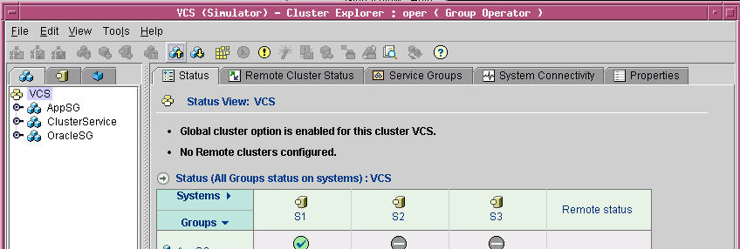
Configuration Methods
Online configuration tools: HAD is running
  Java and Web GUIs graphical user interface
  VCS CLI and shell scripts
Offline configuration methods: HAD must restart
  Manual modification of configuration files
  Modification using the VCS Simulator
  # vi main.cf
  ~
  include "types.cf"
  cluster vcs_train (
  …
  )
  system train1 (
  )
  system train2 (
  )
  group ClusterService (
  …
  )

Slide 71
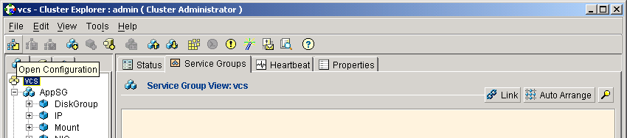
Opening the Cluster Configuration
ReadOnly=0
1
haconf -makerw
Shared cluster configuration
in memory
hares –modify ... .
2
In-memory configuration
not equal to
main.cf
main.cf
main.cf

Slide 72
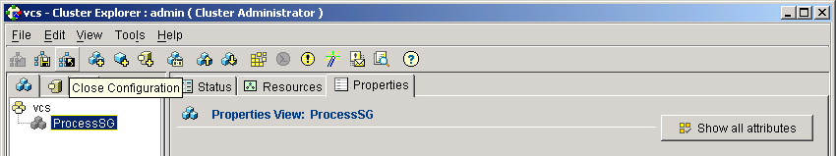
Closing the Cluster Configuration
haconf –dump -makero
ReadOnly=1
1
Shared cluster configuration
in memory
2
main.cf
main.cf
Link to Pre-5.0 Slides

Slide 73
Automatic Configuration Backups
Configuring automatic main.cf backups:
BackupInterval is 0 by default.
When set > 0, VCS saves the configuration in memory to main.cf.autobackup.
haclus -modify BackupInterval 3
BackupInterval minimum is 3 (minutes).
ls –l /etc/VRTSvcs/conf/config/main*
-rw------ 2 root other 5992 Oct 10 12:07 main.cf
-rw------ 1 root root 5039 Oct 8 8:01 main.cf.08Oct2006...
-rw------ 2 root other 5051 Oct 9 17:58 main.cf.09Oct2006...
-rw------ 2 root other 5992 Oct 10 12:07 main.cf.10Oct2006...
-rw------ 1 root other 6859 Oct 11 7:43 main.cf.autobackup
-rw------ 2 root other 5051 Oct 9 17:58 main.cf.previous

Slide 74
Offline Configuration Characteristics
Can be more efficient than online configuration for:
  Large configurations
  Many similar resources or service groups
  Many similar clusters
Requires root to modify main.cf
Requires restarting VCS
Enables services to continue running, but they are not highly available while VCS is being restarted

Slide 75
Example 2: Reusing a Service Group Definition
Service Group Definition |  |  | Sample Value
Group |  |  | TestSG
 | Required Attributes
 |  | FailoverPolicy | Priority
 |  | SystemList | S1=0, S2=1
 | Optional Attributes
 |  | AutoStartList | S1
Service Group Definition |  |  | Sample Value
Group |  |  | AppSG
 | Required Attributes
 |  | FailoverPolicy | Priority
 |  | SystemList | S1=0, S2=1
 | Optional Attributes
 |  | AutoStartList | S1
TestProcess
AppProcess
Test
Mount
App
Mount
TestIP
AppIP
Test
NIC
TestVol
App
NIC
AppVol
TestDG
AppDG

Slide 76
Relating VCS and UNIX User Accounts
In nonsecure mode:
No UNIX to VCS user account mapping
Cluster Administrator privileges given to root
Nonroot users are prompted for a VCS account name and password when using the CLI
Mode | Authentication | Authorization
Non-secure (default) | System-level VCS | VCS
Secure (VxSS) | System-level only | VCS

Slide 77
VCS User Account Privileges
VCS levels of authorization:
Cluster Administrator
Full privileges
Cluster Operator
All cluster, service group, and resource-level operations
Cluster Guest
Read-only access; new users given Cluster Guest authorization by default
Group Administrator
All operations for specified service group, except deletion
Group Operator
Service group and resource online and offline; temporarily freeze or unfreeze service groups

Slide 78
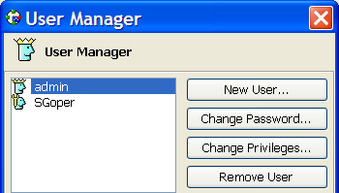
Creating Cluster User Accounts
To configure VCS user accounts:
Open the cluster configuration.
Add a user with the hauser command.
hauser –add user
Type a password.
Add privileges:
  Cluster:
  hauser –addpriv user priv
  Groups:
hauser -addpriv user priv –group group
Save and close the configuration.
GUI alternative.

Slide 79
VERITAS Cluster Server for UNIX, Fundamentals
Lesson 7
Preparing Services for VCS
Notes:
Hello, and welcome to lesson 5, Preparing Services for High Availability, of the VERITAS Cluster Server for UNIX, Fundamentals course.

Slide 80


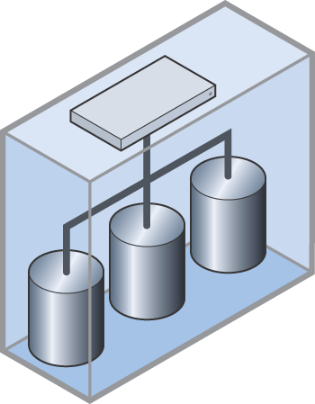
Application Service Overview
IP Address
NIC
Network
End Users
Process
File System
Volume
Disk Group
Application
Storage
Notes:
>>>
An application service is the service that the end-user perceives when accessing a particular network address. An application service typically consists of multiple components, some hardware- and some software-based, all cooperating together to produce a service.
For example, a service can include:
>>>one or more IP addresses and a NIC for network access,
>>>application software,
>>>a file system containing data files and a physical disk on which the file system resides.
If this application service needs to be migrated to another system for recovery purposes, all of the resources that compose the service must migrate together to re-create the service on another system.

Slide 81
Identifying Components
Application
Start, stop, and monitor processes
File locations
Process
Storage
IP
Mount
Network
IP addresses
Network interfaces
NIC
Volume
DiskGroup
Disk group and volume devices
File systems
Mount point directories
Notes:
The first step in preparing services to be managed by VCS is to identify the components required to support the services. These components should be itemized in your design worksheet and may include the following, depending on the requirements of your application services:
>>>
Shared storage resources:
Disks or components of a logical volume manager, such as Volume Manager disk groups and volumes
File systems to be mounted
Directory mount points
>>>
Network-related resources:
IP addresses
Network interfaces
>>>
Application-related resources:
Identical installation procedures
Procedures to manage and monitor the application
The location of application binary and data files
The following sections describe the aspects of these components that are critical to understanding how VCS manages resources.

Slide 82
Testing the Application Service
N
Ready for
VCS
Bring up resources.
S1
More
Systems?
Start up all resources
in dependency order.
Y
Shared storage
S2
Virtual IP address
S2…Sn
Stop resources.
Application software
Test the application.
Test the application.
Stop resources.
Bring up resources.
Notes:
Before configuring a service group in VCS to manage an application service, test it on each system that can be a startup or failover target for the service group. Following this best practice procedure ensures that VCS will successfully manage the service when you configure a service group to manage the service.
>>>
In this example, the S1 system is tested first. Notice that this procedure emulates how VCS manages application services.
>>>
Start resources in dependency order.
>>>
This example shows bring up shared storage resources first.
>>>
There may be no inherent dependency between storage and networking. You may
choose to bring up networking components, such as the virtual IP first.
>>>
Start the application.
>>>
Test the application in the most real-world environment possible.
>>>
When finished, take the resources down in the reverse order.
>>>
When testing is complete on the first system, migrate the service to the next system.
...
>>>
Continue testing each system that is a startup or failover target for the service in the same fashion.
>>>
When the service has been tested on all target systems, you are ready to configure VCS service groups and resources.
The next set of slides shows more detailed examples how these task might be performed.

Slide 83
Testing the Integrated Components
Test the application real-world scenarios.
Involve key users of the application.
Test network connectivity from client systems on different subnets.
Failed
192.168.21.198
S2
S1
Notes:
When all components of the service are running, test the service in situations that simulate real world use of the service.
>>>
This example describes how you might test a database service.
>>>
Start the database, and listener, if applicable.
>>>
Start the application.
>>>
Connect to the application over the networking from an appropriate
client system using the virtual IP address.
>>>
Perform whatever tests are appropriate for your application and database software.

Slide 84
Manually Migrating an Application Service
IP Address
NIC
Network
Process
Application
File System
S1
S2
Storage
Notes:
After you have verified that the application service works properly on one system, manually migrate the service between all intended target systems.
>>>
Performing these operations enables you to:
Ensure that your operating system and application resources are properly configured on all potential target cluster systems.
Validate or complete your design worksheet to document the information required to configure VCS to manage the services.
Use the same procedures shown throughout this lesson to configure and test the underlying operating system resources.

Slide 85
VERITAS Cluster Server for UNIX, Fundamentals
Lesson 8
Online Configuration

Slide 86
Online Configuration Procedure
Open the cluster configuration.
Add Service Group
Set SystemList
Modify the cluster configuration using the GUI or CLI.
Set Opt Attributes
Save and close the configuration.
Add/Test Resource
Resource Flow Chart
This procedure assumes:
You have prepared and tested the application service on each system
Resources are offline everywhere
Y
More?
Test
N

Slide 87

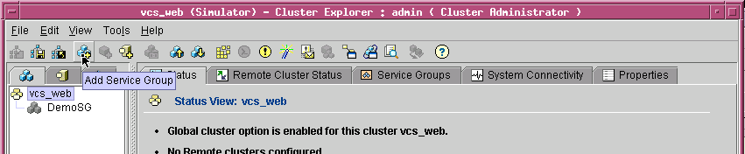
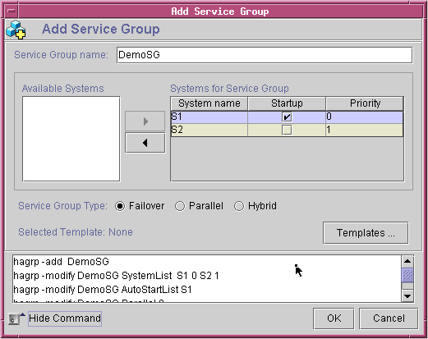
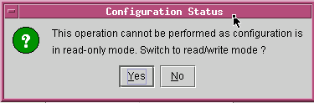
Adding a Service Group Using the GUI
main.cf
group DemoSG (
SystemList = {S1 = 0, S2 = 1}
AutoStartList = {S1}
)

Slide 88
Online Resource Configuration Procedure
Considerations:
Add resources in order of dependency, starting at the bottom.
Set each resource to non-critical until testing has completed.
Configure all required attributes.
Enable the resource.
Bring each resource online before adding the next resource.
Add Resource
Set Non-Critical
Modify Attributes
Enable Resource
Bring Online
Online?
N
Troubleshoot Resources
Y
Done

Slide 89

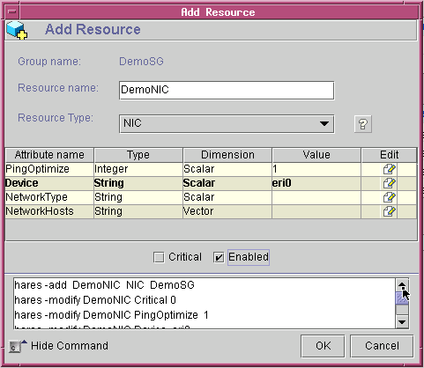
Adding a Resource Using the GUI: NIC Example
NICs are monitored using:
  ICMP pings to NetworkHosts address, if specified
  A broadcast to the administrative IP subnet
An administrative IP address must be configured first.
main.cf
NIC DemoNIC (
Critical = 0
Device = eri0
)

Slide 90
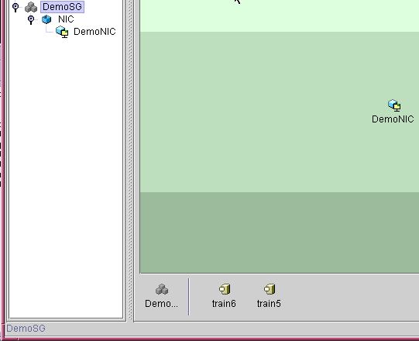
Persistent Resources
Persistent resources:
Are of type on-only or none
Are online when enabled
Cannot be taken offline
Do not affect service group state; for example:
  A service group with only a NIC shows the state as offline.
  Addition of a nonpersistent resource, such as IP, affects the service group state.

Slide 91
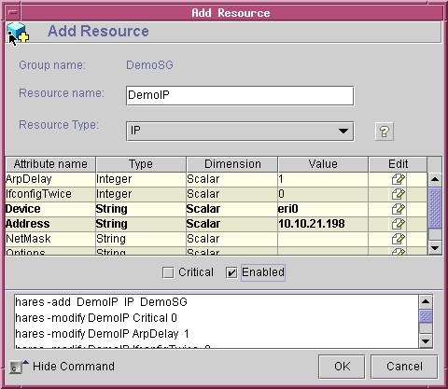
Adding an IP Resource
Virtual IP addresses:
Are configured by the agent using ifconfig
Must be different from the administrative IP address
main.cf
IP DemoIP (
Critical = 0
Device = eri0
Address = "10.10.21.198"
)

Slide 92
Adding a Resource Using Commands: DiskGroup Example
hares -add
You can use the hares command to add a resource
and modify resource attributes.
The DiskGroup agent:
Imports and deports a disk group
Monitors the disk group using vxdg
haconf –makerw
hares –add DemoDG DiskGroup DemoSG
hares –modify DemoDG Critical 0
hares –modify DemoDG DiskGroup DemoDG
hares –modify DemoDG Enabled 1
haconf –dump –makero
DiskGroup DemoDG (
Critical = 0
DiskGroup = DemoDG
)
main.cf

Slide 93
The Volume Resource
The Volume agent:
Starts a volume using vxrecover and stops a volume using vxvol
Reads a block from the raw device interface using dd to determine volume status
Resource Definition |  |  | Sample Value
Service Group Name |  |  | DemoSG
Resource Name |  |  | DemoVol
Resource Type |  |  | Volume
 | Required Attributes
 |  | Volume | DemoVol
 |  | DiskGroup | DemoDG
main.cf
Volume DemoVol (
Volume = DemoVol
DiskGroup = DemoDG
)
Volume resources:
Are not required; DiskGroup resources can start volumes
Provide additional monitoring

Slide 94
The Mount Resource
The Mount agent:
Mounts and unmounts a block device on the directory
Runs fsck to remount if mount fails
Uses stat and statvfs to monitor the file system
Resource Definition |  |  | Sample Value
Service Group Name |  |  | DemoSG
Resource Name |  |  | DemoMount
Resource Type |  |  | Mount
 | Required Attributes
 |  | MountPoint | /Demo
 |  | BlockDevice | /dev/vx/dsk/DemoDG/DemoVol
 |  | FSType | vxfs
 |  | FsckOpt | -y
Mount DemoMount (
BlockDevice = /dev/vx/dsk/DemoDG/DemoVol
FSType = vxfs
MountPoint = /Demo
FsckOpt = -y )
main.cf
CLI escape character
hares –modify . . FsckOpt %-y

Slide 95
The Process Resource
The Process agent:
Starts and stops a daemon-type process
Monitors the process by scanning the process table
Property |  |  |  | Value
Service Group |  |  |  | DemoSG
Resource Name |  |  |  | DemoProcess
Resource Type |  |  |  | Process
 | Required Attributes
 |  | PathName |  | /bin/sh
 | Optional Attributes
 |  |  | Arguments | /Demo/orderproc up
main.cf
Process DemoProcess (
PathName = "/bin/sh"
Arguments = "/Demo/orderproc up"
)

Slide 96
Process Attribute Specification
Attribute | Binary Executable | Shell Script
PathName | Fully-qualified path to binary file: | Fully-qualified path to shell:
 | "/Demo/orderproc | /bin/sh
Arguments (optional) | Parameters passed to binary file: | Path to shell script and parameters:
 | up | /Demo/orderproc up

Slide 97
Troubleshooting Resources
Bring Online
Y
Online?
Done
Primary focus
Modify Attributes
N
Values?
Bad
Flush Group
Good
Check Logs
Fix Problems
Faulted?
N
Y
Clear Resource
Notes:
The reasons for putting this section within this lesson are:
It gives users an overall context for solving problems they are going
to make while setting up service groups. Rather than wait to explain this later,
in a separate lesson or with troubleshooting, tell them right now because this
is when they are going to run into these problems. Then they understand what
clearing, flushing, disabling all mean in relation to the overall procedure to fix
up what they’ve done wrong during configuration.
They now know how to solve the problems they’re going to see
in the lab. If this information is not in this lesson, the instructor
ends up teaching this to each student in the lab. Experience shows
that most students will make a configuration mistake and have to
resolve it in order to get their service group tested and working.
Rather than teach individually during lab time, teach them how
to solve their own problems.
Now that they’ve seen this all here, they can apply the same
procedure to fixing problems they’ve made in offline configuration.
Putting this information within a lesson helps address a concern
that it makes VCS look difficult to configure properly. Giving it
a whole lesson elevates that message.

Slide 98
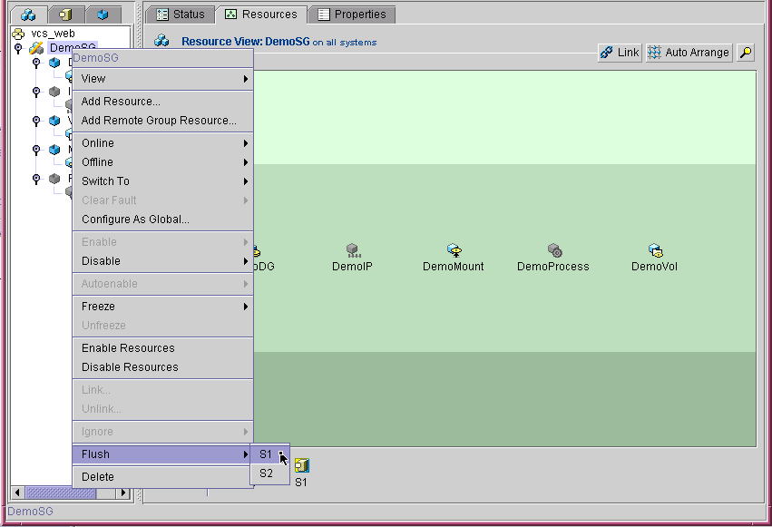
Flushing a Service Group
Agents appear to hang when resources are misconfigured.
To fix:
Ensure the resource is stopped at the operating system level.
Flush the service group to stop all online and offline processes.
hagrp –flush DemoSG –sys S1

Slide 99
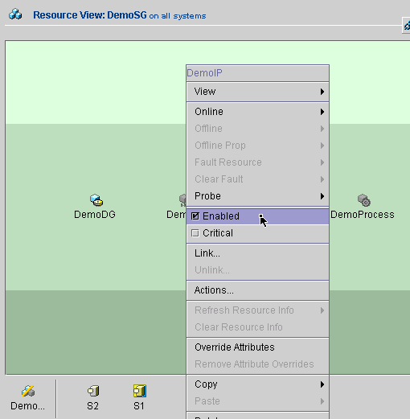
Disabling and Enabling a Resource
Upon disabling:
  VCS calls the agent on each system in the SystemList.
  The agent:
    Calls the close entry point, if present, to reset the resource
    Stops monitoring disabled resources.
Upon enabling:
VCS calls the agent to monitor the resource on each system.
Nonpersistent resources must be taken offline before disabling.
hares –modify DemoIP Enabled 0

Slide 100
Clearing Resource Faults
Agents monitor both online and offline resources periodically.
A resource fault occurs when:
  The underlying component is not available
  The next monitor entry point returns an unexpected offline status
Fix the underlying problem.
Clear the fault in VCS:
  Clear nonpersistent resources and bring them back online manually.
  Probe persistent resources or wait for a monitor cycle to return an online state.
hares –clear
hares -probe

Slide 101
Test Procedure
Start
After all resources are
online locally:
Link resources.
Switch the service group to each system.
Set resources to critical, as needed.
Test failover.
Link Resources
Test Switching
Success?
N
Check Logs/Fix
Y
Set Critical
Test Failover
N
Success?
Y
Check Logs/Fix
Done

Slide 102
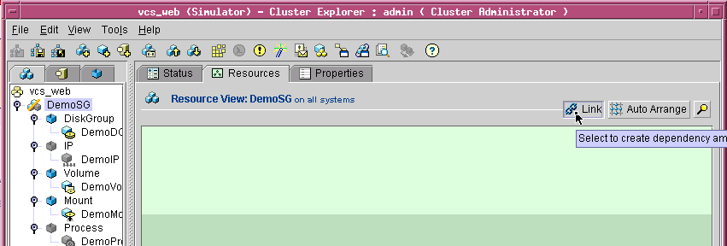
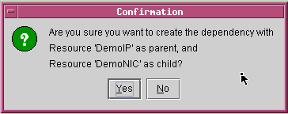

Linking Resources
main.cf
DemoIP requires DemoNIC
hares –link DemoIP DemoNIC
hares –dep
hares –unlink DemoIP DemoNIC

Slide 103
Resource Dependencies
DemoSG
DemoProcess
Dependency rules:
Parent depends on child:
  Child resource comes online first
  Parent can only come online if the child is online
  Parent must go offline first
Parents cannot be persistent
No resource links across service groups
Unlimited number of parent/child resources
No cyclical dependencies
DemoIP
DemoMount
DemoNIC
DemoVol
DemoDG
Resource Dependency Definition
Service Group | DemoSG
Parent Resource | Requires | Child Resource
DemoVol |  | DemoDG
DemoMount |  | DemoVol
DemoIP |  | DemoNIC
DemoProcess |  | DemoMount
DemoProcess |  | DemoIP

Slide 104
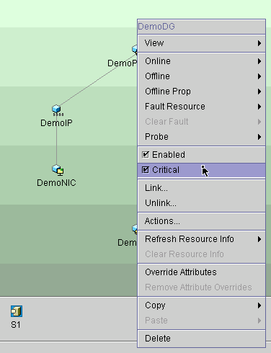
Setting the Critical Attribute
When Critical is set:
The attribute is removed from main.cf
(Critical=1 is the default setting for all resources.)
The entire service group is faulted if the resource faults.
main.cf
DiskGroup DemoDG (
DiskGroup = DemoDG
)
hares –modify DemoDG Critical 1

Slide 105
VERITAS Cluster Server for UNIX, Fundamentals
Lesson 9
Offline Configuration
Notes:
Hello and welcome to the "Offline Configuration" lesson in the VERITAS Cluster Server course.

Slide 106
Offline Configuration Procedure—New Cluster
Save and close the configuration.
haconf –dump -makero
Change to configuration directory.
cd /etc/VRTSvcs/conf/config
Stop VCS on all systems.
hastop -all
Edit the configuration file.
vi main.cf
Verify configuration file syntax.
hacf –verify .
Y
Errors?
Primary System
N
Start VCS on this system.
hastart
Verify that VCS is running.
hastatus -sum
Start VCS on all other systems.
hastart
All Other Systems
Notes:
The procedure shown in the slide applies to configuring service groups and resources in a new cluster with no preexisting
service groups.
>>>
Select one system to be the primary node for configuration.
>>>
Start by saving and closing the configuration to ensure that the main.cf file on disk
is the most recent in-memory configuration.
Then change to the configuration directory, stop VCS on all systems, and make the necessary
changes to the main.cf file. When finished, verify the syntax and start VCS on this primary
system. This ensures that the cluster configuration is built from the modified main.cf on this system.
>>>
When the first system is running, start VCS on all other systems. They will build their configuration
from the primary system.

Slide 107
Existing Cluster Procedure: Part 1
Save and close the configuration.
haconf –dump -makero
Change to the config directory.
cd /etc/VRTSvcs/conf/config
Back up the main.cf file.
cp –p main.cf main.cf.orig
Create a working directory.
mkdir stage
Copy main.cf and *types.cf.
cp *.cf stage
Change to the stage directory.
cd stage
First
System
Edit the configuration file.
vi main.cf
Set Frozen attribute.
Set Frozen=1 for modified groups.
Notes:
The procedure for manually modifying the main.cf file is slightly different when you
have existing service groups in a running cluster.
In this case, you want to keep VCS running as long as possible to protect existing
applications.
>>>
You also want to work on copies of the main.cf file to ensure you can
recover to a working configuration if you have errors in your edited version.
>>>
While editing the copy of main.cf, you should freeze the service groups you are modifying to ensure
they do not fail over if you have misconfigured a resource while editing the main.cf file.

Slide 108
Existing Cluster Part 2: Restarting VCS
Verify configuration file syntax.
hacf –verify .
Stop VCS; leave services running.
hastop –all -force
Copy the main.cf file back.
cp -p main.cf ..
Start VCS on this system.
hastart
Primary
System
Verify that HAD is running.
hastatus -sum
Start VCS on other systems.
hastart
Other Systems
After you verify that all resources come online properly:
Unfreeze service groups.
Test switching the service group.
Notes:
When you have completed your changes, verify the syntax to ensure that the
configuration will build properly.
>>>
To restart the cluster with the new configuration, stop VCS and leave applications
running, copy the main.cf file into the conf/config directory, and start VCS on the primary
system.
>>>
When VCS is running on the primary system with the new configuration in memory,
start VCS on all other systems.
>>>
After all resources are online, you can unfreeze the service groups and test failover.

Slide 109
VCS Startup Using a Specific main.cf File
S1
S2
Local Build
VCS not running
Cluster
Conf
No config in
memory
4
2
main.cf
main.cf
had
hashadow
1
hastart
3
System with modified main.cf
Notes:
The diagram in the slide illustrates the VCS startup process that ensures
that a specific main.cf file is used to build the cluster configuration in memory.
The system names in this example are S1 and S2, which S1 as the primary
system with the modified main.cf file.
>>>
When you run hastart on S1, the had and hashadow processes are started.
>>>
HAD then checks for a valid main.cf file.
HAD also checks for an active cluster configuration on the cluster interconnect, even if the
main.cf file is valid.
>>>
Because there is no active cluster configuration, HAD on S1 reads the local main.cf file and loads the cluster configuration into local memory on S1.

Slide 110
Building the Configuration
S1
S2
Local Build or Running
Remote
Build
Cluster
Conf
Cluster
Conf
Cluster
Conf
11
main.cf
main.cf
7
had
hashadow
had
hashadow
9
10
8
hastart
6
hastatus -sum
5
Notes:
After the primary system is in the local build or running state,
start VCS on the S2 system.
>>>
HAD checks for a valid main.cf file and then checks for an active cluster
configuration on another system in the cluster using the cluster interconnect.
>>>
S1 sends its copy of the in-memory configuration when it is running state.
If S1 is not yet in a running state, but is in local build state, S2 waits for
S1 to transition to running state.
>>>
S2 then performs a remote build and HAD moves existing configuration files
to backup copies and writes the in-memory configuration the main.cf and types.cf files.

Slide 111
Resource Dependencies
Ensure resource dependencies are defined.
Review these rules:
  No persistent parent resources
  No links between resources in different groups
  No limits to the number of parent and child resources
  No cyclical dependencies
Resource Dependency Definition
Service Group | AppSG
Parent | Requires | Child
AppProcess |  | AppIP
AppProcess |  | AppMount
AppMount |  | AppVol
AppVol |  | AppDG
AppIP |  | AppNIC
AppProcess requires AppIP
AppProcess requires AppMount
AppMount requires AppVol
AppVol requires AppDG
AppIP requires AppNIC
Notes:
Remember to create the resource dependency definitions at the end of the service group definition.
>>>
Add the links using the syntax shown in the slide. A complete example service group definition is shown in the next section.

Slide 112
A Completed Configuration File
main.cf
. . .
group DemoSG (
SystemList = { S1 = 0, S2 = 1}
AutoStartList = { S1 }
Operators = { DemoSGoper }
Frozen = 1
)
DiskGroup DemoDG (
DiskGroup = DemoDG
)
IP DemoIP (
Device = eri0
Address = "10.10.21.198"
)
. . .
Original group
Copied group
. . .
group AppSG (
SystemList = { S1 = 1, S2 = 0}
AutoStartList = { S2 }
Operators = { AppSGoper }
Frozen = 1
)
DiskGroup AppDG (
DiskGroup = DemoDG
)
IP DemoIP (
Device = eri0
Address = "10.10.21.199"
)
. . .
Check these common problems.
Notes:
A portion of the completed main.cf file with the new service group definition for AppSG is displayed in the slide.
This service group was created by copying the DemoSG service group definition and changing the attribute names and values.

Slide 113
Starting From an Old Configuration
You start the cluster from the wrong system.
VCS starts but builds the in-memory configuration from an old configuration.
To recover:
  Close the configuration, if open.
  Stop VCS on all systems and keep applications running.
  On the system with the good main.cf file, copy main.cf.previous to main.cf.
  Verify the syntax.
  Start VCS on this system using the hastart command.
  Verify that VCS is running using hastatus.
  Start VCS on all other systems only after the first system is running.
Notes:
One common problem you may encounter with offline configuration is
building the in-memory configuration from the wrong system with an old
main.cf file.
>>>
To restart VCS with the correct configuration file, use the offline configuration
procedure, starting on the system with the modified main.cf file.

Slide 114

Forcing VCS to Start from a Wait State
S1
S2
Local Build
Waiting for a running config
Cluster
Conf
No config in memory
4
5
1
main.cf
main.cf
had
hashadow
had
hashadow
3
hasys –force S1
2
hacf –verify /opt/VRTSvcs/conf/config
Notes:
Another problem you may encounter with offline configuration is that all systems
are stuck in a wait state and VCS does not start up.
This can occur if you have a syntax problem with your main.cf and you try to
start VCS with that invalid main.cf file. If you then start VCS on all other systems,
all systems transition into wait states.
>>>
If this occurs, you can force VCS to start on the system with the modified main.cf
file after you inspect the file to ensure it is the modified version, and verify the syntax.
>>>
When you force VCS to start, HAD starts up and checks for a valid main.cf file.
>>>
HAD reads the local main.cf file, and if it has no syntax errors, HAD loads the cluster configuration into local memory on S1.

Slide 115
Forcing VCS to Start (Continued)
S1
S2
Running
Remote
Build
Cluster
Conf
Cluster
Conf
Cluster
Conf
8
main.cf
main.cf
had
hashadow
had
hashadow
6
7
Notes:
When HAD is running on S1, this state change is broadcast on the cluster interconnect by GAB.
S2 then performs a remote build to place the new cluster configuration into its memory.
>>>
HAD on S2 copies the cluster configuration into the local main.cf and types.cf files after moving the original files to backup copies with timestamps.

Slide 116
Configuration File Backups
ls –l /etc/VRTSvcs/conf/config/main*
-rw------ 2 root other 5992 Oct 10 12:07 main.cf
-rw------ 1 root root 5039 Oct 8 8:01 main.cf.08Oct2006...
-rw------ 2 root other 5051 Oct 9 17:58 main.cf.09Oct2006...
-rw------ 2 root other 5992 Oct 10 12:07 main.cf.10Oct2006...
-rw------ 1 root other 6859 Oct 11 7:43 main.cf.autobackup
-rw------ 2 root other 5051 Oct 9 17:58 main.cf.previous
  main.cf linked to last timestamp file
main.cf.09Oct2006.12.07.46 linked to main.cf.previous
Notes:
Each time you save the cluster configuration, VCS maintains backup copies of the main.cf and types.cf files.
Although it is always recommended that you copy configuration files before modifying them, you can revert to an earlier version of these files if you damage or lose a file.

Slide 117
Service Group Testing Procedure
Determine service group state.
Switch the service group to each system.
Change critical attributes, as appropriate.
Test failover.
Start
N
Online?
Troubleshoot
Test Switching
Success?
N
Check Logs/Fix
Y
Set Critical Res
Test Failover
N
Success?
Y
Check Logs/Fix
Done
Notes:
After you restart VCS throughout the cluster, use the procedure shown in the slide to verify that your configuration additions or changes are correct.
If you need to make additional modifications, you can use one of the online tools or modify the configuration files using the offline procedure.

Slide 118
VERITAS Cluster Server for UNIX, Fundamentals
Lesson 10
Sharing Network Resources

Slide 119

Parallel Service Groups
Storage Foundation for
Oracle RAC example:
Enables multiple instances of Oracle to run simultaneously
Uses parallel service groups
Monitors an Oracle 10g instance running on each system simultaneously
Manages concurrent access to database files

Slide 120
Other Example Parallel Applications
Cluster Volume Manager
  Simultaneously import and read/write to volumes across cluster nodes
  Application must control mutual exclusion of read/writes to blocks
Cluster File System
  Simultaneously mount and read/write to file systems across cluster nodes
  Read/writes are direct to/from disk (except for metadata)
  Global lock management
Read-only Web servers
Networking
  Share network resources among service groups
  No shared data to manage
Notes:
CVM: Uniform shared storage model (all nodes must see all storage or fail)
Talk about any changes to volume like mirroring etc. are reflected on all nodes
Talk about how DB2 EEE MPP support is different (Shared nothing)
ODM: bypass FS buffering, locking, shared file descriptors across multiple processes, recovery bypassed for data files
Clients of RAC do not need to know that DB is running in parallel mode
Clients of CFS keep using same FS semantics

Slide 121
Properties of Parallel Service Groups
All service groups:
Start up only on systems defined in AutoStartList
Fail over to target systems defined in SystemList (where they are not already online)
Are managed by the GUI/CLI in the same manner
Parallel groups:
Can be online on more than one system without causing a concurrency violation
Cannot be switched

Slide 122



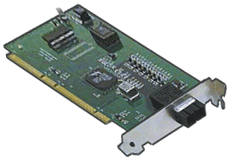
NIC Resources in Multiple Service Groups
Three service groups contain
a NIC resource:
Each NIC resource monitors the same network interface.
The NIC agent monitors each NIC resource every 60 seconds.
Additional network traffic is generated by three monitor cycles running for the same device.
eri0

Slide 123
Configuration View
WebSG
main.cf
DBSG
main.cf
NFSSG
main.cf
.
.
.
IP DBIP (
Device = qfe1
Address = " 10.10.21.198"
)
NIC DBNIC (
Device = qfe1
)
DBIP requires DBNIC
Orac1SG
main.cf
.
.
.
IP AppIP (
Device = qfe1
Address = " 10.10.21.198"
)
NIC AppNIC (
Device = qfe1
)
AppIP requires AppNIC
.
.
.
IP WebIP (
Device = eri0
Address = “10.10.21.198"
)
NIC WebNIC (
Device = eri0
)
WebIP requires WebNIC
Ora1SG
main.cf
.
.
.
IP AppIP (
Device = qfe1
Address = " 10.10.21.198"
)
NIC AppNIC (
Device = qfe1
)
AppIP requires AppNIC
DBSG
main.cf
.
.
.
IP AppIP (
Device = qfe1
Address = " 10.10.21.198"
)
NIC AppNIC (
Device = qfe1
)
AppIP requires AppNIC
.
.
.
IP DBIP (
Device = eri0
Address = " 10.10.21.199"
)
NIC DBNIC (
Device = eri0
)
DBIP requires DBNIC
Solaris

Slide 124
Using Proxy Resources
DBProcess1
A Proxy resource mirrors the state of another resource (for example, NIC).
DBMount1
DBIP1
DBVol1
DBProxy1
DBDG1
WebProcess
WebIP
WebMount
WebVol
WebNIC
WebDG

Slide 125
The Proxy Resource Type
The Proxy agent:
  Monitors the status of a specified resource on the local system
  Monitors the resource on another system if TargetSysName is specified.
TargetResName must be in a separate service group.
Resource Definition |  |  | Sample Value
Service Group Name |  |  | DBSG
Resource Name |  |  | DBProxy
Resource Type |  |  | Proxy
 | Required Attributes
 |  | TargetResName | WebNIC
main.cf
Proxy DBProxy (
Critical = 0
TargetResName = WebNIC
)

Slide 126
Parallel Network Service Group
WebSG
DBSG
WebProxy
DBProxy
NetSG
S1
NetNIC
S2
How do you determine the status of a service group with only a persistent resource?

Slide 127
Phantom Resources
WebSG
DBSG
WebProxy
DBProxy
NetSG
NetNIC
Phantom
S1
S2
A Phantom resource enables VCS to report the online status of a service group containing only persistent resources.

Slide 128
The Phantom Resource Type
Determines the status of a service group
Requires no attributes
Resource Definition |  |  | Sample Value
Service Group Name |  |  | NetSG
Resource Name |  |  | NetPhantom
Resource Type |  |  | Phantom
 | Required Attributes
main.cf
Phantom NetPhantom (
)

Slide 129
Localizing a NIC Resource Attribute
main.cf
NIC NetNIC (
Device@S1 = eri0
Device@S2 = qfe1
)
NetSG
NetNIC
eri0
qfe1
Phantom
S1
S2
You can localize the Device attribute for NIC resources when systems have different network interfaces.

Slide 130
VERITAS Cluster Server for UNIX, Fundamentals
Lesson 12
Configuring VCS Response to Faults

Slide 131
Failover Decisions and Critical Resources
A service group must have at least one critical resource to enable automatic failover.
Default VCS behavior for a failover service group:
  If a critical resource faults, the service group fails over.
  If any critical resource is taken offline as a result of a fault, the service group fails over.
Other attributes modify this behavior, as described throughout this lesson.

Slide 132
How VCS Responds to Resource Faults
Default
Behavior
A resource goes
offline unexpectedly
Execute clean entry point
for the failed resource
Fault the resource
Take all resources in path offline
Y
Critical
online resource
in path?
N
Keep group
partially online
Fault the service group
Take the entire SG offline
Failover
target
available?
N
Keep the service group offline
Y
Bring the service group online elsewhere

Slide 133
The Impact of Service Group Attributes
Fault resource and service group
Send notification
Run resfault
A resource goes
offline unexpectedly
Yes
Frozen?
No
NONE
Place resource in an
ADMIN_WAIT state
ManageFaults
Path for default settings
ALL
Execute clean entry point
Fault the resource and the service group
Do not take any
other resource offline
0
1
Take all resources
in the path offline
FaultPropagation
1

Slide 134
The Impact of Service Group Attributes (Continued)
Critical
online resource
in path?
N
Keep group
partially online
1
Y
Take the entire
group offline
0
AutoFailOver
1
Choose a failover target from
SystemList based on FailOverPolicy
Bring the service group
online elsewhere
Y
Failover
target
available?
N
Keep the service
group offline

Slide 135
Practice Exercise
ManageFaults
FaultPropagation
AutoFailOver
Case | Non-Critical | (M, F, A) SG Attributes | Offline | Taken offline due to fault | Starts on another system
A | - | ALL, 1, 1 | -
B | 4 | ALL, 1, 1 | -
C | 4,6,7 | ALL, 1, 1 | -
D | - | ALL, 1, 1 | 7
E | - | NONE,1,1 | -
F | - | ALL, 0, 1 | -
G | - | ALL, 1, 0 | -
7
5
6
8
3
4
9
1
2
Resource 4 Faults

Slide 136
Practice Exercise
ManageFaults
FaultPropagation
AutoFailOver
Case | Non-Critical | (M, F, A) SG Attributes | Offline | Taken offline due to fault | Starts on another system
A | - | ALL, 1, 1 | - | 4,6,7 | All
B | 4 | ALL, 1, 1 | - | 4,6,7 | All
C | 4,6,7 | ALL, 1, 1 | - | 4,6,7 | -
D | - | ALL, 1, 1 | 7 | 4,6 | All but 7
E | - | NONE,1,1 | - | * | -
F | - | ALL, 0, 1 | - | 4 | -
G | - | ALL, 1, 0 | - | 4,6,7 | -
7
5
6
8
3
4
9
1
2
Resource 4 Faults

Slide 137
Failover Duration When a Resource Faults
Service group failover time is the sum of the duration of each failover task.
You can affect failover time behavior by setting resource type attributes.
Detect the resource failure (< MonitorInterval).
Fault the resource.
Take the entire service group offline.
Select a failover target.
Bring the service group online on another system in the cluster.
Failover Duration

Slide 138
Adjusting Monitoring
MonitorInterval: Frequency of online monitoring
  Default is 60 seconds for most resource types
  Reduce to 10 or 20 seconds for testing
  Use caution when changing this value:
    Lower values increase load on cluster systems.
    Some false resource faults can occur if resources cannot respond in the interval specified.
OfflineMonitorInterval: Frequency of offline monitoring
  Default is 300 seconds for most resource types
  Reduce to 60 seconds for testing
!
If you change a resource type attribute, you affect all resources of that type.

Slide 139
Adjusting Timeouts
Timeout interval values define the maximum time within
which the entry points must finish or be terminated.
OnlineTimeout and OfflineTimeout:
  Default is 300 seconds
  Increase if all resources of a type require more time to be brought online or taken offline in your environment
MonitorTimeout:
  Default is 60 seconds for most resource types
Before modifying defaults:
Measure the online and offline times outside of VCS.
Measure the monitor time:
  Fault the resource.
  Issue a probe.

Slide 140
Recovering a Resource from a FAULTED State
To clear a nonpersistent resource fault:
Verify that:
  The fault is fixed outside of VCS
  The resource is completely offline.
Run hares –clear resource to clear the FAULTED status.
To clear a persistent resource fault:
Ensure that the fault is fixed outside of VCS.
Either wait for the monitor cycle to run, or probe the resource manually:
hares –probe resource –sys system

Slide 141
Recovering a Resource from ADMIN_WAIT
When a resource is in ADMIN_WAIT state, VCS:
Waits for administrative intervention
Takes no further action until the status is cleared
Solutions:
To continue operation without a failover:
  Fix the fault and bring the resource online outside of VCS.
  Clear the ADMIN_WAIT status without faulting the service group.
  hares –probe resource –sys system
If the resource is offline at the next monitor cycle, it is placed back into ADMIN_WAIT state.
To initiate failover after collecting debug information:
  hagrp –clearadminwait –fault group –sys system
!
Remember to set ManageFaults back to ALL
after resolving the problem causing the fault.

Slide 142
VERITAS Cluster Server for UNIX, Fundamentals
Lesson 13
Cluster Communications

Slide 143

On-Node and Off-Node Communication
Agent
Agent
Agent
Agent
Agent
Agent
Agent
Agent
Agent
HAD
HAD
HAD
GAB
GAB
GAB
LLT
LLT
LLT
LLT sends a heartbeat on each interface every ½ second.
Each LLT module tracks the status of heartbeats from each peer on each interface.
LLT forwards the heartbeat status of each node to GAB.

Slide 144
Cluster Interconnect Specifications
Up to eight links per cluster
High-priority:
  Heartbeats every half-second
  Cluster status information carried over links
  Usually configured for dedicated cluster network links
Low-priority:
  Heartbeats every second
  No cluster status sent
  Automatically promoted to high priority if there are no high-priority links functioning
  Can be configured on public network interfaces

Slide 145
GAB Status and Membership Notation
Cluster with four nodes: 0, 1, 21, 22
Nodes 0 and 1
20s placeholder
# gabconfig -a
GAB Port Memberships
===============================================
Port a gen a36e003 membership 01 ; ;12
Port h gen fd57002 membership 01 ; ;12
HAD is communicating.
Indicates 10s digit
(0 displayed if node 10
is a member of the cluster)
GAB is communicating.
Nodes 21 and 22
Cluster with 22 nodes
Port a gen a45e098 membership 0123456789012345678901
Port h gen fe25061 membership 0123456789012345678901

Slide 146
LLT Link Status: The lltstat Command
Solaris Example
S1# lltstat -nvv | more
LLT node information:
Node State Link Status Address
* 0 S1 OPEN
qfe0 UP 08:00:20:AD:BC:78
qfe4 UP 08:00:20:AD:BC:79
1 S2 OPEN
qfe0 UP 08:00:20:B4:0C:3B
qfe4 UP 08:00:20:B4:0C:3C
Shows which system runs the command

Slide 147
Topic 3: Cluster Interconnect Configuration
After completing this topic, you will be able to describe the files that specify the cluster interconnect configuration.
Notes:
This is <topic 1>, <topic one title>.
As a reminder, the objective(s) for this topic is/are: <topic 1 objective(s)>.

Slide 148
Configuration Overview
The cluster interconnect is automatically configured
during installation.
You may never need to modify any portion of the interconnect configuration.
Interconnect configuration and functional details are provided to give you a complete understanding of the VCS architecture.
Knowing how a cluster membership is formed and maintained is necessary for understanding effects of system and communications faults, described in later lessons.

Slide 149
LLT Configuration Files
The llttab file:
Assigns node numbers to systems.
Sets the cluster ID number to identify a system with a cluster.
Specifies the network devices used for the cluster interconnect.
Modifies default LLT behavior, such as heartbeat frequency.
/etc/llttab
set-cluster 10
set-node S1
link qfe0 /dev/qfe:0 - ether - -
link qfe4 /dev/qfe:4 - ether - -
Solaris
AIX
HP-UX
Linux

Slide 150
How Node and Cluster Numbers Are Specified
/etc/llttab
set-cluster 10
set-node S1
link qfe0 /dev/qfe:0 - ether - -
link qfe4 /dev/qfe:4 - ether - -
0 S1
1 S2
0 – 64K
Solaris
0 - 31
/etc/llthosts
AIX
HP-UX
Linux

Slide 151
The llthosts File
Associates a system name with a VCS
cluster node ID:
Has the same entries on all systems
Maps unique node numbers to system names
Matches system names with llttab and main.cf
Matches system names with sysname, if used
0 S1
1 S2
/etc/llthosts

Slide 152
The sysname File
Is configured automatically during installation
Provides VCS with a short-form system name
Removes VCS dependency on UNIX uname
S1
/etc/VRTSvcs/conf/sysname

Slide 153
The GAB Configuration File
The /etc/gabtab file:
Contains the command to start GAB:
/sbin/gabconfig -c -n number_of_systems
Specifies the number of systems that must be communicating to allow VCS to start.
/etc/gabtab
/sbin/gabconfig –c –n 4

Slide 154
Seeding During Startup
I am alive
2
I am alive
HAD
3
HAD
I am alive
HAD
Failed
GAB
GAB
GAB
LLT
1
LLT
LLT
S1
S2
S3
1
LLT starts on each system.
GAB starts on each system with a seed value equal to the number of systems in the cluster: gabconfig –c –n 3
When GAB sees three members, the cluster is seeded.
2
3
HAD starts only after GAB is communicating on all systems.
Solaris
AIX
HP-UX
Linux

Slide 155
Manual Seeding
!
Warning: Manual seeding can cause split-brain condition.
5
HAD
HAD
Seeded
Seeds
Failed
3
GAB
GAB
4
1
LLT
2
LLT
S1
S2
S3
1
S3 is down for maintenance. S1 and S2 are rebooted.
2
LLT starts on S1 and S2. GAB cannot seed with S3 down.
3
Start GAB on S1 manually and force it to seed: gabconfig –c -x.
Start GAB on S2: gabconfig -c; S2 seeds because it can detect another seeded system (S1).
4
5
Start HAD on S1 and S2.

Slide 156

Probing Resources During Normal Startup
1
A, B Autodisabled for S1, S2
A
B
3
3
monitor
2
HAD
HAD
1
During startup, HAD autodisables service groups.
2
HAD directs agents to probe (monitor) all resources on all systems in the SystemList to determine their status.
3
If agents successfully probe resources, HAD brings service groups online according to AutoStart and AutoStartList attributes.

Slide 157
Topic 5: Changing the Interconnect Configuration
After completing this topic, you will be able to change the cluster interconnect configuration.
Notes:
Jade: I made the arrow head a little bigger.
This is <topic 2>, <topic two title>.
As a reminder, the objective(s) for this topic is/are: <topic 2 objective(s)>.

Slide 158
Example Scenarios
Cluster interconnect configuration is required for:
Adding or removing cluster nodes
Merging clusters
Changing communication parameters, such as the heartbeat time interval
Changing recovery behavior
Changing or adding interfaces used for the cluster interconnect
Configuring additional network heartbeat links

Slide 159
Procedure for Modifying the Interconnect
llttab
set-node S1
set-cluster 10
  
gabtab
llthosts
path/gabconfig –c –n #
0 S1
1 S2
sysname
S1
Back up and
edit files
*One system
All systems
*
Start VCS
hastart
Stop VCS
hastop –all -force
Stop GAB
gabconfig -U
Start GAB
sh /etc/gabtab
Stop LLT
lltconfig -U
Start LLT
lltconfig -c

Slide 160
The llttab File on AIX
Range (all)
SAP
# cat /etc/llttab
set-node S1
set-cluster 10
link en1 /dev/en:1 - ether - -
link en2 /dev/en:2 - ether - -
Tag Name
Device:Unit
Link Type
MTU

Slide 161
The llttab File on HP-UX
Range (all)
SAP
# cat /etc/llttab
set-node S1
set-cluster 10
link lan1 /dev/lan:1 - ether - -
link lan2 /dev/lan:2 - ether - -
Tag Name
Device:Unit
Link Type
MTU

Slide 162
Specifying the Node Number On AIX
/etc/llttab
set-cluster 10
set-node S1
link en1 /dev/en:1 - ether - -
link en2 /dev/en:2 - ether - -
0 S1
1 S2
0 - 255
AIX
0 - 31
/etc/llthosts

Slide 163
Specifying the Node Number on HP-UX
/etc/llttab
set-cluster 10
set-node S1
link lan1 /dev/lan:1 - ether - -
link lan2 /dev/lan:2 - ether - -
0 S1
1 S2
0 - 255
HP-UX
0 - 31
/etc/llthosts

Slide 164
Specifying the Node Number on Linux
/etc/llttab
# cat /etc/llttab
set-cluster 10
set-node S1
link link1 eth1 - ether - -
link link2 eth2 - ether - -
# cat /etc/llthosts
0 S1
1 S2
0 - 255
Linux
0 - 31
/etc/llthosts

Slide 165
How LLT, GAB, and HAD are Started Automatically on Solaris
/etc/rc2.d/S70llt
/etc/rc2.d/S92gab
/etc/rc3.d/S99vcs
/etc/llttab?
/etc/gabtab?
hastart
/sbin/lltconfig -c
/etc/gabtab
/sbin/gabconfig –c –n #

Slide 166
How LLT and GAB are Started Automatically on AIX
/etc/rc.d/rc2.d
S70llt
S92gab
S99vcs
/etc/llttab?
/etc/gabtab?
hastart
/sbin/lltconfig -c
/etc/gabtab
/sbin/gabconfig –c –n #

Slide 167
How LLT and GAB are Started Automatically on HP-UX
/sbin/rc2.d/S680llt
/sbin/rc2.d/S920gab
/sbin/rc2.d/S990vcs
/etc/llttab?
/etc/gabtab?
hastart
/sbin/lltconfig -c
/etc/gabtab
/sbin/gabconfig –c –n #

Slide 168
How LLT and GAB are Started Automatically on Linux
/etc/rc[2345].d
*
/etc/rc3.d/S66llt
/etc/rc3.d/S67gab
/etc/rc3.d/S99vcs
/etc/llttab?
/etc/gabtab?
hastart
*
Note: Linux startup scripts are not executed cumulatively for each level.
/sbin/lltconfig -c
/etc/gabtab
/sbin/gabconfig –c –n #

Slide 169
Adding LLT Links on Linux
Range (all)
SAP
/etc/llttab
set-node S1
set-cluster 10
# Linux example
link link0 eth0 - ether - -
link link1 eth1 - ether - -
link link2 eth2 - ether - -
link-lowpri link3 eth3 - ether - -
Linux
Tag Name
Device
Link Type
MTU

Slide 170

Dissimilar Network Interfaces Example
eri0
eri0
eri0
qfe0
qfe4
qfe0
qfe4
hme0
qfe2
Node 0
Node 1
Node 2
Solaris
Range of node #s
set-node S1
set-cluster 10
# Solaris example
link link1 /dev/qfe:0 0-1 ether - -
link link1 /dev/hme:0 2 ether - -
link link2 /dev/qfe:4 0-1 ether - -
link link2 /dev/qfe:2 2 ether - -
link-lowpri eri0 /dev/eri:0 - ether - -
/etc/llttab
Tag Name

Slide 171
VERITAS Cluster Server for UNIX, Fundamentals
Lesson 14
System and Communication Faults

Slide 172
Ensuring Data Integrity
VCS methods for protecting shared storage:
I/O fencing for storage hardware with SCSI-3 persistent reservation (PR) support
GAB seeding
Hardware without SCSI-3 PR support:
  Redundant communication links
  Jeopardy cluster membership
  Autodisabled service groups
Details provided in the next lesson.

Slide 173
System Failure Example
A
C
B
C
Failed
S1
S2
S3
S3 faults; C started on S1 or S2
Regular Membership: S1, S2
No Membership: S3

Slide 174
Failover Duration on a System Failure
In the case of a system failure, service group
failover time is the sum of the duration of each of
these tasks.
Detect the system failure—21 seconds for heartbeat timeouts.
Select a failover target—less than one second.
Bring the service group online on another system in the cluster.
Failover Duration

Slide 175
Single LLT Link Remaining
A
B
C
Regular Membership: S1, S2, S3
S1
S2
S3
gabconfig -a
GAB Port Memberships
================================
Port a gen a36e003 membership 012
Port a gen a36e003 jeopardy ; 2
Port h gen fd57002 membership 012
Port h gen fd57002 jeopardy ; 2
Jeopardy Membership: S3

Slide 176
Jeopardy Membership
Jeopardy is:
A special cluster membership
Formed when one or more systems have only a single LLT link
Returned to normal membership when links are fixed
Effects of jeopardy:
The cluster functions normally.
Service groups continue to run.
Failover and switching actions are unaffected.
Service groups running on a system in jeopardy cannot fail over if the system faults or loses its last link.

Slide 177
Transition from Jeopardy to Network Partition
3
C autodisabled for S1, S2
3
A, B autodisabled for S3
A
B
C
C
A
B
S1
S2
1
S3
2
1
Jeopardy membership: S3
Mini-cluster with regular
membership: S3
No Jeopardy membership
Mini-cluster with regular membership: S1, S2
2
3
SGs autodisabled

Slide 178
Recovering from a Network Partition
3
C autoenabled for S1, S2
3
A, B autoenabled for S3
A
B
C
C
A
B
1
S1
S2
S3
2
3
1
Stop HAD forcibly on S3.
Mini-cluster with S1, S2 continues to run.
2
Fix and check LLT links.
Start HAD on S3.
A, B, C are autoenabled by HAD.
3

Slide 179
Default Recovery Behavior
If you reconnect the interconnect after a network partition
without first stopping VCS as recommended, VCS is
automatically stopped and restarted as follows:
Two-system cluster:
  The system with the lowest LLT node number continues to run VCS.
  VCS is stopped on the higher-numbered system.
Multisystem cluster:
  The mini-cluster with the most systems running continues to run VCS.
  VCS is stopped on the systems in the smaller mini-clusters.
  If split into two equal size mini-clusters, the cluster containing the lowest node number continues to run VCS.

Slide 180
Potential Split Brain Condition
A
C
B
A
B
C
2
S1
S2
1
S3
S1 and S2 determine that S3 is faulted. No jeopardy occurs, so no SGs are autodisabled.
1
1
S3 determines that S1 and S2 are faulted.
2
If all systems are in all SGs SystemList, VCS
tries to bring them online on a failover target.

Slide 181
Interconnect Failures with a Low-Priority Public Link
A
B
C
S1
S2
1
S3
2
2

1
No change in membership
Jeopardy membership: S3
Public is now used for
heartbeat and status.
2
Regular membership: S1,
S2, S3
2

Slide 182
Preexisting Network Partition
A
C
B
C
1
Failed
S1
S2
S3
2
3
1
S3 faults; C started on S1 or S2
Regular membership: S1, S2
2
LLT links to S3 disconnected
No membership: S3
3
S3 reboots; S3 cannot start HAD because
GAB on S3 can only detect one member

Slide 183
VERITAS Cluster Server for UNIX, Fundamentals
Lesson 15
I/O Fencing

Slide 184
Topic 1: Data Protection Requirements
After completing this topic, you will be able to describe data protection requirements in a cluster environment.
Notes:
Jade: I made the arrow head a little bigger.
This is <topic 1>, <topic one title>.
As a reminder, the objective(s) for this topic is/are: <topic 1 objective(s)>.

Slide 185

Normal VCS Operation
App
DB
Heartbeats travel on the cluster interconnect sending “I am alive” messages.
Applications (Service Groups) run in the cluster and their current status is known.

Slide 186
System Failure
Failed
App
DB
System failure is detected when the “I am alive” heartbeats no longer are seen coming from a given node.
VCS then takes corrective action to fail over the service group from the failed server.

Slide 187
Interconnect Failure
App
DB
If the interconnect fails between the clustered systems:
The symptoms look the same as a system failure.
However; VCS should not take corrective action and fail over the service groups.

Slide 188
Split Brain Condition
App
App
DB
DB
Changing Block 1024
Changing Block 1024
If each system were to take corrective action and bring
the other system’s service groups online:
Each application would be running on each system.
Data corruption can occur.

Slide 189


I/O Fencing
VCS uses a mechanism called I/O fencing to guarantee data protection.
I/O fencing uses SCSI-3 persistent reservations (PR) to fence off data drives to prevent split brain condition.
App
Failed
DB

Slide 190
I/O Fencing Components
Coordinator disks:
Act as a global lock device
Determine which nodes are currently registered in the cluster
Ensure that only one cluster survives in the case of a network partition
App
DB

Slide 191
Data Disks
Are located on a shared storage device
Store application data for service groups
Must support SCSI-3
Must be in a Volume Manager 4.x or 5.x disk group
Disk group must be managed by a VCS DiskGroup resource
App
DB

Slide 192
Registration with Coordinator Disks
At GAB startup, just after port
a membership is established:
Nodes must register with the coordinator disks
Nodes register keys based on node number.
  Nodes can only register with the fencing membership if coordinator disks have expected keys.
  Fencing membership uses GAB port b.
  HAD cannot be started until port b membership is complete.
a 01
b 01
a 01
b 01
Node 0
Node 1
A
A
A
B
B
B
Keys are based on LLT node number:
0=A, 1=B, and so on.

Slide 193
Service Group Startup
HAD is allowed to start after fencing is finished.
As service groups are started, VM disk groups are imported.
Importing a disk group:
  Writes a registration key
  Places a reservation on its disks
a 01
b 01
h 01
a 01
b 01
h 01
App
DB
Node 0
Node 1
A
A
A
B
B
B
Disk group for DB, has key of AVCS and reservation for Node 0 exclusive access
Disk group for App, has key of BVCS and reservation for Node 1 exclusive access

Slide 194
System Failure
a 01
b 01
h 01
a 01
b 01
h 01
a 0
b 0
h 01
a 0
b 0
h 0
Node 0 detects no more heartbeats from Node 1.
Node 0 races for the coordinator disks, ejecting all “B” keys.
Node 0 wins all coordinator disks.
Node 0 knows it has a perfect membership.
VCS can now fail over the App service group and import the disk group, changing the reservation.
a 0
b 01
h 01
Failed
App
App
DB
Node 0
Node 1
A
A
A
B
X
B
X
X
B
Disk group for DB, has key of AVCS and reservation for Node 0 exclusive access
Disk Group for App, has key of BVCS and Reservation for Node 1 exclusive access
Disk group for App, has key of AVCS and reservation for Node 0 exclusive access
A
X
B
A

Slide 195
Interconnect Failure
a 01
b 01
h 01
a 0
b 01
h 01
a 01
b 01
h 01
a 0
b 0
h 0
Node 0 detects no more heartbeats from Node 1. Node 1 detects no more heartbeats from Node 0.
Nodes 0 and 1 race for the coordinator disks, ejecting each other's keys. Only one node can win each disk.
Node 0 wins majority coordinator disks.
Node 1 panics.
Node 0 now has perfect membership.
VCS fails over the App service group, importing the disk group and changing the reservation.
a 0
b 0
h 01
a 1
b 01
h 01
X
App
App
DB
Node 0
Node 1
A
A
A
B
B
X
X
X
B
Disk group for DB, has key of AVCS and reservation for Node 0 exclusive access
Disk Group for App, has key of BVCS and Reservation for Node 1 exclusive access
Disk group for App, has key of AVCS and reservation for Node 0 exclusive access
A
A
B

Slide 196
Interconnect Failure on Node Restart
Node 1 reboots.
Node 1 cannot join; gabconfig –c –n2 is set in gabtab and only one node is seen.
Admin mistakenly seeds Node 1 with gabconfig –c –x.
The fence driver expects to see only “B” keys or no keys on coordinator disks.
When the fence driver sees “A” keys, it is disabled. No further cluster startup can occur without a reboot.
To start the cluster, fix the interconnect.
a 01
b 01
h 01
a 0
b 01
h 01
a 1
b
h
a 0
b 0
h 0
a
b
h
a 0
b 0
h 01
App
DB
Node 0
Node 1
A
A
A
B
X
X
X
B
B
Disk group for DB, has key of AVCS and reservation for Node 0 exclusive access
Disk group for App, has key of AVCS and reservation for Node 0 exclusive access
A
X
A
B

Slide 197
I/O Fencing Behavior
I/O fencing behavior is the same for both scenarios:
  System failure
  Cluster interconnect failure
I/O fencing makes no assumptions—the driver races for the control of the coordinator disks to form a perfect membership.
Data disks are fenced when imported by Volume Manager.
Nodes that have departed from the cluster membership are not allowed access to the data disks until they rejoin the normal cluster membership and the service groups are started on those nodes.

Slide 198
Fencing Driver
The VERITAS fencing driver (vxfen):
Coordinates membership with the race for coordinator disks
Is called by other modules for authorization to continue
Is installed by VCS and started during system startup

Slide 199
Fencing Implementation in VCS
HAD:
  Is modified to use fencing for coordination
  Requires UseFence to be set to SCSI3 in the main.cf file
  Cannot be set dynamically:
    Edit main.cf
    Restart VCS
  Does not start unless the fencing driver is operational
Legacy behavior available
  UseFence=NONE

Slide 200
Dynamic Multipathing (DMP) Support
Fencing supports DMP for coordinator and data
disks.
Set mode in /etc/vxfenmode:
cp /etc/vxfen.d/vxfenmode_scsi3_dmp /etc/vxfenmode
Other modes: raw, sanvm, disabled
/etc/vxfentab
DMP Mode
Raw Mode
/dev/vx/rdmp/c3t0d74s2
/dev/vx/rdmp/c3t0d75s2
/dev/vx/rdmp/c3t0d76s2
/dev/rdsk/c3t0d74s2
/dev/rdsk/c2t4d74s2
/dev/rdsk/c3t0d75s2
/dev/rdsk/c2t4d75s2
/dev/rdsk/c3t0d76s2
/dev/rdsk/c2t4d76s2

Slide 201
I/O Fencing Configuration Procedure
vxdisksetup –i disk1
vxdisksetup –i disk2
vxdisksetup –i disk3
vxdg init fendg disk1 disk2 disk3
vxdg –g fendg set coordinator=on
Configure coordinator
disk group.
Verify SCSI-3 support.
vxfentsthdw –g fendg
vxfentsthdw –rg dataDG1
vxfentsthdw –rg dataDG2
Deport disk group.
vxdg deport fendg
Create /etc/vxfendg
on all systems.
echo "fendg" > /etc/vxfendg
Create /etc/vxfenmode
on all systems.
cp /etc/vxfen.d/vxfenmode_scsi3_raw \
/etc/vxfenmode
Solaris
AIX
HP-UX
Linux

Slide 202
Configuring Fencing (Continued)
Run the start
script for fencing.
/etc/init.d/vxfen start
Solaris Example
Save and close the
configuration.
haconf –dump -makero
On each system
Set UseFence in main.cf.
Verify syntax.
UseFence=SCSI3
hacf –verify /etc/VRTSvcs/conf/config
Stop VCS on all systems.
hastop –all
Restart VCS.
hastart
!
You must stop and restart service groups so that the disk groups are imported using SCSI-3 reservations.

Slide 203
Viewing and Clearing Keys
Use vxfenadm to view fencing status, keys, and
registrations.
Read existing keys on coordinator disks:
vxfenadm –G all –f /etc/vxfentab
Read existing reservations on data disks listed in disklist file:
vxfenadm –R all –f /tmp/disklist
Display fencing membership and state information:
vxfenadm –d
Read SCSI inquiry information for a disk:
vxfenadm –i /dev/rdsk/c1t2d3s2

Slide 204
Stopping Systems Running I/O Fencing
To shut down a cluster system with fencing
running:
Use a graceful shutdown command.
This ensures that keys are removed from disks reserved by that system.
Do not use the reboot command.
Keys are not removed from the disks reserved because the shutdown scripts are bypassed.

Slide 205
VERITAS Cluster Server for UNIX, Fundamentals
Lesson 16
Troubleshooting
Notes:
Hello, and welcome to lesson 16, Troubleshooting, of the VERITAS Cluster Server for UNIX, Fundamentals course.

Slide 206
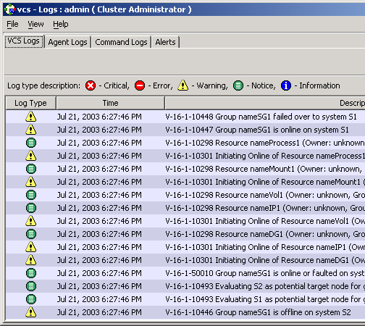
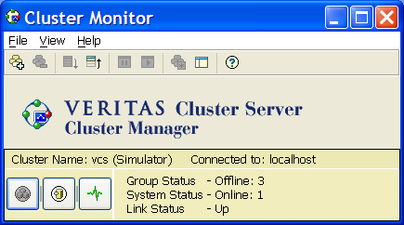
Monitoring Facilities
VCS log files
System log files
The hastatus utility
Notification
Event triggers
VCS GUIs
Notes:
VCS provides numerous resources you can use to gather information about the status and operation of the cluster. These include:
>>>
VCS log files
System log files
The hastatus utility
Notification
Event triggers
and
>>>
The Cluster Manager and Cluster Monitor GUIs

Slide 207
VCS Logs
Engine log: /var/VRTSvcs/log/engine_A.log
View logs using the GUI or the hamsg command:
hamsg engine_A
Agent logs kept in /var/VRTSvcs/log
Unique Message Identifier (UMI)
2003/05/20 16:00:09 VCS NOTICE V-16-1-10322
System S1 (Node '0') changed state from STALE_DISCOVER_WAIT to STALE_ADMIN_WAIT
2003/05/20 16:01:27 VCS INFO V-16-1-50408
Received connection from client Cluster Manager - Java Console (ID:400)
2003/05/20 16:01:31 VCS ERROR V-16-1-10069
All systems have configuration files marked STALE. Unable to form cluster.
Most Recent
Notes:
In addition to the primary VCS engine log file, VCS logs information for had, hashadow, and all agent programs.
>>>
Starting with the 4.0 version of VCS, messages in VCS logs have a unique message identifier.
>>>
Each entry includes a text code indicating severity, from CRITICAL entries to INFO entries with status information.
CRITICAL entries indicate problems requiring immediate attention—contact Customer Support immediately
ERROR entries indicate exceptions that need to be investigated

Slide 208
Procedure Overview
Start
hastatus -sum
Cannot connect to server
SG1 Autodisabled . . .
Communication Problems
Service Group Problems
System1 in WAIT State
VCS Startup Problem
Notes:
VCS problems are typically one of three types:
>>>
Cluster communication
VCS engine startup
Service groups, resources, or agents
>>>
To start troubleshooting, determine which type of problem is occurring based on the information displayed by hastatus -summary output:
Cluster communication problems are indicated by the message:
>>>
Cannot connect to server
>>>
VCS startup problems are indicated by systems in the STALE_ADMIN_WAIT or ADMIN_WAIT state.
>>>
Other problems are indicated when the VCS engine, LLT, and GAB are all running on all systems, but service groups or resources are in an unexpected state.

Slide 209
Topic: Cluster Communication Problems
After completing this topic, you will be able to resolve cluster communication problems.
Notes:
This is topic 3: Cluster Communication Problems.

Slide 210
Checking GAB
Check GAB by running gabconfig –a:
No port a membership indicates a GAB or LLT problem.
  Check the seed number in /etc/gabtab.
  If a node is not operational preventing the cluster from seeding, force GAB to start:
  gabconfig -x
If GAB starts and immediately shuts down, check LLT and cluster interconnect cabling.
No port h membership indicates a VCS engine (had) startup problem.
HAD not running:
GAB and LLT functioning
# gabconfig -a
GAB Port Memberships
========================
# gabconfig -a
GAB Port Memberships
===================================
Port a gen 24110002 membership 01
Notes:
Check the status of GAB using gabconfig –a
>>>
If no port memberships are present, GAB is not seeded. This indicates a problem with GAB or LLT.
>>>
Check the /etc/gabtab file and verify that the seed number is specified correctly.
>>>
If a system is down, you can force GAB to seed without that system being operational by using gabconfig –x.
>>>
If GAB starts and then shuts down immediately, check LLT as described in the next section.
>>>
If port a membership is present and port h membership is not, GAB and LLT are fine, but the VCS engine (had) is not running.

Slide 211
Checking LLT
Check LLT by running lltconfig. If LLT is not running:
Check console and system log messages.
Check LLT configuration files:
  /etc/llttab:
    Verify the node number (0-31).
    Verify the cluster number (0-255).
    Determine whether the link directive is correct (for example, qf3 should be qfe3).
  /etc/llthosts:
    Verify that node numbers are within range.
    Verify system names match entries in llttab or sysname.
  /etc/VRTSvcs/conf/sysname:
    Ensure the name listed is the local host (system) name.
    Verify the system name matches the entry in llthosts.
Notes:
Run the lltconfig command to determine whether LLT is running. If it is not running:
>>>
Check the console and system log for messages indicating missing or misconfigured LLT files.
>>>
Check the LLT configuration files:
>>>
llttab
>>>
llthosts
>>>
sysname
Verify that they contain valid and matching entries.
You can also use other LLT commands to check the status of LLT, such as lltstat and lltconfig. For example:
lltconfig -a list

Slide 212
Duplicate Node IDs
VCS responds to duplicate node IDs on LLT
links differently depending on the version.
5.x
4.x
VCS shuts down LLT on the links where duplicates are detected.
VCS panics the first system to detect the duplicate ID if another system is started with the same ID on high-priority links only.
3.5
VCS panics the first system that detects another system starting with the same node ID on any LLT link, high- or low-priority.
2.0
Notes:
How VCS responds to duplicate node IDs in a cluster configuration depends on the version of VCS you are running.
>>>
Version 4: If LLT detects a duplicate node ID, LLT shuts down on the links where duplicate IDs were detected.
>>>
3.5: If LLT detects a duplicate node ID, it informs GAB and GAB panics the system only if the duplicate IDs are detected on the high-priority links.
>>>
2.0: If LLT detects a duplicate node ID on any LLT link, whether the link is high- or low-priority, it informs GAB and GAB panics the system.

Slide 213
Problems with LLT
If LLT is running, determine which systems are detected:
Run lltstat –n.
Check the physical network connections.
lltstat options:
-l: link status
-z: reset counters
-vv: very verbose
S1# lltconfig
LLT is running
S1# lltstat -n
LLT node information:
Node State Links
* 0 S1 OPEN 2
1 S2 CONNWAIT 2
S2# lltconfig
LLT is running
S2# lltstat -n
LLT node information:
Node State Links
0 S1 CONNWAIT 2
* 1 S2 OPEN 2
Notes:
If LLT is running on each system, verify that each system can see all other cluster systems by running lltstat -n.
>>>
The first example shows the results of running lltstat –n on the train11 system, as indicated by the
asterisk next to the node in the output. The CONNWAIT state for the train12 system indicates that LLT on
train11 is not communicating with LLT on train12.
>>>
The second example shows the results of running lltstat –n on the train12 system. Each system showing a CONNWAIT
state on both links for the other indicates a problem with the physical network connections.
>>>
Check the physical connections if you determine that systems cannot see each other.

Slide 214
Topic: VCS Engine Problems
After completing this topic, you will be able to identify and solve problems VCS engine problems.
Notes:
This is topic 4, VCS Engine Problems.

Slide 215
Startup Problems
HAD does not start under certain conditions related to:
  Licensing
  Seeding
  Misconfigured files
Run hastatus –sum:
  If you see this message:
  Cannot connect to server -- Retry Later
    Check GAB and LLT
    Check licensing
  Verify the main.cf syntax:
  hacf –verify /etc/VRTSvcs/conf/config
  Verify system names match in main.cf, llthosts, and llttab
  Check for systems in WAIT states.
Notes:
The VCS engine fails to start in some circumstances, such as:
VCS is not properly licensed.
The cluster is not seeded.
The llthosts file does not exist, or contains entries that do not match the cluster configuration.
>>>
The output of hastatus –sum will guide you in solving the problem.
>>>
Check licensing if you see the "Cannot connect" message.
>>>
Verify the main.cf file syntax, and ensure that system names match entries in llthosts and llttab.
>>>
If the engine state is STALE_ADMIN_WAIT or ADMIN_WAIT, this indicates a problem building the configuration in memory, as discussed in the following pages.

Slide 216
STALE_ADMIN_WAIT
A system enters STALE_ADMIN_WAIT when:
  There is no other system in a RUNNING state.
  The system has an invalid main.cf file.
  You start VCS on that system.
To recover from the STALE_ADMIN_WAIT state:
  Visually inspect the main.cf file to determine if it is valid.
  Edit the main.cf file, if necessary.
  Verify the syntax of main.cf, if modified.
  hacf –verify config_dir
  Start VCS on the system with the valid main.cf file:
  hasys -force system
  All other systems perform a remote build from the
  system now running.
Notes:
If you try to start VCS on a system where the local disk configuration is invalid and there are no other running systems, the VCS engine transitions to the STALE_ADMIN_WAIT state. This signals that administrator intervention is required in order to get the VCS engine into the running state.
>>>
If the VCS engine is in the STALE_ADMIN_WAIT state:
>>>
Visually inspect the main.cf file to determine if it is up-to-date (reflecting the expected current configuration).
>>>
Edit the main.cf file, if necessary.
>>>
Verify the main.cf file syntax, if you modified the file.
>>>
Start the VCS engine on the system with the valid main.cf file:
>>>
The other systems perform a remote build from the system now running.

Slide 217
ADMIN_WAIT
A system can be in the ADMIN_WAIT state under these circumstances:
  A disk error occurs, affecting main.cf during a local build.
  The system is performing a remote build, and the last running system fails.
To fix this, restore main.cf and use the procedure for STALE_ADMIN_WAIT.
Notes:
The ADMIN_WAIT state results when:
>>>
A disk error occurs during local build
>>>
A system is performing a remote build and the last running system in the cluster fails before the configuration is delivered.
>>>
In either case, fix the problem as follows:
Locate a valid main.cf file from a main.cf.previous file on disk or a backup on tape or other media.
Replace the invalid main.cf with the good version on the local node.
Use the procedure specified for a stale configuration to force VCS to start.

Slide 218
Topic: Service Group and Resource Problems
After completing this topic, you will be able to resolve problems related to service groups and resources.
Notes:
This is topic 5: Service Group and Resource Problems.

Slide 219
Service Group Does Not Come Online
Check the AutoStart and AutoStartList attributes:
hagrp –display group
Check the SystemList attribute and verify that the system name is included.
Notes:
To enable VCS to bring a service group online automatically after engine startup, the service group AutoStart attribute must be set to 1 and the target system must be listed in the AutoStartList attribute of the service group.
>>>
If the system is not included in the SystemList attribute of a service group, you cannot bring the service group online on that system even if the system is part of the same cluster. The systems listed in the SystemList attribute should be a superset of the systems listed in the AutoStartList attribute.

Slide 220
Service Group AutoDisabled
Autodisabling occurs when:
  GAB sees a system, but HAD is not running on the system.
  Resources are not fully probed on all systems in the SystemList attribute.
To autoenable a service group:
  Restart VCS on all systems.
  Fix resource attributes preventing probing.
  If a system is down, preventing probing:
    Verify that the service group is offline on all systems.
    Ensure that no resources are running outside of VCS.
    Verify that there are no network partitions.
    Clear the AutoDisabled attribute:
    hagrp –autoenable group -sys system
Notes:
VCS automatically disables service groups under these conditions:
>>>
GAB sees the system but the VCS engine is not running.
>>>
Resources in a service group are not fully probed.
The autodisable feature is a mechanism used by VCS to prevent a split-brain condition. If VCS cannot verify that the resources are offline everywhere, it sets the AutoDisabled attribute to prevent the service group from coming online on more than one system.
If a service group was autodisabled because HAD could not probe all its critical resources then after HAD has successfully probed them, it clears the service group’s autodisabled flag.
In contrast, if a system that was in a jeopardy membership fails, VCS does not enable you to bring the service group online on other systems until you manually clear the AutoDisabled attribute for the service group.
>>>
Before clearing the AutoDisabled attribute:
Ensure that the service group is offline on all running systems in the cluster.
Ensure that the resources are not running outside of VCS control.
>>>
Verify that there are no network partitions in the cluster.
>>>
Clear the AutoDisabled attribute.

Slide 221
Service Group Not Fully Probed
A service group cannot come online if all resources cannot be probed on all systems in SystemList.
If the service group cannot come online:
  Check the ProbesPending attribute:
  hagrp -display group -attribute ProbesPending
  Determine which resources are not probed:
  hastatus -sum
  Check the Probed attribute for resources:
  hares –display resource –attribute Probed
  Probe the resources:
  hares –probe resource -sys system
The cause is usually improperly configured attributes.
Notes:
A service group must be probed on all systems in the SystemList attribute before VCS attempts to bring the group online. This ensures that even if the service group was online prior to VCS starting, VCS does not inadvertently bring the service group online on another system.
>>>
If the agent have not monitored each resource, the service group does not come online. Follow this guideline determine whether resources are probed.
>>>
Check the ProbesPending attribute
A value of 0 indicates that each resource in the service group has been successfully probed. If there are any resources that cannot successfully be probed, the ProbesPending attribute is set to 1 (true) and the service group cannot be brought online.
>>>
Check which resources are not probed.
>>>
Check the Probed attribute for resources.
>>>
Probe the resources.
>>>
Resources that cannot be probed usually have incorrect values specified for one or more attributes.
See the engine and agent logs in /var/VRTSvcs/log for more information.

Slide 222
Service Group Frozen
When a service group is frozen, no further agent
actions can occur.
Determine the value of the Frozen and TFrozen attributes:
  hagrp -display group
Unfreeze the service group:
  hagrp -unfreeze group [-persistent]
If you freeze persistently, you must unfreeze persistently.
Notes:
A service group can be frozen in the online or offline state. When a service group is frozen, no further agent actions can take place on any resources in the service group, including failover.
Use the output of the hagrp command to check the value of the Frozen and TFrozen attributes.
>>>
The Frozen attribute shows whether a service group is frozen persistently or not. If set to 1, it is a persistent freeze.
The TFrozen attribute shows whether a service group is frozen temporarily or not. If set to 1, it is a temporary freeze.
>>>
Note: If you freeze persistently, you must unfreeze persistently.

Slide 223
Service Group Is Not Offline Elsewhere or Waiting for Resource
Case 1: The service group is not offline elsewhere.
Solution: Switch the service group.
Case 2: The service group is waiting for a resource that is stuck in a wait state.
Solution:
  Determine state of resource:
    hastatus -sum
  Ensure resources are offline outside of VCS on all systems.
  Verify the service group State attribute:
    hagrp -display group
  Flush the service group:
    hagrp -flush group -sys system
Notes:
VCS does not allow you to bring a service group online if the service group is partially or fully online elsewhere in the cluster. If you want to bring a service group online elsewhere, switch the service group using hagrp -switch.
>>>
Because VCS brings resources online hierarchically according to the dependency diagram, a service group cannot come online successfully if any resource cannot come online. This can be due to:
Problems with the physical resource
Errors in the resource attribute values
Incorrectly specified resource dependencies
>>>
First determine whether the service group is already online on another system.
If the resource is stuck in an internal state (Istate attribute), such as Waiting to Go Online, you may need to flush the service group before taking any corrective measures. Flushing clears the internal state and enables you to bring the service group online after correcting the error.
>>>
Use the steps shown in the slide to determine the state of the service group and flush it, if necessary.

Slide 224
Concurrency Violation
This occurs when:
  A service group is online under VCS control.
  You bring that service online outside of VCS.
Notification is provided by the Violation trigger. This trigger:
Is configured by default with the violation script in:
/opt/VRTSvcs/bin/triggers
Notifies the administrator and takes the service group offline on the system causing the violation
Is invoked on the system that caused the concurrency violation
!
To prevent concurrency violations, do not manage resources outside of VCS.
Notes:
A concurrency violation occurs when a failover service group becomes fully or partially online on more than one system. When this happens, VCS takes the service group offline on the system that caused the concurrency violation and invokes the violation event trigger on that system.
>>>
The Violation trigger is configured by default during installation.
>>>
The violation trigger script is placed in /opt/VRTSvcs/bin/triggers and no other configuration is required.
>>>
The script notifies the administrator and takes the service group offline on the system where the trigger was invoked.
The script can send a message to the system log and console on all cluster systems and can be customized to send additional messages or e-mail messages.
>>>
The trigger runs on the system where the violation occurred.
>>>
Concurrency violations occur as a result of managing applications outside of VCS control. To prevent violations, use VCS to start and stop applications.

Slide 225
Problems Taking Service Groups Offline
If a service group is waiting for a resource to go
offline:
Identify which resource is not offline:
  hastatus –sum
Check logs.
Manually take the resource offline, if necessary.
Configure the ResNotOff trigger for notification or action.
Example: NFS service groups
An NFS client does not disconnect.
The Share resource cannot come offline when a client is connected.
You can configure ResNotOff to forcibly stop the share.
Notes:
You can occasionally encounter problems when trying to take VCS service groups offline. If this happens during a failover, it can prevent the service group from coming online on another system.
For example, if a resource is stuck in the internal state of WAITING TO GO OFFLINE, none of the child resources can be taken offline and failover cannot occur. This situation is often a result of a resource being controlled outside of VCS. For example, a file system is unmounted before the Mount resource was taken offline.
>>>
Check the status of resources using hastatus and log files.
>>>
You may need to manually take the resource offline.
>>>
The ResNotOff trigger can be configured to notify an administrator or, in case of very critical services, to reboot or halt the system so that another system can start the service group.
However, a careful analysis of the systems and the applications is required, because halting a system causes failover, interrupting other service groups that were online on that system.
>>>
Another example is a Share resource that cannot come offline because an NFS client is connected.

Slide 226
Problems with Service Group Failover
If a service group does not fail over, check:
Critical attributes for resources
Service group attributes:
  ManageFaults
  FaultPropagation
  Frozen and TFrozen
  AutoFailOver
  FailOverPolicy
  SystemList
Values for timeout-related attributes
Notes:
If a service group does not fail over as you expect when a fault occurs, check all resource and service group attributes that can affect fail over.
>>>
Determine whether resources are critical.
>>>
Check the service group attributes listed in the slide.
...
>>>
Also check attributes related to timeout values.

Slide 227
Resource Problems: Critical Resource Faults
A service group cannot come online on a system
where a critical resource is marked as FAULTED.
Determine which critical resource has faulted:
  hastatus –sum
Ensure that the resource is offline.
Examine the engine log to analyze the problem.
Fix the problem.
Freeze the service group.
Verify that the resources work properly outside of VCS.
Clear the fault in VCS.
Unfreeze the service group.
Note: Persistent resource faults are cleared automatically after the underlying problem is fixed.
Notes:
A service group does not come online on a system where a critical resource is marked as FAULTED.
>>>
Nonpersistent resource faults need to be explicitly cleared using the procedure shown in the slide.
...
>>>
Persistent resource faults are cleared automatically after the underlying software or hardware problem is fixed. The next monitor cycle determines that the resource is responding properly and reports the resource as online. You can also probe the resource to force a monitor cycle.

Slide 228
Unable to Bring Resources Online or Take Them Offline
Resources cannot be brought online or taken
offline when:
A resource is waiting for child or parent resources.
A resource is stuck in an internal WAIT state.
The agent is not running.
Notes:
If VCS is unable to bring a resource online or offline, these are the likely causes:
>>>
The resource is waiting for a child or parent resource.
VCS does not bring a resource online if one or more of its child resources cannot be brought online.
Likewise, VCS does not take a resource offline if one or more of its parent resources cannot be taken offline. Solve the problem with the child or parent resource first.
>>>
The resource is stuck in a WAIT state.
You can encounter this situation if VCS has directed the agent to run the online or offline entry point for the resource, but for some reason the resource is stuck in the internal state Waiting to Go Online or Offline. Check the VCS engine and agent logs to identify the problem and solve it.
>>>
The agent is not running.
This is described in more detail in the next section.

Slide 229
Agent Problems: Agent Not Running
Determine whether the agent for that resource is faulted:
  hastatus –sum
Use the ps command to determine whether the agent process is running.
Check the log files for:
  Incorrect path name for the agent binary
  Incorrect agent name
  Corrupt agent binary
Verify that the agent is installed on all systems.
Restart the agent after fixing the problem:
  haagent –start agent –sys system
Notes:
An agent process should be running on the system for each configured resource type. If the agent process is stopped for any reason, VCS cannot carry out operations on any resource of that type.
To determine if the agent is running:
Check VCS status.
>>>
Check the process listing.
If the agent is not running:
>>>
Check the VCS engine and agent logs to identify what caused the agent to stop or prevented it from starting. It could be an incorrect path for the agent binary, the wrong agent name, or a corrupt agent binary.
>>>
Verify that the agent is installed on all systems where it is needed.
>>>
Use the haagent command to restart the agent. Be sure to start the agent on all systems in the cluster.

Slide 230
Resource Type Problems
If a resource does not come online after you check all other
possible causes, check the resource type definition:
Verify that the resource attributes are correctly specified using hares –display resource.
Verify that the agent is running using
haagent –display.
Verify that the resource works properly outside of VCS.
Display values for ArgList and ArgListValues type attributes using hatype –display res_type.
If ArgList is corrupted in *types.cf:
  Stop VCS on all systems.
  Fix types.cf or replace with types.cf.previous.
  Restart VCS.
Notes:
Another common problem preventing VCS from bringing a resource online is an invalid specification of the agent argument list in a resource type ArgList attribute. If you inadvertently selected a resource type rather than a resource in the Cluster Manager, and changed the ArgList attribute, the agent cannot function properly.
>>>
Perform the tasks shown in the slide to determine if this problem is occurring.
...

Slide 231
Topic 1: Removing a System
After completing this topic, you will be able to remove a system from a cluster.
Notes:
This is topic 1, Removing a System.

Slide 232
Recommended Procedure for Task 1
1.Open the configuration and inhibit application failover to the system to be removed.
2. Switch any application services that are running on the system to be removed to any other system in the cluster.
3. Close the configuration and stop VCS on the system to be removed.
4. Remove any disk heartbeat configuration on the system to be removed.
5. Stop fencing and the VCS communication modules (GAB, LLT) on the system to be removed.
Notes:
Open the configuration and prevent application failover to the system to be removed.
>>>
Switch any application services that are running on the system to be removed to any other system in the cluster.
>>>
Close the configuration and stop VCS on the system to be removed.
>>>
Remove any disk heartbeat configuration on the system to be removed.
>>>
Stop VCS communication modules (GAB, LLT) on the system to be removed.
On the Solaris platform, you also need to unload the kernel modules for LLT and GAB.

Slide 233
Recommended Procedure for Task 1 (Continued)
6. Physically remove private network links from the system to be removed.
7. Remove VCS software from the system taken out of the cluster.
8. Update service group and resource configurations that refer to the system that is removed.
9. Remove the system from the cluster configuration.
10. Modify the VCS communication configuration files on the remaining systems in the cluster to reflect the change.
Notes:
Physically remove cluster interconnect links from the system to be removed.
>>>
Remove VCS software from the system taken out of the cluster.
>>>
Update service group and resource configurations that refer to the system that is removed.
>>>
Remove the system from the cluster configuration.
>>>
Modify the VCS communication configuration files on the remaining systems in the cluster to reflect the change.

Slide 234
Inhibiting Application Fail Over and Stopping VCS
1. Open the configuration and inhibit application from failing over to the system to be removed.
haconf –makerw
hasys –freeze –persistent
-evacuate system
2. Switch service groups on the system to be removed to any other system in the cluster.
3. Close the configuration and stop VCS on the system to be removed.
haconf –dump –makero
hastop –sys system
Note: You can also carry out the same steps using different options,
such as:
hasys –freeze -persistent system
hastop –sys system –evacuate
Notes:
Open the configuration and prevent application failover to the system to be removed, persisting through VCS restarts.
>>>
Switch any application services that are running on the system to be removed to any other system in the cluster.
>>>
This step can be combined with either step 1, as shown, or step 3.
>>>
Close the configuration and stop VCS on the system to be removed.
>>>
Steps 1-3 can also be accomplished using the alternate commands shown.

Slide 235
Removing Disk Heartbeat Configuration
On the system to be removed:
4. Remove any disk heartbeat configuration on the system to be removed.
gabdiskhb -l
gabdiskhb –d device -s start
To prevent the disk heartbeat from starting again in case the system crashes and is rebooted before you remove the VCS software, remove the corresponding lines in the /etc/gabtab file that starts the disk heartbeat.
gabdiskx -l
gabdiskx –d device
-s start
Disk heartbeats are not supported in VCS 5.0.
Notes:
Remove any disk heartbeat configuration on the system to be removed.
>>>
Use the gabdiskhb and gabdiskx commands, as shown in the slide.
>>>
After you remove the GAB disk heartbeats, also remove the corresponding lines in the /etc/gabtab file that starts the disk heartbeat.
Also remove any service group heartbeats you may have configured.

Slide 236
Stopping VCS Communications
/sbin on HP-UX
On the system to be removed:
5. Stop fencing and VCS communication modules (GAB, LLT) on the system to be removed.
/etc/init.d/vxfen stop
gabconfig -U
6. Physically remove private network links from the system to be removed.
lltconfig -U
  modinfo | grep vxfen
  modinfo | grep gab
  modinfo | grep llt
Solaris
only
modunload –i vxfen_id
modunload –i gab_id
modunload –i llt_id
Notes:
Stop VCS communication modules (GAB, LLT) and fencing on the system to be removed.
>>>
Use the vxfenconfig, gabconfig, and lltconfig commands as shown.
>>>
On the Solaris platform, unload the kernel modules for LLT and GAB.
>>>
Physically remove cluster interconnect links from the system to be removed.

Slide 237
Removing VCS Software
7. Remove VCS software from the system taken out of the cluster.
cd /opt/VRTSvcs/install
./uninstallvcs
If you have remote shell access (rsh or ssh) for root between the cluster systems, you can run uninstallvcs on any system. Otherwise, you have to run the script on the system to be removed.
You can also remove VCS software packages using the command specific to the operating system:
  pkgrm for Solaris
  swremove for HP-UX
  installp –u for AIX
  rpm –e for Linux
You may need to manually remove configuration files and VCS directories that include customized scripts.
Notes:
Remove VCS software from the system taken out of the cluster.
>>>
Use the uninstallvcs script to automate the removal of the VCS software.
>>>
If you have remote shell access (rsh or ssh) for root between the cluster systems, you can run uninstallvcs on any system in the cluster. Otherwise, you have to run the script on the system to be removed.
WARNING: When using the uninstallvcs script, you are prompted to remove software from all cluster systems. Do not accept the default of Y or you will inadvertently remove VCS from all cluster systems.
>>>
Alternately, use the command specific to the operating platform to remove the VCS software packages individually.
>>>
You may need to manually remove configuration files and VCS directories that include customized scripts.

Slide 238
Updating Service Group and Resource Configuration
8. Update service group and resource configurations that refer to the system that is removed.
haconf -makerw
hagrp –modify group AutoStartList –delete system
hagrp –modify group SystemList –delete system
…
You may need to modify other attributes, such as:
  The SystemZones attribute for the service groups
  Localized resource attributes
Notes:
Update service group and resource configurations that refer to the system that is removed.
Open the cluster configuration.
Modify appropriate service group attributes, such as AutoStartList and SystemList.
>>>
You may also need to modify SystemZones and localized resource attributes, such as Device for NIC or IP resources.

Slide 239
Updating Configuration Files
9. Remove the system from the cluster configuration.
hasys –delete system
haconf –dump -makero
10. Modify the VCS communication configuration files on all other systems to reflect the change.
Edit /etc/llthosts on all other systems to remove the line for the removed system.
Note: You do not need to stop and restart LLT and GAB on the remaining systems when you make these changes to the configuration files.
Edit /etc/gabtab on all the other systems to reduce the
–n option to gabconfig by 1.
Notes:
Remove the system from the cluster configuration.
Delete the system and then save and close the configuration.
>>>
Modify the VCS communication configuration files to reflect the change.
Edit llthosts on all the systems remaining in the cluster to remove the line corresponding to the removed system.
Edit gabtab on all the systems remaining in the cluster to reduce the –n option to gabconfig by 1.
>>>
You do not need to stop and restart LLT and GAB on the remaining systems when you make changes to the configuration files unless the you change the include, exclude, or set-addr directives in llttab.

Slide 240
Topic 2: Adding a System
After completing this topic, you will be able to add a system to a running VCS cluster.
Notes:
This is topic 2, Adding a System.

Slide 241
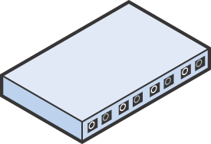
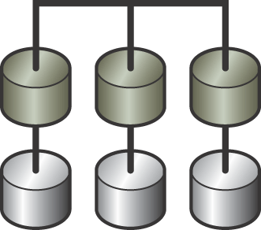
Task 2: Adding a New System to a Running VCS Cluster
Objective
Add a new system to a running VCS cluster while keeping the application services and VCS available and enabling the new system to run all of the application services.
Assumptions
  The cluster has two or more systems.
  The new system does not have any VCS software.
  The storage devices can be connected to all systems.
+
Notes:
The objective of this task is to add a new system to a running VCS cluster with minimal or no impact on application services.
>>>
Take these assumptions into account while planning this procedure:
>>>
The VCS cluster consists of two or more systems, all of which are up and running.
There are multiple service groups configured in the cluster. All of the service groups are online somewhere in the cluster.
The new system to be added to the cluster does not have any VCS software, but has the same
same version of operating system and VERITAS Storage Foundation as the systems in the cluster.
The new system may not have all the required application software.
The storage devices can be connected to all systems.

Slide 242
Recommended Procedure for Task 2
1. Install necessary application software on the new system.
2. Configure application resources needed to support clustered applications.
3. Physically cable cluster interconnect network links.
4. Install VCS on the new system.
5. Configure GAB and LLT on the new system.
6. Configure fencing.
7. Update GAB and LLT on the existing systems.
Notes:
Install any necessary application software on the new system.
>>>
Configure any application resources necessary to support clustered applications on the new system.
The new system should be capable of running all application services.
>>>
Physically cable cluster interconnect links.
>>>
Install VCS on the new system.
>>>
Configure GAB, LLT, and fencing on the new system.
>>>
Update GAB and LLT on the existing systems to reflect the added system.

Slide 243
Recommended Procedure for Task 2 (Cont’d)
8. Install any VCS agents required on the new system.
9. Copy any triggers, custom agents, scripts and so on from existing cluster systems to new cluster system.
10. Start cluster services on the new system and verify cluster membership.
11. Update service group and resource configuration to use the new system.
12. Verify updates to the configuration by switching the application services to the new system.
Notes:
Install any VCS agents required on the new system.
>>>
Copy any triggers, custom agents, and scripts from existing cluster systems to the new system.
>>>
Start cluster services on the new system and verify cluster membership.
>>>
Update service group and resource configurations to use the new system.
>>>
Verify updates to the configuration by switching the application services to the new system.

Slide 244
Preparing The New System for Clustered Application Services
1. Install any necessary application software on the new system.
The new system should be capable of running the application services in the cluster it is about to join.
Preparing application resources may include:
  Creating user accounts
  Copying application configuration files
  Creating mount points
  Verifying shared storage access
2. Configure any application resources necessary to support clustered applications.
3. Physically cable cluster interconnect.
If the original cluster is a two-node cluster with crossover cables, change to hubs or switches before adding another node.
Ensure that the private network is not completely disconnected while you are carrying out the changes.
Notes:
Install any necessary application software on the new system.
>>>
Configure any application resources necessary to support clustered applications.
You may need to:
Create user accounts
Copy application configuration files
Create mount points
Verify shared storage access
Check NFS major and minor numbers
>>>
Physically cable cluster interconnect links.
Ensure that the cluster interconnect is not completely disconnected while you are carrying out the changes.

Slide 245
Installing VCS On a Single System
On the new system:
4. Install VCS on the new system.
Login as root, mount the CD
Change into the CD directory
Alternately, use the command specific to the operating system:
  pkgadd for Solaris
  swinstall for HP-UX
  installp –a for AIX
  rpm –qa for Linux
If you are installing packages manually:
  Follow the package dependencies.
  After the packages are installed, license VCS:
  vxlicinst
  See the VCS Installation Guide.
./installvcs -installonly
Notes:
Install VCS on the new system.
You can use the installvcs script to automate the installation of the VCS software.
>>>
Alternately, you can use the command specific to the operating platform to install the VCS software packages individually.
>>>
If you are installing packages manually,
refer to the VERITAS Cluster Server Installation Guide.
After manual installation, you must license VCS on the new system.

Slide 246
Configure Communications and Fencing
Create /etc/llttab, /etc/llthosts and /etc/gabtab files on the new system.
5. Configure GAB and LLT on the new system.
Create /etc/vxfendg and
enter the coordinator disk
group name.
6. Configure fencing, if applicable.
This assumes fencing is already configured on other systems; therefore SCSI-3 support has been verified.
Notes:
After the installation script has completed, create the communication configuration files on the new system.
Create llttab with the existing cluster ID and a unique node name.
Create llthosts with a unique node number for each system in the cluster.
Create gabtab with the command to start GAB and a node number equal to the new number of nodes.
>>>
Configure fencing on the new system, if used in the cluster.
Create vxfendg and enter the coordinator disk group name.
>>>
This example assumes fencing is already configured on the existing cluster systems and SCSI-3 verification has already been completed.

Slide 247
Updating Cluster Communications
Edit /etc/llthosts on all the existing systems to add an entry for the new system.
7. Update GAB and LLT on the existing systems.
Edit /etc/gabtab on all the systems to increase the –n option to gabconfig by 1.
Note: You do not need to stop and restart LLT and GAB on the existing systems unless you change include, exclude, or set-addr in llttab.
Notes:
Update GAB and LLT on the existing systems.
Edit llthosts on the previously existing systems to add an entry for the new system.
>>>
Edit gabtab on all the systems to increase the value of the –n option to gabconfig by 1.
>>>
You do not need to stop and restart LLT and GAB on the existing systems change the configuration files unless you change the include, exclude, or set-addr directives in the llttab file.

Slide 248
Additional Configuration on the New System
8. Install VCS Enterprise agents.
Add VCS software packages using the command specific to the operating system.
Custom and enterprise agents should only be installed, not configured.
Copy any triggers and customized scripts to the new system.
9. Copy triggers, custom agents, etc.
Notes:
Install any VCS agents required on the new system.
At this point, install agents but do perform agent configuration.
>>>
Copy any triggers, custom agents, or scripts from existing systems to the new system.

Slide 249
Starting Cluster Services on the New System
On the system to be added:
10. Start cluster services on the new system and verify cluster membership.
lltconfig -c
sh /etc/gabtab
/sbin on HP-UX
/etc/init.d/vxfen start
hastart
You can also use LLT, GAB, fencing, and VCS startup files to start cluster services.
gabconfig –a
Both port a and port h memberships should include the new system (and port b if fencing is configured)
Notes:
Start cluster services on the new system using the commands shown in the slide.
>>>
Then verify cluster membership.
After HAD starts, both port a and port h memberships should list the new system in the output of gabconfig –a.
>>>
You can also use LLT, GAB, and VCS startup files installed by the VCS packages to start cluster services.

Slide 250
Updating and Testing Service Group and Resource Configuration
11. Update service group and resource configuration to use the new system.
haconf -makerw
12. Verify updates to the configuration by switching the application services to the new system.
hagrp –modify group SystemList –add system priority
hagrp –modify group AutoStartList –add system
…
You may need to modify other attributes, such as:
  SystemZones
  Localized resource attributes
haconf –dump -makero
hagrp –switch group \
–to system
Notes:
Update service group and resource configuration to use the new system.
Start by opening the configuration.
Then modify service group attributes to add the new system.
You may need to modify other service group attributes, such as Device for NIC or IP resource types.
>>>
When finished making changes, close the configuration.
>>>
Then verify updates to the configuration by switching the application services to the new system.

Slide 251
VERITAS Cluster Server for UNIX, Implementing Local Clusters
Lesson 2
Service Group Dependencies

Slide 252

Multitier Services
Many services have multiple tiers.
Tiers are represented by separate service groups.
Relationships exist between tiers.
Relationships must be enforced within VCS.
Web
App
DB

Slide 253
Example 1: Online on Different Systems
Example criteria:
Both must be online to provide the service.
App and DB cannot run on the same system, due to system usage constraints.
App requires DB to be online first.
If App faults, DB continues to run.
App
DB
App
DB

Slide 254
Example 2: Offline on the Same System
Example criteria:
One node is used for a test environment.
Prod always has priority.
Test and Prod cannot be online on the same system.
Test
Prod
Test
Prod

Slide 255
Topic 2: Service Group Dependencies
After completing this topic, you will be able to define service group dependencies.
Notes:
This is <topic 1>, <topic one title>.
As a reminder, the objective(s) for this topic is/are: <topic 1 objective(s)>.

Slide 256
Service Group Dependency Definitions
Startup Category |  | Failover Type
Online |  | Soft
 |  | Firm
 |  | Hard
 |  | Soft
 |  | Firm
 |  | Soft
 |  | Firm
Offline | Local | -
Local
Same system
Global
Child starts first
Any system
Remote
Different system
Notes:
VCS provides service group dependencies as the main tool in solving application relationship requirements in multi-application environments. The table in the slide lists the available service group dependencies according to the category,
>>>
the location,
>>>
and the type of the dependency.
Detailed information about how these dependencies impact service group operations is provided in VERITAS Cluster Server User’s Guide. Examples are
provided in the next section.

Slide 257
Failover Types
Soft:
  Keeps the parent online when the child faults
Firm:
  Takes the parent offline when the child faults
Hard:
  Takes child and parent offline when either faults
  Applies only to an online local dependency
  Is allowed only between a single parent and a single child
Notes:
Service Group Dependency Types
Firm Dependency
Firm dependency means VCS imposes maximum constraints when onlining parent/child
groups. Specifically, a) the child group must be online before the parent group is brought
online, and b) the parent group must be taken offline when the child group faults. When
the child is brought online on another system, the parent group is brought online on any
system other than the system on which it was taken offline.
For example:
A link configured as online local firm designates that the parent group is taken offline
when the child group faults.When the child group fails over to another system, the
parent group is then migrated to that system.
A link configured as online global firm designates that the parent group is taken offline
when the child group faults.When the child group fails over to another system, the
parent group is migrated to another system.
A link configured as online remote firm is similar to online global firm, with the
exception that the parent group is brought online on any system other than the system
on which the child group was brought online.
In addition to the constraints imposed by soft dependency, firm dependency also includes
the following constraints:
If the child group faults, VCS takes the parent group offline as well. When the child
group is brought online, the parent is brought online.
 When both groups are online, the child group cannot be taken offline while the parent
group is online. However, the parent group can be taken offline while the child is
online.
If child group faults, the parent is taken offline. If the child cannot failover, the parent
remains offline.
To link a parent and child group with firm dependency, the parent group must be
offline or the parent and child group must be online in such a way that their online
states do not conflict with the type of link between parent and child.
Both soft and firm dependencies allow that if the parent group faults, the child group
doesn’t. The parent group may or may not failover, depending on the link constraints
(such as online local versus online global). For example, for a failover parent and failover
child linked with online local soft/firm dependency, if the parent faults, it cannot failover
to another system. However, if they were linked with an online global soft/firm
dependency, and if the parent faults, it can.
Soft Dependency
Soft dependency means that VCS imposes minimal constraints while onlining
parent/child groups. The only constraint is to bring the parent group online, the child
group must be online. The location of the link designates whether or not a parent group
will fail over after a fault and failover of the child group.
For example:
 A link configured as online local soft designates that when the child group faults and
fails over, the parent group fails over to the same system on which the child group
was brought online.
A link configured as online global soft designates that when the child group faults and
fails over, the parent group never fails over (remains where it is).
A link configured as online remote soft designates that when a child group faults and
child group selects as the target system the system on which the parent is online, the
parent group is taken offline. When a child group fails over, the parent group is
brought online on another system within the cluster.
Soft dependency provides the following enhanced flexibility:
VCS does not immediately take the parent offline if the child group faults.
When both groups are online the child group can be taken offline while the parent is
online and vice versa (the parent group can be taken offline while the child is online).
The parent remains online if the child group faults and cannot fail over.
To link a parent and child group with soft dependency, it is not required that the child
group be online if parent is online. However, if the child group is also online, the
parent and child may not be linked in such a way that their online states conflict with
the type of link between parent and child.

Slide 258
Topic 3: Service Group Dependency Examples
After completing this topic, you will be able to describe example service group dependency behavior.
Notes:
This is <topic 1>, <topic one title>.
As a reminder, the objective(s) for this topic is/are: <topic 1 objective(s)>.

Slide 259
Online Remote Example
Startup behavior:
Child must be online
Parent can come online only on a remote system
Failover example for soft type:
The child faults and fails over to an available system.
If there is an available system for the child, the parent continues to run.
If the only available system is where the parent is online:
  The parent is taken offline.
  The child is brought online.
  The parent then restarts on a system different from the child's system.
App
DB
Firm difference:
The parent is always taken offline when the child faults.

Slide 260
Offline Local Example
Startup behavior:
Child can come online anywhere the parent is offline
Parent can come online only where child is offline
Failover example:
The child faults and fails over to an available system.
If there is an available system for the child, the parent continues to run.
If the only available system is where the parent is online:
  The parent is taken offline
  The child is brought online.
  The parent then restarts on a system different from the child's system.
Test
Prod

Slide 261
Topic 4: Configuring Service Group Dependencies
After completing this topic, you will be able to configure service group dependencies according to VCS rules.
Notes:
This is <topic 1>, <topic one title>.
As a reminder, the objective(s) for this topic is/are: <topic 1 objective(s)>.

Slide 262
Service Group Dependency Rules
Service group dependency rules:
Child has priority
Multiple parents
Only one child
Maximum of five levels
Cyclical dependencies prohibited

Slide 263

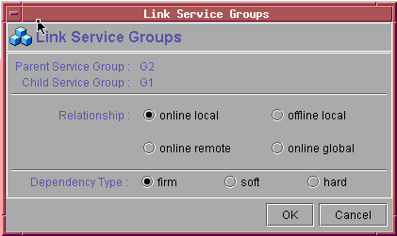
Creating Service Group Dependencies
Group G2 (
…
)
…
requires group G1 online local firm
…
Service group attributes
Resource definitions
Resource dependencies
main.cf
hagrp –link parent child online local firm

Slide 264
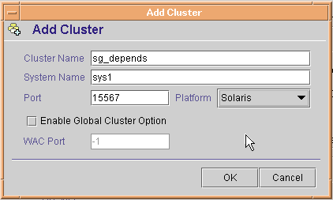
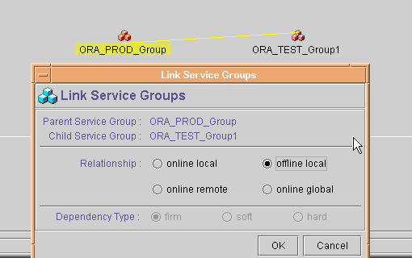
Simulating Service Group Dependencies
To model service group
dependency behavior:
Create a new Simulated cluster.
Copy the main.cf file from your cluster into the new configuration directory.

Slide 265
Topic 5: Alternative Methods of Controlling Interactions
After completing this topic, you will be able to implement resources and triggers to control service group interactions.
Notes:
This is <topic 1>, <topic one title>.
As a reminder, the objective(s) for this topic is/are: <topic 1 objective(s)>.

Slide 266


Limitations of Service Group Dependencies
Consider these requirements:
Online at the same time:
  DB first, then App
  NFS before Web
  NFS before App
Must not be online on the same system:
  Application and database
  Application and NFS service
App
Web
Online
Remote
Online
Remote
Online
Global
DB
NFS
!
The App service group cannot have two child service groups.

Slide 267
VERITAS Cluster Server for UNIX, Implementing Local Clusters
Lesson 3
Startup and Failover Policies

Slide 268
Topic 1: Startup Rules and Policies
After completing this topic, you will be able to describe rules and policies controlling service group startup.
Notes:
This is <topic 1>, <topic one title>.
As a reminder, the objective(s) for this topic is/are: <topic 1 objective(s)>.

Slide 269
Rules for Automatic Service Group Startup
The service group must have:
  AutoStart = 1
  A nonempty AutoStartList attribute
  Frozen and TFrozen = 0
All systems in SystemList must be up and running.
All resources must be probed on all systems in SystemList.

Slide 270
Startup System Selection
The initial set of candidate systems is derived from the AutoStartList attribute.
Systems are eliminated if:
  They are frozen.
  The service group has a FAULTED status.
  They do not meet service group requirements.
The target system is then selected based on the startup policy of the service group.

Slide 271
Automatic Startup Policies
AutoStartPolicy attribute values: | System selection based on:
Order | Order listed in AutoStartList (default policy)
Priority | Lowest priority number in SystemList
Load | Greatest available capacity
Example configuration:
hagrp –modify DB AutoStartPolicy Priority

Slide 272
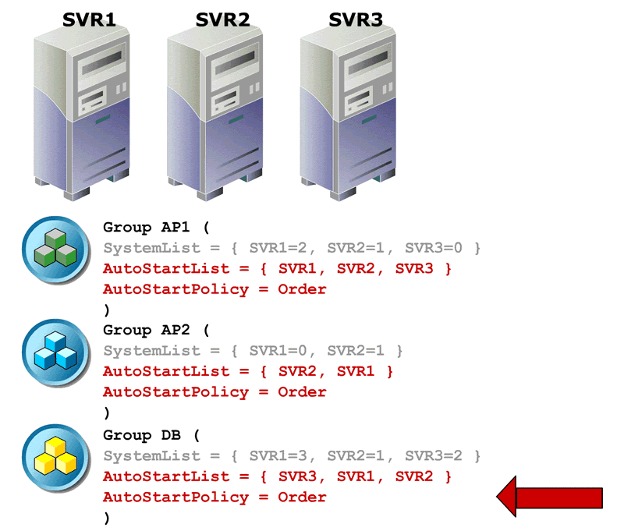
AutoStartPolicy=Order
The first available system in AutoStartList is selected.
AP1
AP2
DB
Animation

Slide 273
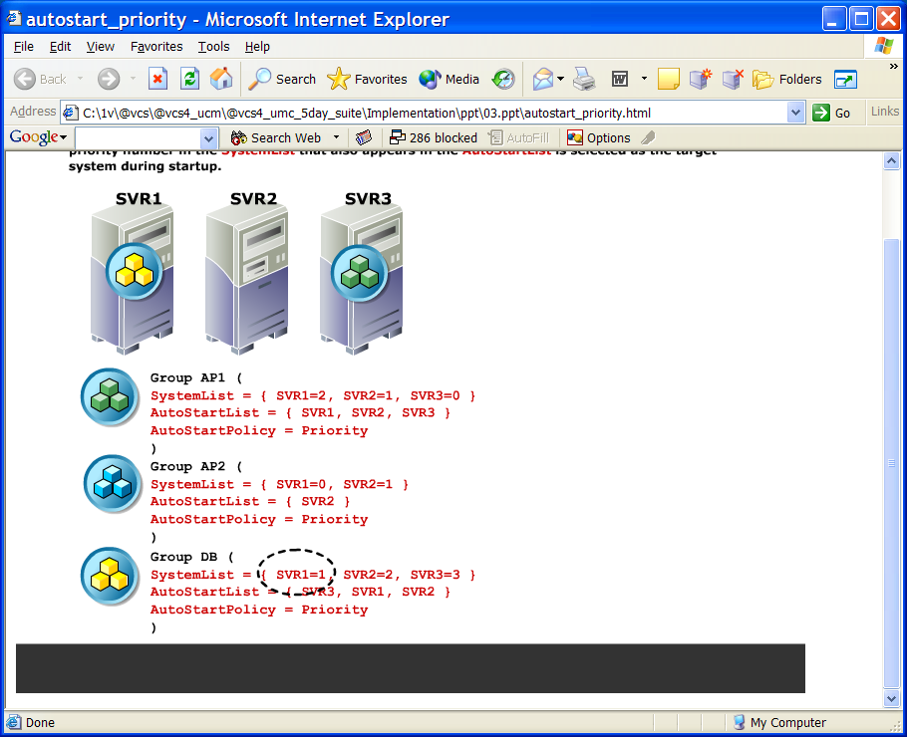
AutoStartPolicy=Priority
The lowest-numbered system in SystemList that is also in AutoStartList is selected.
{ SVR2, SVR1 }
Animation

Slide 274
Topic 2: Failover Rules and Policies
After completing this topic, you will be able to describe rules and policies controlling service group failover.
Notes:
This is <topic 1>, <topic one title>.
As a reminder, the objective(s) for this topic is/are: <topic 1 objective(s)>.

Slide 275
Rules for Automatic Service Group Failover
The service group must have a critical resource.
These service group attributes must be set to default values:
  AutoFailOver = 1
  ManageFaults = ALL
  FaultPropagation = 1
The service group cannot be frozen.
At least one system in the service group’s SystemList attribute must be up and running.

Slide 276
Failover System Selection
The initial set of candidate systems is derived from the SystemList attribute.
Systems are eliminated if:
  They are frozen.
  The service group has a FAULTED status.
  They do not meet service group requirements.
The target system is selected based on the failover policy of the service group.

Slide 277
Failover Policies
FailOverPolicy attribute values: | System selection based on:
Priority | Lowest priority number in SystemList (default policy)
RoundRobin | Least number of active service groups
Load | Greatest available capacity
Example configuration:
hagrp –modify DB FailOverPolicy RoundRobin

Slide 278
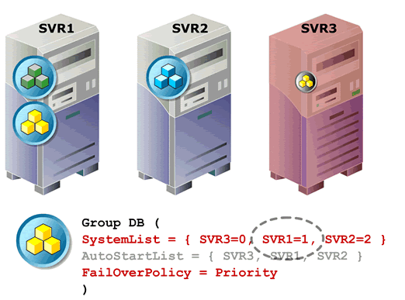
FailOverPolicy=Priority
The lowest- numbered system in SystemList is selected.
Animation

Slide 279
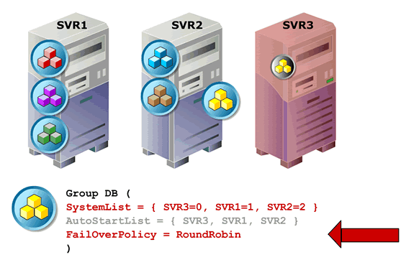
FailOverPolicy=RoundRobin
The system with
the fewest running
service groups is
selected.
Animation

Slide 280
Lab Exercise
• Building a two node VCS cluster
• Creating VCS user
• Use of VCS simulator and VCS GUI tool
• Creating Service group using command line
• Adding resources in service group
• Adding Proxy resource
• Adding Phantom resource
• Modify the cluster interconnect without downtime
• Configuring I/O fencing in VCS
• Add a new node into existing cluster
• Removing a node from a cluster
• Merge two clusters

Slide 281
Day 17
Recap of Day 16 ( Recap 30 min)
• SST( 1hour)
• Bart (30 min)
• TCP Wrappers( 1hour)
• Performance Management( 1 hour)
Recap ( 30 min)
Lab Exercise
• Hardening Solaris OS using SST tool( 1hour)
• Implementing File level auditing using BART( 1 hour)
• Securing services access using TCP wrapper( 1hour)
Recap of the day & Q/A ( 30 min)

