Slide 1

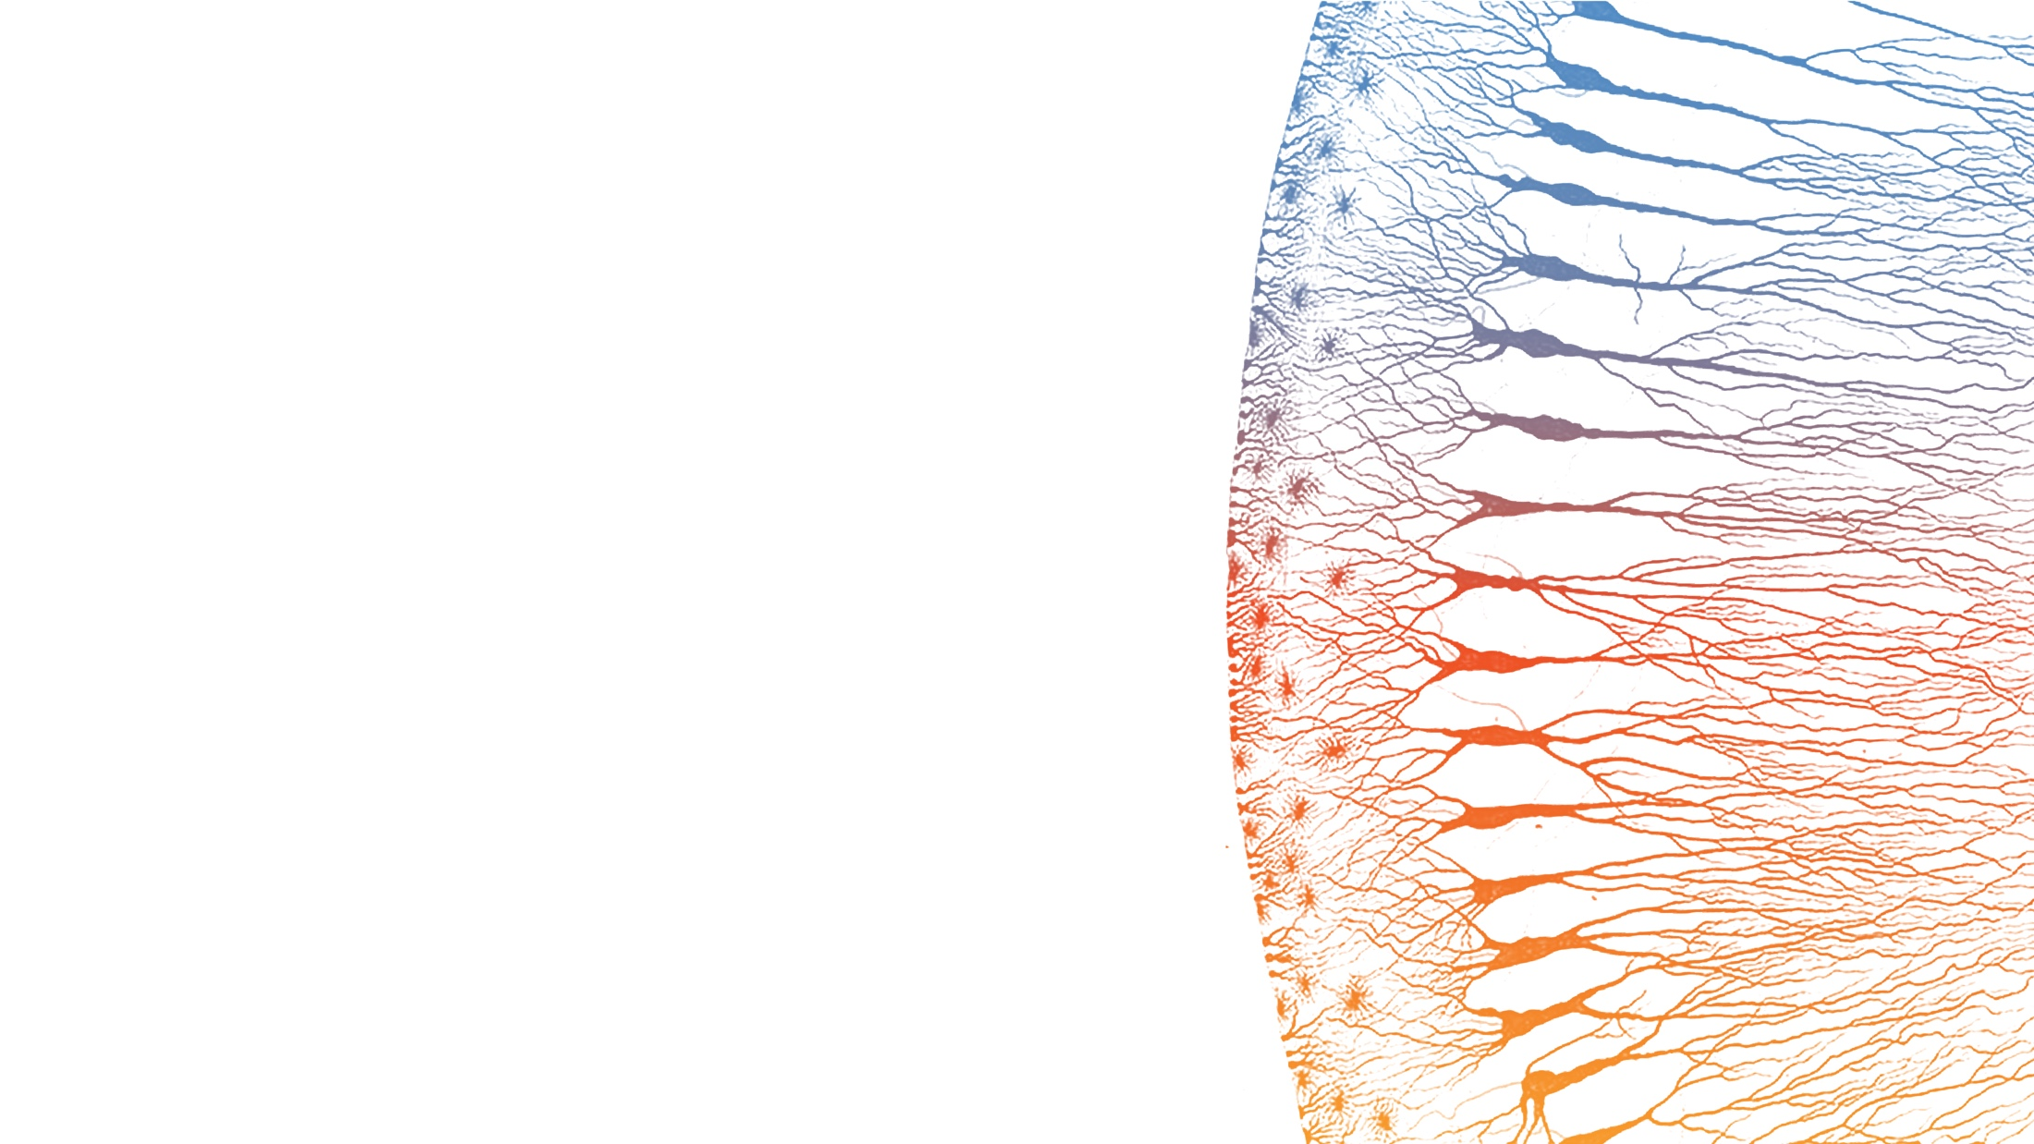
TRACER-Nano Idea B3
Splicing-Based VHH Display
Feasibility Analysis for Intron Retention Approach
Payload Group | January 2026

Slide 2
Executive Summary
GO
B3 Splicing Approach is Feasible
All design constraints satisfied with optimized 27 nt X region
Key Findings
B3 Approach
X region: 27 nt optimized sequence (9 amino acids)
Translation: LTLLLSFFQ - all acceptable residues
Frame: 462 nt total (divisible by 3)
Target: VP2 N-terminal insertion preferred
Retention: 10-25% predicted display rate
Insert VHH as retained intron in VP2
Weak splice sites allow 10-25% retention
Spliced (75-90%): Normal VP2 production
Retained (10-25%): VHH-VP2 fusion
No need for co-transfection or second plasmid
2 | CONFIDENTIAL

Slide 3
The B3 Concept: Intron Retention
Mechanism
5'-VP
GT
ATG-VHH-linker-X
AG
VP-3'
GT...AG = splice sites | Orange = retained intron
SPLICED (75-90%)
RETAINED (10-25%)
Normal VP protein
Met-VHH-linker-X-VP fusion
Why Intron Retention?
Controls VHH:VP ratio through splicing efficiency
Single-plasmid system (no co-transfection)
Tuneable display rate via splice site strength
Maintains wild-type VP production
Design Requirements
Weak splice sites (10-25% retention target)
X region must preserve reading frame
No stop codons in retained intron
Acceptable amino acids from polyY tract
3 | CONFIDENTIAL

Slide 4
Why B3? The Library Problem
Challenge: Current N-terminal insertion approach (Ideas A/B) hardcodes a single VHH sequence
Ideas A/B (Current)
Library Challenge
B3 Solution
VHH inserted at N-terminus of VP1 or VP2
Requires co-transfection with WT cap plasmid
Fixed VHH:VP ratio determined by plasmid ratio
Problem: One VHH = one plasmid
VHH discovery requires testing many variants
Each variant needs separate cloning
Co-transfection limits scalability
Bottleneck: Cannot easily screen libraries
VHH in retained intron = single plasmid
Splicing controls VHH:VP ratio automatically
Easy VHH swapping via restriction sites
Advantage: Library-compatible design
4 | CONFIDENTIAL

Slide 5
The Core Challenge: X Region Design
The Problem
The X region must contain a functional splice acceptor (branch point + polypyrimidine tract + AG). But the polypyrimidine tract will be translated when the intron is retained. What amino acids result?
Splice Acceptor Needs
Translation Constraint
Branch point: YUNAY motif
PolyY tract: 12+ pyrimidines (C/T)
AG dinucleotide: Essential splice site
Spacing: 18-40 nt between BP and AG
Solution
No stop codons allowed
Avoid proline (CCN codons = kinks)
Frame preservation: Length mod 3 = 0
Pure pyrimidines limit codon choices
27 nt X region (9 codons)
Ser, Phe, Leu from polyY
Branch point adenine encodes Thr (ACT)
AG terminus encodes Gln (CAG)
5 | CONFIDENTIAL

Slide 6

Polypyrimidine Tract Translation
Pure Pyrimidine Codons (C and T only)
Branch Point Challenge
Design Strategy
Branch point consensus YUNAY contains adenine (A), breaking pure pyrimidine. Solution: Position the A in codon context that gives acceptable amino acid (ACT = Thr).
Use Leu-Thr-Leu pattern to incorporate branch point A while avoiding Pro (CC dinucleotides). Terminate with CAG (Gln) at splice junction.
6 | CONFIDENTIAL

Slide 7
Reading Frame Verification
462 mod 3 = 0
FRAME ALIGNMENT
ATG
VHH (357)
Link
X
VP2...
Frame preserved - VHH fuses in-frame with VP2
All components divisible by 3
7 | CONFIDENTIAL

Slide 8
Optimized X Region Sequence
FINAL SEQUENCE (27 nt)
5'-CTAACTCTTCTTCTTTCTTTTCTTCCAG-3'
branch ---polyY (19nt)--- AG
TRANSLATION (9 amino acids)
CTA
-
ACT
-
CTT
-
CTT
-
CTT
-
TCT
-
TTC
-
TTC
-
CAG
Leu
Thr
Leu
Leu
Leu
Ser
Phe
Phe
Gln
VERIFICATION CHECKLIST
Length: 27 nt = 9 codons
Branch: CTAAC (valid)
PolyY: 19 nt pure C/T
No Pro codons
No stop codons
Retention: 10-25%
8 | CONFIDENTIAL

Slide 9
Insertion Site: VP2 Preferred
Winner: VP2
Intron ATG outcompetes weak ACG start
VP1 and VP3 remain completely unaffected
Natural N-terminal fusion point
VP2 ARCHITECTURE
[VP1]-ACG-GT-ATG-VHH-X-AG-[VP2/3]
When retained: Strong ATG overrides weak ACG
When spliced: Normal VP2 from ACG
9 | CONFIDENTIAL

Slide 10
Final B3 Construct Design
COMPLETE ARCHITECTURE
5'-[VP1]
ACG
GT
GCCATGG
VHH3 (357bp)
(GGGGS)5
X (27)
AG
[VP2/3]-3'
WHEN SPLICED (80-90%)
WHEN RETAINED (10-25%)
Normal VP2 from ACG start
Met-VHH3-linker-X-VP2 fusion
Total insertion (when retained): 462 nt / 154 amino acids
10 | CONFIDENTIAL

Slide 11
Risk Analysis
No fatal risks identified. All design constraints verified. Only empirical tuning needed for retention rate.
11 | CONFIDENTIAL

Slide 12
Validation Roadmap
1
Minigene Reporter
2
AAV Context
3
Functional
GFP split reporter construct
RT-PCR splice quantification
Target: 80-90% / 10-20%
Full Rep-Cap with B3
Western blot VP proteins
Confirm VHH-VP2 (~88 kDa)
ALPL ELISA binding
Cell transduction assay
Compare ALPL+ vs ALPL-
GO/NO-GO Decision Point: After Phase 1
EXPECTED WESTERN BLOT RESULTS (Phase 2)
VP1: ~87 kDa
VP2: ~73 kDa
VP3: ~62 kDa
VHH-VP2: ~88 kDa (new band)
12 | CONFIDENTIAL

Slide 13

Conclusions and Recommendations
FEASIBLE
B3 Splicing Approach is Ready for Validation
All design constraints satisfied: frame preservation, no stop codons, acceptable amino acids
27 nt X region enables functional splice acceptor with 10-25% predicted retention
VP2 N-terminal insertion is the optimal target site
NEXT STEPS
Finalize X region sequence
Order minigene reporter construct
Establish RT-PCR splice assay
If Phase 1 passes: proceed to VP2-VHH
UNCERTAINTIES
Exact retention rate (empirical)
Cell-type splicing variation
VHH folding in intron context
Ready to proceed: 27 nt X region | VP2 target | 10-25% display
13 | CONFIDENTIAL

