Slide 1

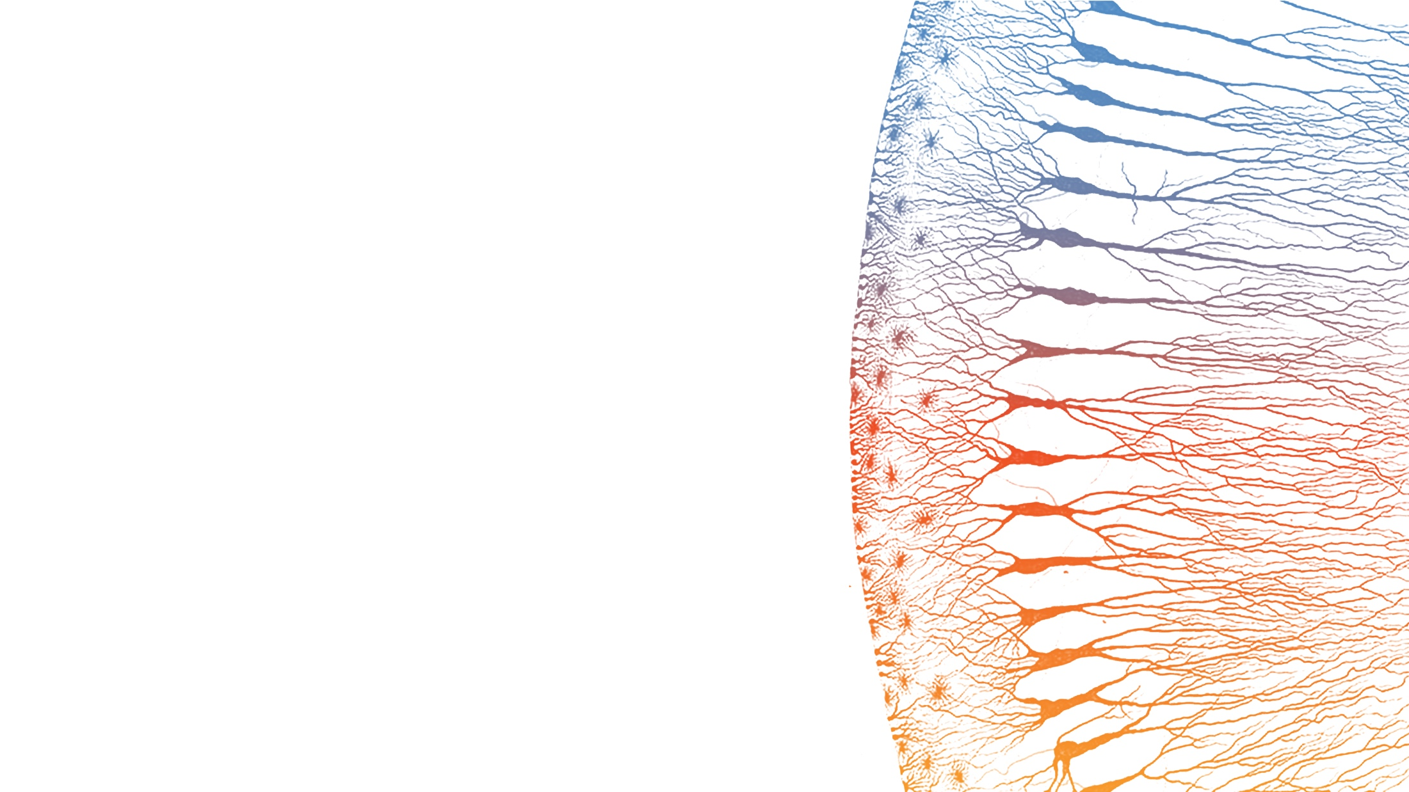
TRACER-Nano VR4
Splicing Design Validation
Computational Feasibility Analysis for
VR4 Loop-Based VHH Display on AAV Capsids
Payload Group | January 2026

Slide 2
Executive Summary
KEY QUESTION
Can we use inefficient splicing in VR4 to display VHH on all VP proteins?
APPROACH
VS VP2 N-TERMINAL
Insert intron in VR4 loop region
Splice sites OUTSIDE linkers (Config A)
~85% spliced = 6 aa scar (minimal)
~15% retained = 187 aa VHH insert
All VPs modified (not just VP2)
~9 VHH/capsid vs ~0.75
Surface-exposed (better access)
Higher avidity for targeting
GO
VR4 Splicing Design is FEASIBLE
6 aa scar | 187 aa retained | 10-20% retention | No frame shift
6 aa
187 aa
~9
561 nt
Spliced scar
Retained insert
VHH per capsid
Frame preserved
2 | CONFIDENTIAL

Slide 3
The VR4 Splicing Concept
CONFIG A: Splice Sites OUTSIDE Linkers
VR4
X-exon
GT
linker
VHH
linker
AG
Y-exon
VR4
Green = exons | Orange = intron
SPLICED (85-90%)
RETAINED (10-15%)
Minimal 6 aa scar in VR4
187 aa VHH-containing insert
VR4 - AAK-AAK - VR4
Normal capsid assembly
VR4 - X - linker - VHH - linker - Y - VR4
Surface-displayed nanobody
WHY VR4 LOOP?
DESIGN REQUIREMENTS
Surface-exposed variable region
Common to VP1, VP2, VP3
Tolerates small insertions (5-15 aa)
Higher VHH copy number than VP2
Spliced scar must be small (<10 aa)
Reading frame preserved in both states
No stop codons when retained
10-20% retention target
3 | CONFIDENTIAL

Slide 4
Config A vs Config B: Why Placement Matters
RECOMMENDED
Config A: Splice sites OUTSIDE linkers
When spliced:
When retained:
VR4 - [X-exon][Y-exon] - VR4
VR4 - X - linker - VHH - linker - Y - VR4
= 6 aa scar (AAKAAK)
= 187 aa insert
AVOID
Config B: Splice sites INSIDE linkers
When spliced:
Problem:
VR4 - linker - [X][Y] - linker - VR4
56 aa insertion in VR4 even when spliced
= ~56 aa scar (TOO BIG!)
Would disrupt capsid assembly
COMPARISON
Parameter
Config A
Config B
Spliced scar size
6 aa
~56 aa
Capsid assembly
Normal
Disrupted
VR4 tolerance
Within limits
Exceeds limits
4 | CONFIDENTIAL

Slide 5

5' Splice Donor Design
X-REGION STRUCTURE (21 nt)
GCT GCC AAG
|
GTA AGT GCT GCT
Exon: AAK (Ala-Ala-Lys)
5'-exon (9 nt)
Intron 5' (12 nt)
Intron: VSAA (Val-Ser-Ala-Ala)
SPLICE DONOR CONTEXT
DONOR SCORE
~9-10
AAG | GTAAGT
GT dinucleotide: Required (present)
+3 to +6 (AAGT): Near-consensus match
Strong donor (GTAAGT is consensus)
Expected: 90-95% splicing
TUNING OPTIONS (to increase retention)
Variant
Sequence
Score
Retention
Strong
GTAAGT
~10
5-10%
Moderate
GTACGT
~7
10-20%
Weak
GTATGT
~5
20-35%
5 | CONFIDENTIAL

Slide 6

3' Splice Acceptor Design
Y-REGION STRUCTURE (33 nt)
CTAAC
TCTTCTTCTTTCTTTCC
AG
|
GCT GCC AAG
branch
polyY tract (17 nt)
AG
3'-exon (9 nt)
COMPONENT ANALYSIS
ACCEPTOR SCORE
Branch Point: CTAAC
~6-8
Valid YUNAY pattern (A at +4 is lariat point)
PolyY Tract: 17 nt
Moderate acceptor strength
Expected: 10-20% retention
100% pyrimidine (C/T only)
Junction: CAG | GCT
Essential AG present, Gln-Ala junction
Target achieved!
TRANSLATION WHEN RETAINED (Intron 3' = 24 nt = 8 codons)
CTA
ACT
CTT
CTT
CTT
TCT
TTC
CAG
No stops!
Leu
Thr
Leu
Leu
Leu
Ser
Phe
Gln
No Pro!
6 | CONFIDENTIAL

Slide 7
Frame Preservation Verification
SPLICED PRODUCT (85-90%)
5'-exon + 3'-exon:
18 mod 3 = 0
Translation:
GCTGCCAAG + GCTGCCAAG = 18 nt
AAK-AAK (6 aa scar)
RETAINED PRODUCT (10-15%)
Component
nt
Cumulative
aa
5'-exon (AAK)
9
9
3
Intron 5' (VSAA)
12
21
4
Linker 1 (GGGGS)x5
75
96
25
VHH3
357
453
119
Linker 2 (GGGGS)x5
75
528
25
Intron 3' (LTLLLSFQ)
24
552
8
3'-exon (AAK)
9
561
187
Frame Verification: 561 mod 3 = 0
No internal stop codons | No problematic prolines
7 | CONFIDENTIAL

Slide 8

Stoichiometry: VR4 vs VP2 N-Terminal
VP2 N-TERMINAL (Original B3)
VR4 LOOP (This Design)
VPs modified: VP2 only
VPs modified: VP1, VP2, VP3 (all)
Copies affected: ~5 per capsid
Copies affected: ~60 per capsid
VHH per capsid at 15% retention:
VHH per capsid at 15% retention:
~0.75
~9
Location: Internal (N-terminus)
Location: Surface-exposed (loop)
DETAILED COMPARISON
Parameter
VP2 N-term
VR4 Loop
VHH at 10% retention
~0.5
~6
VHH at 15% retention
~0.75
~9
VHH at 20% retention
~1
~12
Target accessibility
Lower
Higher
Steric risk
Low
Medium
VR4 offers 12x higher VHH density with better surface accessibility
Optimal for high-avidity targeting | Monitor for steric effects at high retention rates
8 | CONFIDENTIAL

Slide 9
Cryptic Splice Site Analysis
LINKER (GGGGS)x5 - 75 nt
VHH3 - 357 nt
0
5
0
~17
0
LOW
GT sites
AG sites
Functional
GT sites
Functional AG
Risk
AG sites lack upstream polyY - not functional acceptors
GT sites exist but lack paired acceptors
WHY CRYPTIC SITES ARE LOW RISK
1. Requires donor AND acceptor
2. Designed sites are stronger
3. Position matters
Splicing requires both 5' donor (GT) and 3' acceptor (polyY + AG) working together
Our acceptor has 17 nt polyY - much stronger than any cryptic site
Cryptic donor usage would skip designed donor and disrupt VHH
LOW
Overall Cryptic Site Risk
RECOMMENDATION
No functional cryptic acceptors | Designed sites outcompete any cryptic donors
Monitor by RT-PCR for unexpected splice products. Silent mutations available if needed.
9 | CONFIDENTIAL

Slide 10
Risk Assessment Matrix
Risk
Likelihood
Impact
Mitigation
Frame shift in retained product
None
Fatal
Verified: 561 mod 3 = 0
Stop codon in intron translation
None
Fatal
Verified: none present
Splicing too efficient (<5% retention)
Medium
Low
Weaken donor/acceptor sites
Cryptic splice site usage
Low
High
Silent mutations if needed
Capsid assembly failure (6 aa scar)
Low-Med
High
Test with minigene first
Excessive VHH steric clash
Medium
Medium
Tune to 10-15% retention
Cell-type splice variation
Medium
Medium
Test in target cell types
No fatal risks identified | Critical design constraints verified | Proceed to validation
10 | CONFIDENTIAL

Slide 11
Validation Roadmap
1
Minigene Reporter
2
AAV Context
3
Functional
GFP split reporter construct
RT-PCR splice quantification
Target: 85-90% / 10-15%
Full Rep-Cap with VR4-B3
Western blot VP proteins
Titer comparison to WT
ALPL ELISA binding
Cell transduction assay
Compare ALPL+ vs ALPL-
GO/NO-GO Decision Point: After Phase 1
EXPECTED WESTERN BLOT RESULTS (Phase 2)
Normal bands (spliced ~85%):
Shifted bands (retained ~15%):
VP1: 87 kDa
VP2: 73 kDa
VP3: 62 kDa
+VHH: 107 kDa
+VHH: 93 kDa
+VHH: 82 kDa
Insert: 187 aa x 110 Da = ~20.5 kDa shift
11 | CONFIDENTIAL

Slide 12

Conclusions and Recommendations
GO
VR4 Splicing Design is FEASIBLE
Config A provides minimal 6 aa scar when spliced
187 aa VHH insert with correct reading frame when retained
~9 VHH per capsid at 15% retention (12x higher than VP2 approach)
NEXT STEPS
UNCERTAINTIES
Order minigene reporter construct
Establish RT-PCR splice assay
If Phase 1 passes: Build full Rep-Cap
Compare to VP2 N-term in parallel
Exact retention rate (empirical)
Capsid assembly with 6 aa scar
VHH folding in intron context
Cell-type splicing variation
Ready to proceed with VR4 validation
Questions?
Config A | 6 aa scar | 187 aa retained | ~9 VHH/capsid
12 | CONFIDENTIAL

